Slide 1
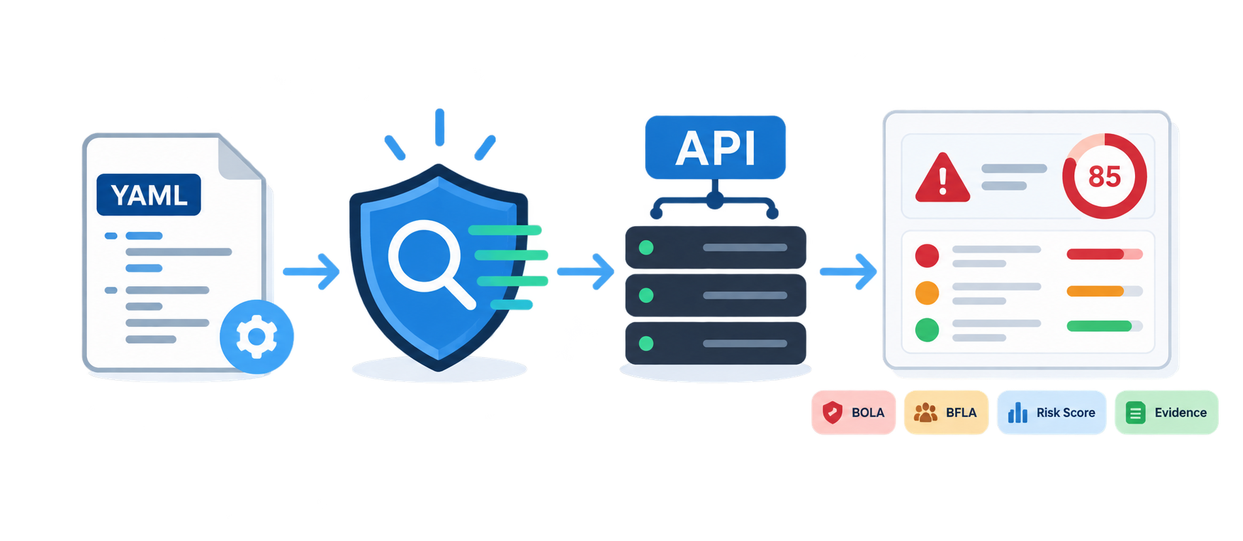
AuthZ Scanner
Config-Driven API Authorization Security Scanner
• Python-based authorization testing tool
• Repeatable scans through YAML configuration
• Pentest-style JSON, Markdown and HTML reporting
Tayfun Ozgur
API Security Internship Project
Notes:
Introduce the project as an API authorization security scanner, not only a demo API. The goal is to turn manual authorization checks into repeatable, configurable and reportable scanner workflows.

Slide 2
02
Motivation
• Authorization bugs are common in API pentests
• Manual checks become slow as roles and endpoints grow
• The scanner makes the checks repeatable and reportable
Manual API Testing
AuthZ Scanner
One-off requests
Hard to repeat
Evidence copied manually
→
Config-driven
Repeatable
Report-ready evidence
repeatable security workflow
AuthZ Scanner technical presentation
Notes:
Explain that login is not enough. After authentication, the API still needs to enforce which user can access which resource and which function.

Slide 3
03
Authentication vs Authorization
Authentication
Authorization
Question:
Who are you?
Example:
Login, JWT, session
Question:
What are you allowed to access or modify?
Example:
Own order yes, another user's order no
→
AuthZ Scanner technical presentation
Notes:
Use a simple example: a customer can view their own order, but should not view another customer's order or admin functions.

Slide 4
04
Authorization Vulnerability Classes
BOLA
BFLA
Mass Assignment
Object-level access bypass
Function-level role bypass
Server-controlled fields
Data Exposure
Unauthenticated
Body Mismatch
Sensitive response fields
Missing auth enforcement
Response contract violation
AuthZ Scanner technical presentation
Notes:
Introduce the vulnerability classes at a high level. Details come later in the module slides.

Slide 5
05
Project Objective
• Authenticate multiple test identities
• Test role and ownership rules
• Compare expected and observed API behavior
• Generate reports with evidence and remediation
1. Authenticate identities
2. Test role boundaries
3. Test ownership rules
4. Compare behavior
5. Generate pentest reports
AuthZ Scanner technical presentation
Notes:
Frame the scanner as a tool that produces findings with severity, risk score, business impact, evidence and reproduction steps.

Slide 6
06
High-Level Architecture
• YAML config defines the target and test rules
• Identity manager prepares authenticated users
• Scanner modules create authorization checks
• Reports convert findings into pentest evidence
YAML Config
↓
Identity Manager
↓
Scanner Modules
↓
HTTP Executor
↓
Finding + Evidence
↓
Reports
AuthZ Scanner technical presentation
Notes:
Keep this slide as the big picture. Detailed execution flow comes later.

Slide 7
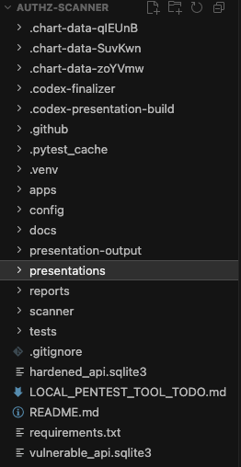
07
Repository Structure
• apps: vulnerable and hardened API lab
• scanner: core, modules, reporting and discovery
• config: YAML scan definitions
• tests and reports support validation and output
AuthZ Scanner technical presentation
Notes:
Show that the project separates the API lab, scanner engine, configuration, tests and reports.

Slide 8
08
Demo API Lab
• vulnerable_api contains intentional authorization weaknesses
• hardened_api implements the same surface with protections
• The same scanner can run against both targets
vulnerable_api
hardened_api
Same API surface
Intentional authorization weaknesses
Expected to produce findings
Same API surface
Authorization checks enforced
Expected 0 findings
controlled lab for scanner validation
AuthZ Scanner technical presentation
Notes:
Explain why the two API versions exist. They let us test vulnerable behavior and secure behavior in a controlled lab.

Slide 9
09
Vulnerable vs Hardened API Design
• Same endpoints
• Same roles
• Same domain model
• Different authorization behavior
Same Surface
Different Behavior
Endpoints
Roles
Domain model
Config structure
Vulnerable allows bypasses
Hardened blocks them
Scanner compares outcomes
→
AuthZ Scanner technical presentation
Notes:
Do not reveal all results here. The point is that the test surface is the same while security behavior differs.

Slide 10
10
Domain and Role Model
• Domain objects: users, orders, order items, invoices, organizations and support tickets
• Roles: customer, support, manager and admin
• The lab supports ownership, tenant and workflow-style scenarios
Domain Entities
Role Hierarchy
Users
Orders
Order Items
Invoices
Organizations
Support Tickets
customer
support
manager
admin
AuthZ Scanner technical presentation
Notes:
Explain how the project grew from a simple user-order model into a richer lab with invoices, organizations and support tickets.

Slide 11
11
JWT Authentication Flow
• Scanner logs in as each configured identity
• The access token gets attached to later requests
• Cookie, static token, custom header and refresh token flows are also supported
Login
→
Access Token
→
Identity
Protected Request
→
JWT is identity transport; AuthZ is tested after login
AuthZ Scanner technical presentation
Notes:
Clarify that JWT is a mechanism for carrying identity. The main test target is authorization after authentication.

Slide 12
12
Config-Driven Design
• The scanner does not import API models
• It does not read the target database
• It observes API behavior through HTTP
• Target-specific rules live in YAML
API Internal Code
HTTP Behavior Scanner
Database models
Framework internals
Implementation details
Requests
Responses
Expected vs observed
Findings
→
AuthZ Scanner technical presentation
Notes:
This is a key technical decision. The scanner remains portable because API-specific knowledge lives in config, not in Python test code.

Slide 13
13
YAML Configuration Model
• Config defines target, auth, identities and roles
• It maps ownership fields and expected behavior
• It stores severity, risk score and business impact
• Manual YAML evolved into OpenAPI starter config plus review
Manual YAML
OpenAPI Starter
Human Review
→
→
Generated config is a starting point, not final security truth
AuthZ Scanner technical presentation
Notes:
Explain that YAML started manually so authorization rules could be modeled accurately. OpenAPI starter generation was added later to reduce onboarding effort, but human review remains necessary.

Slide 14
14
Identity and Ownership Mapping
• Profile response gives the current subject id
• Resource list response exposes resource id and owner field
• Scanner tests boundaries between different subjects
• The logic is role-based, not tied to userA or userB names
userA
userB
→
Order #1001
→
owns order
owner_id = A
same role
attack request
resource id
owner boundary
BOLA = same role, different subject, same resource
AuthZ Scanner technical presentation
Notes:
Explain how BOLA needs at least two identities with the same role. The scanner finds a resource owned by one identity and requests it as another.

Slide 15
15
Scanner Execution Flow
• Load and validate config
• Authenticate identities
• Run enabled modules
• Send HTTP requests
• Build findings and reports
1. Prepare
2. Execute
Load config
Authenticate identities
→
Run modules
Send HTTP requests
3. Analyze
4. Report
Compare expected
vs observed behavior
→
Build findings
Generate reports
AuthZ Scanner technical presentation
Notes:
Describe the runtime pipeline from YAML to report. This slide is the detailed version of the high-level architecture.

Slide 16
16
Core Components
• config.py models the YAML structure
• identity.py handles login and token extraction
• executor.py sends HTTP requests
• finding.py, evidence.py and risk.py shape the output
• config_doctor.py validates readiness before scanning
config.py
identity.py
executor.py
finding.py
risk.py
config_doctor.py
AuthZ Scanner technical presentation
Notes:
Walk through scanner/core and explain each file's responsibility without opening every file unless asked.

Slide 17
17
HTTP Executor and Response Handling
• Attaches token, cookie or custom auth values
• Normalizes JSON and text responses
• Supports refresh-token retry behavior
• Keeps request and response details for evidence
Module
→
Executor
→
API
→
Normalized Response
auth header / cookie / refresh retry handled centrally
AuthZ Scanner technical presentation
Notes:
Explain that modules do not deal with HTTP client details directly. The executor centralizes request handling.

Slide 18
18
BOLA Testing Module
• Select two identities with the same role
• Find a resource owned by identity A
• Request that resource as identity B
• Report when the API allows cross-user access
Owner User
Attacker User
userA owns
Order #1001
→
userB requests
the same order
Expected
Observed
403 / 404
200 OK
Allowed cross-user access becomes a BOLA finding
AuthZ Scanner technical presentation
Notes:
Use the order or order item example. Expected status is usually 403 or 404. Observed 200 creates a BOLA finding.

Slide 19
19
BFLA Testing Module
• Select a low-privilege identity
• Call a privileged function or endpoint
• Compare observed status with expected denial
• Report role or function-level bypass
GET /admin/users
Expected denied
Observed allowed
BFLA finding
customer
→
→
→
→
AuthZ Scanner technical presentation
Notes:
Use /admin/users as the main example. BFLA asks which role can run a function, not who owns an object.

Slide 20
20
Property Authorization and Mass Assignment
• Tests server-controlled fields in request bodies
• Tries multiple payloads per test
• Verifies role, status, ownership or price manipulation
• Marks mutation-capable tests as destructive
Payload Attempts
{ role: admin }
{ status: paid }
{ owner_id: other_user }
{ total_price: 0 }
Authorization Check
→
Server must reject client-side changes to protected fields
AuthZ Scanner technical presentation
Notes:
Explain role promotion and manipulated order total examples. This module catches field-level authorization weaknesses.

Slide 21
21
Excessive Data Exposure
• Status code can be correct while the body is unsafe
• Checks for sensitive fields such as password_hash, token and internal_notes
• Reports exposed field paths in evidence
Status Code
Response Body
200 OK
Can still be expected
≠
password_hash
token
internal_notes
AuthZ Scanner technical presentation
Notes:
This explains why expected and observed status can both be 200 while the scanner still reports a finding.

Slide 22
22
Response Body Matchers
• Defines response security contracts in YAML
• Checks required or forbidden text in the body
• Checks expected or forbidden field values
• Creates Response Body Mismatch findings
YAML Matcher
body_should_not_contain:
- internal_notes
field_should_not_equal:
status: internal_only
Finding
→
Response body violates expected security contract
AuthZ Scanner technical presentation
Notes:
Explain this as the newest response-analysis layer. It moves the scanner beyond status-code-only checks.

Slide 23
23
Unauthenticated Access Testing
• Sends requests without token or session
• Targets protected endpoints
• Expects 401 or 403
• Reports if anonymous access succeeds
No token
Protected endpoint
Expected 401/403
Observed 200?
Finding
→
→
→
→
AuthZ Scanner technical presentation
Notes:
Mention that the module runs, but the current demo endpoints correctly return 401, so default demo scans do not show an unauthenticated finding.

Slide 24
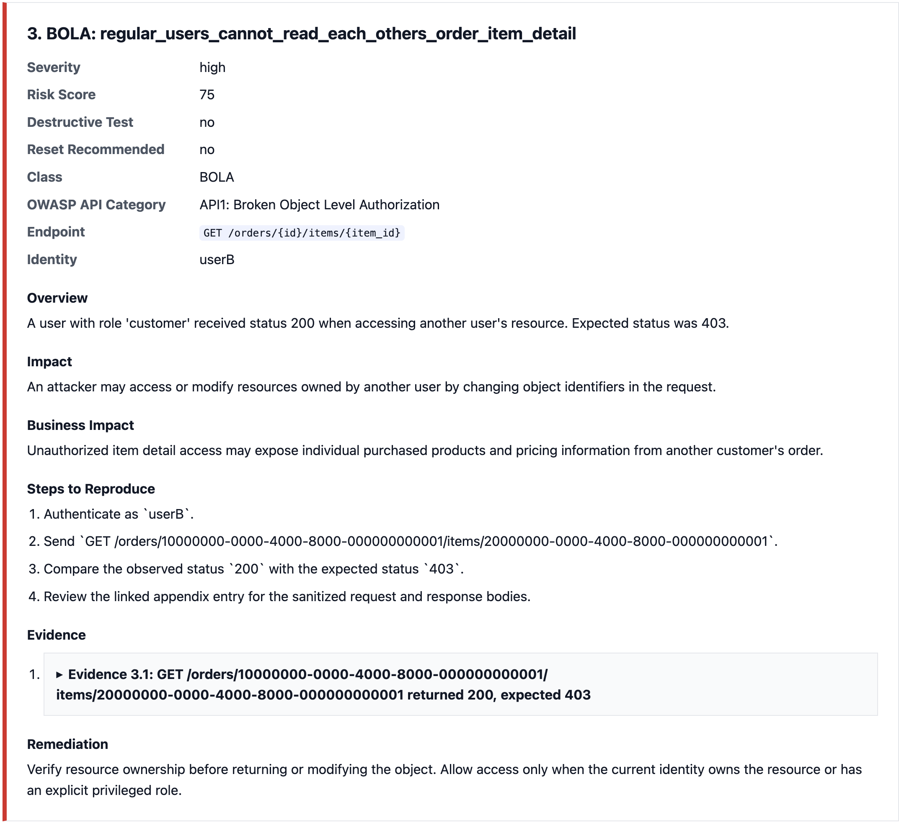
24
Finding and Evidence Model
• Findings standardize vulnerability class, endpoint and identity
• Evidence stores expected and observed behavior
• Reports include reproduction steps and appendix entries
• cURL commands make findings repeatable
AuthZ Scanner technical presentation
Notes:
The important message is repeatability. A pentest finding needs proof, not just a label.

Slide 25
25
Severity, Risk Score and Business Impact
• Severity labels: low, medium, high and critical
• Numeric risk score from 0 to 100
• Config can override severity and score
• Business impact explains why the issue matters
Finding Card
Severity: CRITICAL
Risk Score: 95
Class: BOLA
Business Impact: cross-tenant invoice exposure
Evidence: request + response + cURL
technical proof + business meaning
AuthZ Scanner technical presentation
Notes:
Explain that two technically similar bugs can have different business impact. Tenant invoice access is not the same risk as a low-sensitivity read.

Slide 26
26
Reporting Layer
• JSON for automation
• Markdown for technical documentation
• HTML for readable review and demos
• Reports include summary, evidence, cURL and appendix
JSON
Markdown
HTML
automation
write-up
demo review
summary + evidence + cURL + appendix
AuthZ Scanner technical presentation
Notes:
Mention collapsible HTML evidence sections and sensitive data redaction.

Slide 27
27
Safety Features
• Destructive test guard
• Explicit include-destructive flag
• Reset recommendation
• Config doctor
• Sensitive data redaction
✓ Destructive guard
✓ include-destructive flag
✓ reset recommendation
✓ config doctor
✓ sensitive data redaction
AuthZ Scanner technical presentation
Notes:
Explain that real API scanners must avoid hidden state changes. The scanner skips destructive tests by default.

Slide 28
28
OpenAPI Starter Config and Config Doctor
• Manual YAML gives accuracy but costs time
• OpenAPI starter config automates endpoint discovery
• Human review keeps authorization decisions safe
• Config doctor validates readiness before scanning
OpenAPI
Starter Config
TODO Review
Config Doctor
Scan Ready
→
→
→
→
automation reduces setup; human review keeps rules correct
AuthZ Scanner technical presentation
Notes:
Explain the evolution: manual YAML first, OpenAPI starter later, human review always preserved.

Slide 29
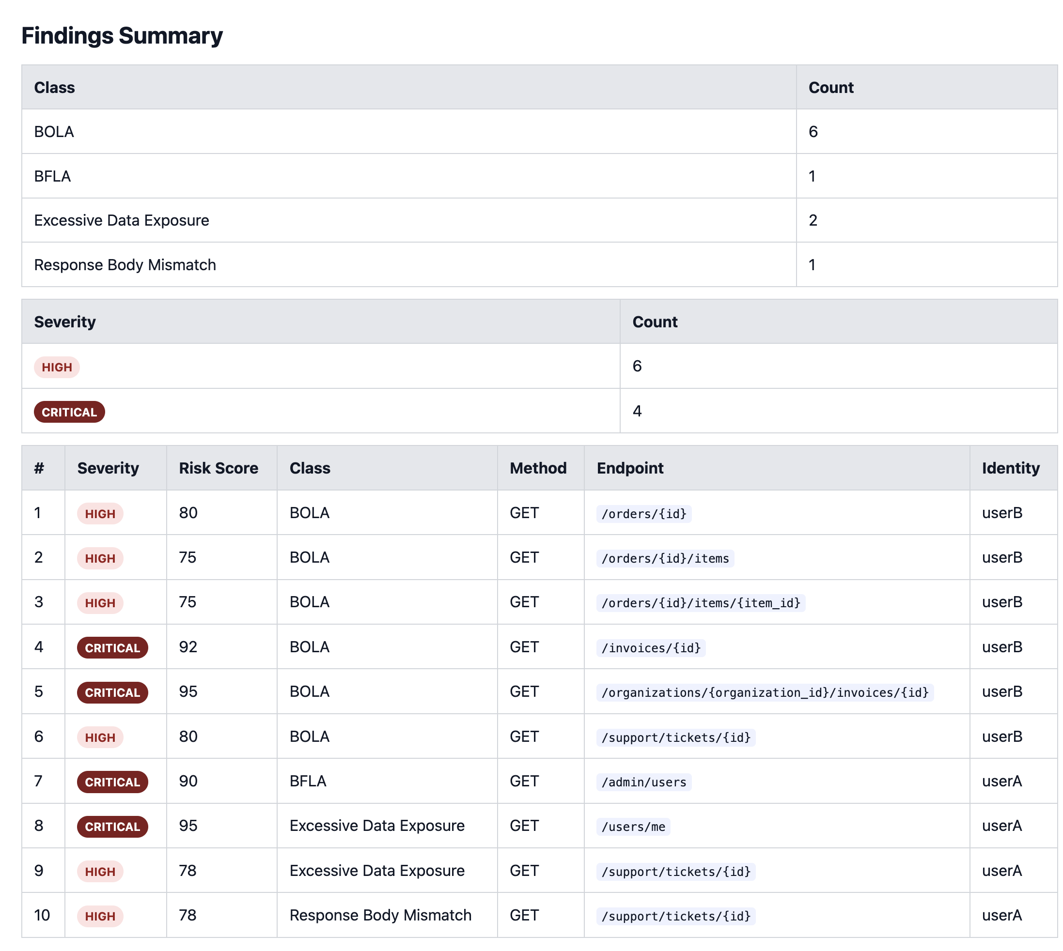
29
Demo Results
• Vulnerable API: 10 findings in the default scan
• Hardened API: 0 findings
• Destructive tests are skipped by default
• 19 became 10 after destructive checks moved behind an explicit flag
AuthZ Scanner technical presentation
Notes:
Be explicit that the reduction from 19 to 10 did not remove vulnerabilities. It reflects a safer default scan policy.

Slide 30
30
Vulnerable vs Hardened Comparison
Vulnerable API
Hardened API
10 findings
BOLA, BFLA, Data Exposure,
Response Body Mismatch
0 findings
Same scanner, same rules,
secure behavior
• Same test engine
• Same scanner modules
• Same security expectations
• Different target behavior produces different results
AuthZ Scanner technical presentation
Notes:
Explain that the scanner is not special-cased for either target. The target changes through config.

Slide 31
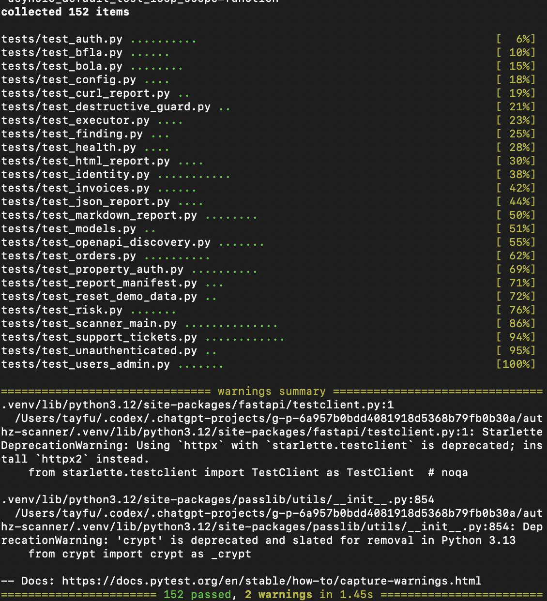
31
Test Coverage
• API behavior tests
• Authentication flow tests
• Scanner module tests
• Reporting and config doctor tests
• Current suite: 152 passed, 2 warnings
AuthZ Scanner technical presentation
Notes:
Use this slide to show engineering reliability. The project is backed by automated tests, not only manual demo steps.

Slide 32
32
Limitations
• Final authorization rules still require human review
• OpenAPI cannot infer business logic completely
• Workflow and state-transition testing is limited
• ID discovery strategies are still basic
• Enterprise OAuth2 flows remain future work
Current Limits
Human rule review
Basic ID discovery
Limited workflow/state testing
Next Direction
→
Roadmap items turn the MVP into a stronger pentest tool
AuthZ Scanner technical presentation
Notes:
State limitations clearly. This makes the project look more serious, because authorization testing cannot be fully solved from schema data alone.

Slide 33
33
Future Work
• Scan profiles for quick, full and non-destructive scans
• Advanced response diffing
• Workflow and state-transition tests
• IDOR enumeration strategies
• OAuth2 client credentials and richer OpenAPI analysis
Scan Profiles
Response Diffing
Workflow Tests
IDOR Enumeration
OAuth2
→
→
→
→
AuthZ Scanner technical presentation
Notes:
Present future work as a roadmap for turning the current MVP into a fuller pentest tool.

Slide 34
34
Conclusion
• Manual authorization checks became repeatable tests
• Scanner logic became configurable through YAML
• Findings include evidence, risk and business impact
• The lab validates both vulnerable and hardened behavior
Config
HTTP Tests
Findings
Reports
Reusable Scanner
→
→
→
→
manual checks became repeatable security automation
AuthZ Scanner technical presentation
Notes:
Close by positioning the project as API security automation: a scanner engine, a controlled lab, reusable test modules and pentest-style reporting.

