Slide 1
AppSec
Where to Start, and Some Free, Easy Wins

Slide 2






whoami && background
Jack Walker
Born January 1st, 1990
Surrounded by technology as a kid. Avid (competitive) gamer and tinkerer.
Consultant at big and small firms across a variety of industries with a focus on offensive and application security.
Currently → Principal Security Consultant @
Med Student
Pathology Assistant
Pentester
Uni Drop-out
Developer
AppSec Consultant

Slide 3

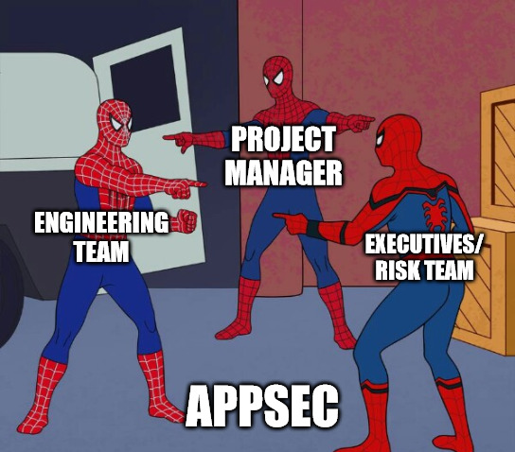
The AppSec Problem

Slide 4
The AppSec Problem
The scope of the problem is large
Solving it in-house often results in increased responsibility for people who are already busy and have an ever-growing pile of problems
Justifying the cost of (and finding) dedicated hires is very challenging
The cost and time involved in maintenance of automated tools and triaging their output is commonly high.
The balancing act of product development revolves around: cost, quality, and speed of delivery.
Quality is often the first area where sacrifices are made.
Quality
Speed of delivery
Cost
Speed of Delivery

Slide 5
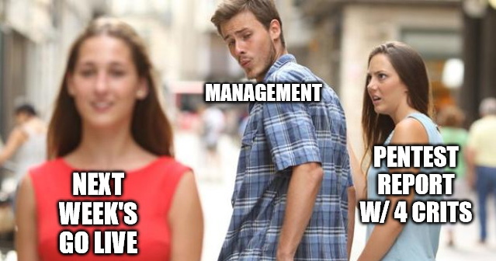

Slide 6

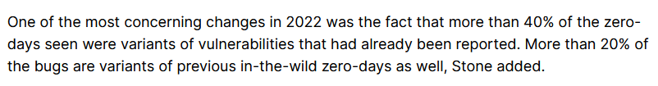
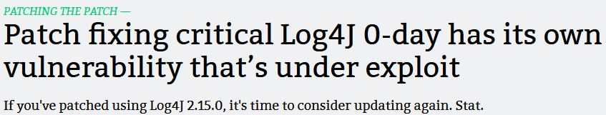
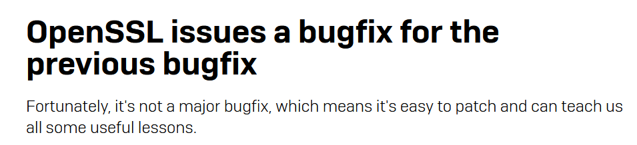
https://therecord.media/google-zero-days-report-2022
https://arstechnica.com/information-technology/2021/12/patch-fixing-critical-log4j-0-day-has-its-own-vulnerability-thats-under-exploit/
https://news.sophos.com/en-us/2022/06/24/openssl-issues-a-bugfix-for-the-previous-bugfix/

Slide 7

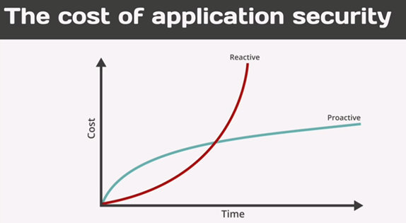
How Can We Get Buy-in?
Re-frame the conversation
Talk the language of the stakeholders who you need buy-in from:
Risk
Project predictability
Finance

Slide 8

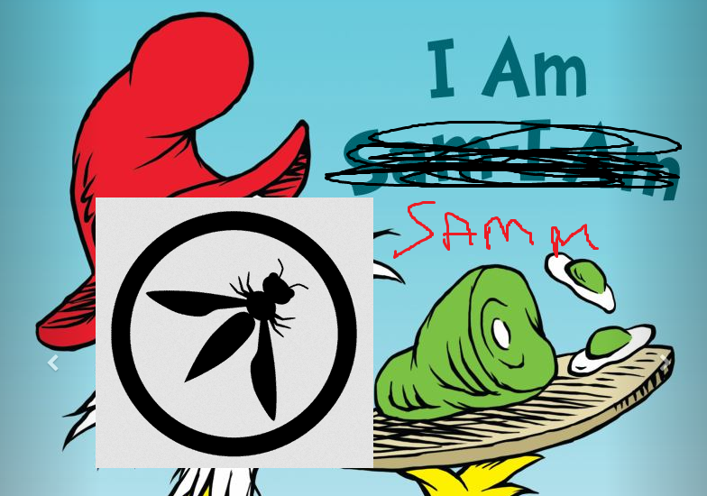
Breaking Down the Problem
So, if this is such a broad problem, where do we start?
What resources already exist that could help get us going?

Slide 9
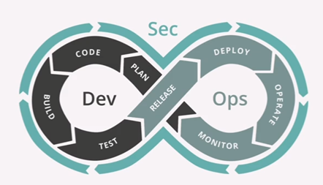
OWASP SAMM
Software Assurance Maturity Model (SAMM)
OWASP Flagship Project
Aims to provide the clear, measurable steps and pathways to maturing a software assurance programme (SAP)
The components of a SAP typically include governance and strategy, a SDLC, and operational management practices.
SDLC = Software Development Lifecycle

Slide 10
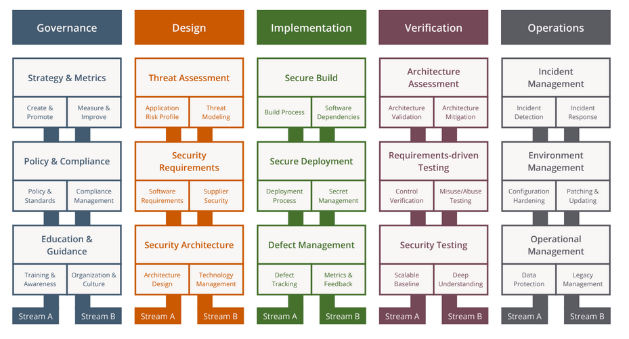

Slide 12

Maturity Model
Level 1 – ad-hoc, best effort.
Level 2 – consistent, repeatable.
Level 3 – systematic, and continuously evolving with technology.

Slide 13

Where Do We Start?
What makes a good place to start?
Too much time investment to do everything.
Ideally, we’d start with activities we can do locally just with a laptop and a command line.
Don’t make the mistake of getting fancy too quickly.

Slide 14



Slide 15


Implementation
What area would be good to tackle here?

Slide 16
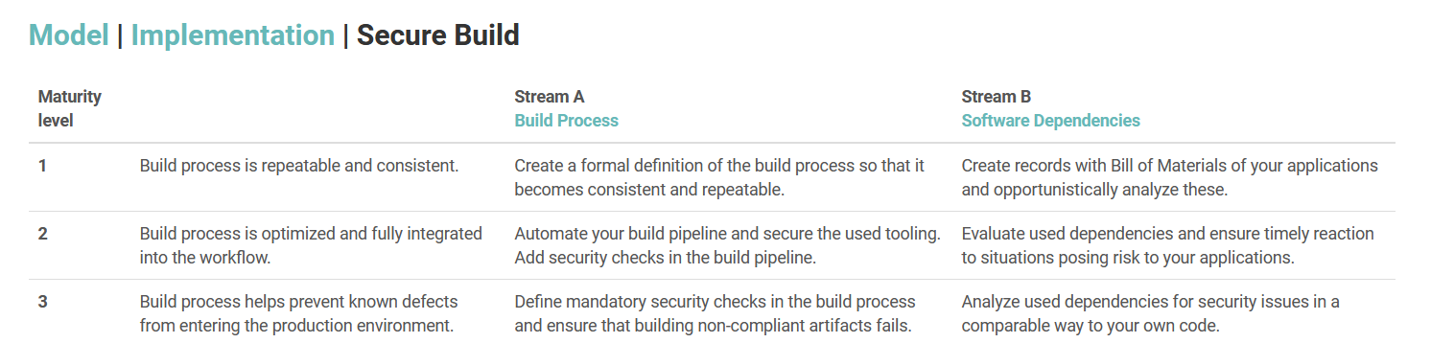
Secure Build Practice

Slide 17
Implementation
What area would be good to tackle here?
Software Bill of Materials → SBOM
Industry standards:
OWASP CycloneDX – SBOM specification
Tools for most common programming languages to generate CycloneDX SBOMs
Software Component Analysis → SCA
Tooling:
OWASP DependencyTrack

Slide 18
Demo

Slide 19

Verification
Static Application Security Testing → SAST
Automated code scanning attempting to identify code-level vulnerabilities
Tooling:
Semgrep – Free, with great language support and extensive community-driven rule-base
CI/CD friendly

Slide 20
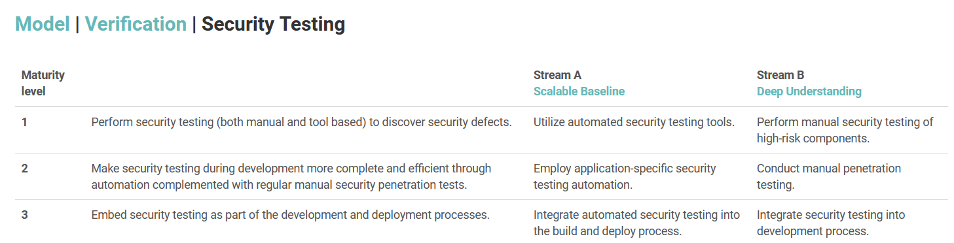
Security Testing Practice

Slide 21
Demo

Slide 22
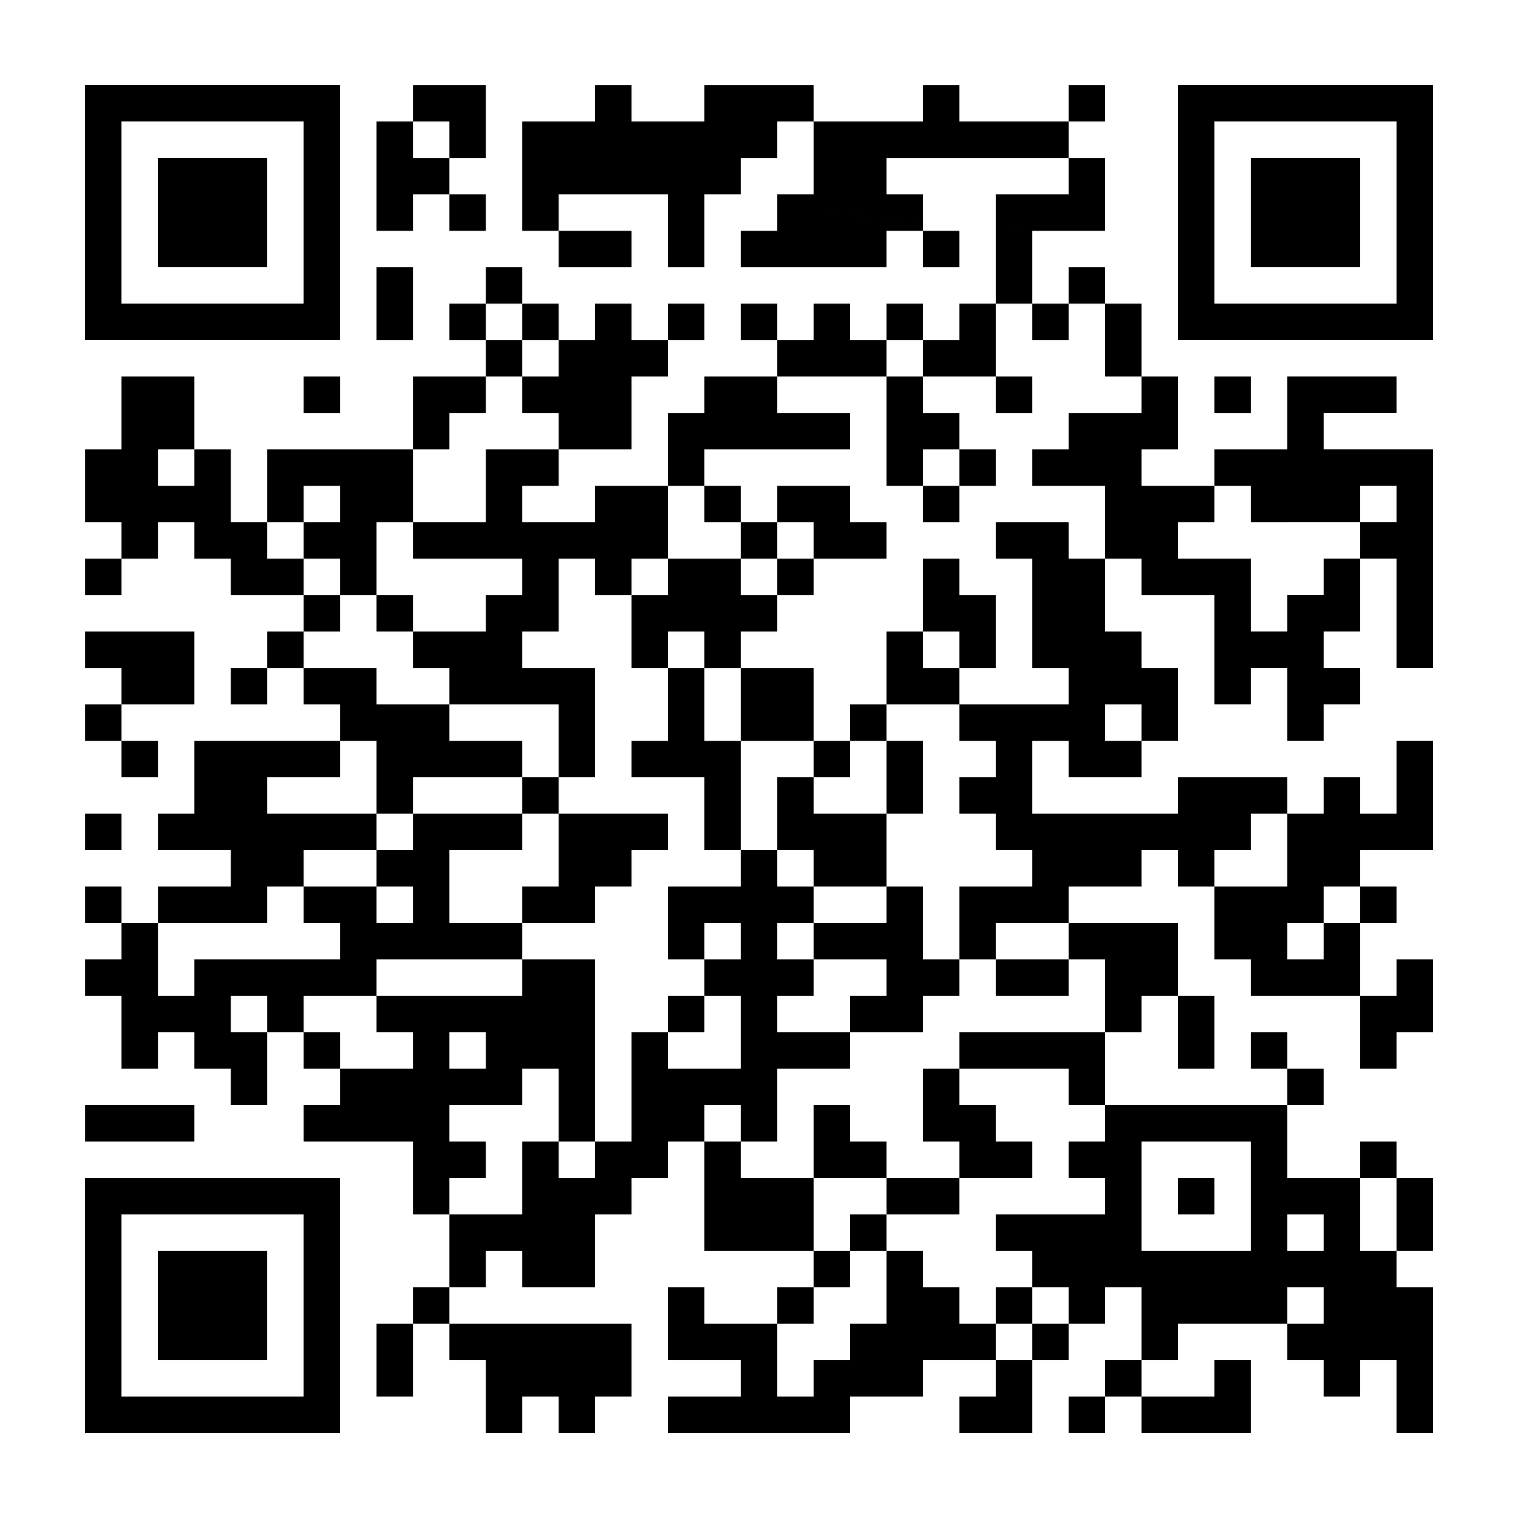
<< EOF
Feel free to get in touch!
Email - jack@tayko.io
Discord - @xel_au
Presentation Repo →

