Slide 1
The ultimate converter
Anthony, Nikita, taylan

Slide 2
Goals
Design an image converter (compressor and decompressor)
Store and read images from SD card
Create User Interface on Host PC using UART to select image and format
Convert the image and save it to SD or Host PC

Slide 3
Components
MicroBlaze
Custom AXI Lite IP
DDR
SD Card
Uart
Interrupt

Slide 4
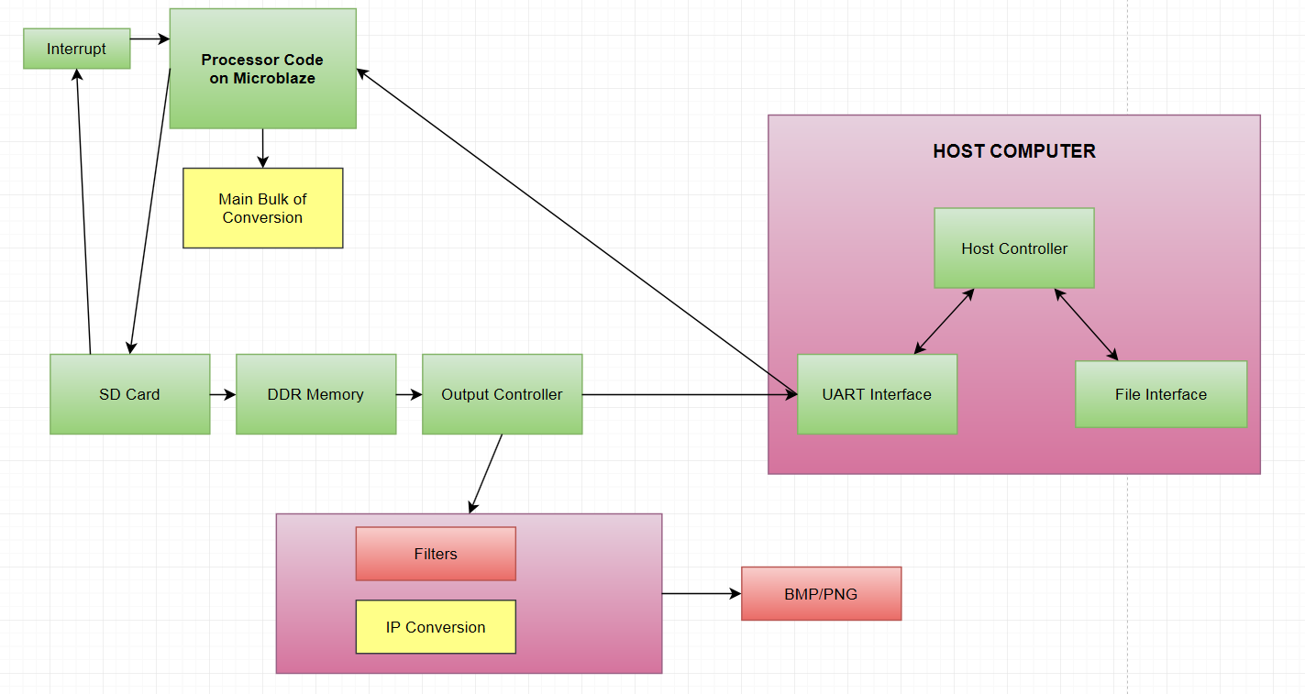
Diagram

Slide 5
CUSTOM IP
AXI LITE IP to perform mathematical functions to speed up the conversion
Implements and FSM to ensure the calculations are completed before user tries to read the result
6 registers: 2 for input, 2 status and 2 output
Used for converting “color table index” to “color” and vice versa.

Slide 6
SD Card
Communication using AXI Quad SPI
Uses FATfs (Elm Chan) for high level reading and writing to the file system
Implemented interrupt to check if the SD card is inserted/taken out, mid-program run
Reads through entire file system on the card displaying the various files for the user to read from
Reads data, and sends it to the custom IP

Slide 7
Host PC
Sends start command to the FPGA
Reads data from
Has read files, sent the contents to the FPGA, got data back from the FPGA and stored it properly

Slide 8
UART
Sends command for the program to start running
Displays information from the user onto the Host PC screen
Polls the UART’s control register for both reading and writing
Uses code we developed
Could be used to read files from the Host PC and read them back properly

Slide 9
DDR
Collects text or picture memory from SD Card
Is later read to produce values for the Custom IP

Slide 10
Future Considerations
Nicer UI
Displays images
Allows the user to select image on SD Card
Allows user to select type

Slide 11
IMAGE conversion
Initially: given format to multiple formats
Can be done on a computer GNU libraries
Xilinx GNU has only the basic C libraries
Not able to attempt to do most of the conversions we wanted to

Slide 12
Modified Converter
Settle down on a bmp - png converter
Lightweight standalone implementation of libpng library, lodepng
Convert between the two image formats
Using only the GNU libraries available in Xilinx
MicroBlaze processor: cannot allocate the space for the hash table required for the zlib deflate/inflate algorithm.

Slide 13
Future considerations
Image conversion requires at least a basic OS and virtual memory manager
Heavy on memory usage, in the case of compression, frequent allocation-deallocation
Custom IPs should be used to do the hashing and bulk of the other conversions
Has potential because image conversion is common and necessary

