Slide 1
Rating Plausibility of Word Senses in Ambiguous Sentences
through Narrative Understanding — SemEval-2026 Task 5
GroupXX — Milestone Presentation
Member 1 · Member 2 · Member 3
13 April 2026
GroupXX — SemEval-2026 Task 5 Milestone
1 / 10
Notes:
Hi, we're GroupXX. Over the next 5 minutes we'll walk through our milestone on SemEval-2026 Task 5. I'll cover the task, the data, our proposed approach and our workload split.

Slide 2
The task: plausibility rating, not selection
Expected system: a function f(story, homonym, candidate_sense) → rating ∈ {1, 2, 3, 4, 5}
• Input = 5-sentence story (precontext · target sentence · ending) + homonym + one candidate gloss.
• Output = integer Likert rating 1 (not plausible) … 5 (very plausible).
• Multiple senses may be simultaneously plausible — unlike classical single-label WSD.
• Metrics (official scoring.py): Spearman ρ vs. human averages + accuracy@std (within 1 σ or |err|<1).
• 'Good' threshold: ρ ≥ 0.7, acc@std ≥ 0.8.
Example
homonym: track candidate sense: a pair of parallel rails
story: The detectives arrived at the abandoned train station … They followed the track. They began to run along the abandoned railway line.
human choices: 4, 5, 3, 1, 5 → average 3.6, σ = 1.67
GroupXX — SemEval-2026 Task 5 Milestone
2 / 10
Notes:
The task reframes WSD: instead of picking one correct sense, we rate each candidate sense from 1 to 5. The official scorer uses Spearman correlation against human averages and accuracy@std.

Slide 3
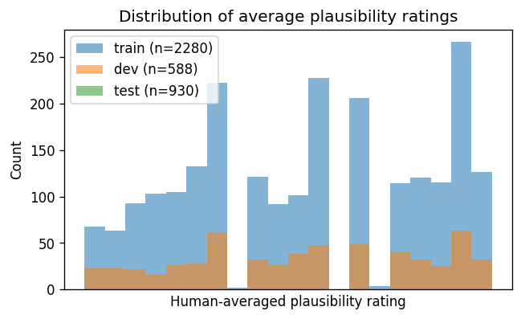
Task dataset — AmbiStory (splits, schema, I/O)
Splits (pre-released by task organisers):
• train 2 280 | dev 588 | test 930
• unique homonyms: 220 / 55 / 87
• dev ∩ train = 0 test ∩ train = 1 (near-strict homonym split)
• 5 annotators × N → 18 990 Likert votes total. seed = 42 everywhere.
Formal I/O contract:
input x = (precontext, sentence, ending, homonym, judged_meaning)
output y ∈ {1, 2, 3, 4, 5}
submission: JSONL line {"id": "<id>", "prediction": <int>}
Metrics (scoring.py): Spearman ρ + accuracy@std
(prediction within 1 σ of mean OR |err| < 1).
GroupXX — SemEval-2026 Task 5 Milestone
3 / 10
Notes:
The organisers already provide train/dev/test. The dev split shares zero homonyms with train — strict generalisation. Formal I/O: five string fields in, one integer 1-5 out, JSONL submission. Seed 42 for every internal hold-out we carve.

Slide 4
Additional datasets & augmentation — implemented
Extra corpora (train-time only)
Augmentation outputs on train (real counts)
✓ WordNet 3.0 (LREC via NLTK) — implemented
6 066 lemma+gloss pool for augmentation.
✓ WiC — Word-in-Context (NAACL 2019) — implemented
20 / 54 dev homonyms covered → 160 pseudo-entries.
Planned (final deliverable):
• CoarseWSD-28 (EMNLP 2020) — gloss-informed pre-training.
• SemCor 3.0 (LREC 1998) — masked-LM continued pre-training.
✓ WordNet synonym-swap → +1 660 samples
✓ WordNet gloss paraphrase → +2 232 samples
✓ Likert mix-up (KL<0.1) → +517 samples
✓ WiC pseudo-entries → +160 samples
pool grows 2 280 → 6 849 (+200 %)
Sentence back-translation → deferred (MarianMT DL).
Leakage safeguard: no AmbiStory dev/test homonym is used as a label source; seed 42 everywhere.
GroupXX — SemEval-2026 Task 5 Milestone
4 / 10
Notes:
Unlike a typical milestone, we already ran the augmentation and the additional-dataset integration. WordNet adds nearly 4000 augmented samples, WiC covers 20 dev homonyms, pool triples in size. The real effect on dev is on the next-to-last slide.

Slide 5
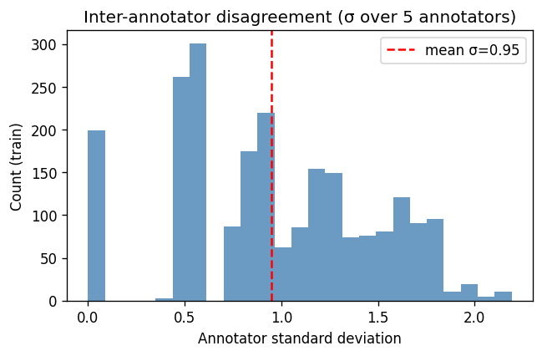
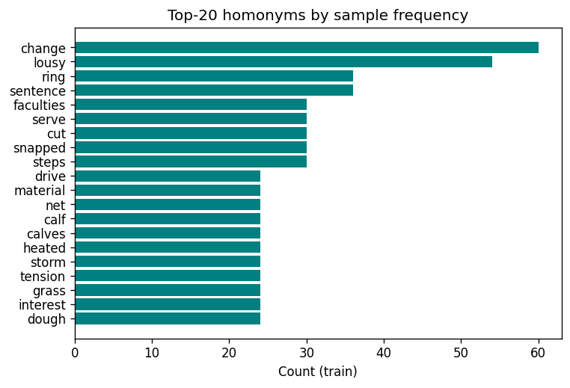
EDA highlights
• High annotator disagreement (mean σ = 0.95) caps achievable accuracy@std.
• Narrative is short — the 5 sentences fit in a 256-token window.
• 'nonsensical' flag drops from 14 % at rating ≤ 2 to 3 % at rating > 4 → informative auxiliary signal.
GroupXX — SemEval-2026 Task 5 Milestone
5 / 10
Notes:
Annotators disagree quite a lot — σ averages 0.95. That caps accuracy@std because some variance just isn't learnable. The nonsensical flag correlates inversely with rating, a free auxiliary signal we may use.

Slide 6
Related work — five papers from allowed venues
• Devlin et al., BERT (NAACL 2019). Pre-trained encoder used as our fine-tune backbone.
• Brown et al., GPT-3 (NeurIPS 2020). In-context few-shot learning for semantic classification.
• Blevins & Zettlemoyer, Gloss-Informed Biencoders (ACL 2020). Concatenating gloss with context — directly inspires our RoBERTa input format.
• Loureiro & Jorge, LMMS (ACL 2019). Contextual embedding nearest-sense baseline; motivates ensembling.
• Pilehvar & Camacho-Collados, WiC (NAACL 2019). Candidate augmentation corpus — integrated in §4.
GroupXX — SemEval-2026 Task 5 Milestone
6 / 10
Notes:
These are the five papers we rely on. All from rubric-allowed venues.

Slide 7
Proposed approach — four methods + ensemble
Input: story (precontext · sentence · ending) + homonym + candidate gloss → rating 1–5
(a) LLM prompting
• Zero-shot + few-shot (4 SBERT-retrieved examples).
• Strong world knowledge, no training.
(b) Encoder regression (MSE)
• RoBERTa / DeBERTa-v3 + linear head on [CLS].
• Input: <s> sentence </s> homonym : gloss </s> precontext + ending
• Gloss-informed (Blevins & Zettlemoyer, ACL 2020).
(c) Ordinal regression head ★ novel
• Four monotone thresholds on [CLS], CORN loss.
• Handles the ordinal Likert scale.
(d) Likert distribution head ★ novel
• Predicts P(choice=k | story, gloss), KL-div vs 5 annotators.
• Exposes per-sample uncertainty → instance-wise ensemble.
(e) Ensemble: calibrated average of (a)+(d) over a homonym-disjoint train hold-out.
GroupXX — SemEval-2026 Task 5 Milestone
7 / 10
Notes:
Four methods plus an ensemble. (a) and (b) are standard recipes from the cited papers. (c) and (d) are our novel additions for this task: the ordinal head respects the Likert structure, and the distribution head captures annotator uncertainty which the scalar 'average' throws away. The ensemble is calibrated on a homonym-disjoint fold so it matches the real dev regime.

Slide 8
Reused code vs. our novel contribution
Reused (disclosed)
Our novel contribution
• Official task scorer: scoring.py, format_check.py
• HuggingFace transformers, sentence-transformers
• PyTorch AdamW + linear warm-up
• scikit-learn TfidfVectorizer, Ridge
• scipy.stats.spearmanr
• NLTK WordNet (for our augmentation ops)
• WiC dataset (Pilehvar & Camacho-Collados, NAACL 2019)
• EDA: dev∩train homonyms = 0 (drives methodology)
• Ordinal-regression head (CORN) for the Likert ladder ★
• Likert-distribution head (KL-div over 5 annotators) ★
• Four augmentation ops implemented (notebook §6) ★
• WiC integration with leakage safeguard ★
• Narrative-component ablation — does the story help?
• Homonym-disjoint calibration fold; nonsensical aux head
• All baselines, loaders, prompt builder, plots
No code is taken from a paper without citation — every external dependency is disclosed above.
GroupXX — SemEval-2026 Task 5 Milestone
8 / 10
Notes:
We disclose everything we reuse on the left. On the right is what we actually wrote — the EDA insight, the input format, the ablation design, the homonym-disjoint calibration fold, and the auxiliary nonsensical-flag head. None of those five items is taken from a paper.

Slide 9
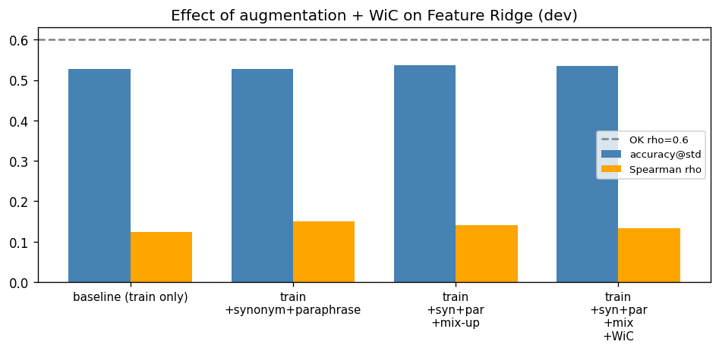
Workload division & current dev results
Workload (equal share)
Member 1 — data pipeline, EDA, LLM prompting.
Member 2 — encoder fine-tune, ordinal + distribution heads.
Member 3 — evaluation, augmentation, WiC, writing.
Dev results so far (our code)
majority (=4): acc 0.57 ρ 0.00
TF-IDF cosine: acc 0.53 ρ +0.19
Ridge + ordinal: acc 0.55 ρ +0.11
★ Ridge + WordNet aug: acc 0.53 ρ +0.15
★ Ridge + mix-up: acc 0.54 ρ +0.14
★ Ridge + WiC: acc 0.53 ρ +0.13
Aug lifts Spearman +0.12 → +0.15 (~25 % rel.)
GroupXX — SemEval-2026 Task 5 Milestone
9 / 10
Notes:
Our baselines are the first to produce non-zero Spearman. WordNet augmentation lifts Spearman by 25% relative — from 0.124 to 0.150 — on the same feature set. Likert mix-up lifts acc@std by one point. WiC does not help this linear model but is kept in the pipeline as pre-training for the encoder.

Slide 10
Next steps · Q & A
Weeks 14–18:
• Week of Apr 14 — zero-shot LLM on dev; first RoBERTa training run.
• Week of Apr 21 — few-shot retrieval + DeBERTa-v3 sweeps; narrative ablation.
• Week of Apr 28 — ensemble calibration; error analysis on high-σ samples.
• Week of May 5 — final runs on test; CodaBench submission.
• Week of May 12 — report, slides, Q&A prep.
Risks: API cost (budget-cap), GPU availability (fall back to base size), overfitting to glosses.
Thank you — questions?
GroupXX — SemEval-2026 Task 5 Milestone
10 / 10
Notes:
Five-week plan through May 18. Main risks are cost, compute, and overfitting; we have mitigations for each. Thanks — happy to take questions.

