Slide 1
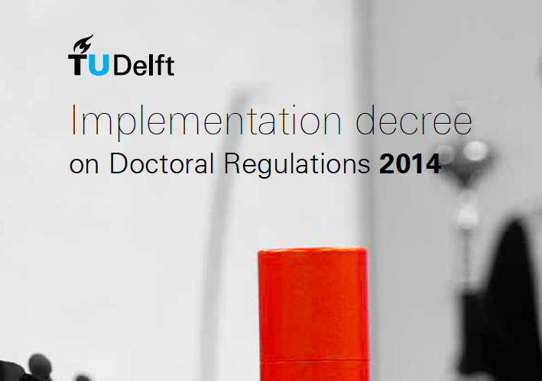

Slide 2
Why propositions
The propositions should demonstrate that the doctoral candidate has a broad base of scientific knowledge that is not limited to the subject of the dissertation
dissertation demonstrates the ability as a researcher, but it gives no evidence that they are able to formulate hypotheses that would serve as a challenge to further investigation
(hypotheses underlying a doctoral study are developed with the necessary guidance, and are no longer explicitly discussed during long periods of investigation)
ability to pose scientific questions oneself that is tested by the formulation of bold propositions and their defence in public

Slide 3
General aim propositions
Formulate propositions that can spark a scientific debate
Not be only positive statements that can be defended within a certain field of science but must also be challenging
The sun will rise tomorrow (defendable but not challenging in current intellectual climate, never trigger a debate of pros and cons)
Propositions appended to the dissertation must be not only scientifically sound and defendable but also opposable

Slide 4
Requirements (implementation decree 2014)
At least six of these shall not relate to the subject of the dissertation
Total number of propositions should not exceed ten
All the propositions must be scientifically grounded,
It must be possible to take a position for or against their veracity
The promotor should approve the propositions on this basis
A maximum of two of the propositions may be somewhatplayful in nature
The propositions are to be written in Dutch or in English, with English being the preferred language
The propositions should preferably include literature references and/or sources.
Not offending

Slide 5
Possible subjects
new perspectives created by the dissertation
results of incidental interest, which are not included in the dissertation
(critical) comments on the literature relating to technical sciences
comments on related disciplines and/or the methods used
speculative statements about future developments, which cannot yet be definitively verified.

Slide 6
Proposition needs to be
Opposable and defendable (general requirement)
Decisiveness and boldness (way of posing)
Aim for True/False propositions
Vague quantors (‘often’, ‘sometimes’, ’may’) cannot be refuted by opponents
A proposition with existence quantor (there is a case where ... applies) is only opposable when no example is yet known (e.g. before 1988: ‘a proof of Fermat’s last theorem exists’)
A generalizing all-quantor (it may be stated in any case that …) challenges the opposition to present counter-examples.

Slide 7
The challenging nature of propositions
There is some doubt about its scientific truth or falsehood
Arguments pro and contra it can be weighed against one another
If there is absolutely no doubt about the truth of a proposition, it no longer has any relevance for the advancement of science
A proposition assumed by everyone to be true can be defended, but there is no point in investigating it any further
The most valuable propositions are those which are generally regarded to be untrue (such as the views put forward by Copernicus in his time)
Demonstrate the candidate’s critical and innovative approach and his or her ability to advance the boundaries of science

Slide 8
Defendability
while the truth of the proposition is not self-evident (i.e. the proposition is challenging in the sense used above), sound scientific arguments can be advanced in its favour
Aim: limit the number of playful propositions and allows the candidate to show that his or her insights extend beyond the boundaries of his or her own domain

Slide 9
My additions
Innovative
Google your propositions
Not religious (offending)
Watch out for very repetitive topics
Doing a phd
Valuing science (‘h-factor is hampering progress in science’)

Slide 10
The brain is not a neural net
Good engineering practices give you advantage while carrying out your phd in computer science
Fairness hampers efficiency
If there is feature set that can classify prime numbers than p=np
Society will only benefit from robotization/automation
Our universe is a simulation being one out of recursive simulations of universes
Hinton is god

Slide 11
Scientifically/Mathematically speaking there is no difference between small or big data
Government should stimulate performance improving drugs for scientist
Perfection does not guarantee success
Regulation in science is not sustainable
Science can be automated

