Slide 1
ACTIVITY #1
90% ranges

Slide 2
How many people live in the city of Richmond (2020 census)?

Slide 3
How many people live in Virginia (2024 estimate)?

Slide 4
How many countries are member states of the United Nations?

Slide 5
What is the diameter (in centimeters or inches) of a basketball hoop?

Slide 6
In what year was Charlemagne crowned the Emperor by the Pope?

Slide 7
Among adults who drink coffee, how many cups of coffee does the average American drink per day?

Slide 8
What is the average lifespan (in years) of a domestic cat?

Slide 9
How many episodes of Friends were produced?

Slide 10
What is the median length of an episode of Friends ?

Slide 11
What is the average number of steps an adult takes in a day (in the U.S.)?

Slide 12
What is the average height of an adult male in the U.S. (cm or in)?

Slide 13
What is the average height of an adult female in the U.S. (cm or in)?

Slide 14
What is the average number of words on the front page of The New York Times?

Slide 15
What is the average number of words spoken by an English-speaking adult in the U.S.?

Slide 16
Answers

Slide 17
How many people live in the city of Richmond (2020 census)?
226,610

Slide 18
How many people live in Virginia (2024 estimate)?
8,811,195

Slide 19
How many countries are member states of the United Nations?
193

Slide 20
What is the diameter (in centimeters or inches) of a basketball hoop?
18 inches or 46 cm

Slide 21
In what year was Charlemagne crowned the Emperor by the Pope?
800

Slide 22
Among adults who drink coffee, how many cups of coffee does the average American drink per day?
3

Slide 23
What is the average lifespan (in years) of a domestic cat?
15

Slide 24
How many episodes of Friends were produced?
236

Slide 25
What is the median length of an episode of Friends ?
23 minutes

Slide 26
What is the average number of steps an adult takes in a day (in the U.S.)?
4,500

Slide 27
What is the average height of an adult male in the U.S. (cm or in)?
175.3 cm or 69 in

Slide 28
What is the average height of an adult female in the U.S. (cm or in)?
161.3 cm or 63.5 in

Slide 29
What is the average number of words on the front page of The New York Times?
1,700

Slide 30
What is the average number of words spoken by an English-speaking adult in the U.S.?
16,000

Slide 31
ACTIVITY #2
memory game

Slide 32
chair

Slide 34
bright

Slide 36
window

Slide 38
heavy

Slide 40
apple

Slide 42
smooth

Slide 44
bottle

Slide 46
quiet

Slide 48
stone

Slide 50
yellow

Slide 52
cloud

Slide 54
sharp

Slide 56
carpet

Slide 58
fuck

Slide 60
cold

Slide 62
river

Slide 64
metal

Slide 66
bread

Slide 68
circle

Slide 70
wooden

Slide 72
Answers

Slide 73
1. chair
2. bright
3. window
4. heavy
5. apple
6. smooth
7. bottle
8. quiet
9. stone
10. yellow
11. cloud
12. sharp
13. carpet
14. fuck
15. cold
16. river
17. metal
18. bread
19. circle
20. wooden

Slide 74
ACTIVITY #3
video

Slide 75
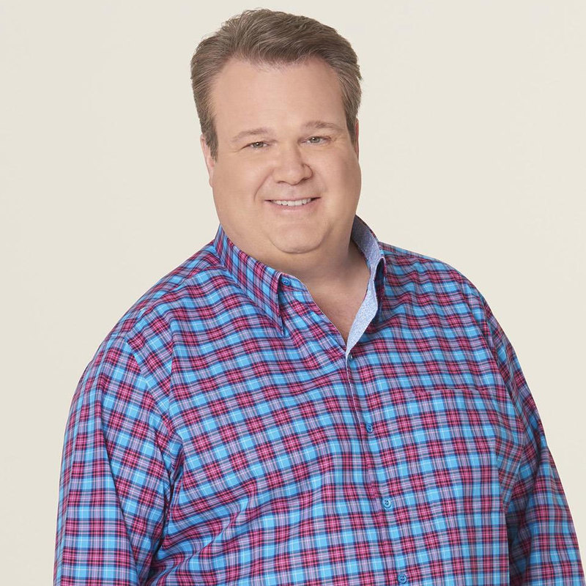
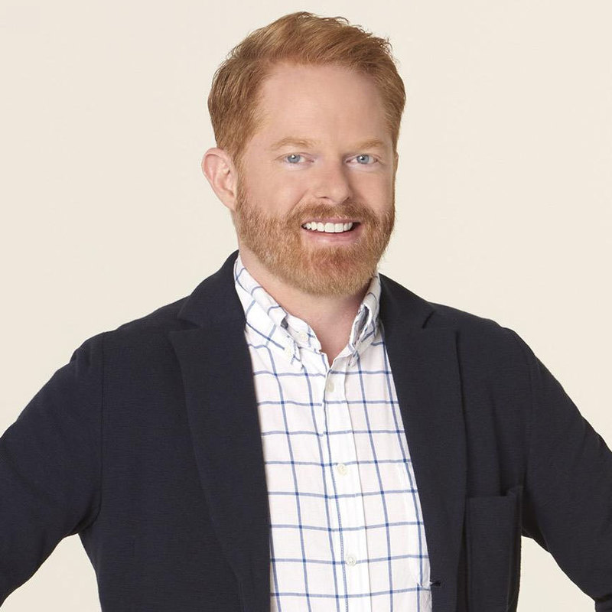
We are going to watch a 90 second video from the show Modern Family. The only thing you need to know about the show are the names of the two characters below.
Try to remember as much as possible!
Cam(eron)
Mitch(ell)

Slide 76
Questions:
1. What item did Cam and Mitch originally need at the store?
2. What two items did Cam add to the cart that Mitch thought belonged in a
general store?
3. What item first got Mitch excited that it was in the store?
4. Cam referenced bringing what animal to the market?
5. In what did Mitch suggest they could store the additional diapers?
6. What color was Mitch’s shirt?
7. What color was Cam’s shirt?
8. What product to Mitch call someone about to see if they needed any?
9. The kid on the other line had what on his face?
10. What two items did Mitch cite as giving the full range of products sold?
11. How many diapers are in one of the big boxes?
12. What aisle was Mitch going to at the end of the scene?

Slide 77
Answers:
1. What item did Cam and Mitch originally need at the store? diapers
2. What two items did Cam add to the cart that Mitch thought belonged in a
general store? toothpaste and soap
3. What item first got Mitch excited that it was in the store? paper shredder
4. Cam referenced bringing what animal to the market? a mule
5. In what did Mitch suggest they could store the additional diapers? a barn
6. What color was Mitch’s shirt? purple
7. What color was Cam’s shirt? blue
8. What product to Mitch call someone about to see if they needed any? olives
9. The kid on the other line had what on his face? a milk moustache
10. What two items did Mitch cite as giving the full range of products sold?
baby formula and coffins
11. How many diapers are in one of the big boxes? 216
12. What aisle was Mitch going to at the end of the scene? apple sauce

