Slide 1



LLMs for Cleaning and Creating Tabular Data
The new class of large language models offer a number of possibilities for assisting with the cleaning and creation of tabular datasets.
Let's see a few examples, along with some points of caution, using ChatGPT!
ChatGPT (OpenAI)
(Google)
Claude (Anthropic)

Slide 2
A. Normalizing Data
One persistent issue with tabular data is making sure that all of the records in a column are written consistently. For example, assume that we have a column of dates that were entered by different people that include the following:
02 05 92
01-04-2020
1996/05/01
first day of spring in 2024
2020-may-01
02-04-96
le 3 mars 2013
7 de septiembre de 2014
Normally, we would have to go through and manually put them into a single format. Let's see how ChatGPT can help with this.

Slide 3
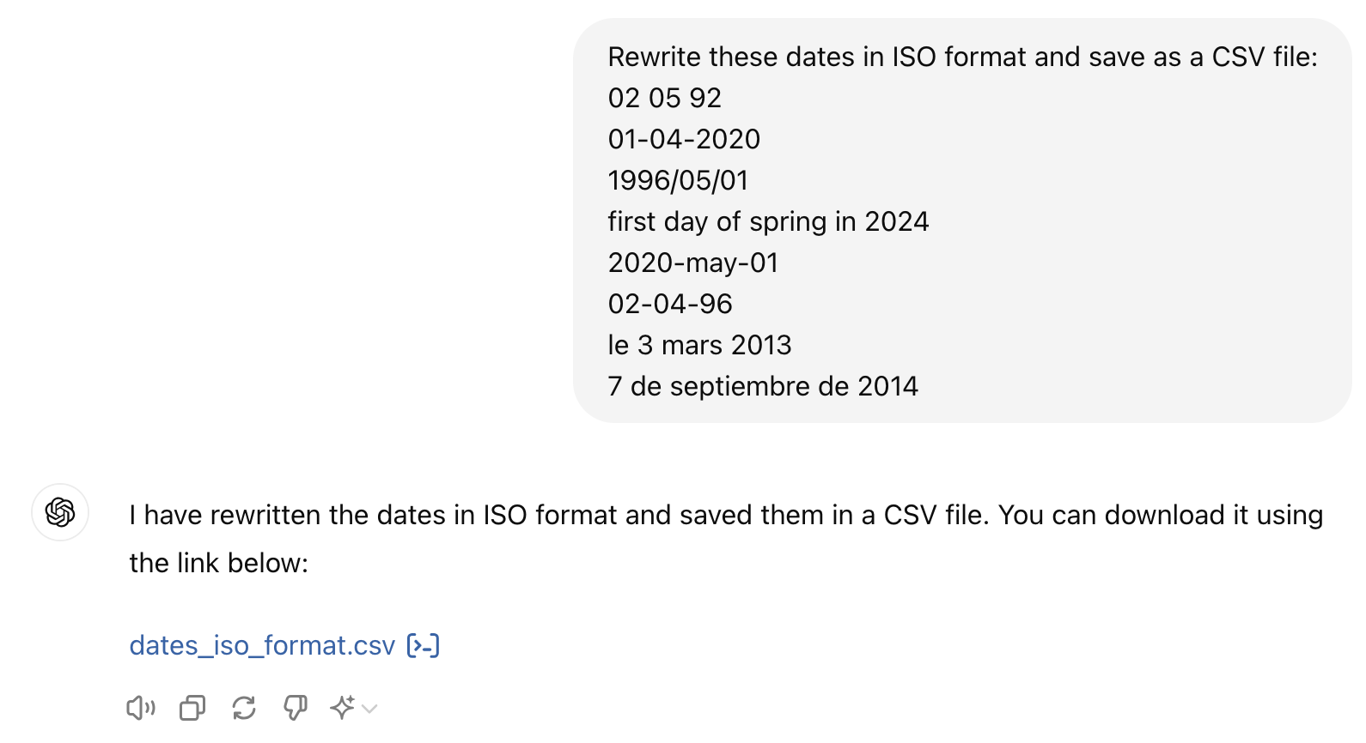
A. Normalizing Data

Slide 4
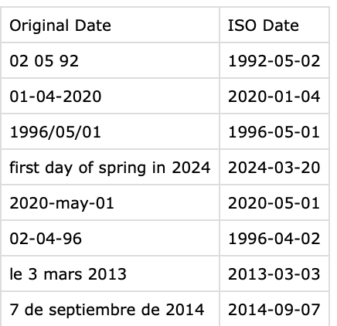
A. Normalizing Data
And here is the output file that was provided for download:

Slide 5
A. Normalizing Data
What are some potential concerns with this approach? More specifically, what assumptions did the model make here that may not be appropriate?

Slide 6
A. Normalizing Data
What are some potential concerns with this approach? More specifically, what assumptions did the model make here that may not be appropriate?
The first entry could be the 2nd of May or the 5th of February. The model assumes that the first entry is the day. The same thing occurs in the sixth entry.
The fourth entry provides the first day of spring in the Northern Hemisphere, which is different from the first day of spring if we were referring to the Southern Hemisphere (22 September 2024).
Note that human editors would also have to make decisions about these choices, but they would have the benefit of additional context and could better document any decisions that were made.

Slide 7
B. Creating New Data
Let's say that you need to create a tabular dataset from publicly available information. For example, we might want a dataset of all the countries in the European Union with associated metadata. Or, an ordered set of the heads of state for a particular country. Following the movies theme, we might want to get information about all of the top grossing films for a given year.
Usually, we would seek out these kinds of information in a physical book or reputable online resource. For many queries this would work well, but the issue would be turning the information we found into a tabular data format.

Slide 8
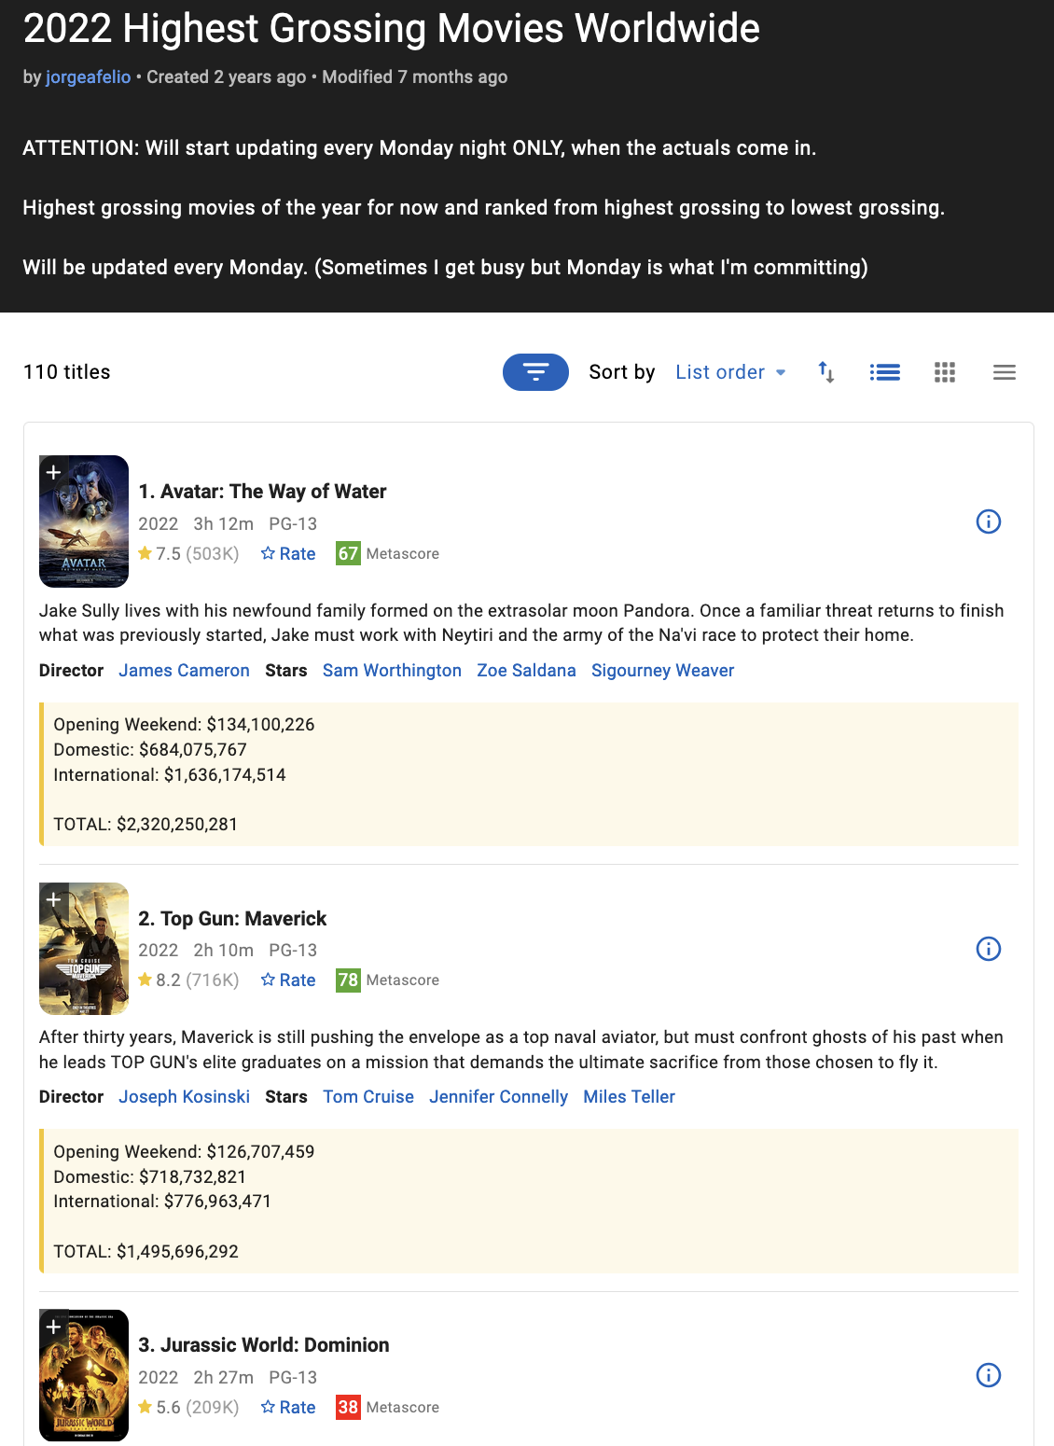
B. Creating New Data
There is a lot of data here, but it's not in a tabular data format that we could easily load and work with.
One option would be to manually copy and paste each of the fields into a spreadsheet.
Another would be to do web scraping, which is often effective but requires a lot of coding.

Slide 9
B. Creating New Data
Since large language models are trained on large amounts of text from the internet and other machine readable sources, often the information that we need is already hidden somewhere inside the model.
We can use this, along with the LLMs training data about how to create structured data, to generate the information in a way that is already usable.

Slide 10
TABLE

Slide 11
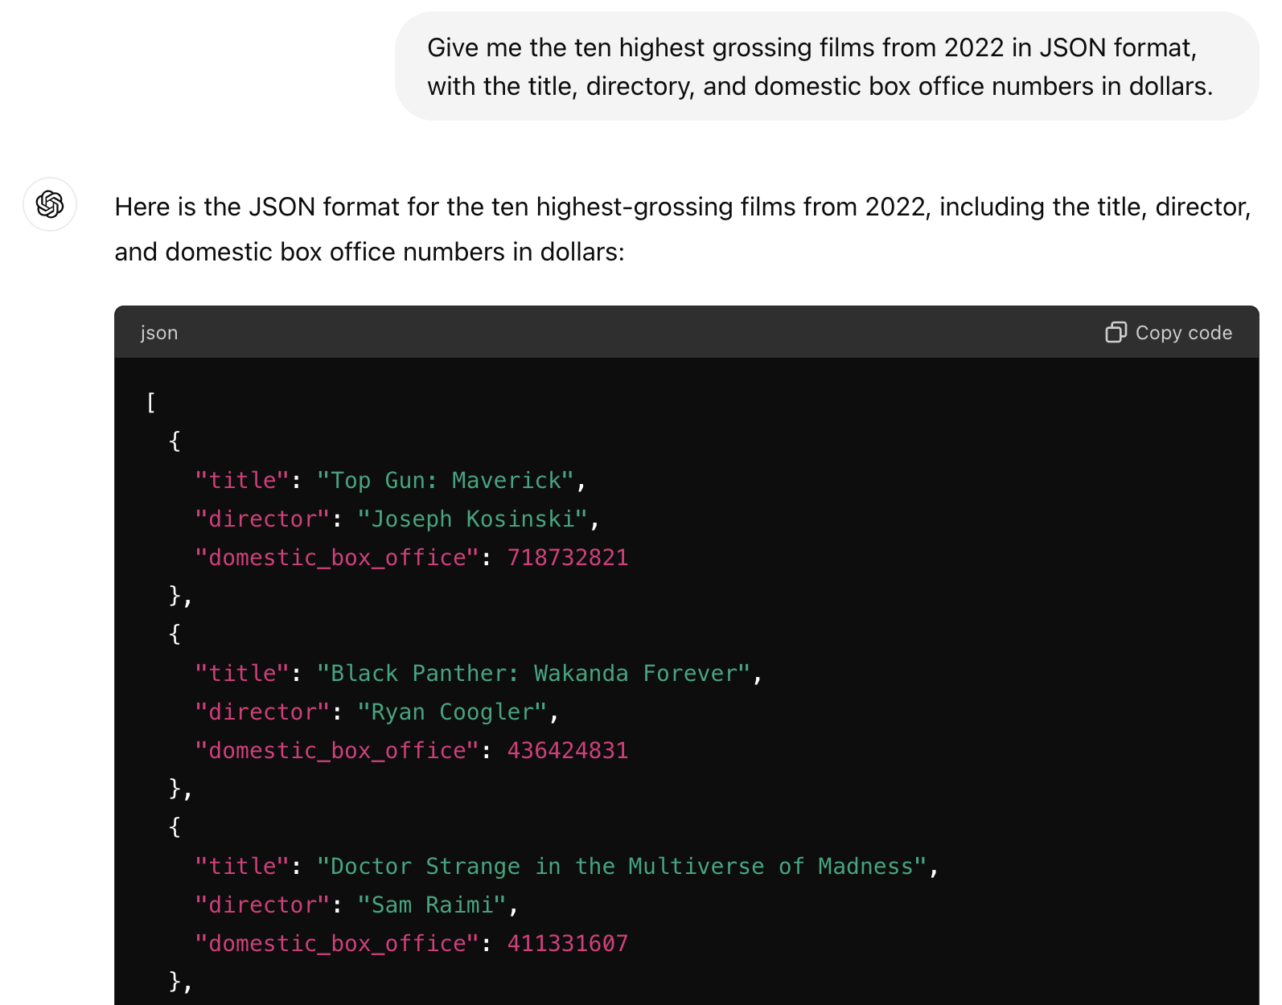
B. Creating New Data
We use a JSON format here to more easily show on the screen, but you could also ask for a CSV that you can download and use just like any other dataset.

Slide 12
B. Creating New Data
What are some of the drawbacks of using an LLM such as ChatGPT to generate a dataset from publicly available data?

Slide 13
B. Creating New Data
What are some of the drawbacks of using an LLM such as ChatGPT to generate a dataset from publicly available data?
We don't know exactly where the data is coming from, so cannot cite it of check it.
Always the chance the it will hallucinate information that it does not have.
Data is potentially old.
ChatGPT (at least the current version) will refuse to make datasets like this that are too large.

Slide 14
C. Annotating Data
Another common task in creating tabular data is producing annotations from unstructured inputs. For example, rating the tone of a piece of text or identifying the objects in an image. Often this involves some level of subjective decision making.
Annotations may be generating manually, though this can be time consuming for large datasets. Also, if different people collaborate on the annotations, they may have different systematic interpretations that affect the results.
Other computer vision and natural language processing algorithms can also be used, but require having a model specifically built for the application at hand.

Slide 15
C. Annotating Data
Using an LLM is another option. For example, let's see how it is able to convert a textual review of the movie Everything Everywhere All at Once into a numeric score.

Slide 16
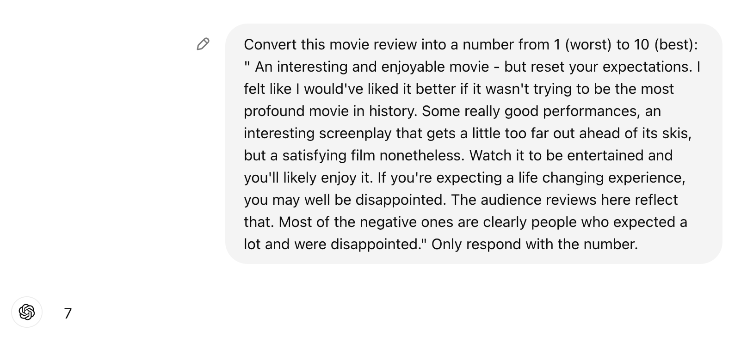
C. Annotating Data

Slide 17
C. Annotating Data
Similarly, we can upload a movie poster and ask how many people are in the image.

Slide 18
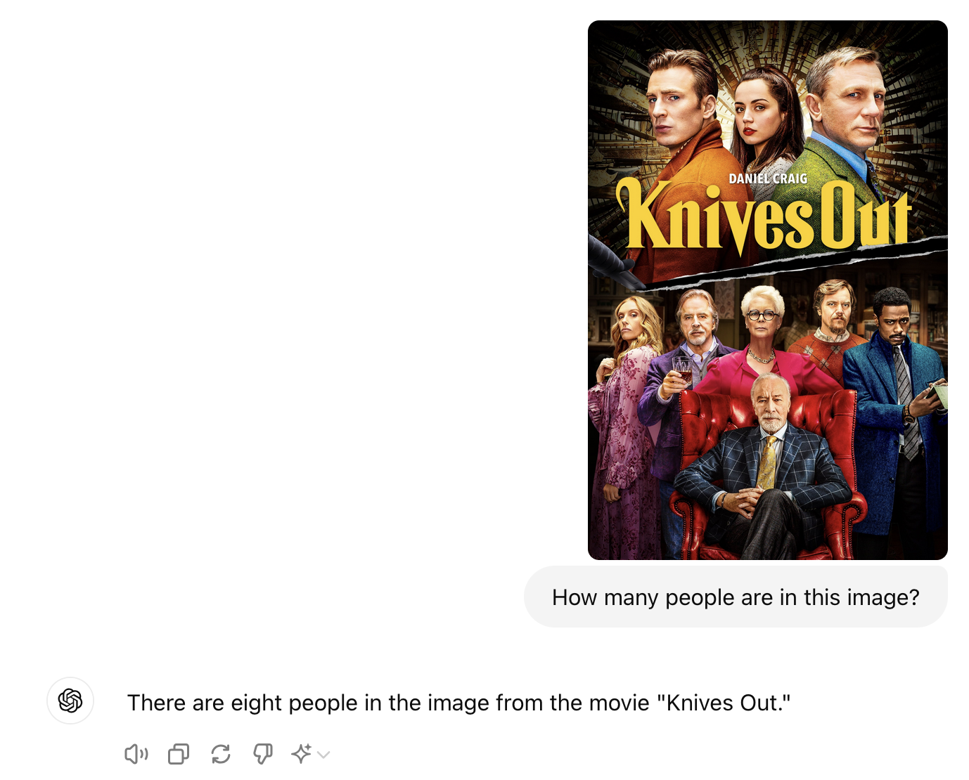
C. Annotating Data
Similarly, we can upload a movie poster and ask how many people are in the image.
As we can see here, it is not always correct.

Slide 19
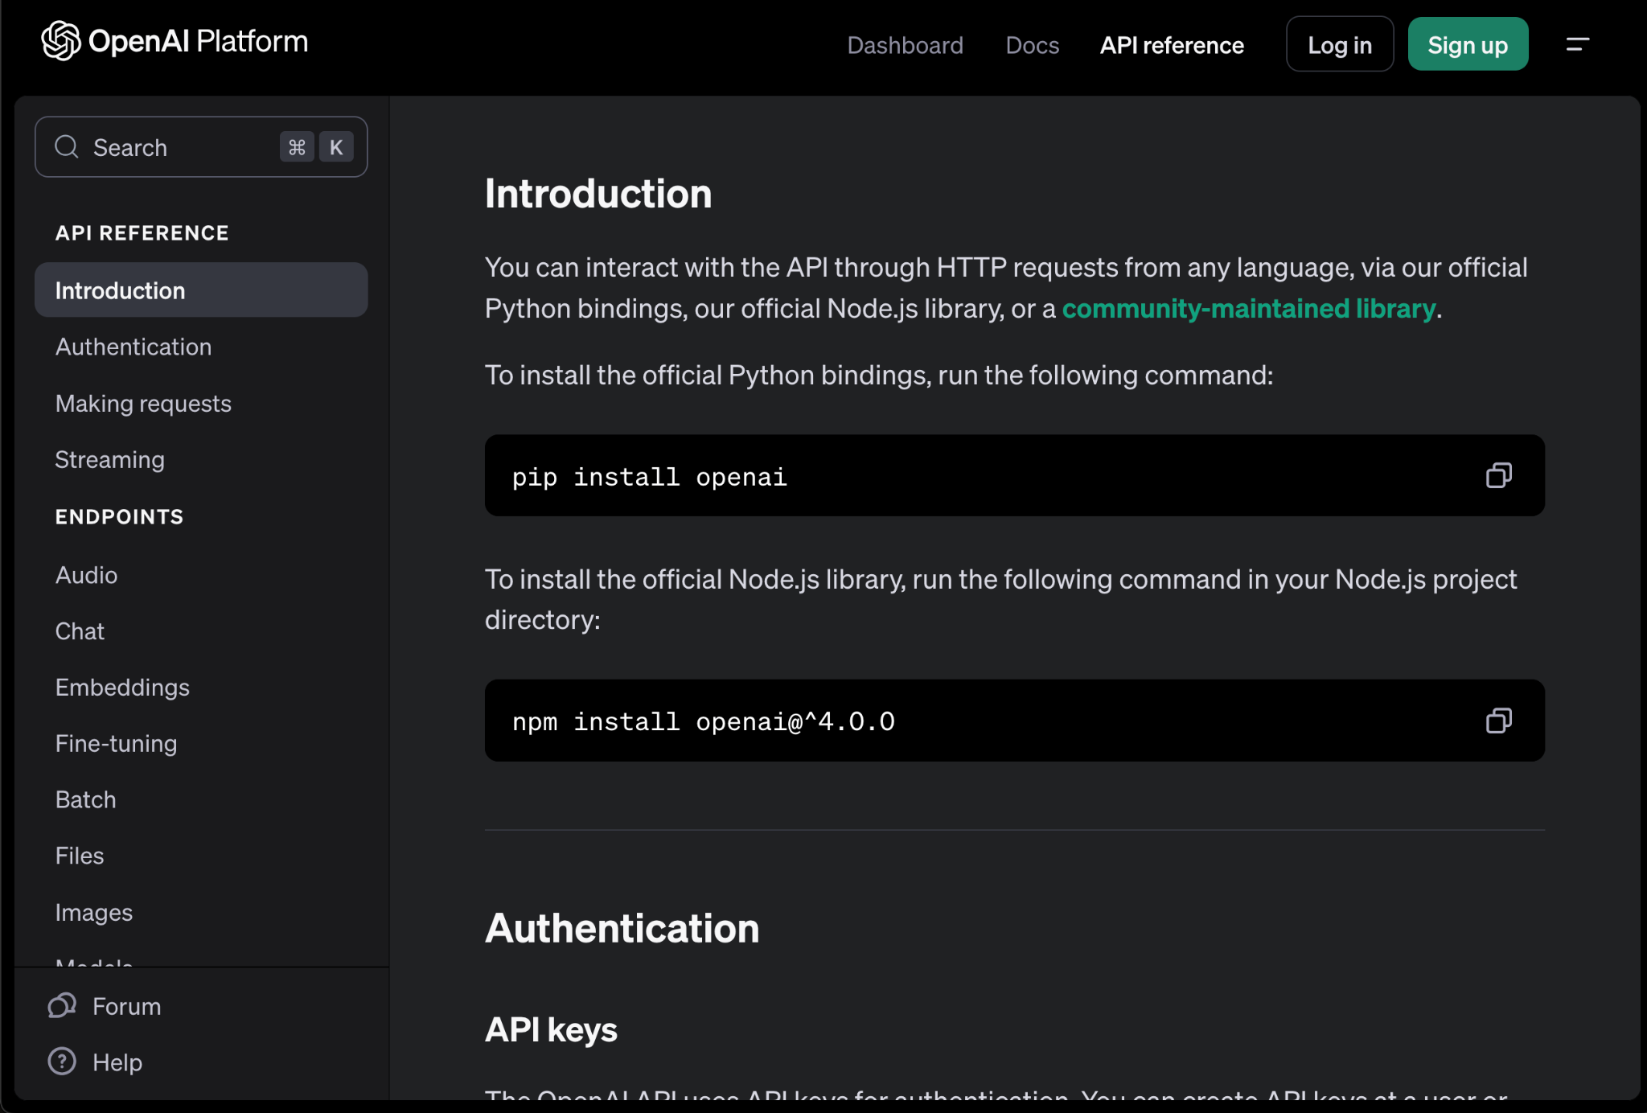
C. Annotating Data
Of course, these are only the results for a single review and single image. If the dataset had only a few dozen, we could input them all in like this and compile the data ourselves.
For most practical data annotation tasks, we need to automatically run the LLM over a large number of inputs. This requires using an API and some programming.

Slide 20
C. Annotating Data
What are some cautions we might have when using an LLM to augment existing unstructured data?

Slide 21
C. Annotating Data
What are some cautions we might have when using an LLM to augment existing unstructured data?
Requires some more programing (and cost) to run over the entire dataset.
When asked an objective question, the results are often as accurate as custom-build algorithms.
Privacy of the input data being sent through the API.
Potential reproducibility issues: Stochastic (random) nature of LLMs will not always produce the same output each time. Also, models are constantly be updated and we don't always have access to older versions.

Slide 22
D. Programing Help
On a completely different note, LLMs are also a great way to lower the barrier to entry for writing code to clean and explore tabular datasets. This is particularly useful to answer quick questions when learning a language outside of a classroom environment or without someone local to ask questions of.

Slide 23
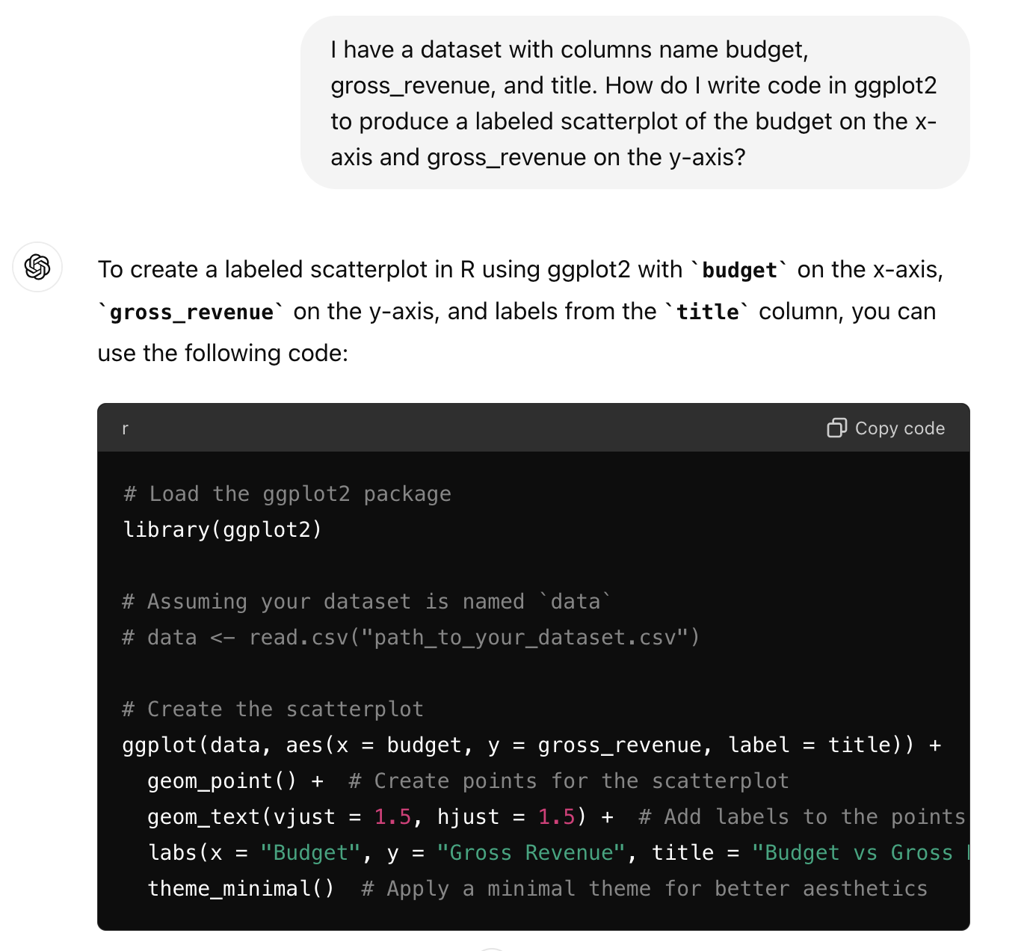
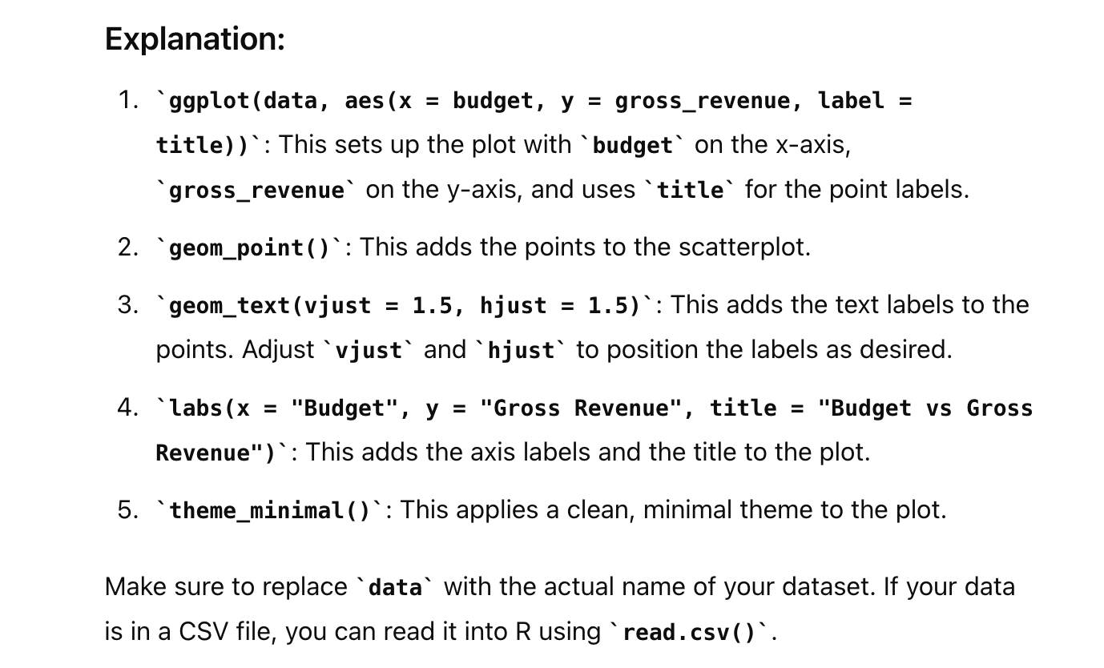
D. Programing Help

Slide 24
D. Programing Help
Often, as in the example above, ChatGPT will not only give you the answer but will also explain all of the steps. You can ask further questions and even ask it to give you practice problems (though note that it does not always get the answers completely correct).
It's best to pair ChatGPT with a more cohesive resource for learning a program language, such as a textbook or online tutorial.

Slide 25
Summary
There are many potential use-cases for applying large language models to the cleaning and creation of tabular data. Each of these, however, come along with potential points of difficulty that must always be considered when applying them.
Like all tools, LLMs do not remove the need to understand tidy data principles nor does it replace writing code to clean, check, and explore data (though, it can help us learn how to code).

Slide 26
Further Activities
Can you think of any other application of LLMs to the creation of tabular data other than those shown here?
Try to apply similar techniques to other tasks and take note of any other potential concerns that you see in the output.
How does changing the way that you ask ChatGPT the question (called the "prompt") affect the output?
Try to compare the output of using ChatGPT, Gemini, and/or Claude. What systematic differences do you notice?

