Slide 1

Introduction to the Teacher Pet
Our app provides a user-friendly interface for teachers to effortlessly generate lesson plans and define clear objectives. With a unique prompting strategy, it simplifies the process of lesson planning, making it an invaluable tool for educators.

Slide 2

Problem Statement: Challenges Faced by Teachers in Lesson Planning
1
Lack of Time
Teachers often struggle to find time for comprehensive lesson planning amid their busy schedules.
2
Diverse Learning Needs
Meeting the varied needs of students while planning lessons can be overwhelming for educators.
3
Resource Constraints
Accessing and organizing resources for effective lesson planning can pose significant challenges for teachers.

Slide 3

Benefits of Using the App for Teachers
Efficiency Boost
The app streamlines the lesson planning process, saving teachers valuable time and effort.
Customization
It enables personalized lesson plans that cater to the diverse needs of students, enhancing the teaching experience.

Slide 4
Lesson Plan Generation: How the App Helps in Creating Lesson Plans
Interactive Interface
Guided Process
The app features an interactive platform, allowing teachers to visually organize and structure their lesson components.
Teachers are guided through a step-by-step process, ensuring the completeness and coherence of their lesson plans.

Slide 5
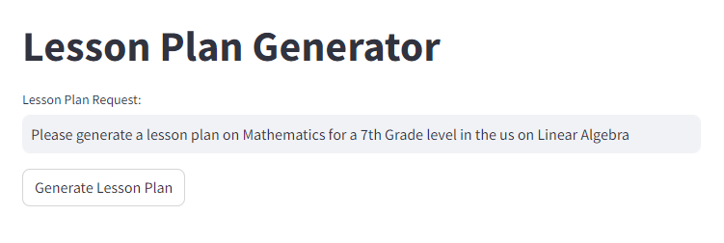
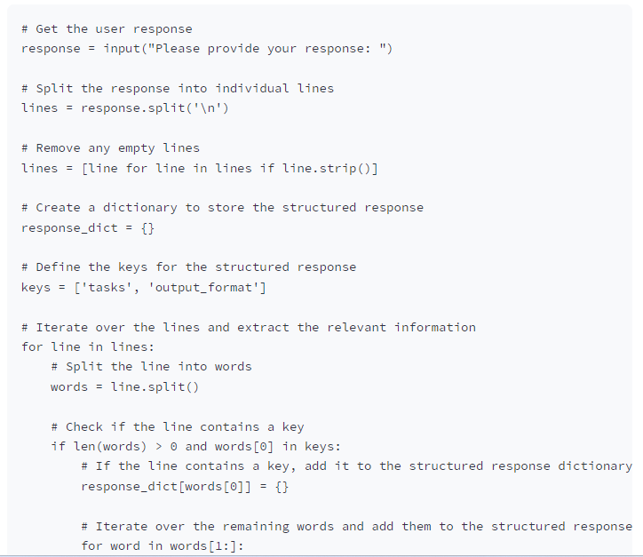

Slide 6




Conclusion
Reflection
Teachers can reflect on their experiences and lessons with insightful feedback from the app.
Continuous Improvement
By leveraging the prompting strategy, teachers can continuously improve their lesson planning and delivery.
Supportive Community
The app fosters a supportive community, allowing teachers to share best practices and innovative ideas.

