Slide 1
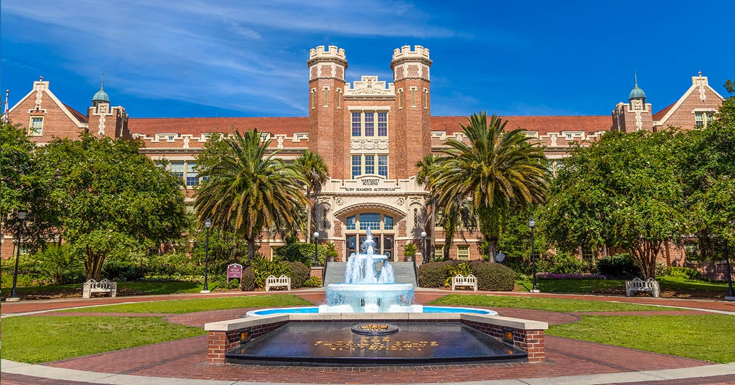
Intro to Graduate School and R
Day 1 of the RI Workshop, Summer 2026 Taylor Hill

Slide 2
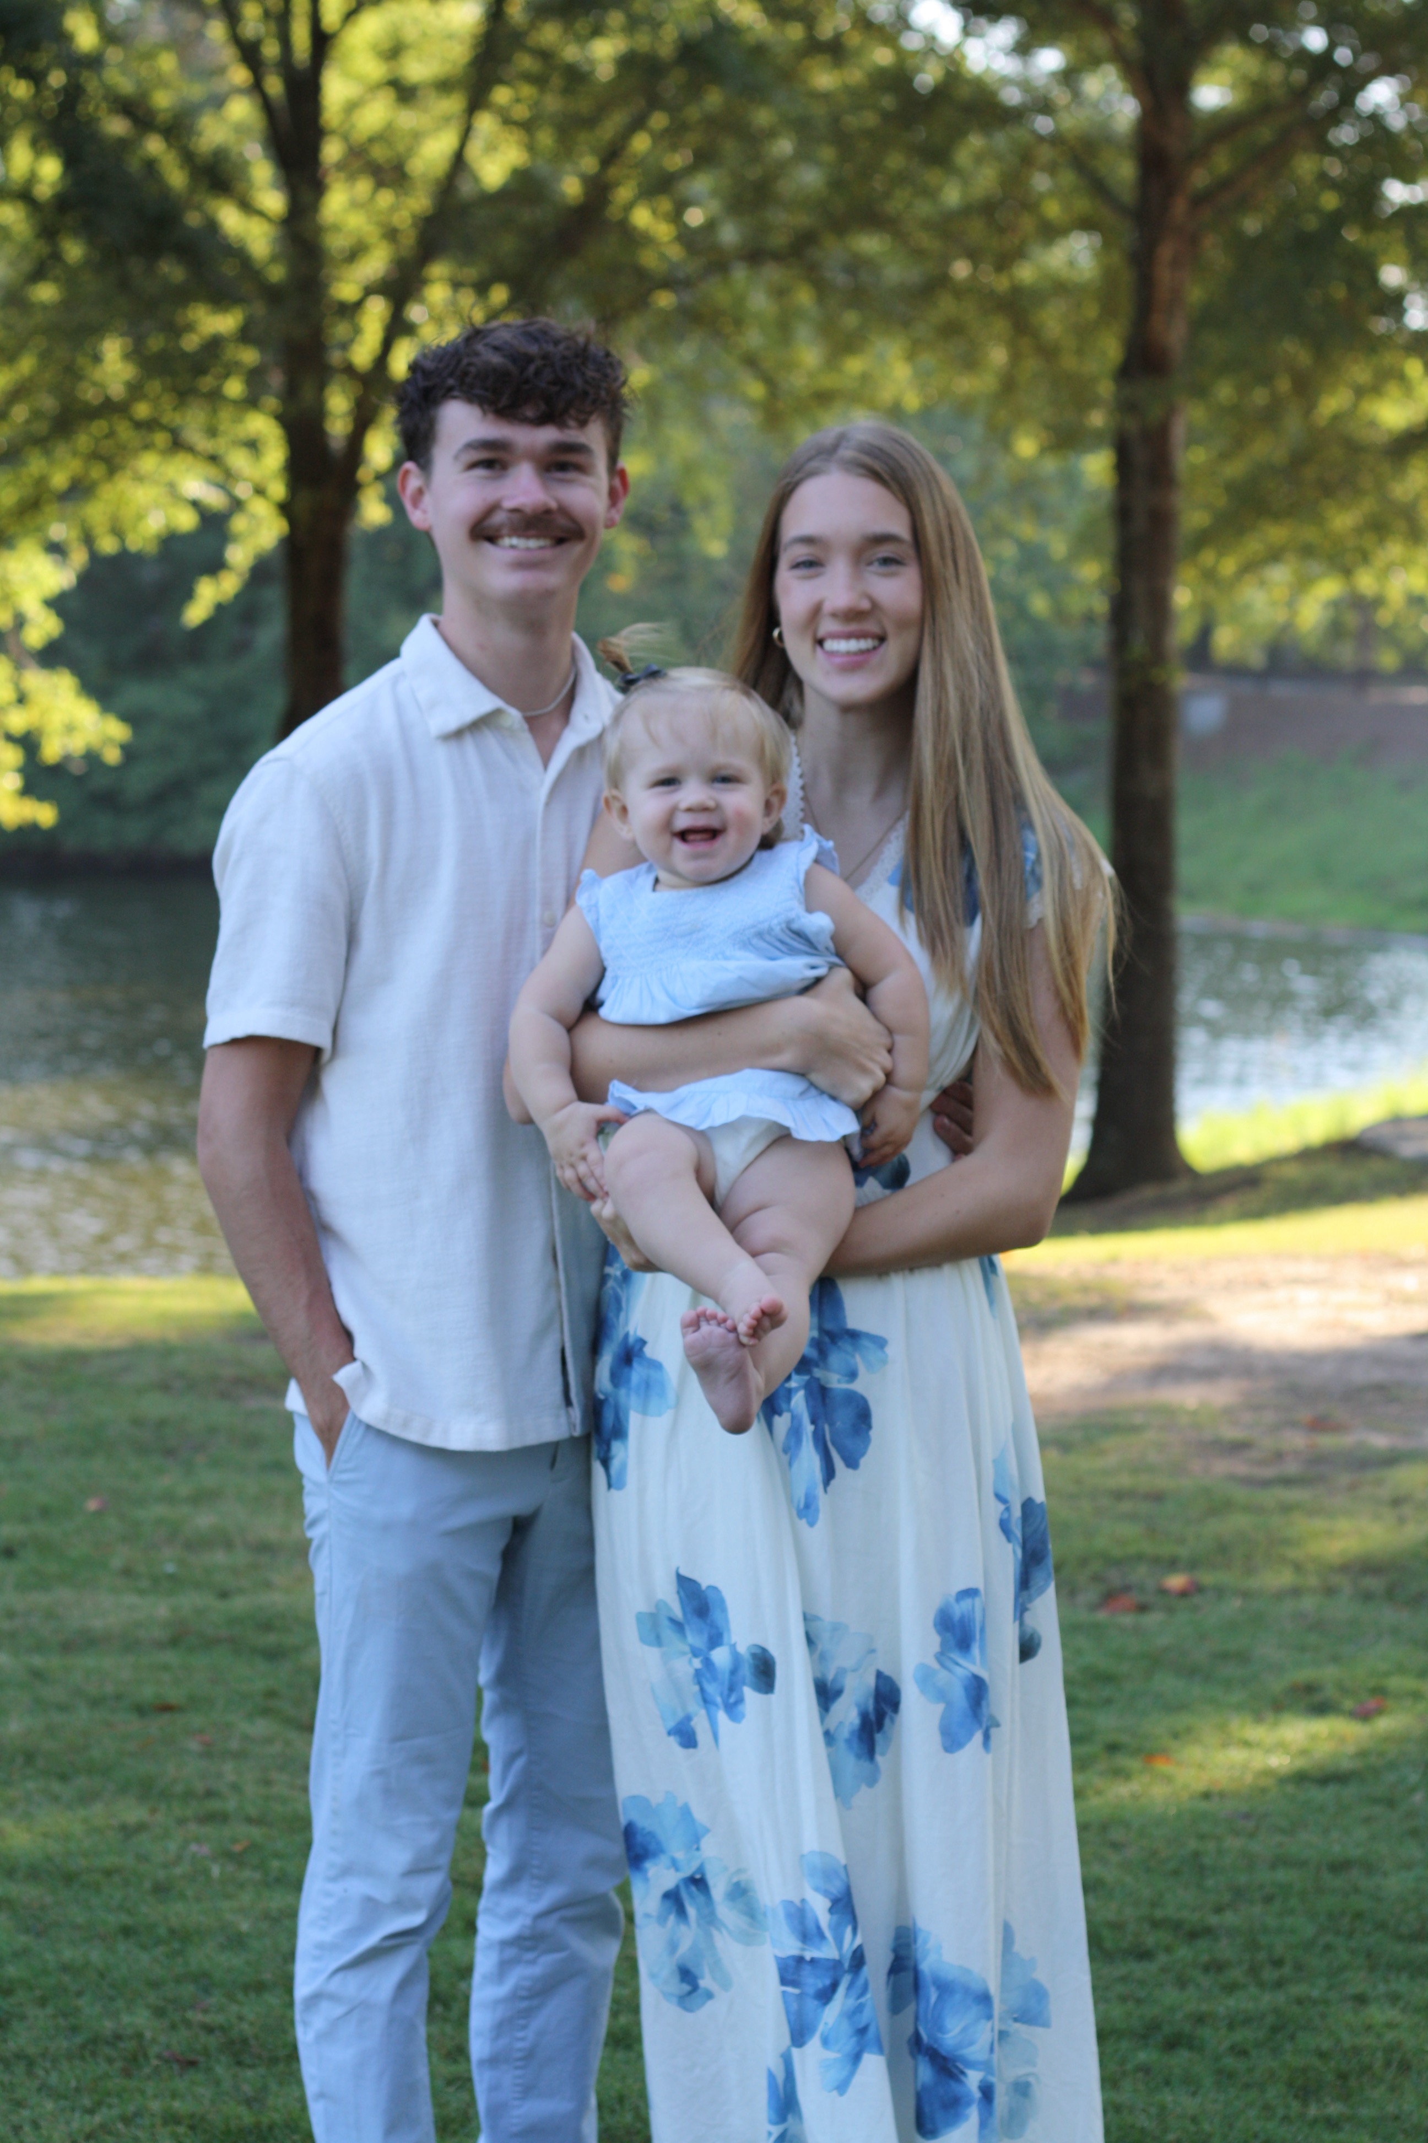
Introductions!
Taylor Hill
Rexburg, Idaho
American Behaviorist
Research interest: voting behavior, democratic backsliding, public opinion, experimental methods, political psychology
I am starting my third-year in the program.
I am married with a 2-year-old daughter and a baby girl on the way in September.

Slide 3
What is this workshop?
This workshop is an introduction to using R.
No prior knowledge of R is assumed.
The goal is to make your time in POS 5737 and future methods courses a little easier.
R is fairly complicated to use, but we’re going to get as far as we can this week!
It is okay if we do not get through everything, the goal is to ensure that you understand the basics of R.

Slide 4
Ground Rules for the Class
Please ask questions–feel free to interrupt at any time.
The material will build fast so please make sure you understand each step before we move to the next one.
It is okay if we need to take more time on a certain concept to ensure that everyone understands.
Look into Stack Exchange–this is a great resource when you run into coding issues.
Use the Help function in RStudio–we can talk more about how to do this.
Do not use AI… more on this in a minute.

Slide 5
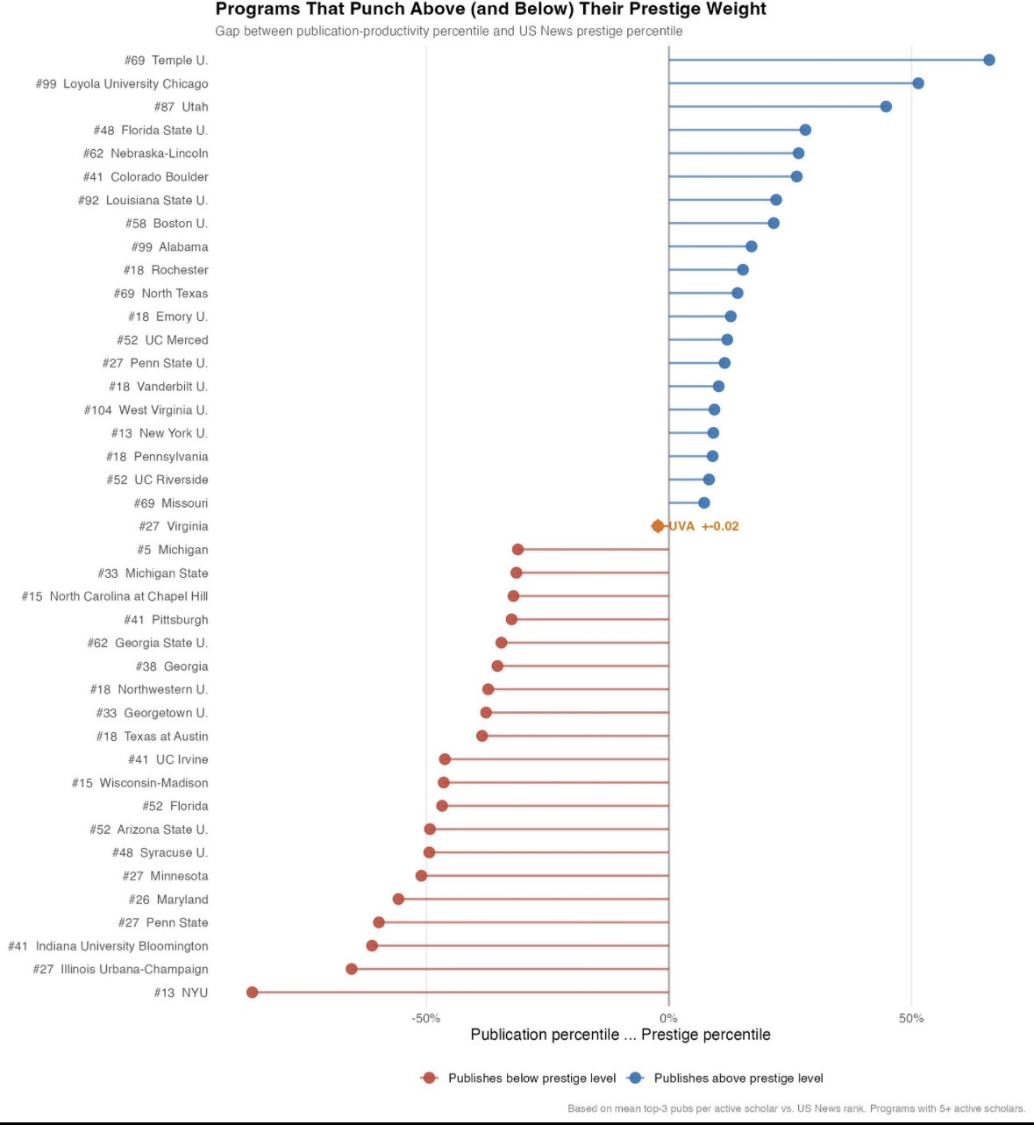
Welcome to FSU!
As I’m sure you are aware, you are joining one of the best political science departments in the country.
This is the best political science department in the state of Florida.
FSU punches far above its weigh in publications in top journals than our rank.

Slide 6
What To Expect From Grad School
This is not undergrad 2.0–it is less structured, you have much more freedom.
While that can be good, it requires more personal discipline.
This is a lot of work.
Expect to read about 300 pages a week, complete at least 1 problem set, and write occasional papers on top of your RA/ODL responsibilities.
It is very rewarding, and you will learn A LOT.
Everyone is here to support you.
Reach out to your advisor, fellow graduate students, your professors, or Carlisle if you are facing any challenges.
It can be intimidating at first to reach out to professors, but they are more than happy to help.

Slide 7
How to Be Successful
1) Go to class
Participate when you do go to class.
Do the readings!
Come to class with thoughts and comments about the readings.
Besides methods classes, the 2.5 hours of class are controlled by the students talking. It can get really awkward if no one has done the readings.
2) Go to department functions.
About three hours of your contract are allotted to professionalization events.
The colloquiums, job talks, and guest speakers are part of your paycheck.
They are also very helpful and allow you to learn some important skills.
3) Fulfill your GA and RA responsibilities.
Faculty differ in what they ask, but they are usually good about respecting the allotted time.
If there is a problem, talk to Carlisle.
I have never heard of anyone being over worked or taken advantage of in these roles.

Slide 8
The Most Important Way to Be Successful: DO NOT RELY ON AI
Using AI in graduate school is a slippery slope!
It can be very easy and inciting to get AI to summarize the readings for you, write the code for your problem sets, or do your work for you.
It is extremely hard to be successful in graduate school if you rely heavily on AI.
A significant part of this program requires students to orally defend their theory, methods, and arguments.
Relying on AI will make this very difficult.
Relying on AI summaries of the text or AI generated code will leave you confused and left behind as the courses move quickly through material.
Use AI as sparingly as possible.
PLEASE DO NOT ALLOW AI TO REPLACE LEARNING.

Slide 9
How to Use AI Effectively for Coding
AI is a very useful tool for coding--but not if you rely on it to do everything for you.
Make sure that you learn how to do code before you begin using AI.
AI coding is still far from perfect.
You must be able to check the work the AI model did for you to ensure that your code is correct.
You should also be able to explain any code that you have AI produce for you.
Best approach
Work through a problem on your own as best as you can.
If your code is returning errors or you are stuck, copy and paste the error into an AI model to help problem solve.
If the AI generates new code for you, pepper it with questions to ensure you fully understand what each line of code is doing.
For this workshop, try not to use AI. We need to make sure you understand R first.

Slide 10
Managing Graduate School
Impostor syndrome is real. Do your best not to let it get to you.
FSU has therapy resources–while not all students need this, it is a great resource.
Work together with your cohort.
Cohorts that work together stay together.
Collaboration is welcomed in most methods classes—just turn in your own work.
Keep a schedule and learn when you work best.
Do things other than graduate school.
Tallahassee and FSU have plenty to explore- Wakulla Springs, 30A beaches, St. George Island, etc.

Slide 11
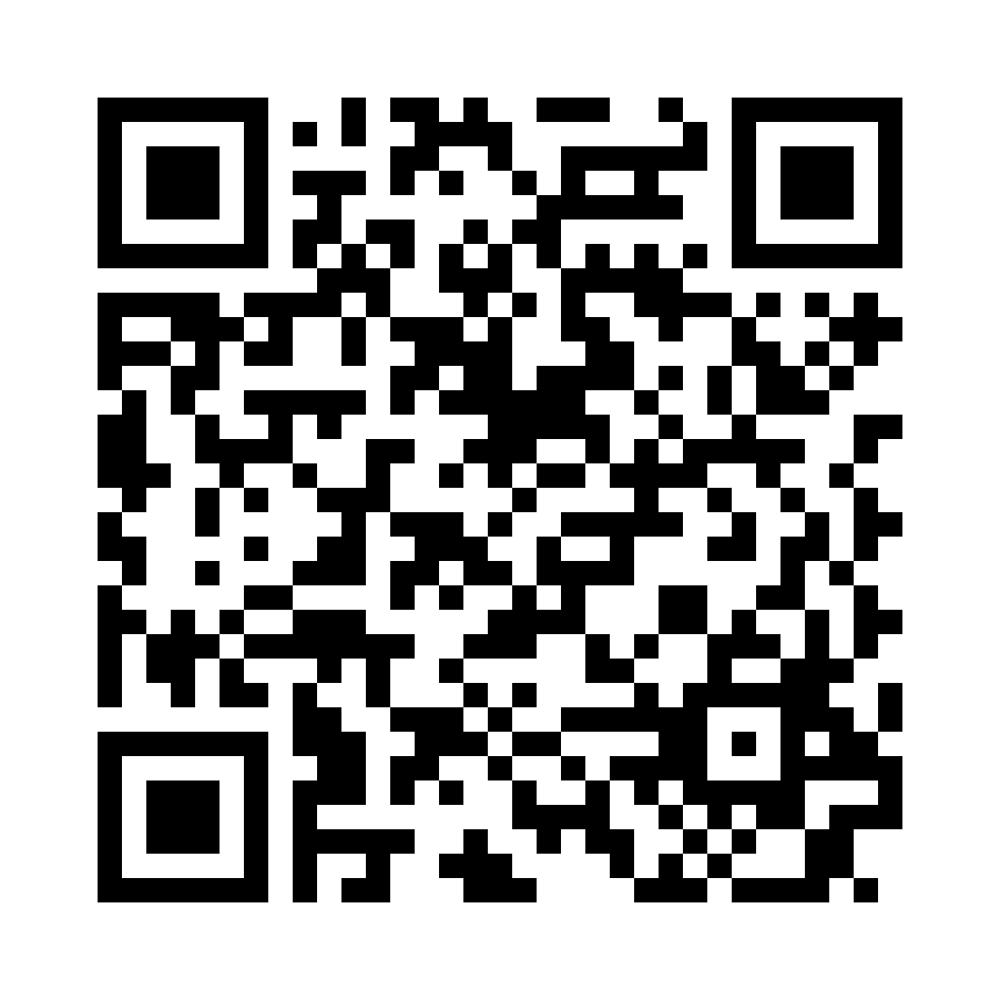
Workshop Website
This website will have all of the slides, code, data, and other resources to help you get the most out of this workshop.

Slide 12
Installing RStudio

Slide 13
Download Day 1 R Script
Click the link for “Day 1 Code” under course materials.
Once it is downloaded, I recommend making an R workshop folder on your device.
Move the code to your R workshop folder.
Double click to open in R.
I will have you follow along with the code, running each line, and will have you practice writing your own code on this script.

Slide 14
Changing the RStudio Theme

Slide 15
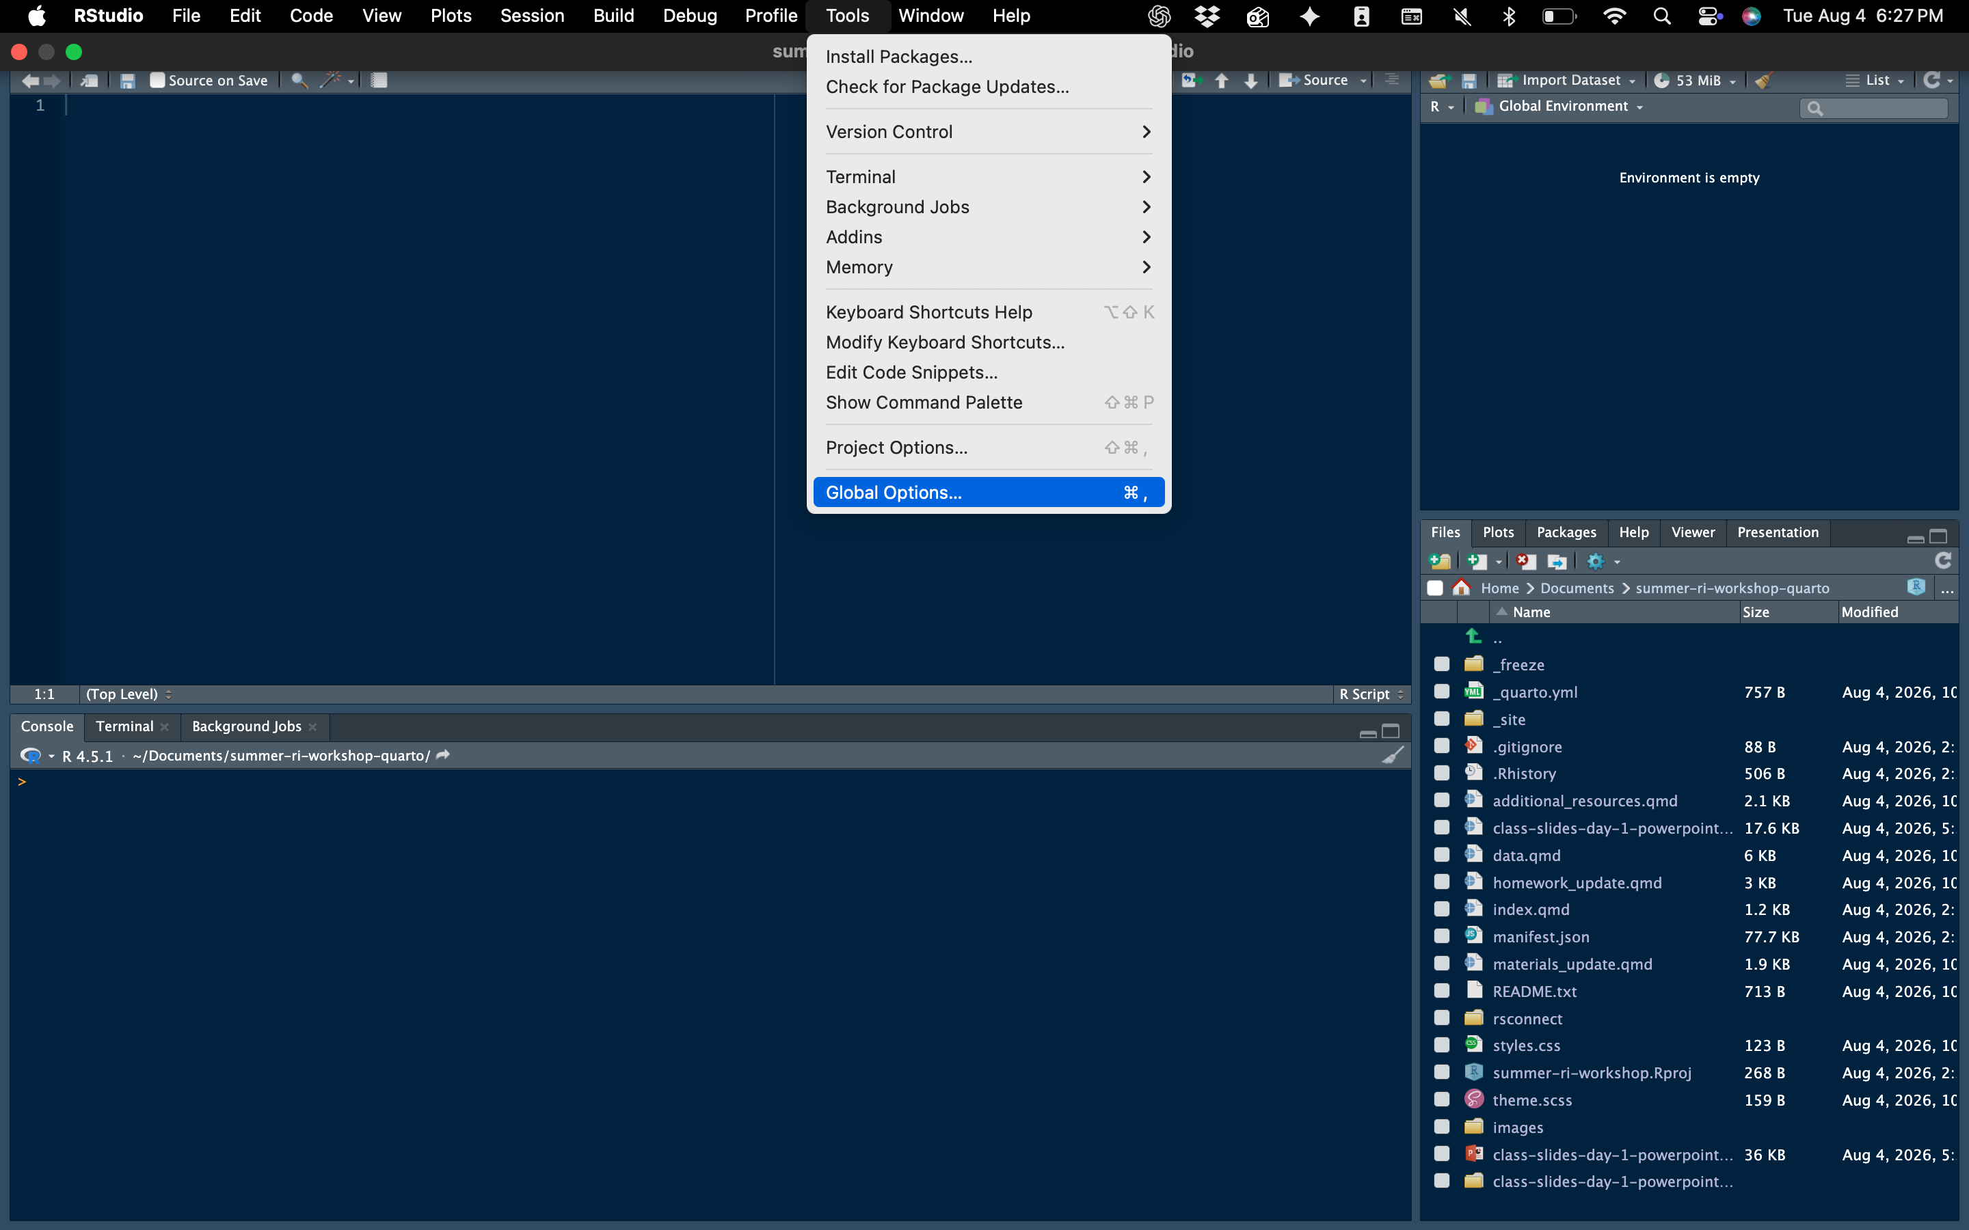

Slide 16
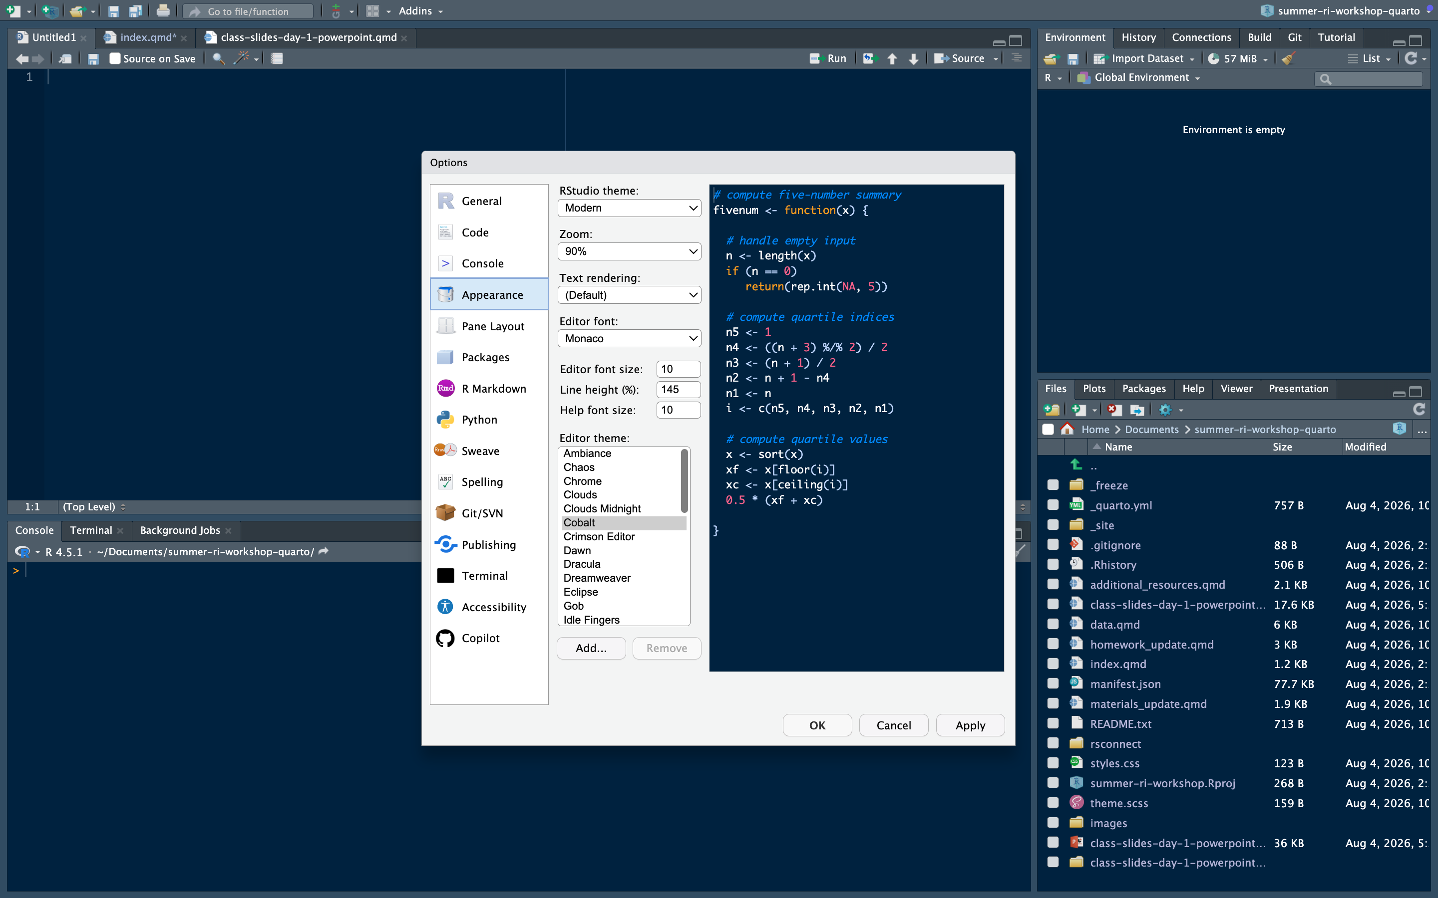

Slide 17
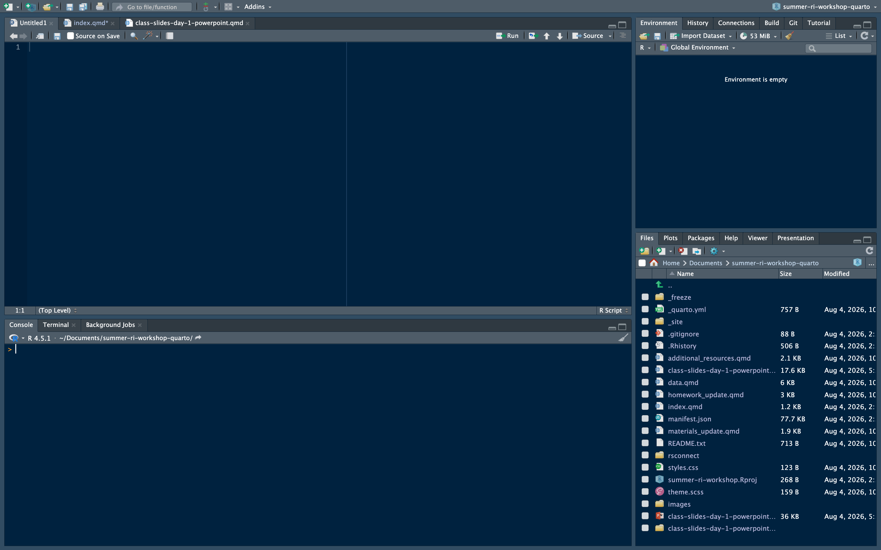
This is where you run the code.
Generally, you do not type code directly into the console but rather run it from a script.

Slide 18
RStudio Theme: Step 4
Image placeholder: www/screenshot4.png
This is where you write your code.
This allows you to create an entire project of code and save it for future reference.
This is also essential for replication and uploading code required by most publications.

Slide 19
RStudio Theme: Step 4
This is where you can see all the “objects” you have saved.
This includes data frames, vectors, etc.
Image placeholder: www/screenshot4.png

Slide 20
RStudio Theme: Step 4
This sections has a lot of helpful tabs.
Files shows you what files you have in your working directory.
Plots display your plot after you run the code for it.
Packages shows the packages you have installed and can find info about each one.
Help displays info about different commands
Image placeholder: www/screenshot4.png

Slide 21
Live Demo Parts of RStudio

Slide 22
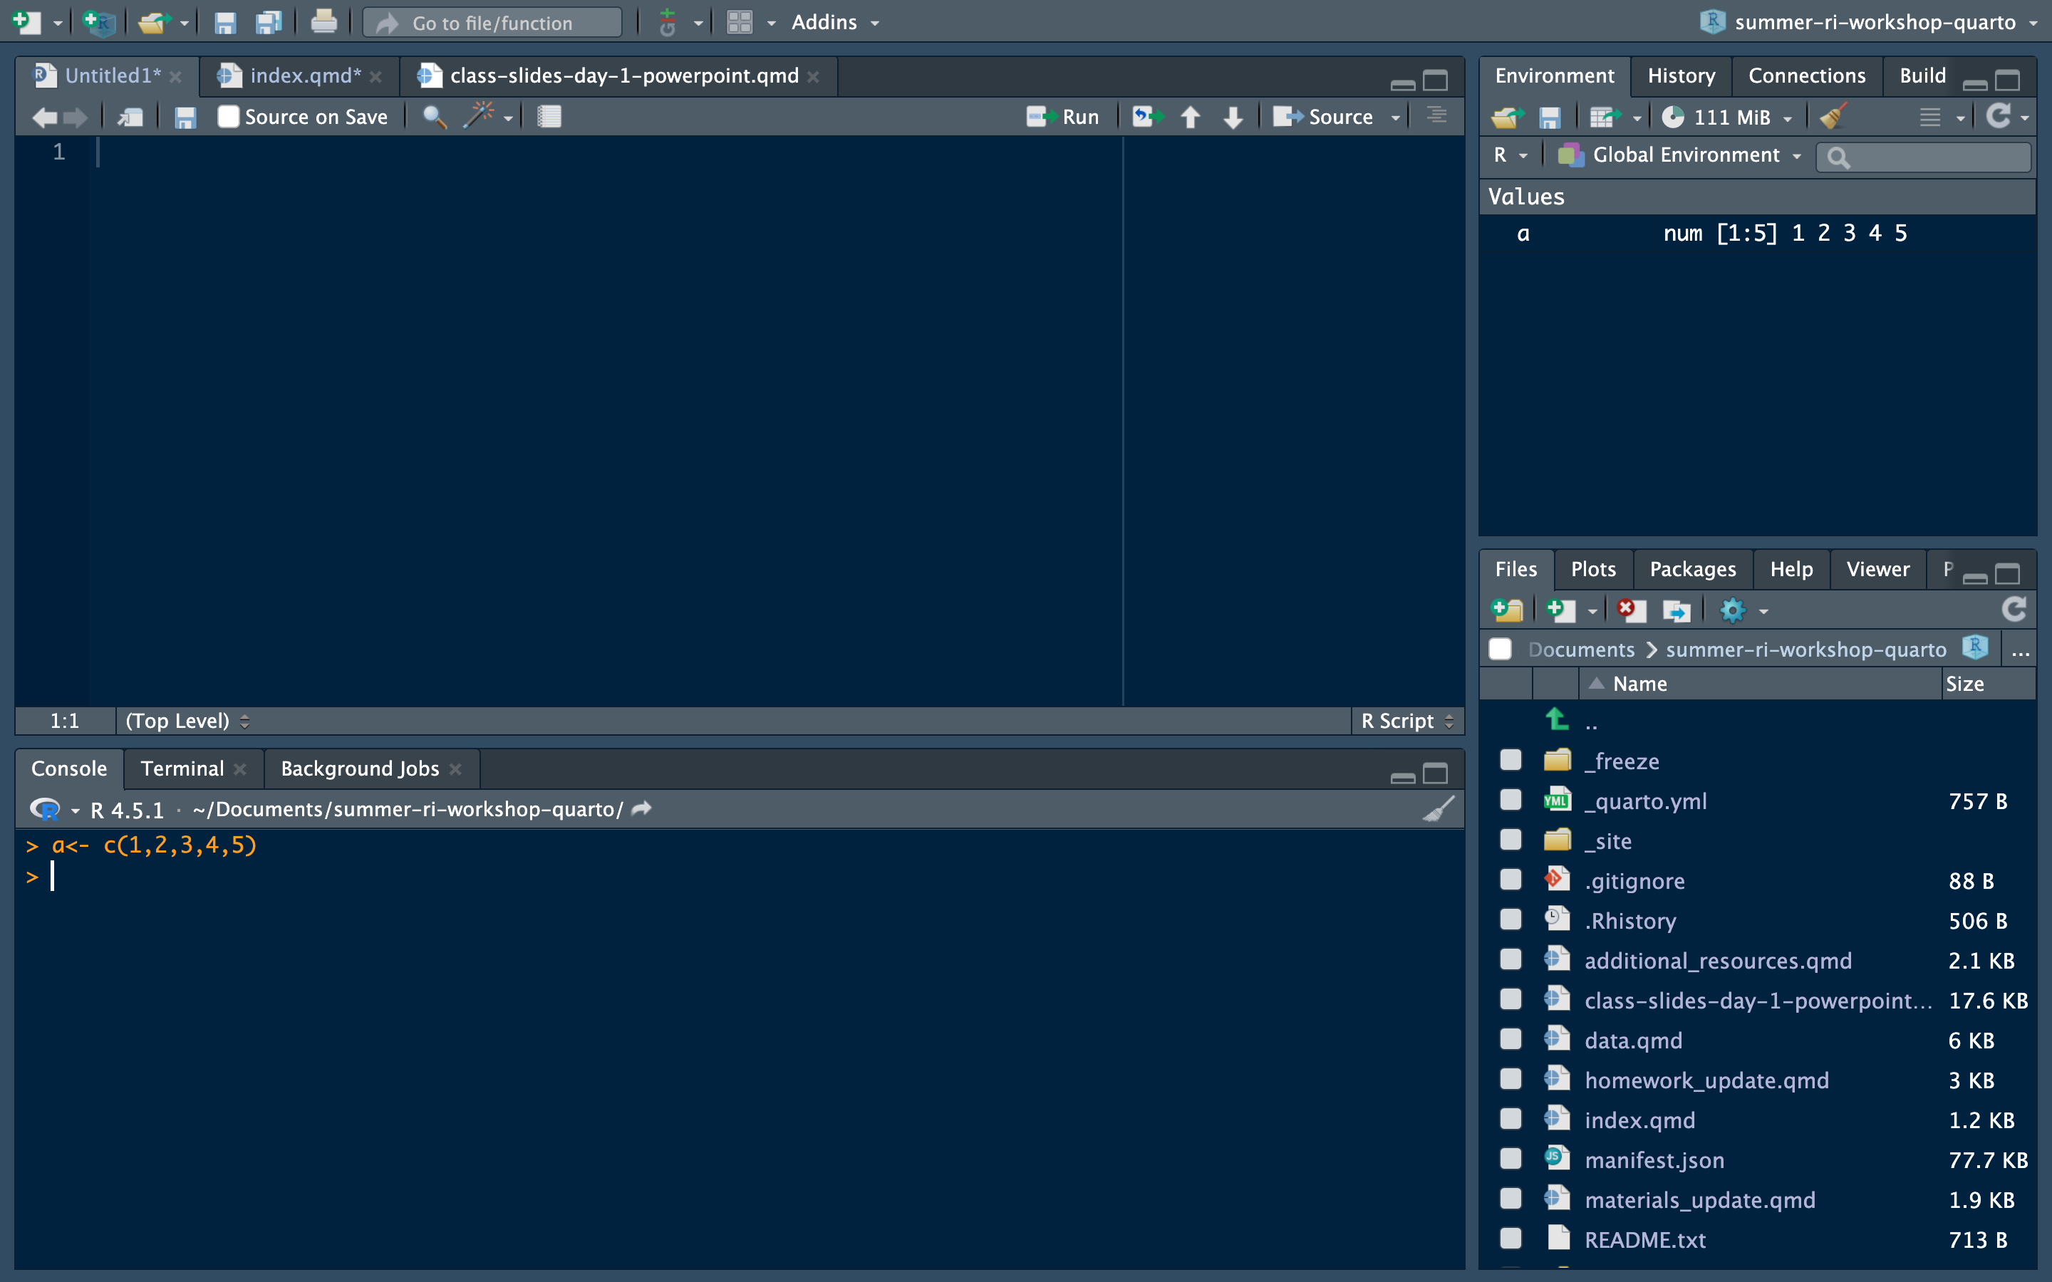
Running Code: 1) Type in the Console
Type your code in the console.
Hit enter or return to run the code.
Best for quick commands you don’t need to save.
Shouldn’t be done very often.

Slide 23
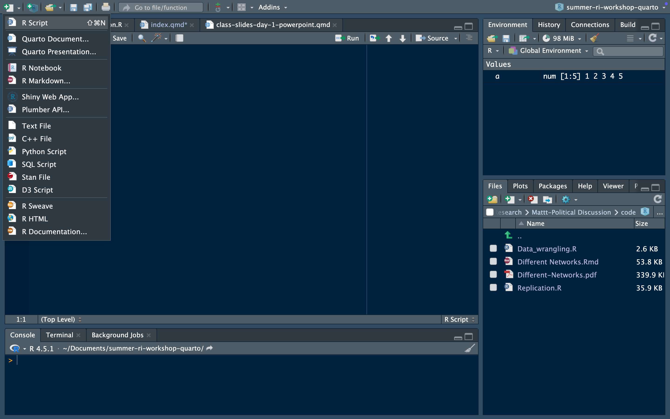
Running Code: 2) Type in Script
Open a new R script by clicking the paper image in the top corner and then “R Script”

Slide 24
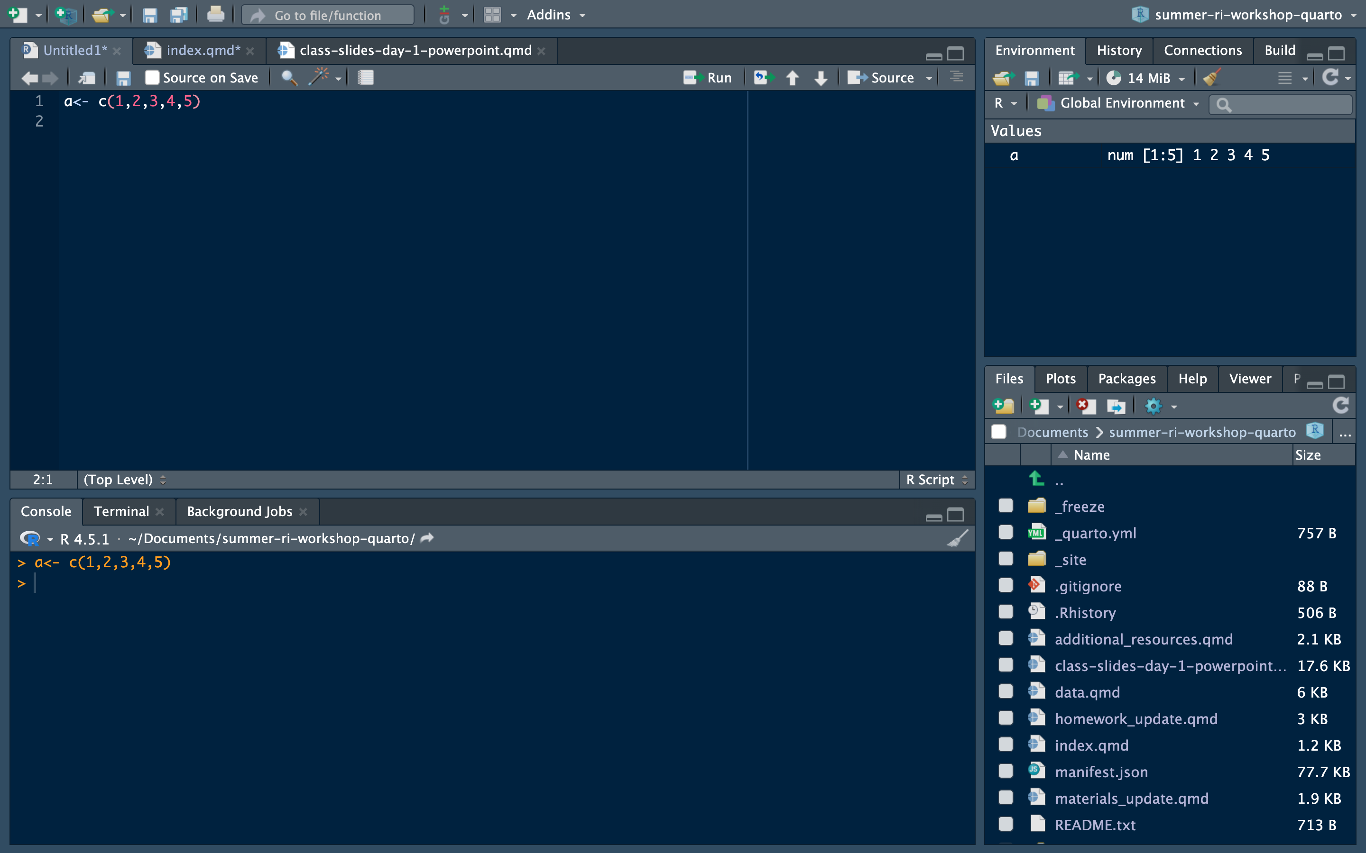
Type your code in a new R script.
Use the shortcut Ctrl + Enter (Return) to run the code in the console
This allows you to run code while also keeping a record of your code.

Slide 25
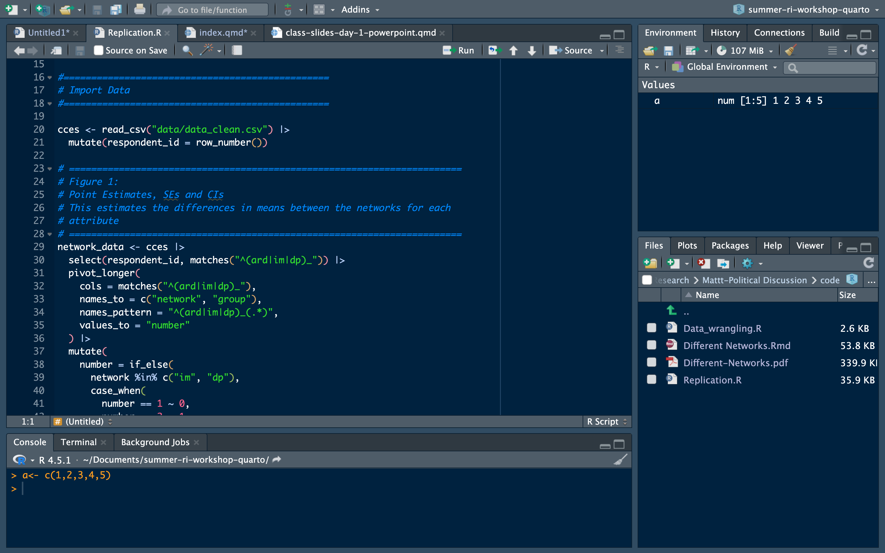
Use # to leave comments.
This reminds you what your code is doing and also informs professors or co-authors.

Slide 26
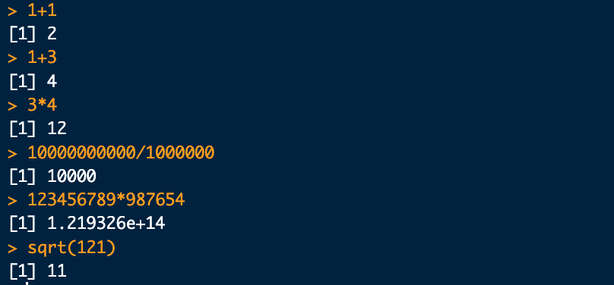
Using R as a Calculator

Slide 27
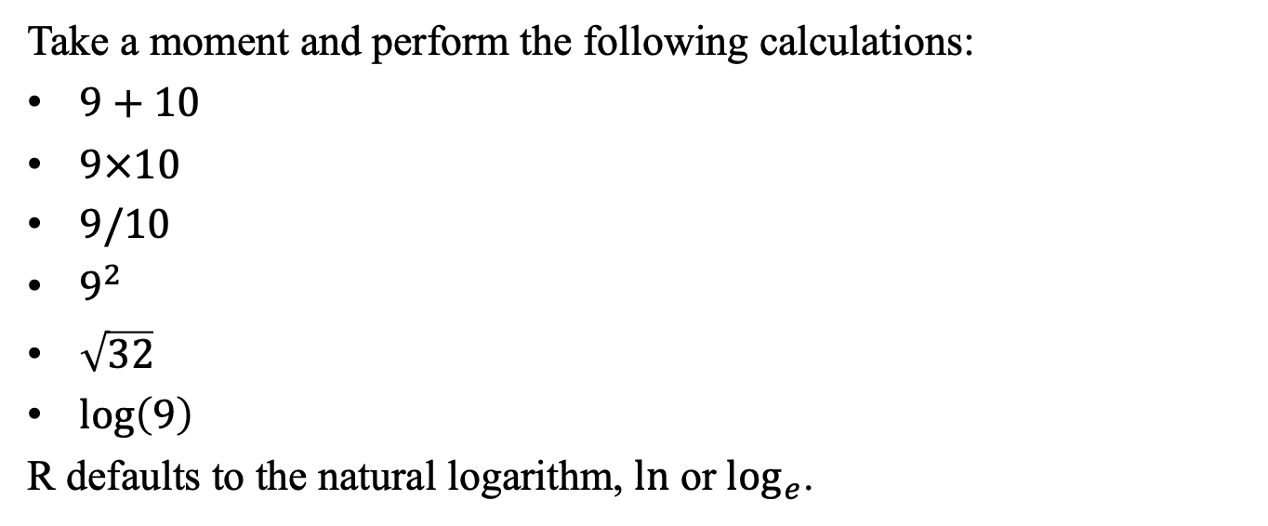
Practice with R as a Calculator
Take a moment and perform the following calculations:
$9+10$
$9×10$
$9/10$
$9^{2}$
$\sqrt{32}$
$log\left(9\right)$
R defaults to the natural logarithm, $ln$ or $\log_{e}$.

Slide 28
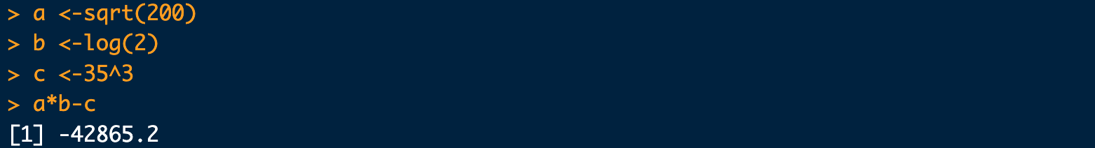
Objects and Scalars
This is how you create an object. After you run this code, you should be able to see b in your environment.
You can save a single value, a vector (multiple numbers), or an entire data frame by using the arrow <-
This is one way you can send a complex number for use later.

Slide 29
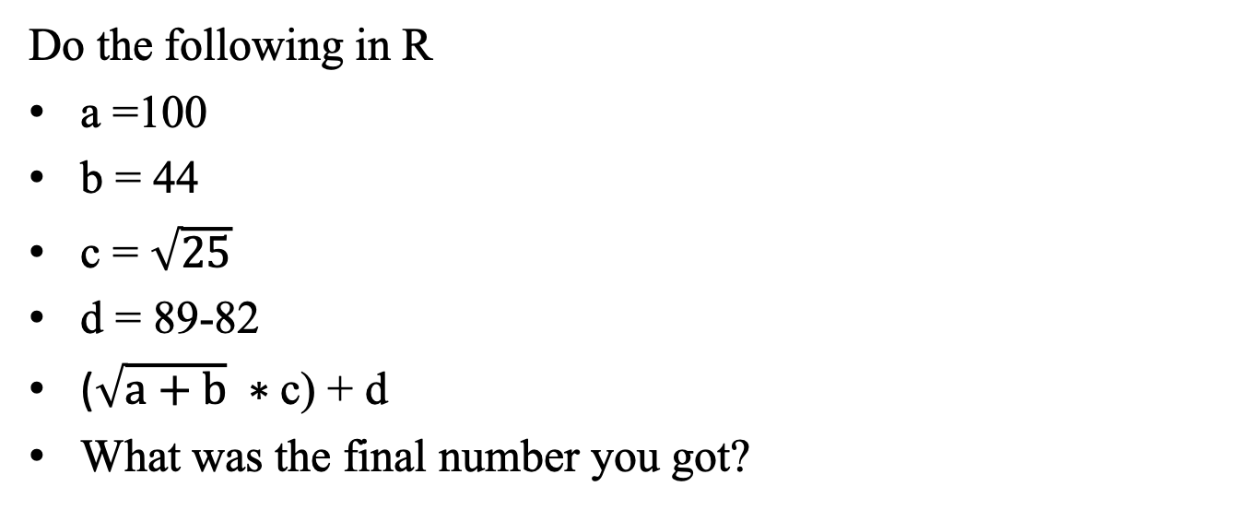
Practice with Using Objects
Do the following in R
a =100
b = 44
c = $\sqrt{25}$
d = 89-82
($\sqrt{a+b} ∗$c) + d
What was the final number you got?

Slide 30
Strings
In strings, spacing is allowed.
Numbers can also be strings if we tell R to treat them as such with quotation marks
You can also assign strings to objects.

Slide 31
Strings Cannot Be Used as Numbers
The same is true when you use numbers as strings.

Slide 32
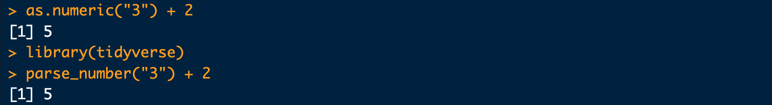
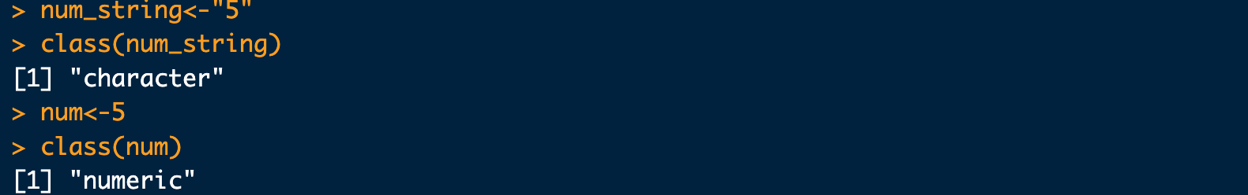
Converting Strings to Numbers
Use the class() function to see what class an object is.

Slide 33
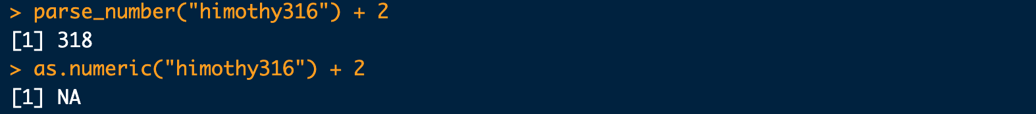
parse_number() Extracts a Number
parse_number( ) is in the tidyverse package.

Slide 34
Vectors
Working with only one number is not realistic.
Instead, we work with collections of values called vectors.
Common types include:
Numeric: 1.1, 2, and 100
Character: "Republican", "Democratic", and "Independent"
Factor: ordered categories (“Strongly agree”, “Agree”, “Disagree”, “Strongly Disagree”)
Logical: TRUE or FALSE

Slide 35
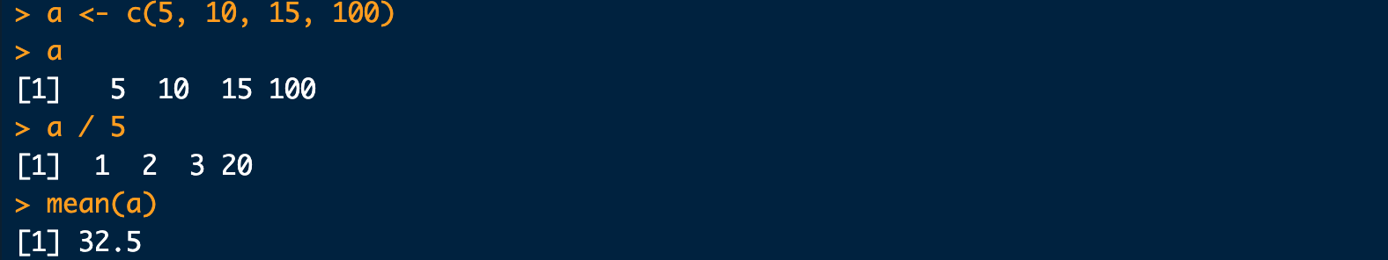
Numeric Vectors
You can assign an entire numerical to an object.
When you use it in a command, it uses each number in the vector.

Slide 36
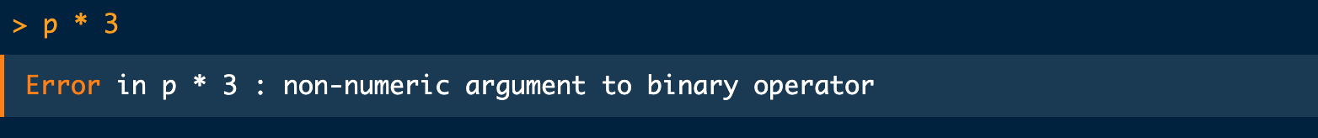
Character Vectors
Numeric functions do not work on character vectors.

Slide 37
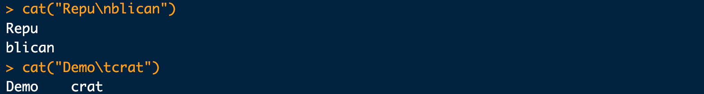
Escape Sequences in Strings
\n starts a new line.
\t inserts a tab.

Slide 38
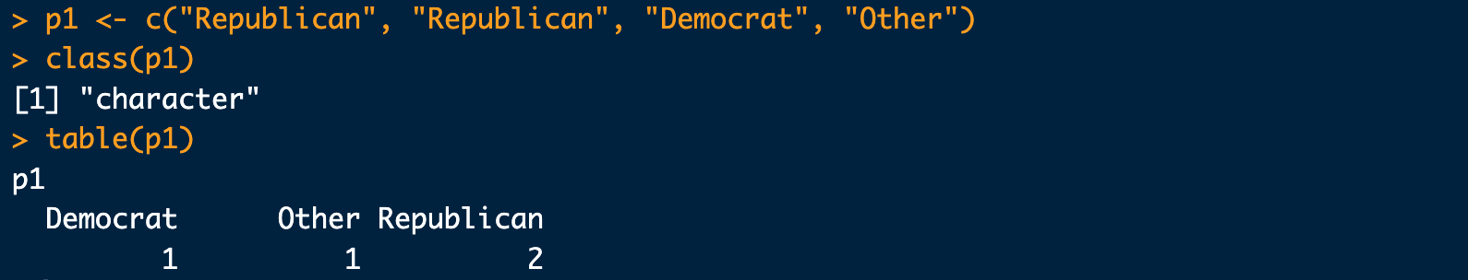
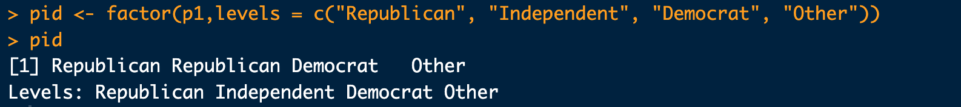
Factor Vectors
Problem: the ordering is odd, and Independents are missing.

Slide 39
Practice with Vectors
Include comments throughout your code.
Numeric
Create my_vector with 2, 6, 4, 3, 5, and 17.
Find the sum with sum().
Find each square root with sqrt().
Character and factor
Create sex: Male, Female, Male, Male, Female.
Create ideology: Liberal, Moderate, Moderate, Conservative, Liberal.
Convert both to a factor with meaningfully ordered levels.

Slide 40
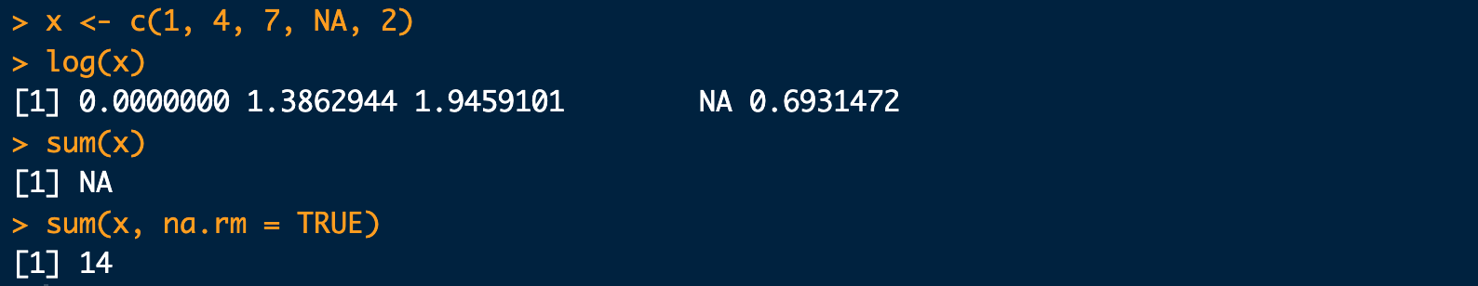
Missing Values
Missing values are denoted by NA.
Some functions preserve them.

Slide 41
Data Frames and Tibbles
Most data will be organized as data frames or tibbles.
Think of a data frame or tibble as a collection of vectors.

Slide 42
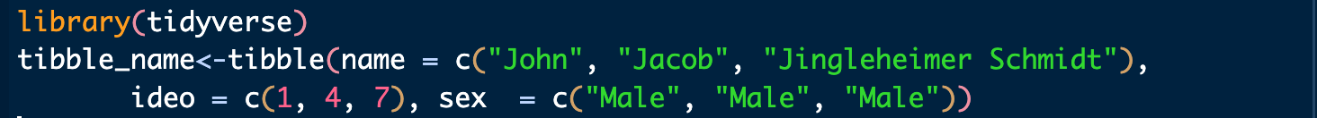
Creating a Tibble
Install and load the tidyverse package first from the console:

Slide 43
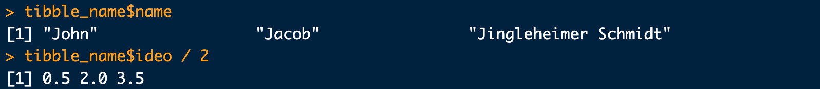
Calling a Column or Value
The $ operator extracts one column as a vector.
You can use square brackets to pull out a single value form a vector.

Slide 44
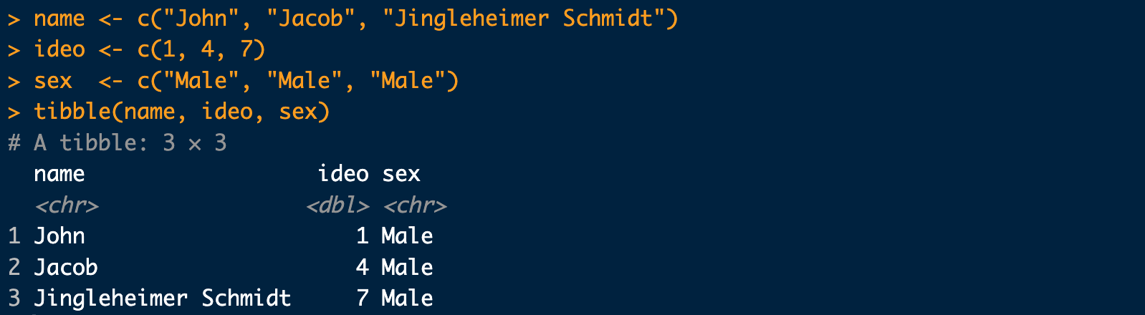
Combining Vectors into a Tibble

Slide 45
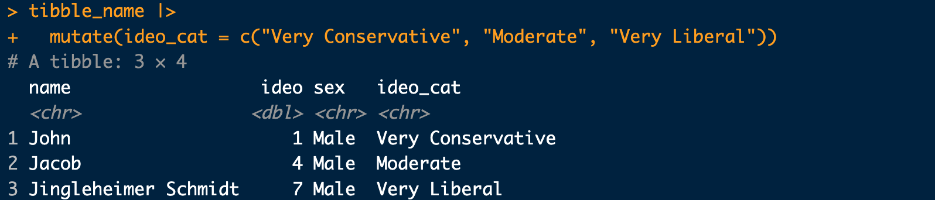
Editing Data with mutate()
The %>% (|>) operator is a pipe. Insert it with Ctrl—or Command—Shift-M.

Slide 46
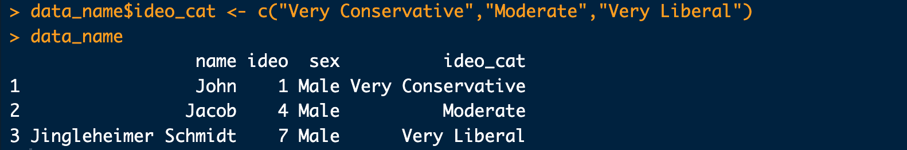
The Base R Equivalent

Slide 47
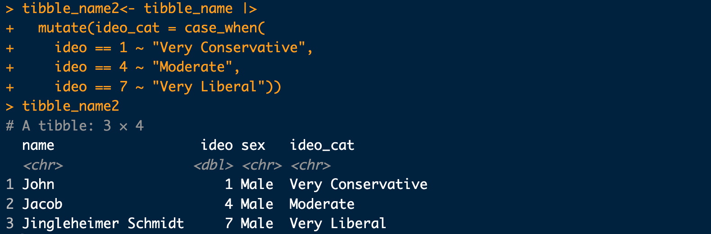
mutate() and case_when()
Use case_when() to create a variable condition on another variable.

Slide 48
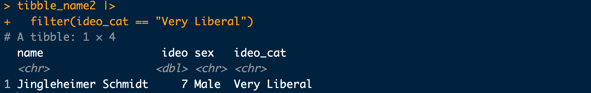
filter()
Use filter() to keep rows matching a condition.

Slide 49
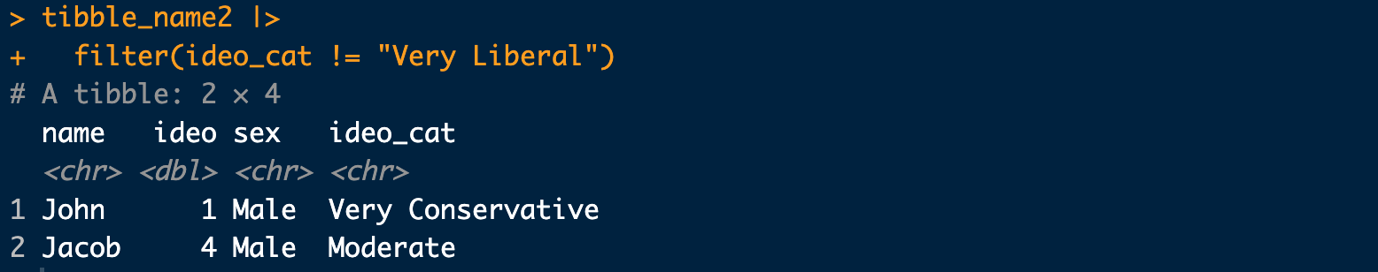
Removing Rows with filter()
Use != to keep rows that are not equal to a value.

Slide 50
Logical Operators
Logical operators can be used in the filter() command.
Operator | Syntax
Less than | <
Less than or equal to | <=
Exactly equal to | ==
Greater than or equal to | >=
Greater than | >
Not equal to | !=
Or | \|
And | &

Slide 51
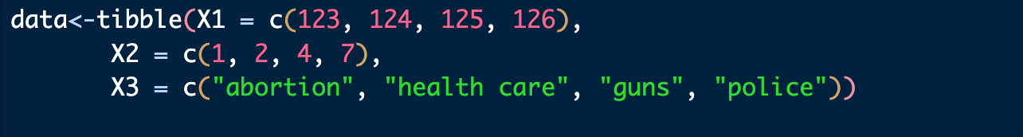
Variable Names
Research data often arrive with unclear variable names.
What does each variable represent?

Slide 52
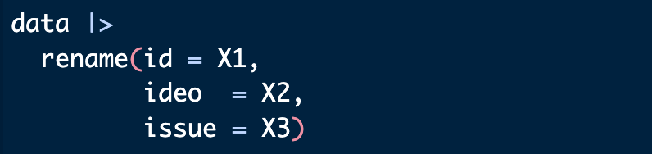
Renaming Variables
Ask two questions:
Is the name informative?
Is the name easy to work with?

Slide 53
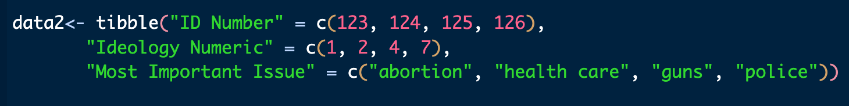
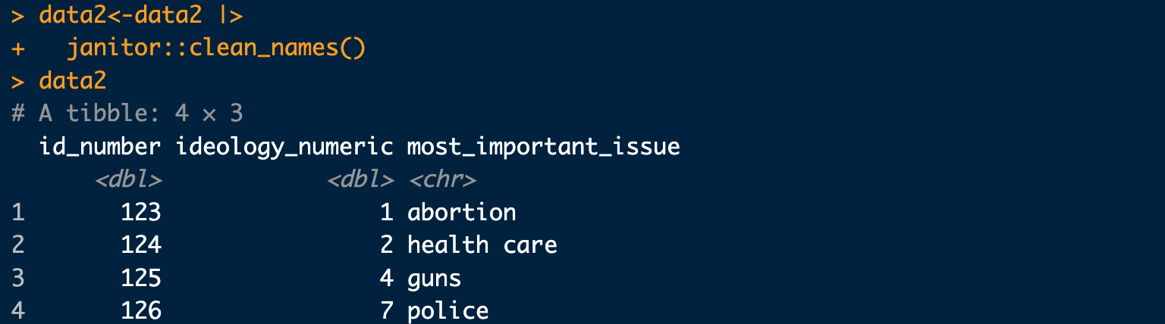
Informative Names Can Still Be Awkward
The clean_names() function from janitor can fix them.

Slide 54
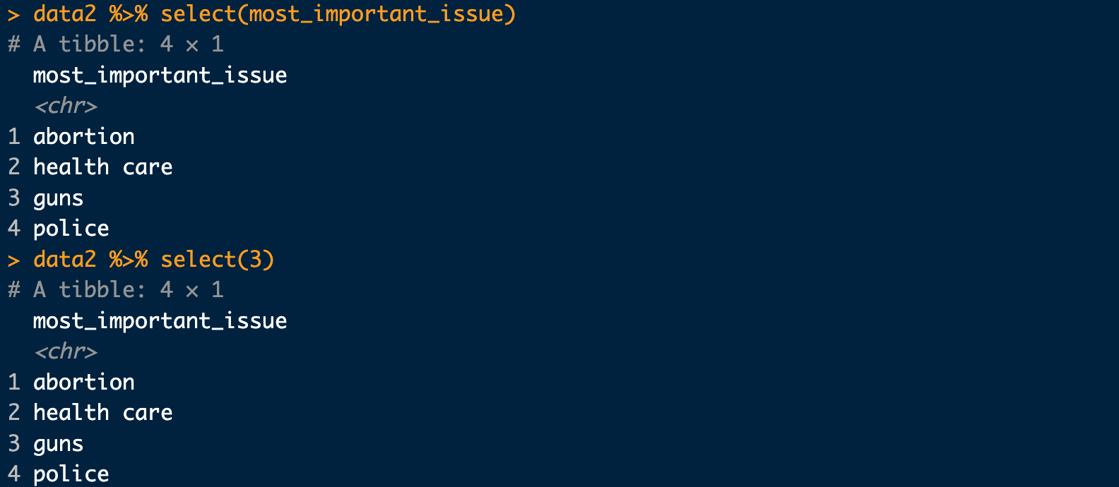
Selecting Variables
Use select() with either a variable name or position.
data %>% select(most_important_issue) data %>% select(3)

Slide 55
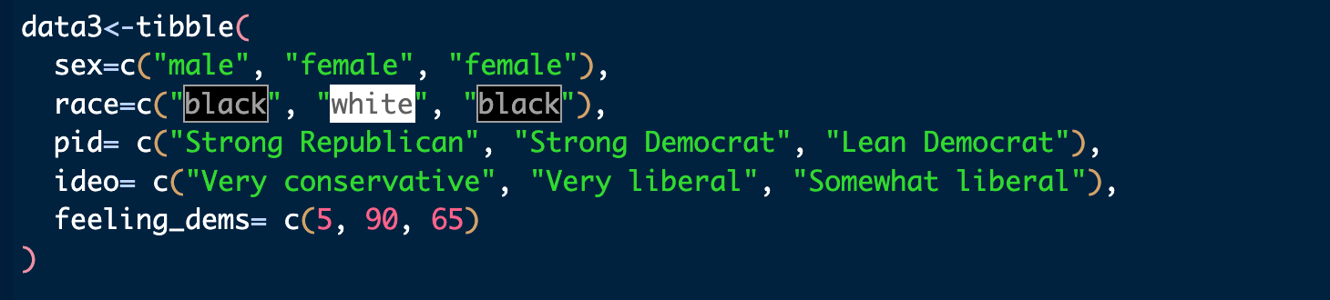
Selecting Multiple Variable
Use select() to collect your desired variables.
This is helpful as research data has a lot of variables you won’t use and can get in the way.
Say we only care about sex, pid, and feeling_dems

Slide 56
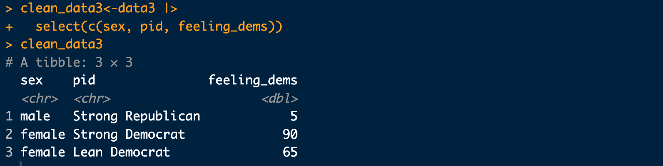
Selecting Multiple Variable
We can select just the variables we will use and clean out the others we won’t use.
You should always create a new dataset when doing this just in case you want to add more variables later.

Slide 57
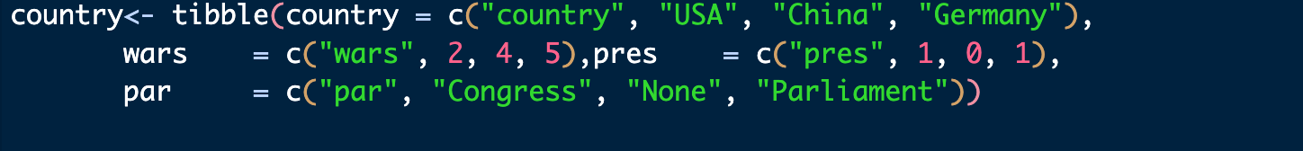
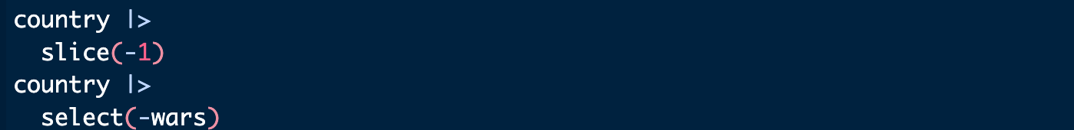
Selecting Rows with slice()
Suppose the first row contains variable names rather than data.
Use a minus sign to remove a row with slice() or a column with select().

Slide 58
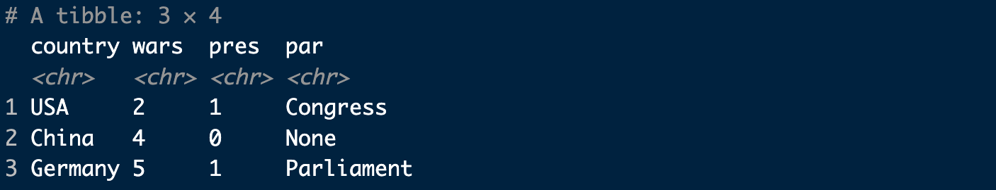
More on Cleaning
One of the last cleaning steps is ensuring variables use the proper types.
wars and pres are character variables but need to be numeric.

Slide 59
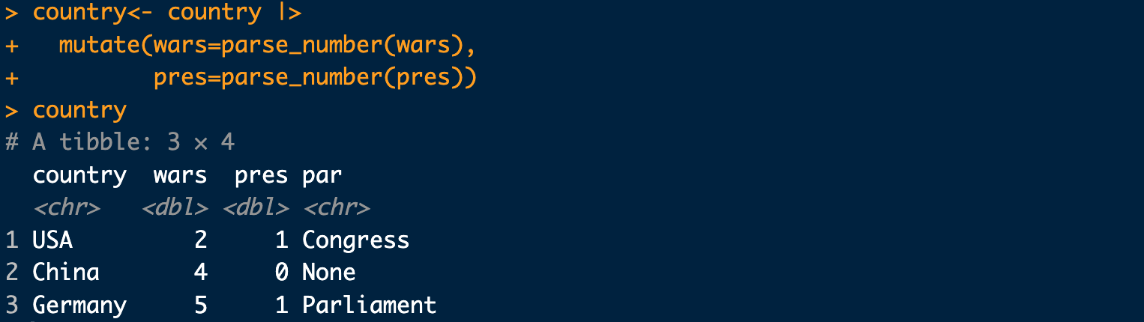
More on Cleaning
Use mutate() to change the variables to the correct class.

Slide 60
Practice with Data Cleaning
Create the tibble above.
Use slice(), parse_number(), and mutate() to clean it.

Slide 61
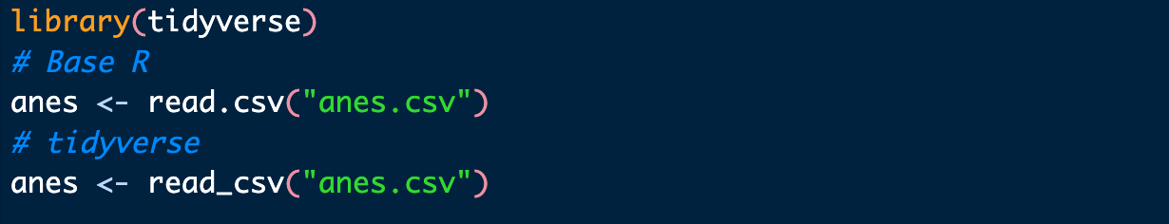
Reading Data into R
Most data will come from a file, often a CSV.
Running these lines sequentially leaves only the second version of anes in the global environment.

Slide 62
Working Directories
The previous code works only if the file is in your working directory.
Your working directory is where you should keep your data, code, and other files for a project.
You can set your working directory in 2 ways.

Slide 63
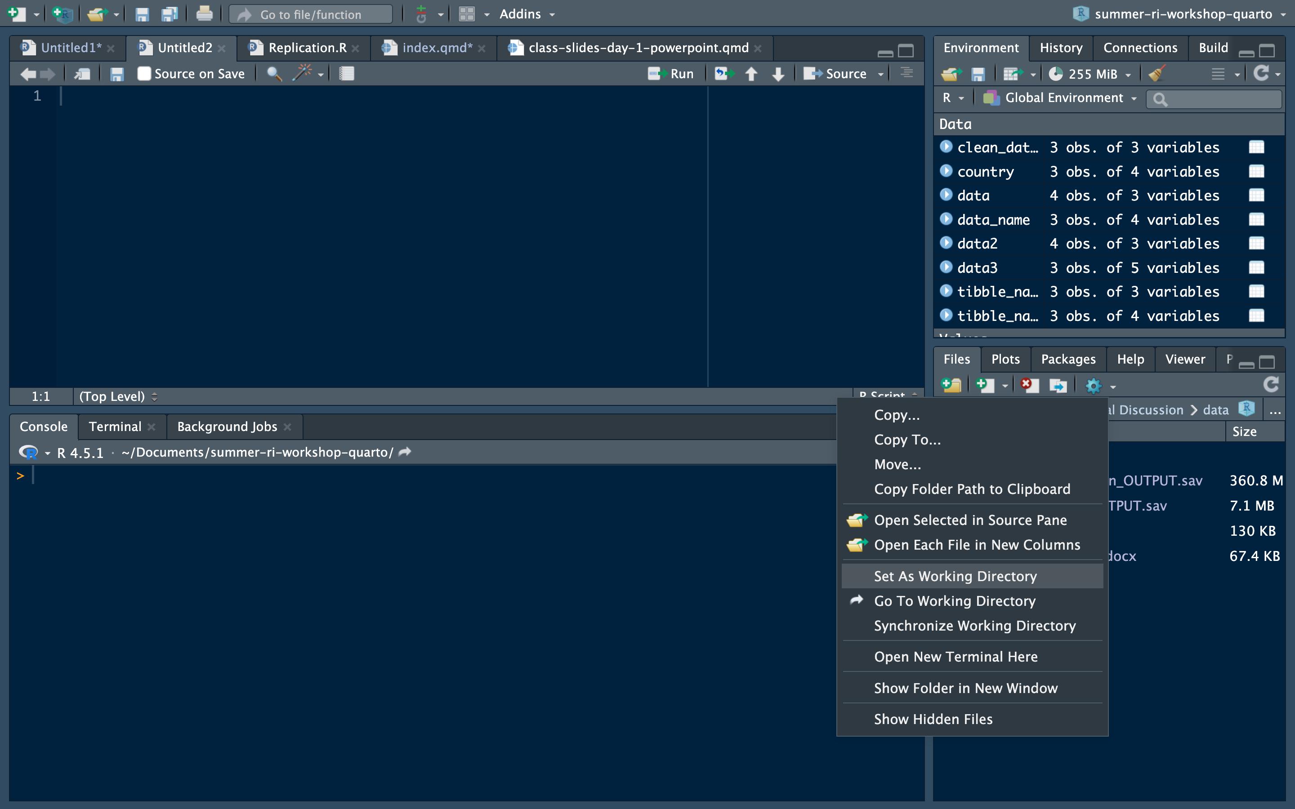
Navigate to your folder with the data in the files tab.
Click on the gear.
Click “Set as Working Directory”

Slide 64
More on Working Directories
Change the working directory with setwd().
Check it with getwd().
Alternatives:
Open R by opening an R script.
Specify the full path in your code.
Work inside an R project.

