Slide 1
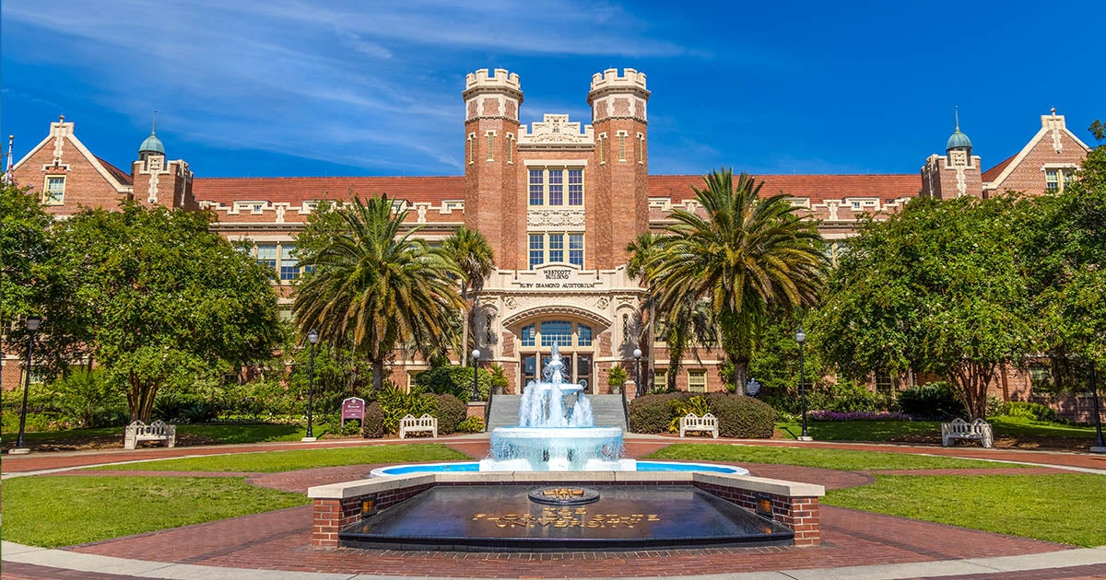
Intro to Loops and Functions
Day 3 of the RI Workshop, Summer 2026 Taylor Hill

Slide 2
Reviewing Homework Plots

Slide 3
Figure 1

Slide 4
Figure 2

Slide 5
Figure 3

Slide 6
Figure 4

Slide 7

Some Non-R Resources for Graduate School
The best resource: Zotero

Slide 8
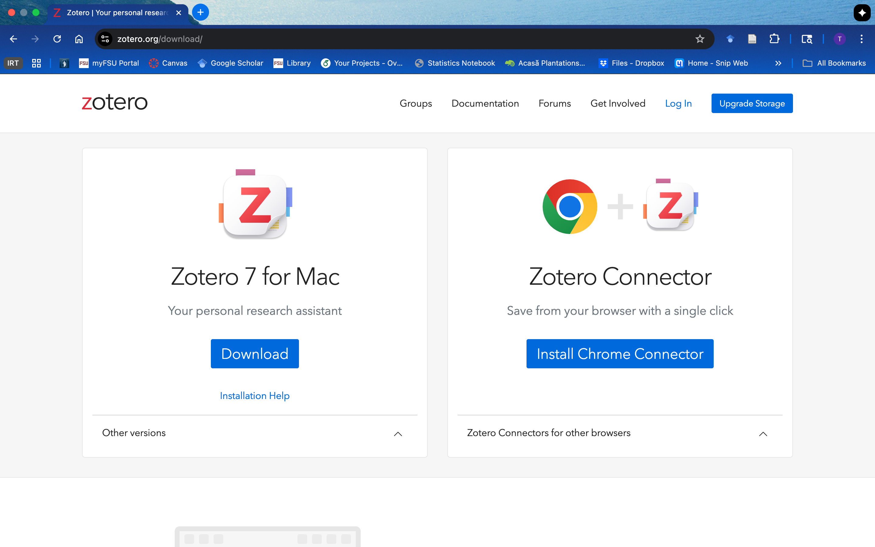

Slide 9
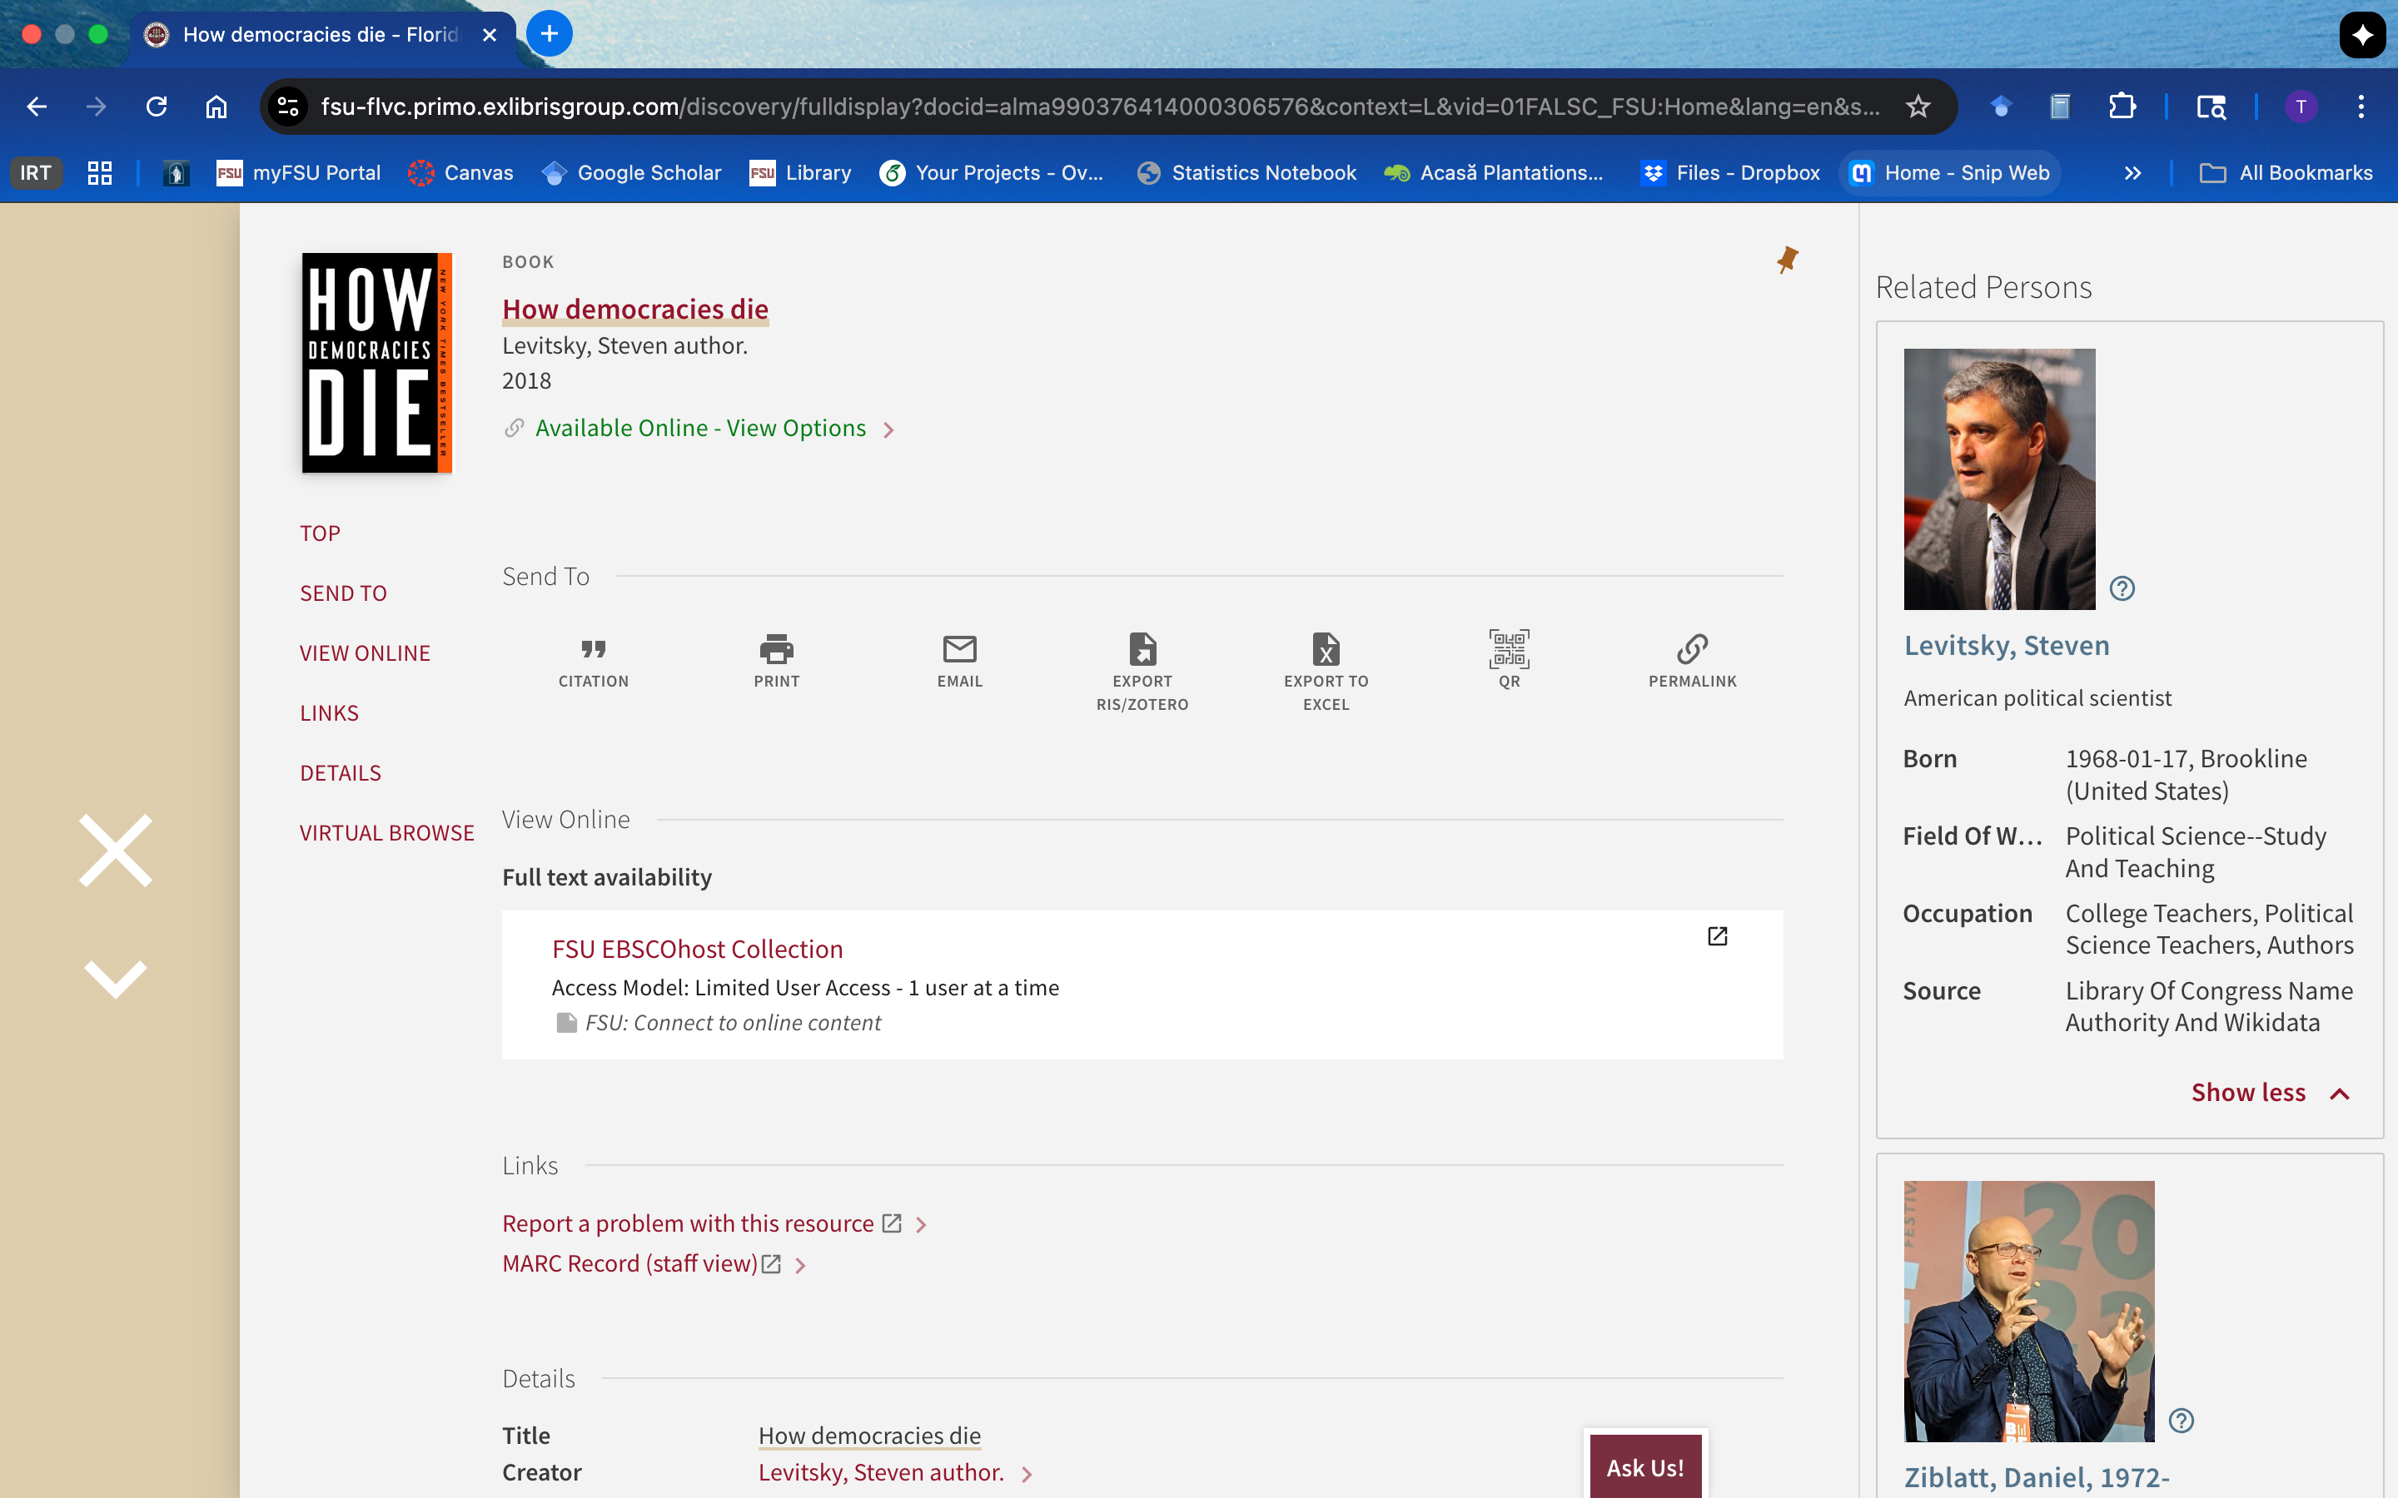

Slide 10
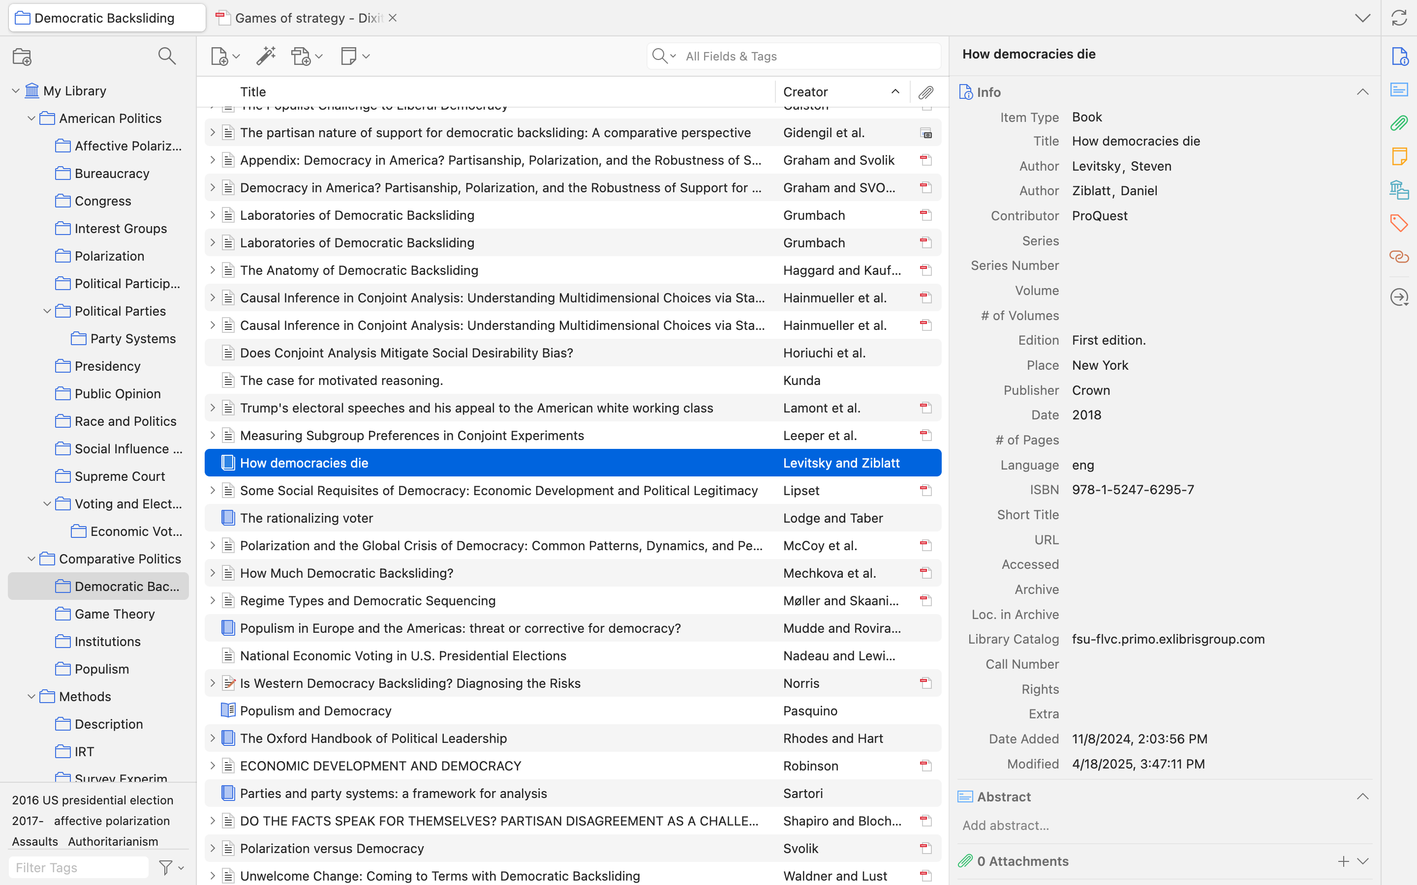

Slide 11
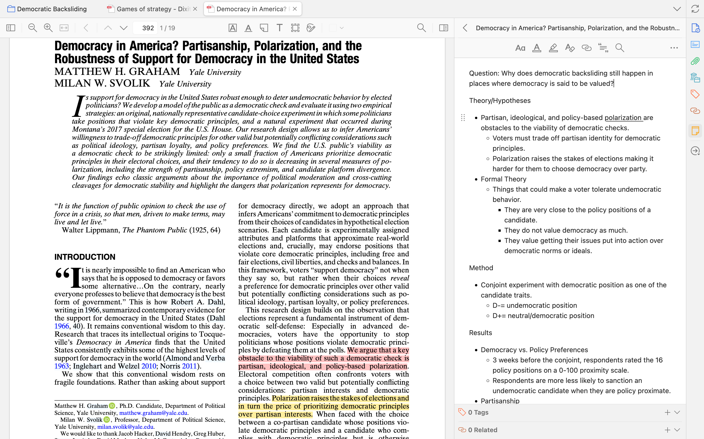

Slide 12
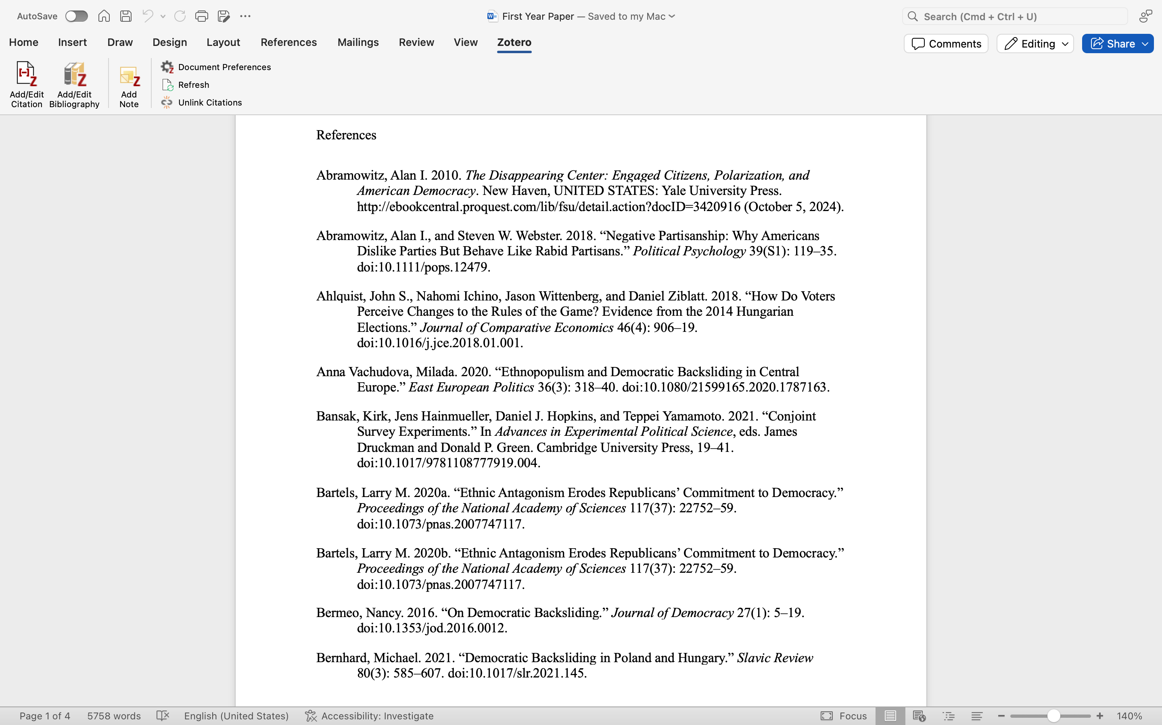
For Creating Bibliography
For In-Text Citations

Slide 13
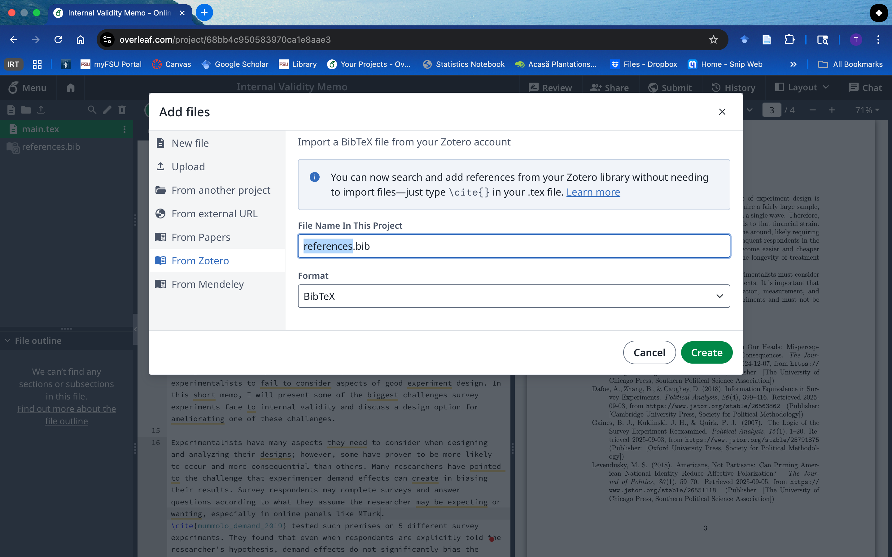

Slide 14
Practice Manipulating Data
Create a dataframe with the following variables and name it world_data
country: USA, JAP, CAD, RUS, UK
wars: 10, 3, 6, 8, 4
gov: pres, par, par, auth, par
turnout: 60, 80, 75, 99, 80
elect_yr: TRUE, FALSE, FALSE, NA, TRUE
Estimate the average turnout by government type.
Create a frequency table for government type.
Create a new variable in the data that is a dummy variable that is 1 when a country is authoritarian and 0 when they are not. Be sure to save the dataframe with this new variable in it.
Filter the data to only countries that have elections in this year i.e. elect_yr=TRUE.

Slide 15
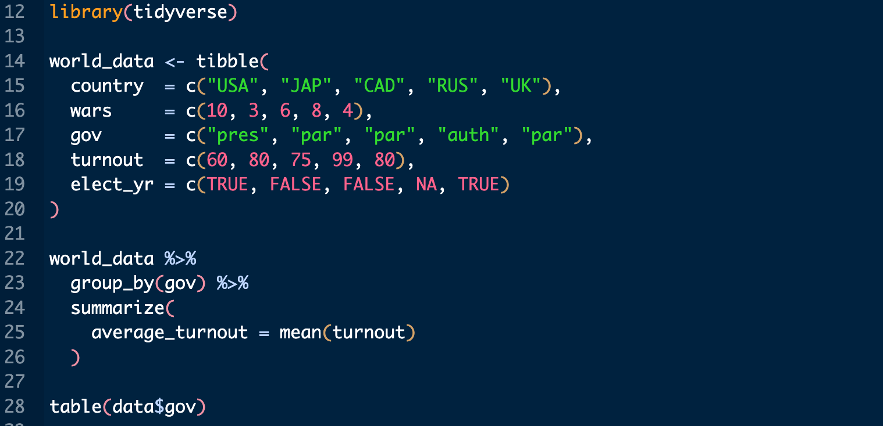
Solution

Slide 16
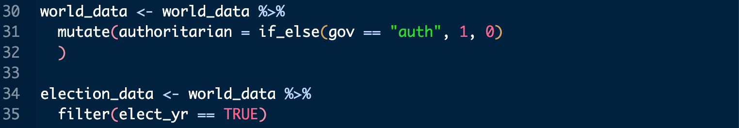
Solutions 2

Slide 17
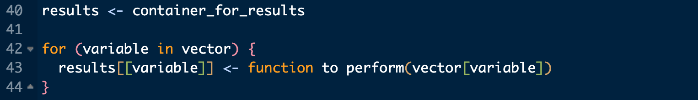
For Loops
This portion of the workshop we will review lists and being practicing with for loops
For loops are used to iterate through the same task repeatedly
This is the basic structure of a for loop

Slide 18
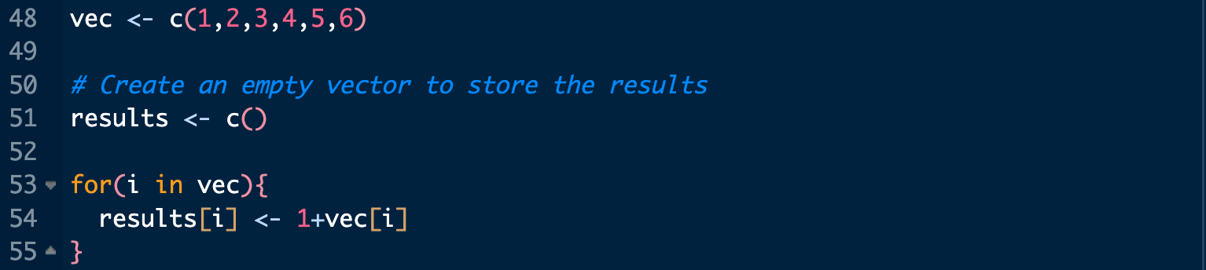
Loop Example
This simple for loop takes each number in our vector and adds 1 to it and then stores the result in our empty vector.

Slide 19
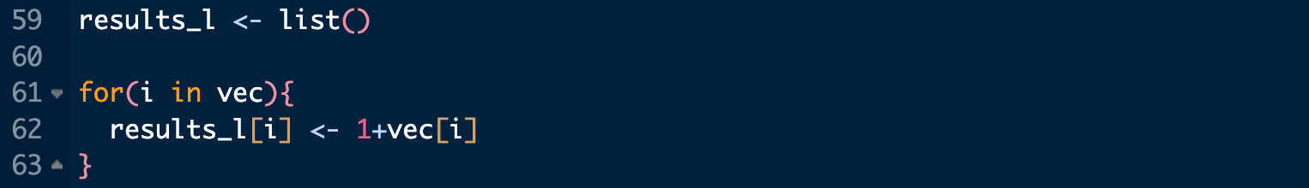
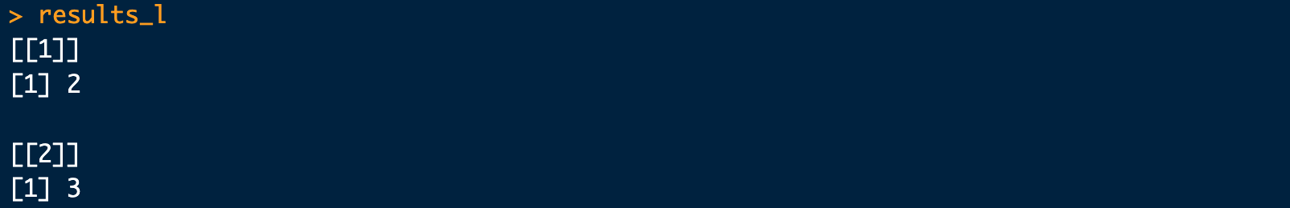
Loops and Lists
Note that in the previous example our results were stored in a vector, we are also able to store results in lists or data frames.

Slide 20
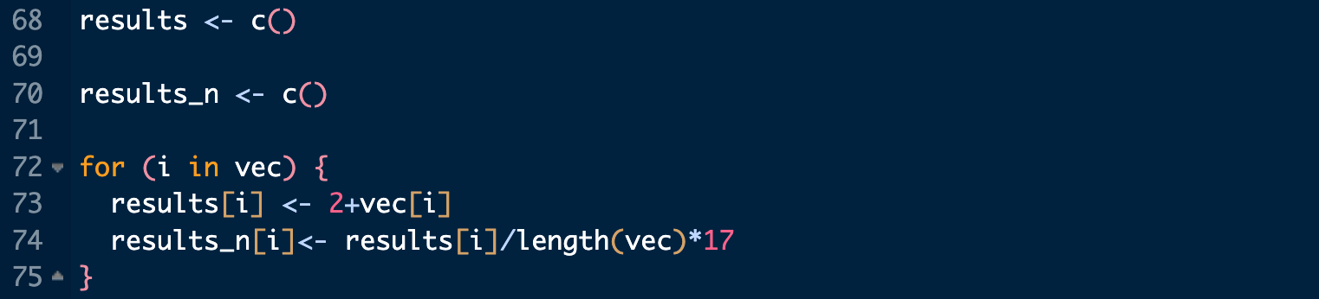
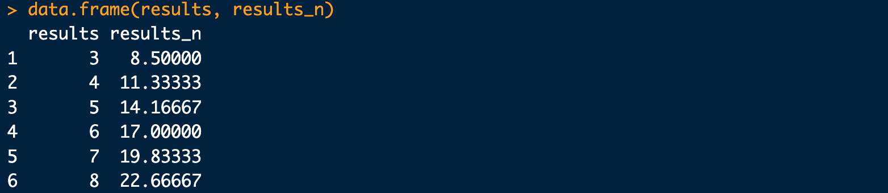
More on Loops
This loop takes each value in our vector, adds 2 and saves it.
It then takes this number and divides it by the length of the vector*17.

Slide 21
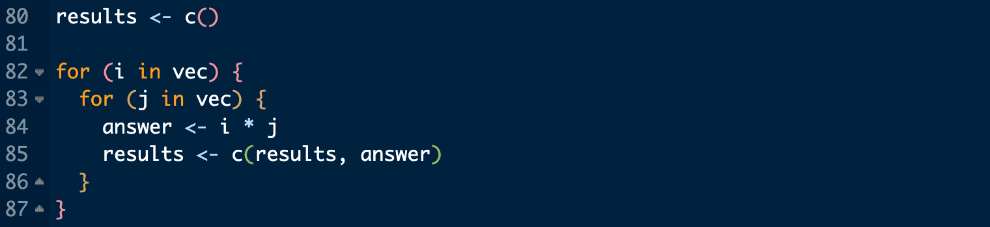
Nested Loops
This loop takes each number in the vector and multiplies it by all the others.
1*1, 1*2, 1*3, 1*4, 1*5, 1*6, 2*1, 2*2, 2*3…

Slide 22
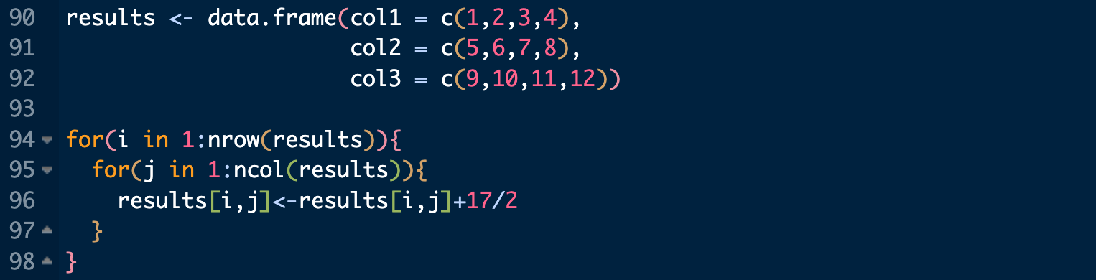
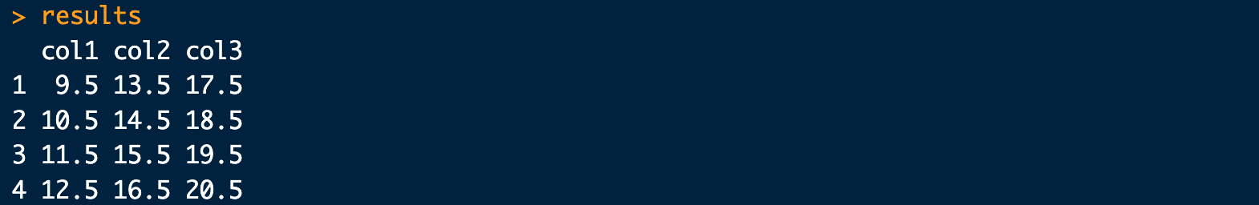
Loops and Dataframes
This loop iterates across each number in the dataset and then divides it by 17/2.
You can index a dataset using square brackets [row, column].

Slide 23
Practice
Start with the following vector:
Write separate for loops to do the following:
Go through and add 7 to each item (store results in a new vector)
Divide each number by 5 (store results in a new vector) Bonus 2:
Make a dataframe with 3 columns, counting up by 2 (col 1: 2,4,6,8,10,12, col 2: 14, 16, etc.) and add the last item from vec to the first item in each column (hint: invert the index with abs(i-length(vec)))
Write a loop to save each cell in the data from from 3. as an item in a list

Slide 24
Writing a Function
In R, we can also write our own functions.
These functions have the same structure as the canned functions in R and are stored in our global environment.

Slide 25
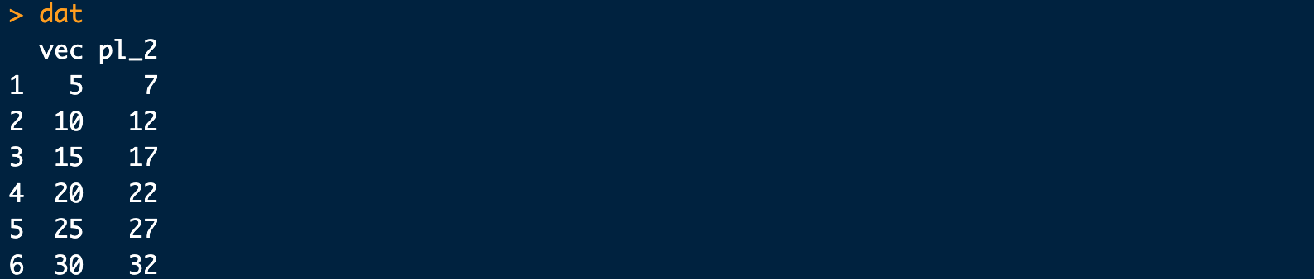
Applying Functions
Depending on the function, they may be applicable to whole vectors or need to be applied to individual points in the data.

Slide 26
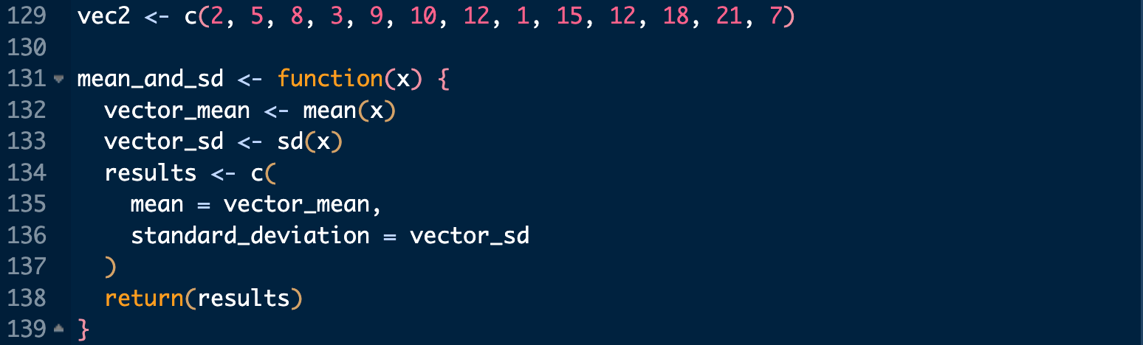
More Complex Functions
This function estimates the mean and standard deviation of a vector.

Slide 27
Practice with Functions
Run this code.
Do the following:
This vector represents minutes, write a function to convert it to hours.
Create a new vector that converts mins to hours,
Combine mins and your hours vector in a new dataframe

Slide 28
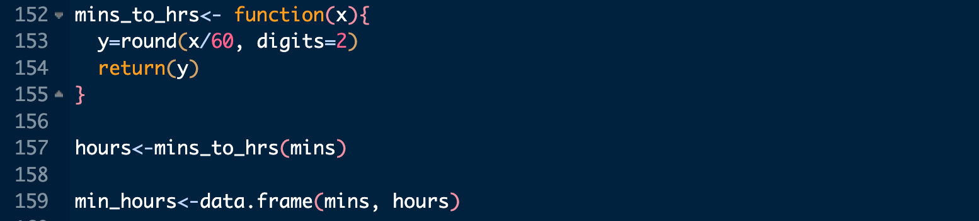
Solution

