Slide 1

Reading Data into R and Aggregating Data
Day 2 of the RI Workshop, Summer 2026 Taylor Hill

Slide 2
Questions about the homework?

Slide 3
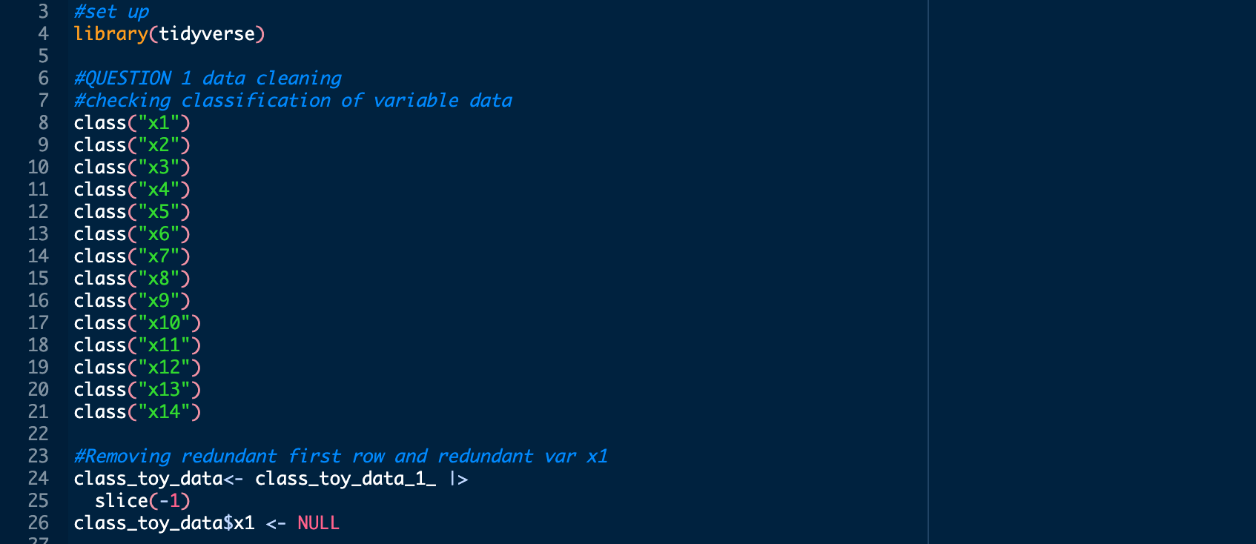
Write the code to import the data with read_csv() or read.csv()
When using class(), make sure to do data$variable.
Class(class_toy_data_1_$x1)
Otherwise, it is just telling you that the term “x1” is a character because it is in quotation marks.
If you don’t include the import data code, it won’t import it if someone else runs your code, like a co-author.

Slide 4
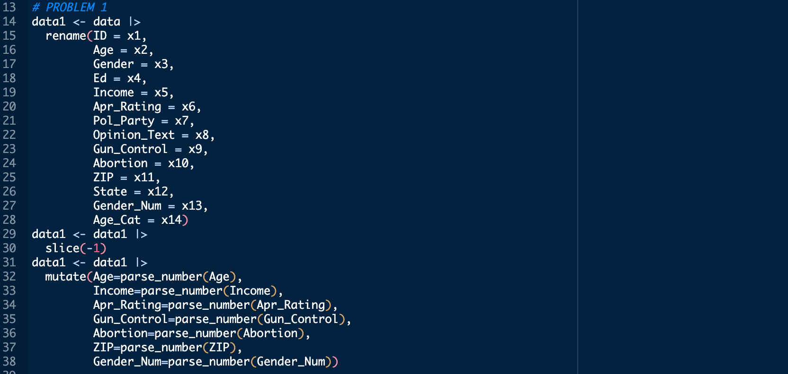
Recommendation: use all lowercase letters for variables
Using lowercase is better for 2 reasons
1) You don’t have to hit shift everytime you want to type your variable.
2) If you miss a capital letter, R will return an error.
Obviously, do what works best for you.

Slide 5
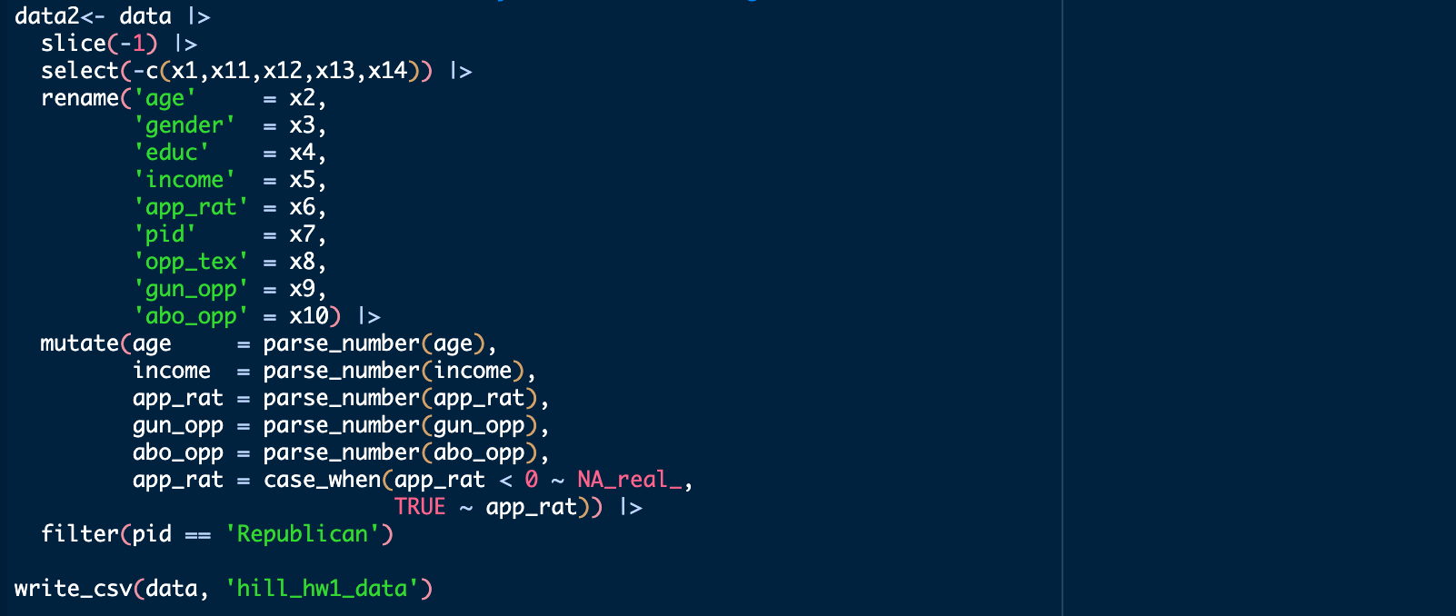
Solution: All of the cleaning can be done in one chunk of code

Slide 6
Review
What are the different types of vectors?
Numeric, string/character, factor, logical
What is an object in R and where are they shown?
Created data, can be either a vector or data frame; global environment
What is this %>% (|>) called?
The pipe operator
What functions did we learn about last class to clean data?
mutate(), select(), filter(), slice()
What functions can be used to rename variables?
rename(), clean_names()

Slide 7
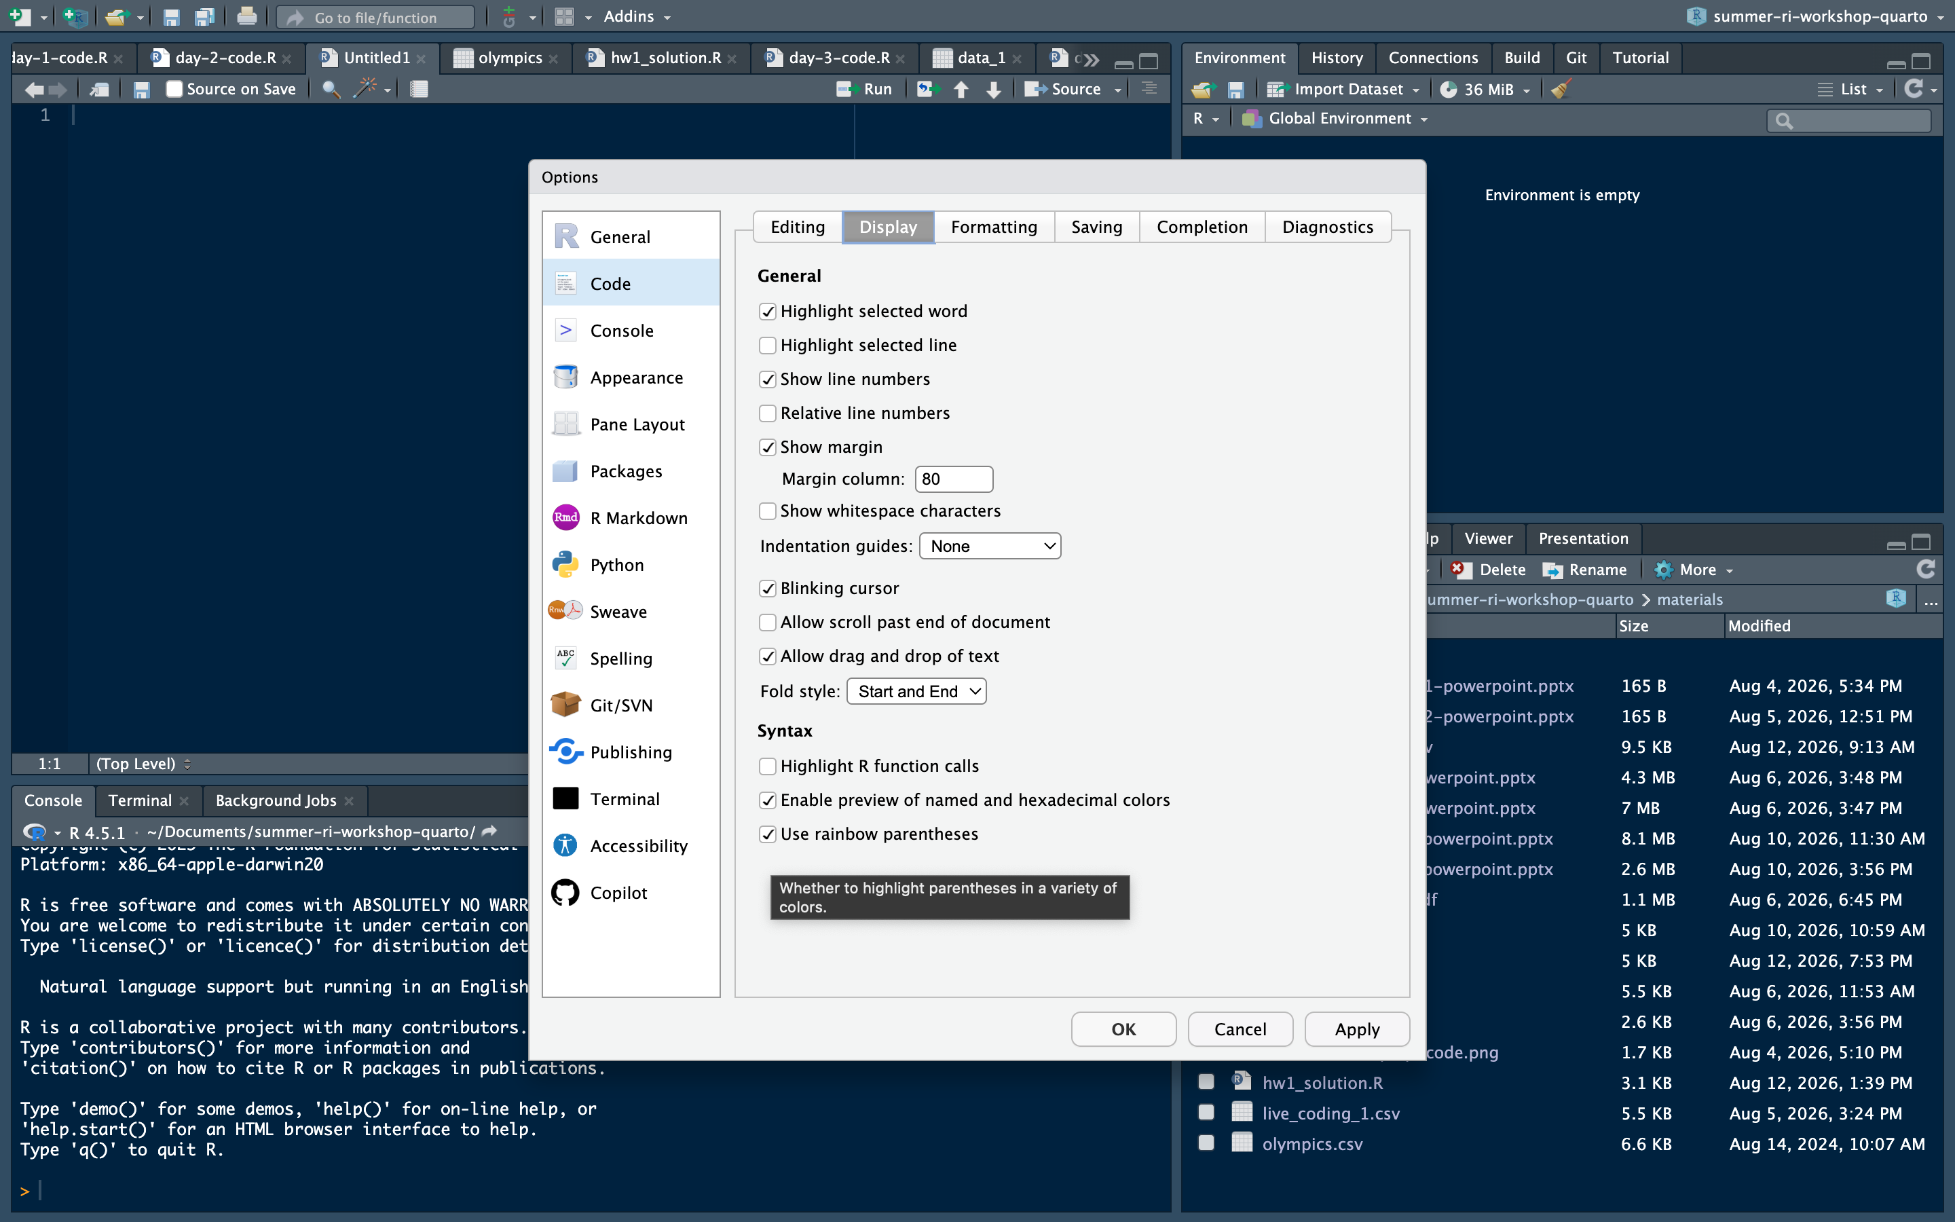
As Promised… Rainbow Parentheses

Slide 8
Creating an R Project
R projects allow you to be even more organized when working in R.
These allow you to also change to a different project without having to constantly change your working directory.
Live demo
Written instructions for future reference
Click on the project tab in the top right-hand corner of RStudio.
Click “New Project”
Click “Existing Directory”
Click Browse and navigate to your project file on your computer.
Click create project
FYI, your project will be titled whatever your folder is titled.
Your working directory for that project will always be that folder, so now you don’t need to change it.

Slide 9
Other Forms of Data
Data can come in forms other than a csv
Below are some common data formats
Note that the functions read_dta() and read_sav() come from the haven package
Data Format | Function
.dta | read_dta()
.sav | read_sav()
.rds | readRDS()
.RDATA | load()
.txt | read.delim()

Slide 10
Cleaning Data
Cleaning data is a big part of your first-year RA responsibilities.
tidyverse commands are the most effective at cleaning data.
These include mutate(), select(), filter(), case_when()
These commands can do a lot of the work when cleaning data.

Slide 11
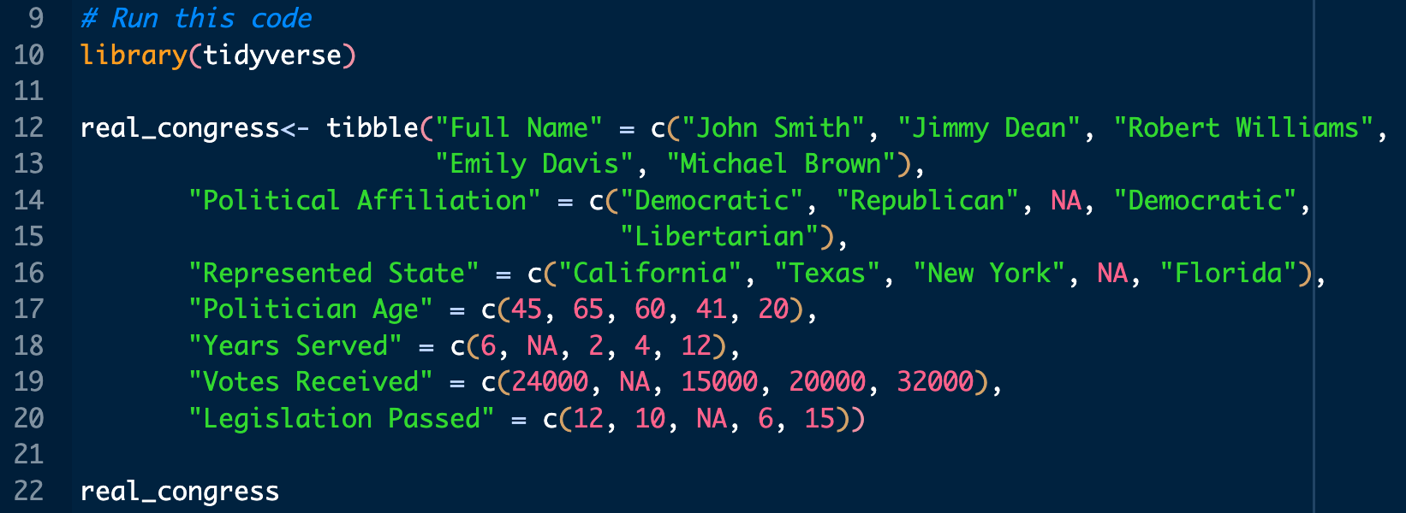
Live Coding Practice Cleaning Data
What should we do to clean this data and what commands should we use?

Slide 12
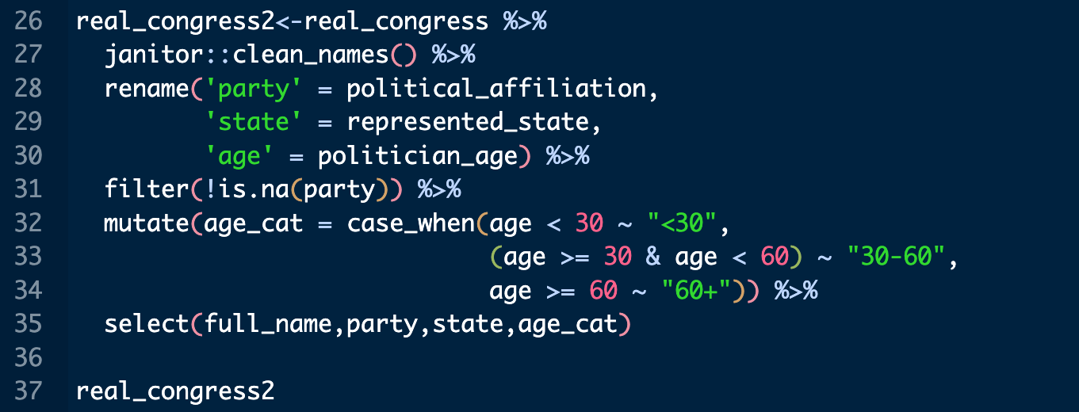
Solution

Slide 13
Personal Practice
Download the Live Coding 1 data on the course materials page.
Try on your own to do the following:
Rename all the variables
Make categorical variables for age, experience, legislator’s activeness using committee membership and bill sponsorship, and electoral outcome (let’s assume each district has 60,000 voters)
Remove NAs from any variables where there are NAs
Make the data set only has their name, party, years served, bills sponsored, and the categorical variables from above

Slide 14
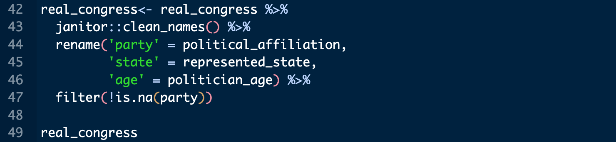
Aggregating Data
In some applications, it is useful to get aggregate (summarized) level information about our data.
We can use group_by() and summarize() to accomplish this.
group_by() works similarly to row_wise() from the homework, let’s start there.

Slide 15
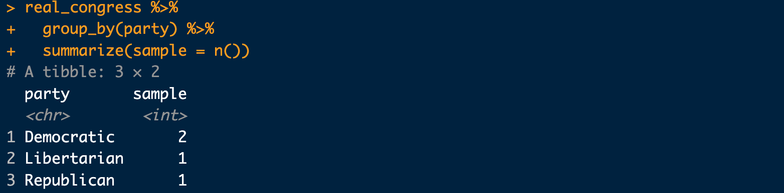
Aggregating Data
n() counts the number of the variable you group by.
This code counts the number of people in each party

Slide 16
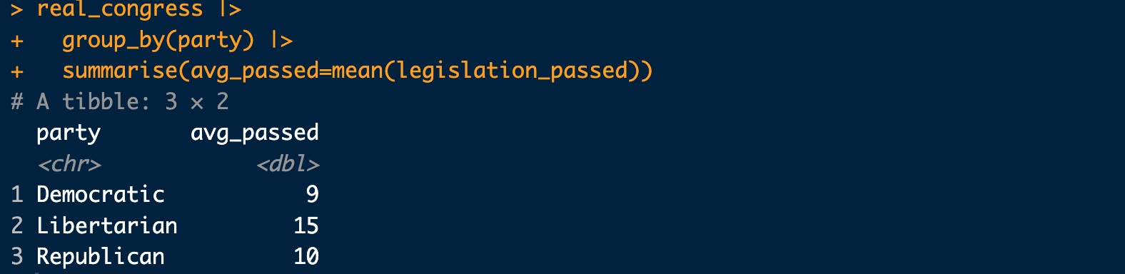
Aggregating Data
This code estimates the average number of bills passed by each party.

Slide 17
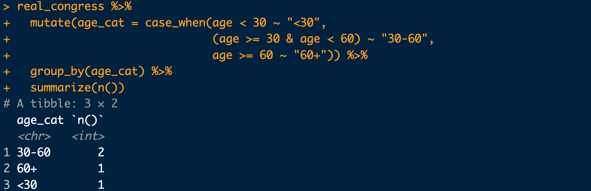
Aggregating Data
This code creates a new age category and then counts the number of people in each category.

Slide 18
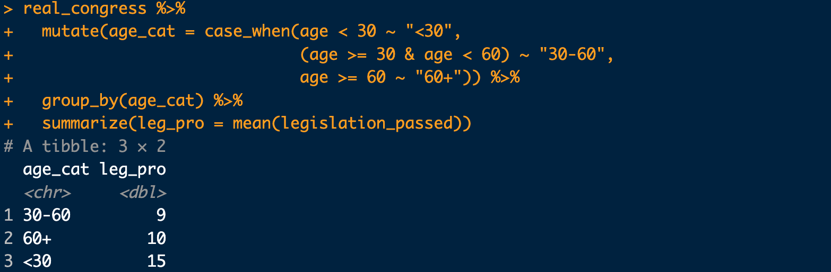
Aggregating Data
The categories are ordered in a strange way. How would we fix this?

Slide 19
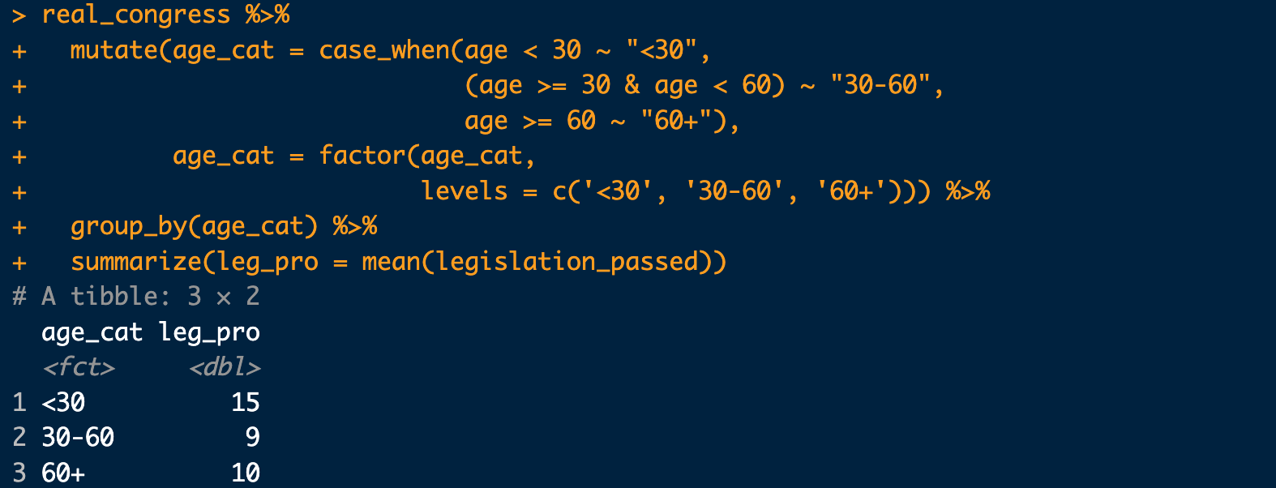
Solution: Change to a Factor

Slide 20
Practice Aggregating Data
Use the real_congress2 data to do the following
Calculate the average number of votes received and age by party.
Calculate the average number of years served by age category
Create a new variable called region
Put Florida and New York in the East, California and Texas in the West
Calculate the number of bills passed by region

Slide 21
Data Structure
When performing operations with data, it is important to understand the dimensions of the data
To do so, we can use several functions such as summary(), or names()
It is also important to be able to take a closer look at a single variable
Data can also be stored in different types of objects (we’ve covered vectors and dataframes/tibbles, lists are another way data can be stored)

Slide 22
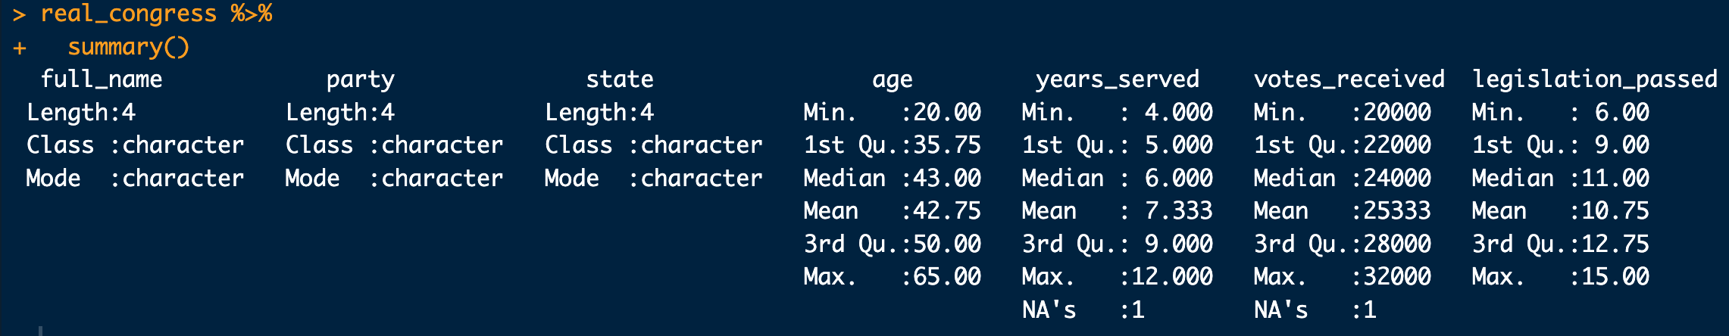
Summary
Using summary() on a full dataset will give you summary statistics for each variable in the data.

Slide 23
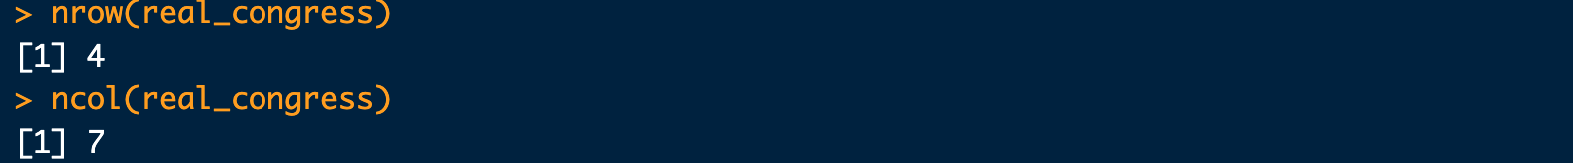
Data Dimensions
If we just want the names of columns for each variable, we can use the names() function
Additionally, it might be useful to know the dimensions of our data. To do this, we can use the nrow() and ncol() functions

Slide 24
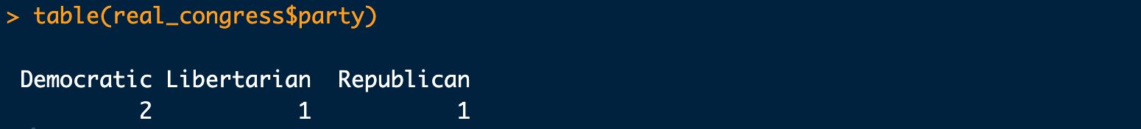
Summarizing Single Variable
If we want to analyze just a single variable, or apply a function to a single variable, we can use the $ to pull a single variable from a dataset:
We can also use this format to create frequency tables of our data, using the table() function
To get the dimensions of a single variable, we can use the length() function:

Slide 25
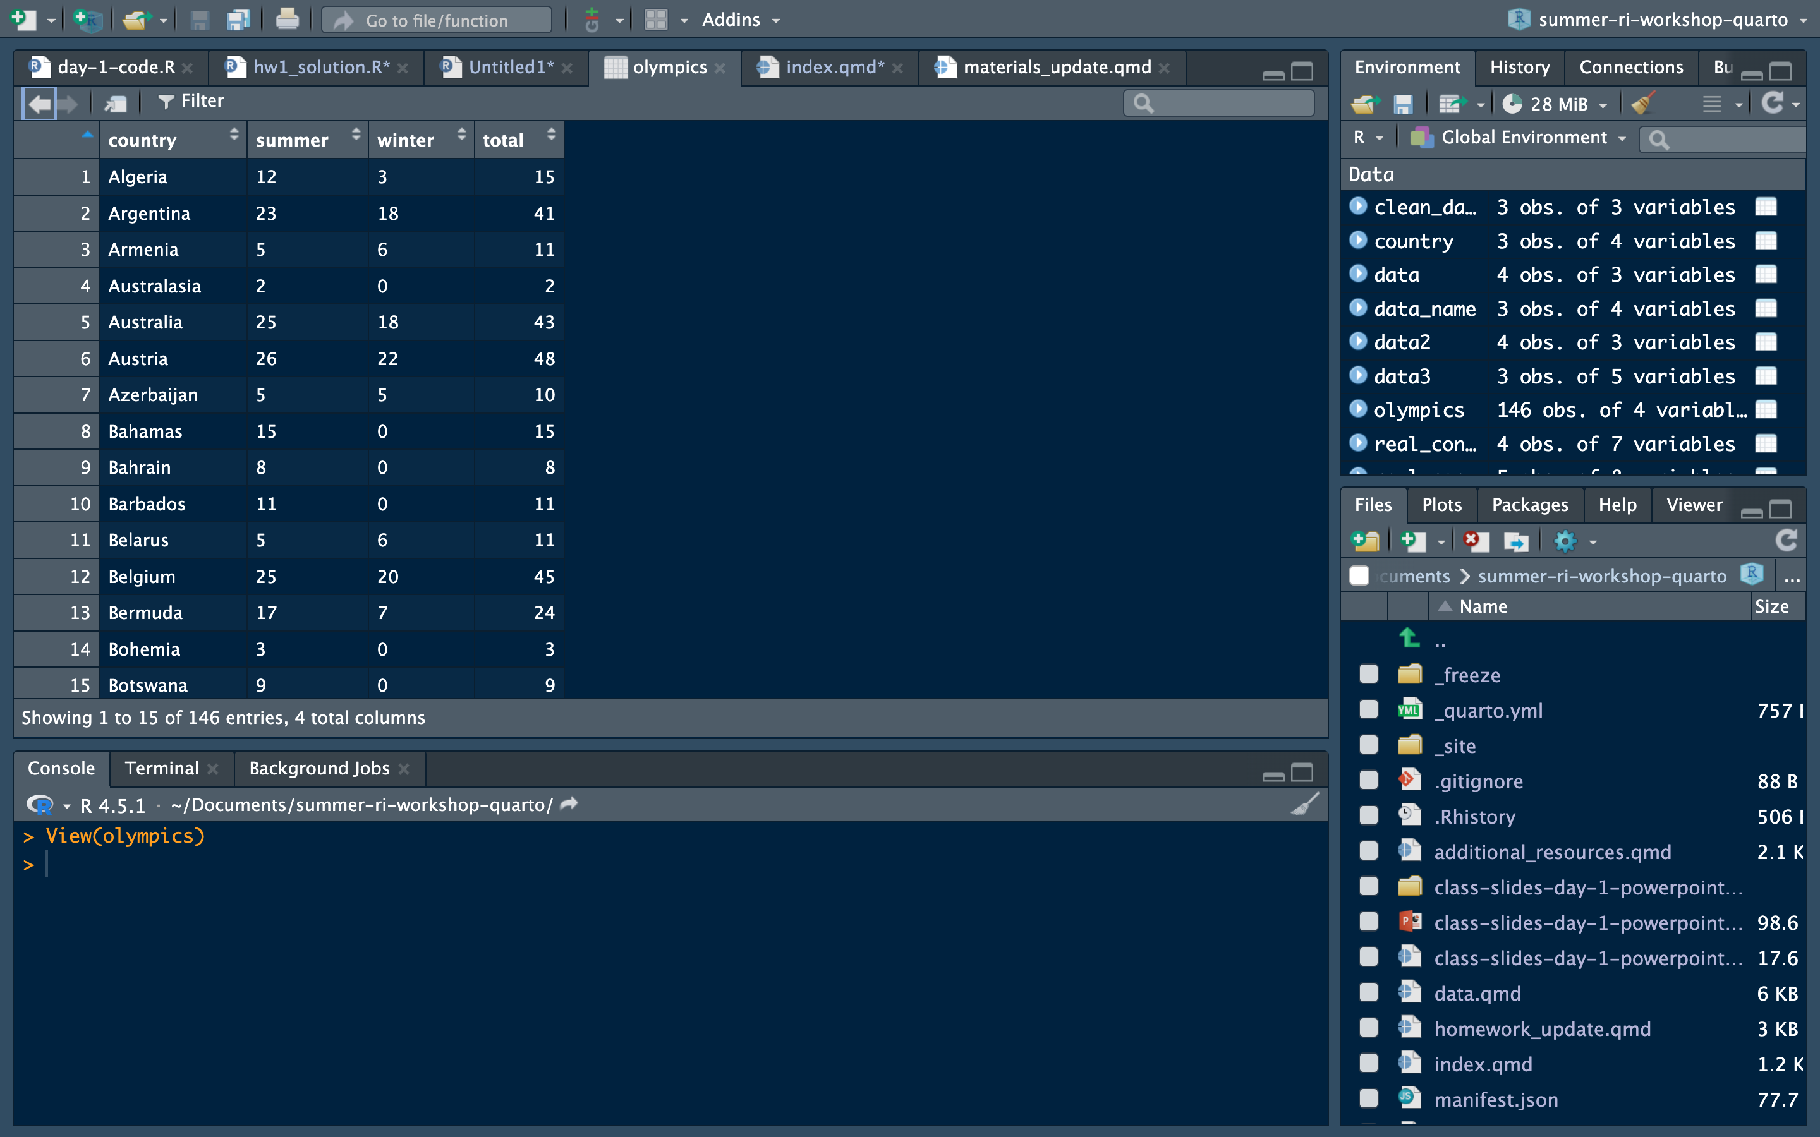

Slide 26
Practice
Using the live coding data from earlier, answer the following questions (feel free to work together!):
How many rows does our data have?
How many columns?
What is the mean, median, and 3rd quantile of number bills a member of Congress has sponsored, and number of years served in congress?
What is the number of members of Congress in each party?
What is the average number of bills sponsored by age category?
What is the median number of bills sponsored by party?

Slide 27
More on Vectors
On the first day, we created short numerical, character, or factor vectors.
When running simulations, we will want larger numeric vectors.
Therefore, we can use commands that generate random variables to create a long vector of numbers we can use in our simulations.

Slide 28
Vectors
You want use the set.seed() command first to make sure that your code is reproducible.
This ensures that you get the same random set of numbers each time you run your code.
We can use a command like rnorm() to create a random vector of numbers.
If we do not set the seed first, it will give us a different set each time.

Slide 29
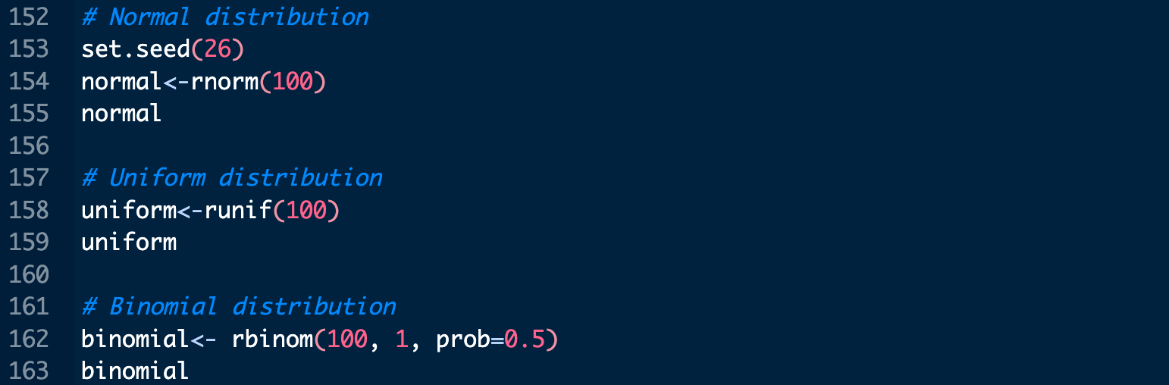
rnorm, runif, rbinom
Using a command that takes the form of r + distribution.

Slide 30
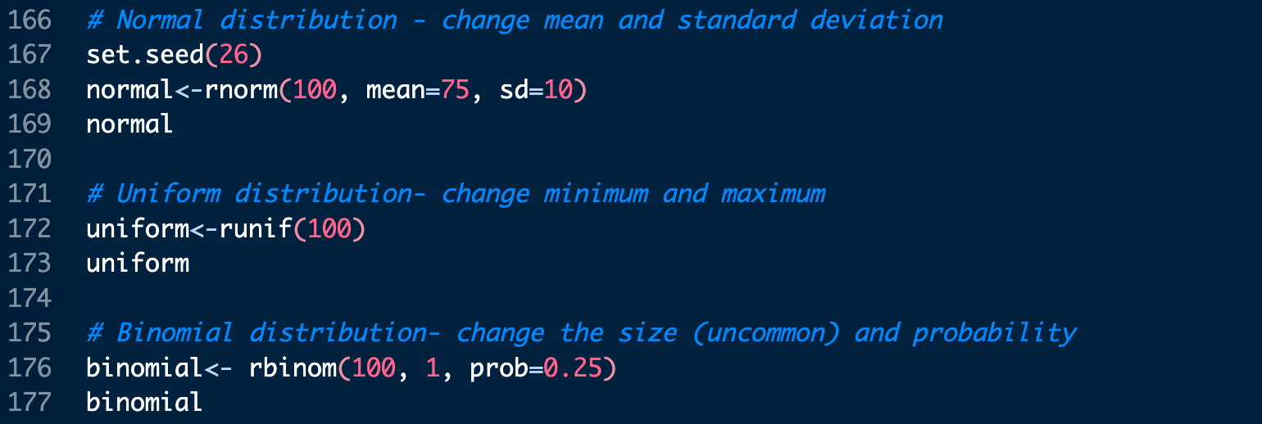
rnorm, runif, rbinom
You can also change the features of each distribution

Slide 31
Practice with Vectors
Do the following:
Create a vector, age, that has 10,000 values with a normal distribution, mean = 40, and standard deviation = 15.
Create another vector, vote_margin, that has 10,000 values with a uniform distribution.
Create one more vector, gender, that has 10,000 values with a binomial distribution and a probability = 0.5
Combine all three vectors into a single data frame.
Find the mean of age to see how closely it matches 40

Slide 32
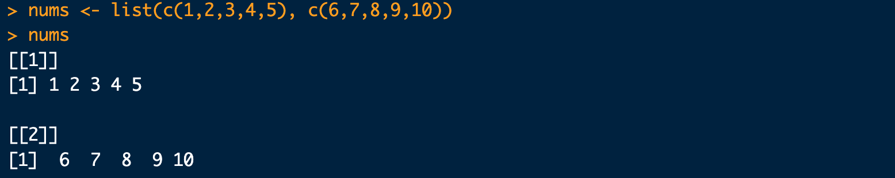
Lists
Lists are incredibly useful for certain tasks
One benefit of lists is that multiple dataframes can be stored together, which is helpful for any iterative process (covered more in day 4)
Lists can also store multiple vectors together

Slide 33
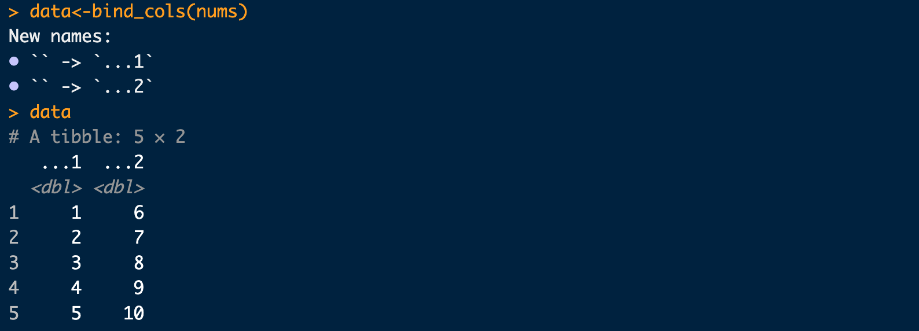
Using Lists
Using lists, we can extract a single item from the list, using brackets like so:
If needed, we can also merge them using bind_rows() and/or bind_cols() depending on our application.

Slide 34
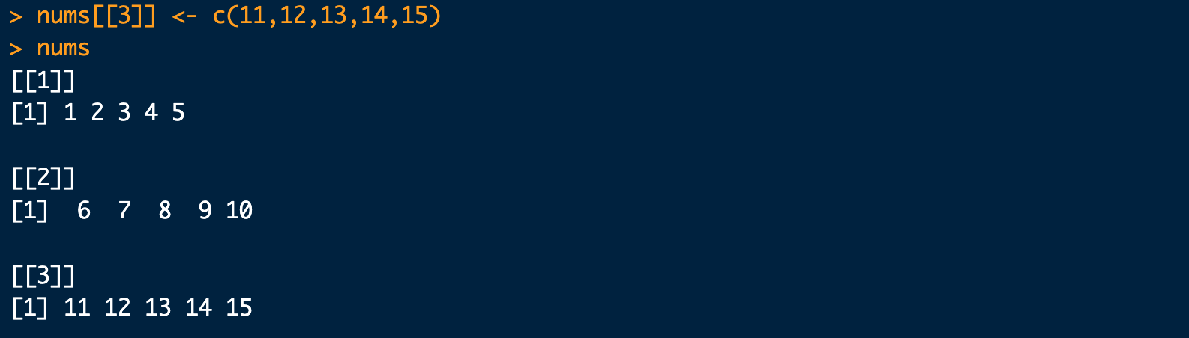
Adding Items to Lists
We can also add items to lists using the following approach:

Slide 35
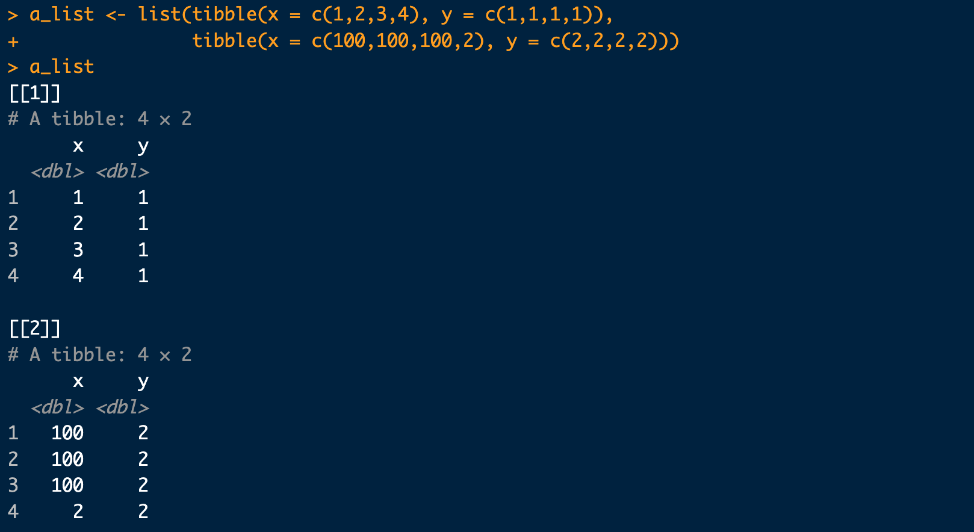
Dataframes and Lists
Lists can be made of dataframes or vectors

Slide 36
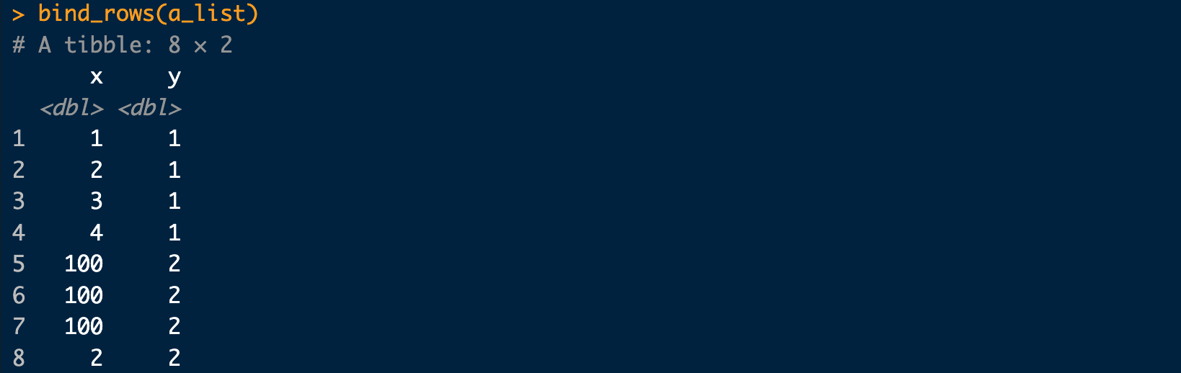
Working with Dataframes in Lists
We can add in objects the exact same way we did with vectors
We can also combine these dataframes using bind_rows() or bind_cols()

