Slide 1

Factor Variables and Thinking in Pictures
Day 3 of the RI Workshop, Summer 2026 Taylor Hill

Slide 2
Any questions about the homework?
Did anyone run into any issues or have any questions?

Slide 3
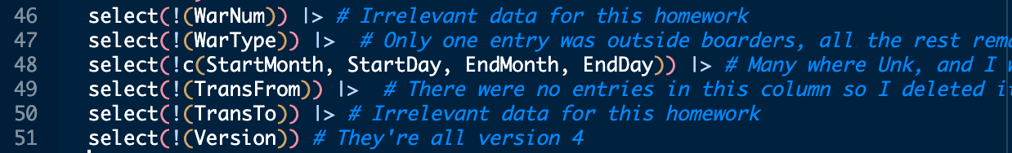
You only need to run install.packages() once per device for every package. Once it is installed, you just call it with library.
You can remove all unwanted variables in one select. I might rename the variables too.
select(-c(WarNum, WarType, StartMonth, StartDay, EndMonth, EndDay, TransFrom, TransTo, Version))
Also, you can do select(!c()). I actually did not know this. You taught me something new!!

Slide 4
If you use na.omit() just be very careful. In this case, after running this line, the data went from 60,000 observations to 35,470.
So, it nearly cut the sample size in half. I suggest either keeping them in your data and only removing NAs when you use a certain variable.
You will learn more in your methods courses but cutting our sample size can have significant consequences for our estimate.
The larger the sample size, the better we can approximate the real population.
So, if we cut the sample size, it makes our estimates less precise.
For summary, you generally don’t use the pipe.
If you want the summary of statistics of one variable you should do summary(data$variable_name)

Slide 5
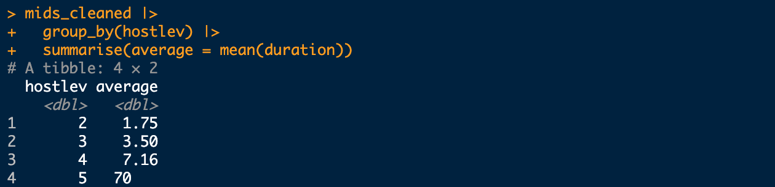
Remember to add labels to categorical variables.
We would want 2, 3, 4, and 5 here to have labels so that we know what they represent.
Most of the time, if you group by a variable, you probably want to add labels.
Separate filter arguments with a comma unless you are using the same variable.
This code still worked but generally you use & when you use the same variable twice and a comma when you filter another variable.
filter(stday! = -9 & stday != -8, stmon != -9)
You can also hit return if your code is going off the page.
It is best practice to try to stay within the border line (show in R)

Slide 6
Look at Solution in R
Everyone did the homework correctly.
I just want to show a few tricks

Slide 7
Grad School Professionalization
Residency: They may have mentioned this at orientation, but in order to get in-state tuition next year, you need to get your Florida drivers license ASAP.
You need to have it valid for a full year before the start of Fall 2027.

Slide 8
Group Work
On the course website, under Day 3, download the Olympics data and do the following:
Read the data into R
Tell me the names of all the variables and the dimensions of our data
Use select() so the data only has the country, winter, and summer variables.
Rename the variables to something that makes sense
Make a new variable that is the total number of medals:
hint: you will need to use the rowwise() to sum in each row, I will put that on the board when everyone is ready
Use filter() to show the results for only one country
Use filter() to remove one country

Slide 9
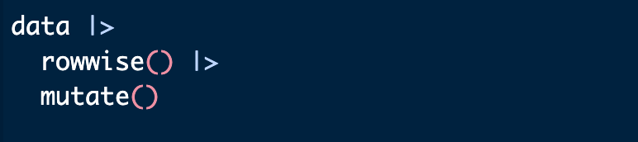
rowwise() Code

Slide 10
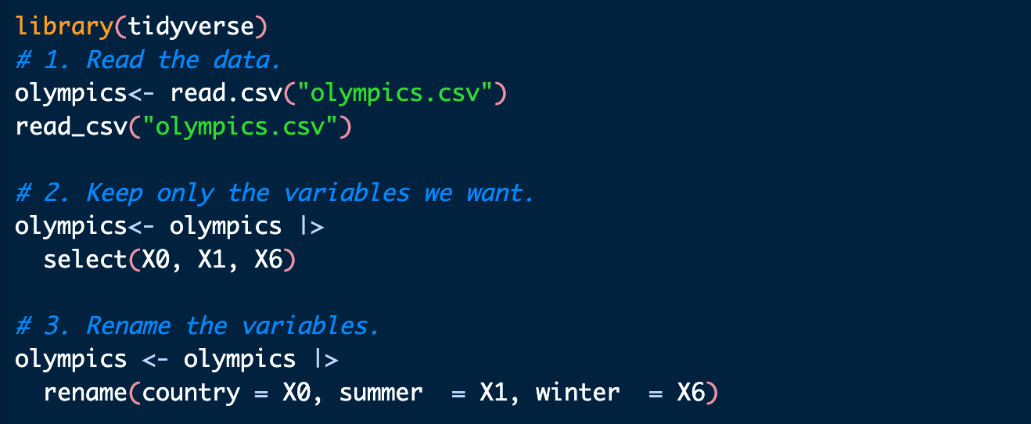
Olympics Data: Complete Solution

Slide 11
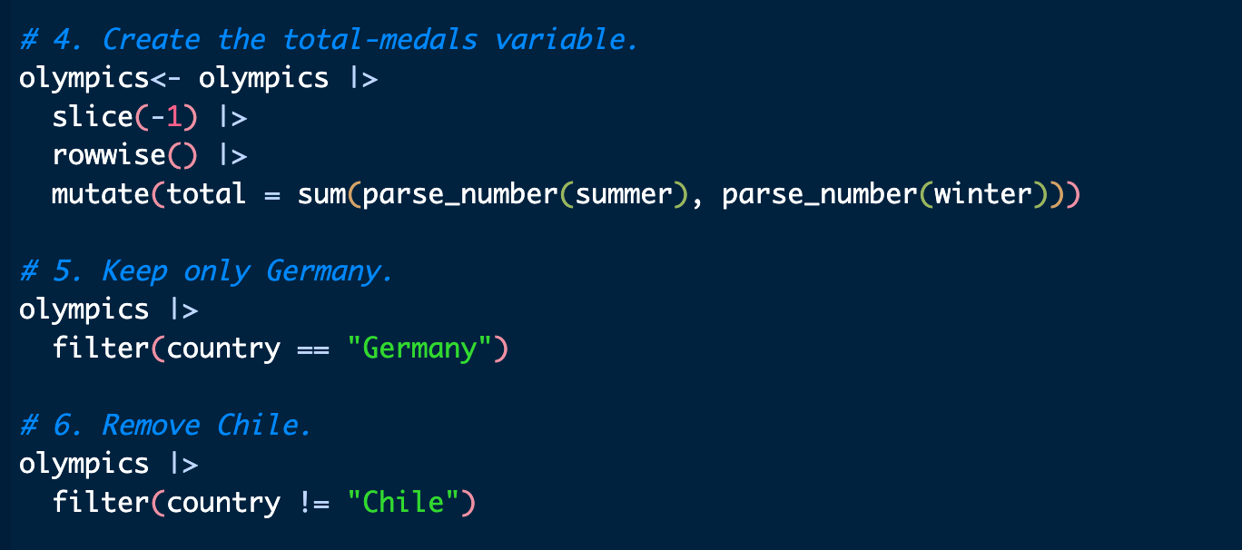
Olympics Data: Solution, Continued

Slide 12
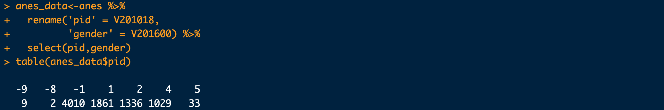
Becoming Familiar with Data
Run the code below.
What does negative pid or gender mean?

Slide 13
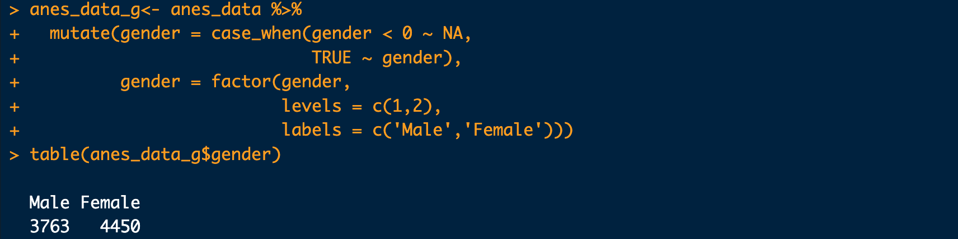
Fixing Gender
Note that we used the labels argument inside of factor to add labels to the values of gender.

Slide 14
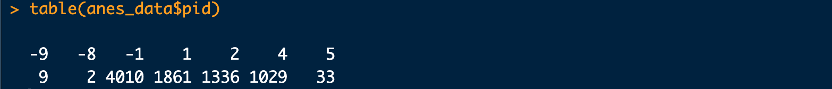
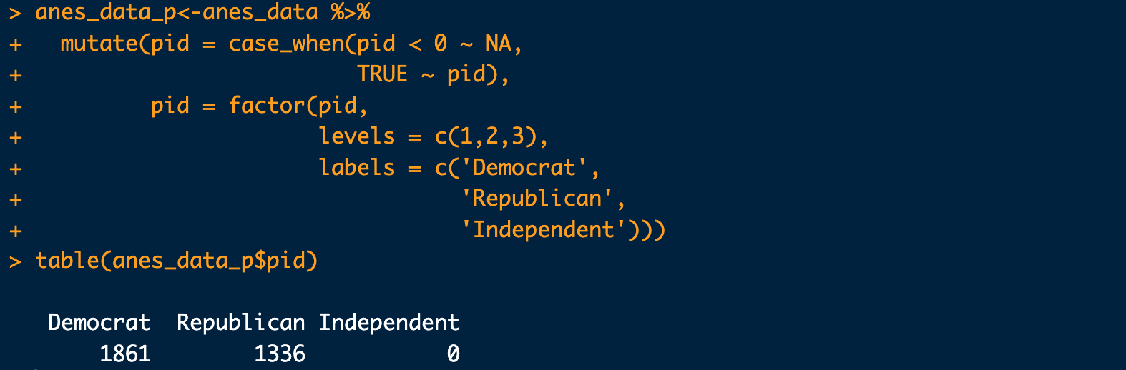
Fixing PID
Note that we reshaped the variable to remove “other” by only allowing for values 1-3 in the factor.

Slide 15
ggplot
R has a default plot function plot() that you should play around with at some point
Within the tidyverse package, there is a function and package called ggplot
ggplot is an incredibly powerful method for creating graphics
ggplot creates the the best-looking graphs in R.
Some professors prefer, and require, base R (Causal Inference)
The resources page on the website points out a few books that help learn more on ggplot, for now, let’s get into the basics

Slide 16
The Parts of ggplot
ggplot has several important components
ggplot() is how any graph is started, it takes the argument of data, and aes() or aesthetic
Within aes(), you set things such as the x and y variables
Rather than using %>% to pipe between lines, we use a +
“geoms” are how you actually decide what type of graph you’re making
Some examples are geom_bar(), geom_density(), or geom_point()
Lastly, the theme, which determines how the graph is presented
You can use preset option, such as theme_minimal() or theme_classic() or use the theme() function to change things individually, or both together!

Slide 17
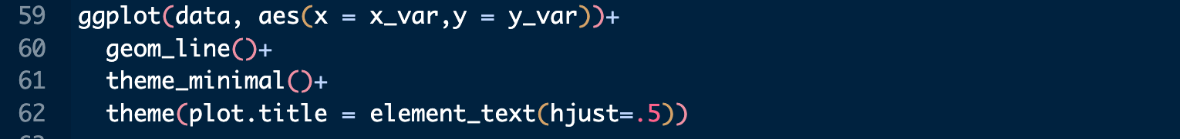
Structure of ggplot Code
This is the basic structure—this is all you technically need to make a graph.
geom_line() creates a line graph
You can add more lines to the graph to make it look better.
theme_minimal() changes the look of the graph (More on this later)
The theme() argument is where you can add many arguments to change the look of your plot.
plot.title=element_text(hjust=.5) moves the plot title slightly up

Slide 18
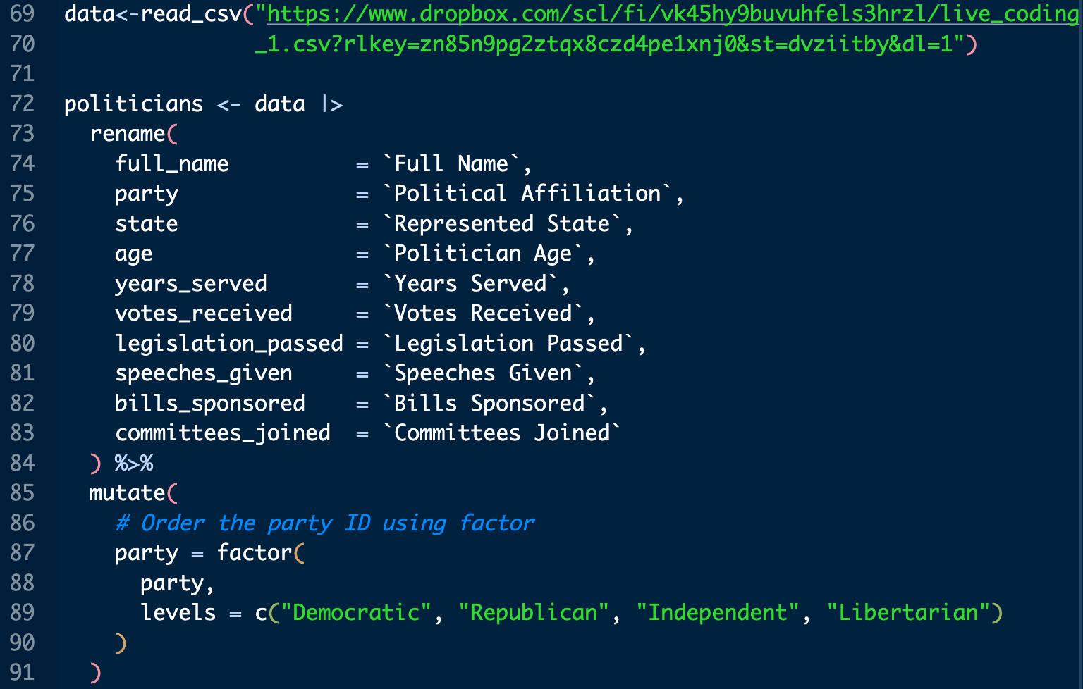
ggplot with Data
Run the code below to read in the dataset we used in the previous class.

Slide 19
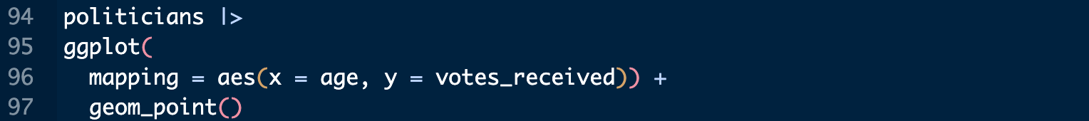
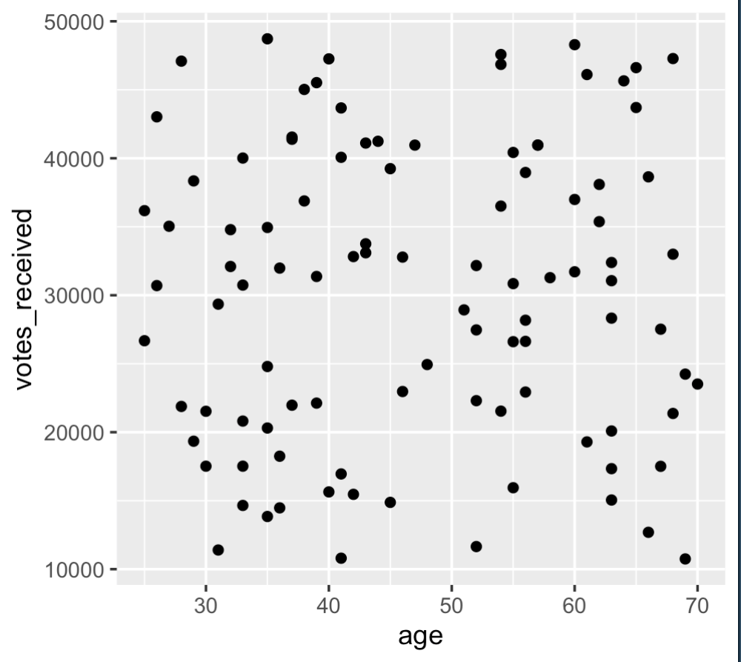
Scatter Plot
This code returns the plot on the right.
What does one point represent in this plot?
Notice you can pipe your data into the ggplot command.
This can be helpful if you want to make changes to your data for your plot

Slide 20
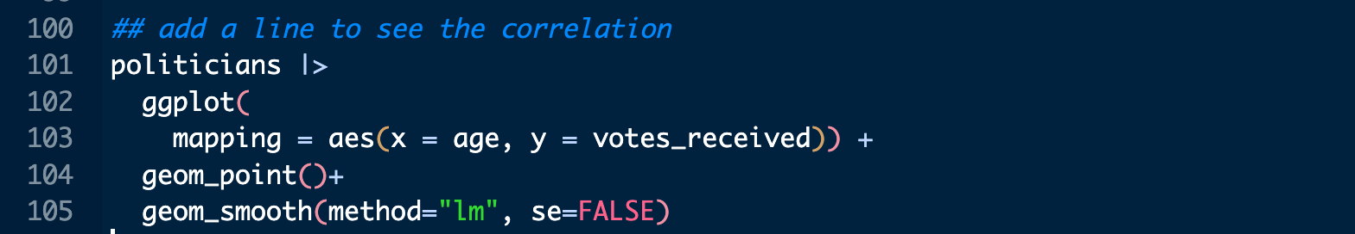
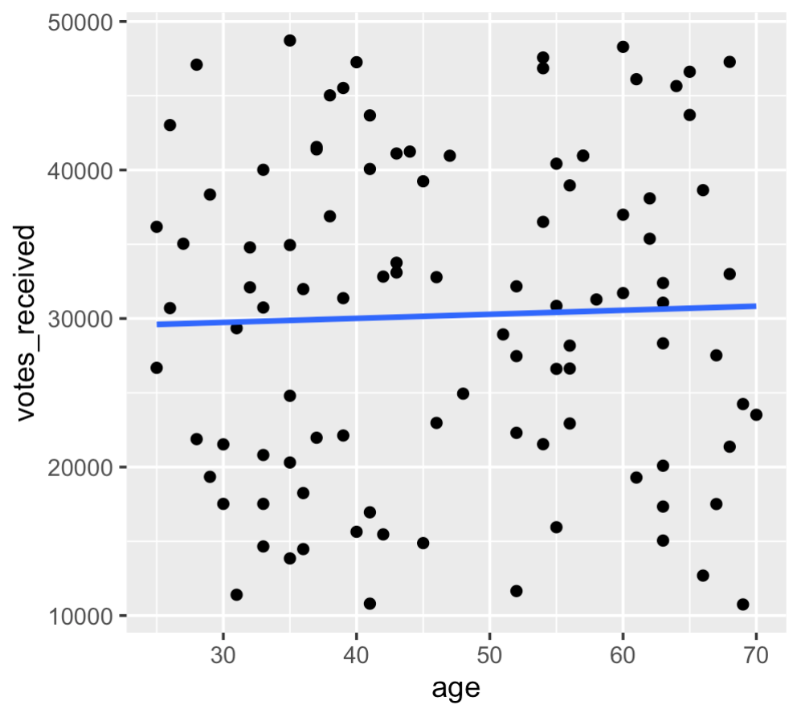
Scatter Plot with a Line
You can make a scatter plot and then add a line on top to see the correlation between two variable.
Useful when you have two numeric variables.

Slide 21
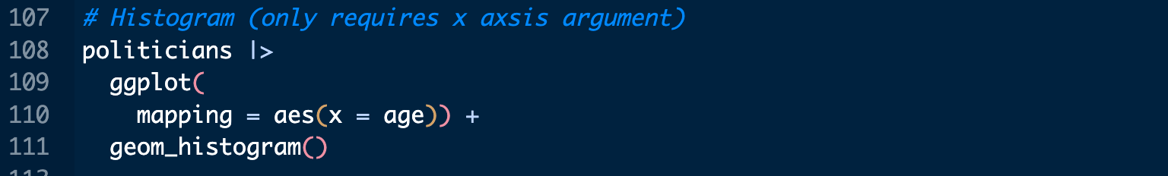
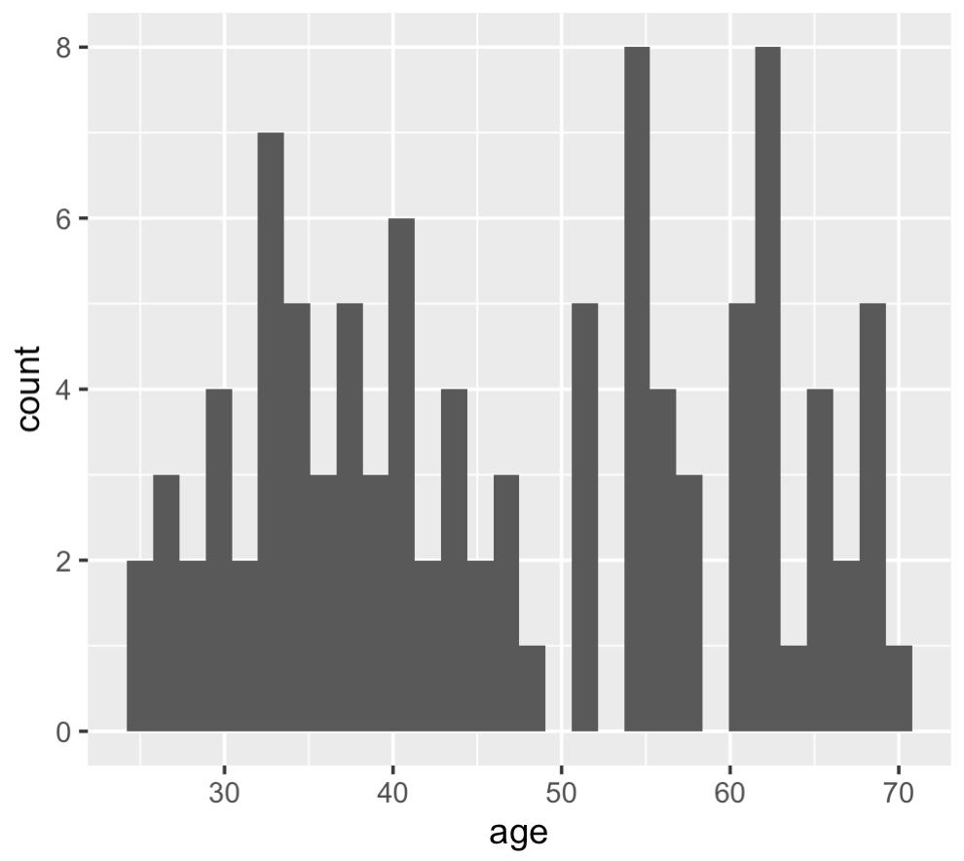
Histograms
Great for seeing the distribution of a variable.
Can also use base R hist() if you want to quickly look and don’t care about the look.

Slide 22
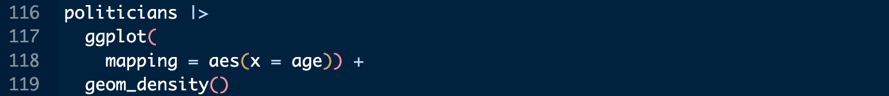
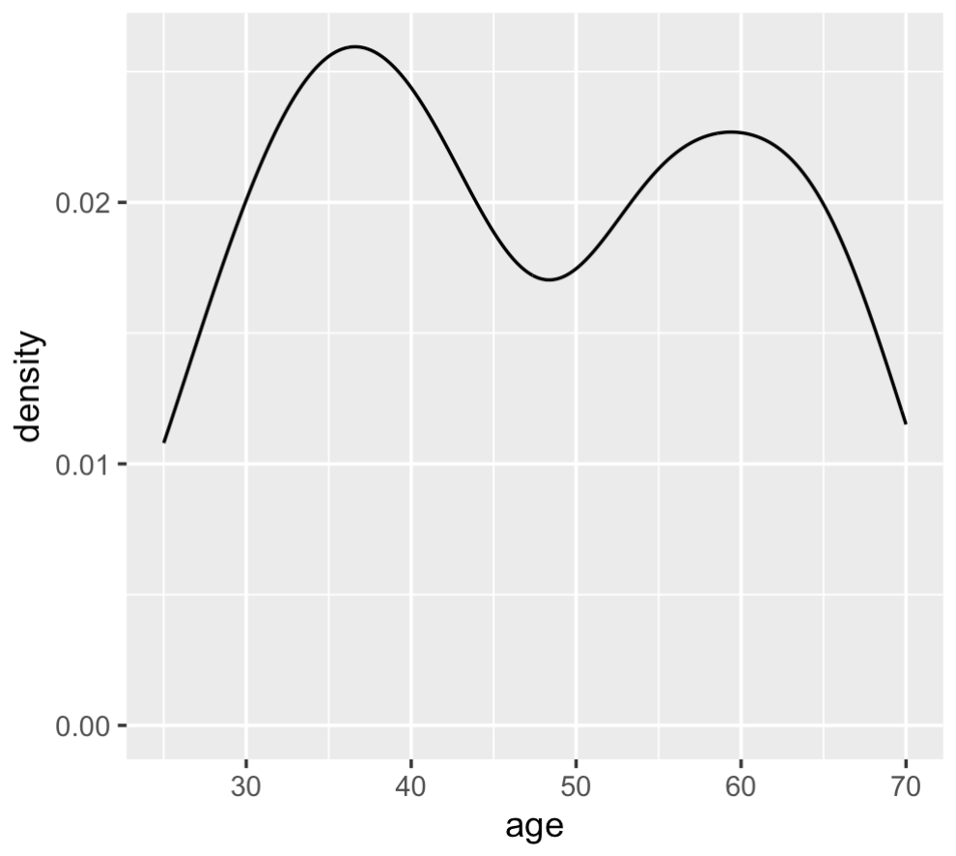
Density Plots
Another way to see a variable distribution.

Slide 23
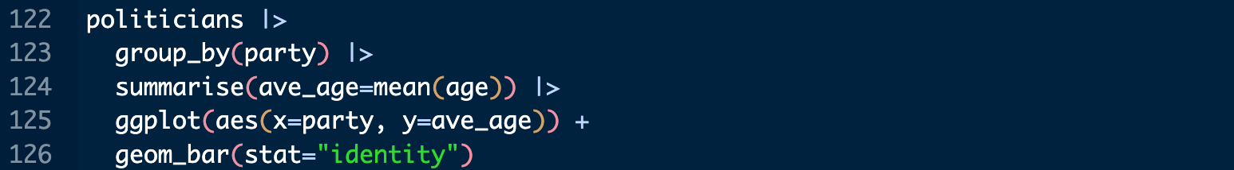
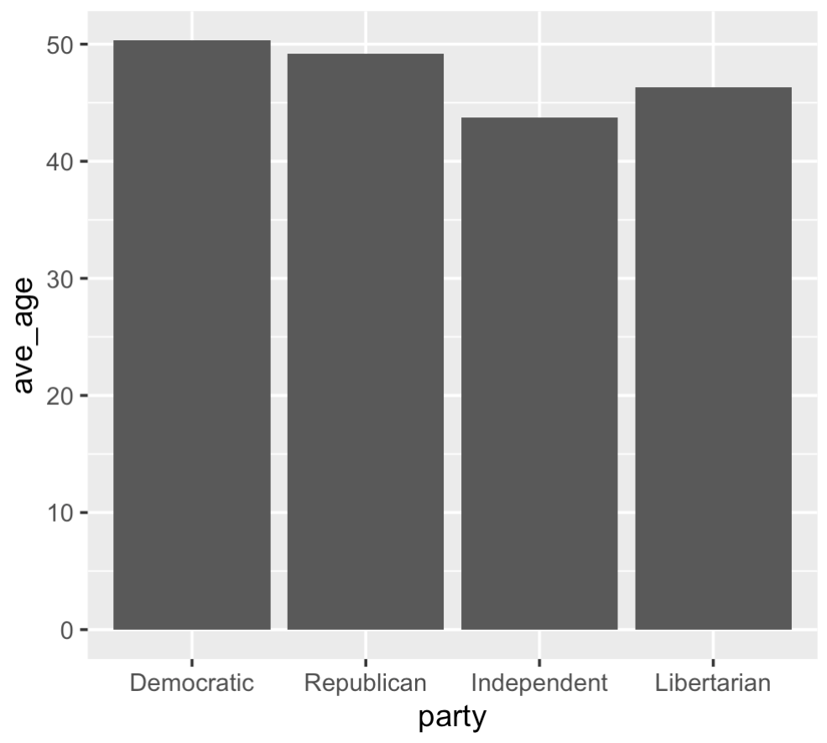
Bar Plots
Useful when you have one categorical and one numeric variable.

Slide 24
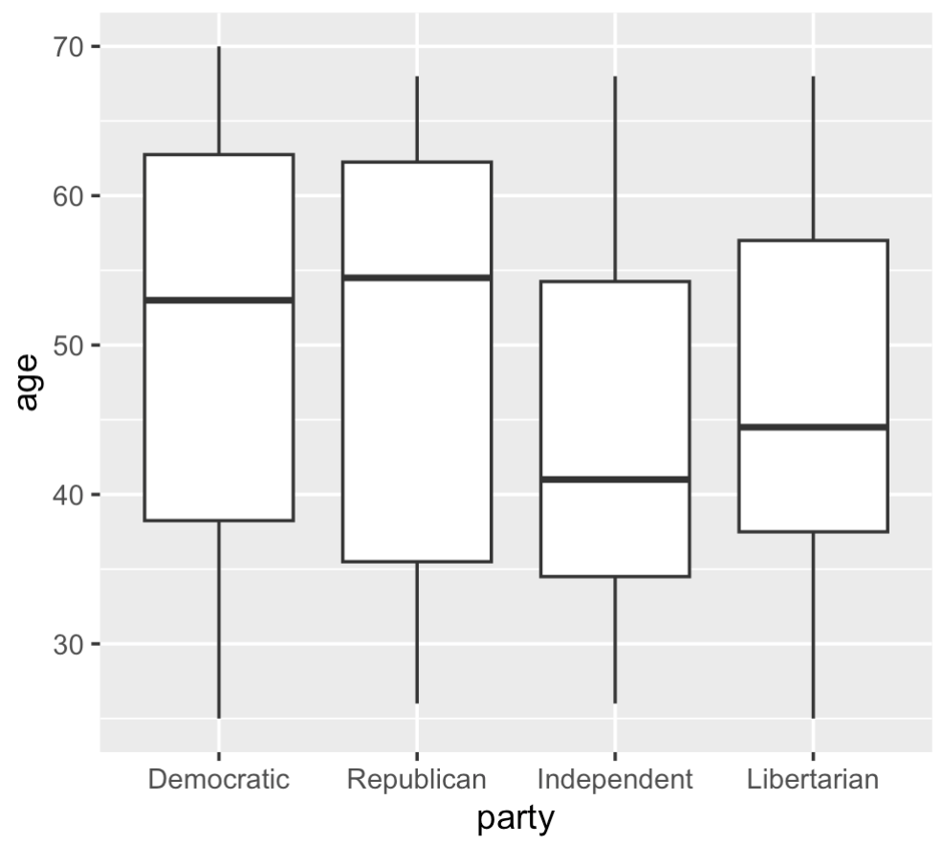
Boxplots
Useful when you have one categorical and one numeric variable.
Shows you the max, min, mean, first quartile, and third quartile for each group.

Slide 25
Ways to Improve a Graph
Change the theme
Add color to each bar
Change the axis labels to something that makes sense
Maybe we want a title?
A caption of where the data is from?
There are more options, these ideas are meant to get you thinking. A figure is meant to communicate data effectively.

Slide 26
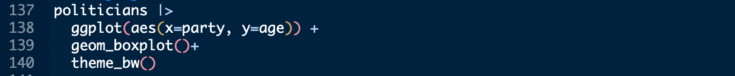
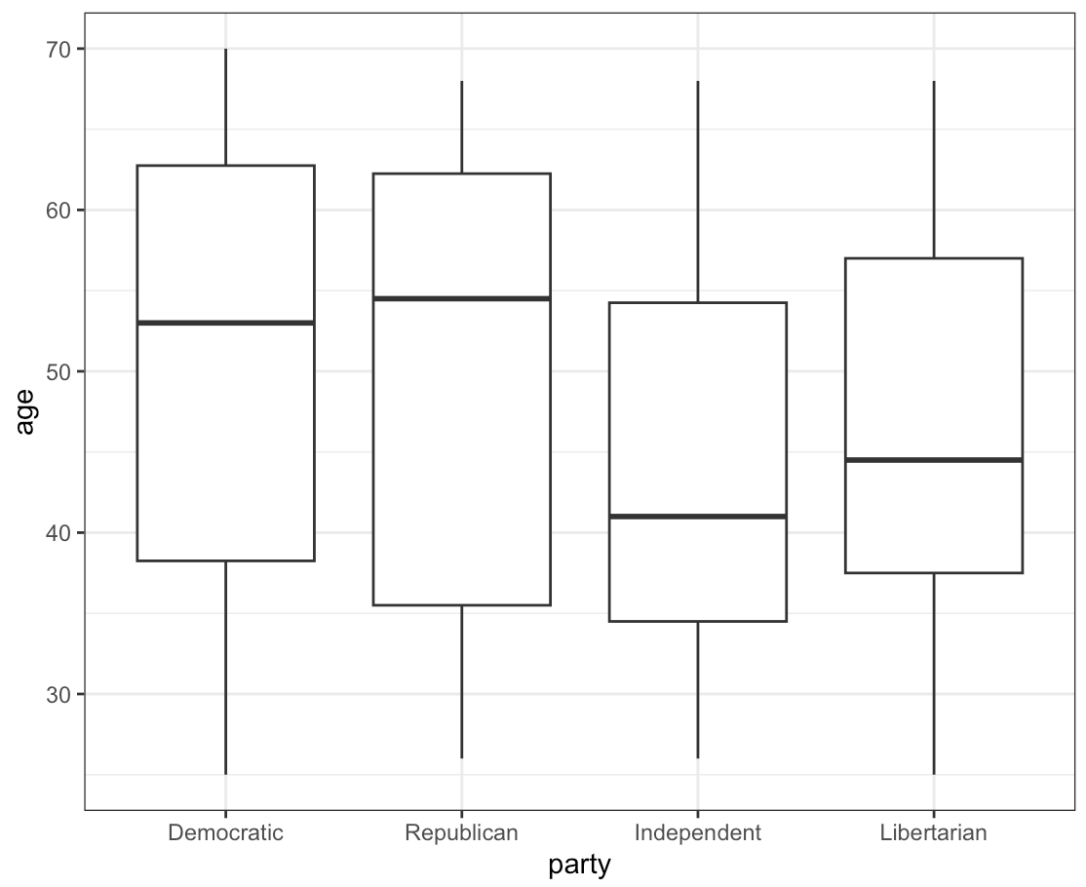

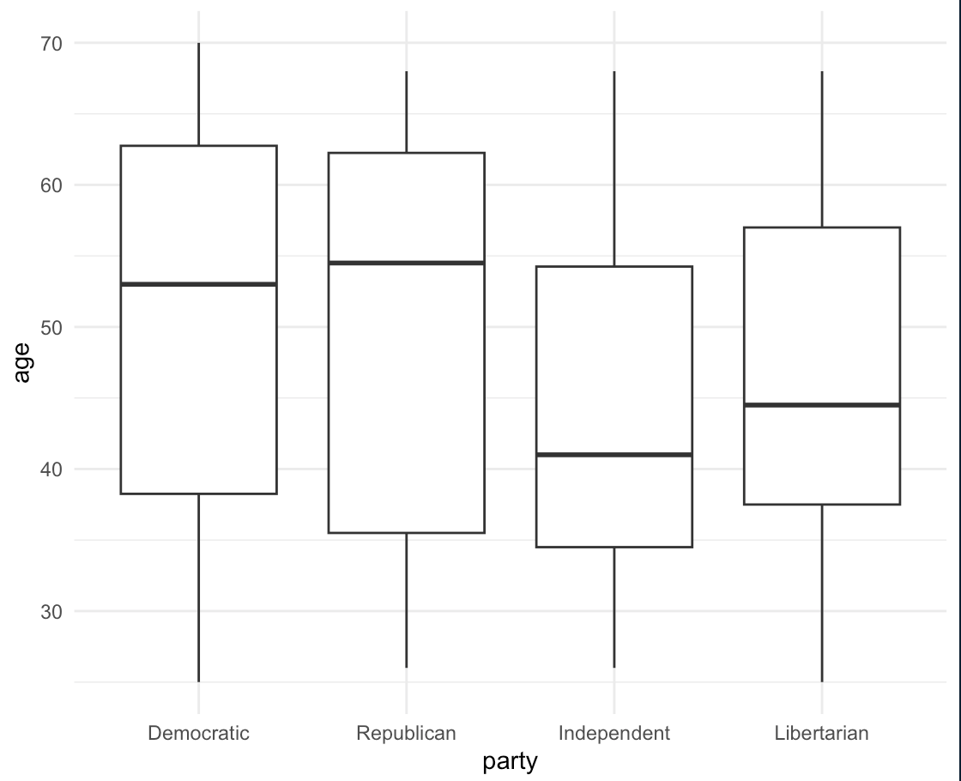
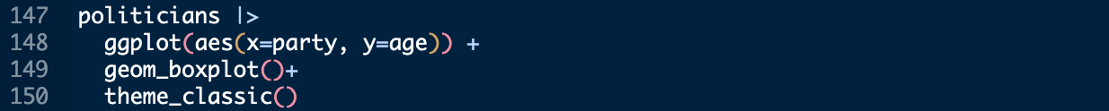
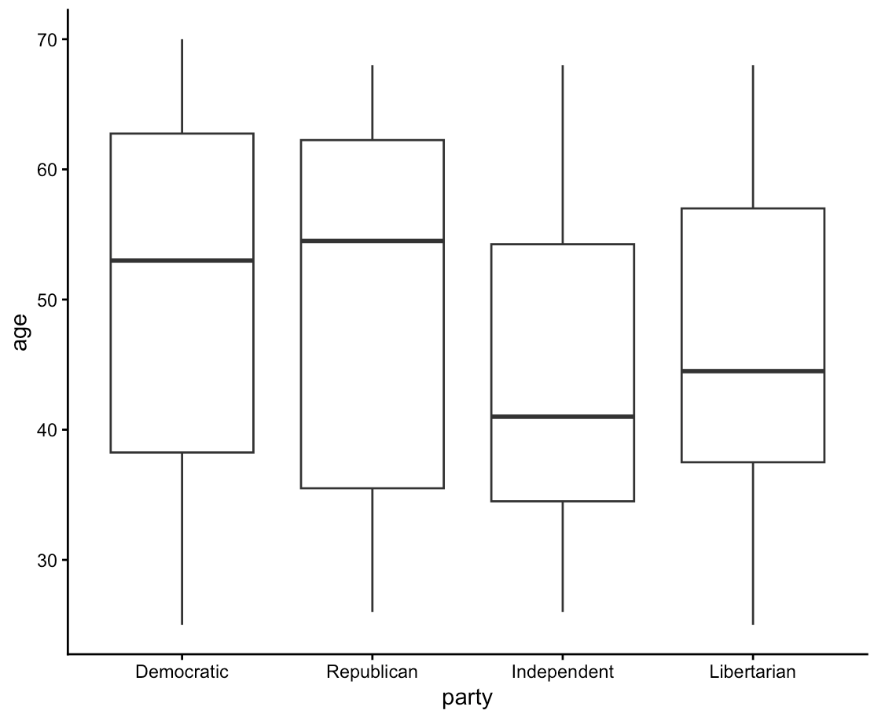
Changing the Theme

Slide 27
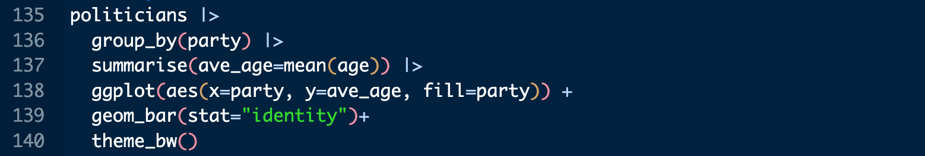
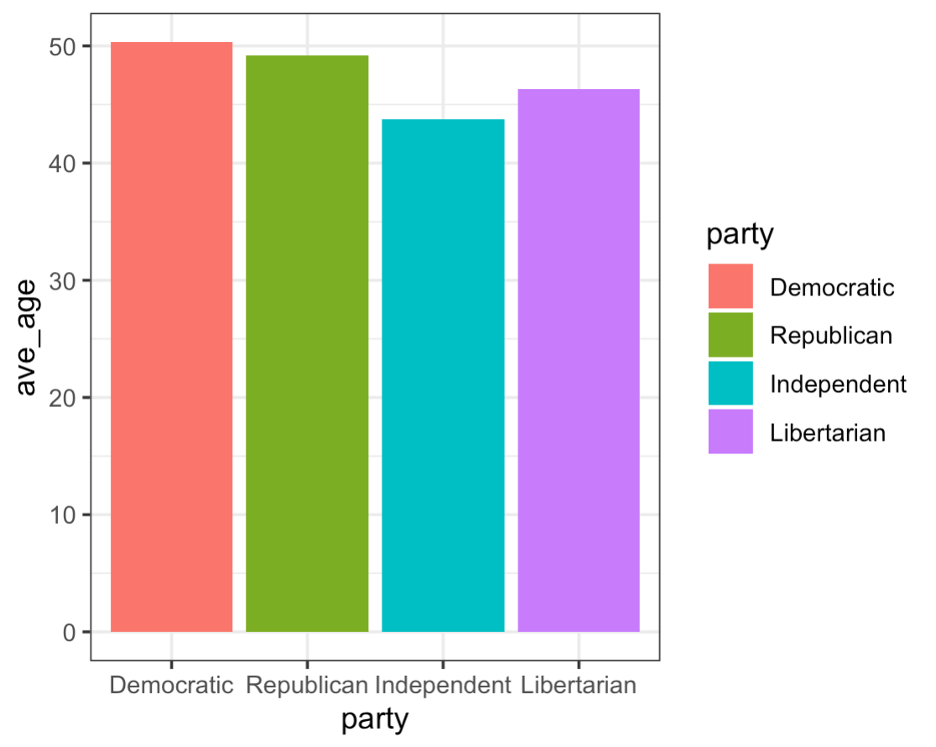
Adding Color
We can add color according to a specific variable in the aes() argument with fill=
We can also manually choose colors for each level.

Slide 28
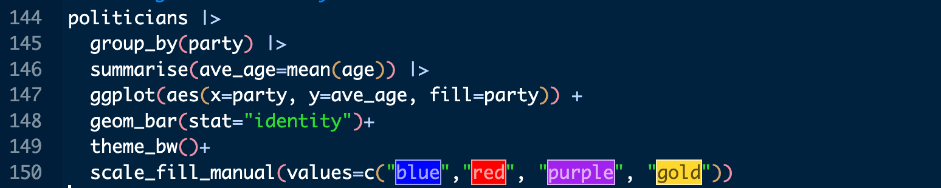
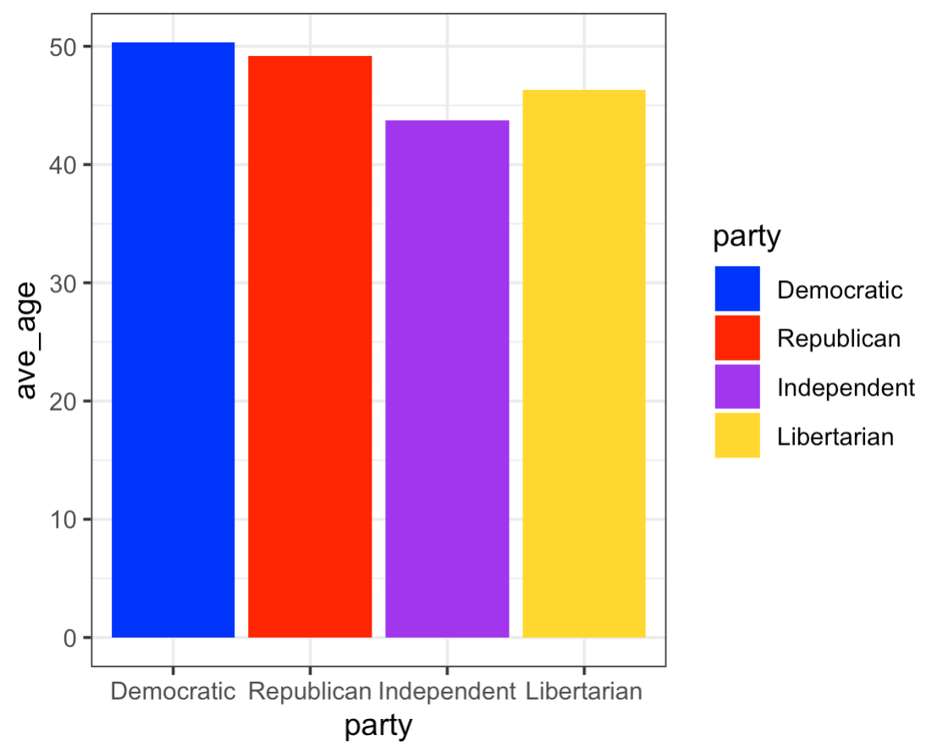
Adding Color Manually
You can use scale_fill_manual() to manually describe the colors you want.

Slide 29
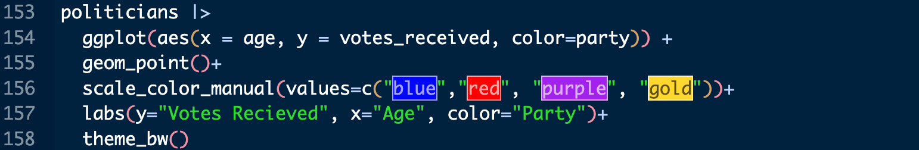
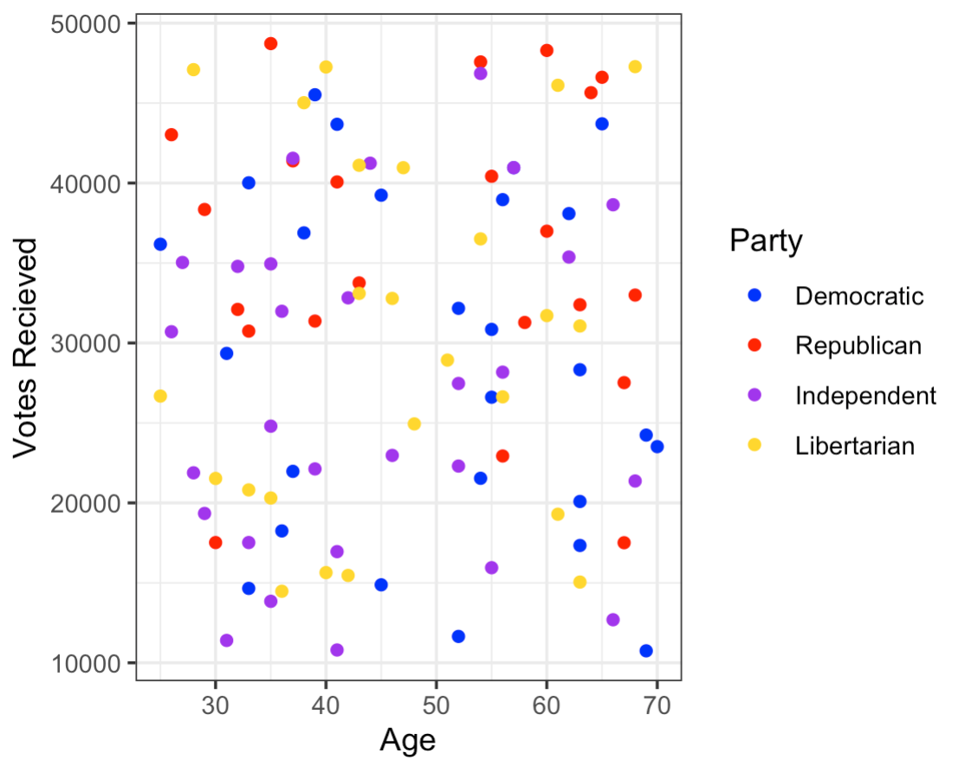
Changing Axis Labels
Using the labs() argument you can label the axis and the legend.
Notice when coloring points and lines we use color= for bars and boxes we use fill=.

Slide 30
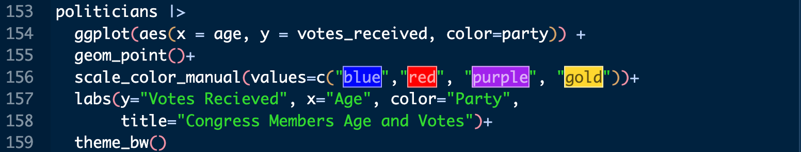
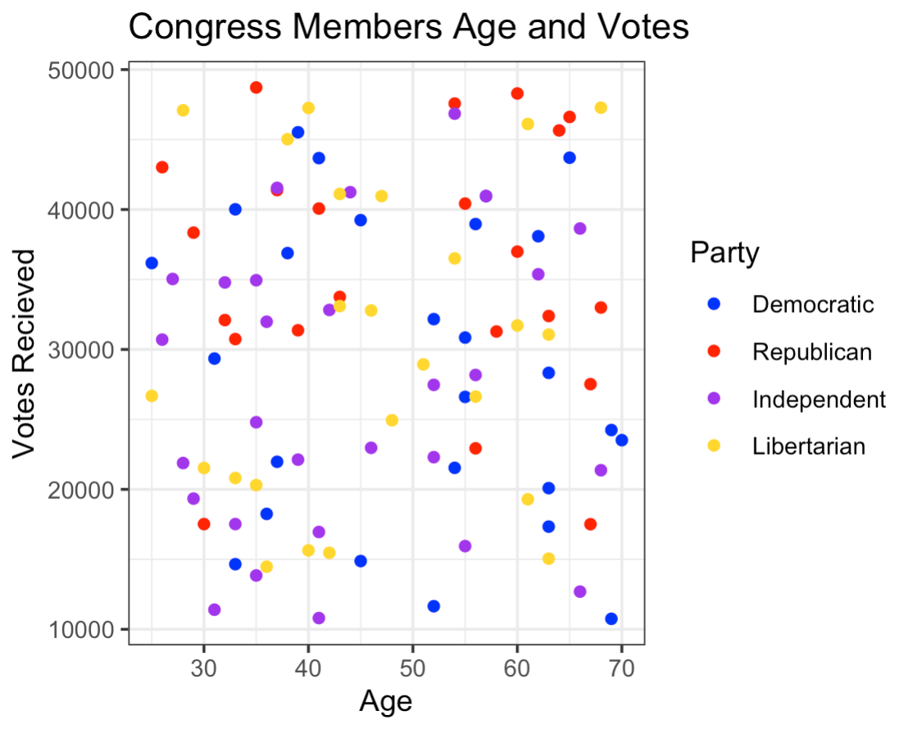
Adding a Title
Using the labs() argument you can also add a title to your plot.

Slide 31
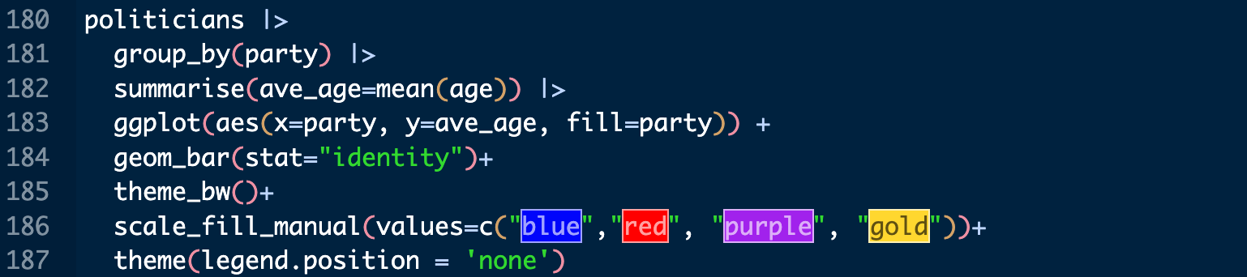
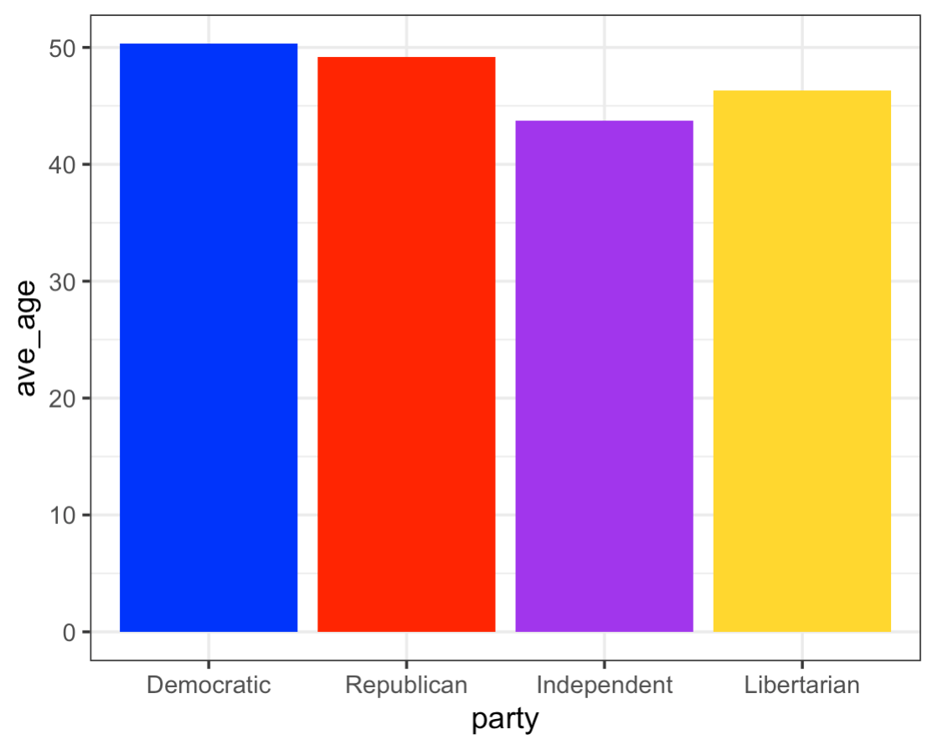
Removing the Legend
Using the legend.position= argument you can remove the legend.
You can also use this argument to move it to a different location.

Slide 32
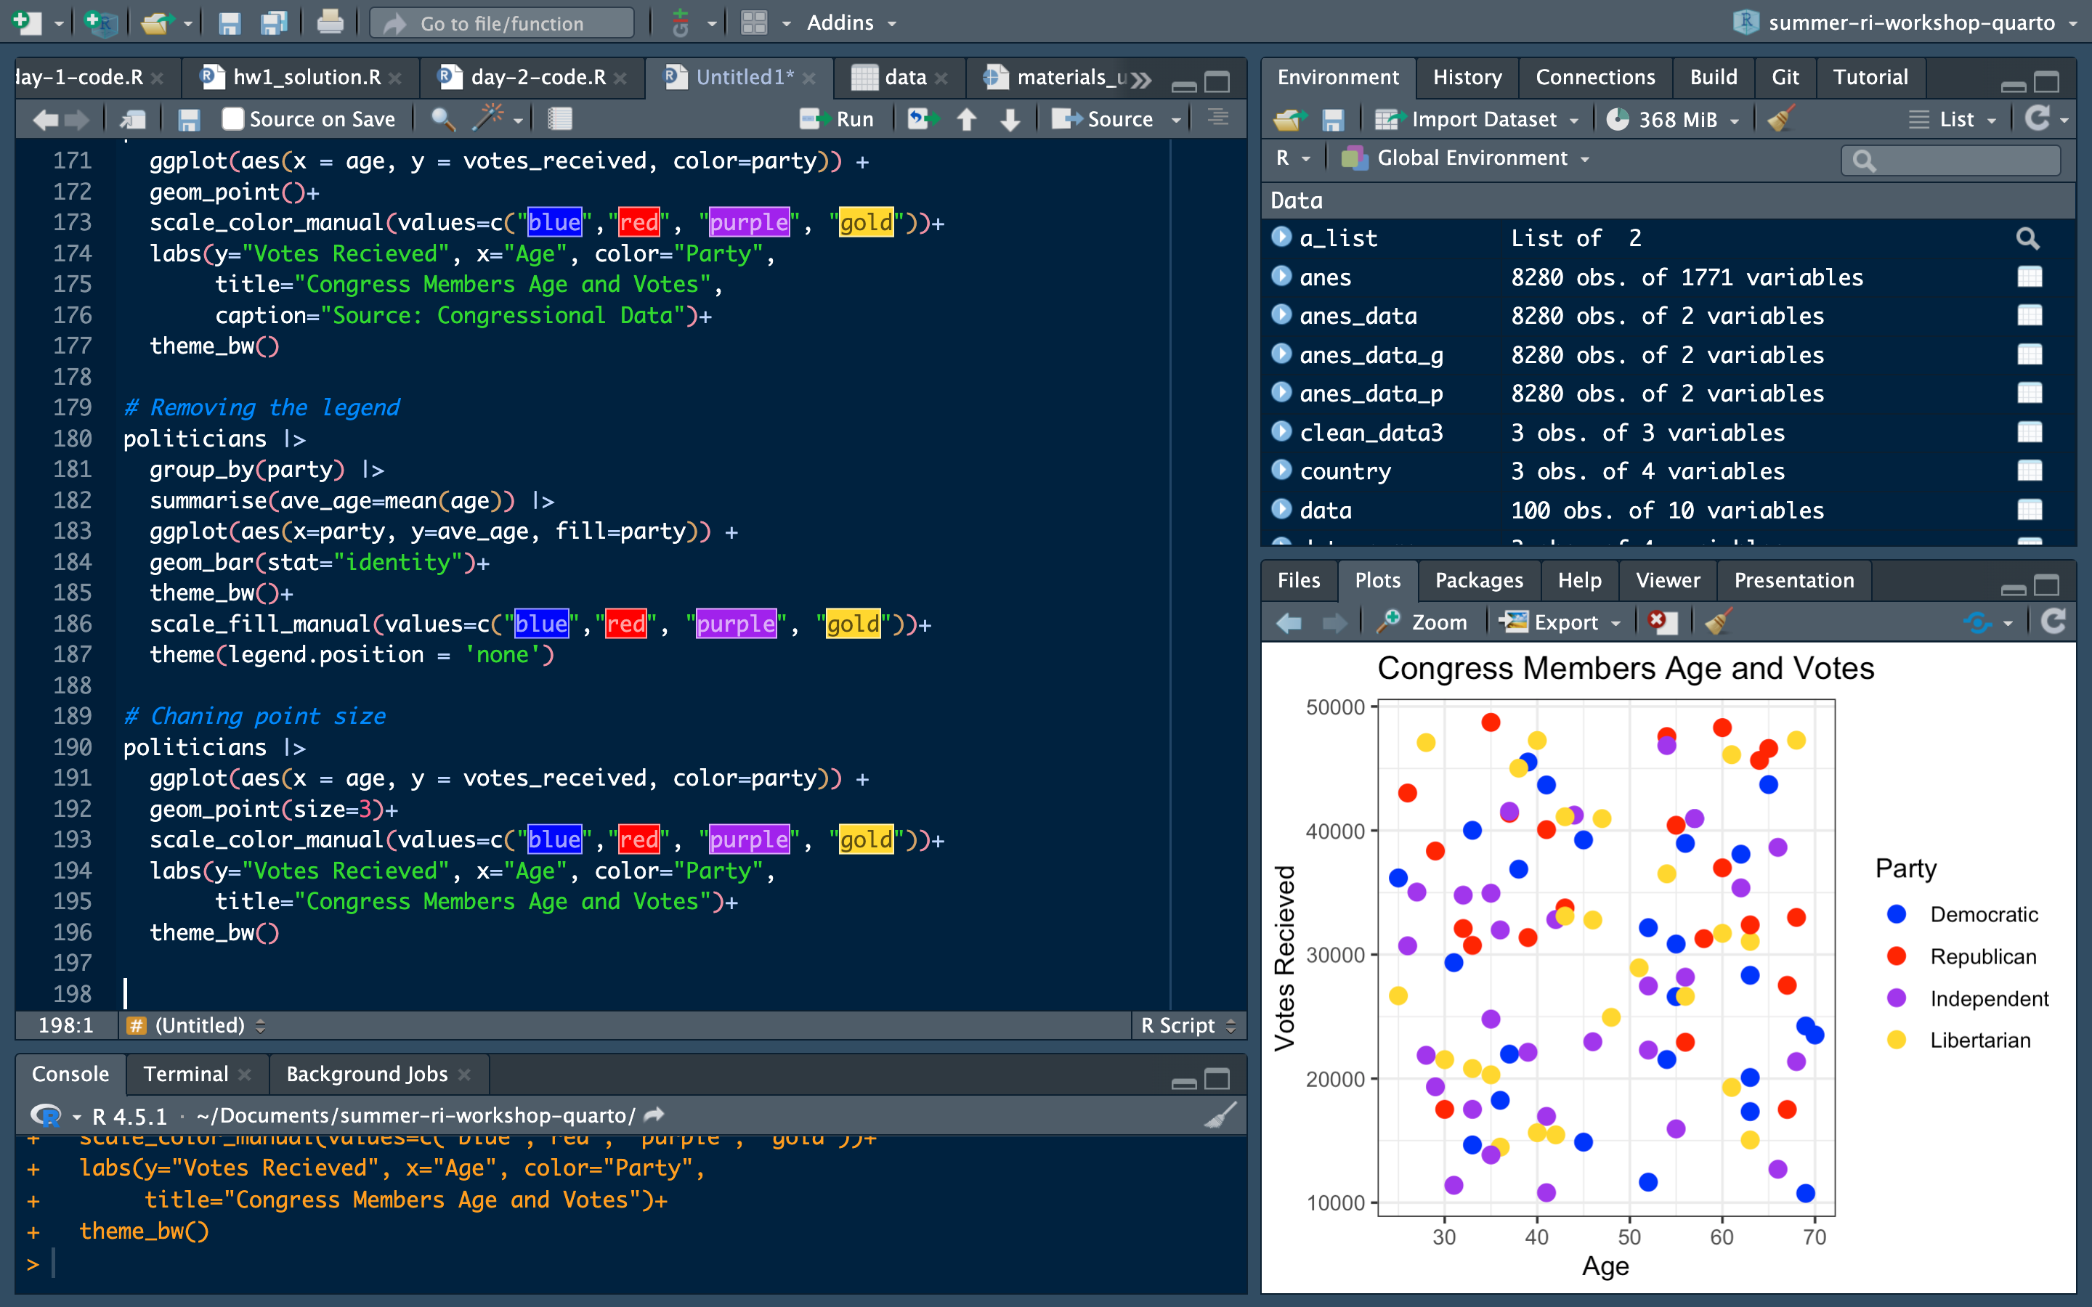
Changing Point Size
Using the size= argument to set the size of your points.
Generally, you would use this to shrink the size because the data you will use will have a lot of points.

Slide 33
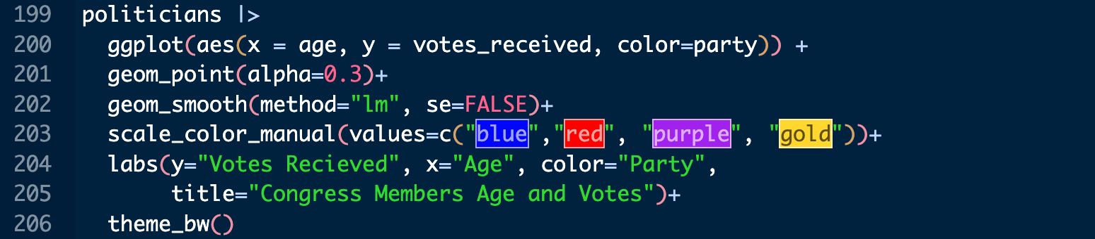
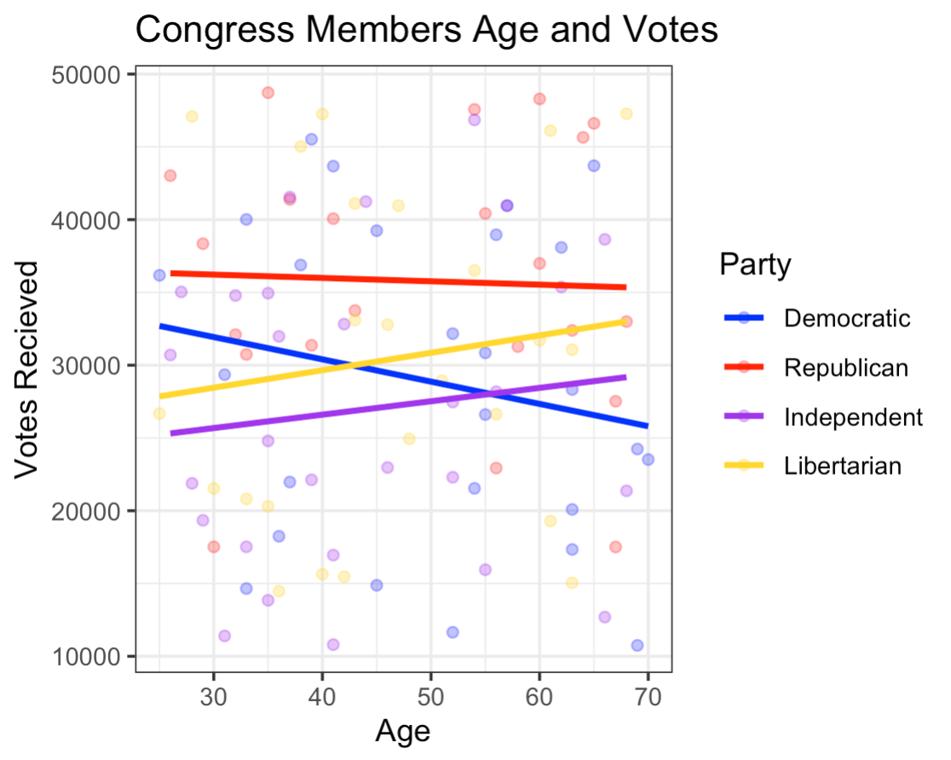
Changing Transparency of Points
When you have a lot of points, I prefer using the alpha= argument.
This makes your points more transparent.
It also allows you to add other things like lines that you want to stand out more but still allow for the visualization of your data.

Slide 34
Practice with ggplot
Using the politicians data, do the following:
Create a plot that visualizes a correlation between legislation passed and speeches given.
Make sure your plot has appropriately labeled x and y axes, a title.
Make all of the points “skyblue”.
Add a line to the plot.
Change the theme to theme_bw()

Slide 35
If Extra Time: Overleaf Introduction

