Slide 1
Getting RevEngE:
A System for Analyzing Reverse Engineering Behavior
Claire Taylor and Christian Collberg

Slide 2
Motivation
Consider a malware author Alice who wants to best obfuscate their malware
Consider a benevolent Bob who wants to reverse engineer the malware

Slide 3
Motivation
My malware has an asset I do not want Bob to have
I want to infect Bob’s machine with my malware
I can obtain this asset trivially
main() {
<asset>
}
<asset>

Slide 4
Motivation
How resilient are different types of obfuscation?
If I obfuscate the code, it is harder to reverse engineer
This asset is not trivial to obtain
What is the best strategy to reverse engineer <asset>’?
T( )
‘
main() {
<asset>
}

Slide 5
Introduction
Man-at-the-end attacks (MATE):
Reverse engineer code to obtain an ‘asset’
Crack code to bypass protections
Protecting against MATE
On modern commodity hardware: Code obfuscation
How code obfuscation works:
Transform T
T takes a program P and produces functionally identical program P’
P’ is harder for humans to reverse engineer and for algorithms to analyze and revert to P
T(P) = P’
Who uses obfuscation?
Commodity malware authors?
Advanced persistent threats

Slide 6
Related Work: Empirical Analysis
Human experiments
Limited number of subjects
Low quality subjects
Limited amount of data analyses to determine user behavior
Students
Training
Experiment
Quantitative
Results

Slide 7
Related Work: Empirical Analysis
Human experiments
Limited number of subjects
Low quality subjects
Limited amount of data analyses to determine user behavior
Red Team
Reverse Engineers
Observation
Qualitative
Results

Slide 8
Related Work: Algorithmic Analysis
Prove difficulty of obfuscation
It often assumes particular reverse engineering modalities
It often does not consider useful approximate solutions
It does not consider the human element
Transform
Reduce to
Hard Problem
Proof of
Difficulty

Slide 9
RevEngE
Crowdsources reverse engineering attacks on obfuscations
Analyzes the data to develop answers to Alice and Bob’s questions
1: Generate Program
2: Obfuscate Program
3: Reverse Engineer Program
4: Grade Solution
5: Analyze Data
Reverse Engineers
Best RE
Practices
RevEngE
Challenges
RevEngE
Analytics
Resilience
Metrics

Slide 10
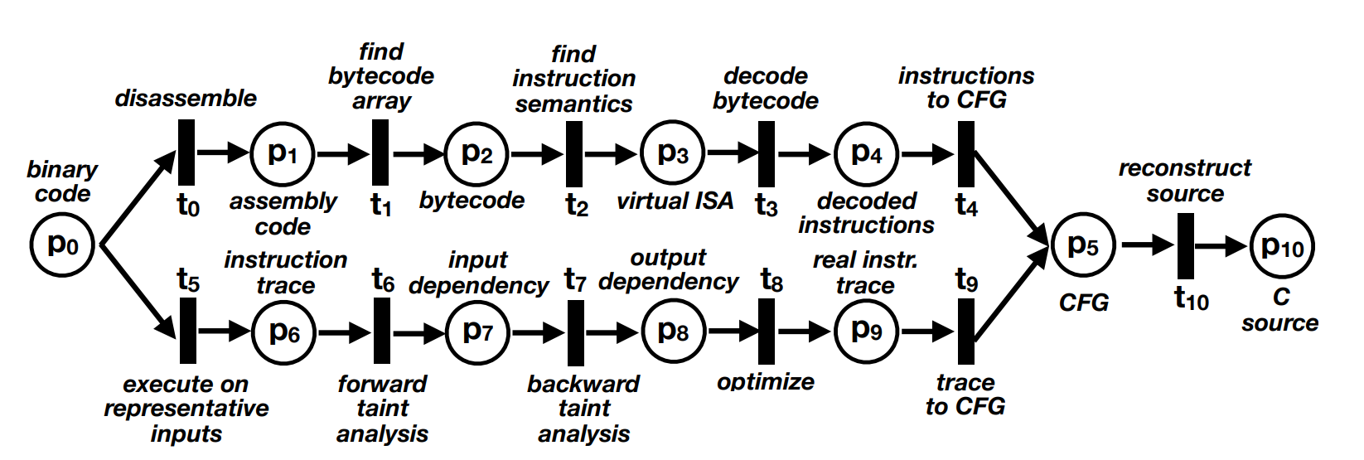
Deliverables: Petri Nets

Slide 11
Deliverables: Resilience Metrics
Transform | Description | Difficulty
Virtualize | Translates a function into virtual machine code that is interpreted at runtime. | ?
Jit | Translates a function into virtual machine code that is compiled to machine code at runtime. | ?
Dynamic Jit | Translates a function into binary code which is decoded and re-encoded at runtime. | ?
Flatten | Removes direct control flow from a function. | ?
Merge | Merges two functions into a single function. | ?
Split | Splits a function into two functions. | ?
AddOpaque | Adds bogus control flow to a function. | ?
EncodeData | Encodes variables so that their values are hidden at runtime. | ?
Anti Branch Analysis | Impedes branch analysis using, for example, branch functions. | ?
Anti Alias Analysis | Impedes alias analysis by adding indirect references. | ?
Anti Taint Analysis | Impedes dynamic taint analysis by copying variables using, for example, implicit flow. | ?

Slide 12
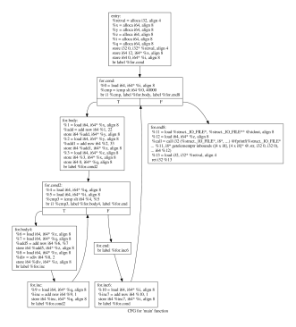
RevEngE: Step 1
Generate Program
Script
Asset
Tigress
Program
Generator
Program0.c
Seed

Slide 13
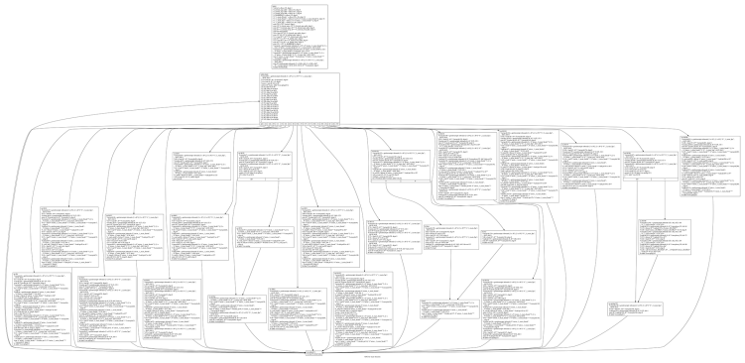
RevEngE: Step 2
Obfuscate Program
Script
Program0.c
Tigress
Program
Obfuscator
Program1.out
Seed

Slide 14
RevEngE: Step 3
Reverse Engineer Program
Reverse Engineers
User Interaction Data
Program1.out
Virtual Machine with Data Collection
Program3.c

Slide 15
RevEngE: Step 4
Grade Submission
Correctness: How functionally identical is Program3.c to Program0.c?
Precision: How deobfuscated is Program3.c?
Correctness
Program3.c
RevEngE Auto Grader
Precision

Slide 16
RevEngE: Step 5
Analyze Data
User Interaction Data
Visualizations
Correctness
RevEngE Database
Automated Analysis
Precision

Slide 17
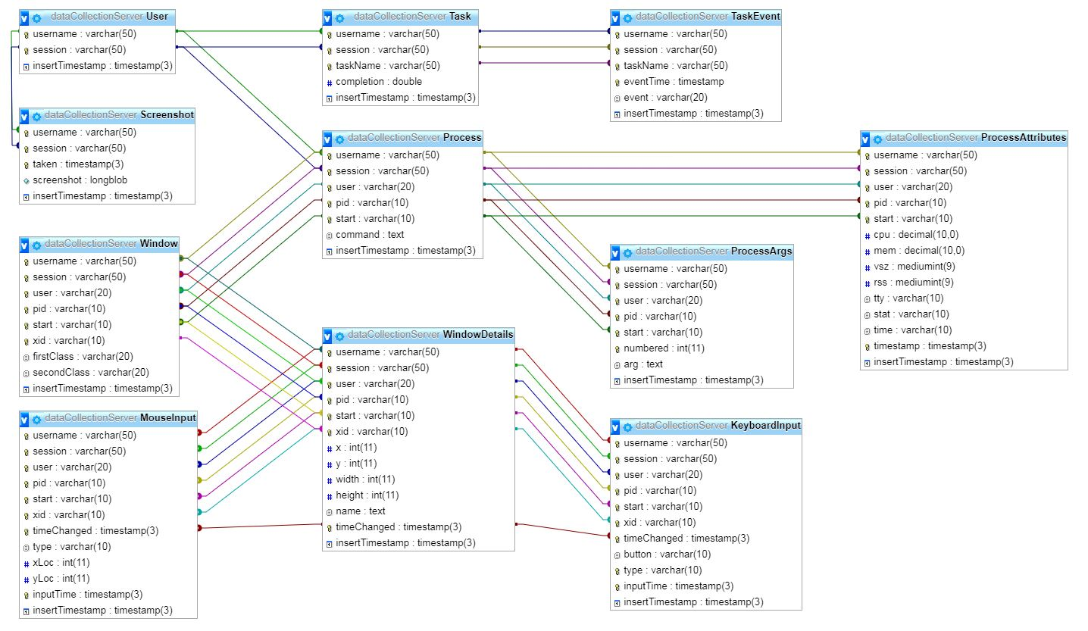
RevEngE Data Collection
User-device interaction data
In Focus Windows
Processes
Screenshots
IO
Mouse Clicks
Keystrokes

Slide 18
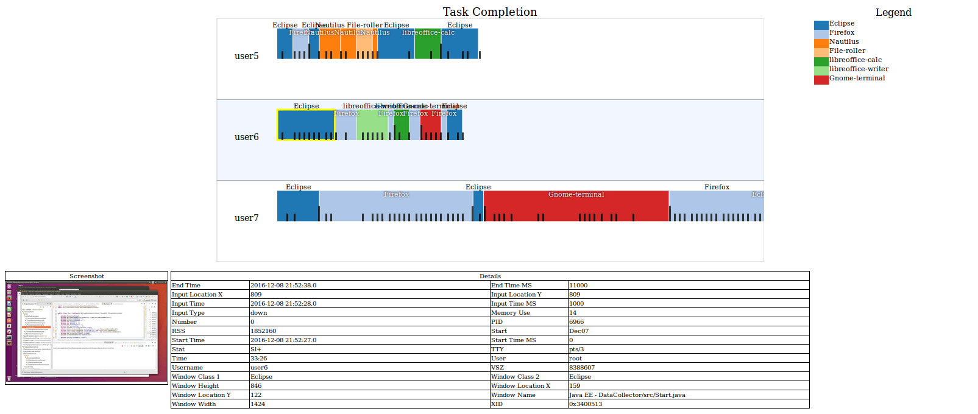
RevEngE Status
System is up and running with challenges
Data collection works
Initial visualization tool built

Slide 19
RevEngE Status
Lots of future work in data analysis
RevEngE is up and in beta testing
We have initial rewards of $500 per challenge in beta testing
We need subjects
Email lists
Posts on forums (such as Hacker News)
We could use your help! To participate:
revenge.cs.arizona.edu

Slide 20
Questions?

