Slide 1
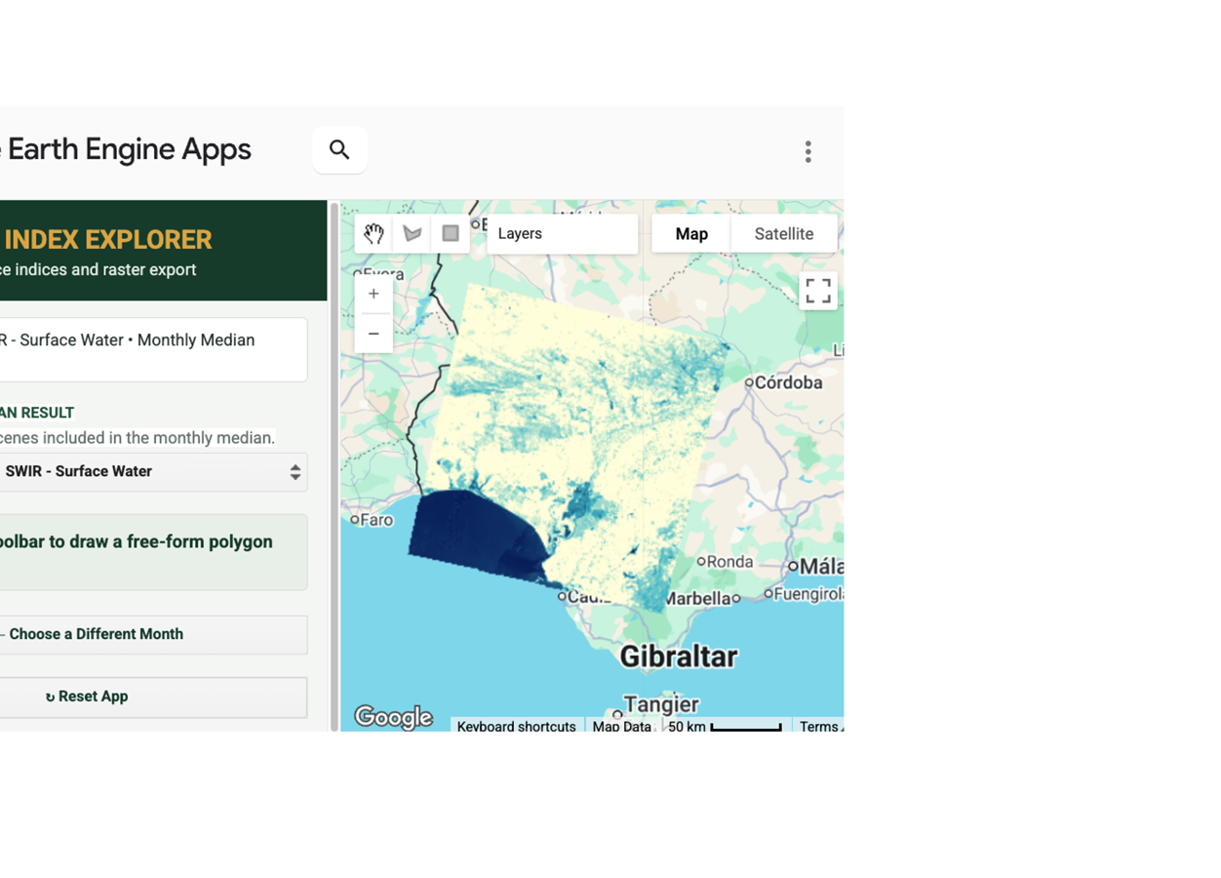
GOOGLE EARTH ENGINE APP
Satellite Index Explorer
Explore surface reflectance indices and export analysis-ready rasters
MULTI-SENSOR
Sentinel-2 and Landsat 7, 8 & 9 imagery
SEVEN INDICES
GPI, NDVI, EVI, NDWI, NDMI, SAVI and SWIR
FLEXIBLE COMPOSITES
Least-cloudy scenes or monthly median mosaics
READY TO USE
Interactive clipping and native-resolution GeoTIFF export
Example: Landsat 9 SWIR monthly median mosaic over southern Spain
Notes:
[Sources]
- User-provided Satellite Index Explorer screenshot.
- Project source: GEE_code/GPI Raster Export.js.

