Slide 1
HTML
XML syntax
<tag attr1="value1" attr2="value2">children</tag>
Creating structured documents
<!DOCTYPE html>
<html>
<head></head>
<body>
<div>A block of content</div>
<div id="myBlock">Another block of content</div>
<!-- This is a comment -->
<button>A button</button>
<ul>
<li class="myListElem">List element</li>
<li class="myListElem">Other list element</li>
</ul>
</body>
</html>

Slide 2
CSS
Applying style to a structured document
selector {
attr1: value1;
attr2: value2;
}
Example with previous document
/* Select by tag name */
button {
background-color: orange;
}
/* Select by class */
.myListElem {
color: red;
}
/* Select by id */
#myBlock {
border: 1px solid blue;
}

Slide 3
JavaScript
Scripting language for the web
var aNumber = 123
var aString = 'blah'
var anArray = [1, 'blah', 2]
var anObject = { key1: 'value1', key2: 2 }
// A comment
/* Another comment */
function aFunction() {
console.log('hello!')
}
// One way to iterate over an array
anArray.forEach(function(elem) {
console.log(elem)
})
// if/else
if (anArray.length == 3) {
console.log('happy')
} else {
console.log('sad')
}

Slide 4
JavaScript
JavaScript is asynchronous, everything works with callbacks
console.log('starting')
asyncCall(function done() {
console.log('nope!')
})
console.log('after asyncCall ?')
Web APIs : examples : DOM, WebSocket, Web Audio, ...
https://developer.mozilla.org/en-US/docs/Web/API
Node.js, for scripting server applications in JavaScript.

Slide 5
JavaScript + CSS + HTML
<!DOCTYPE html>
<html>
<head>
<style>
.blink1 {
background-color: red;
}
.blink2 {
background-color: blue;
}
</style>
</head>
<body>
<div id="blinky" class="blink1">BLINK!</div>
<script>
var blinky = document.getElementById('blinky')
var counter = 0
setInterval(function() {
counter = (counter + 1) % 2
blinky.className = 'blink' + (1 + counter)
}, 150)
</script>
</body>
</html>

Slide 6
JavaScript + CSS + HTML
<!DOCTYPE html>
<html>
<head>
<style>
.blink1 {
background-color: red;
}
.blink2 {
background-color: blue;
}
</style>
<!-- Importing a JavaScript module -->
<script src="https://code.jquery.com/jquery-3.2.1.min.js"></script>
</head>
<body>
<div id="blinky" class="blink1">BLINK!</div>
<script>
setInterval(function() {
$('#blinky').toggleClass('blink1').toggleClass('blink2')
}, 150)
</script>
</body>
</html>

Slide 7
Future of JS
WebAssembly : compile C/C++ code to run in the browser

Slide 8
WebSocket
W3C standard for full-duplex communication
Send string or binary data
Implementation available in all major programming languages
Implementation available in all modern web browsers

Slide 9
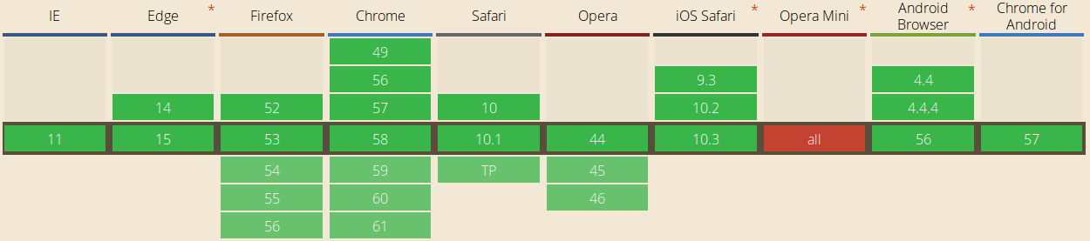
WebSocket
Browser support
Source : http://caniuse.com/#feat=websockets accessed 2017-05-10

Slide 10
WebSocket
Code sample (client)
var ws = new WebSocket('ws://localhost:8080')
ws.onopen = function() {
console.log('open!')
ws.send('GREETINGS!')
}
ws.onmessage = function(message) {
console.log('received: ' + message.data)
}
See full example client/server in examples/WebSocket

Slide 11
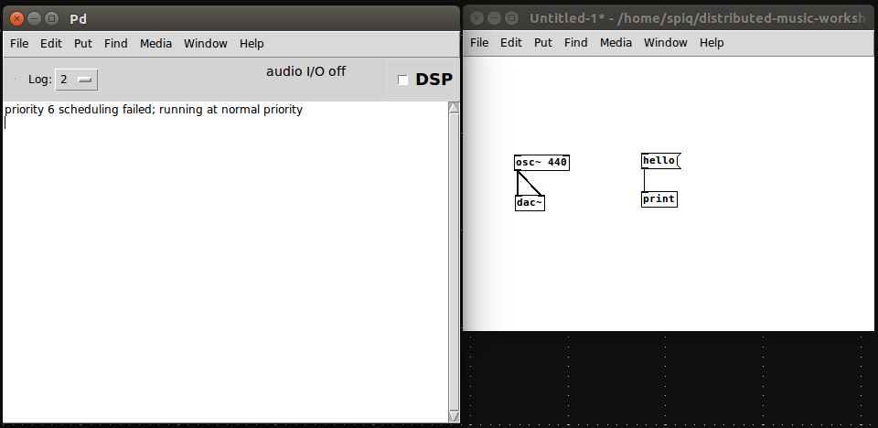
Pure Data
Open-source graphical programming language for audio/visuals
main window
patch window
DSP object
message

Slide 12
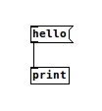


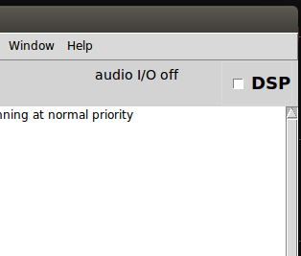
Pure Data
Edit mode / Interact mode , ctrl+e to switch from one to the other
DSP on / off , if you can't hear sound, check that DSP is on.

Slide 13
OSC
Open Sound Control, communication protocol
Types : str, number, array, etc ...
Widely supported : SuperCollider, Pure Data, Processing, ...
See Pure Data example in examples/OSC

Slide 14
Web Audio API
W3C specification draft for audio synthesis
https://webaudio.github.io/web-audio-api/
DSP graph of interconnected nodes
Limited set of native nodes
OscillatorNode, BiquadFilterNode, ...
Possibility to write custom DSP in JavaScript
ScriptProcessorNode, AudioWorkletNode

Slide 15
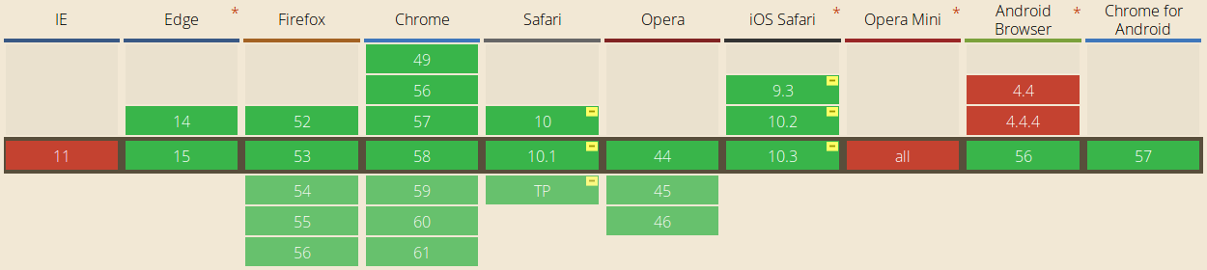
Web Audio API
Browser support
Source : http://caniuse.com/#feat=audio-api accessed 2017-05-10

Slide 16
Web Audio API
Native nodes, code sample
var audioContext = new AudioContext()
var osc = audioContext.createOscillator()
osc.connect(audioContext.destination)
osc.frequency.value = 220
osc.start(0)

Slide 17
Web Audio API
Custom DSP, code sample
var audioContext = new AudioContext()
var osc = audioContext.createScriptProcessor(4096, 1, 1)
var phase = 0
var K = 220 * 2 * Math.PI / audioContext.sampleRate
osc.onaudioprocess = function(event) {
var outBlock = event.outputBuffer.getChannelData(0)
var length = outBlock.length, i = 0
for (i = 0; i < length; i++) {
phase += K
outBlock[i] = Math.cos(phase)
}
}
osc.connect(audioContext.destination)

Slide 18
Web Audio API
A pain to work with
Limited set of nodes
Specification changing all the time
Bugs in implementations
{ Hope }
AudioWorkletNode + WebAssembly

