Slide 1
Term Project: DSC530-T303 Data Exploration and Analysis (2247-1)
Taylor Duncan

Slide 2
Overall Hypothesis
Hypothesis: Higher Track Scores are associated with higher Spotify Popularity.

Slide 3
Variables Used During Analysis
GitHub: https://github.com/taylorduncan/DSC530.git
1. Track Score: Likely a numerical value indicating the overall score or ranking of the track based on certain criteria (e.g., popularity, user ratings).
2. Spotify Popularity: A numerical score representing how popular the track is on Spotify, possibly on a scale from 0 to 100.
3. Apple Music Playlist Count: The number of playlists that feature the track on Apple Music.
4. Deezer Playlist Count: The number of playlists that feature the track on Deezer.
5. Amazon Playlist Count: The number of playlists that feature the track on Amazon Music.
6. TIDAL Popularity: A numerical score representing the track’s popularity on TIDAL, similar to Spotify Popularity.

Slide 4
Histograms and Outliers:
Identify outliers in the histograms. Outliers might be extreme values that fall far from the main cluster.

Slide 5
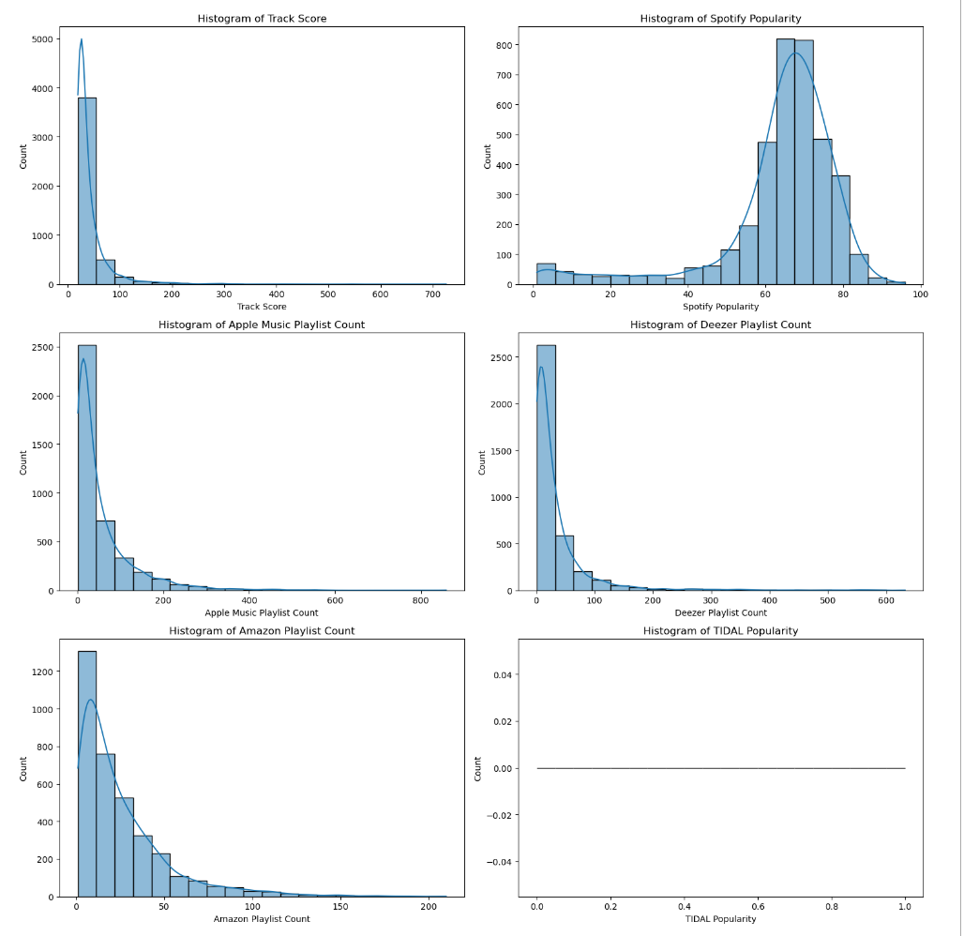

Slide 6
Descriptive Statistics:
Summarize mean, mode, spread, skewness, and kurtosis for each variable. This provides insight into the central tendency, variability, and distribution shape.

Slide 7
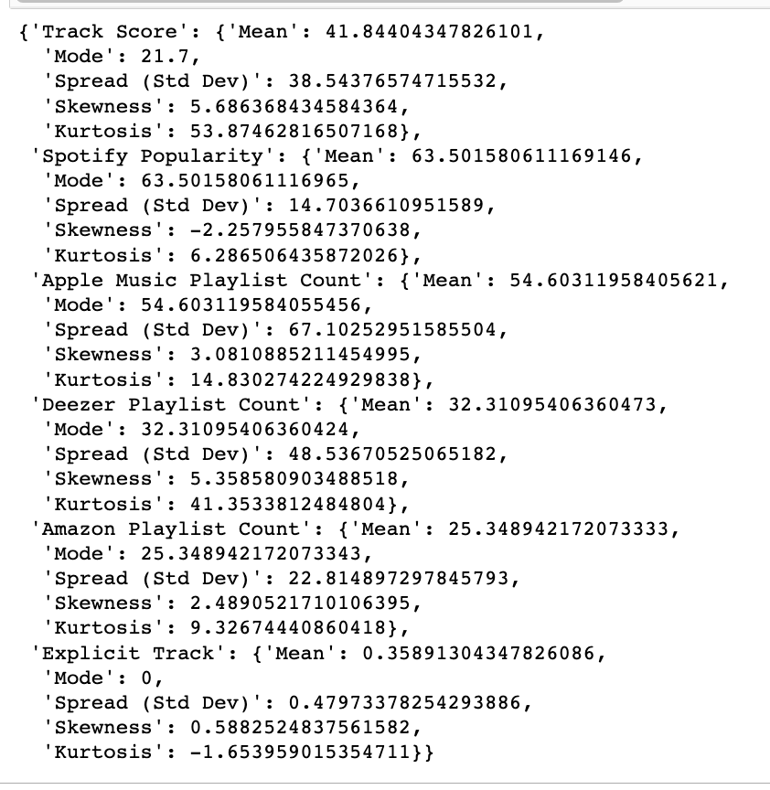

Slide 8
PMF: Compare the PMF to observe how different scenarios affect the distribution.
Compare the PMF to observe how different scenarios affect the distribution.

Slide 9
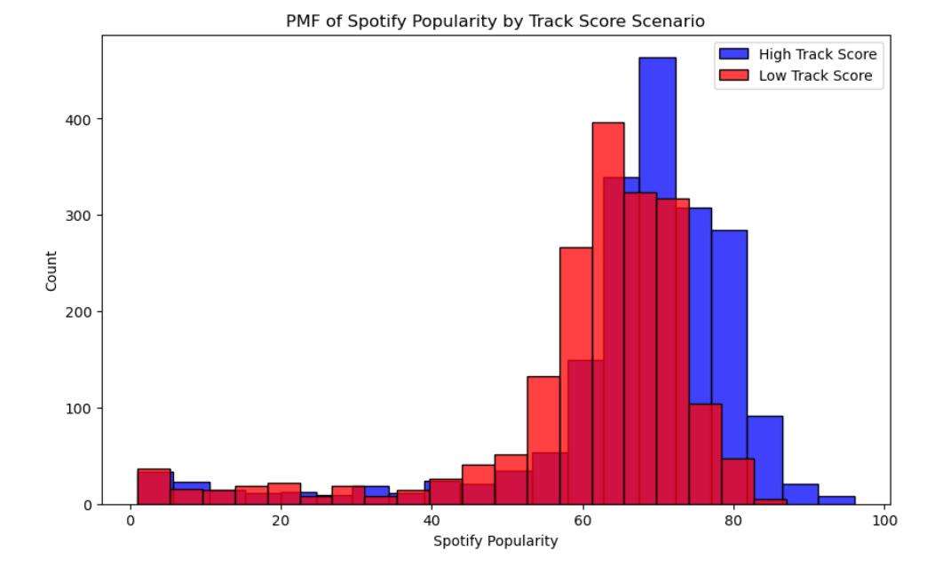

Slide 10
CDF: The CDF shows the cumulative proportion of tracks below a certain Spotify Popularity score.
The CDF shows the cumulative proportion of tracks below a certain Spotify Popularity score.

Slide 11
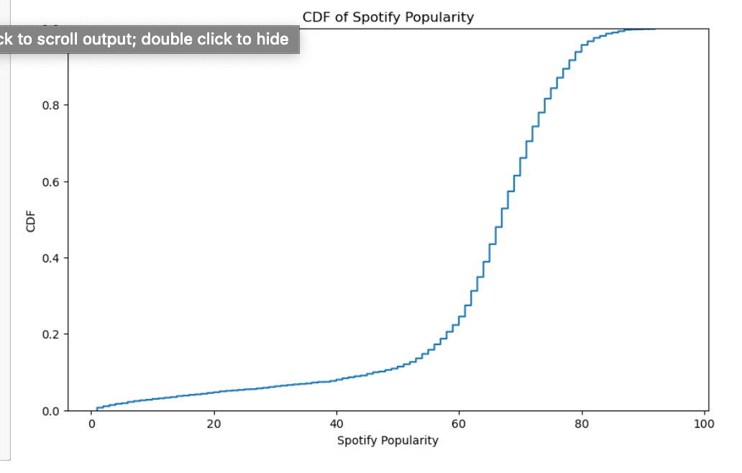

Slide 12
Analytical Distribution:
Analyze how well the data fits the normal distribution.

Slide 13
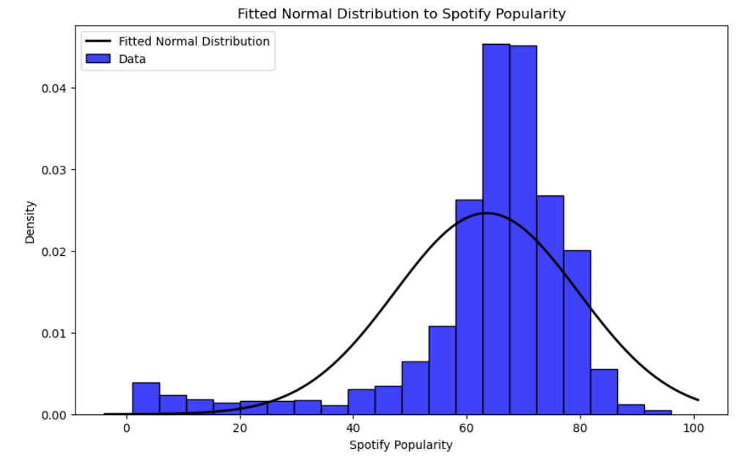

Slide 14
Scatter Plots and Correlation:
Use scatter plots and correlation metrics to explore relationships between variables and assess whether correlations indicate causation or mere association.

Slide 15
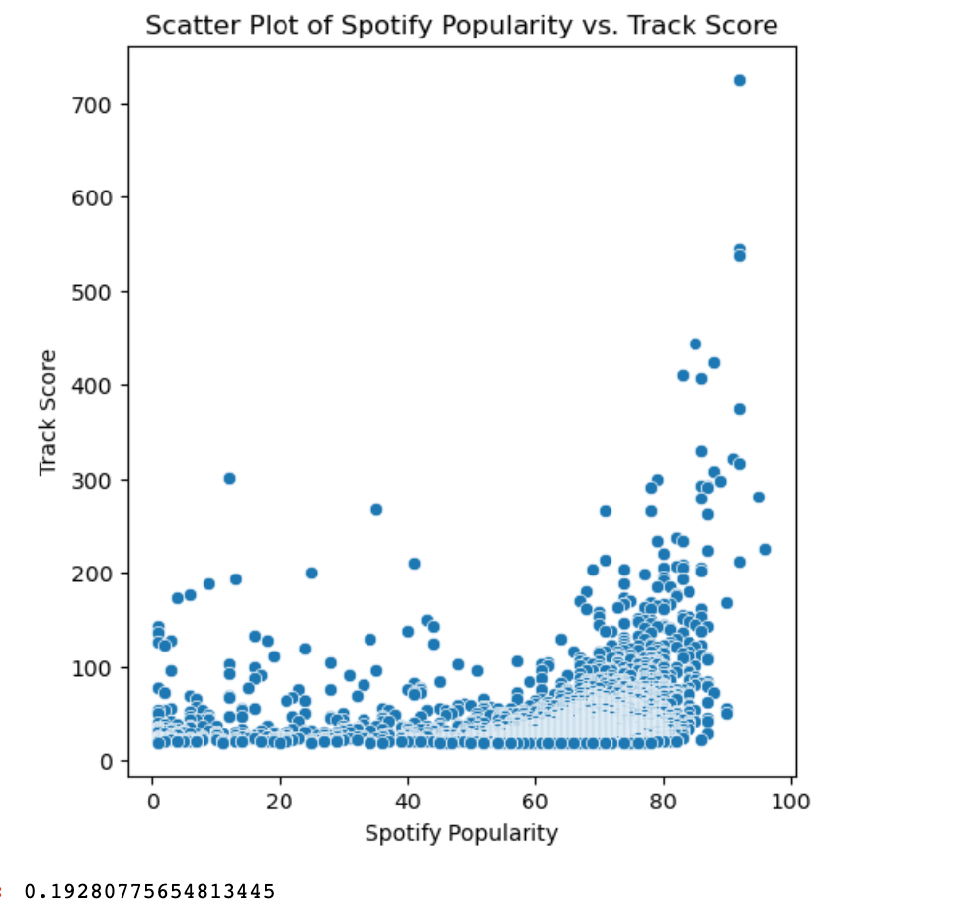

Slide 16
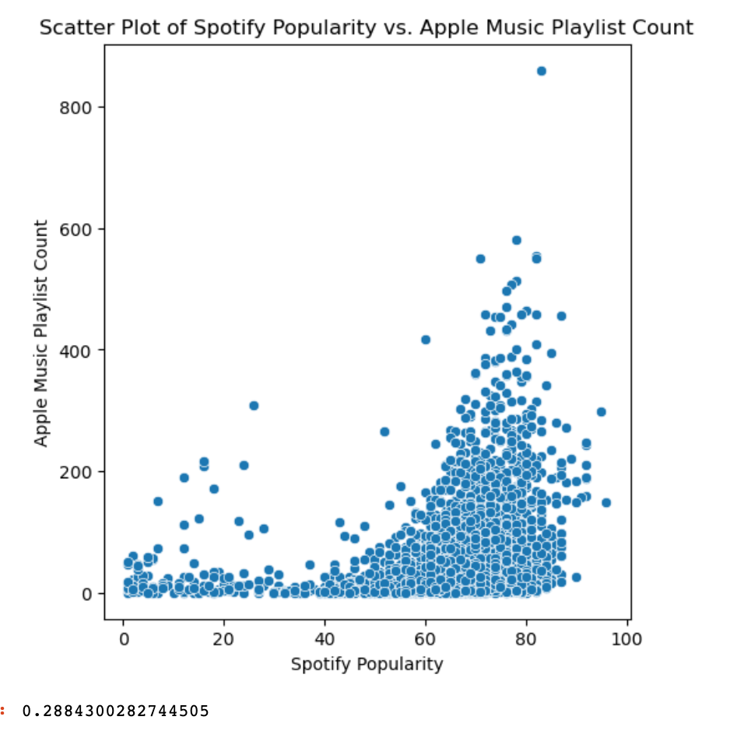

Slide 17
Hypothesis Testing:
Test hypotheses related to the variables to validate assumptions or claims.

Slide 18
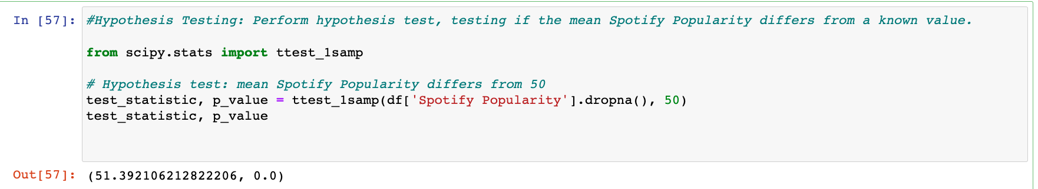

Slide 19
Regression Analysis:
Examine how well your explanatory variables predict the dependent variable and the model's performance.

Slide 20
