Slide 1
CORTEGE
AI Security Companions for Every Household
Taylor Parsons · Rich Rosenthal · Jennifer McKinney · March 2026 AI Agents Hackathon
github.com/taylorparsons/cortege-hackathon

Slide 2
The Problem
$64B
lost to scams in the US in 2025
"Grandma, it's me — I'm in trouble and I need money right now."
77% of Americans encounter scams daily. 7 in 10 were scammed last year.
Only 44% recover any money. One call. Life savings gone.
Fraud filters catch known patterns. They don't know your family.
Source: State of Scams USA 2025 — GASA / Iris Powered by Generali

Slide 3
The Solution
Every household member gets a dedicated AI companion
that learns their patterns and silently protects them.
🛡️
⚔️
🔭
ANCHOR
SENTINEL
SCOUT
Senior Protection Patience-first, scam interception, trusted contact verification
Adult Protection Primary coordinator, household orchestration, threat relay
Teen Protection Age-appropriate, social engineering defense
Not a chatbot. Not a filter. A companion that knows you.

Slide 4
How It Learns
Each companion deepens its understanding over time
Baseline
›
Pattern Recognition
›
Predictive
›
Cortege Mode
Day 1 — it listens.
Week 1 — it recognizes who usually calls.
Week 2 — it blocks the scam before Grandma picks up.
L0 Log
L1 Low
L2 Monitor
L3 Notify
L4 Block + Alert
5-tier escalation: from silent logging to hard-blocking the call and alerting the family

Slide 5
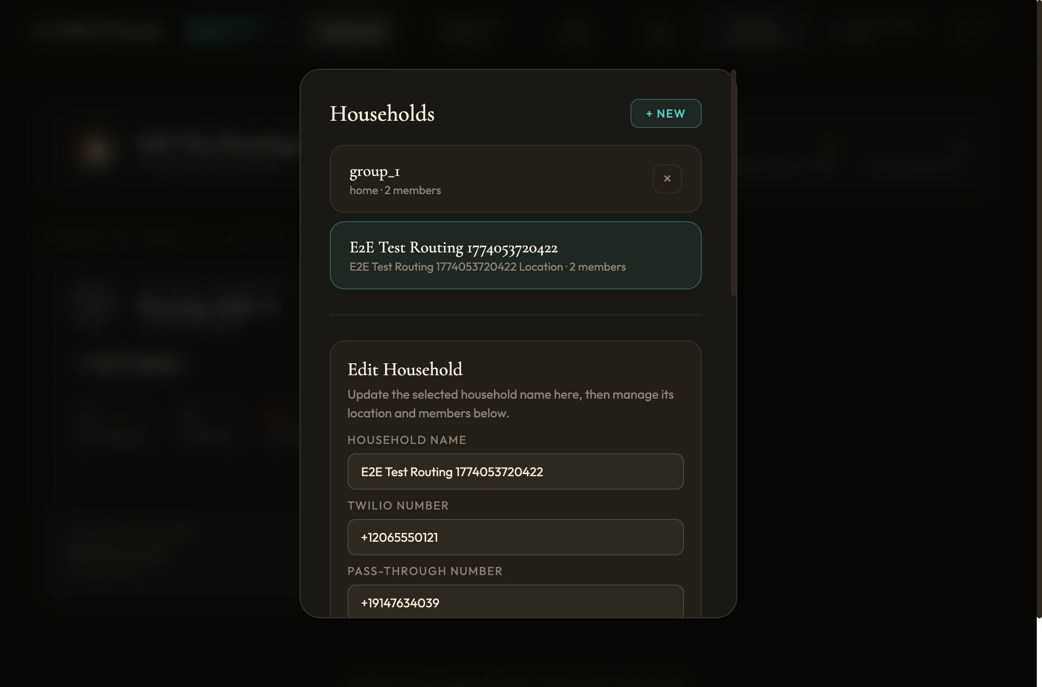
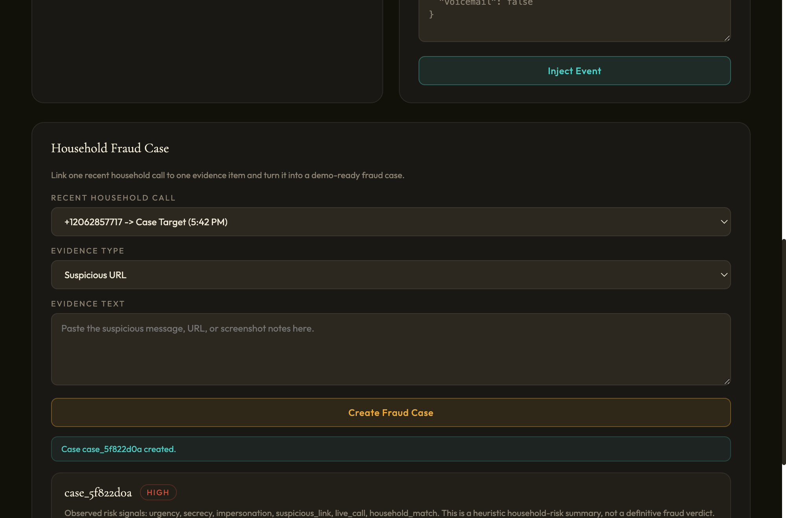
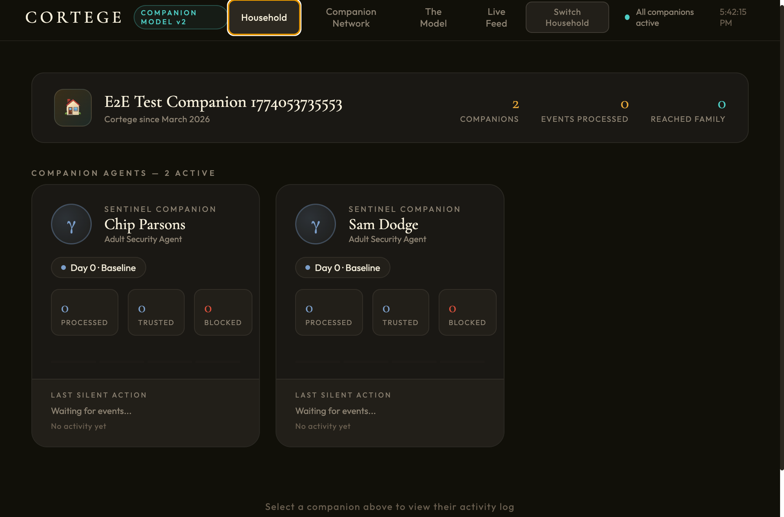
Live Product
Household Editor + Twilio Routing
Fraud Case Creation
Companion Status Dashboard

Slide 6
Platform, Not Just an App
Agent templates are Markdown + YAML. Create a new agent type in minutes.
Twilio Webhook
Manual API
Scenario Simulator
▼
Event Bus → Orchestrator → Agent Instances
▼
Claude API Haiku 4.5 + caching
Memory Store per-instance depth
Escalation Engine L0–L4 routing
▼
SQLite · Append-only event log · SHA-256 hash chain · PII encryption at rest
Multi-household orchestration · WebSocket real-time push · Hot-reload agent templates

Slide 7
This Isn't a Demo — It's Infrastructure
🔒 PII encryption at rest
🔗 Append-only SHA-256 hash chain
🚨 L0–L4 escalation tiers
✅ 174 passing tests
💰 64% cost reduction via prompt caching
📞 Twilio voice webhook integration
🏠 Multi-household data isolation
📝 Tamper-evident audit log
Solo developer · One week · Full-stack agent orchestration system

Slide 8
The Business
130M
$64B
3→N
US households
annual scam losses
agent types scale
Start: Elder care + family safety
Expand: Any per-person behavioral agent
Health monitoring · Financial guardianship · Education
Moat: Behavioral depth compounds over time
The longer a companion runs, the harder it is to replace
github.com/taylorparsons/cortege-hackathon · Taylor Parsons · Rich Rosenthal · Jennifer McKinney

