Slide 1
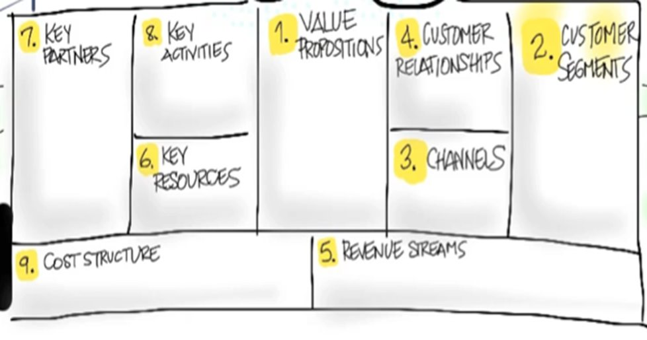
Saehwan Park, Taylor Davis, Asher Bordelon, Nasser Mohammed
Website updating, promotion, Securing a merchant account
It can satisfy the needs of those who need to buy books and those who need to sell them at the beginning of the semester.
Schools or Community Colleges.
Chamber of Commerce.
Seek feedback and show you genuinely care
We can broadly divide into customers who need to sell books and customers who need to buy books, and also by region.
sending an email or contacting by phone to support team.
Computers for application development and server maintenance, each customer's mobile phone and computer
Book transfer and handling costs covered by colleges, or by students in the standalone version
Primarily partnered colleges, secondarily student book fees

