Slide 1
PRELIMINARY SPECIFICATIONS

Slide 2
Specification: Abstract
Design of the 6x6x4 tic-tac-toe game using C#: convenient graphic utilities, increased performance, and legibility
Three main classes: GUI, human player, and artificial intelligence (AI)
Three levels of difficulty
AI based on min and max statistical data to determine selection of winning moves
Each player can register with his or her name
The winning history of register players can be viewed

Slide 3
Boundary class:
GUI
__________________________
Attributes:
Buttons, dropdown, textbook, checkbox, etc.
__________________________
Responsibilities:
-Communication between the user (player) and controller
Specifications:
Classes Diagram
Control class:
Controller
__________________________
Attributes: none
__________________________
Responsibilities:
Interface btw boundary and entity
Get info from HumPlayer and CompPlayer class
Start game
End game
Determine winner
Entity class:
HumanPlayer
__________________________
Attributes:
- Name
- Wins
- Losses
- Win ratio
__________________________
Responsibilities:
- Create player
- Record game statistics
Entity class:
ComputerPlayer
__________________________
Attributes:
- Difficulty level
__________________________
Responsibilities:
- Predict next move using MinMax algorithm

Slide 4
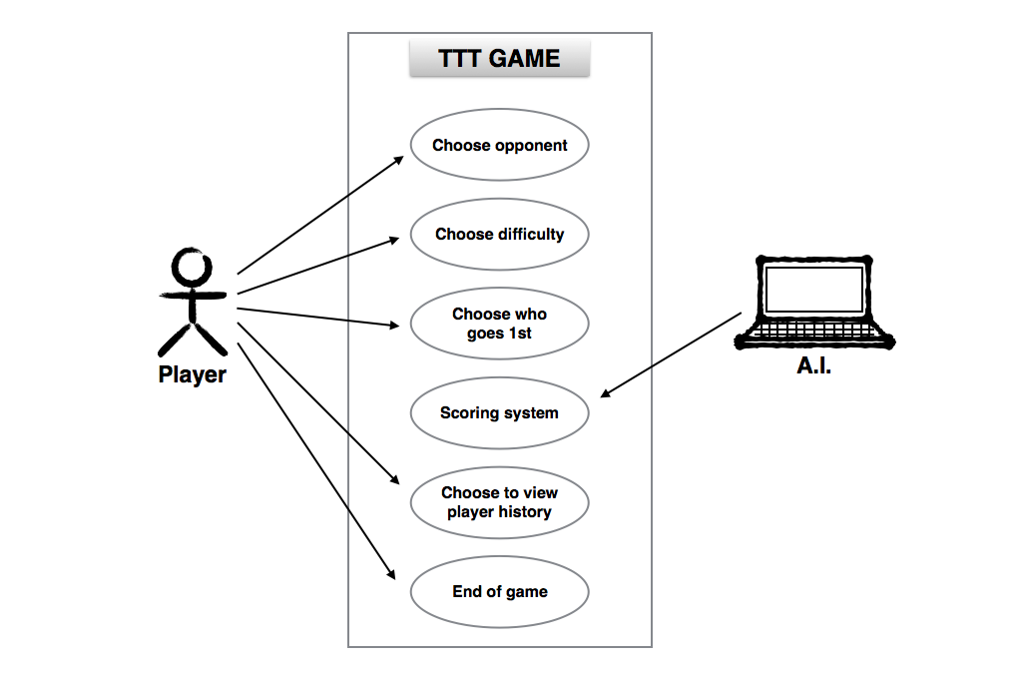
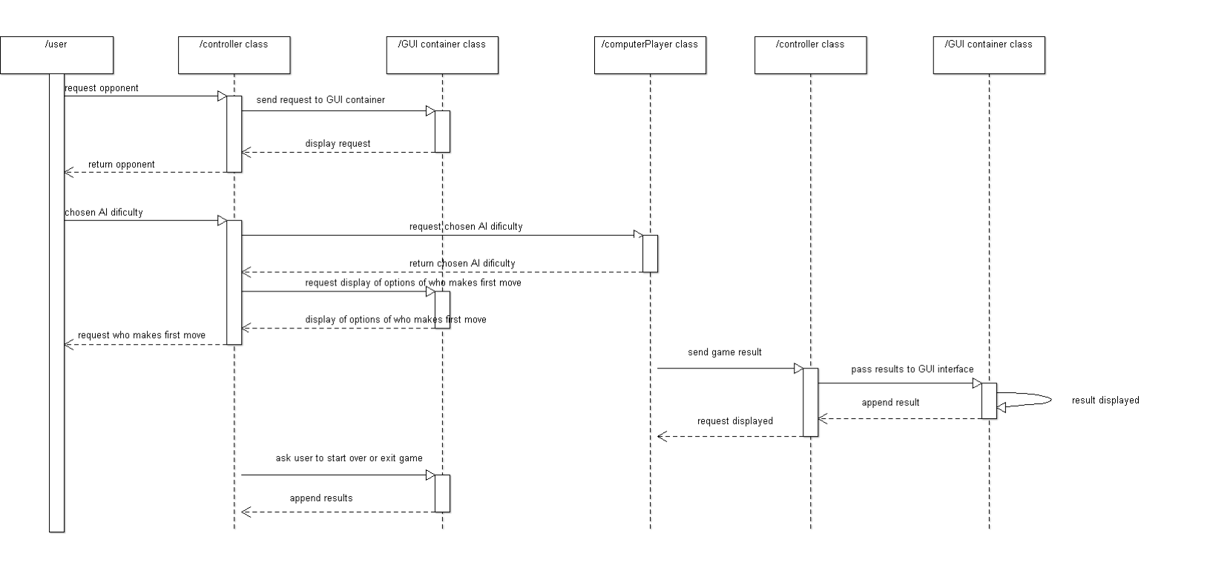
Specification:
Use case 1
Use Case Diagram
Use Case 1:
Figure 1a. Use Case Diagram for TTT Players
Description: Player can choose to opponent (human or computer), choose difficulty (easy, medium, or hard), choose who goes first, choose to restart or end game, and view player history as an option.
Figure 1b. Sequence Diagram for TTT Players

Slide 5
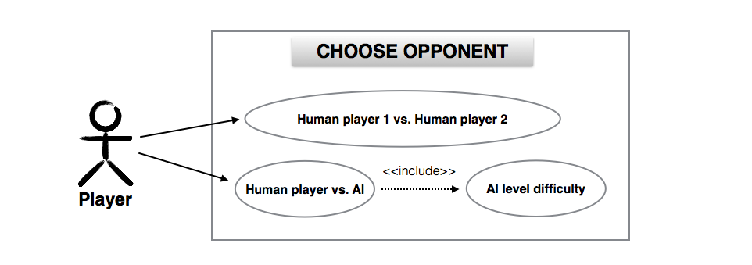
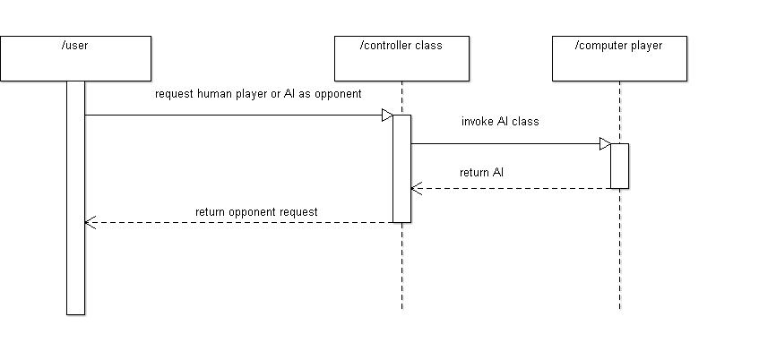
Specification:
Use case 2

Slide 6
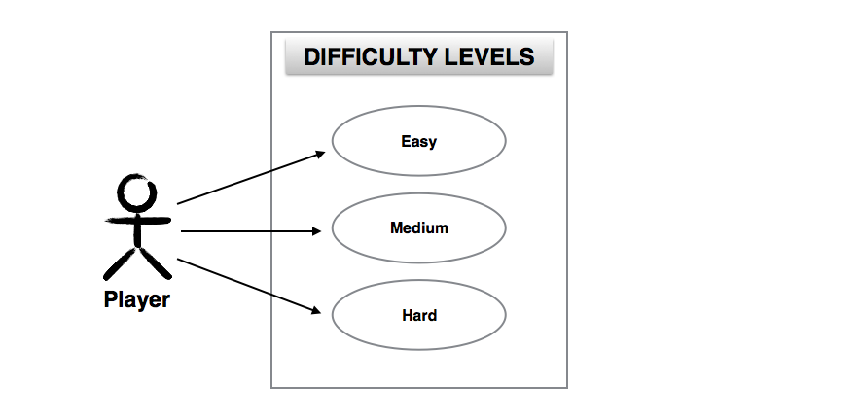
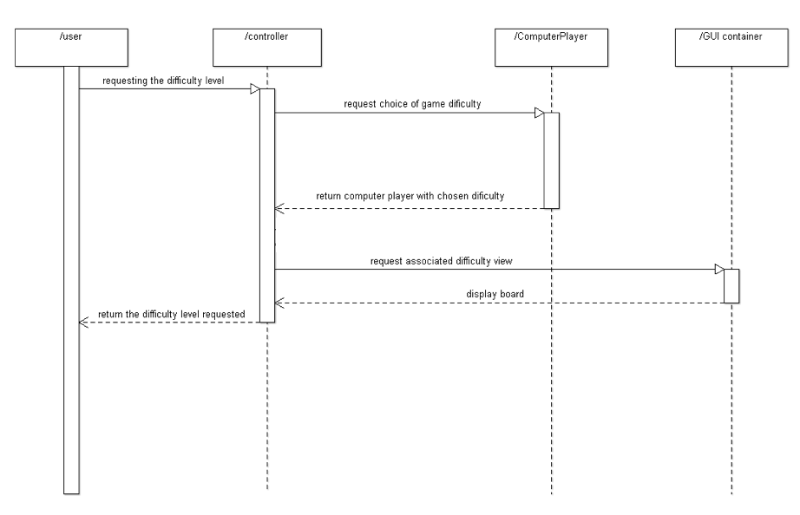
Specification:
Use case 3

Slide 7

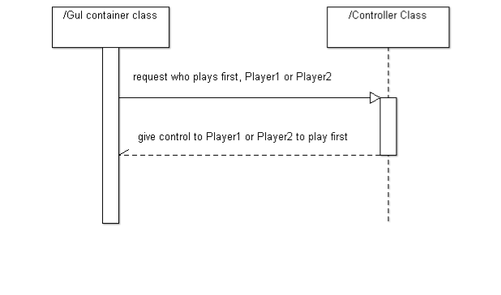
Specification:
Use case 4

Slide 8
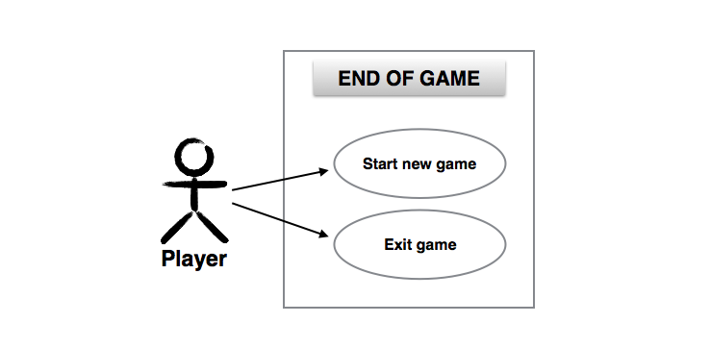
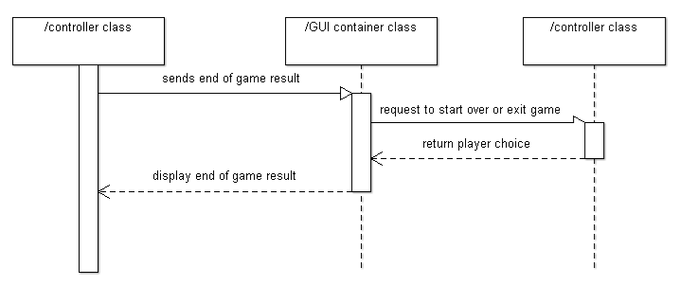
Specification:
Use case 5

Slide 9
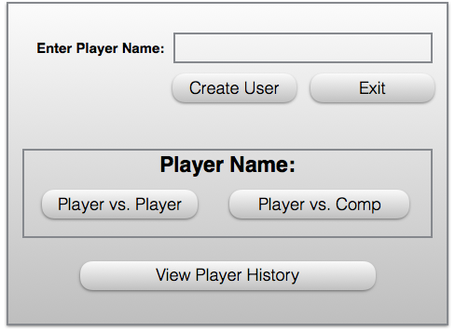
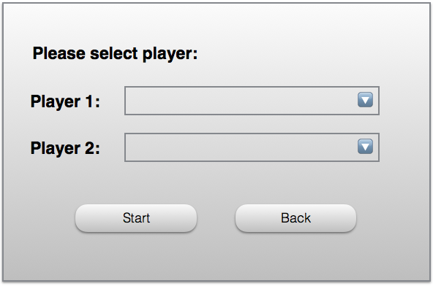
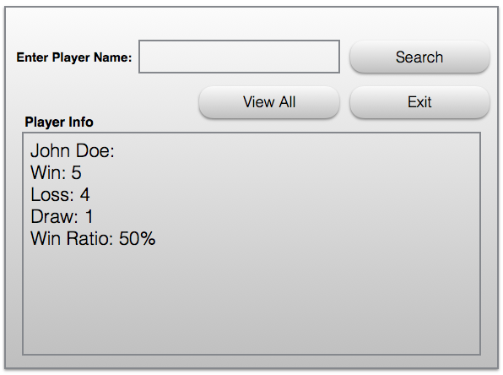
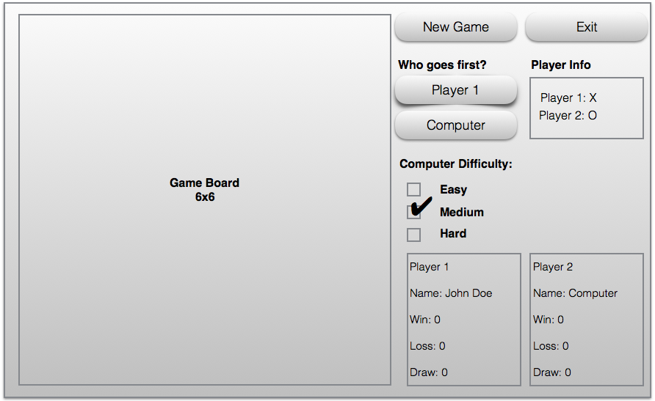
Specification: User Interface

