Slide 2
Requirements

Slide 3
Functional Requirement
Use Cases
Create new player
Game mode selection
Single player mode
Difficulty Level
Exit the game

Slide 4
Non functional Requirement
Cost constraint
Reliability
Time Constraints

Slide 5
PRELIMINARY SPECIFICATIONS

Slide 6
Specification: Abstract
Design of the 6x6x4 tic-tac-toe game using C#: convenient graphic utilities, increased performance, and legibility
Three main classes: GUI, human player, and artificial intelligence (AI)
Three levels of difficulty
AI based on min and max statistical data to determine selection of winning moves
Each player can register with his or her name
The winning history of register players can be viewed

Slide 7
Boundary class:
GUI
__________________________
Attributes:
Buttons, dropdown, textbook, checkbox, etc.
__________________________
Responsibilities:
-Communication between the user (player) and controller
Specifications:
Classes Diagram
Control class:
Controller
__________________________
Attributes: none
__________________________
Responsibilities:
Interface btw boundary and entity
Get info from HumPlayer and CompPlayer class
Start game
End game
Determine winner
Entity class:
HumanPlayer
__________________________
Attributes:
- Name
- Wins
- Losses
- Win ratio
__________________________
Responsibilities:
- Create player
- Record game statistics
Entity class:
ComputerPlayer
__________________________
Attributes:
- Difficulty level
__________________________
Responsibilities:
- Predict next move using MinMax algorithm

Slide 8
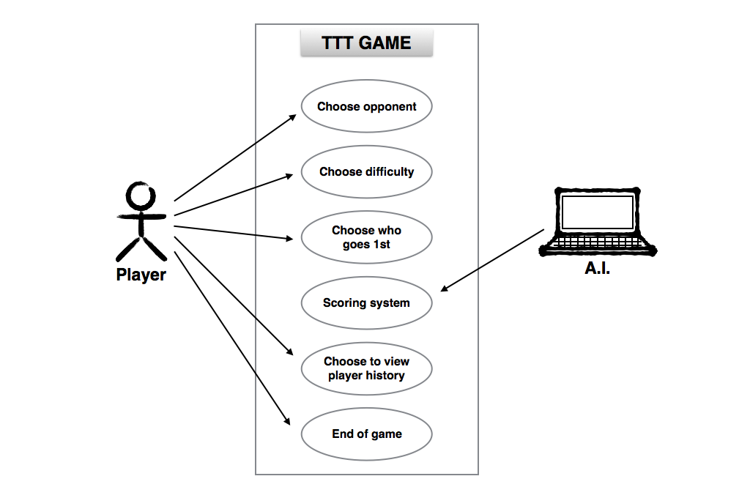
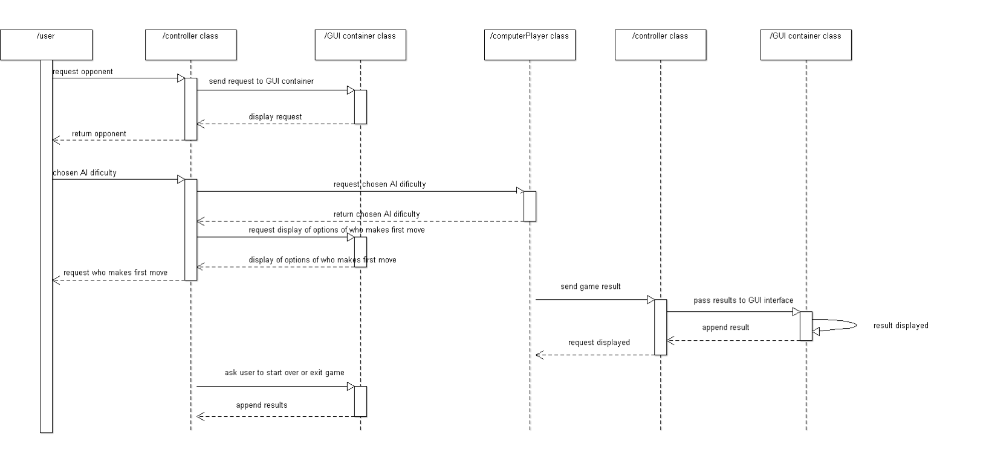
Specification:
Use case 1
Use Case Diagram
Use Case 1:
Figure 1a. Use Case Diagram for TTT Players
Description: Player can choose to opponent (human or computer), choose difficulty (easy, medium, or hard), choose who goes first, choose to restart or end game, and view player history as an option.
Figure 1b. Sequence Diagram for TTT Players

Slide 9
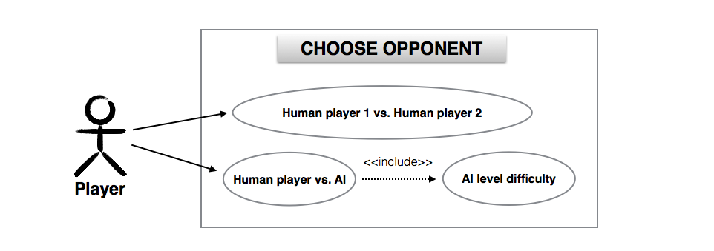
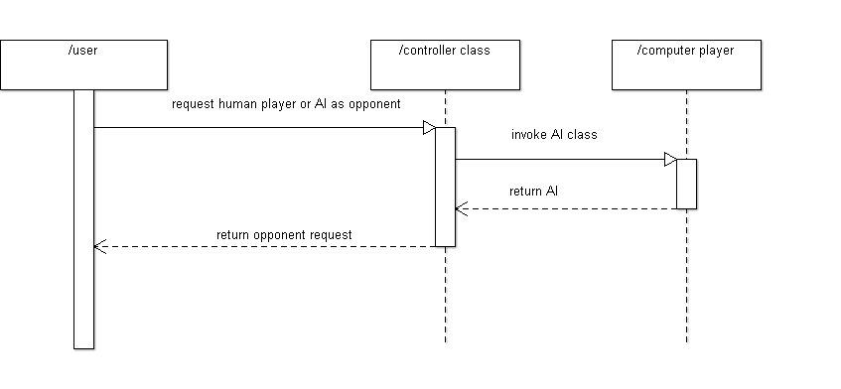
Specification:
Use case 2

Slide 10
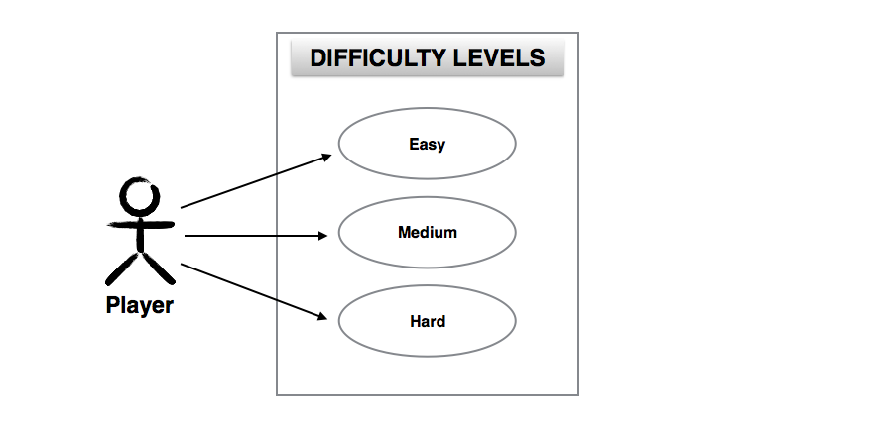
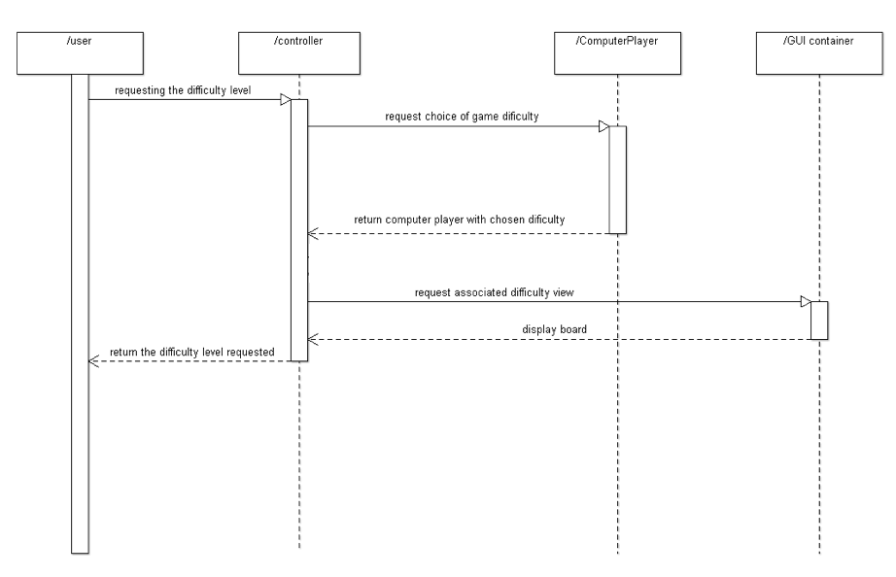
Specification:
Use case 3

Slide 11

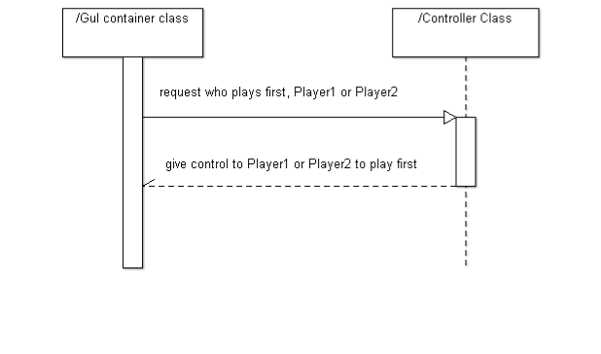
Specification:
Use case 4

Slide 12
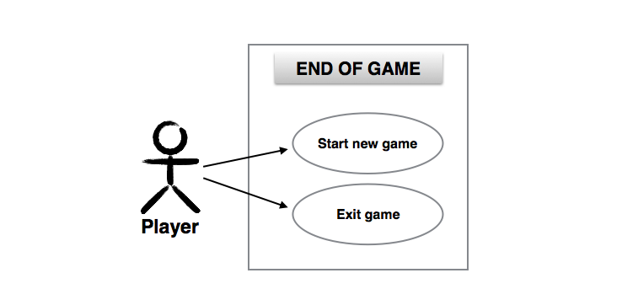
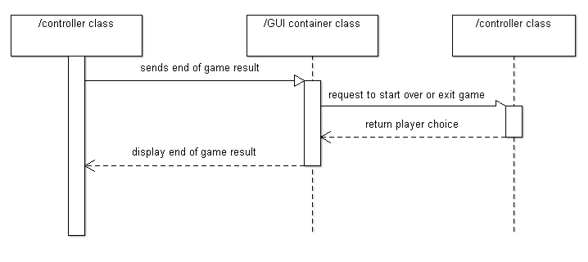
Specification:
Use case 5

Slide 13
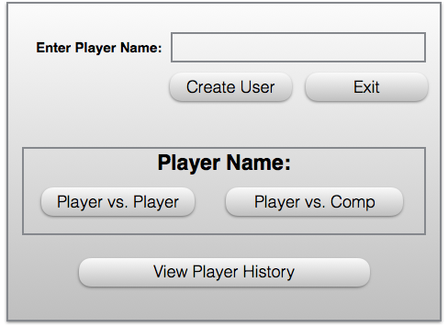
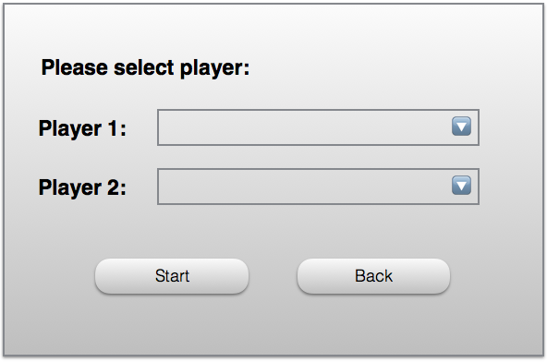
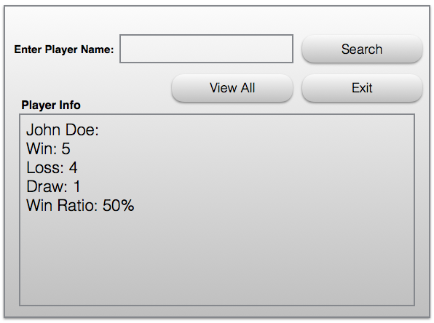
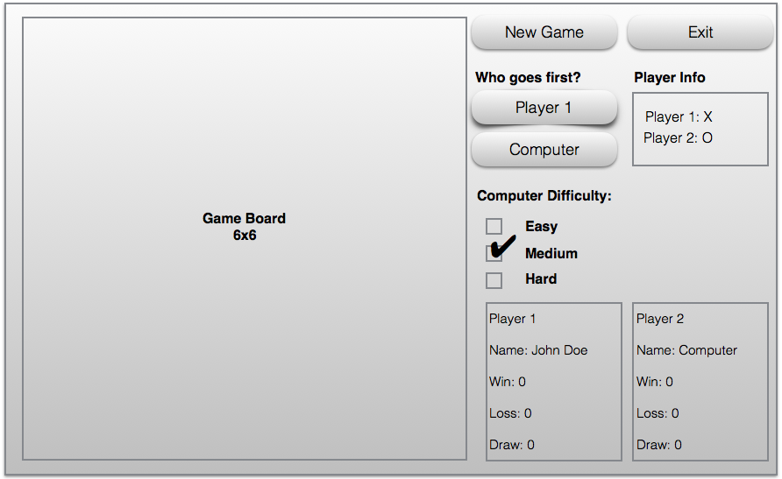
Specification: User Interface

Slide 14
Preliminary Software Project Management Plan

Slide 15
Overview
Project summary: The project is to create a 6x6x4 tic-tac-toe computer game that allows a player to play against another person, or to play against 3 difficulties of AI.
Purpose, scope, and objectives: The purpose of this project is to create tic-tac-toe game on a 6x6 grid on an appropriate GUI. Players/Computers will take turn placing colored stones and will receive points if 4 of the same colors stone, that they are placing, are lined up (either horizontally, vertically, and/or diagonally). The player can register a user name or play as a guest. The program will keep track of the history of each play and be able to tell the user what has happened. The user will be able to select the difficulty of the AI and who goes first. The computer will play each other in class and bonus points will be awarded to the best one.

Slide 16
Project Organization
Taylor Rowan: Team Lead
Zach Meier: Secretary
Imran Hussain: Secretary
Daniel Owen : Lead Programmer
Yiming Zhu: Lead SQA

Slide 17
Risks
The risks in the project will be mitigated by ensuring the needs of the client are met in the very beginning.
Documents will all be kept and all version of the software in case we need to backtrack.
This will maximize our chances of finishing the project on time. The worst case scenario is turning the project in late so timeliness is a priority.

Slide 18
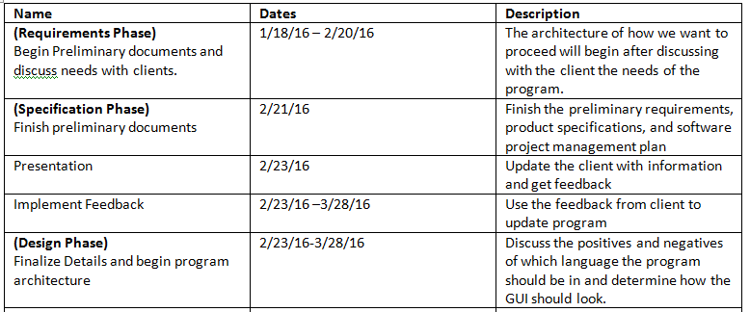
Schedule

Slide 19
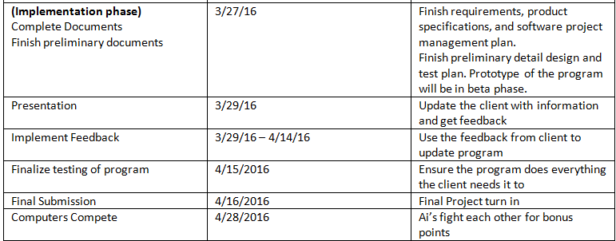
Schedule

