Slide 1
Preliminary Software Project Management Plan

Slide 2
Overview
Project summary: The project is to create a 6x6x4 tic-tac-toe computer game that allows a player to play against another person, or to play against 3 difficulties of AI.
Purpose, scope, and objectives: The purpose of this project is to create tic-tac-toe game on a 6x6 grid on an appropriate GUI. Players/Computers will take turn placing colored stones and will receive points if 4 of the same colors stone, that they are placing, are lined up (either horizontally, vertically, and/or diagonally). The player can register a user name or play as a guest. The program will keep track of the history of each play and be able to tell the user what has happened. The user will be able to select the difficulty of the AI and who goes first. The computer will play each other in class and bonus points will be awarded to the best one.

Slide 3
Project Organization
Taylor Rowan: Team Lead
Zach Meier: Secretary
Imran Hussain: Secretary
Daniel Owen : Lead Programmer
Yiming Zhu: Lead SQA

Slide 4
Risks
The risks in the project will be mitigated by ensuring the needs of the client are met in the very beginning.
Documents will all be kept and all version of the software in case we need to backtrack.
This will maximize our chances of finishing the project on time. The worst case scenario is turning the project in late so timeliness is a priority.

Slide 5
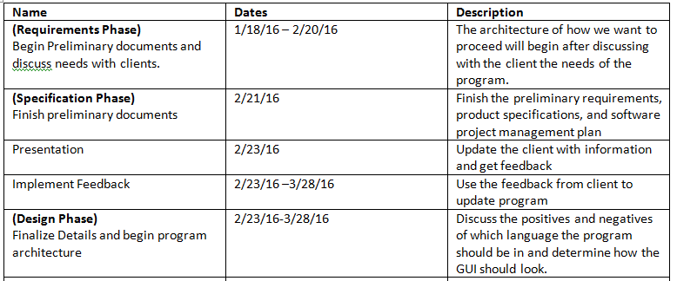
Schedule

Slide 6
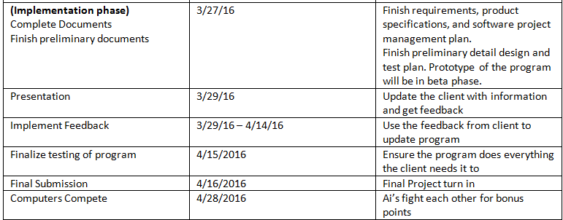
Schedule

