Slide 1
DITZY
Software Engineering
Dr. Yuan
Phase 2 Presentation

Slide 2
Risks- Updated from last presentation
The risks in the project will be mitigated by ensuring the needs of the client are met in the very beginning.
Documents will all be kept and all version of the software in case we need to backtrack. (using Github)
If someone can’t perform there job, they will be replaced by one of the secretaries. If two, then Taylor Rowan will assume two roles. If three or more leave, we will discuss further options with the client.
This will maximize our chances of finishing the project on time. The worst case scenario is turning the project in late so timeliness is a priority.

Slide 3
Specification: Use Cases Scenerios (correction)
Use case 1: Create player (normal)
Brief description: Enables a new player to register with player name
Step-by-step description: Player enters name and registers player Player will be able to view history of win-loss record
Use case 1: Player already registered (exception 1)
Brief description: Player name already exist in database
Step-by-step description: Player attempts to create player Player will receive message indicating player name already registered
Use case 1: Play as a guest (exception 2)
Brief description: Enables a new player to play as a guest
Step-by-step description: Player do not create player and plays as a guest Player will not be able to view history of win-loss record

Slide 4
Design
Status: Currently, the design is in accordance with functionality described within the requirements doc
Language selected: C# (PC platform and suitable graphical coding)
Constraints: A learning curve for some members of the team for C#
System & software architectural design: PC, compatible with windows Vista and above
Prerequisite docs to prelim design: 1) Requirements 2) Specifications 3) Software Product Management Plan

Slide 5
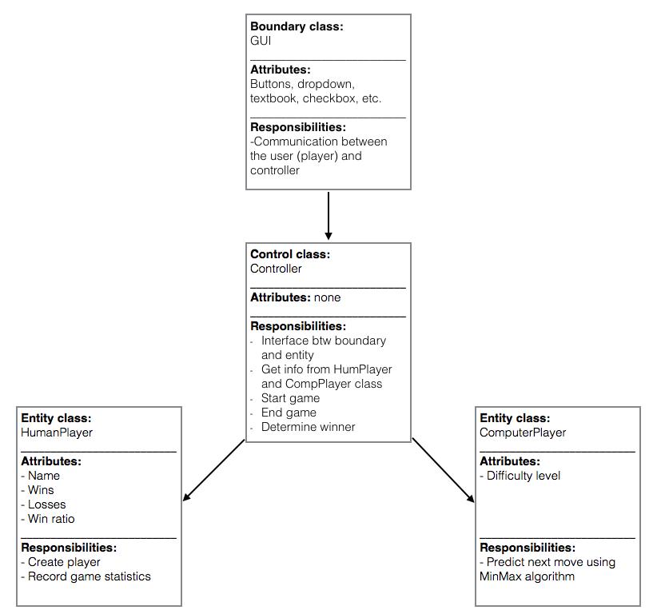
Design: Preliminary Class Diagram

Slide 6
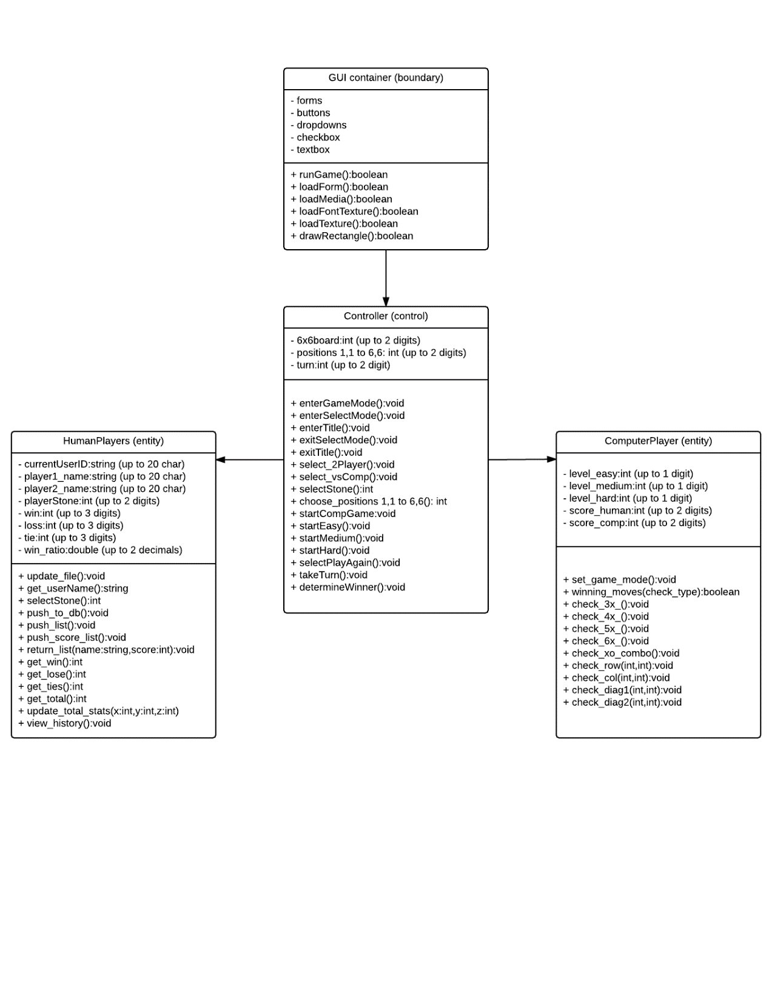
Design: Detailed Class Diagram (with attribute data type and format)

Slide 7
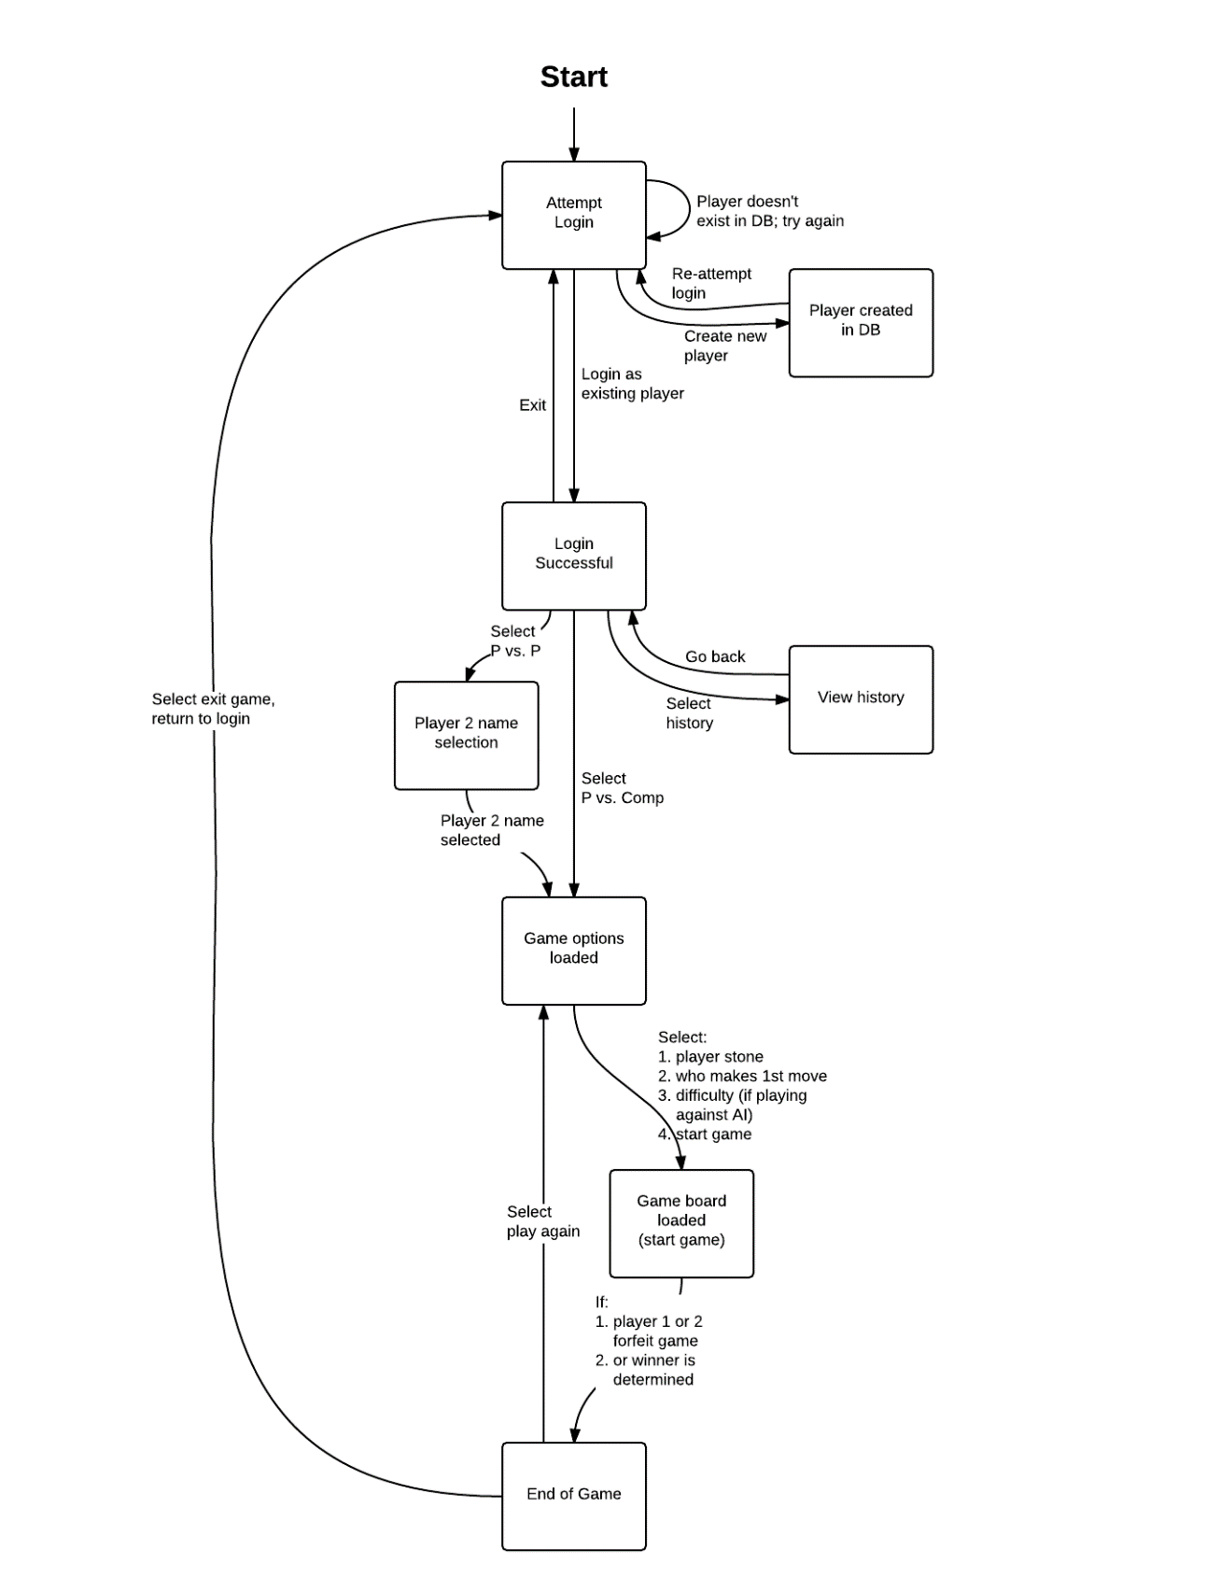
Design Finite State Machine: Human Player

Slide 8
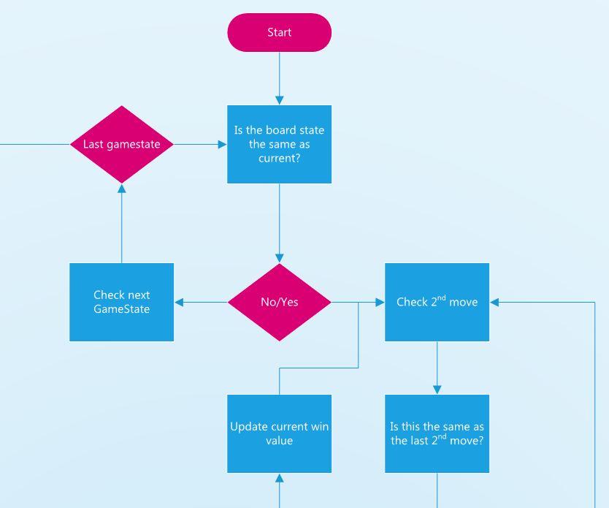
AI Diagram- Top Portion

Slide 9
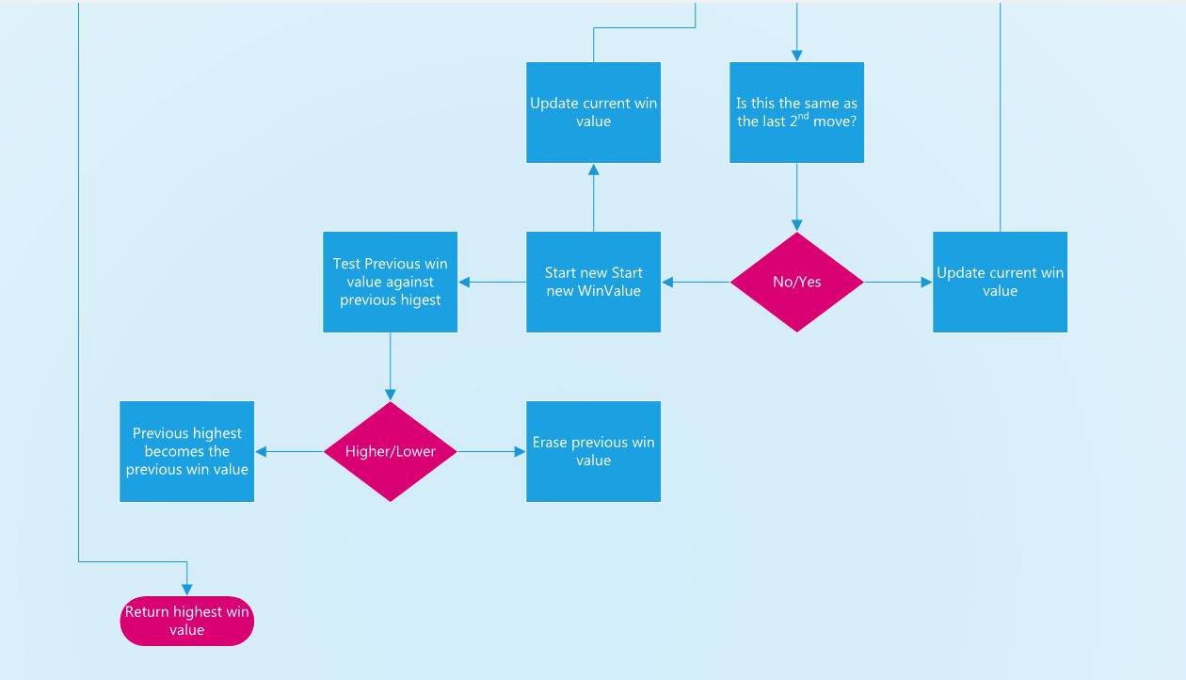
AI Diagram- Bottom

Slide 10
Design: Pseudo-code
Void login()
{
String playerName;
String playerID;
int loginPosition;
int createPosition;
bool success = false;
do
{
If(user clicks at loginPosition)
{
PlayerID = user input ;
If(checkID(playerID) == playerID)
{
Success = true;
}
}
Else if(user clicks on createPosition)
{
playerName = user input;
If(get_name(player_name) != player_name)
{
Player_id = user_input
If(checkID(playerID) == playerID)
{
Success = true;
}
}
}
}while(success == false);
}
Void computerMove()
{
Check_winning_move();
// this method will check all possible winning moves for both player & AI
Check_best_move();
// this method will check for the best possible move based on difficulty
Place_move()
// this method will place the move in the best possible place as calculated
}
Void playerMove()
{
Place_move();
String getPlayerScore(string player)
{
If(player == player1Name)
Return player1Score;
Else if(player == player2Name)
Return player2Score;
}
}

Slide 11
Software Quality Assurance Test Plan DITZY

Slide 12
Objectives
The objective is to complete the software product which is DITZY by May 1st , 2016 within budget and meet the requirements of the client.
This test plan will cover the following objectives:
Identify existing project information and the proposed product to be tested.
List testing requirements.
Describe different testing strategies to be used.
List test activity deliverables.

Slide 13
Testing Strategy
Here we are going to use non-execution based testing:
Inspection:
Team members: Imran, Ming, Taylor, Daniel, Zach
Responsible for analyzing specifications, detect faults, and performing the next workflow development step (Design).
Goal of inspection is to detect faults in the prototype by a representative of the SQA group and follow up into the next step of development.
Walkthrough:
Overview : Walkthrough of all the documents including requirements, specifications, design and codes etc.
Preparation: To analyze all the documents in detail and list all the faults if found.
Inspection: By performing a walkthrough, in order to make sure if all the items are covered.
Rework: Every issues to be resolved and re-tested to ensure no further faults are present.
Follow-up: All the changes are checked to make sure if everything is correct.

Slide 14
The features to be tested are:
Single player mode
Player vs. Player mode
Difficulty level of the computer
Creating a new username/Login to an existing username
Viewing past game history of selected player

Slide 15
APPROACH
At this stage, the team leader and the team secretary will test all the pseudo code and the AI algorithm and look for all the errors and make sure to check the requirements of the product have been met according to our clients need. Following testing will be done
Component Testing: We will be testing each unit using Microsoft Visual Studio. The following testing method will be used:
Integration Testing: Team will be using the sandwich integration technique, where logic artifacts are integrated using the top-down approach while operational artifacts are integrated using the bottom-up approach. Then the two will be integrated together once done.

Slide 16
Unit Testing: Each unit of the software will be tested to ensure that all units are executed with no errors at least once. We are going to perform both black box testing and white box testing.
Some test cases for black box testing:

Slide 17
Test Case | Issue | Result
Test case 1 | Overwriting a previous taken square on the grid. | False, No error
Test case 2 | Selection of difficulty cannot be done during gameplay. | True , No error
Test case 3 | Exit the game at any time using the window buttons. | True , No error
Test case 4 | Start Over Button works during game play or after game play. | True , No error

Slide 18
Job Stream Testing:
Job Stream Testing will be done once we will have a functional product or modules to be to test, we will perform this as follows:
User will run the program using Visual Studio
User will be prompted to either continue as a guest or create a username to keep track of history.
Main menu screen will display showing options of Single Player, Multiplayer, View History.
User selects game mode and begins playing. User can exit the game at any given time.
If username was created, application will update the username’s game history.

Slide 19
Interface Testing
The interface testing mainly focused on the product’s GUI. Team member will be playing the actual games to monitor and compare the actual output.
Recovery Testing
Recovery testing will begin once we have our data storage module up and running.

Slide 20
Regression Testing:
The regression testing will ensure each working update will be compatible with the previous version. In this case there will only be one version delivered to the client.
Acceptance Testing:
Acceptance testing will be conducted once we are in the Design phase to ensure product is in accordance with the client’s needs.
Beta Testing:
Beta testing will conducted by the client at the end of the course.

Slide 21
Testing Schedule
1st Phase – Beginning 4/1 - Ending 4/9
AI will be in a pre-Alpha stage, being feature complete with most features present. Testing will be done by Daniel and Zach.
UI will be in Alpha Stage. Testing by Taylor and Imran.
2nd Phase – Beginning 4/10 – Ending 4/16
Entering final testing of AI with Daniel leading and Zach and Ming testing as part of SQA.
UI will run through with a series of tests to ensure quality. Lead by Taylor with Imran and Ming as SQA.
3rd Phase – Beginning 4/17 – Ending 4/20
Modules of UI and AI will be merged lead by Ming to ensure compatibility and proper functioning.
4th Phase – Beginning 4/21 – Ending 4/25
UI and AI fully merged to be run through with a series of testing to ensure quality.

Slide 22
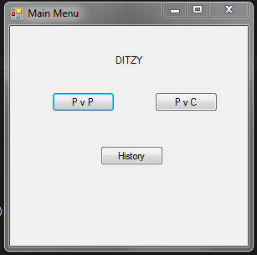
Main Menu Prototype

Slide 23
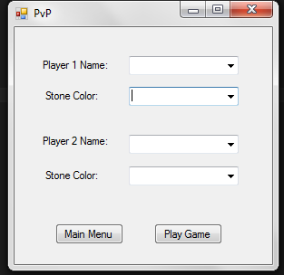
PvP Prototype

Slide 24
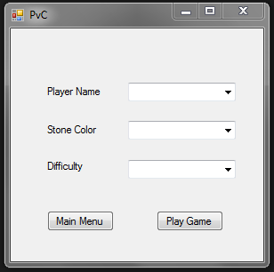
PvC Prototype

Slide 25
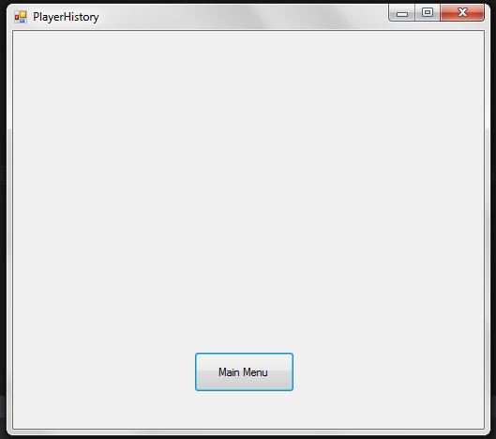
Player History Prototype

Slide 26
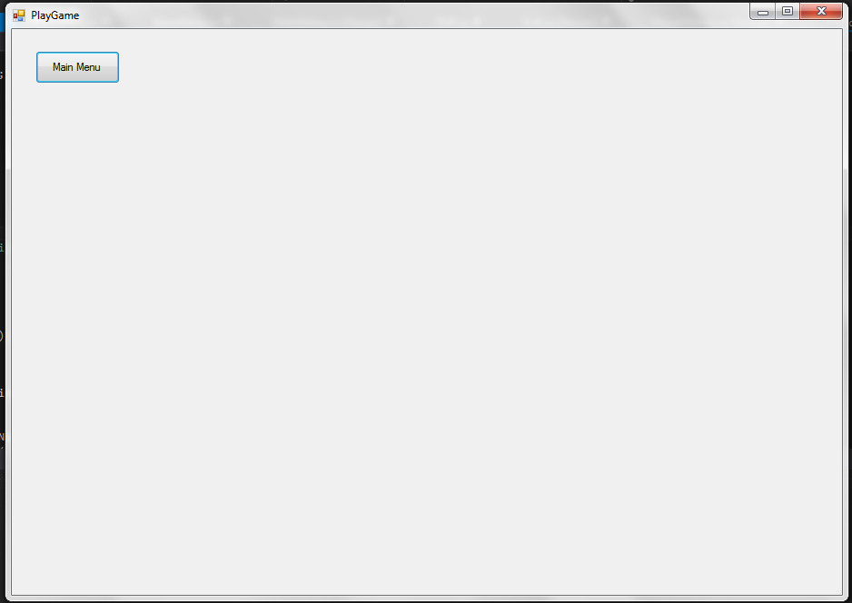
Play Game Prototype

