Slide 1
Mean water temperatures
population | treatment | mean.temp.c
ontario | high | 4.235059
ontario | medium | 4.276868
ontario | low | 4.355195
superior | high | 4.250879
superior | medium | 4.279827
superior | low | 4.336253
Notes:
Slight temperature gradient going from high to low (bottom to top shelves). I noticed a 1-2C gradient when I tested the chamber in October. Was able to minimize it to ~0.15C.

Slide 2
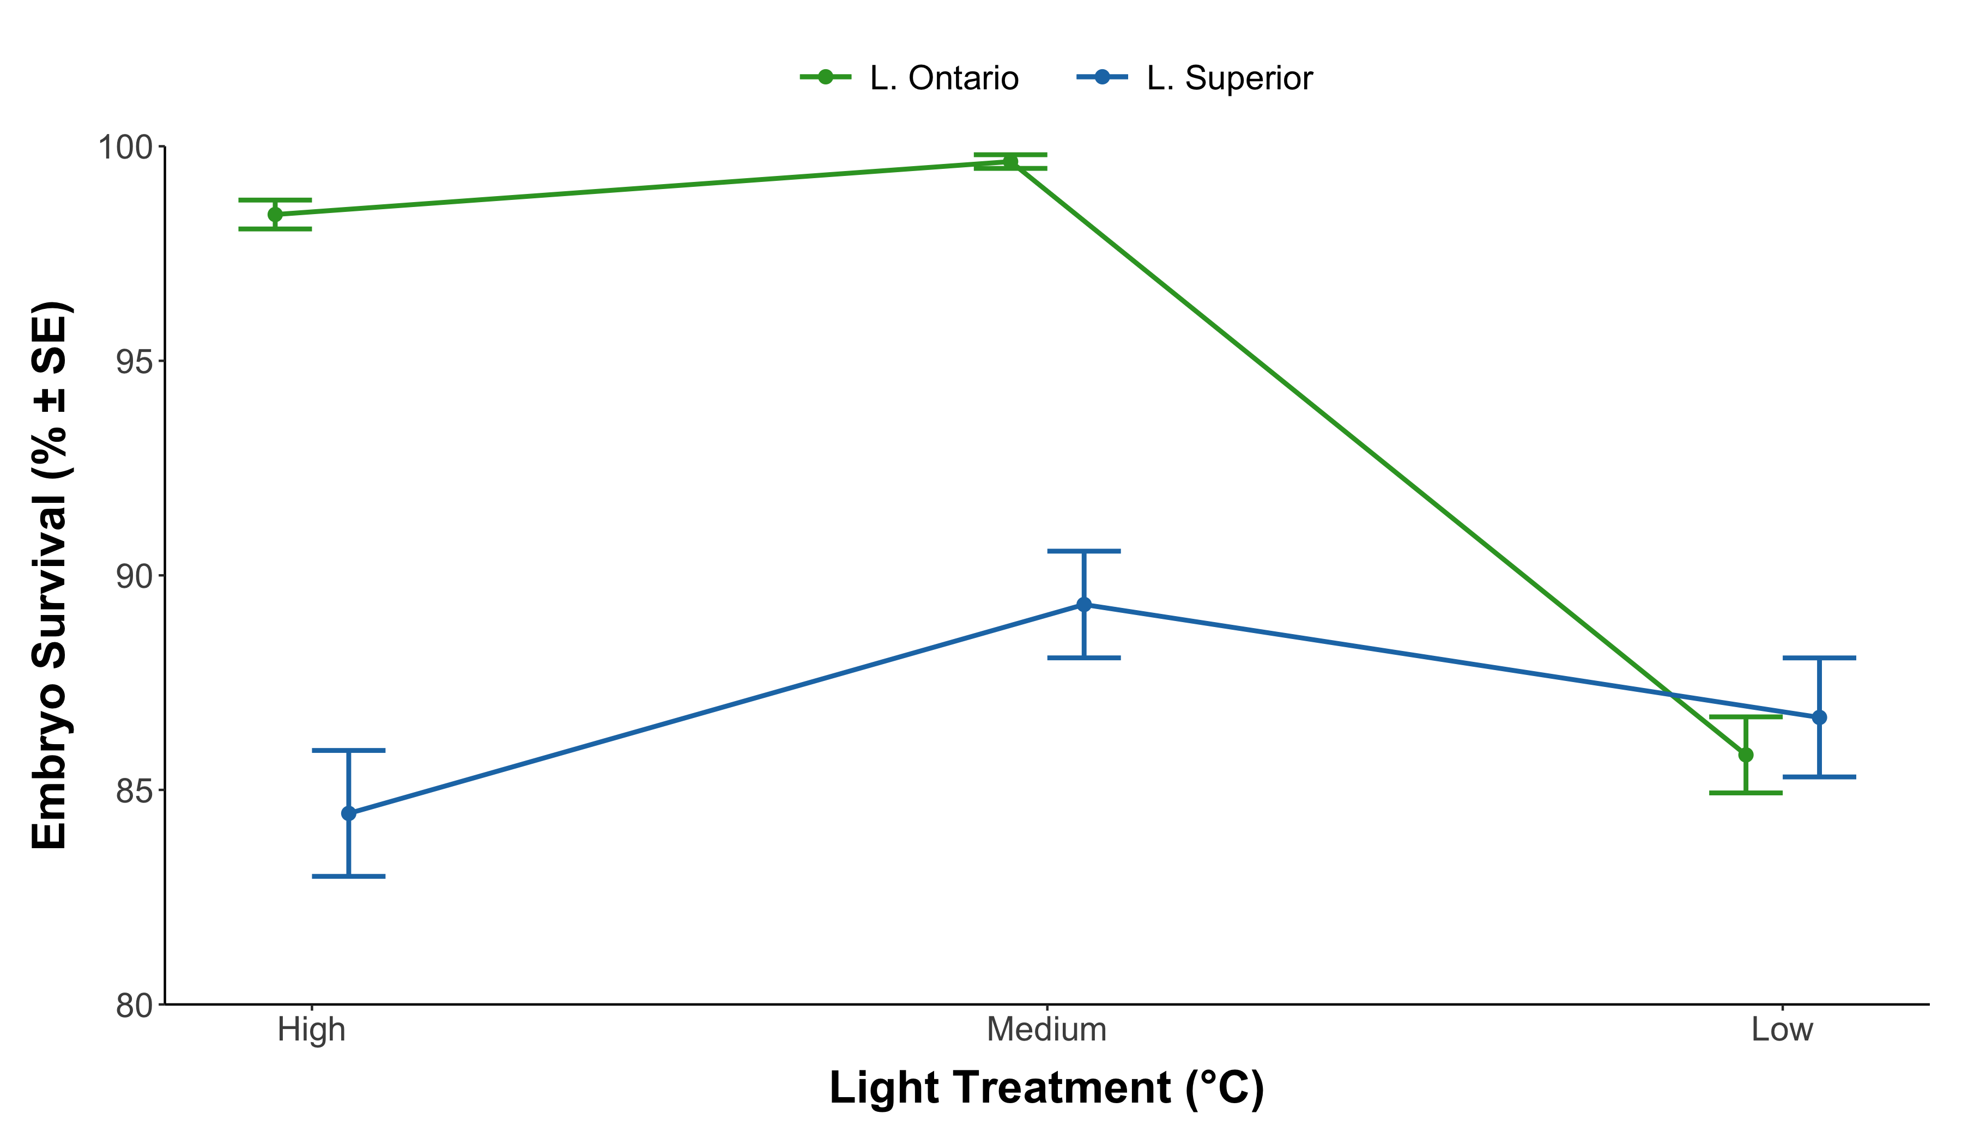
Notes:
This is interesting. Lake Ontario has shallow spawners and shows highest survival when exposed to light. However, shallower water should have more consistent ice and therefore less light. I can look into if this is actually true for Chaumont Bay or not but believe it is.
Lake Superior has deeper spawners and shows the lowest survival when exposed to the highest amounts of light (low ice). Fits the local adaptation hypothesis.
The rapid drop in Ontario survival at low light is surprising. When comparing to the temperature experiment data at 4.5C, where the embryos where never exposed to light, they still had ~98% survival. Have to think about this more.

Slide 3
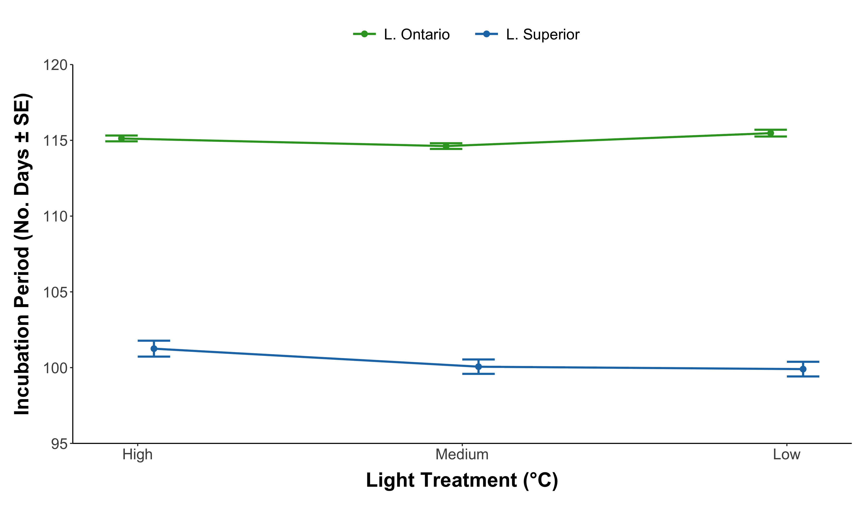
Notes:
Refer to the temperature table. There was a slight temperature gradient so take this with a grain of salt. The degree days figure is more reliable.

Slide 4
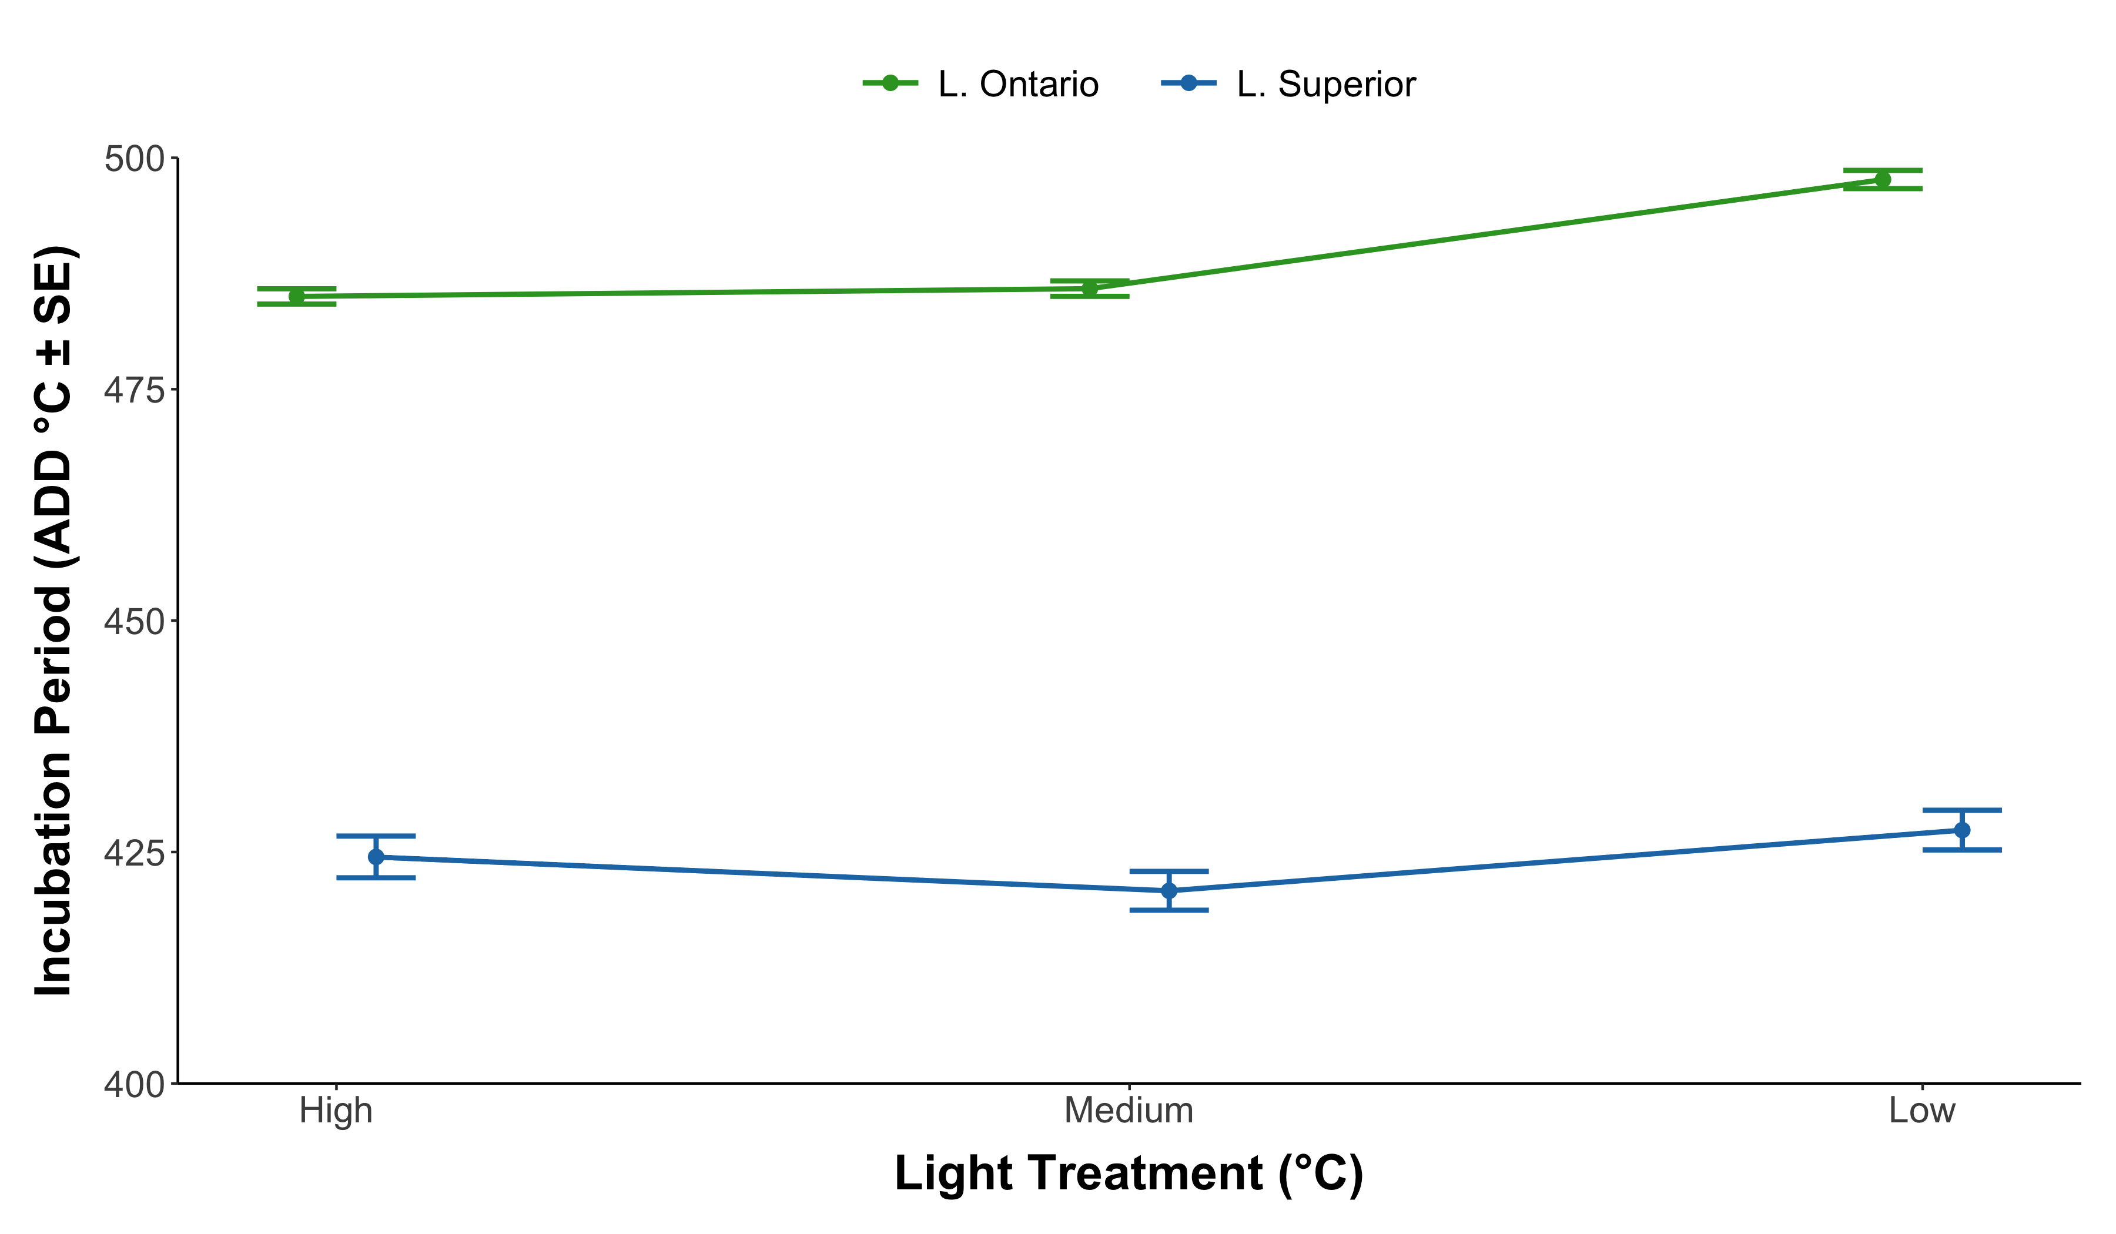
Notes:
Less light = longer incubations for both lakes. But only a small amount (looks like a couple of days - I will calculate).

