Slide 1
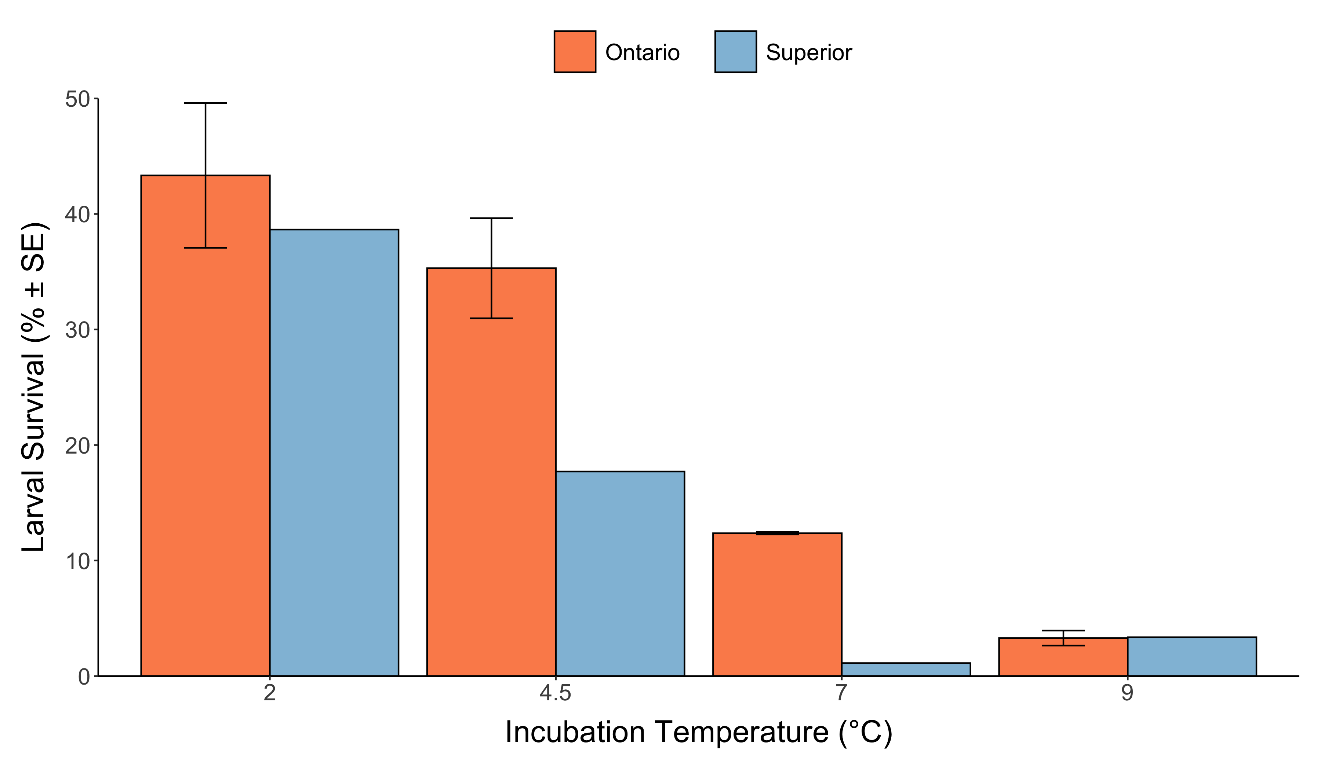
Notes:
Survival after 60 days post hatch
No replicate tank for Superior due to low embryo survival; two replicate tanks for Ontario

Slide 2
Growth

Slide 3
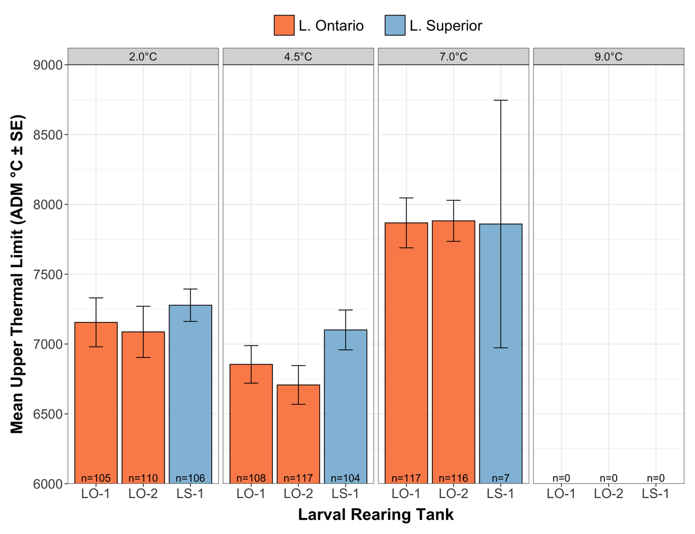
Notes:
winner

Slide 4
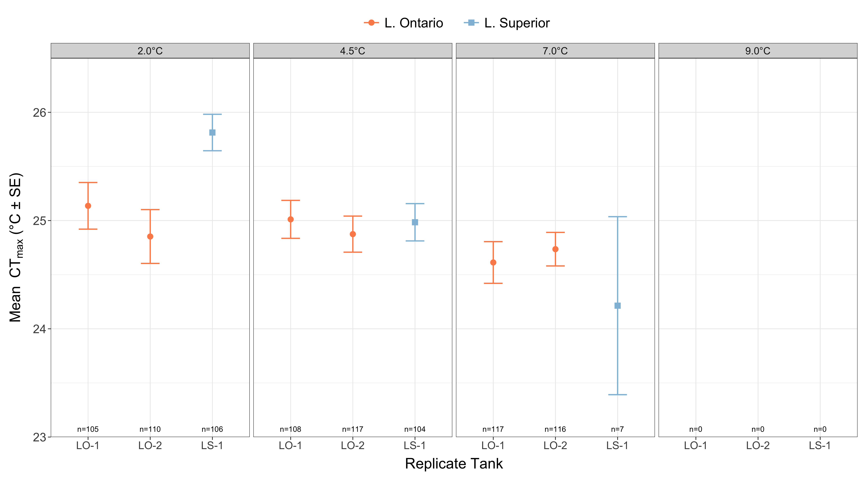

Slide 5
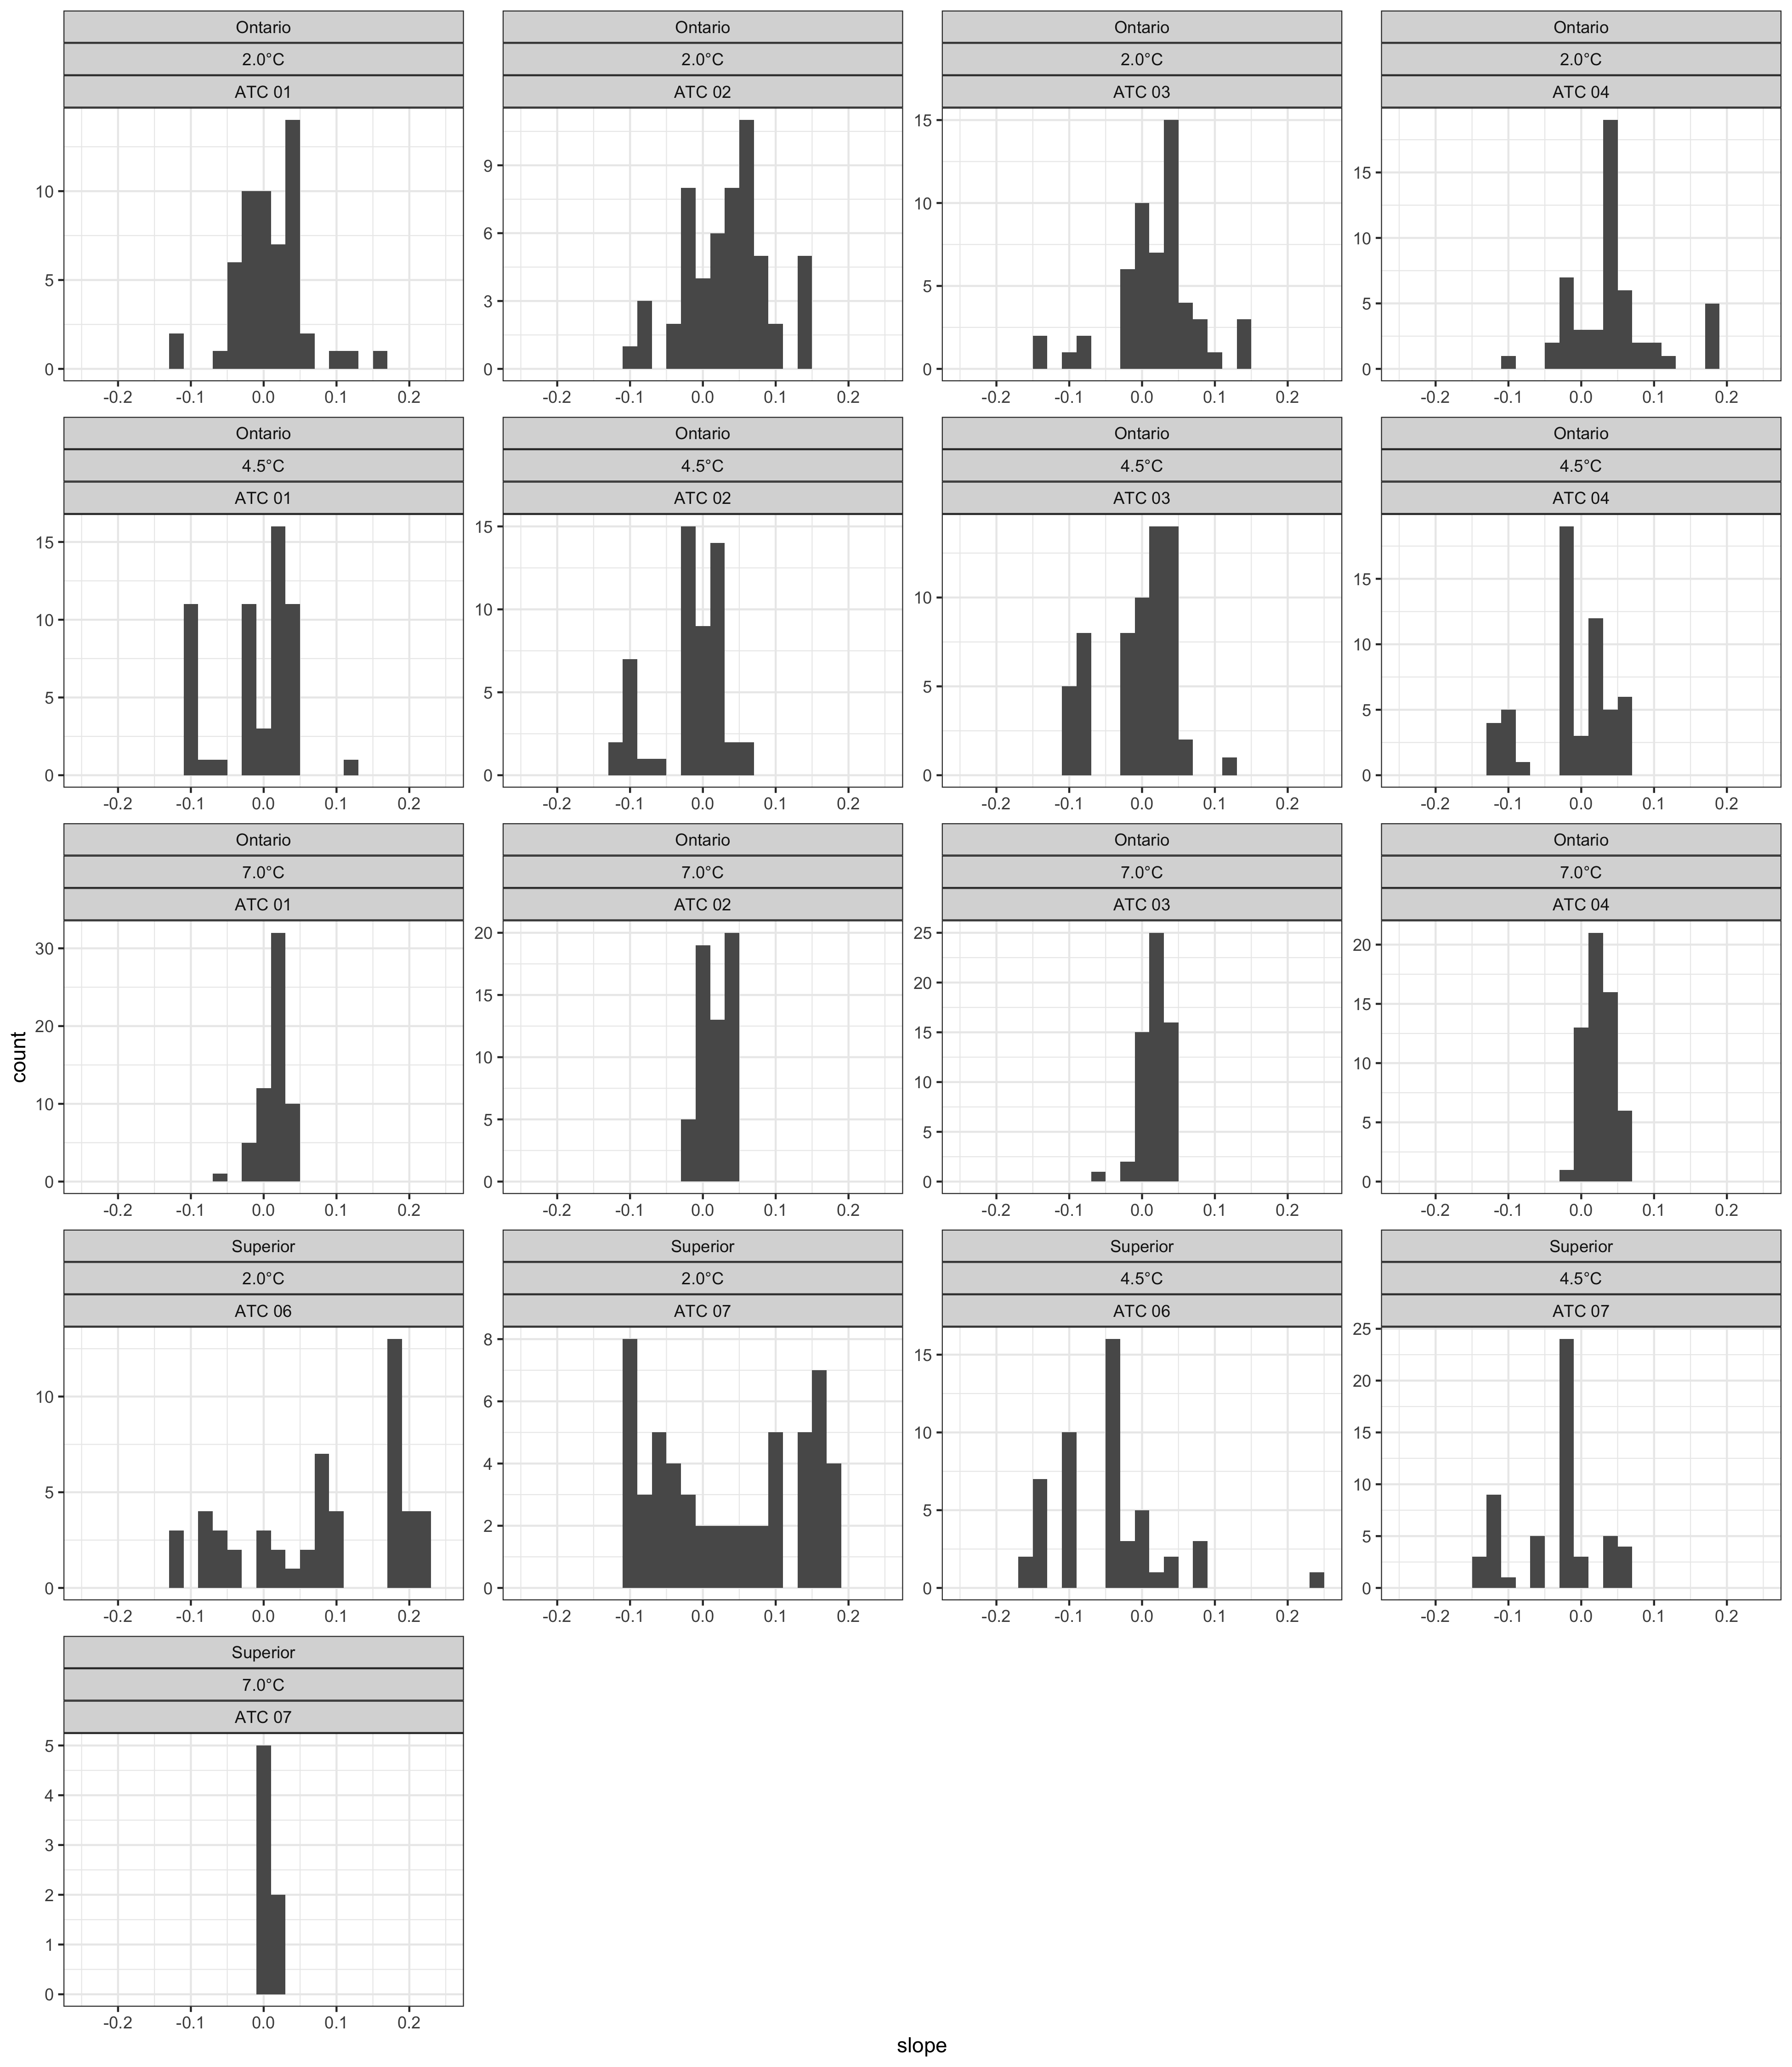

Slide 6
