Slide 1

Constructive
Solid Geometry
Project Presentation
Team Rainbow
Christian Segura
Taylor Stine
Jackie Yang

Slide 2
What is CSG?
How do we know what to remove?
How are the operations performed?
C++ Implementation
Results

Slide 3
What is CSG?

Slide 4
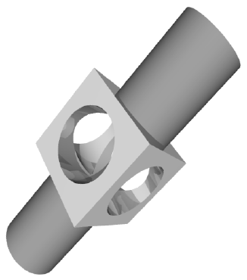
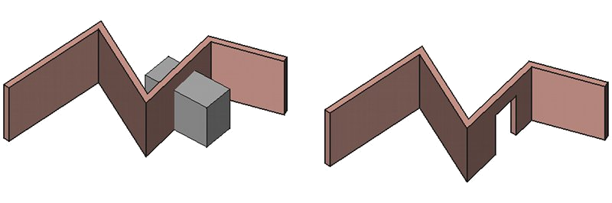
Introduction
Usage
Constructive solid geometry (CSG) is used in solid modeling to combine objects with addition or subtraction
Used primarily in CAD modeling packages and video games
http://www.lems.brown.edu/vision/people/leymarie/Refs/CompGeom/Hoppe92/Hoppe92-CAD.gif
http://sourceforge.net/apps/mediawiki/free-cad/nfs/project/f/fr/free-cad/a/a3/Arch_Remove_example.jpg

Slide 5
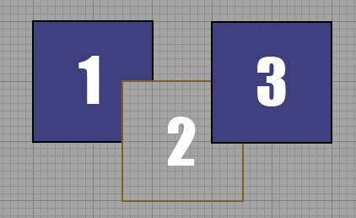
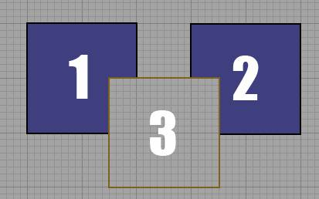
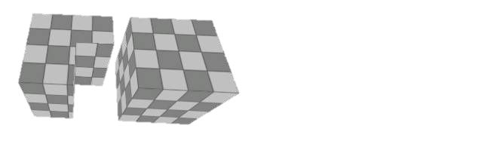
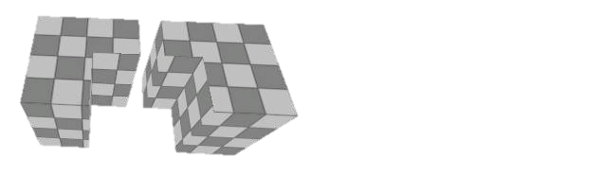
Approach
Surfaces are added/subtracted to create the desired shape
http://waylon-art.com/LearningUnreal/UE3-03A-CSG.htm

Slide 6
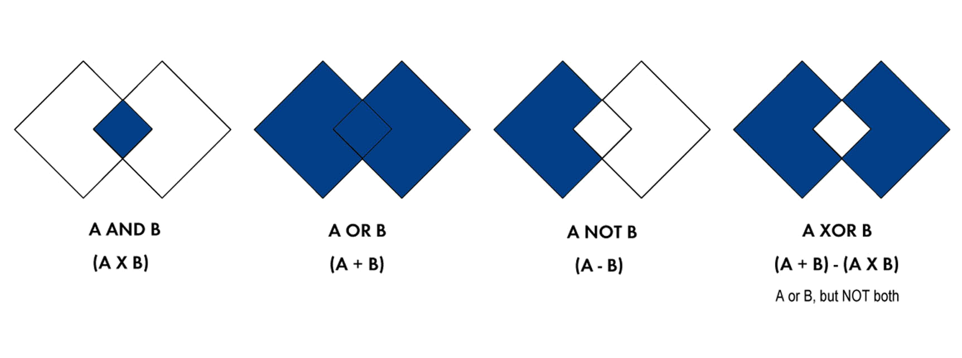
Boolean Operation
http://geoportal.icimod.org/UserFiles/Image/capacity%20building/elearning/Figure%207_1.jpg

Slide 7
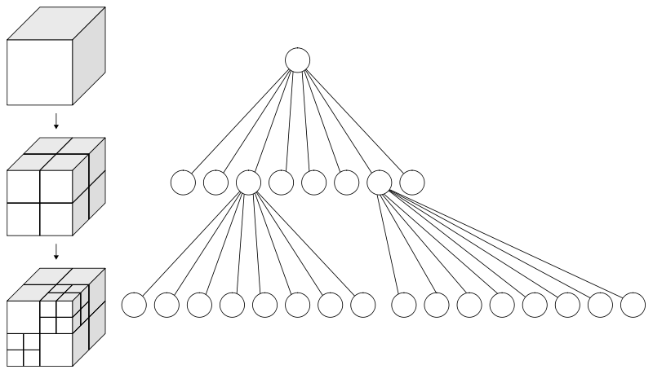
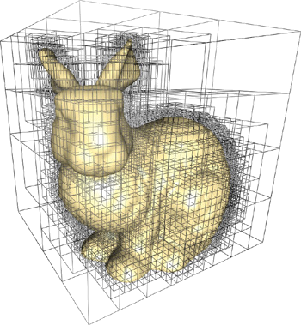
Algorithm – BSP Tree
Binary space partitioning(BSP) tree divide up a 3D volume into smaller boxes using recursion
BSP trees are often represented as octrees, which divide a cube into 8 different sub “voxels”
http://http.developer.nvidia.com/GPUGems2/elementLinks/37_octree_03.jpg
http://upload.wikimedia.org/wikipedia/commons/thumb/2/20/Octree2.svg/800px-Octree2.svg.png

Slide 8
Algorithm – BSP Tree
Each object is broken down into a BSP tree
Depending on the operation desired, the BSP trees are merged (union) or subtracted (difference) or tested for intersection (subspace)
The result is a model that is the combination of two 3D volumes represented by the BSP tree

Slide 9
How do we know what to remove?

Slide 10
Algorithm – BSP Tree
A
B
A
/ \
B C
C

Slide 11
Algorithm – BSP Tree
A
/ \
B1 C
\
B2
B
A
B1
B2
C

Slide 12
Algorithm – BSP Tree

Slide 13
How are the boolean operations performed?

Slide 14
How is this implemented in C++?

Slide 15
Algorithm – BSP Tree
Struct BSP_tree
{
BSP_tree * front;
BSP_tree* back;
BSP_tree* parent;
Triangle triangle;
}
Triangle
{
Vector3 vertices[3];
Vector3 normal;
}

Slide 16
Our Results

Slide 17

?

Slide 18
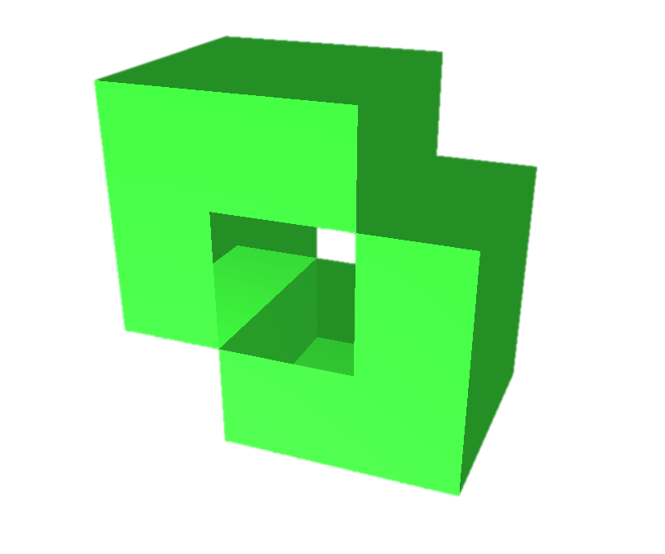
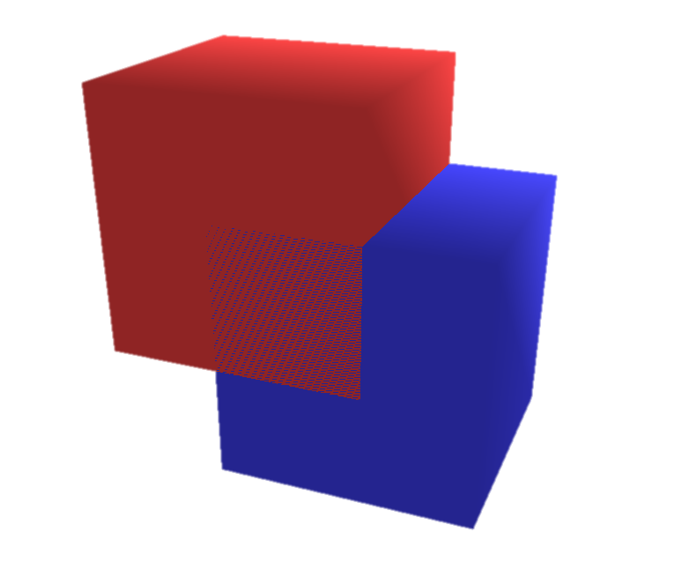

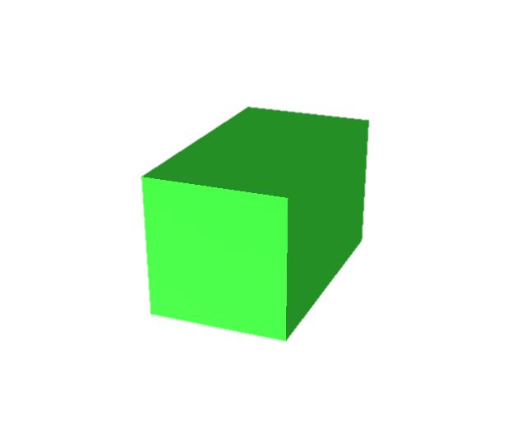
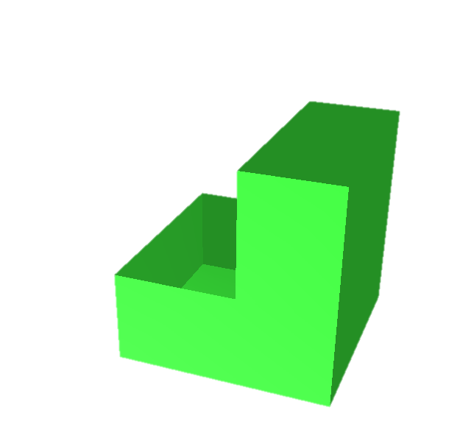
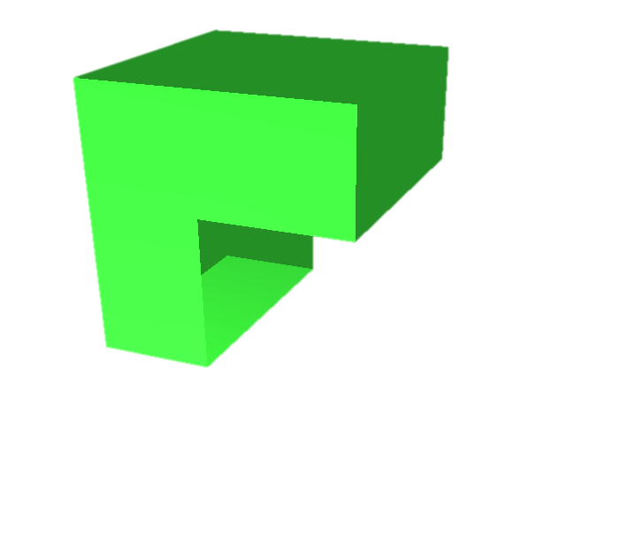
Results – cube & cube
X

Slide 19

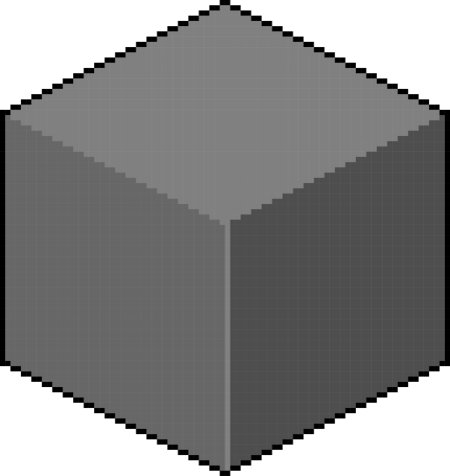
?

Slide 20
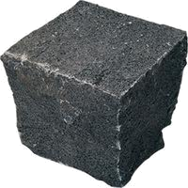

?

Slide 21
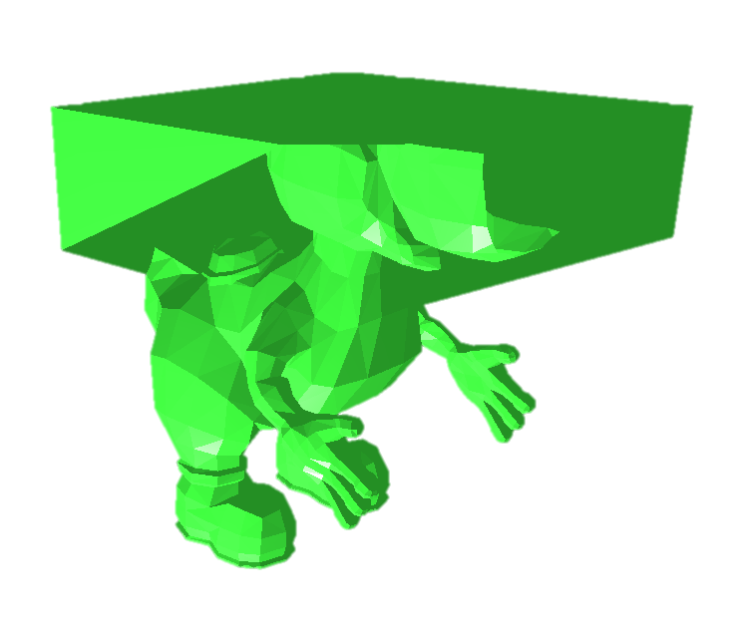
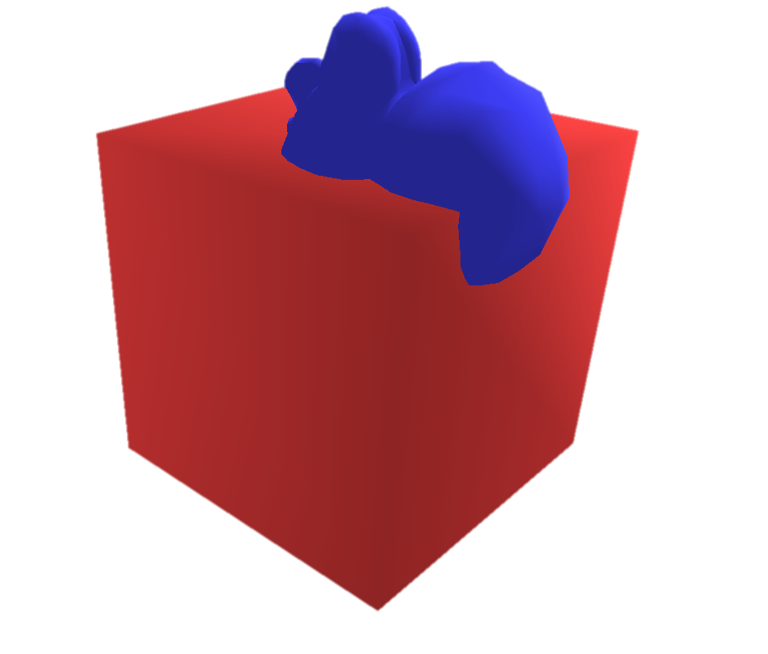
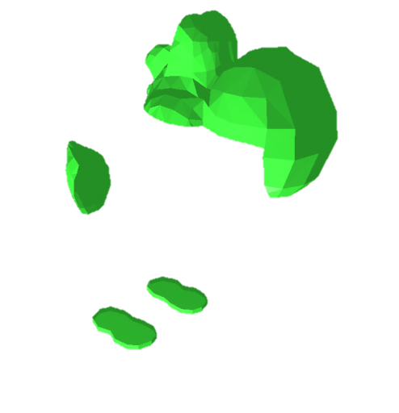
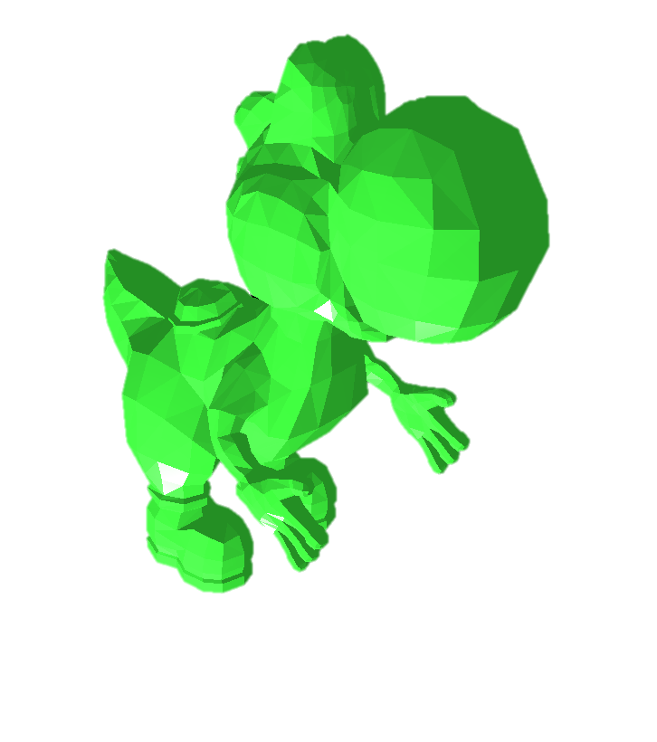
Results – Yoshi & cube
Model

Slide 22
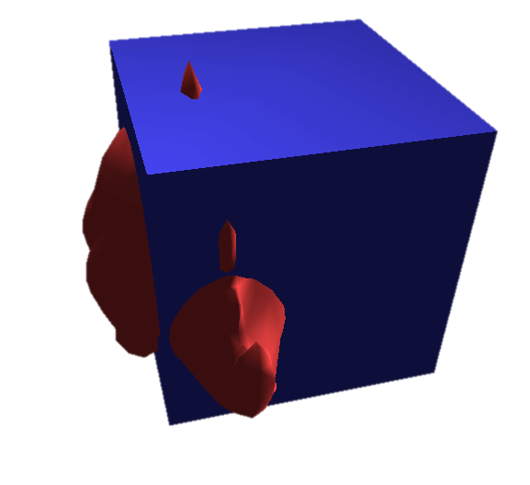

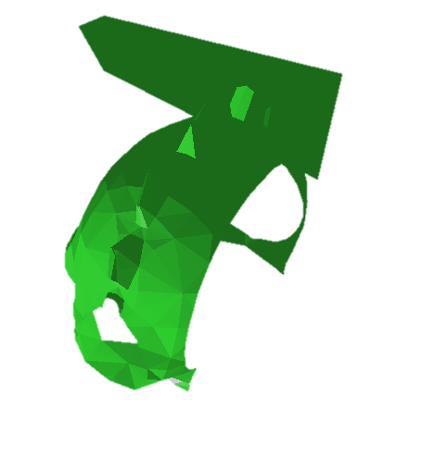
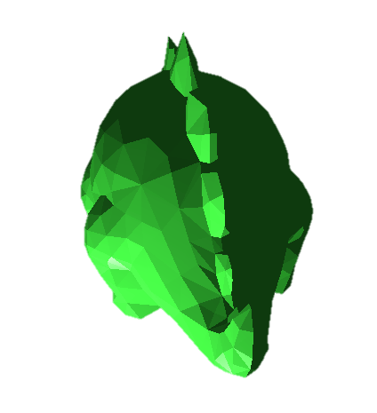
Results – Stegosaurus & cube
Model

Slide 23
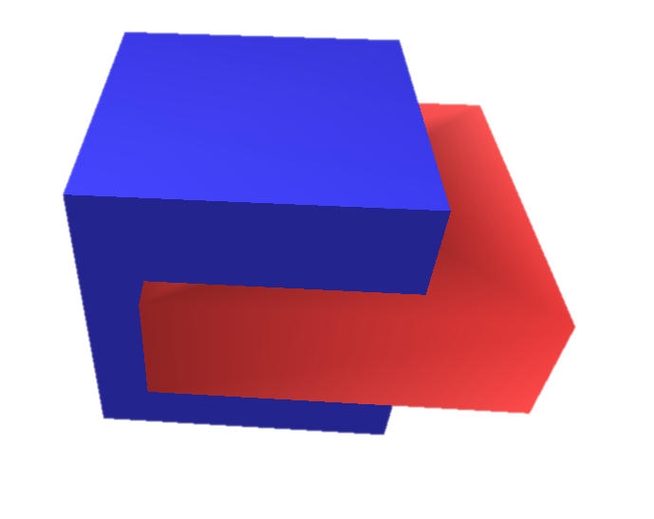
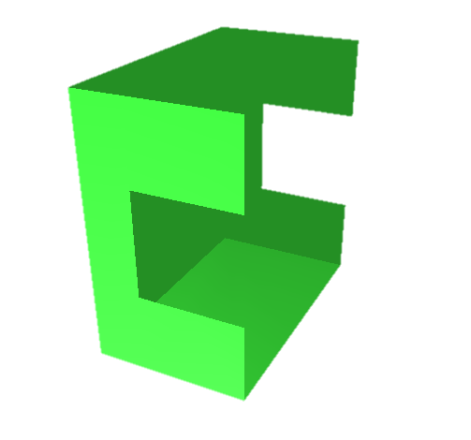

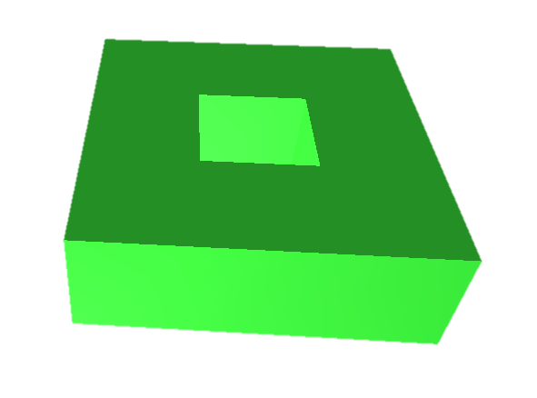
Results – Torus & cube
Model

Slide 24

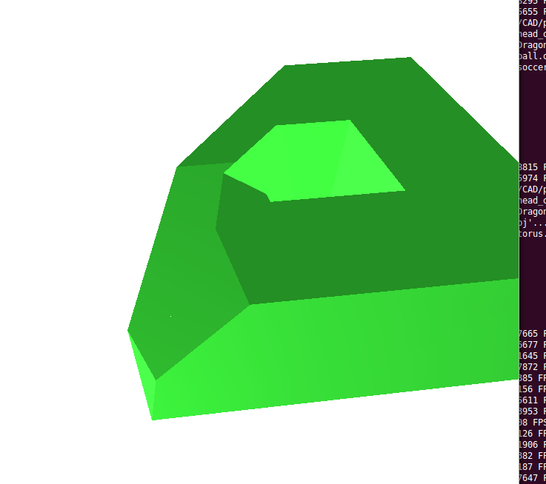
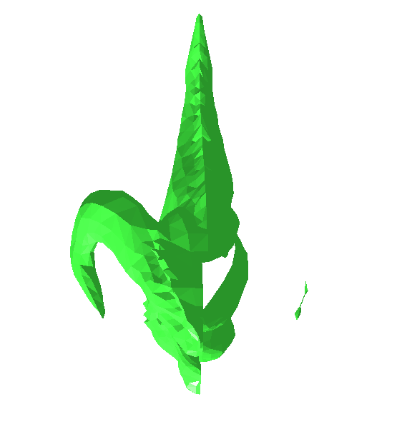
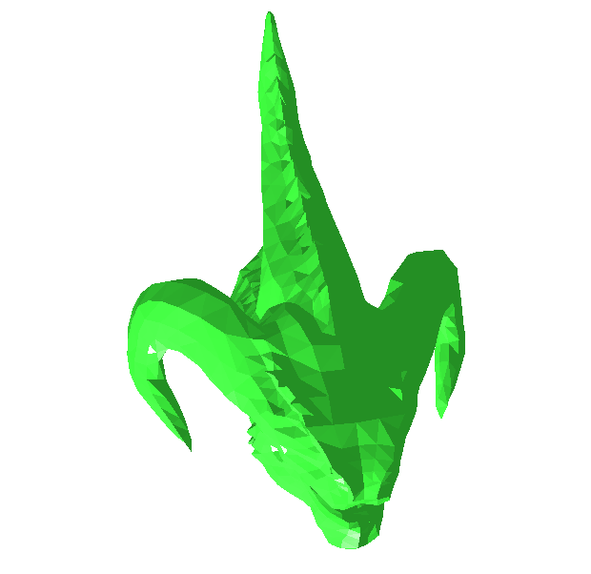
Results – Torus & Dragon
Model

Slide 25
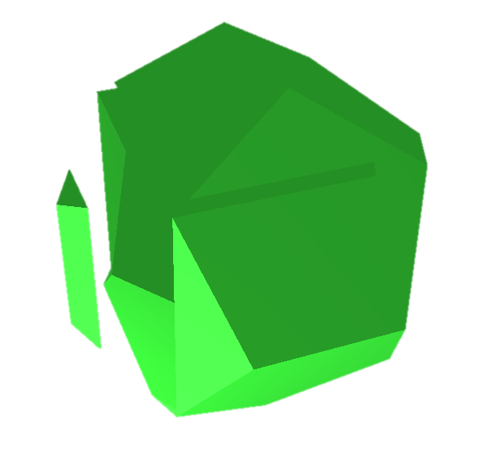
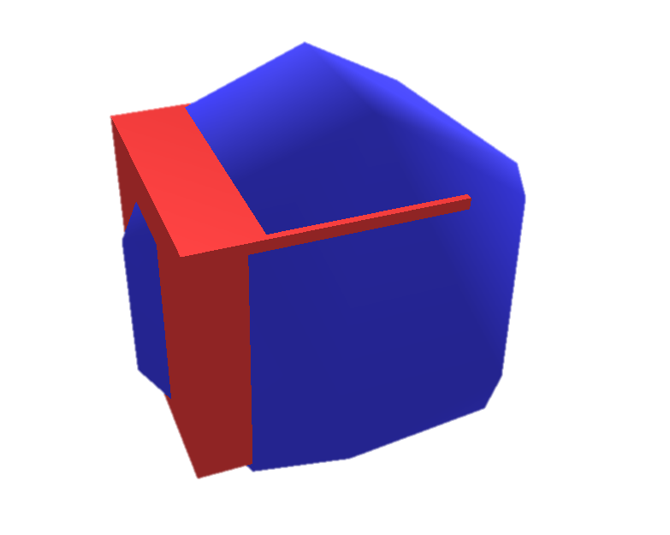
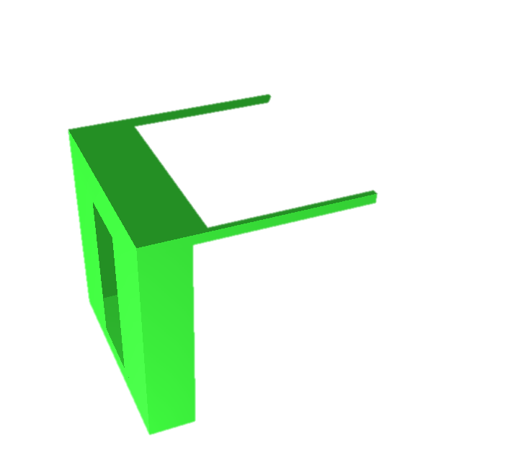
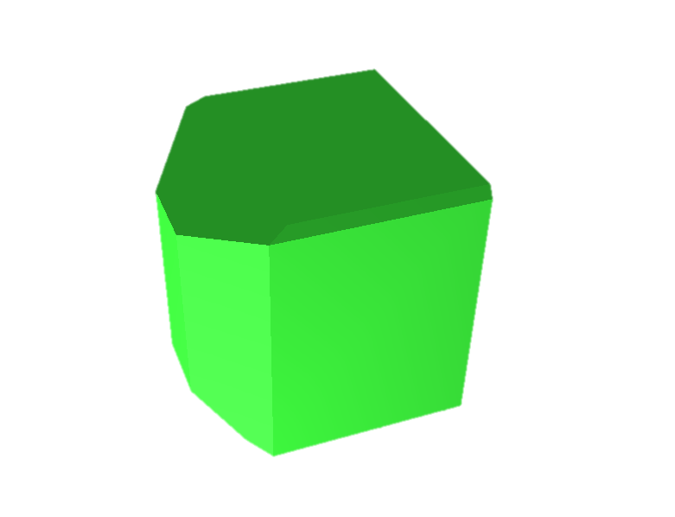
Results – Dodecahedron & Cube

Slide 26
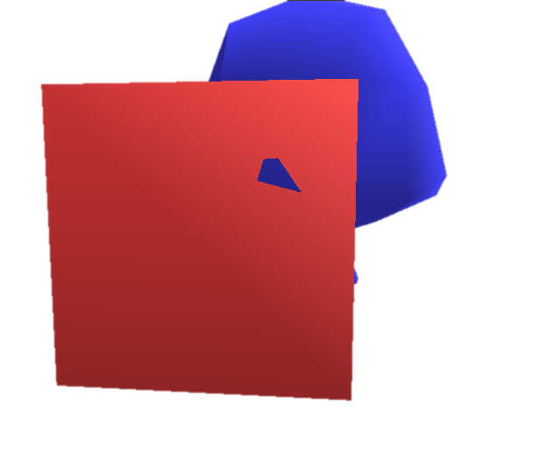
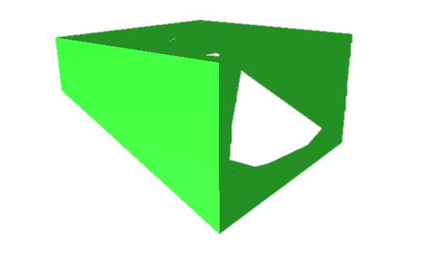
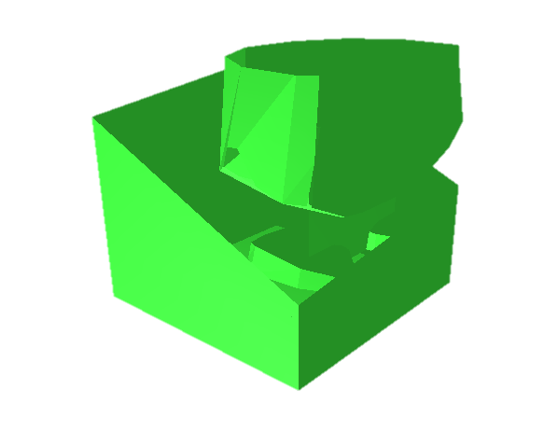

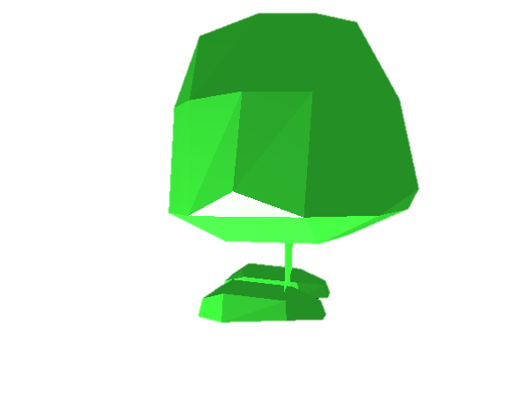
Results – Gooma & Cube
Model

Slide 27
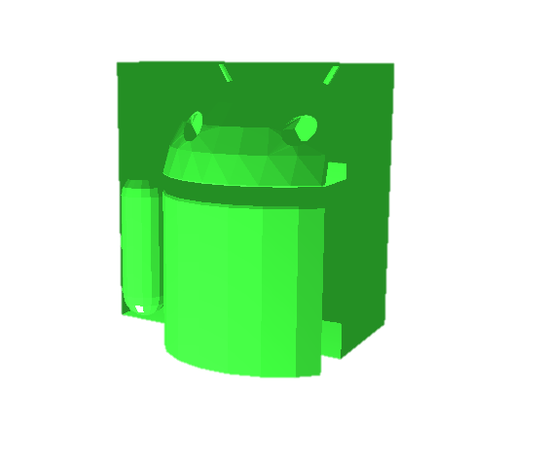



Results – Android & cube
Model

Slide 28
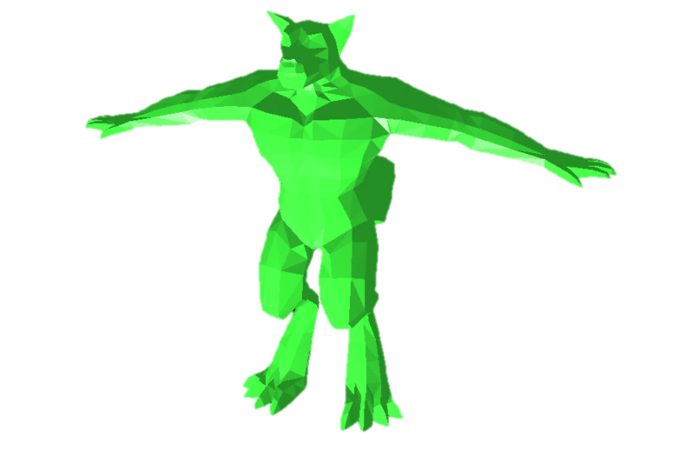
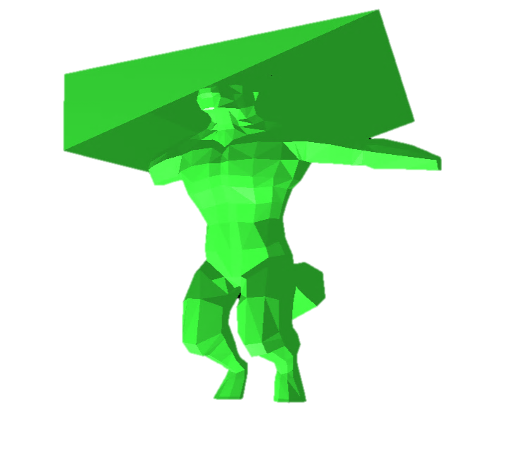
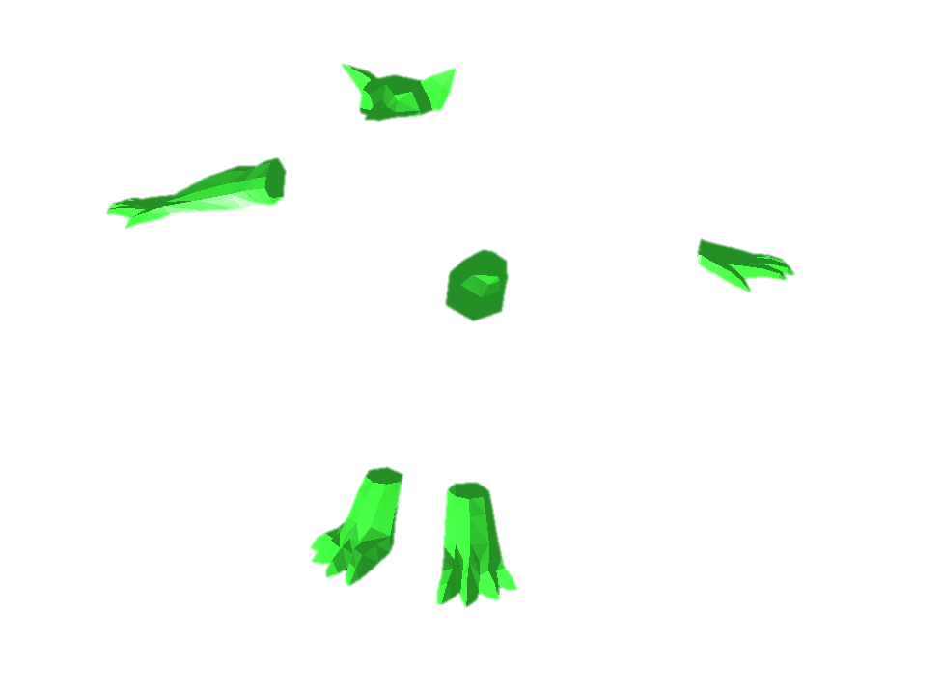
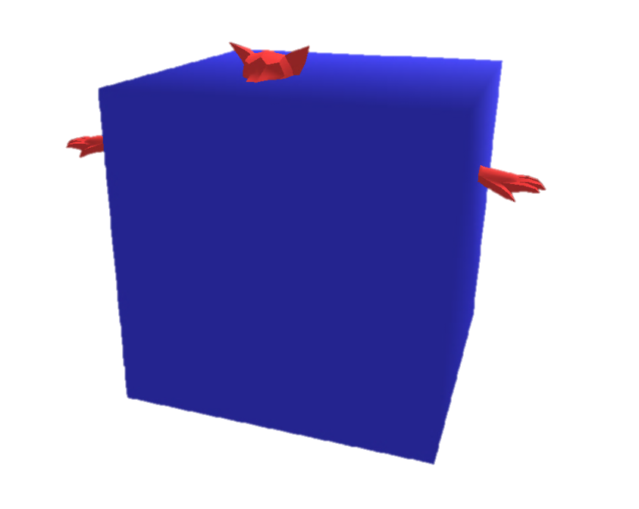
Results – werewolf & cube
Model

Slide 29
Discussion
Challenges
Memory leaks
Floating point error
Subtracting 2 complex models
Improvements
Memory handling
Resolution

Slide 30
Refrences
B. Naylor, J. Amanatides and W. Thibault, "Merging BSP Trees Yields Polyhedral Set Operations", Proc. Siggraph '90, Computer Graphics 24(4), August 1990, pp 115-124.
Miklo Lysenko, Roshan D'Souza and Ching-Kuang Shene, Improved Binary Space Partition Merging, CAD, Vol. 40 (2009), No. 12 (December), pp. 1113-1120.
Shirley, Peter et. a. Fundamentals of Computer Graphics. 3rd ed. Wellesley: A K Peters, 2009.

Slide 31
Q & A
Team Rainbow
Christian Segura
Taylor Stine
Jackie Yang

