Slide 1
Drug consumption and personality profiles
Statistical Learning Group 6
E. Acotto, T. Ghaneh, P. Popp
Notes:
Good afternoon, we’re Elena, Taymaz and Polina from group 6

Slide 2
0. Contents
1. Dataset overview
2. Research questions
3. Methods
3a. Personality profiling
3b. Drug consumption patterns
3c. Classification
4. Results and comments
5. Summary and conclusion

Slide 3
1. Dataset overview
Online survey on 1885 respondents
Data collected between March 2011 and March 2012
The survey’s goal was to evaluate an individual's risk of drug consumption and misuse

Slide 4
1. Dataset overview
DEMOGRAPHIC INFORMATION
Age
Gender
Education
Country
Ethnicity
PERSONALITY MEASUREMENTS
Neuroticism
Extraversion
Openness
Agreeableness
Conscientiousness
Impulsivity
Sensation seeking
DRUG CONSUMPTION
18 central nervous system psychoactive drugs
Frequency of use
NEO-FFI-R
Notes:
12 feautures + 18 target variables.
Revised NEO Five-Factor Inventory
CNS drugs: substances that affect brain function,thus leading to changes in mood, perception, consciousness, cognition, or behavior
Impulsivity measures the behavioural construct of impulsiveness, and comprises three subscales: motor impulsiveness, attentional impulsiveness, and non-planning. The ‘motor’ aspect reflects acting without thinking, the ‘attentional’ component poor concentration and thought intrusions, and the ‘non-planning’ a lack of consideration for consequences
Mention that for the sake of our analysis, we separated the people in current drug users and non users (people who have never consumed drugs or haven’t in over a decade)
Revised NEO Five-Factor Inventory
CNS drugs: substances that affect brain function,thus leading to changes in mood, perception, consciousness, cognition, or behavior
Impulsivity measures the behavioural construct of impulsiveness, and comprises three subscales: motor impulsiveness, attentional impulsiveness, and non-planning. The ‘motor’ aspect reflects acting without thinking, the ‘attentional’ component poor concentration and thought intrusions, and the ‘non-planning’ a lack of consideration for consequences
Mention that for the sake of our analysis, we separated the people in current drug users and non users (people who have never consumed drugs or haven’t in over a decade)

Slide 5
2. Research questions
Are personality-based clusters associated with discernible patterns in drug consumption?
How one may create a Response Variable for Classification/Prediction purposes via Drug Consumption Patterns?
Is it possible to predict the type of drugs a person consumes based on their personality?
Notes:
Is it possible to predict someone’s drug consumption based on their personality?

Slide 6
3. Methods
Personality profiling: clustering analysis to identify personality profiles
Drug consumption patterns: obtain an appropriate response variable
Classification

Slide 7
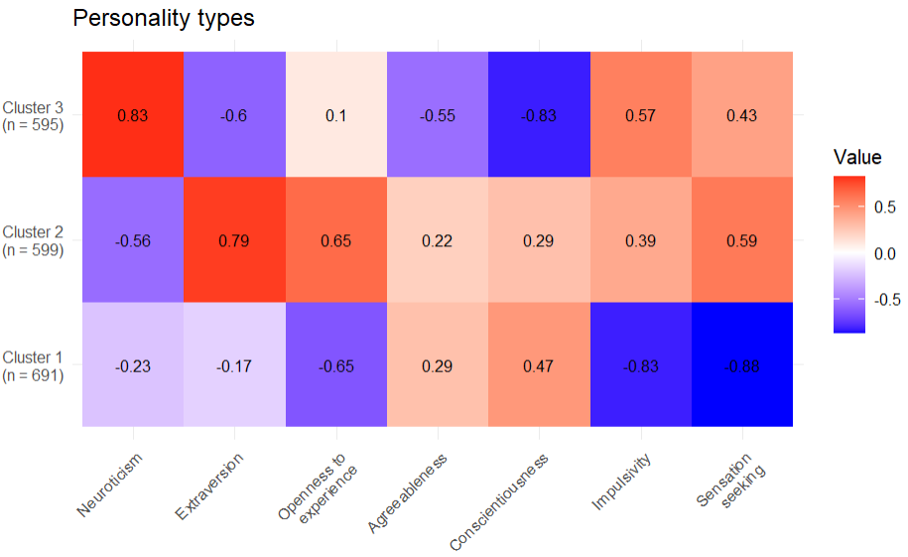
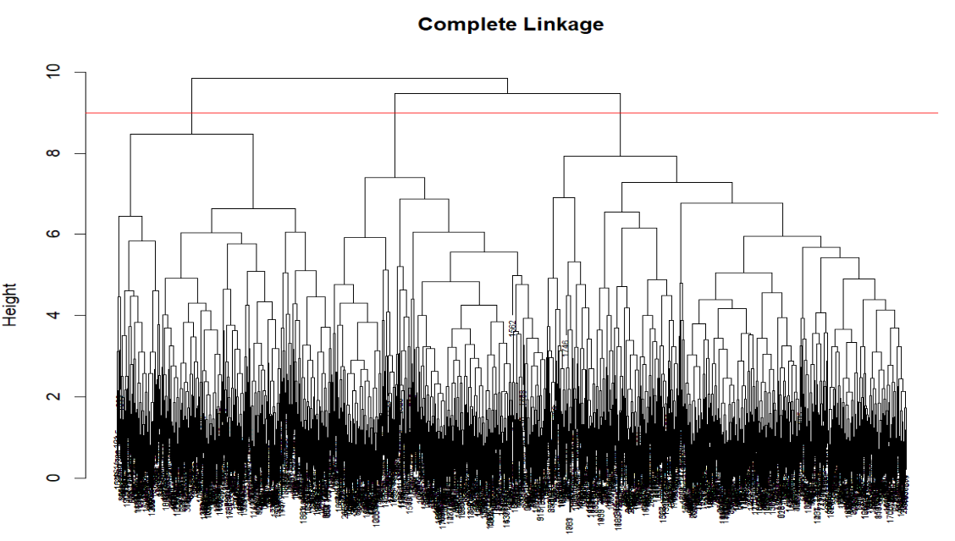
3a. Personality profiling
Hierarchical clustering to find an appropriate K
K-means clustering using centroids from step 1
3 clusters of sizes 691, 599, 595
Cluster 1: cautious individuals who value routine and discipline
Cluster 2: unperturbed and easygoing people who seek out novel sensations
Cluster 3: people who are extremely susceptible to negative emotions and more introverted
Notes:
Use the personality measurements to find personality profiles via clustering analysis. Hierarchical clustering with complete linkage (had the best dendrogram and produced the most reasonable clusters) was used to find an appropriate number of clusters K. This led to K=3. The centroids of these clusters were then used to initialize k.means. The clusters

Slide 8
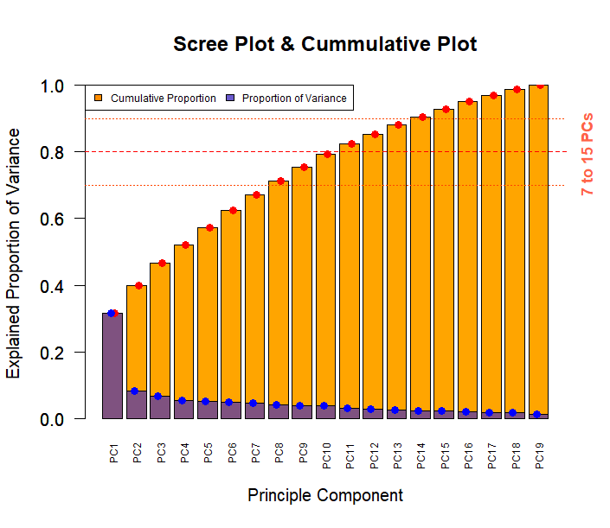
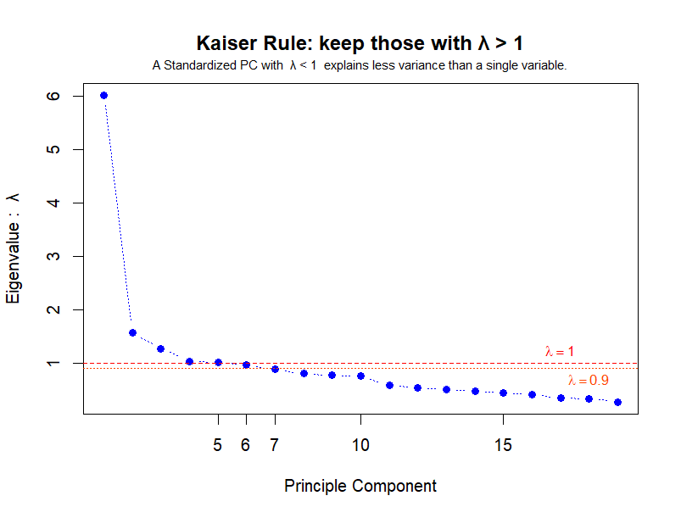
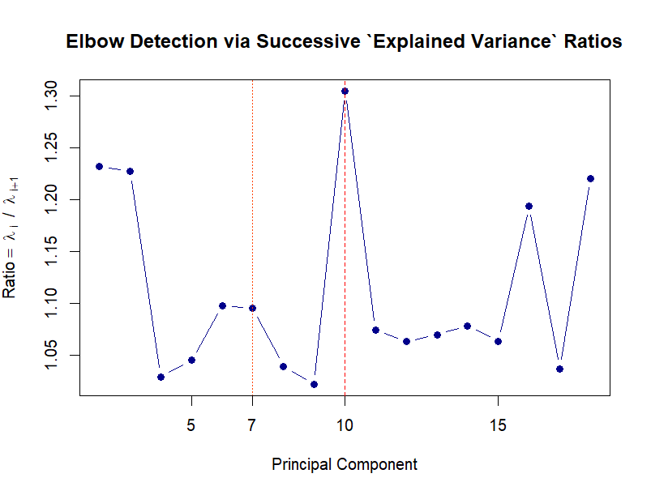
3b. Drug consumption patterns
Trying to make a Response variable for Classification/Prediction purposes
Scaled PCA - Dimension Reduction : How many PCs to keep?

Slide 9
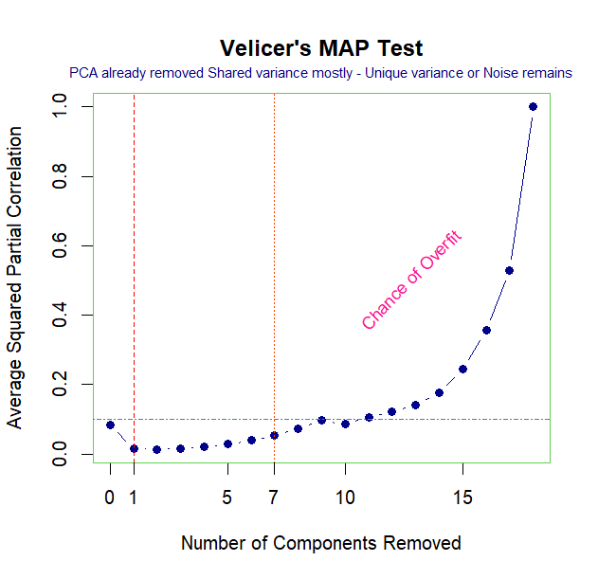
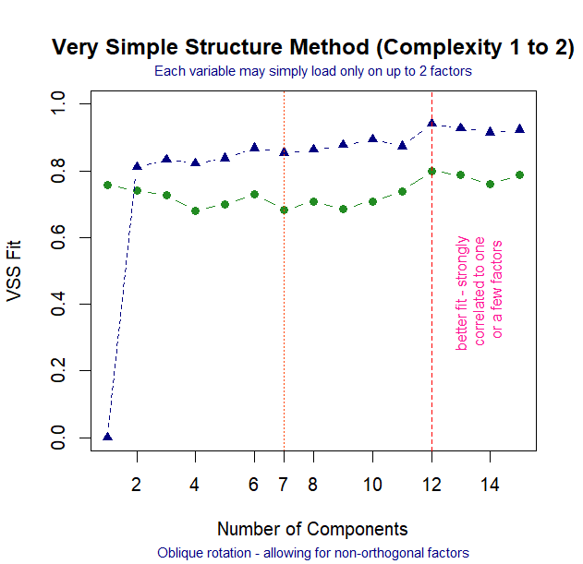
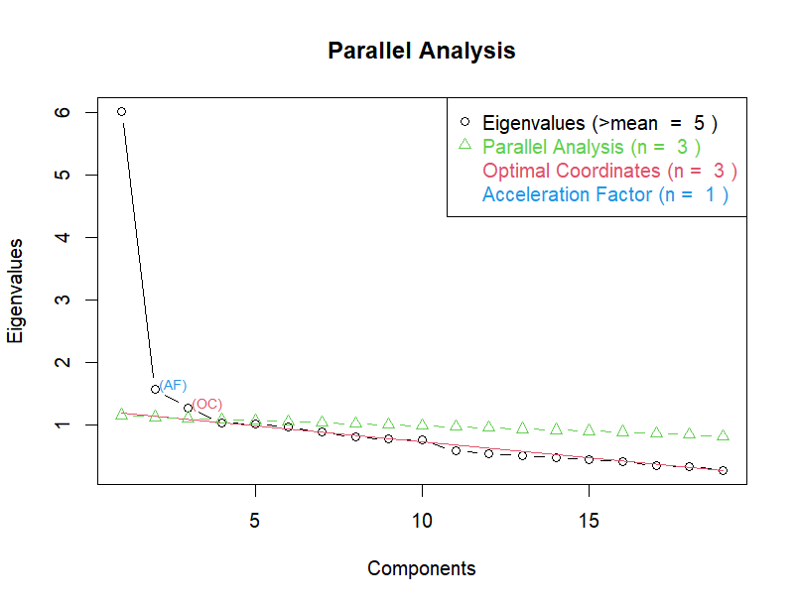
3b. Drug consumption patterns
Trying to make a Response variable for Classification/Prediction purposes
Scaled PCA - Dimension Reduction : How many PCs to keep?

Slide 10
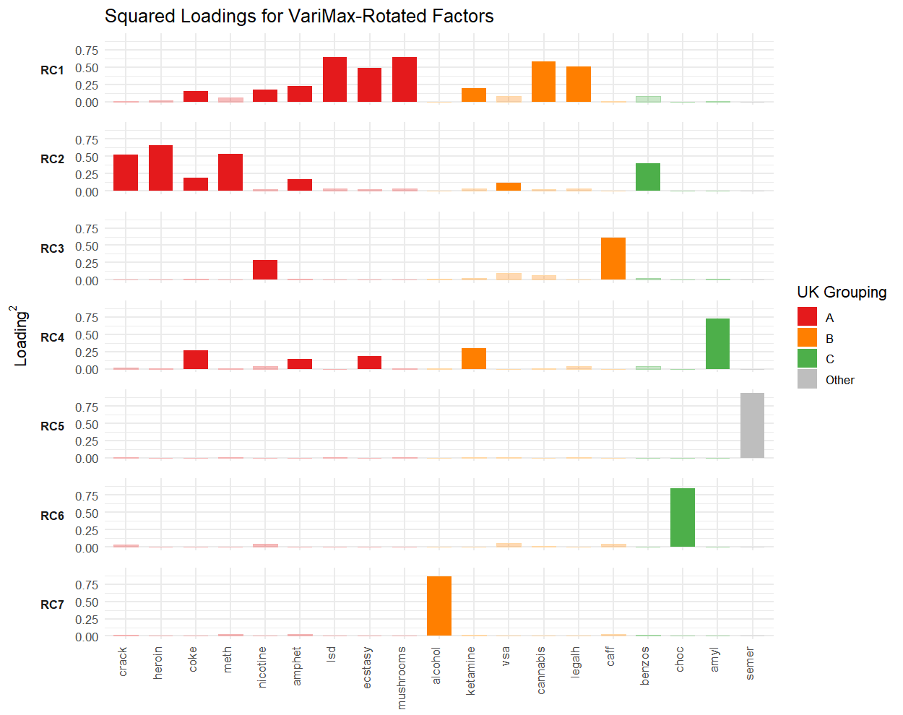
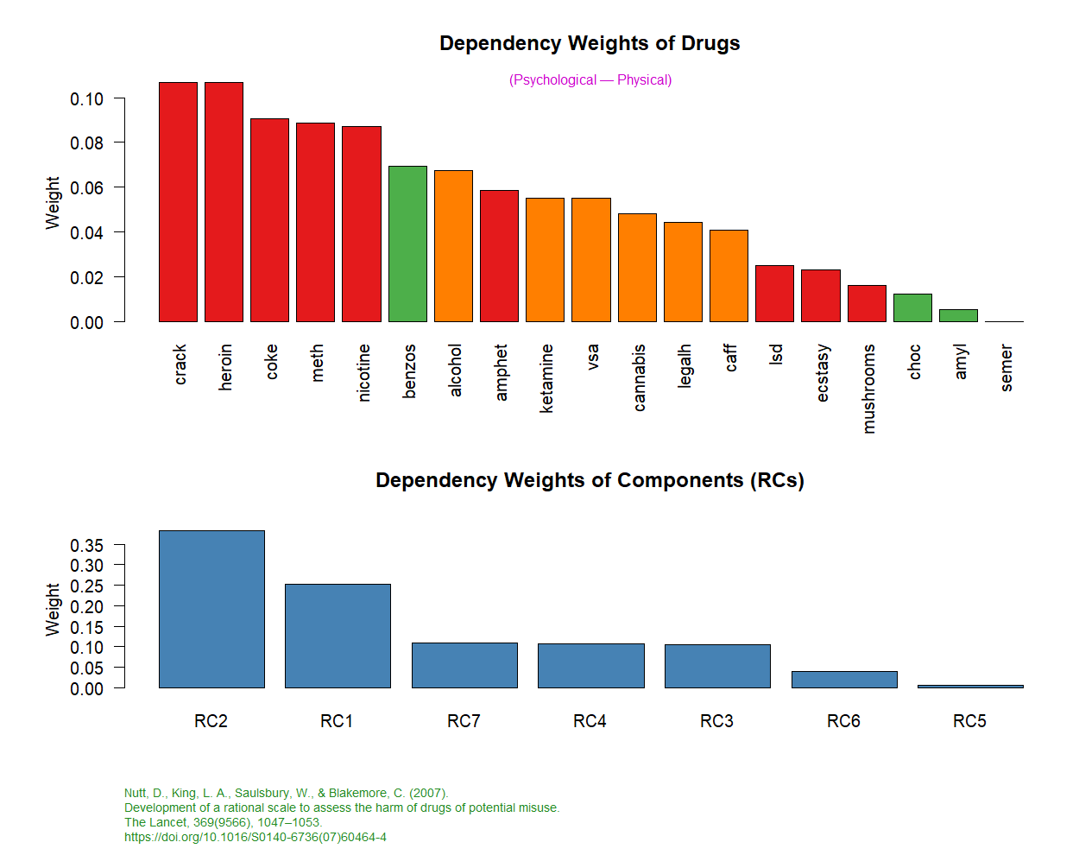
3b. Drug consumption patterns
Trying to make a Response variable for Classification/Prediction purposes
Easier to Infer : 7 RC Dependency Weights vs UK Classification of Drugs

Slide 11
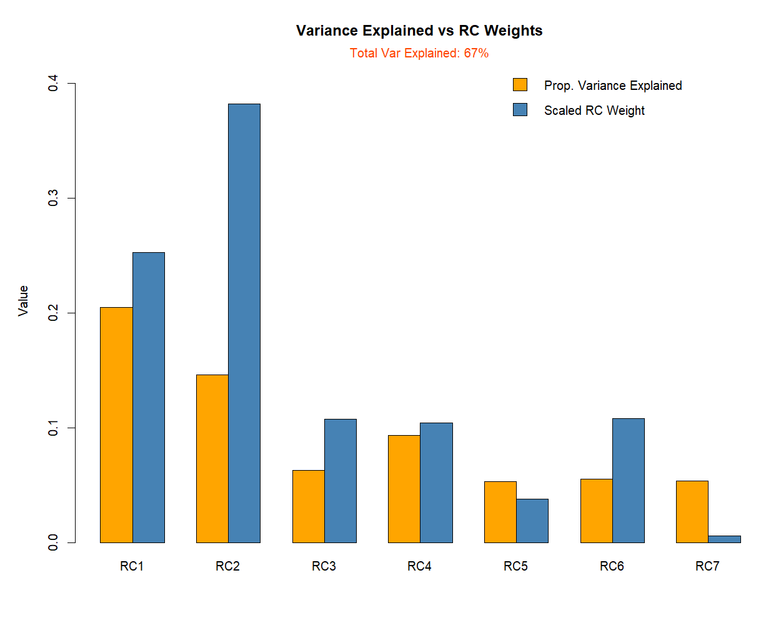
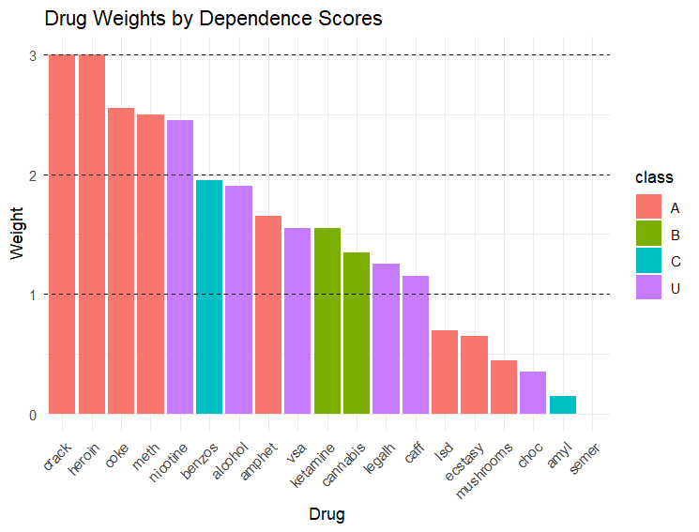
3b. Drug consumption patterns
Trying to make a Response variable for Classification/Prediction purposes
Easier to Infere : 7 RC
Assigning Uncategorized Substances to ABC
Groups According to their Normalized Weights

Slide 12
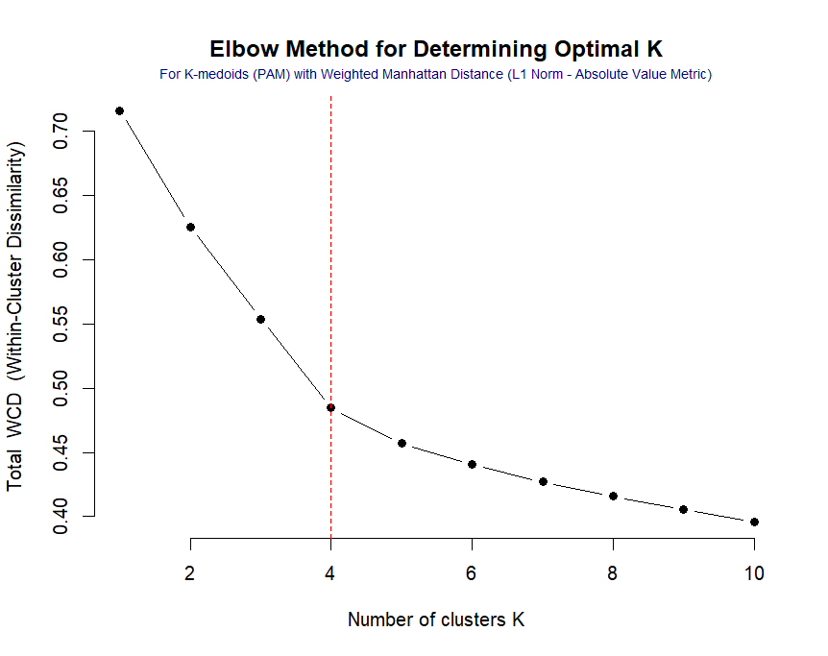
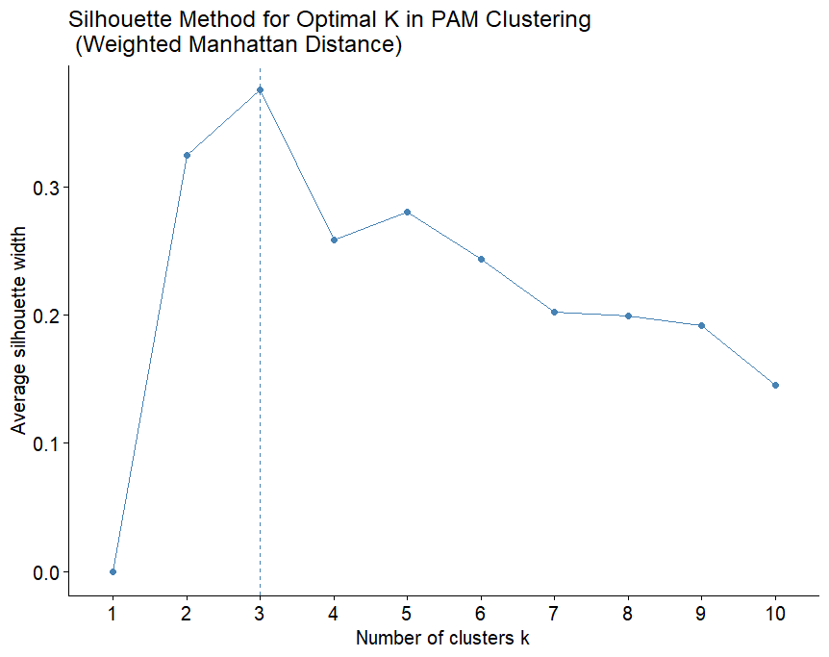
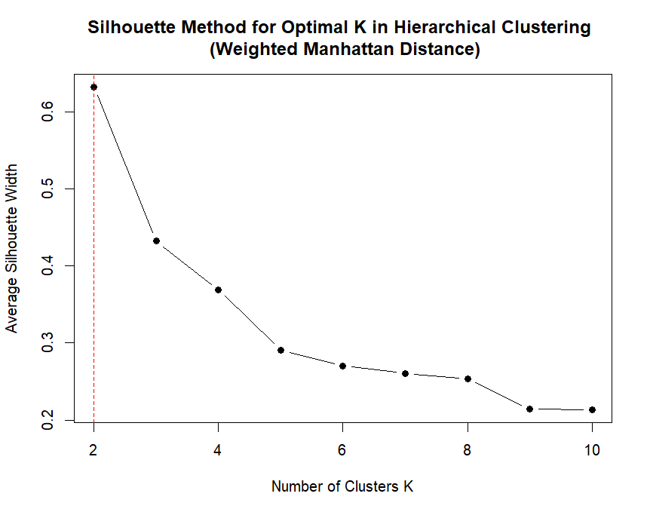
3b. Drug consumption patterns
Trying to make a Response variable for Classification/Prediction purposes
Clustering - K-Medoids & Hierarchical - How many Clusters do we need?

Slide 13
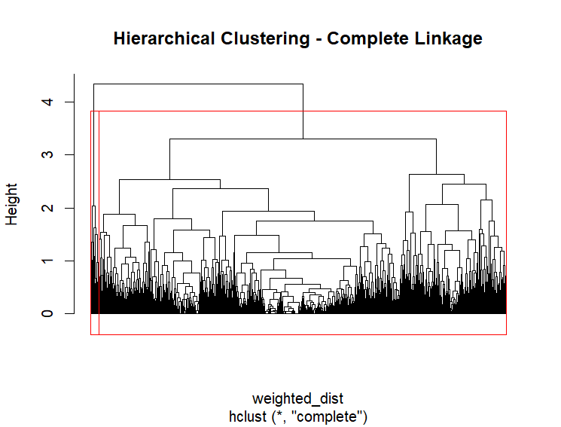
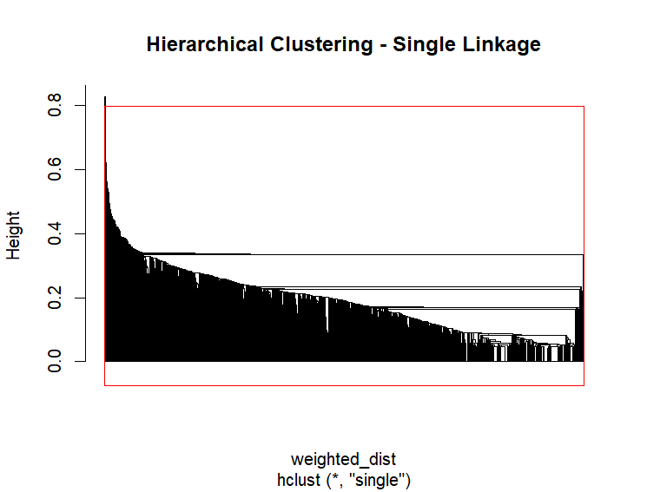
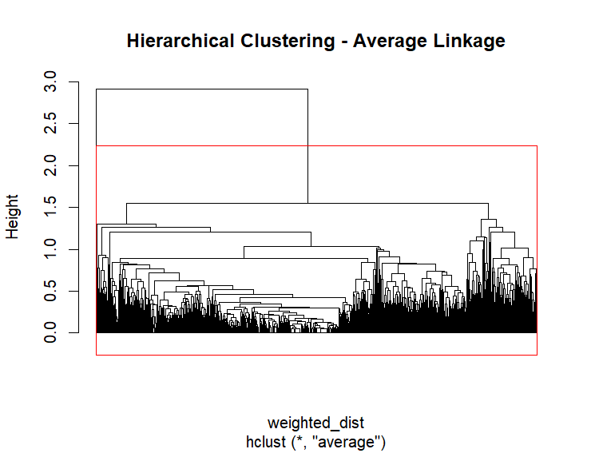
3b. Drug consumption patterns
Trying to make a Response variable for Classification/Prediction purposes
Clustering - K-Medoids & Hierarchical - How many Clusters do we need?

Slide 14
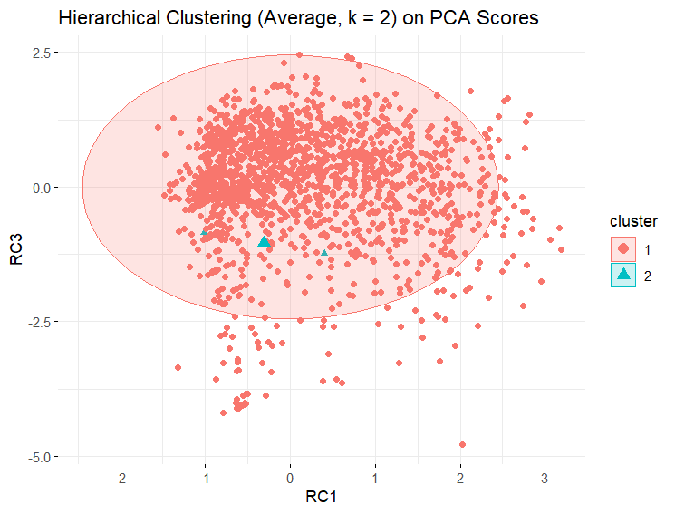
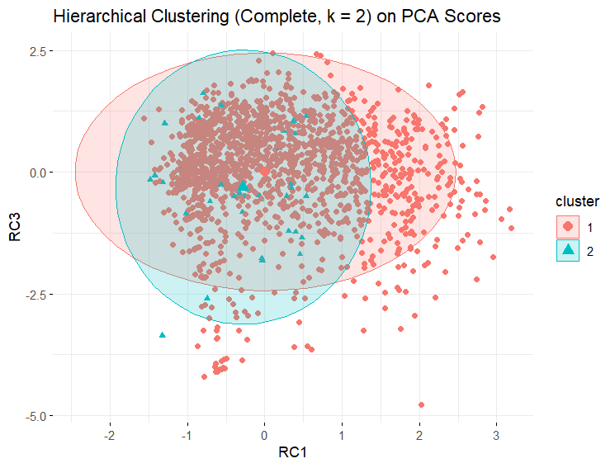
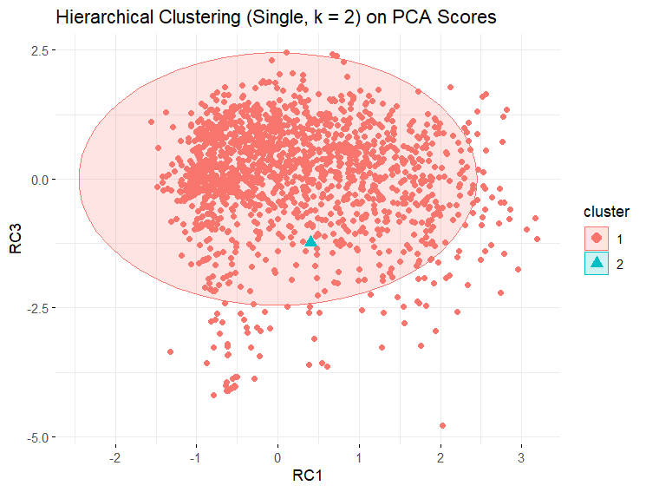
3b. Drug consumption patterns
Trying to make a Response variable for Classification/Prediction purposes
Clustering - K-Medoids & Hierarchical - Does Hierarchical Clustering Sound ?

Slide 15
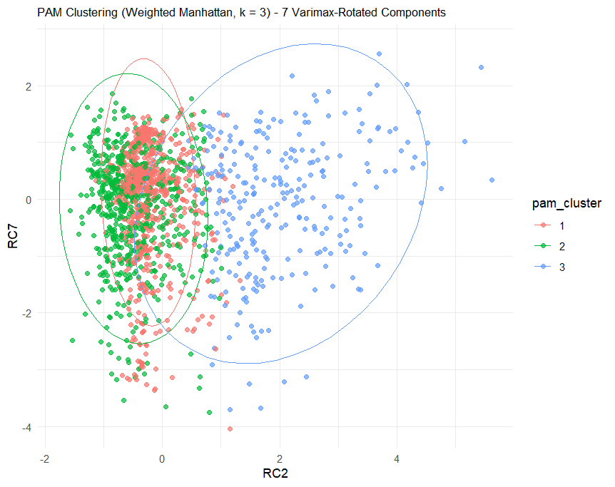
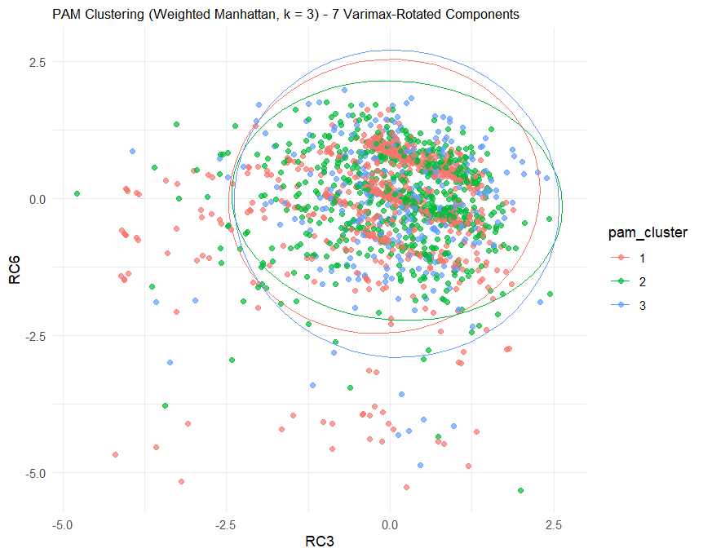
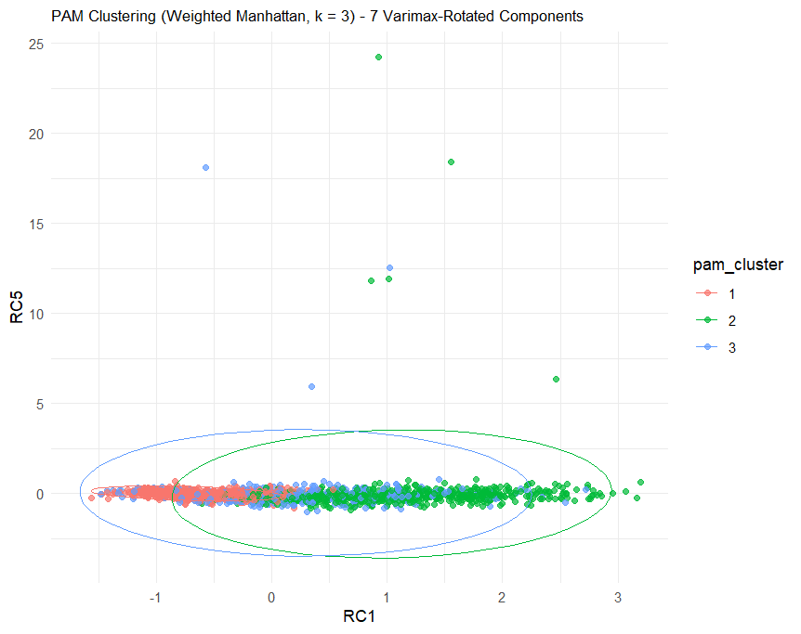
3b. Drug consumption patterns
Trying to make a Response variable for Classification/Prediction purposes
Clustering - K-Medoids & Hierarchical - Does PAM Clustering Sound ?

Slide 16
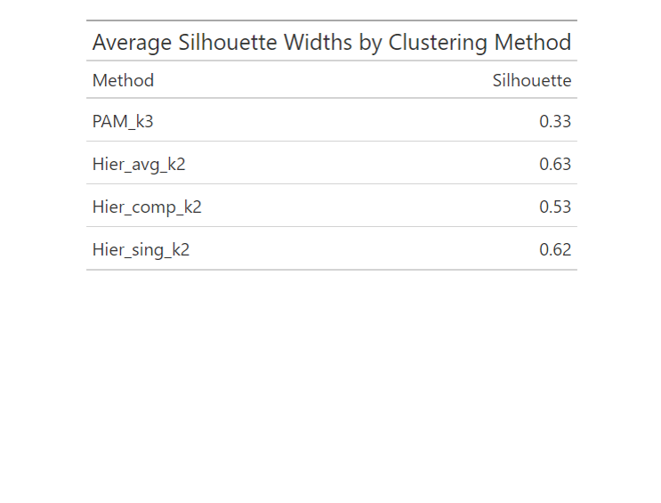
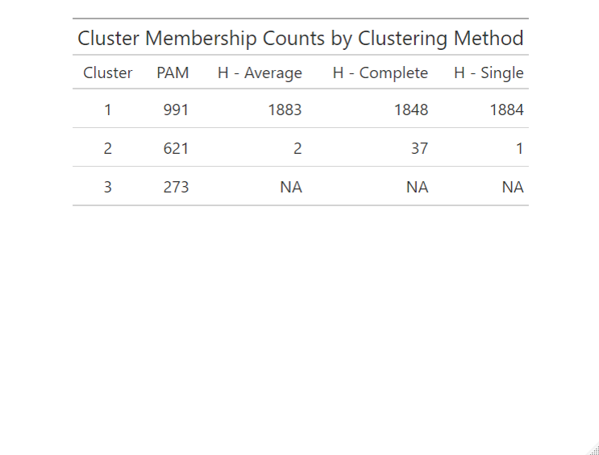
3b. Drug consumption patterns
Trying to make a Response variable for Classification/Prediction purposes
Clustering - K-Medoids & Hierarchical - What the Numbers Claim?

Slide 17
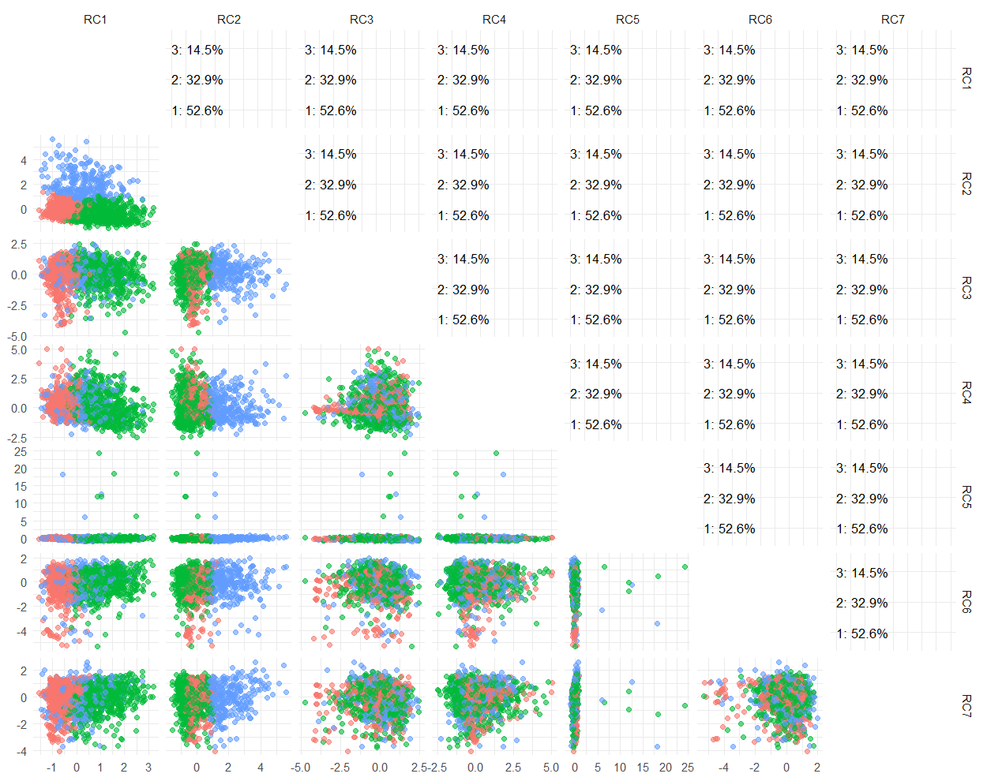
Cross-Sections of 3 PAM Clusters in 7 dimensions - Trying to assign a meaning to each cluster

Slide 18
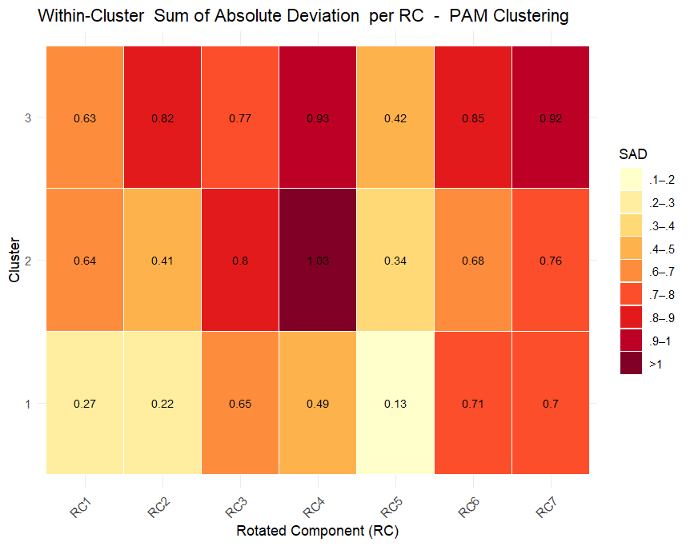
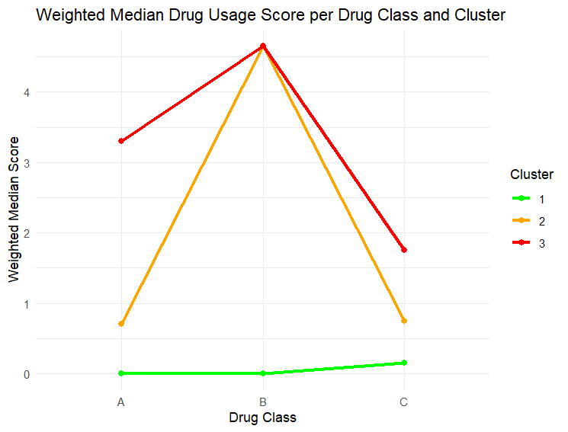
3b. Drug consumption patterns
3 PAM Clusters in 7 dimensions - Trying to assign a meaning to each cluster

Slide 19
3b. Drug consumption patterns
Personality Cluster | Drug 1 | Drug 2 | Drug 3
1 | 29.4% | 5.6% | 1.6%
2 | 13% | 14.9% | 3.9%
3 | 10.1% | 12.5% | 9%

Slide 20
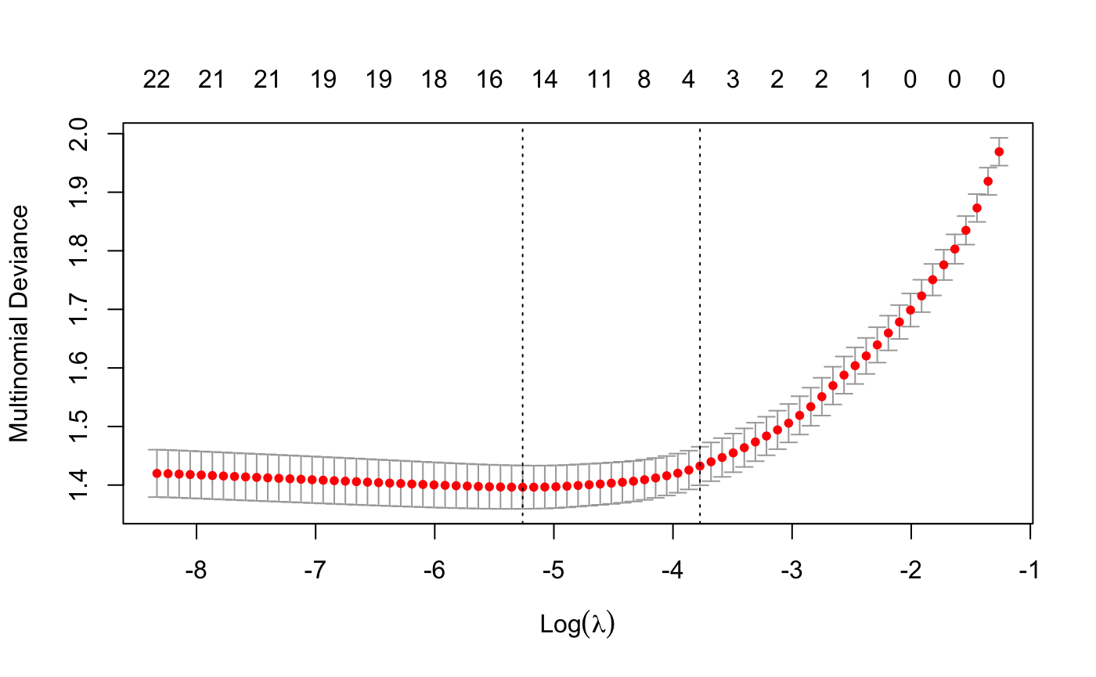
3c. Classification
Multinomial LASSO regression
Prevents overfitting
Variable selection and regularization
Accuracy: 0.7401
 | Reference
 |  | 1 | 2 | 3
 | 1 | 188 | 32 | 15
 | 2 | 12 | 74 | 26
 | 3 | 7 | 6 | 17
Prediction
Notes:
mult deviance: more deviance means more regularization; deviance is -2loglik. Least deviance: best model. lrt=lik of reduced and non reduced. Less deviance means less errors for N; but for other glm: deviance, but not rss;
1,2,3… slides for Polina’s models
!!!!!! Add the confusion matrix (if you want)

Slide 21
4. Results and comments
Coefficients Class 1 | Coefficients Class 2 | Coefficients Class 3
Cluster2 = -0.415 (OR = 0.66) Cluster3 = -0.415 (OR = 0.66) | Cluster2 = 0.102 (OR = 1.11) Cluster3 = 0 (OR = 1) | Cluster2 = 0 (OR = 1) Cluster3 = 0.569 (OR = 1.77)
Being cautious (Personality Cluster 1) is associated with higher odds of being in Drug Class 1
Being curious (Personality Cluster 2) is associated with higher odds of being in Drug Class 2
Being more emotionally unstable (Personality Cluster 3) is associated with higher odds of being in Drug Class 3
The direction of the LASSO coefficients is often correct, but the point estimates are biased due to regularization!
Notes:
Class 3: A drugs, heavier; Class 2: mid level; Class 1: min drug user. We had multiple variables, so we used LASSO to shrink some of them

Slide 22
5. Summary and conclusion
Are personality profiles associated with discernible patterns in drug consumption?
3 personality profiles. Higher proportion of users of harmful drugs can be found among nervous and reckless individuals.
How one may create a Response Variable for Classification/Prediction purposes via Drug Consumption Patterns?
The results of the clustering made are consistent with UK ABC classification: People in Cluster 3 mostly use A drugs with a heavy frequency, and those in Cluster 1 are even cautious about using Group C substances.
Is it possible to predict the type of drugs a person consumes based on their personality?
It is, with an accuracy of 74.01%.

Slide 23
Thank you for your attention

