Slide 1

Operations Data Analyst Challenge Name: Taymour Khan Niazi Submission Date:

Slide 2
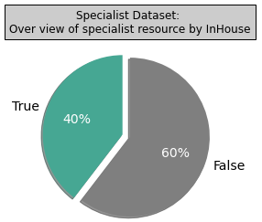
- Specialists Overview
# of Resources
202
Note:
Internal and external specialists are not separated to provide complete picture of important resources.
# of Resources by
“In House”
122 resources are In House
80 resources are In House

Slide 3
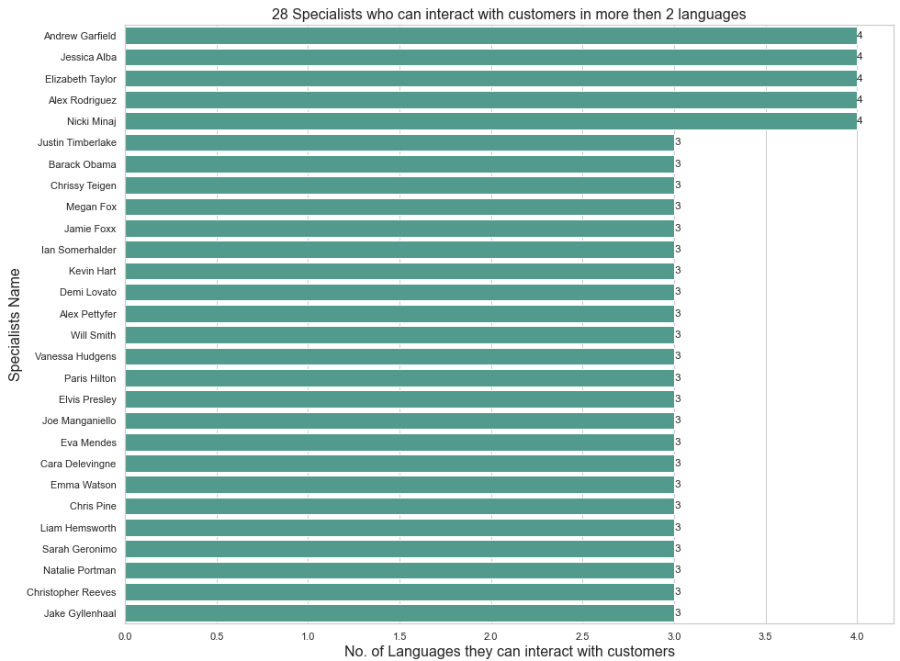
- Specialists Overview -- Continued
Details
Note: Internal and external specialists are not separated to provide complete picture of important resource
The insights generated for specialist is to identifying significant specialist which can be the customer service great asset, where the following 5 resources can interact with customers in 4 languages
Andrew Garfield
Jessica Alba
Elizabeth Taylor
Alex Rodriguez
Nicki Minaj

Slide 4
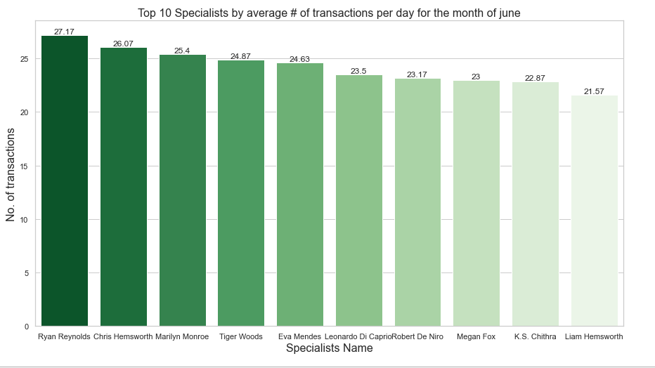
- Specialists Overview -- Continued
Note:
Internal and external specialists are not separated to provide complete picture of important resource.
Dividing transaction count for each specialists by 30 to get average # of transaction for specialists.
Ignoring all transactions where the full name contains “CALL QUEUE” OR “CHAT QUEUE”.

Slide 5
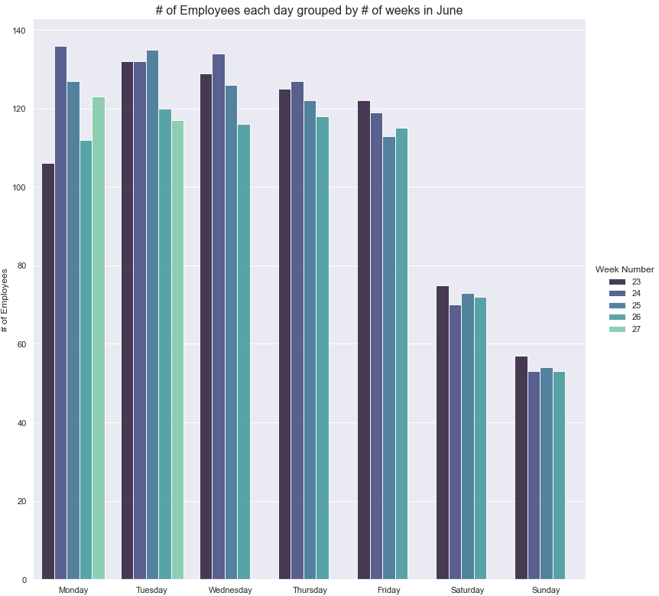
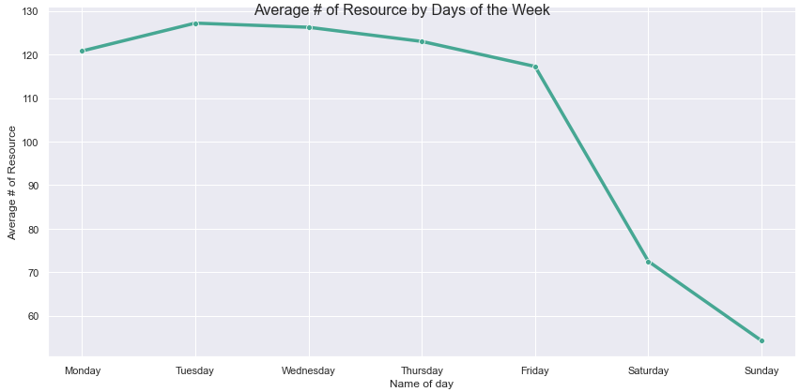
1.B Customer Service Overview
Need to communicate to Workforce (WF) Management how many members of staff will be needed per day of the week for the next 7 days.
Note:
External and internal specialists are not separated as this will be done by the WF Manager.
As per the below left chart there is noticeable pattern for each day of the week
Hence after taking average for each day of the week for the entire month, the right line chart is giving insight on how many resources are required for the next week

Slide 6
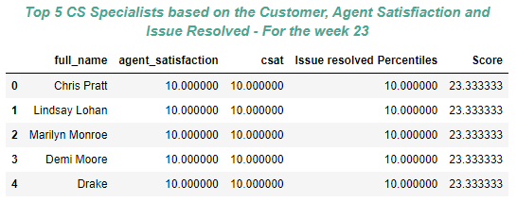
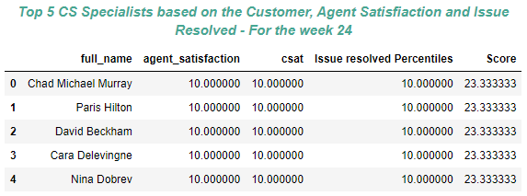
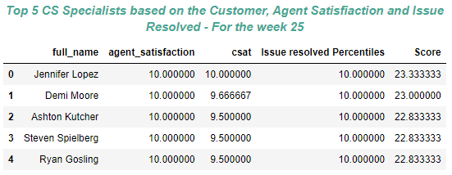
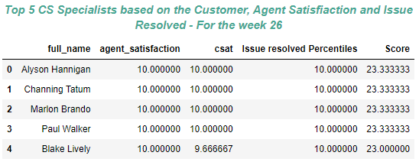
2. CS Specialists
Breakdown per week for the top 5 inhouse CS specialists with respect to 3 KPIs for measuring specialist performance
Note:
The three KPI's took into consideration are Agent satisfaction, Customer satisfaction, Issue resolved
Only considering data where specialists are In-House
Taking data where the week has all the days(week # 27 has only two days so we ignore those data rows)
Taking an average mean of Agent satisfaction, Customer satisfaction and Issue resolved for each week by specialists ID

