Slide 1

Excel : A Friendly Introduction
Presenter: Raja Balaj Sikander
Business Intelligence Executive
Email:balaj.sikander@leverify.com

Slide 2

Where To Get The Dataset?
Kaggle is your friendly neighbor who has no problem sharing datasets
Want to know the buying habits of your fellow pakistani’s, Follow the link below:
https://drive.google.com/drive/folders/1N_fYGSdX7kODGDLlAZ2HbIVieFr7Fr3T?usp=sharing

Slide 3
What’s In The Dataset
The dataset contains detailed information of half a million e-commerce orders in Pakistan from March 2016 to August 2018.
It contains:
Item details
Shipping method
Payment method
Product categories
Date of order, SKU, price, quantity, total, customer ID
And much more

Slide 4
Let’s Get Started
The Basic:
Range
Cells
Row
Column
Answer:
Collection of two or more cells
The boxes you see in the grid of an Excel worksheet
Row runs horizontally
Column runs vertically

Slide 5
Create a New Worksheet
Click “New Sheet” Button on Footer
Rename the Sheet

Slide 6
Some Basic Row Operations
We will learn to:
Insert Row and Column
Move a range
Copy and paste a range
Fill a range

Slide 7
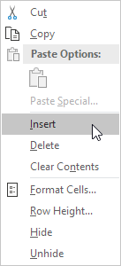
Insert Row and Column
Select a column or row next to where you want to insert
Right click, and then click Insert

Slide 8
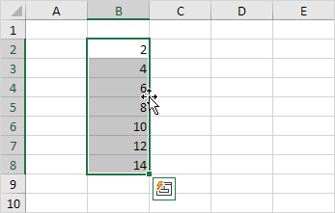
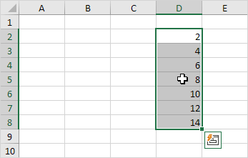
Move a range
1. Select a range and click on the border of the range
2. Drag the range to its new location

Slide 9
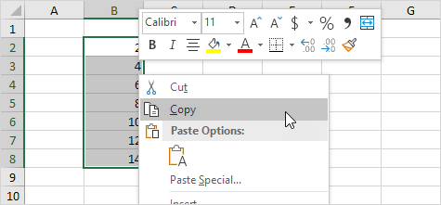
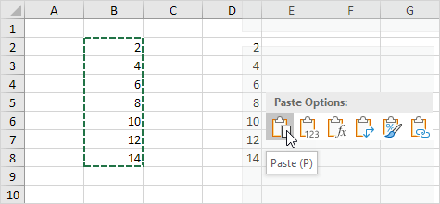
Copy and paste a range
1. Select the range, right click, and then click Copy (or press CTRL + c)
2. Select the cell where you want the first cell of the range to appear, right click, and then click Paste under 'Paste Options:' (or press CTRL + v)

Slide 10
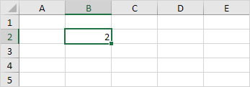
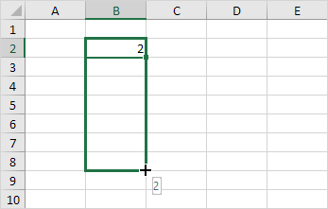
Fill a range
Enter the value into a cell
Select the cell, click on the lower right corner of the cell and drag it down to the cell upto which you want to fill

Slide 11
Assignment #1
1) Insert a column to the right of column A
2) Move Column with Header “Customer ID” to newly form column
3) Copy Range A1:R25
4)Create a New sheet “Exercise”and paste the range
5) Fill “Column S” with “Date of Modification”

Slide 12
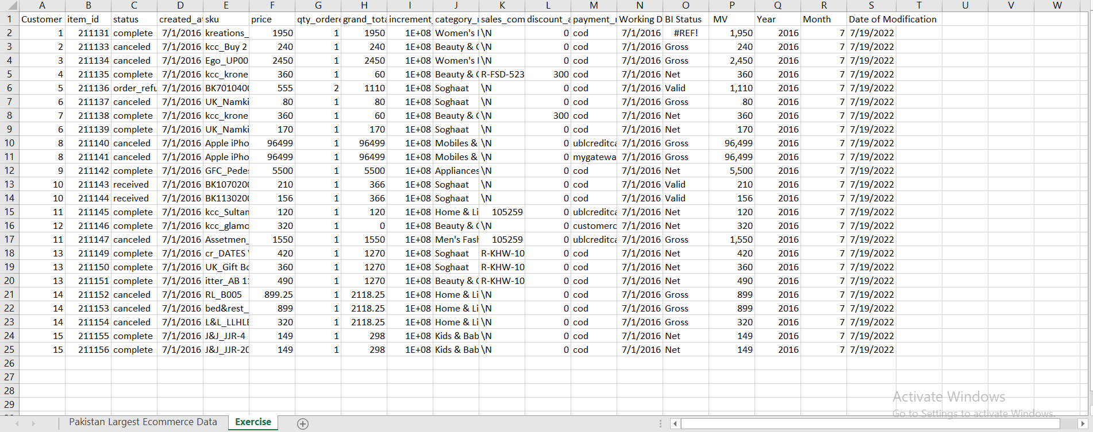
Results

Slide 13
Any Questions

Slide 14
Most Used Formulas
Here are some of most used formula that we will learn:
SUM
IF
AVERAGE

Slide 15
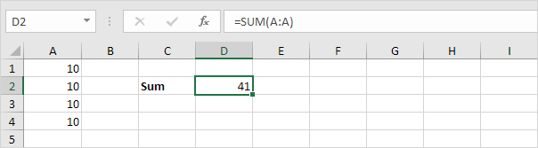
Problem Statement
Add all the numbers in a given column/row.

Slide 16
SUM
To sum a range of cells, use the SUM function in Excel
(you can also use the SUM function to sum an entire row. For example, =SUM(5:5) sums all values in the 5th row)

Slide 17
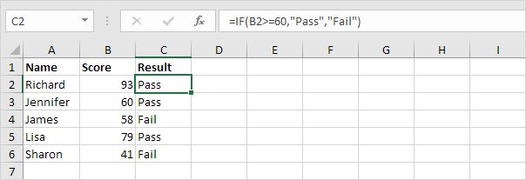
Problem Statement
In column C, I want pass/fail status of the student. Score 60 or above is passing criteria.

Slide 18
IF
The IF function checks whether a condition is met, and returns one value if true and another value if false

Slide 19
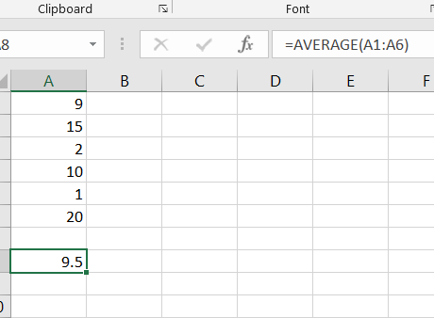
Find AVERAGE of given numbers
To calculate the average of a group of numbers, use the AVERAGE function

Slide 20
Test Your Learning
1) Find if the grand_total of current cell is greater than 1000
2) Find the Sum and Average Price of products bought by Customer ID = 13

Slide 21
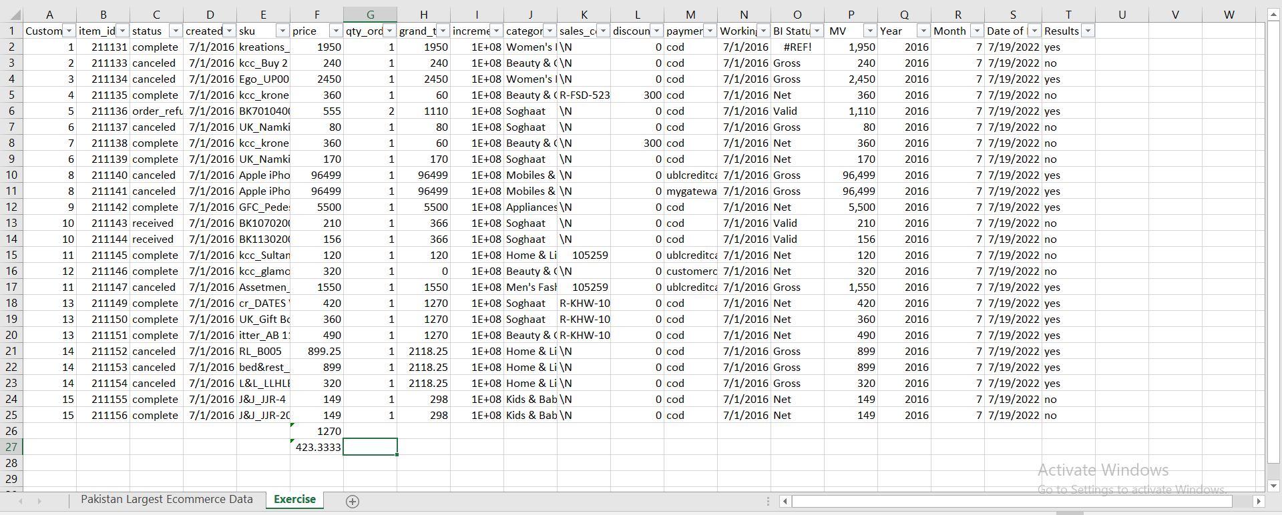
Results
Formula
=IF(H2>= 1000,"yes","no")
=SUM(F18:F20)
=AVERAGE(F18:F20)
Answer
In picture below
1270
423.3333

Slide 22
Any Questions

Slide 23
Thankyou

