Slide 1
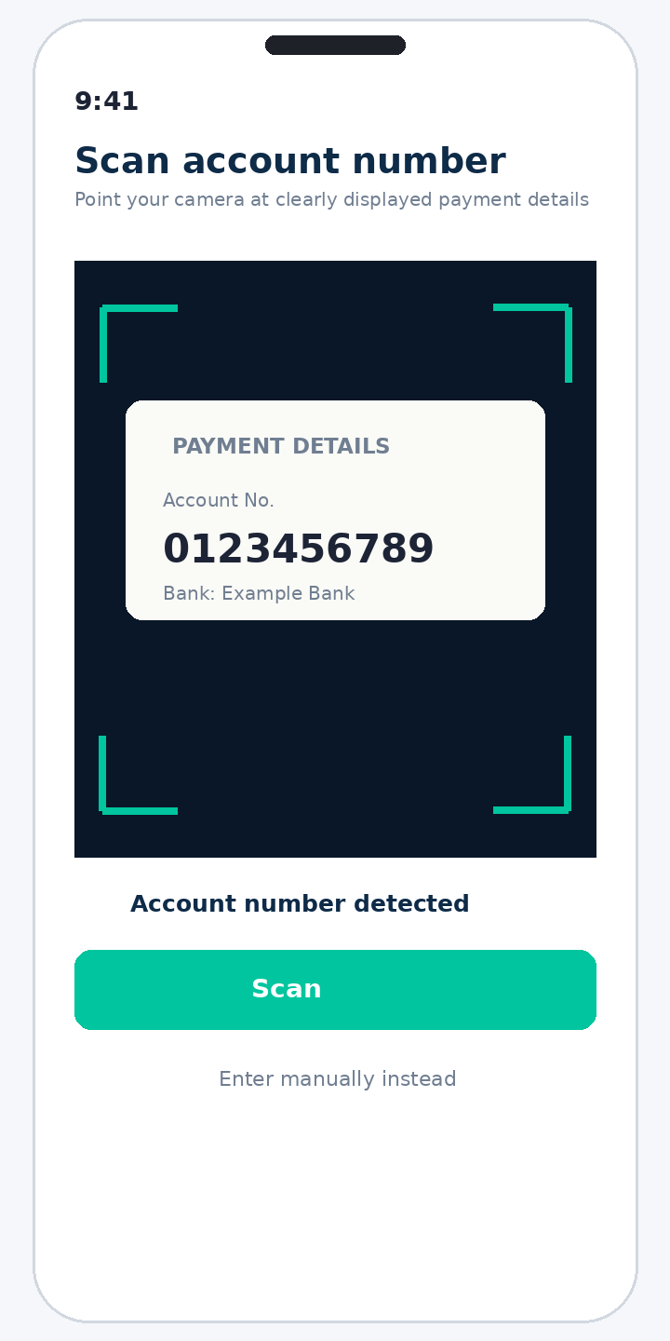
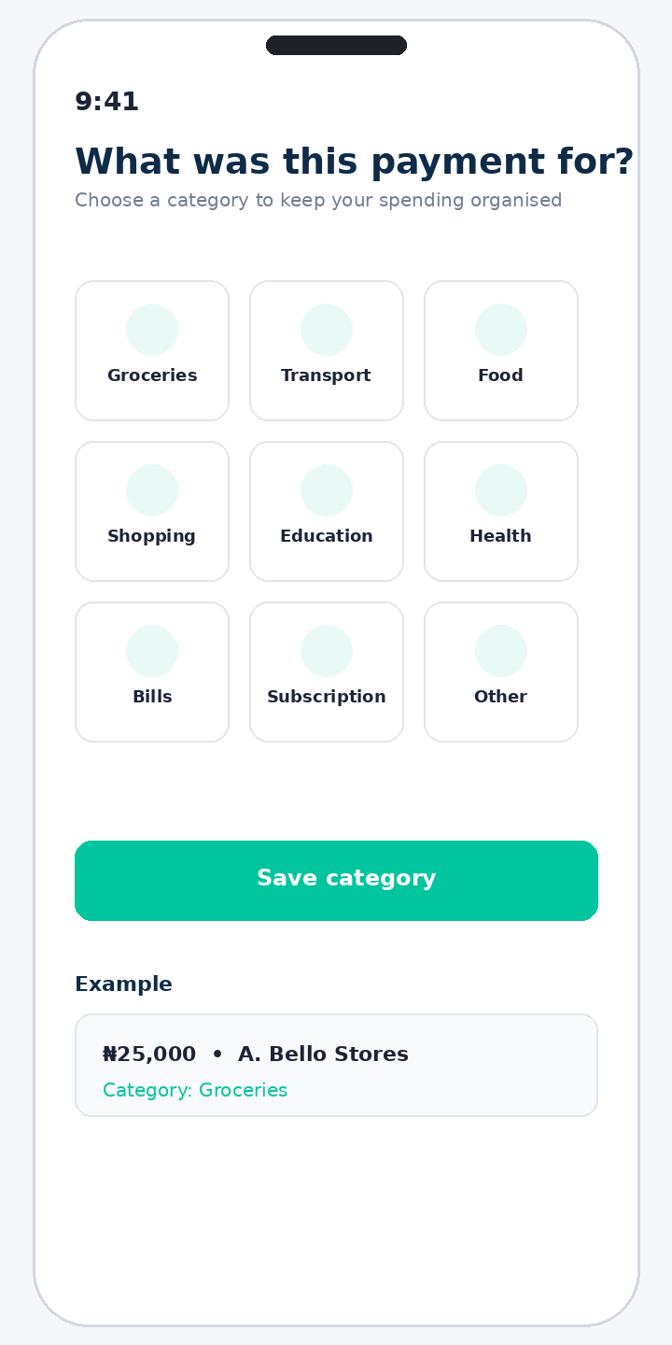
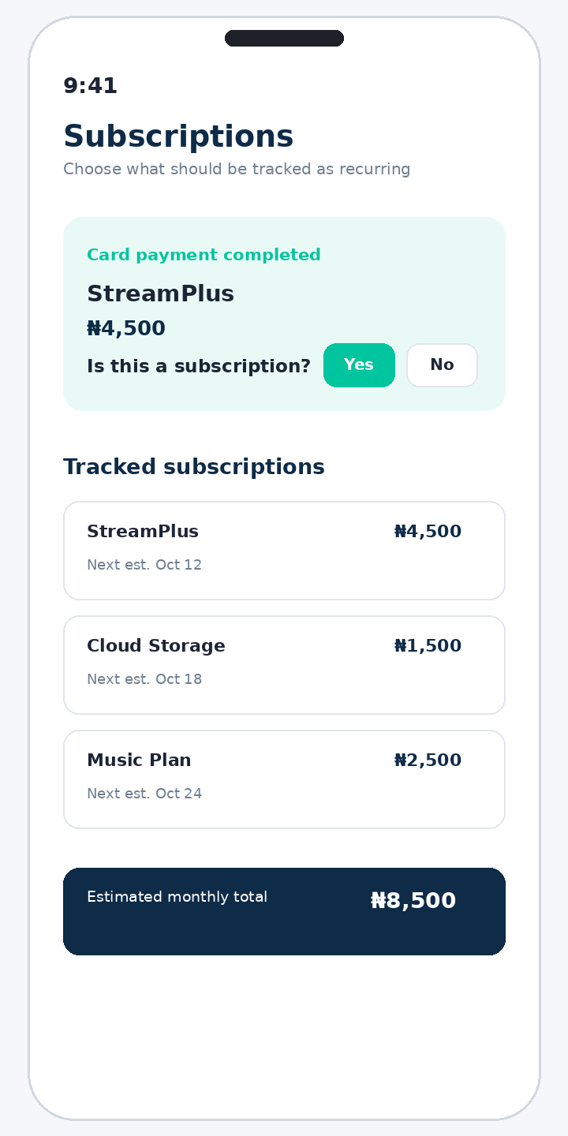
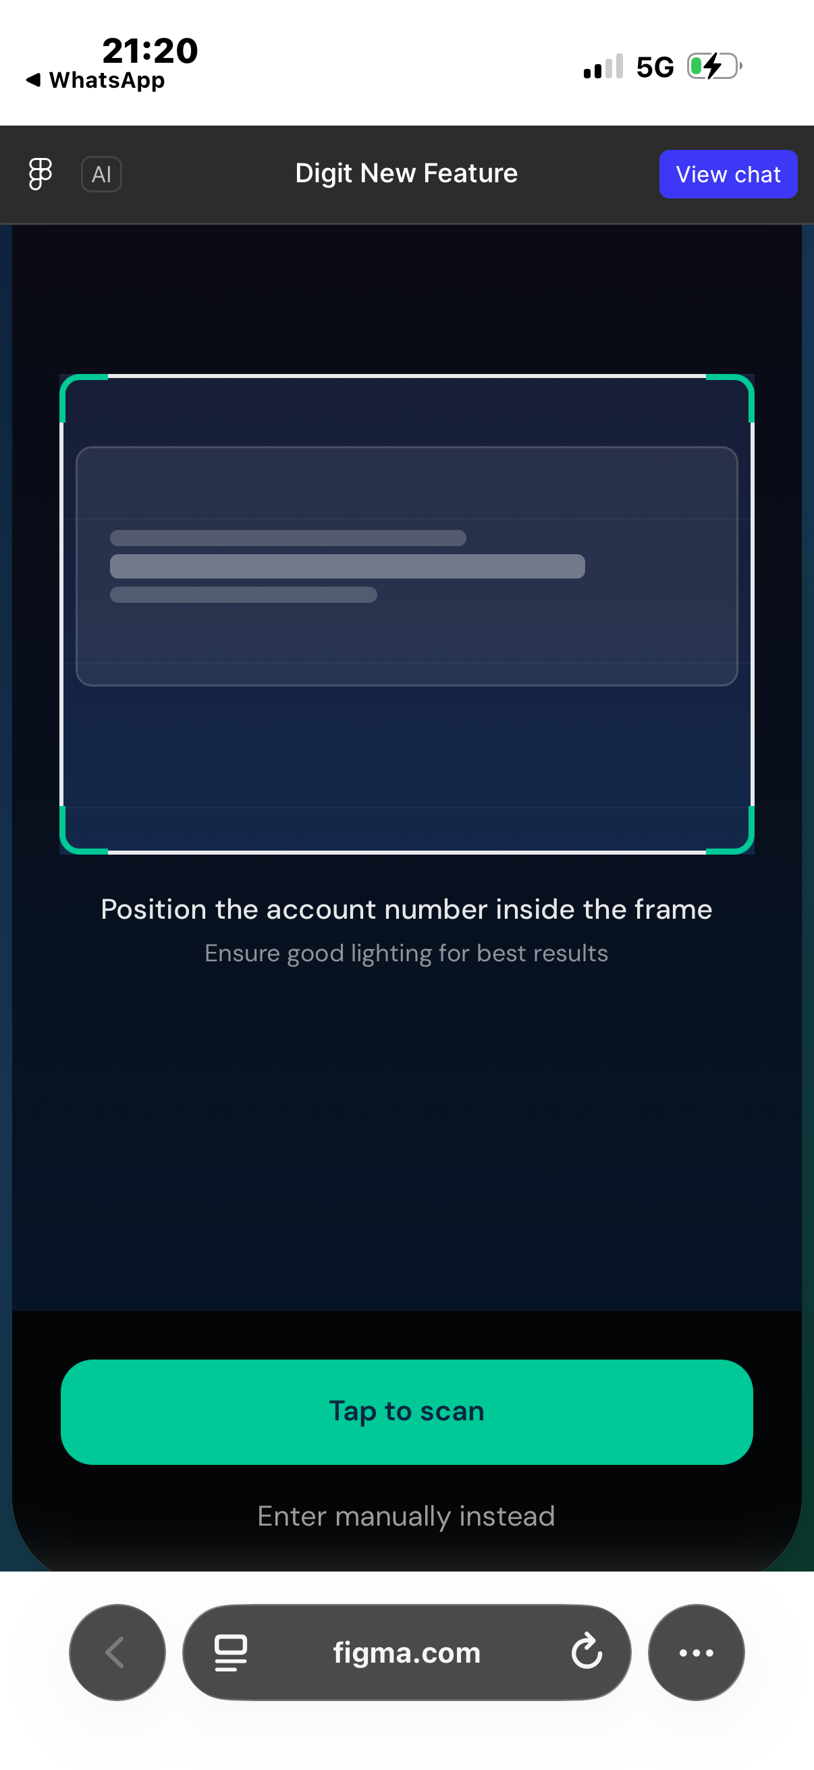
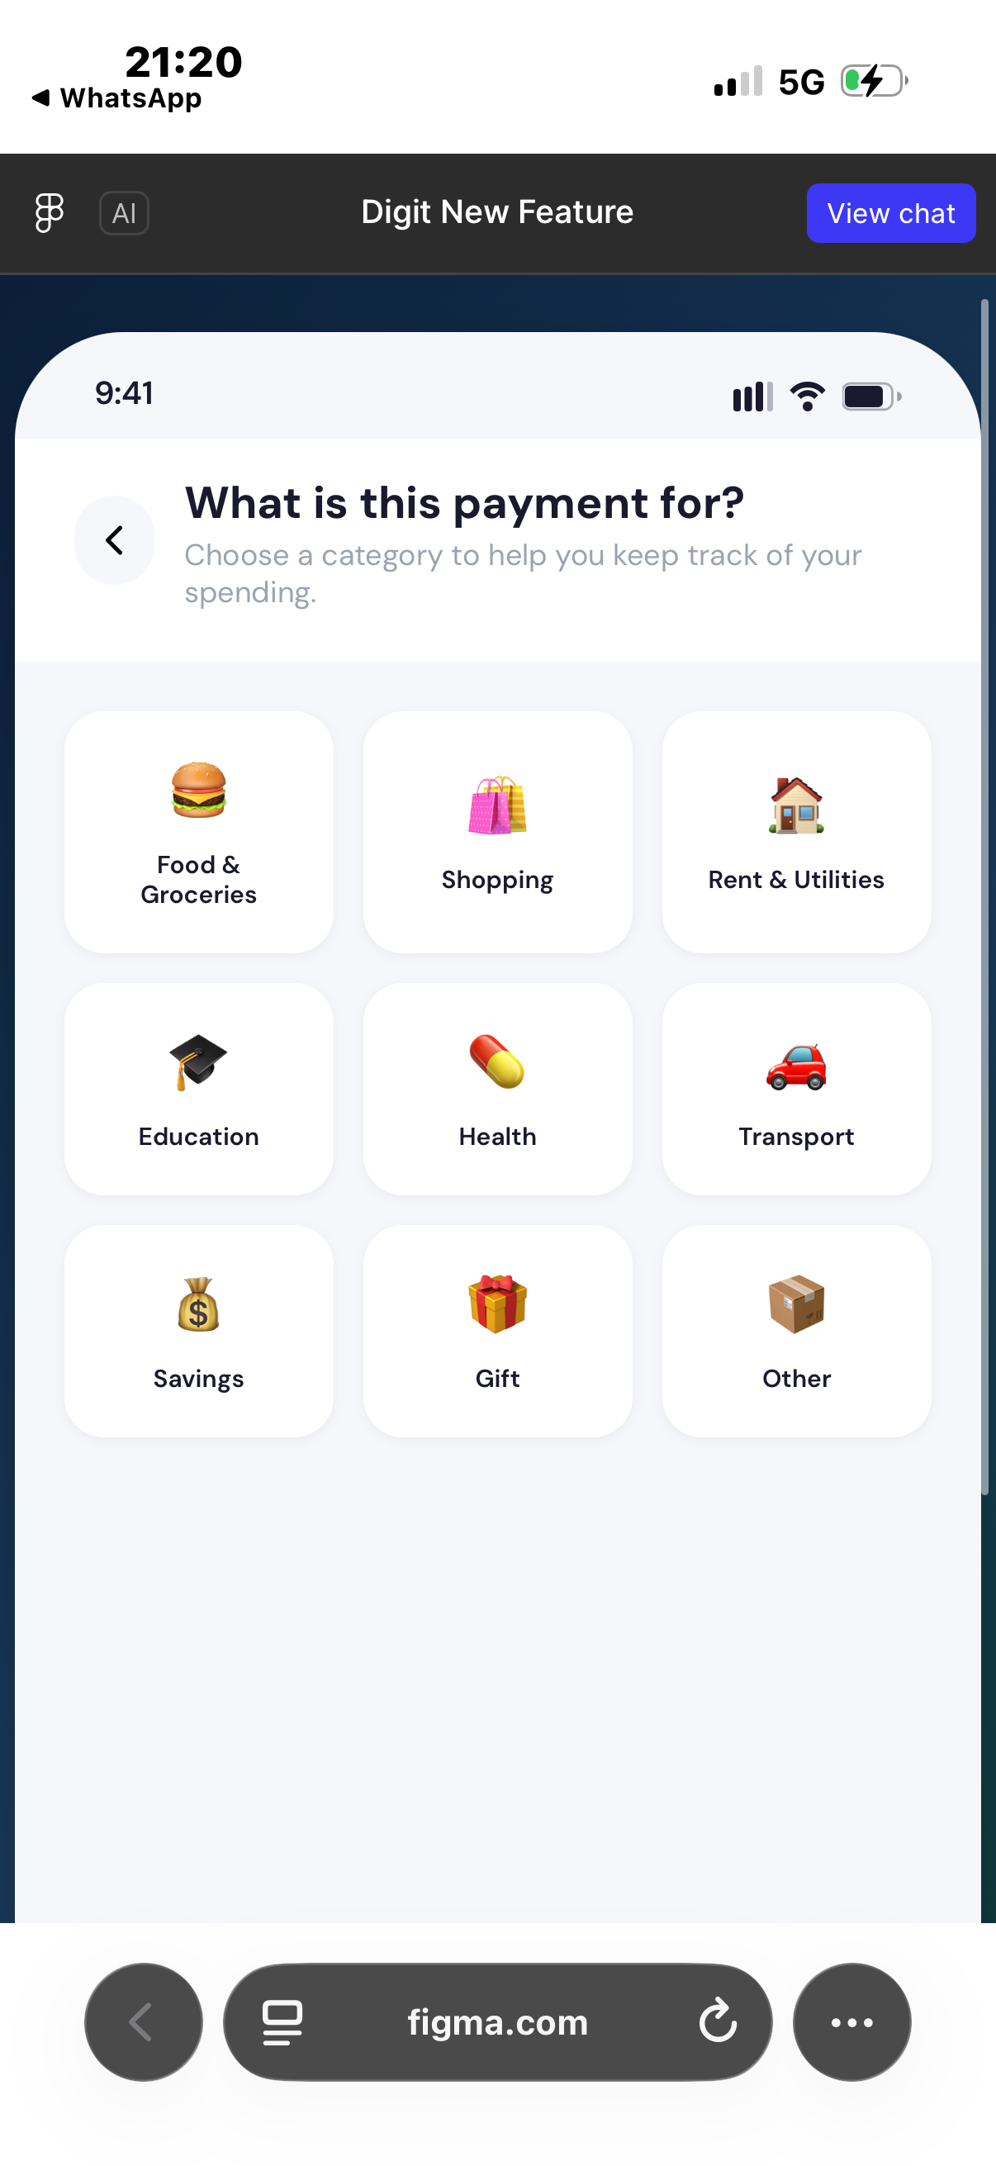
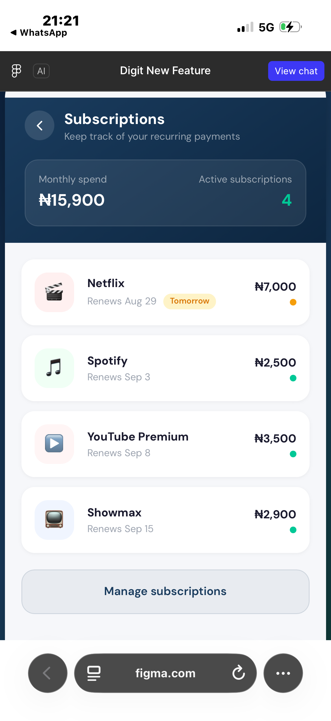
SMART PAYMENTS
Digital Payment Feature Concepts
A smarter payment experience built around speed, clarity, organisation and useful financial insights.
Independent Product Concept Presentation

Slide 2
Proposal at a Glance
Four product concepts for easier payments, clearer spending records, subscription awareness and relevant communication.
01
Scan-to-Pay
02
Payment Categorisation
Capture a printed or displayed account number and reduce manual entry.
Describe a payment with one tap, such as Groceries, Transport or Education.
03
Subscription Tracker
04
Email News & Offers
Let users mark eligible card payments as subscriptions and begin tracking recurring spending.
Send consent-based news and offers by email when they are relevant to a customer's spending categories.

Slide 3
Feature 1 — Scan-to-Pay
Replace error-prone manual typing with camera-assisted account capture.
How it works
1
Capture
The user points the camera at a clearly printed account number or a picture, receipt, invoice, POS display, sign or other image where the business account number is clearly visible.
2
Read
The app detects the account number using image/text recognition and converts it into editable digital text.
3
Resolve
Using the captured number and selected or detected bank, the system performs the normal account-name enquiry.
4
Confirm
The user reviews the retrieved recipient details before proceeding with the transfer.

Slide 4
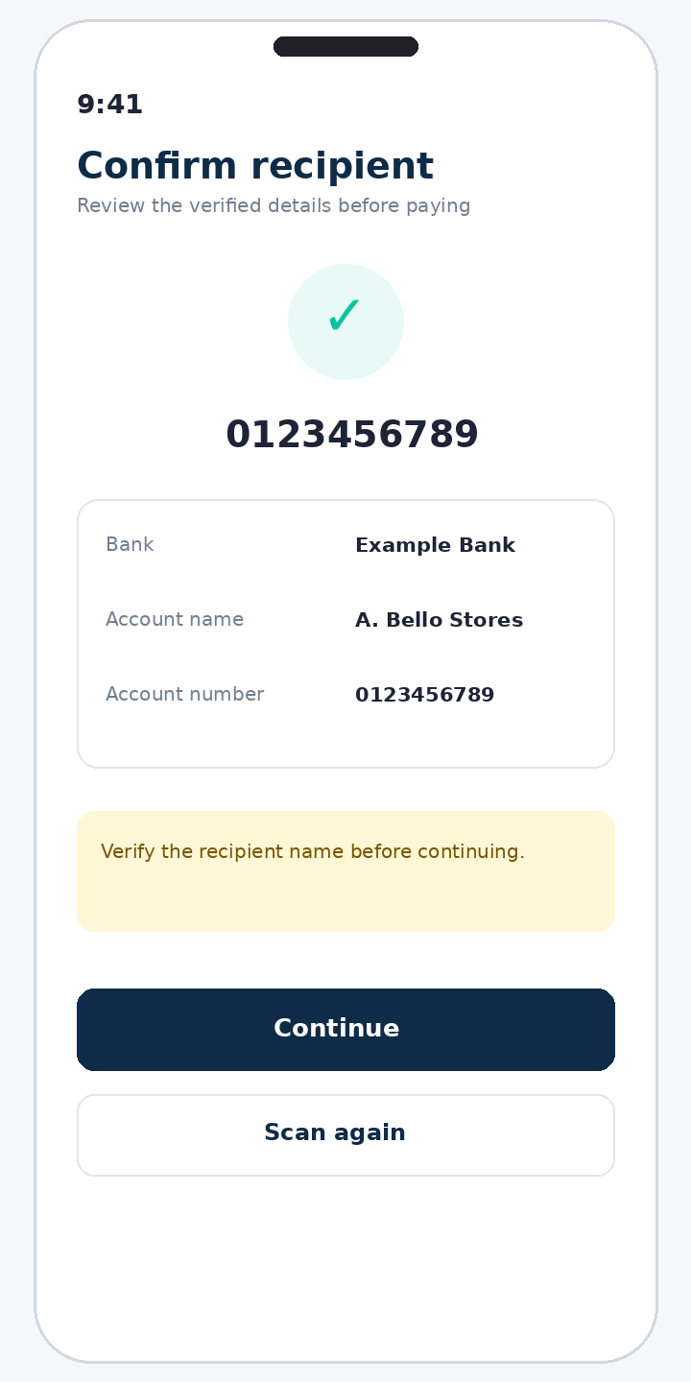
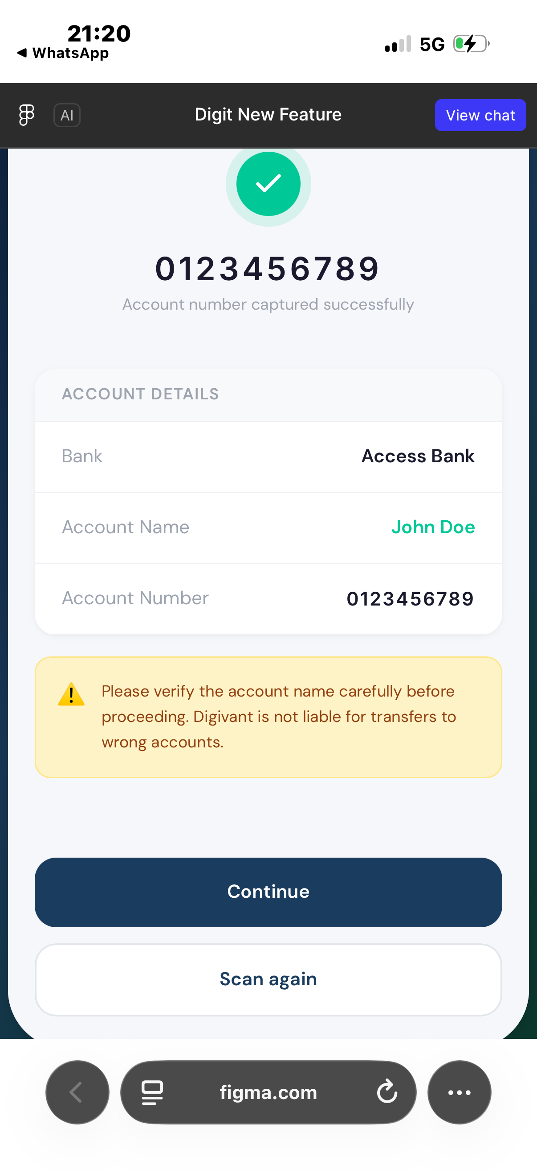
Recipient Verification Before Transfer
Scanning should accelerate data entry—not remove the user's final confirmation.
Proposed confirmation screen
• Display the captured account number prominently.
• Automatically show the bank and recipient name returned by account verification.
• Require the user to visually confirm the recipient before continuing.
• Provide “Scan again” and manual-entry fallbacks when the capture is incorrect.
• Keep a clear warning that transfers should only proceed after the recipient name is verified.
Expected benefit: fewer typing errors, faster transfers and stronger confidence at the point of payment.

Slide 5
Feature 2 — One-Tap Payment Categorisation
Let customers describe a payment quickly by selecting a simple category instead of typing a description.
Why this improves documentation
• After recipient verification, ask: “What is this payment for?”
• Offer clear categories such as Food & Groceries, Shopping, Rent & Utilities, Education, Health, Transport, Savings, Gift and Other.
• Save the selected category with the transaction automatically.
• Use categories to improve the quality of the user's Digital Paymental Wrap/spending summary.
• Reduce dependence on free-text descriptions, which are often skipped, inconsistent or too vague to analyse.
User value: one tap now creates better records later.

Slide 6
Feature 3 — Subscription Tracker
Allow customers to identify eligible card payments as subscriptions so recurring spending can be tracked automatically.
How it could work
• Total estimated monthly subscription spend.
• Number of active subscriptions.
• Individual services and expected renewal dates.
• Amount expected for each upcoming renewal.
• Attention cues for payments due soon, such as “Tomorrow”.
• A management entry point for reviewing or updating tracked subscriptions.
Customer confirmation keeps subscription tracking intentional while making recurring expenses easier to see.

Slide 7
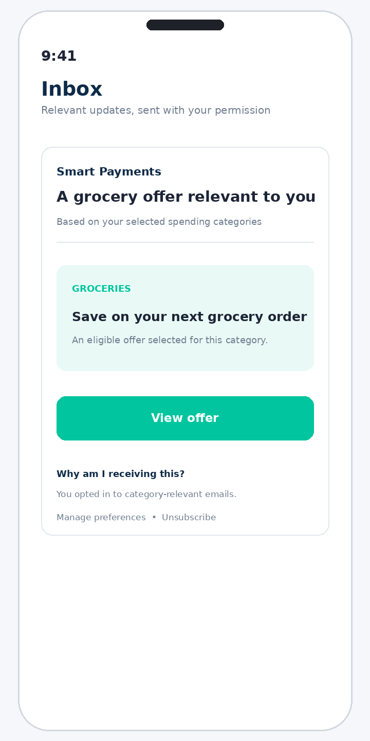
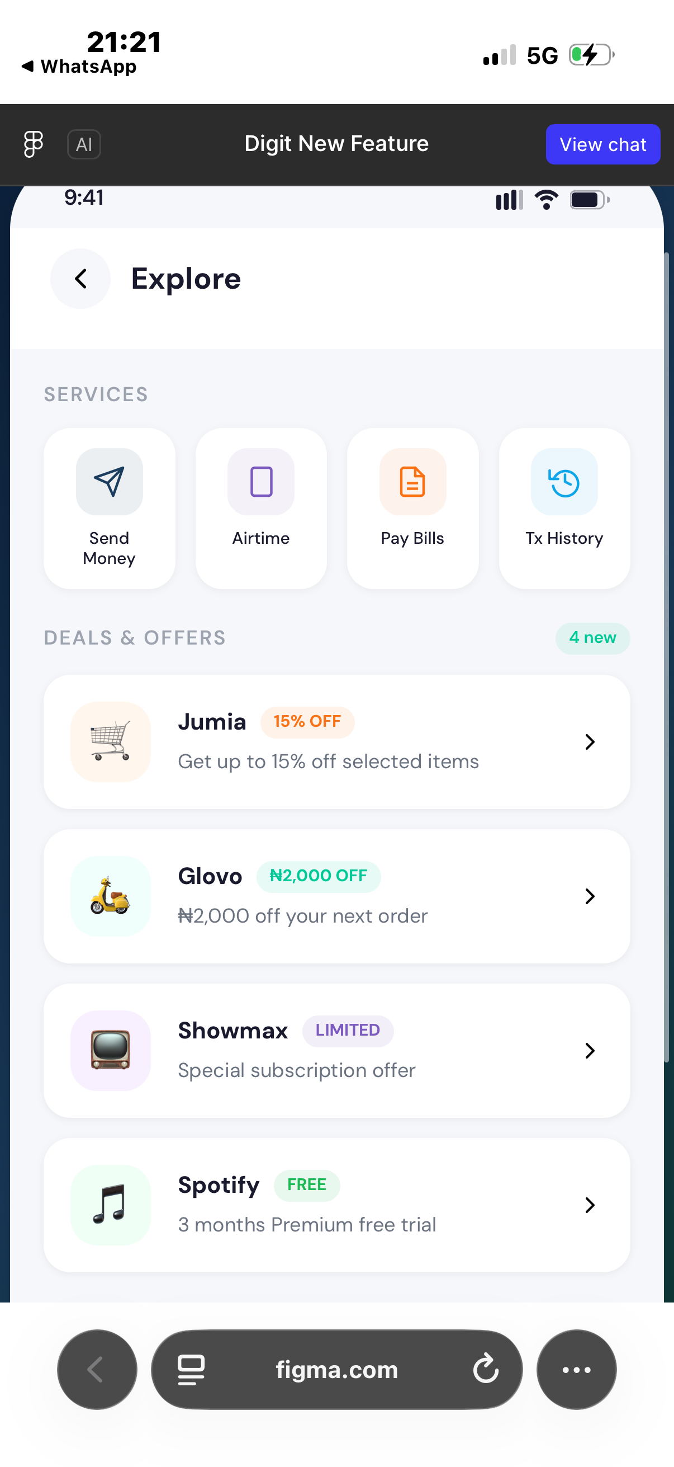
Feature 4 — Relevant News & Offers via Email
Send useful news and relevant offers by email instead of creating another promotional area inside the app.
How email relevance could work
• Provide quick access to frequently used services such as Send Money, Airtime, Pay Bills and Transaction History.
• Show current promotions, discounts, free trials or service announcements from participating merchants and platforms.
• Prioritise offers relevant to the user's normal app activity or spending categories, where consent and privacy rules allow.
• Use clear labels such as “15% OFF”, “₦2,000 OFF”, “FREE” or “LIMITED” so users understand the value immediately.
• Give users a single place to discover useful information without interrupting the core payment flow.

Slide 8
Proposed End-to-End User Journey
The concepts can work independently, while also complementing one another.
1
2
3
4
5
6
Scan
Verify
Categorise
Pay
Track
Inform
Capture payment details
Confirm bank & recipient
Choose payment purpose
Complete transfer
Update spending records
Track subscriptions & receive relevant email
Outcome
A faster payment flow + clearer transaction records + better subscription awareness + more relevant opt-in email communication.

Slide 9
Why This Proposal Matters
The concepts focus on convenience, organisation, recurring-payment awareness and relevant customer communication.
Speed
Accuracy
Organisation
Less manual typing during transfers.
Reduced account-number entry mistakes with a verification step.
Consistent categories create cleaner transaction histories.
Awareness
Engagement
Insight
Subscription visibility helps users anticipate recurring expenses.
Relevant opt-in emails can reduce unrelated promotional communication.
Structured transaction data can strengthen future Digital Paymental Wrap summaries and personal finance features.

Slide 10
Recommended MVP & Implementation Considerations
Prototype the concepts independently, validate customer value, and prioritise privacy and user control.
MVP priority
Key safeguards
• 1. Scan account number
• 2. Confirm bank and recipient
• 3. Select payment category
• 4. Save category with transaction
• 5. Add subscription dashboard
• 6. Add consent-based email news/offers
• Always keep manual entry available.
• Never rely on image recognition alone to validate a recipient; use the bank/account verification service.
• Ask users to confirm the recipient name before payment.
• Handle unclear images and unsupported formats gracefully.
• Use category-based email personalisation only with appropriate consent, privacy controls, transparent data use and easy unsubscribe options.
• Measure scan success rate, correction rate, completion time and category-selection rate.

Slide 11
Small payment improvements can create a clearer and more useful customer experience.
Scan → Verify → Categorise → Identify Subscription → Track → Email
Concept next step: prototype Scan-to-Pay, categorisation and subscription identification, then test usability, accuracy and customer control.
Thank you

