Slide 1
Support Vector Machine
Classification I

Slide 2
Bried Introduction
Support Vector Machine (SVM) refers to a group of both supervised and unsupervised methods that can be applied to:
  Classification
  Regression
  Outlier detection
  Clustering

Slide 3
The Problem
When we applied the k-Nearest Neighbors approach we built decision boundaries :
  Your label depends on the side of the bound you are lying
How can we optimize the decision boundaries?

Slide 4
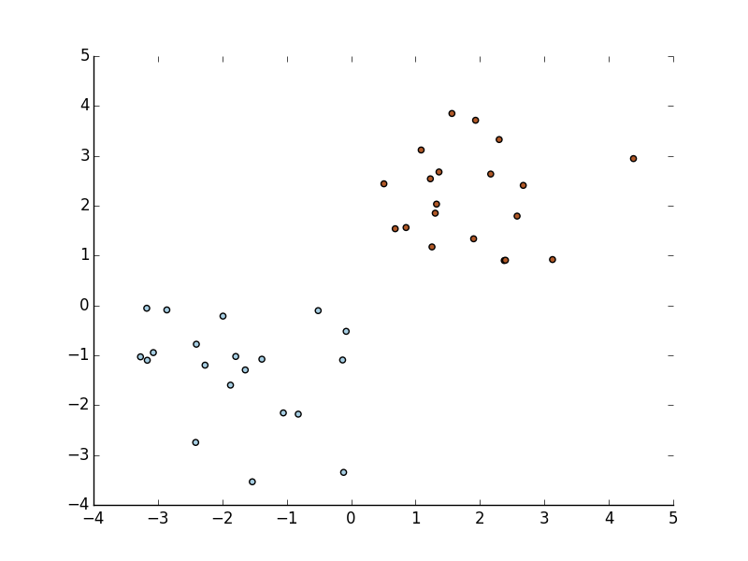
Linear Boundary
For instance how can I find the “best” line to separate two groups.

Slide 5
Linear Boundary
It is a linearly separable binary classification
?

Slide 6
Linear SVM
We want to separate classes with hyperplane but many are acceptable.
We can choose the hyperplane that maximize the distance to the nearest data points,
  maximum-margin hyperplane

Slide 7
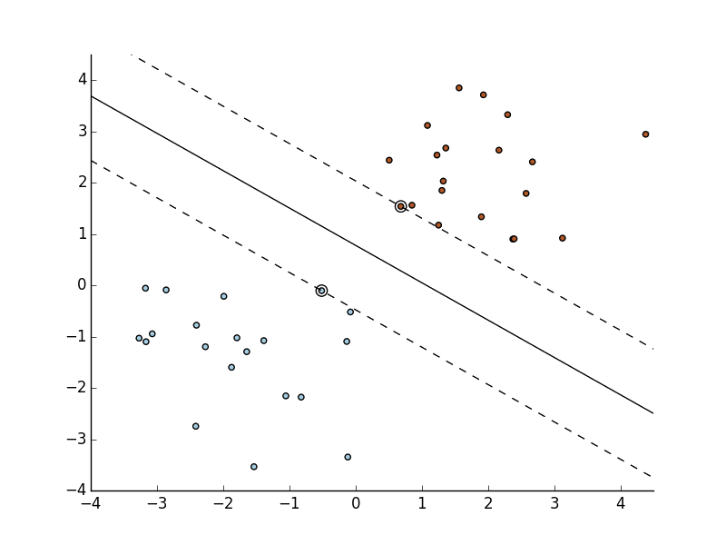
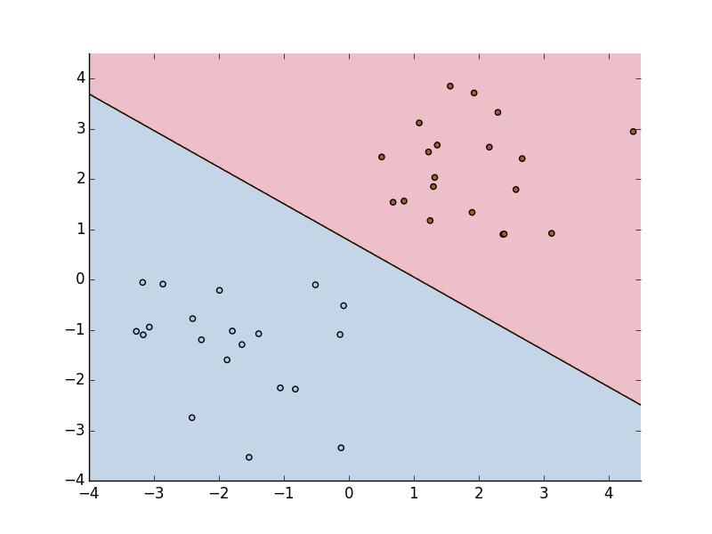
Linear SVM

Slide 8
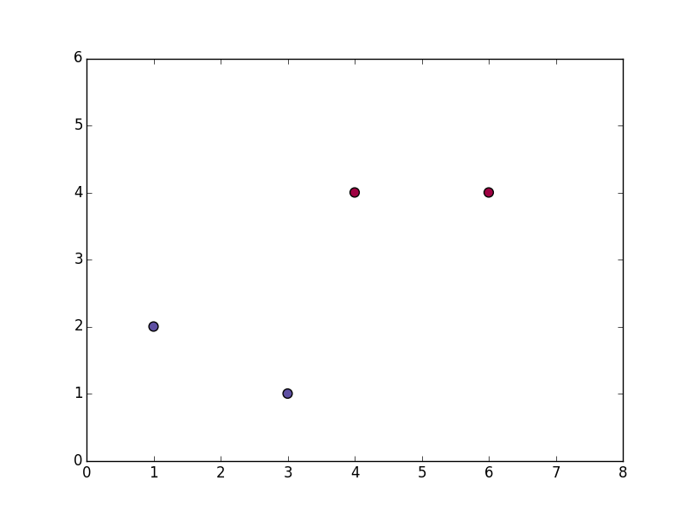
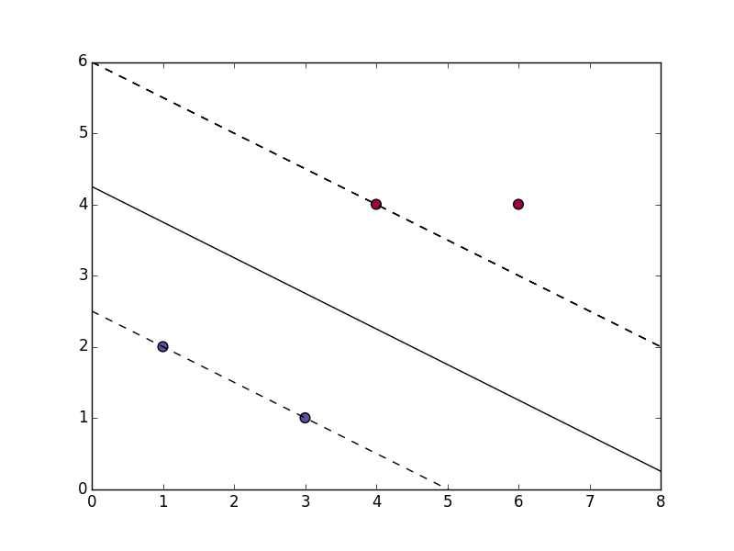
Finding the Hyperplane
Let's w be a vector perpendicular to my hyperplane.
(unknown length)
+ class
- class
w

Slide 9
Finding the Hyperplane
To find where new point lies we take the dot product
u
w.u

Slide 10
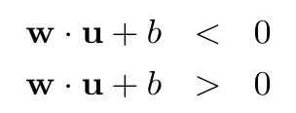
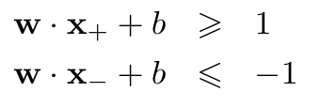
Finding the Hyperplane
We can now set a decision rule :
    If then + class
    If then - class
In addition for the two bounding hyperplanes :

Slide 11
Finding the Hyperplane
x+
x-

Slide 12


Finding the Hyperplane
If we introduce the following parameter :
  yi = +1 if class +
  yi = -1 if class -
We can rewrite the decision rule as :
and at the boundaries :

Slide 13
Finding the Hyperplane
Then to find the distance between the boundaries we just need to compute : ( x+-x- ) . unitary_vector
x+ - x-
x+
x-

Slide 14
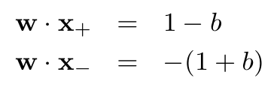

Finding the Hyperplane
But we know that :
Hence :
… and we now want to maximize this width

Slide 15
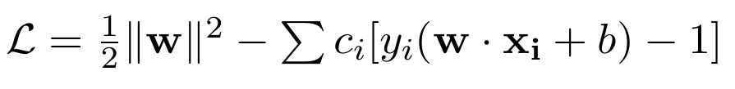
Super Lagrange
Maximizing 2/||w|| is equivalent to minimizing ||w|| … which is equivalent to minimizing ||w||²/2 :
And now comes Lagrange…
We want to find the minima of the following function :

Slide 16



Finding Extrema
Derivation with respect to w :
Derivation with respect to b :

Slide 17


Primary Formulation
Substituing w in the lagrangian (Primary) :
And the decision rule becomes :

Slide 18

… you, right now :

Slide 19

… you, right now :

Slide 20

… you, right now :

Slide 21

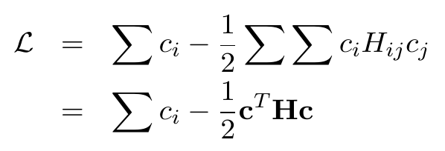
Dual Formulation
Let's define :
Then :
Dual Form of the Primary Lagrangian

Slide 22
Dual Formulation
In the dual form the problem becomes :
It is a convex quadratic optimization problem (which we won't solve here)

Slide 23

Coding Time (1)
Select two classes of the iris data set (yes once again) and perform a support vector machine classification using LinearSVC
Map the predictions and visualize it

Slide 24
Problems
What if the points are not fully linearly separable???
What can we do???

