Slide 1
Decision Tree and
Further...

Slide 2
5min Test
Explain what is the impurity measurement and its purpose.
Cite two ways to limit a decision tree.
Expliquez ce qu'est la mesure d'impureté et son utilisation.
Citez deux moyens de limiter un arbre.

Slide 3
Specific DT Algorithms
CART : Classification And Regression Tree
ID3 : Iterative Dichotomiser 3
C4.5 : extension of ID3
CHAID : Chi-squared Automatic Interaction Detector
...

Slide 4
Decision Tree Regression
Example :
  Knowing a house characteristics can we evaluate its price ?
Work on continuous variable
We can here use a Decision Tree but instead of a class, leaf nodes will contain the price estimation.

Slide 5
Decision Tree Regression
The goal during construction is to reduce the global standard deviation.
Instead of an impurity measurement, the goodness of a split is evaluated using the mean square error :

Slide 6
Decision Tree Regression
Commonly take the mean as estimated value,
at node m :
If Em is small enough we don't split further

Slide 7
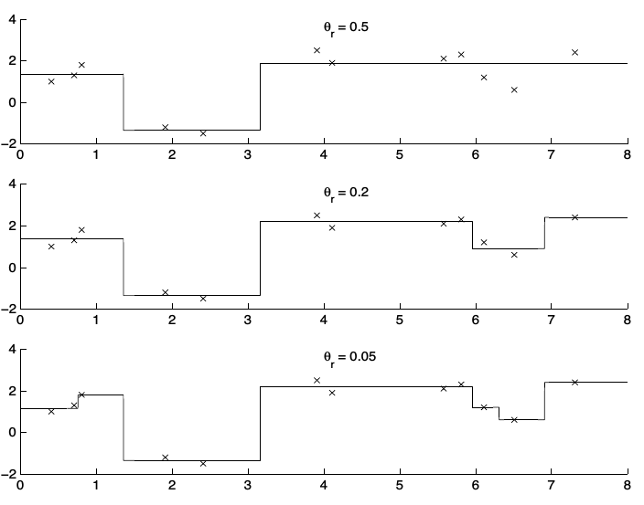
Construction
Source : “Introduction to Machine Learning” , E.Alpaydin

Slide 8
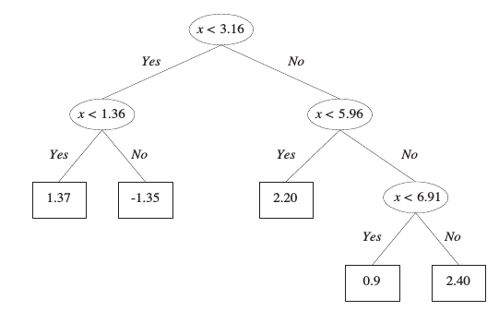
Construction
Source : “Introduction to Machine Learning” , E.Alpaydin

Slide 9

Coding Time (1)
Open the notebook and follow instructions ...
… Or try to perform a decision tree regression on the boston datasets on your own!

Slide 10
From Tree to Forests
To overcome single trees weakness it is also possible to consider several trees using ensemble methods :
  Bagging
  Random Forest
  Boosting

Slide 11
Bagging
Also named “bootstrap aggregation” (Leo Breiman 1994 and 1996).
Three steps :
  Generate m new training sets size n using a
  sampling with replacement method
  Build decision trees for each sets
  Combine results by averaging (regression)
  or voting (classification)

Slide 12
Random Forest
Based on the bagging approach (Ho 1995, Leo Breiman 2001) but use a modified tree algorithm :
  At each decision node, n features are randomly drawn and considered for the split.
The goal is to limit trees correlation

Slide 13
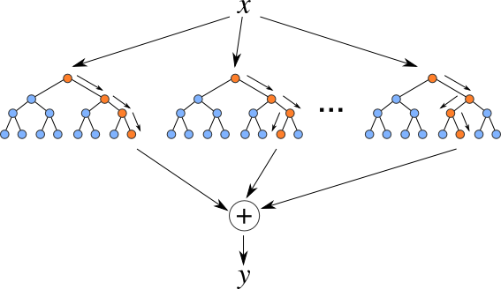
Bagging and Random Forest

Slide 14
Coding Time (1)
Open the other notebook and follow instructions ...
… Or try to perform an ensemble method on your own!

