Slide 1
Nearest Neighbors Search
Kd-Tree and other algorithms

Slide 2
5 Minutes Test
Describe in few lines the
“K-Nearest Neighbors” procedure and give one advantage and one disadvantage of the method.
Décrivez en quelques lignes l'approche
“K-Nearest Neighbors” et donnez un avantage et un inconvénient liés à la méthode.

Slide 3
How to find the closest one(s)?
Brute Force approach :
Let's compute all distances and the k smallest ones…
… time and resource consuming!
Other possible techniques :
  KD Tree
  Ball Tree

Slide 4
Trees
Trees in computer science are structures that allow to save time and resources.
They have been developed to address the computational inefficiency of the brute force approach.
Basic idea :
  A is far from B
  C is close to B
  Therefore C is far from A

Slide 5
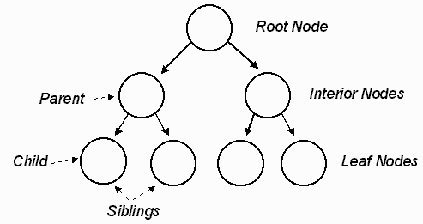
Trees
Same as real trees, trees have a root, branches nodes and leaves :

Slide 6
Building a Kd-Tree
Find the axis with the highest variance.
Divide perpendicularly to this axis.
Often the median is used as criteria, mean and weighted average can be used too.
If there are more than one point in the subdivided spaces repeat the operations in the sub-spaces.
  (NB “K” is the dimension)

Slide 7
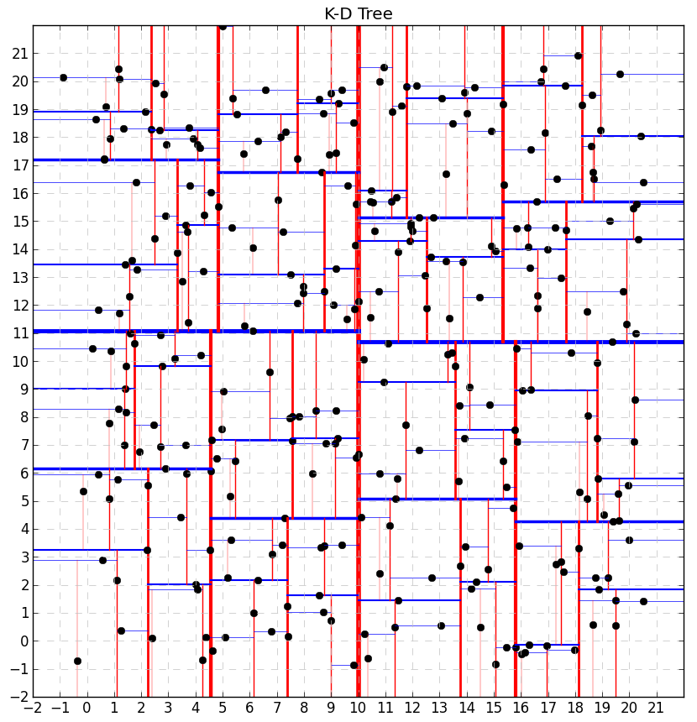
Source : https://salzis.wordpress.com/2014/06/28/

Slide 8
How to find the Nearest Neighbor
1) Find the location of the new point in the tree
2) Keep track of the closest node
3) From here, investigate distances backward in the tree…
… but drawings are much better than long stories …

Slide 9
Visual Help
http://donar.umiacs.umd.edu/quadtree/points/kdtree.html
http://christopherstoll.org/2011/09/k-d-tree-nearest-neighbor-search.html

Slide 10
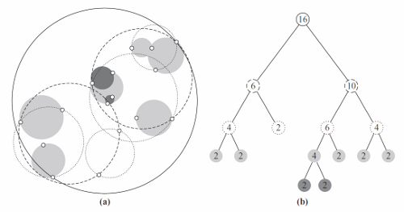
Ball Tree
Developed to address Kd-Tree inefficiency in high dimension.
While Kd-Tree partition data along axis,
BallTree partition data in nested hypersphere.
Source : http://stevehanov.ca/blog/

Slide 11
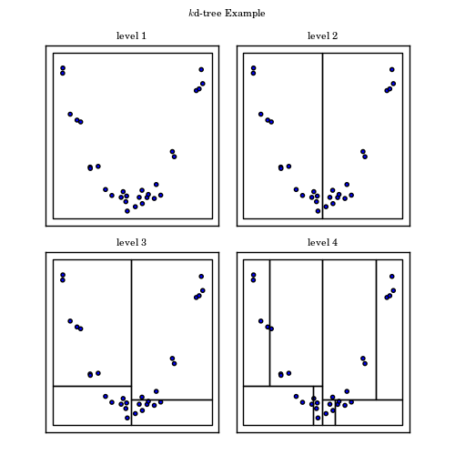
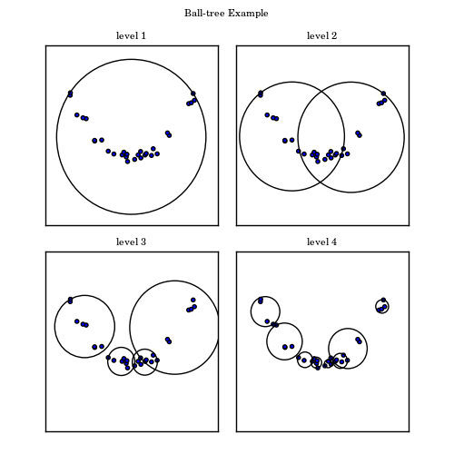
Comparison
Source : http://www.astroml.org

Slide 12
Other NN Algorithms
Metric tree
vp-tree
PCA tree
Etc...
Check this link :
http://arxiv.org/pdf/1007.0085.pdf

Slide 13

Coding Time
Find the work done yesterday
Try the three different algorithms and evaluate their speed (use the command : %timeit )
Are results different?

