Slide 1
Clustering Techniques

Slide 2
Yet Another Problem
We have a data set and we want to know if objects can be grouped based on some similarities (pattern recognition).
We don't have target values and we don't necessarily know how many groups are hidden in the data set.
Clustering Problem

Slide 3
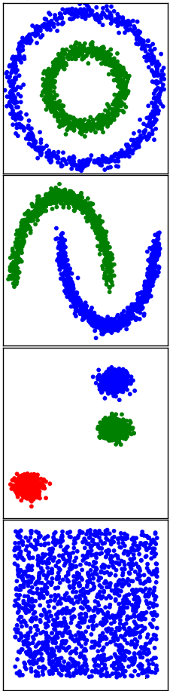
Clustering Problem
Some distribution examples
Source : http://scikit-learn.org/stable/auto_examples/cluster/plot_cluster_comparison.html

Slide 4
Technique Families
Several techniques exist :
  Centroid-based Clustering
  Hierarchical Clustering
  Distribution-based Clustering
  Density-based Clustering
  …
We will review in the following algorithms available with scikit

Slide 5
K-means
Objects are grouped according to their distance to a centroid which is not necessarily a member of the data set. (centroid based)
  Take k centroids randomly
  Iterative procedure :
    Find the closest points
    Compute the barycenter
    Move centroid to barycenter
  Stop when convergence reached (centroids are stable).

Slide 6
K-means
http://www.onmyphd.com/?p=k-means.clustering
Pros and Cons:
  + Simple
  + Fast for low dimensional data set
  - K has to be chosen
  - Different initial centroids can give different results
  - Does not perform well when clusters are different in shapes and sizes
Many variations : K-medoid, Fuzzy C-means, etc...

Slide 7
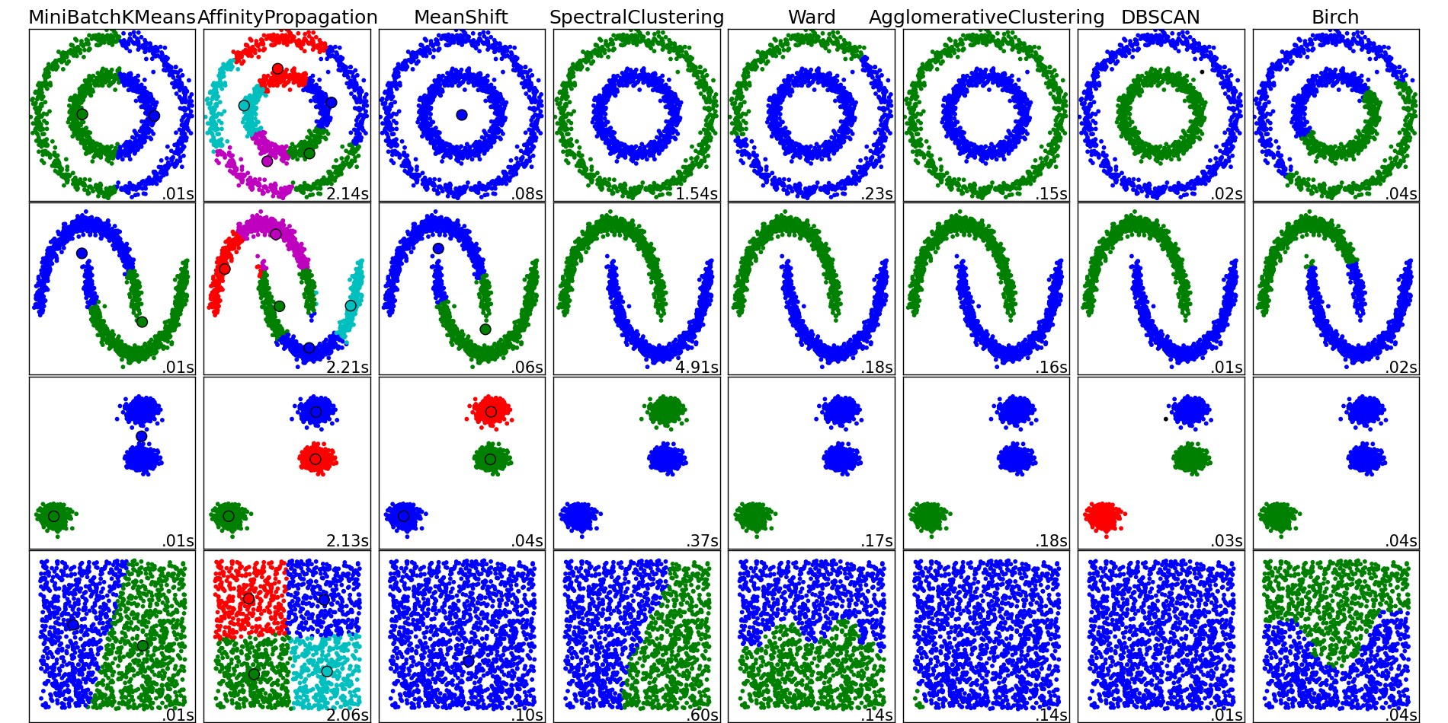
K-means

Slide 8
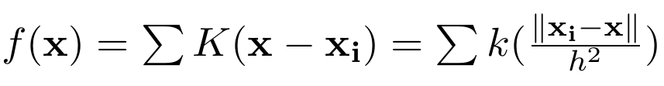
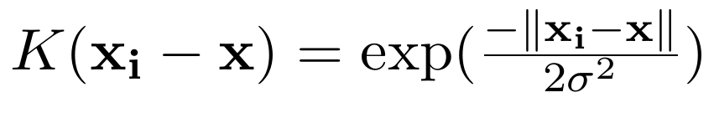
MeanShift
Aims at finding the densest regions and group points based on their distance to the centroids of these regions. (centroid based– Fukunaga & Hostetler 1975)
  Estimate the initial density distribution using a kernel function K(xi – x) of width h.
  Simple approach convolution with RBF kernel

Slide 9
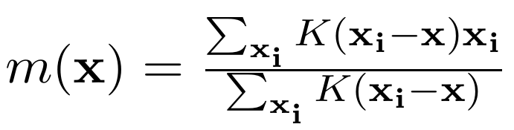
MeanShift
Then similar in the spirit to K-means
  From the local maxima x (centroid), weight the nearest points xi and compute the shift vector :
  Shift the centroids by the shift vector :
  Repeat until convergence

Slide 10
MeanShift
Pros and Cons
  + Does not assume number of clusters
  + Different types of kernel possible (not in scikit)
  - The choice of width h is not trivial.
  - Choice of h has huge impact ; blobs merging or too many clusters (overfitting).

Slide 11
MeanShift

Slide 12
Affinity Propagation
Use a “message passing” approach to find affinity between points to group them around an exemplar.
(Frey and Dueck 2007)
Two types of messages from data point i and candidate exemplar k :
  Responsibility r(i,k) : Sent from i to k, indicating how well-suited it would be for i to have k as an exemplar.
  Availability a(i,k) : Sent from k to i, indicating how appropriate it would be for i to choose k as an exemplar. (initially equal to zero)

Slide 13
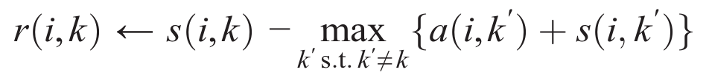
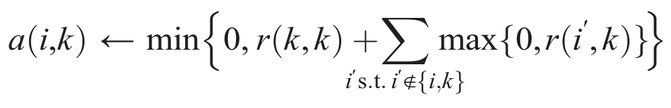
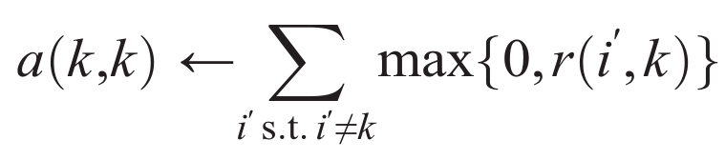
Affinity Propagation
Similarity quantified by s(i,k), then iterations :
Update the responsibility r(i,k) :
Update the availability a(i,k) :
Self-availability :

Slide 14
Affinity Propagation
For i the value of k that maximize a(i,k)+r(i,k) identify k as an exemplar for i (if k=i then i is an exemplar).
Stop when :
  Reach number of iterations
  Messages do not change anymore
  Local decisions stay constant

Slide 15
Affinity Propagation
Pros and Cons
  + Does not assume a number of clusters
  + Similarity can be defined by the user.
  + Works with any shape for the clusters
  - Choice of the preference s(k,k) influence the number of clusters (have to be careful).
  - Time and resource consuming (at least in scikit)

Slide 16
Affinity Propagation

Slide 17
Hierarchical Clustering
Hierarchical method : Group objects based on the distance between them.
Agglomerative Clustering : points are clusters that are merged according to their distance (“bottom up” approach).

Slide 18
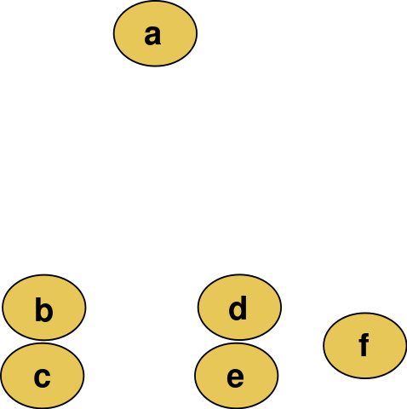
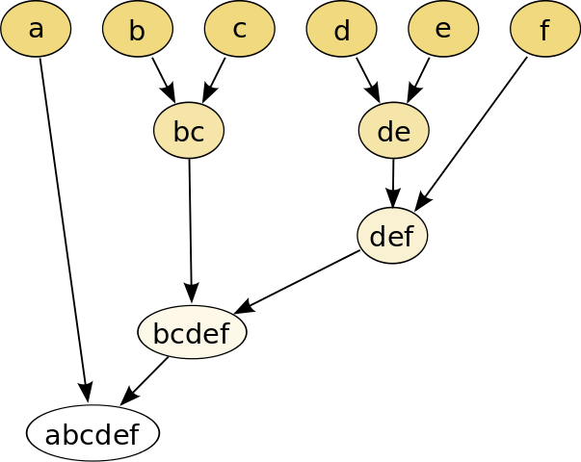
Agglomerative Clustering
Agglomerative Clustering :
Dendogram
Source : wikipedia

Slide 19
Agglomerative Clustering
Two Important Parameters :
Metric : defines how to measure distances between observations
Linkage : determines how to measure distances between sets of observations as a function of pairwise distances between observations.
  Complete-linkage :
  Single-linkage :

Slide 20
Agglomerative Clustering
Average Linkage (UPGMA) :
  average of all distances
  between pairs of objects
  a in A and b in B
Ward : variance-minimizing approach
  At each step, merges two clusters such that it leads to the minimum increase in the final cluster variance (hence forcing Euclidean metric).

Slide 21
Agglomerative Clustering
Pros and Cons
  + Easy to use and to implement
  + Does not assume a number of clusters (we can decide afterwards how many groups we want by cutting the tree).
  - Problems with clusters with irregular shapes and sizes
  - Sensitive to noise

Slide 22
Agglomeration Clustering

Slide 23
DBSCAN
Density-Based Spatial Clustering
of Applications with Noise
Assume groups are regions of higher density.
Iterative method that evaluate the density around points to know if it belongs to a cluster.
Two main parameters : epsilon ε and minimal number of points n

Slide 24
DBSCAN
Pick a random core point and check if there are more than n points (including itself) within a distance ε .
  Yes : all new points become part of the cluster.
  We then repeat the neighbors search for the new points.
  No : the point is a border point - we randomly pick another point and search for its neighbors.

Slide 25
DBSCAN
Core Points and Border Points :
  Core Points : have more than n-1 neighbors within a distance ε.
  Border Points : don't have more than n-1 neighbors within a distance ε.
Some border points can belong to two clusters… arbitrary decision (sometimes based on the order data points are processed).

Slide 26
DBSCAN
Pros and Cons
  + Does not assume a number of clusters.
  + Can find clusters with strongly irregular shapes.
  + Deals very well with outliers.
  - Problems when clusters have very different densities.
  - Choosing good n and ε can be difficult (when little knowledge of the data set).
http://www.naftaliharris.com/blog/visualizing-dbscan-clustering/

Slide 27
DBSCAN

Slide 28

Coding Time (1)
Choose your favorite dataset and try the different algorithms (in 2D first).
Understand why some are performing well or not.

