Slide 1
SPA Revolution with WebAssembly and Blazor Rainer Stropek | software architects @rstropek

Slide 2
Samples: https://github.com/software-architects/learn-blazor https://learn-blazor.com

Slide 3


Blazor
Blazor Introduction
Rainer Stropek
software architects gmbh
ASP.NET Browser
Web
Mail
Twitter
http://www.timecockpit.com
rainer@timecockpit.com
@rstropek

Slide 4


https://commons.wikimedia.org/wiki/File:Images_200px-ISO_C%2B%2B_Logo_svg.png
https://commons.wikimedia.org/wiki/File:Csharp_Logo.png

Slide 5




https://en.wikipedia.org/wiki/File:Google_Chrome_icon_(September_2014).svg
https://commons.wikimedia.org/wiki/File:Microsoft_Edge_logo.svg
https://commons.wikimedia.org/wiki/File:Antu_firefox.svg
https://commons.wikimedia.org/wiki/File:Wikimedia_Foundation_Servers-8055_14.jpg

Slide 6

https://commons.wikimedia.org/wiki/File:Silverlight_Logotyp.jpg

Slide 7


https://de.wikipedia.org/wiki/Datei:Unofficial_JavaScript_logo_2.svg

Slide 8



https://de.wikipedia.org/wiki/Datei:AngularJS_logo.svg
https://de.wikipedia.org/wiki/Datei:Angular_full_color_logo.svg
https://de.wikipedia.org/wiki/Datei:Node.js_logo.svg

Slide 9

WebAssembly
http://webassembly.org/
Binary instruction format for a stack-based VM
For Browser and beyond
Portable compilation target for high-level languages like C/C++/Rust
Open Standard
Why?
Performance
Safe
https://commons.wikimedia.org/wiki/File:Web_Assembly_Logo.svg

Slide 10
Some Facts about WASM
Very different from .NET‘s IL
Much simpler
Linear memory
No GC
Cannot access the DOM = no UI
(…yet)
JavaScript interop exists
WASM calls JS
JS calls into WASM

Slide 11

WASM and the CLR
C++ can be compiled into WASM
The .NET CLR is written in C++
Can the .NET CLR run on WASM?
Yes, it can – with mono

Slide 12
Blazor
Built on the Mono WASM Runtime
ASP.NET Razor Template Syntax
The .NET Core you know and love…

Slide 13
Demos
Anatomy of a Blazor app
JS Interop
Data Binding
Router
RESTful Web APIs

Slide 14
Anatomy of a Blazor App
dotnet command line
dotnet new blazor
dotnet build
Add to a new solution
dotnet new sln
dotnet sln add BlazorDemo.csproj
Publish Solution
dotnet publish -c Release -o out
Review content of out folder
VS2017
Open VS2017 and show how to create Blazor app there
Show Blazor language service extension
Open project in VS2017 (start BlazorDemo.sln)

Slide 15
Running a SPA Blazor App
dotnet command line
dotnet blazor serve
F5 in Visual Studio – show .csproj
Look at Network tab in Chrome Dev Tools
Static hosting
Prove SPA nature by hosting app in Chrome Dev Web Server (chrome://apps)
Speak about rewrite rules

Slide 16
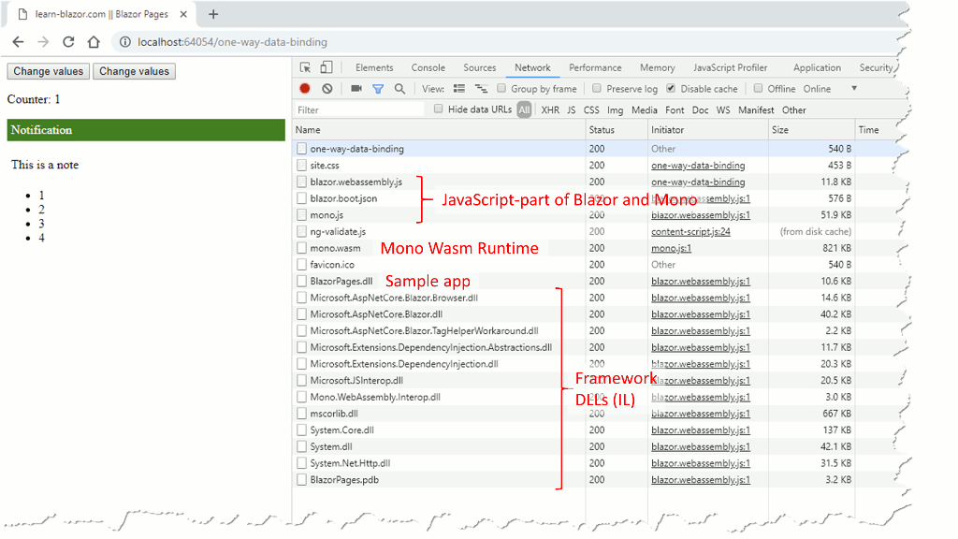
Anatomy
of a Blazor App
Loading
HTML, CSS, JS
WASM (Mono)
.NET DLLs

Slide 17
Hosting in ASP.NET Core
RestApi Sample
Show and discuss Startup.cs
Microsoft.AspNetCore.Blazor.Server in UseBlazor<T>
Show and discuss shared library (Shift+F12)
Publish and discuss result
dotnet publish -c Release -o out
Run hosted app in Docker container: docker run -v C:\Code\GitHub\learn-blazor\samples\RestApi\RestApi.Server\out:/app -w /app -p 8081:5000 microsoft/dotnet:2.1.4-aspnetcore-runtime-alpine dotnet RestApi.Server.dll

Slide 18
Razor Walkthrough
Razor
Counter.cshtml Razor file
Show generated C# file Counter.g.cs → Razor becomes C#
BlazorComponent
Speak about Components-based architecture
Show DynamicRenderTree in BlazorPages app
Blazor templates quick tour (BlazorPages sample)
OneWayDataBinding.cshtml
TwoWayDataBinding.cshtml
EventBinding.cshtml
Initialization.cshtml
ManualRefresh.cshtml

Slide 19
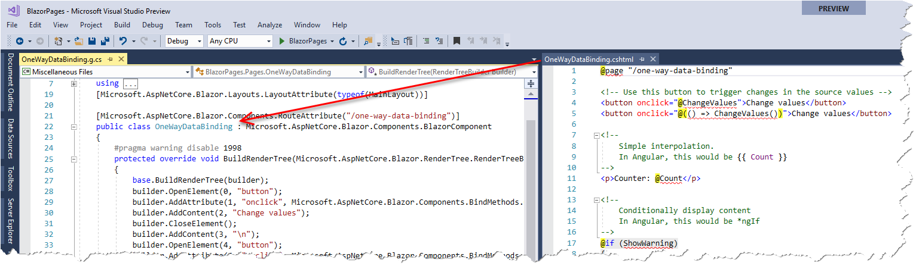
Anatomy
of a Blazor App
Razor Code Generation

Slide 20
JavaScript Interop
Basics
Open two-way-data-binding in BlazorPages sample
Break on node removal at You are an administrator
Trigger node removal and speak about call stack
Coded JS Interop
Open interop-basics in RestApi sample
Set breakpoint in window.say
Trigger breakpoint and speak about call stack
Open auto-complete in RestApi sample
Set breakpoints in fillAutoComplete and select callback
Trigger breakpoint and speak about call stack

Slide 21
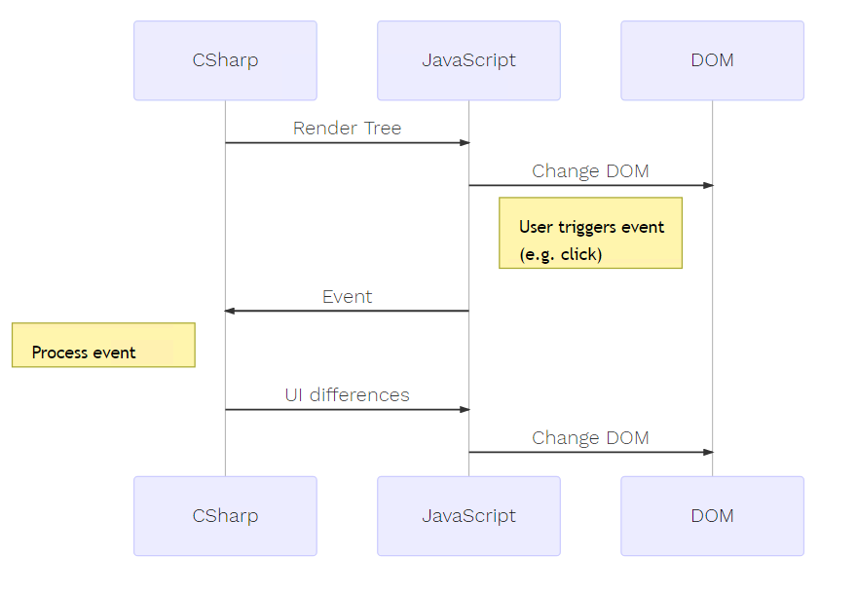
Anatomy
of a Blazor App
Rendering

Slide 22
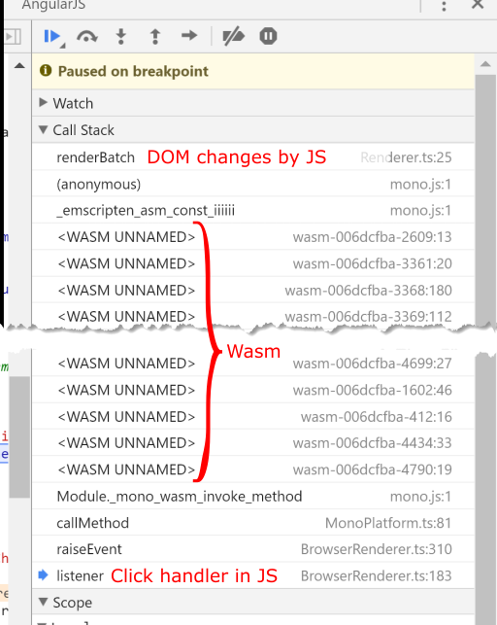
JavaScript Intertop

Slide 23
Dependency Injection
Basics
Open Startup.cs in DependencyInjection sample
Open CustomerList.cshtml in DependencyInjection sample – @inject
Speak about DI basics
Open Repository.cs in DependencyInjection sample – constructor injection
HttpClient
Open FetchData.cshtml in RestApi sample
Speak about HttpClient standard service
HttpClient(HttpMessageHandler) Constructor HttpClient creation in Blazor (Browser) BrowserHttpMessageHandler in Blazor (Browser) JS implementation using fetch API Show call stack for Web API calls in RestApi service

Slide 24
Router
Basics (in RouterDemo sample)
HelloUniverse.cshtml
HelloPlanet.cshtml
HelloWorld.cshtml
Links
MainMenu.cshtml
Talk about base tag in index.html

Slide 25
Server-Side Hosting
Client-side
All benefits of a SPA
Restrictions because of WASM
Maturity of tooling and runtime
Larger initial download
Server-side
Same Blazor programming model
Full .NET environment
Smaller initial download
More server resources
No offline support
Browser
Server
UI Thread
dotnet
Blazor
Blazor (JS)
WS

Slide 26
Server-Side Hosting
Create new Blazor app with Server-Side Hosting
Code Walkthrough
Show blazor.server.js reference in index.html
Show UseServerSideBlazor<T> in Startup.cs
Debug
Run app
Show WebSockets traffic in Chrome Dev Tools
Set breakpoint in counter increment, show it hitting

Slide 27
What else is in the box?
Debugging
Early prototype
Layouts
Master pages
Many details about component model
E.g. Child content

Slide 28
So what?
Is Blazor the Angular/React/Vue Killer?

Slide 29
Should I use it?
JS-based Frameworks
TypeScript
Huge ecosystem of tools and components
Mature
Feature-richness
Proven for small and large projects
Web development skills necessary
No reuse of C# code possible
Blazor
C# and JavaScript/TypeScript
Limited community
Immature tools
Limited functionality
(B)Leading Edge
Less web development skills necessary
Reuse of C# code possible
Maturity of C#/.NET

Slide 30
Learning More…

Slide 31
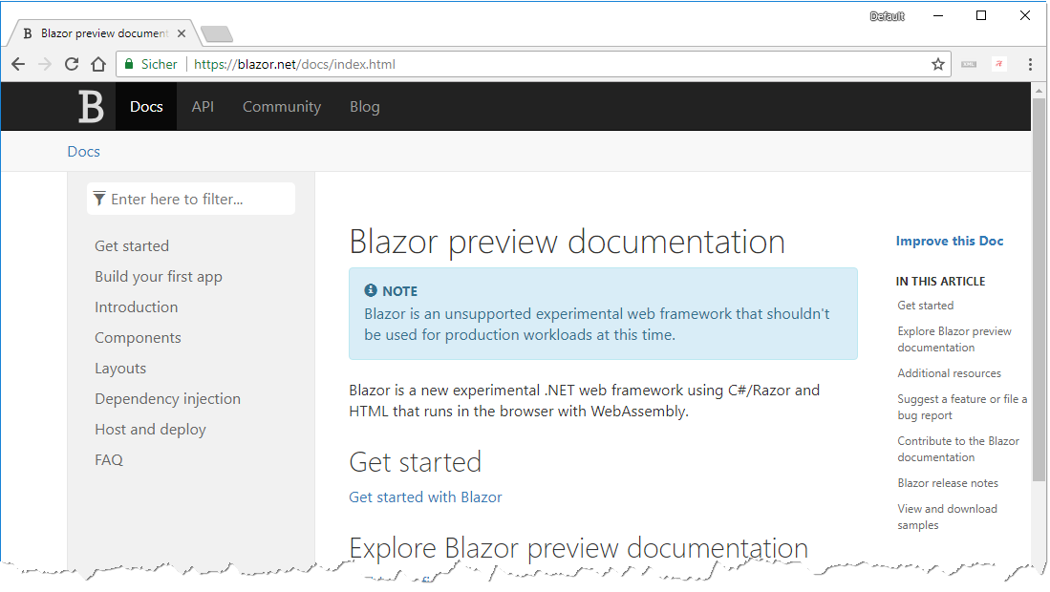
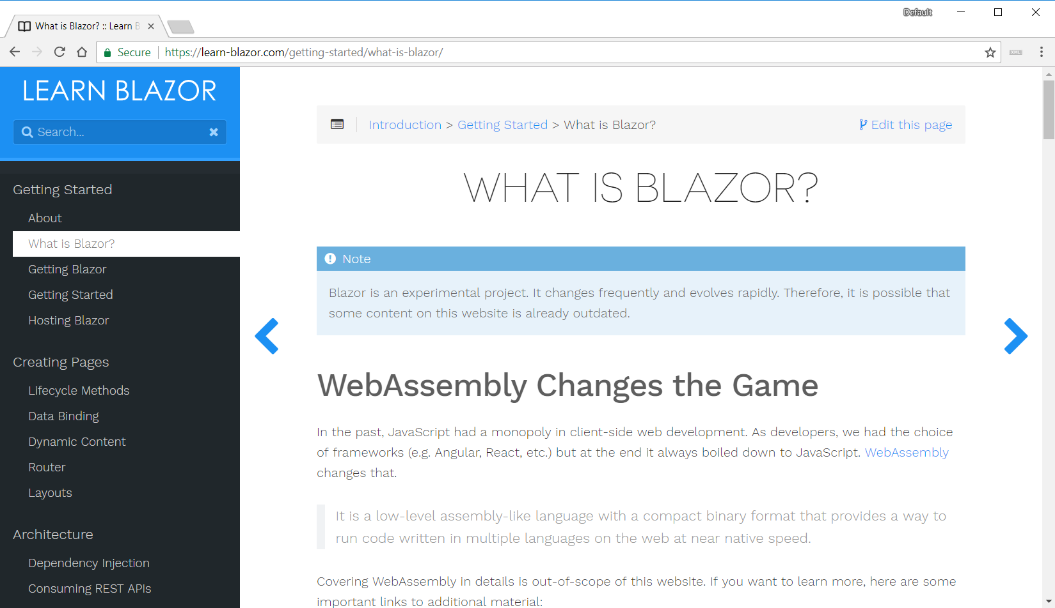

Slide 32
Thank you for coming!

Slide 33
Q&A
Blazor Intro
Rainer Stropek
software architects gmbh
Mail Web Twitter
rainer@timecockpit.com http://www.timecockpit.com @rstropek
Thank your for coming!

