Slide 1
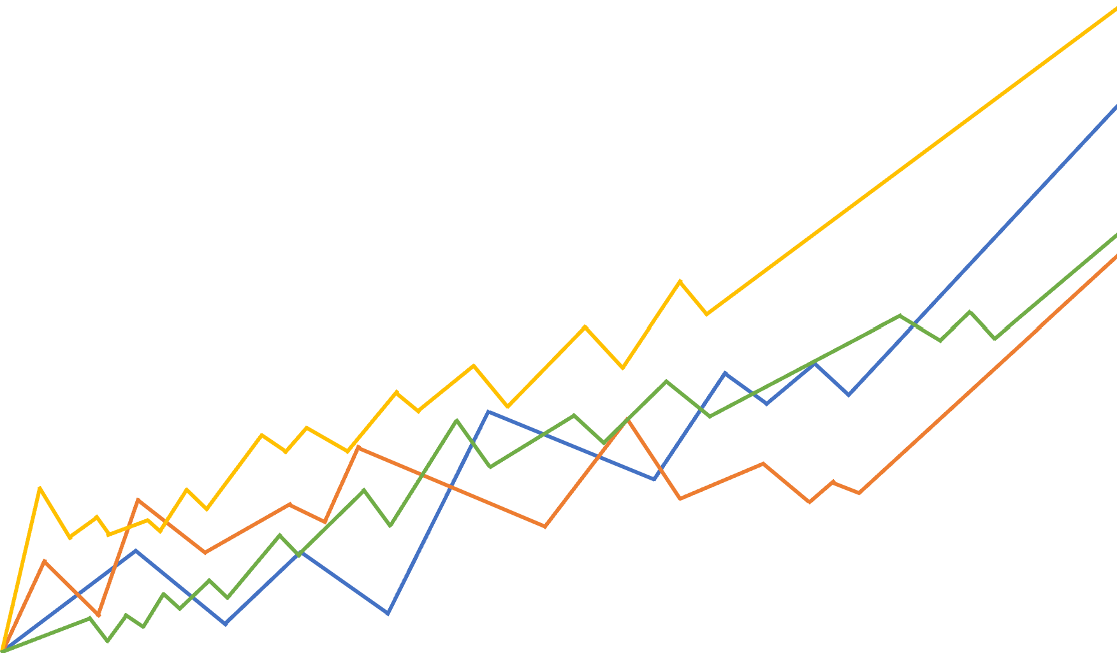
Predicting Chronic Kidney Disease
Group 8
Gabrielle LeBoeuf, Peter Liu, Julian Navarre, Rachel Packer, and Taylor Rotolo

Slide 2
Agenda
Objectives
Overview of Chronic Kidney Disease
Variable Analyses and Target Identification
Project Assumptions
Data Cleansing Methodologies
Data Modeling
Nearest Neighbor (K-NN), Logistic Regression, Random Forest
Model Comparison
Conclusion and Significant Findings
Questions?

Slide 3
Objectives
Work with a Clean Data Set
Identify the Most Significant Predictor Variables for Predicting Chronic Kidney Disease
Identify the Best Machine Learning Model for Predicting Chronic Kidney Disease
Interpret the Results of Model

Slide 4
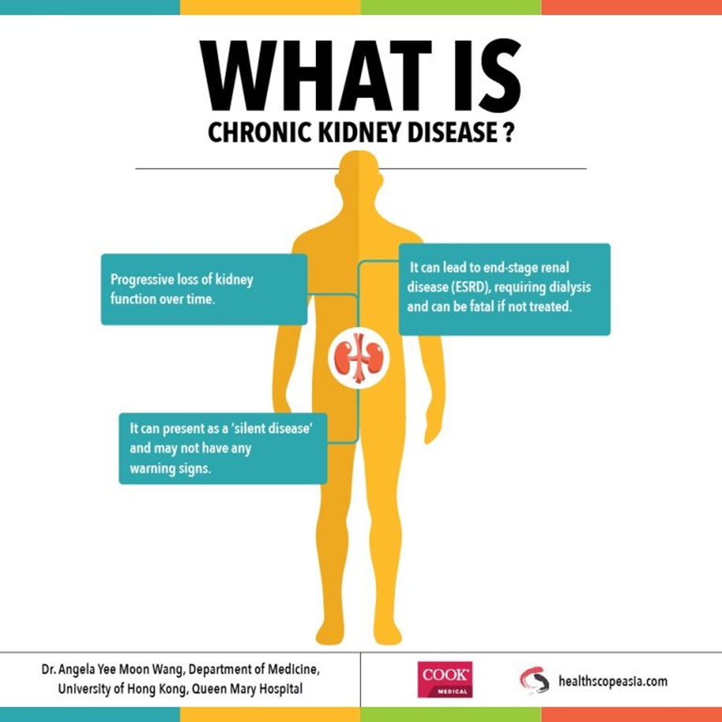
According to the Mayo Clinic:
The gradual loss of kidney function
In advanced stages, dangerous levels of fluid, electrolytes and wastes can build up in the body
Treatment focuses on slowing the progression of the kidney damage
May lead to fatal kidney failure if untreated
https://www.mayoclinic.org/diseases-conditions/chronic-kidney-disease/symptoms-causes/syc-20354521

Slide 5
Data Dictionary and Dummy Coding
We removed one categorical variable for each dummy variable to avoid multicollinearity:
- sg_1.005
- al_0.0
- su_0.0
https://archive.ics.uci.edu/ml/datasets/Chronic_Kidney_Disease
Notes:
When using the code “get_dummies()” → or something like that…..
We created new columns for each value point for three variables: sg, al, su
In order for us to accurately assess the relationships of these variables and avoid overfitting the model, we had to remove one column (one value) from each to avoid multicollinearity issues (we cannot keep all of the dummy columns created bc it will cause inaccurate measurements for the fit of the model)

Slide 6
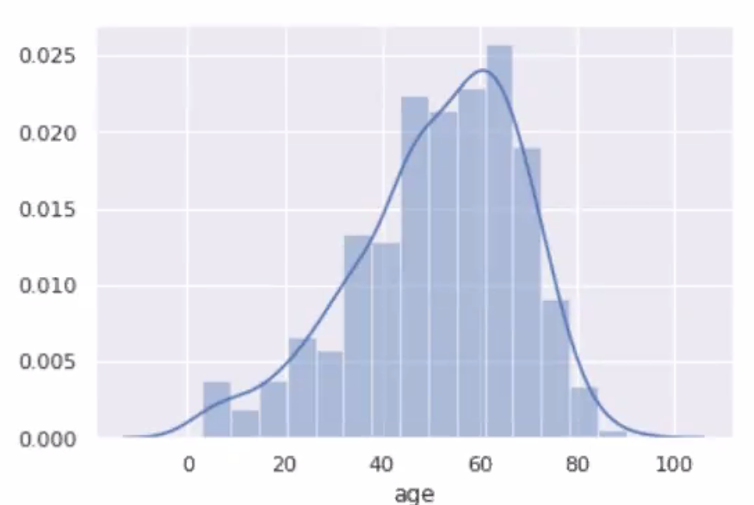
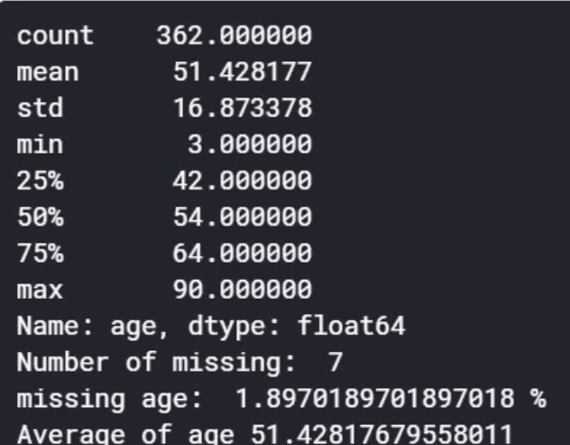
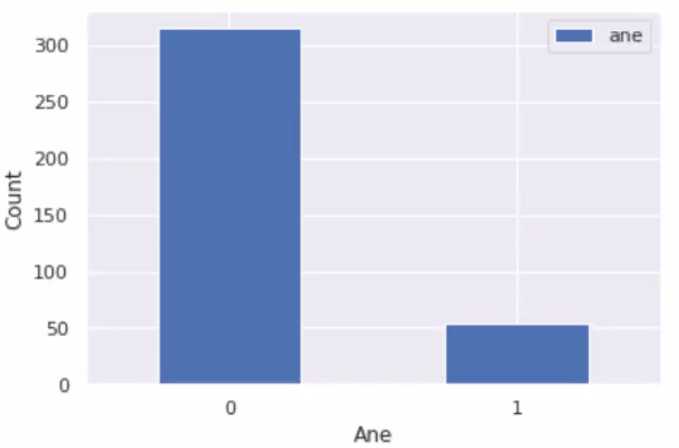
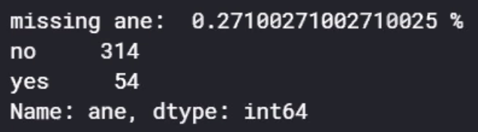
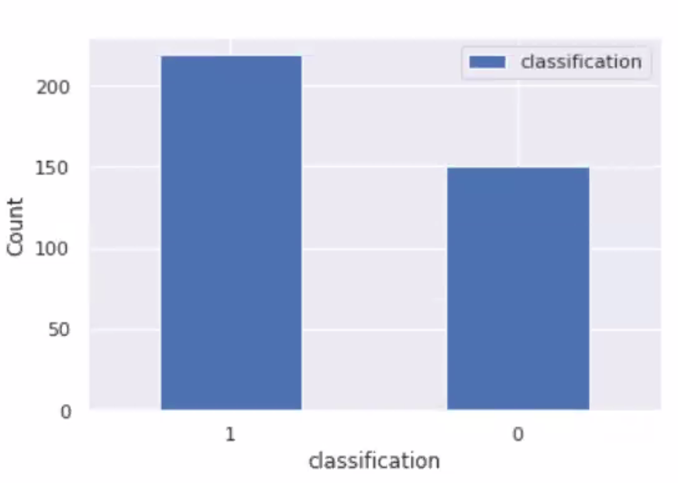
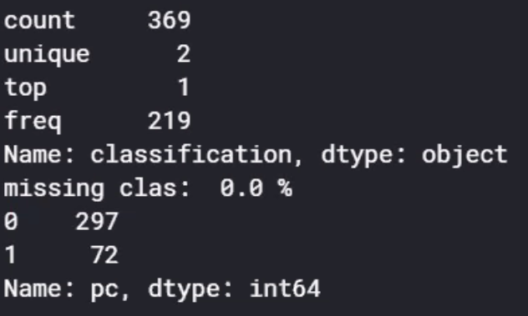
Univariate Analysis Methods
Continuous Analysis:
Categorical Analysis:
Target Analysis:
Notes:
When using the code “get_dummies()” → or something like that…..
We created new columns for each value point for three variables: sg, al, su
In order for us to accurately assess the relationships of these variables and avoid overfitting the model, we had to remove one column (one value) from each to avoid multicollinearity issues (we cannot keep all of the dummy columns created bc it will cause inaccurate measurements for the fit of the model)

Slide 7








Target Classification Variable
Target Variable = “classification”
Does this patient have chronic kidney disease or not?
Chronic Kidney Disease is present:
Chronic Kidney Disease is not present:
classification = 1
classification = 0

Slide 8
Project Assumptions
Quality of Data Assumptions:
Free from bias error
double blinded experiment
Free from data transfer errors
Incorrect units
Inaccurate readings
Multicollinearity has limited effect
True representation of the public
No outliers in the data
Model Assumption
Logistic
Assume linear between log-odds and the predictor
No need for oversampling

Slide 9
Missing Values
We removed any row that had more than 30% missing data
31/400 observations removed from data set
For predictor columns which had less than 12% of missing data:
Numeric – imputed with the mean variable
Categorical – imputed with most frequent value
There were five columns in which we had to analyze further since more than 12% of the column included missing data
Notes:
- We used 12% as a cut off since majority of our data did not have more than 12% missing values

Slide 10
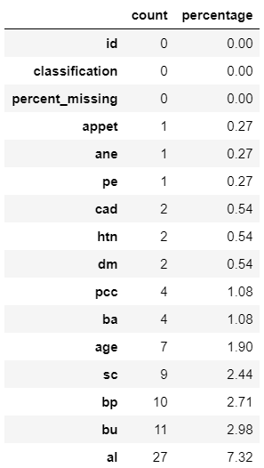

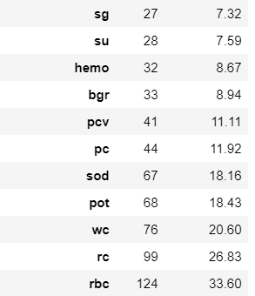
Missing Values
variable
variable
Notes:
For sodium {sod}:
For potassium {pot}: we decided to remove the entire predictor variable from our analysis rather than adjust for missing values.
This is because when we performed a t-test analysis against our target variable, “class” (ckd – Y/N), pot had a p-value greater than our alpha
Therefore, indicating that we should not reject our null hypothesis that potassium and class are independent
Potassium in the presence of our predictor value does not seem to be significant in our prediction
3. For white blood cell count {wc]: we decided to analyze this column further by assessing the results of hypertension, “htn” for replacing missing data
- Using an article from the Journal of Human Hypertension, a link was found between hypertension and elevated white blood cell
levels.
- Excess white blood cells can produce high blood pressure, which, if sustained for a long period of time, can cause hypertension.
- Using this knowledge, we were able to fill in the missing for the WC variable. A categorical variable was created to determine if hypertension was present or not. This new variable was then used to assign either the value 8988 or 8080 to wc dependent on hypertension yes or hypertension no, respectively
For red blood cell count {rc}: we imputed the missing values with the average for the values present for that variable
For red blood cells {rbc}: we decided to further analyze this column to assess the values
- Used article from the Mayo Clinic site to determine what range is considered normal for rbc
- The site offered ranges broken down by female/male
- Once the continuous RC variable was completed using the mean of the variable (or linear regression based on hypertension), that range was utilized in a for loop to determine if the categorical variable RBC would be normal or abnormal

Slide 11
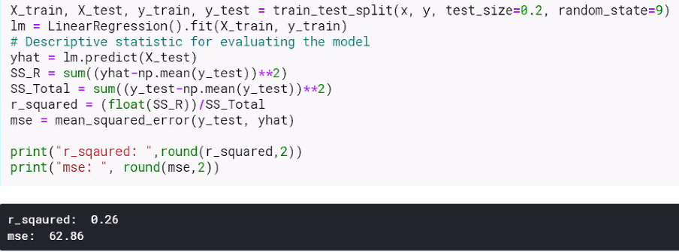
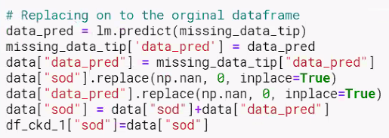
sod: Linear Regression
High sodium levels can be a cause of increased blood pressure; it can also lead to Coronary Artery Disease and other cardiovascular health issues
Source(s): CDC Sodium Excretion, CDC Heart Disease
Notes:
- High sodium levels can be a cause of increased blood pressure. It can also lead to Coronary Artery Disease and other cardiovascular health issues.

Slide 12
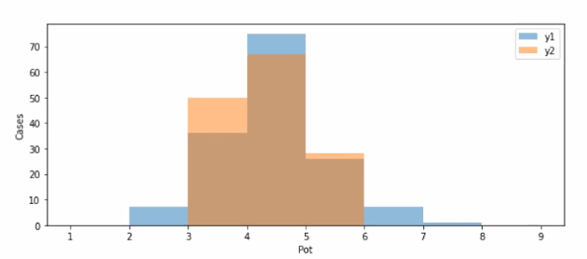
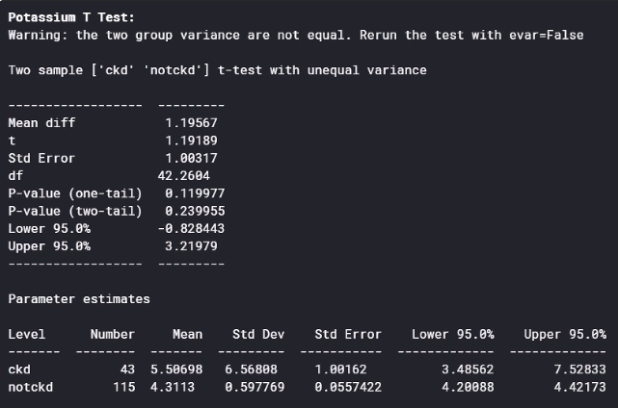
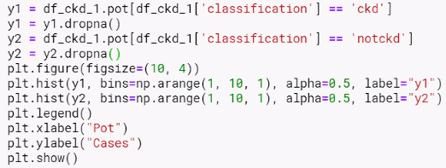
pot: Removed
H₀: σ² ₁ = σ² ₂ → Do NOT reject Null Hypothesis
H₁: σ² ₁ ≠ σ² ₂
α = 0.05

Slide 13

wc: Used Hypertension
A link was found between hypertension and elevated white blood cell levels
Source: Journal of Human Hypertension
Missing wc values were imputed with the average wc for htn = no / yes
Notes:
- Prolonged high blood pressure is hypertension

Slide 14
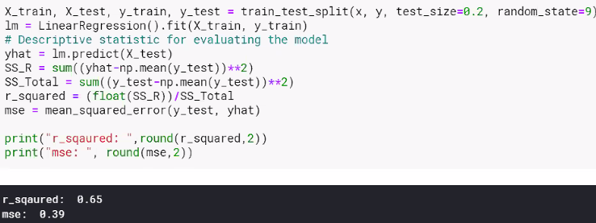

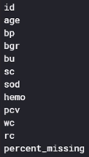
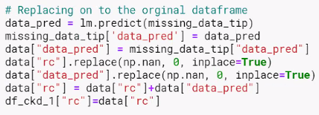
rc: Linear Regression
We identified the variable hemo (hemoglobin) which is most correlated with rc (red blood cell count)
Hemoglobin is the oxygen-carrying protein in red blood cells
Source: Complete Blood Count

Slide 15
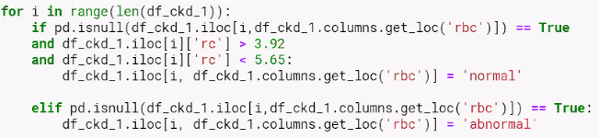
rbc: Used Red Blood Cell Count
Normal Red Blood Cell Count for Adults:
Red blood cell count: | Male: 4.35-5.65 trillion cells/L* (4.32-5.72 million cells/mcL**) Female: 3.92-5.13 trillion cells/L (3.90-5.03 million cells/mcL)
Source: Complete Blood Count

Slide 16
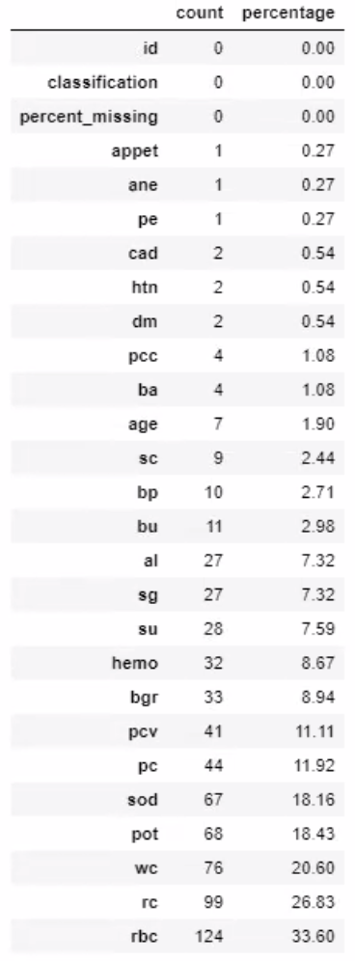
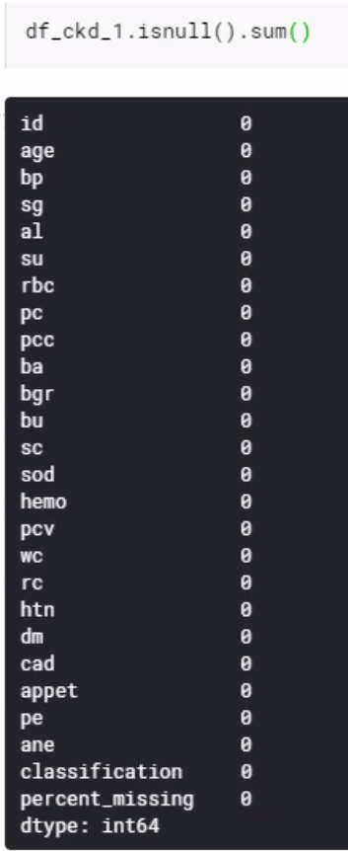
Data Cleansing Results
Before:
After:

Slide 17
Data Modeling
Data Partition Method:
60 train – 40 test split
Three Model Analyses:
Nearest Neighbor (K-NN)
Logistic Regression
Random Forest
Measures of Success:
Model beats Naïve Rule
Model validates
Model has highest validation/test hit rate
Model has high AUC

Slide 18
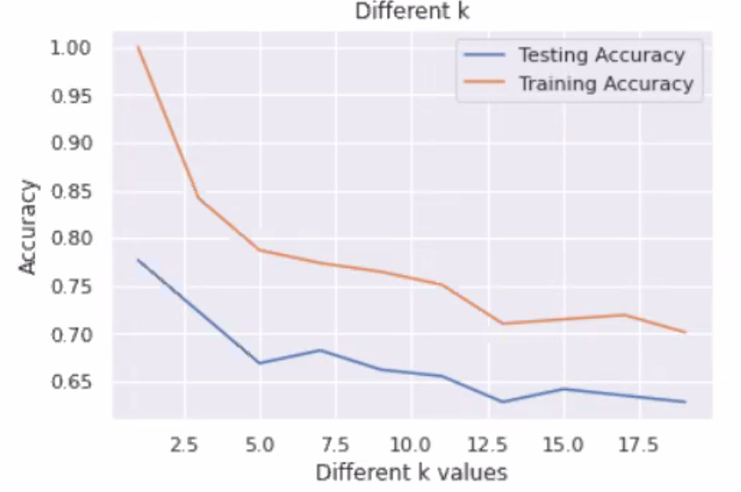
K-NN Analysis
Notes:
- <display image of result>
- We considered different ‘K’ values to potentially improve the fit
- Apply the variable selection

Slide 19
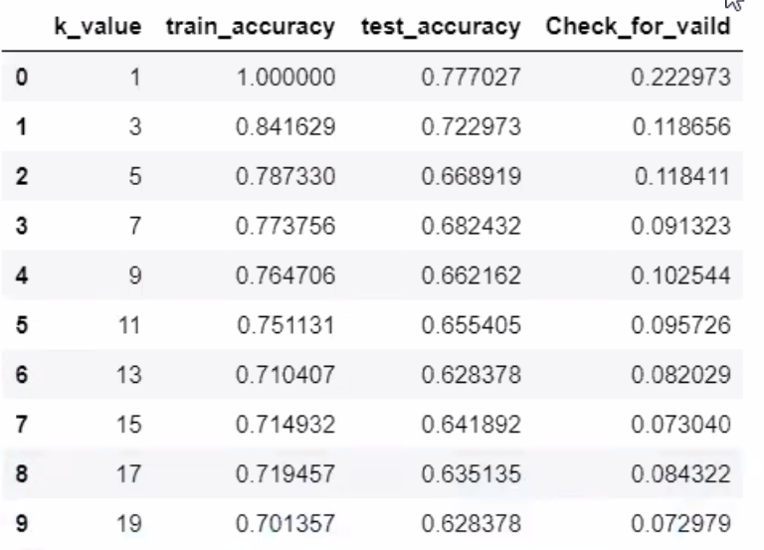
K-NN Analysis
This is the best K-NN model

Slide 20

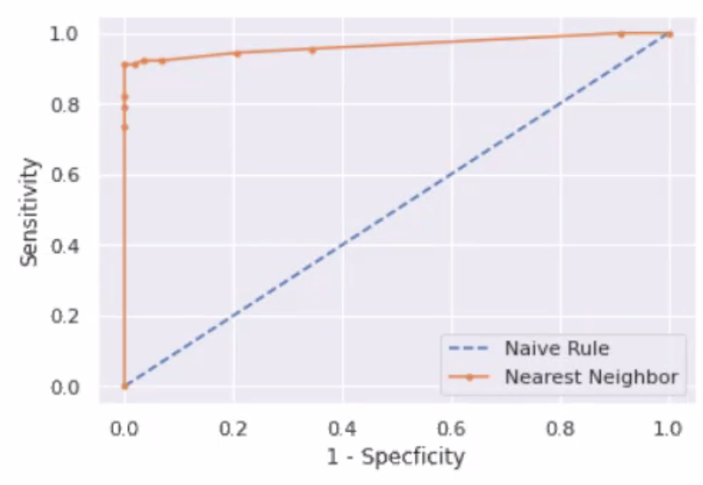
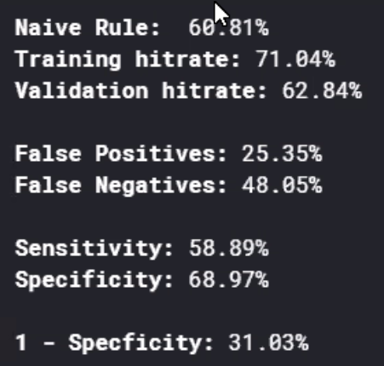
K-NN Analysis
ROC Plot
The best K-NN model at k = 15
This model beats the Naïve Rule
However, this model does NOT validate

Slide 21
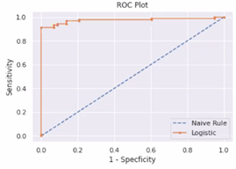

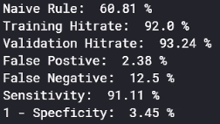
Logistic Regression Analysis
The Logistic Regression model beats the Naïve Rule
The Logistic Regression model DOES validate

Slide 22
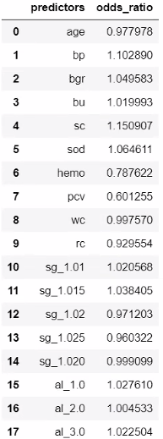

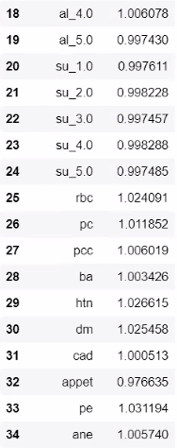
Logistic Regression Analysis
We may need to reduce the amount of variables to lessen the impact of multicollinearity within the model

Slide 23
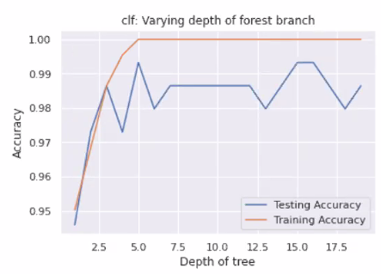

Random Forest Analysis
Notes:
- Best model seems to be around 5 for the Depth of tree

Slide 24
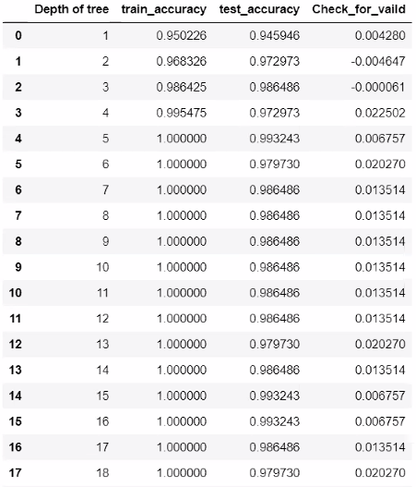
Random Forest Analysis
This is the best Random Forest model

Slide 25
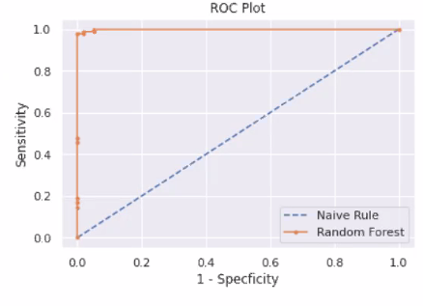

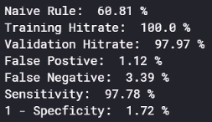
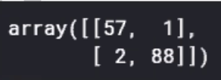
Random Forest Analysis
Confusion Matrix:
Predicted
The best Random Forest model is at Depth of tree = 5
This model beats the Naïve Rule
This model DOES validate
Actual

Slide 26
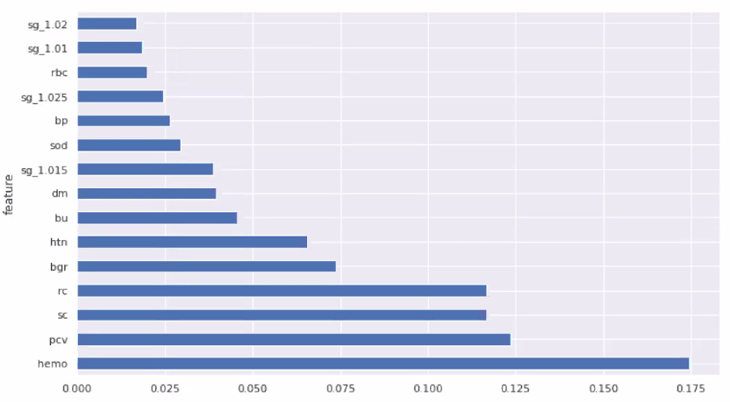
Random Forest Analysis
Importance
The most important variables from analysis, ranked highest to lowest:
1. Hemo
2. PCV
3. SC
4. RC

Slide 27
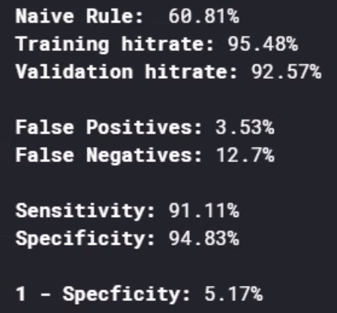
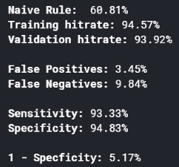



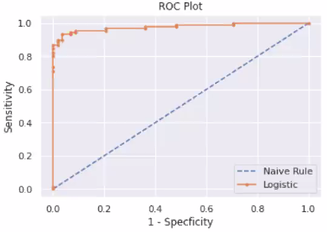
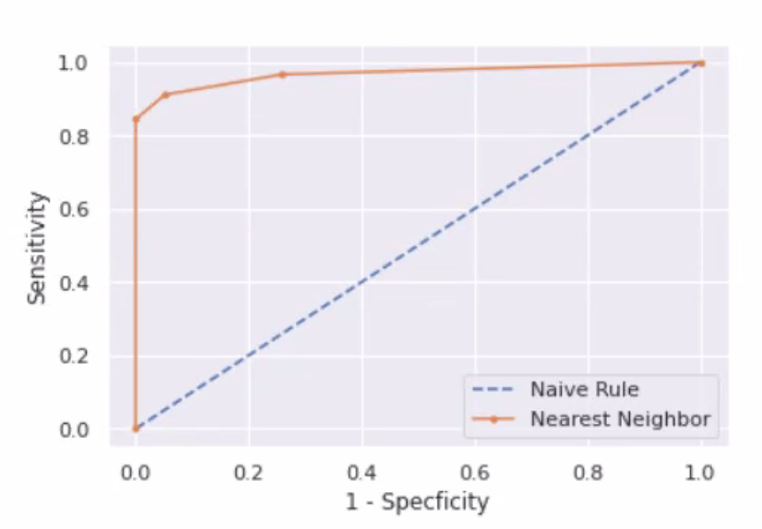
Quick Tune-Up
Nearest Neighbor
Logistic Regression

Slide 28
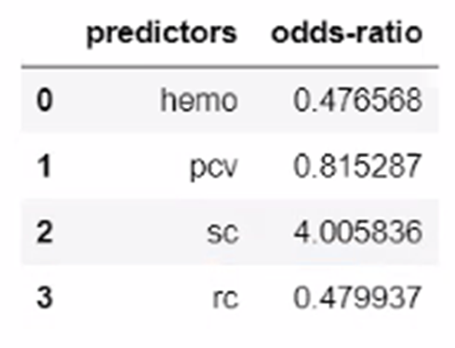
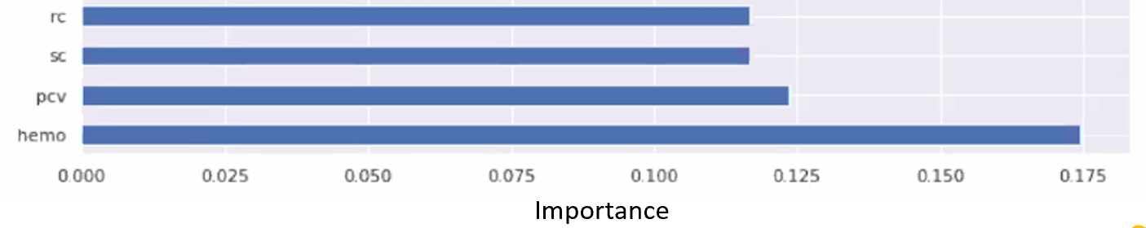
Model Comparison
Which model performed the best?
Random Forest
- Beats the Naïve Rule
- Validates
- Has the highest validation hit rate and ROC

Slide 29
Model Improvement and Recommendations
Data mining is an iterative process
Remove multicollinearity
Explore other data partitioning splits
Evaluate other models, such as:
Logistic Regression: Forward, Backward, Stepwise selection, and Best Subset
QCF, LCF, and Ensemble method
Overall, we want to increase sensitivity to have a better prediction for patients
Notes:
1. Best subset analysis:
- Remove potential overfitting of our model
-Overfitting basically creates a stipulation to where the model will bot be as easily replicable
- It is difficult to tune a model when the training data set is “too good”
2. We should evaluate other data partitioning methods to ensure our model is not overfit
- Ensure validation within 0.03 between the training hit rate and the validation hit rate
- Above 3% differentiation indicates potential overfitting of the model in the end.
3. Overall, we want to aim for improvement of the validation hit rate in addition to a higher ROC Curve index (which is industry standard because it indicates a better overall fit of the model regardless of which cutoff is specified)
- Aiming to reduce the variables included in our best model usually indicates more realistic predicting along with a higher hit rate

Slide 30

Questions?

