Slide 1
MCP Server for SQL Databases
One server that connects an AI model to any SQL database
Tayseer Abdeljaber
AI Engineering Internship | OmniOps
Notes:
Open with one line: I built an MCP server that lets an AI model query SQL databases safely, and it works with any database rather than one specific system.

Slide 2
What I was asked to build
An MCP server is a controlled bridge. Instead of handing an AI model direct access to everything, the model gets a small set of tools and the server decides what actually runs.
Required deliverables
A working MCP server with a README
Tools with documented inputs and outputs
A demo against a real MCP client
A short technical write-up
No hardcoded secrets, sensible validation
1
Start broad, then narrow
The first plan was to connect one specific data source. After talking it through, that changed.
2
Support any database, not one
Bunyan has to reach whatever database a customer already runs, so the server had to be generic.
3
Read-only, tested, documented
Safe by default, with setup instructions clear enough for someone else to run it.
Notes:
Be honest about the scope change: it started as one data source and became a general server, because that is what would actually be useful.

Slide 3
The four tools
A model calls these in order: find the databases, look inside, then ask a question.
1
2
3
4
list_data_sources
list_tables
describe_table
run_query
Which databases are set up
What tables exist inside one
The columns in a table, and their types
Runs a SELECT and returns the rows
Why split it up this way
A model that has never seen the database can list the tables, check the columns, and then write a query that actually fits it. The server never has to guess what the model wants, and the model never has to be told the schema in advance.
That is what makes the same four tools work on a database nobody wrote code for.
Notes:
The ordering is the interesting part. Discovery first, then query. That is what makes it generic.

Slide 4
Adding a database is a config change
Supporting a new database does not mean new code. It means one more line in config.yaml.
config.yaml
SQLAlchemy handles the differences
data_sources:
test_db: "sqlite:///synthetic.db"
reporting: "postgresql://user@host/db"
analytics: "mysql://user@host/db"
Postgres, MySQL and SQLite each describe their own tables differently underneath. SQLAlchemy already smooths that out, so the same four tools work on all of them.
Writing a separate driver for each database would have meant new code for every customer.
Where I have to be careful
Tested against SQLite so far. Postgres and MySQL should behave the same way through SQLAlchemy, but I have not run it against a live one yet, so that part is reasoning rather than proof.
Notes:
This slide carries the main idea. Flag the SQLite limitation here yourself rather than waiting to be asked.

Slide 5
How it fits together
The model never touches the database. Everything goes through the server.
MCP client
Inspector, Claude Desktop, or anything that speaks MCP
talks over stdio
↓
server.py
The four tools. Checks every query before it runs
the only gatekeeper
↓
SQLAlchemy
Translates for whichever database is configured
one engine per source, reused
↓
The database
Whatever config.yaml points at
read-only access
Notes:
Keep this short. One sentence per box, then move on to the demo.

Slide 6
Demo: finding your way around a database
Nothing about this database is hardcoded anywhere. The model works it out using the first three tools.
What is happening
1
list_tables
Comes back with people and comms_metadata
[ SCREENSHOT
MCP Inspector, showing list_tables and describe_table results ]
2
describe_table
Comes back with the columns and their types
3
Now it can query
It knows enough to write SQL that fits
Notes:
Walk through the two calls. The point is that discovery works on a database the server was never told about.

Slide 7
Demo: asking a question, and being told no
[ SCREENSHOT
run_query with SELECT * FROM people ]
[ SCREENSHOT
run_query with DROP TABLE people ]
A normal question works
Anything that writes is refused
The SELECT runs, the rows come back, capped at 25 by default.
The query never reaches the database at all.
Error: only a single read-only SELECT statement is allowed.
The same answer comes back for DROP, DELETE, UPDATE, INSERT, and for hiding a second statement after a SELECT.
Notes:
This pair is the most convincing thing in the deck. It works, and it refuses to do damage.

Slide 8
Three decisions that keep it safe
Parse, do not guess
The cap is mine, not theirs
Log the question, not the answer
The SQL goes through a parser first. It only runs if there is exactly one statement and that statement is a SELECT.
The whole query gets wrapped in another SELECT with the row limit applied on the outside.
Every query is written to the log for the record. The rows that come back never are.
Checking that the text starts with "select" would let SELECT 1; DROP TABLE people straight through.
So the caller cannot widen it by writing their own LIMIT, or by asking for a huge number.
Logging results would quietly turn the log file into a second copy of the database.
Connection strings live in config.yaml and nowhere else. Nothing is hardcoded, and .env is in .gitignore.
Still missing: a read-only database account. Right now writes are blocked by the code alone, which is one parser mistake away from failing.
Notes:
Do not skip the last box. Naming the gap yourself lands better than being asked about it.

Slide 9
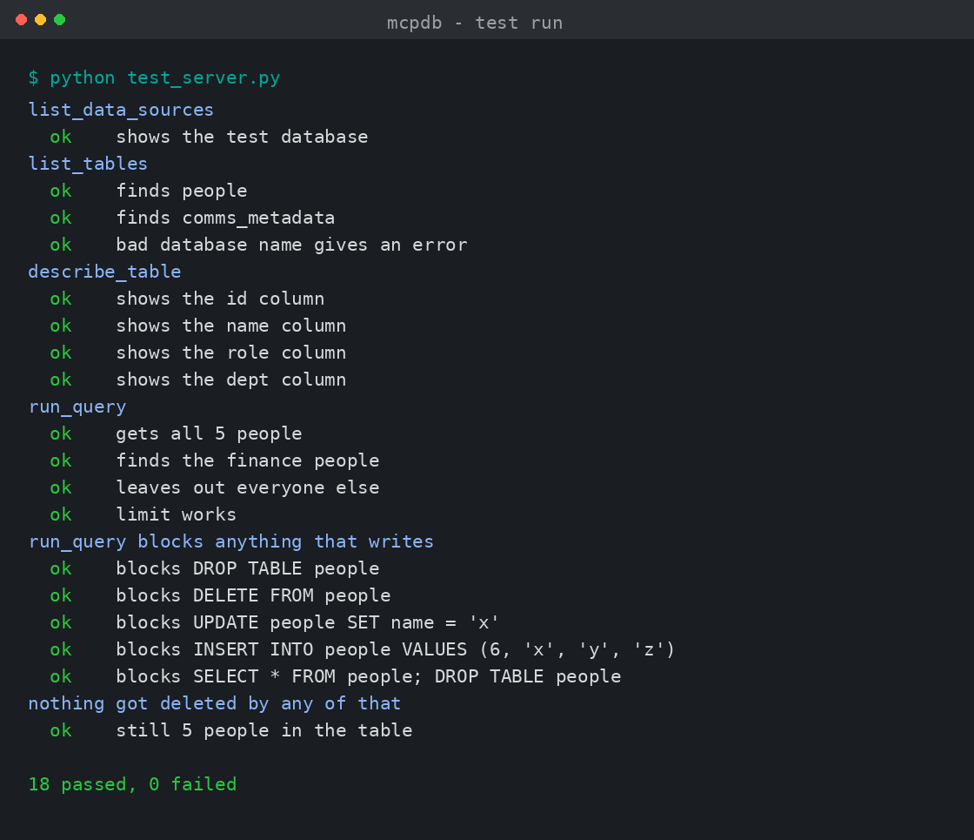
Testing
18 checks, run with one command
Each of the four tools returns what it should
Filtering and row limits behave correctly
A bad database name gives a clear error instead of crashing
Five different ways of writing to the database are all blocked
A final count confirms nothing was actually deleted
Built on invented data
The test database has the same shape as a real people-and-messages table, but there are no real records in it. None of this needed live data to build or demo.
Notes:
Point out that the tests cover the attacks, not just the happy path.

Slide 10
What is left
1
Run it against a live Postgres
The one claim I am reasoning about rather than showing. Closing it turns the idea into a demo.
The open question
How is Bunyan meant to connect to this?
MCP does not have webhooks. A client either speaks MCP or it does not.
If Bunyan has an MCP client built in, this needs a network transport and a token. If webhook meant something else, that is a different build.
I did not want to guess and build the wrong one, so this is the first thing worth settling.
2
Add a read-only database account
So that a mistake in my parsing still could not change anything.
3
Query timeouts, and SQL Server syntax
LIMIT is not universal, and a slow query can sit there holding a connection open.
The repo, README and technical write-up are ready to hand over.
Notes:
End on the open question. It shows the project is understood, not just finished. Then offer to walk through the code or the write-up.

