Slide 1
General Linear Model
Part 3.3 Linear Regression, Correlation, Hypothesis Testing

Slide 2
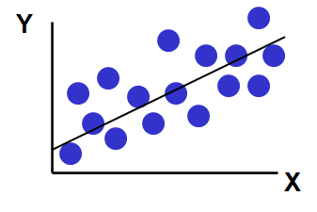
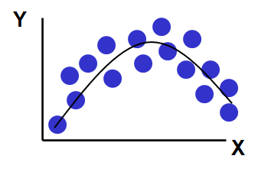
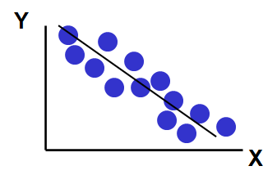
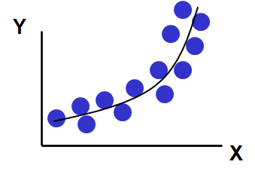
Types of Relationships
Linear relationships
Nonlinear relationships

Slide 3
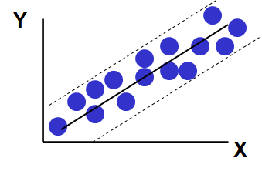
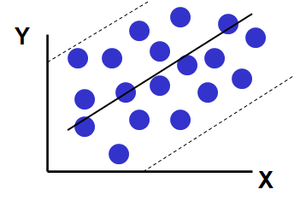
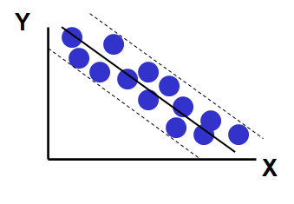
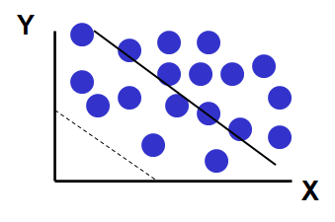
Types of Relationships
Strong relationships
Weak relationships

Slide 4
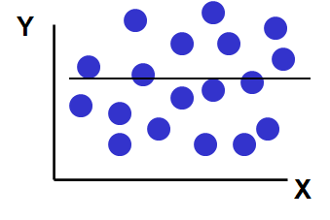
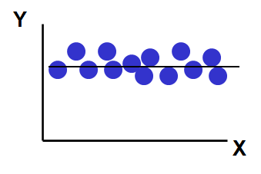
Types of Relationships
No relationship

Slide 5
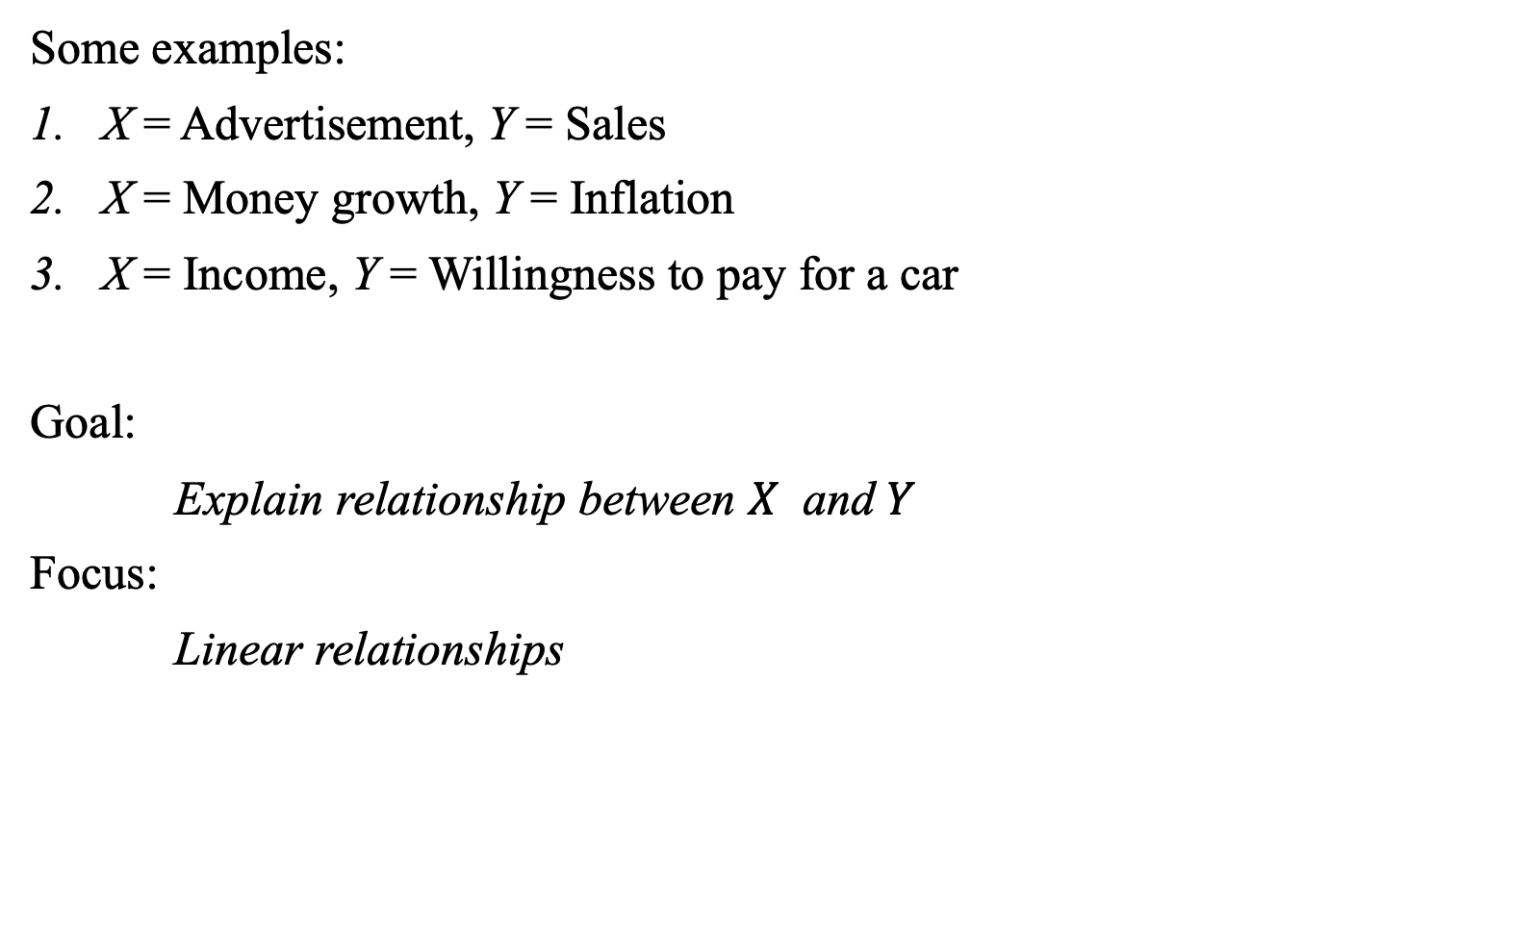
Relationships Between Variables
Some examples:
X = Advertisement, Y = Sales
X = Money growth, Y = Inflation
X = Income, Y = Willingness to pay for a car
Goal:
Explain relationship between $X$ and $Y$
Focus:
Linear relationships

Slide 6
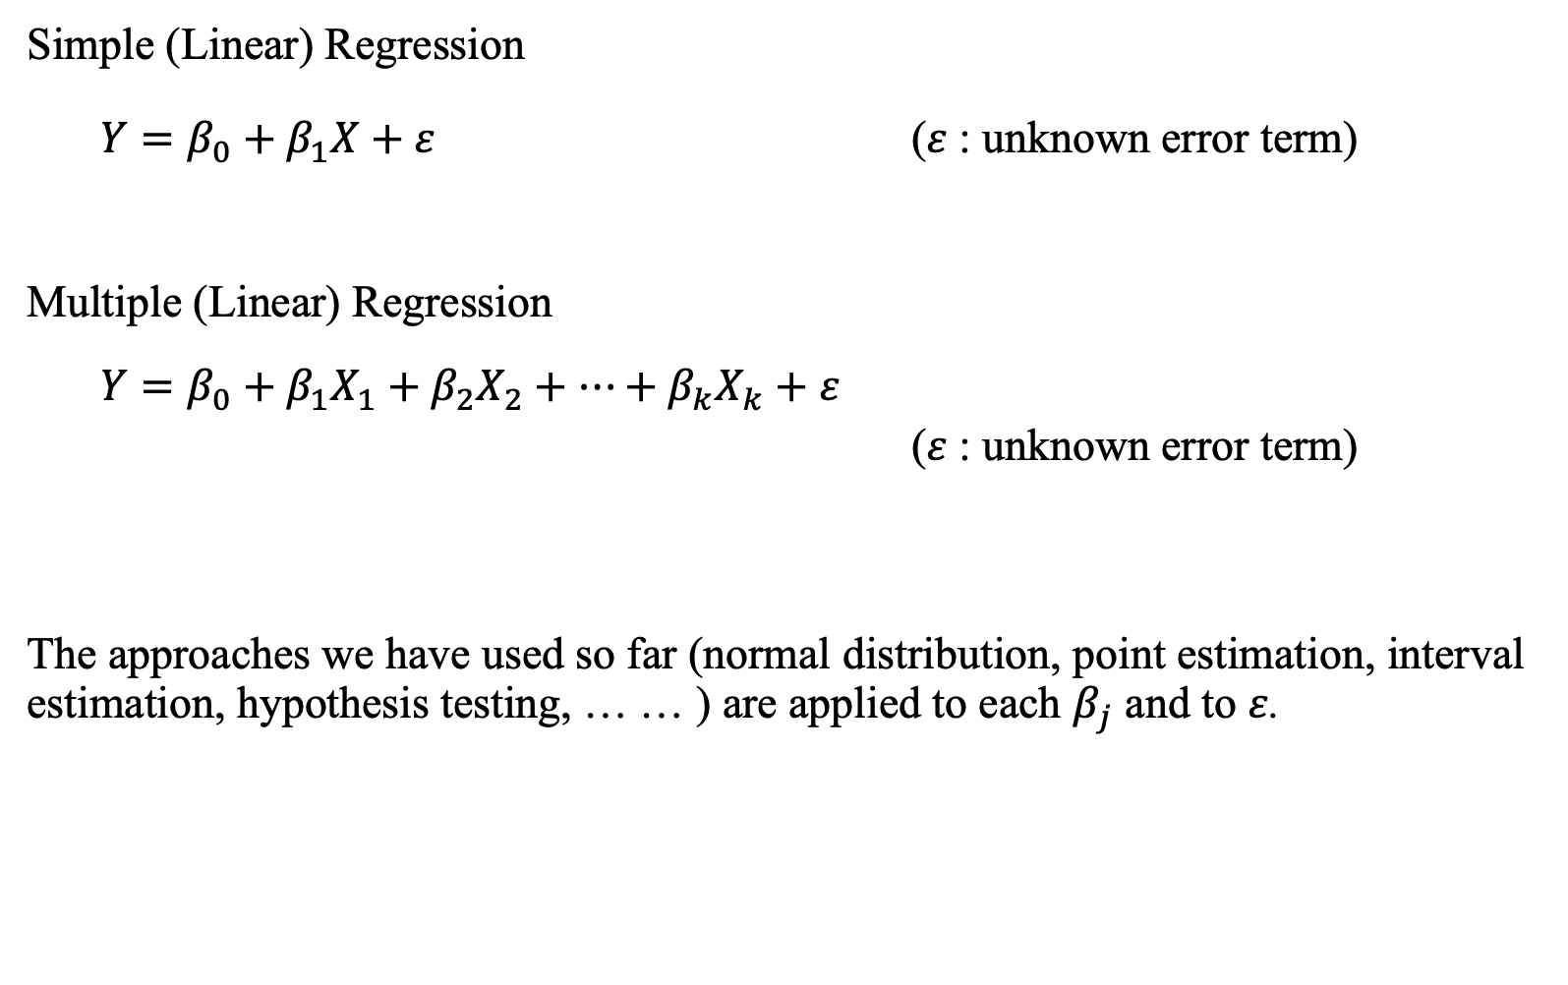
Linear Regression: Roadmap
Simple (Linear) Regression
$Y=β_{0}+β_{1}X+ε$ ($ε$: unknown error term)
Multiple (Linear) Regression
$Y=β_{0}+β_{1}X_{1}+β_{2}X_{2}+⋯+β_{k}X_{k}+ε$
($ε$: unknown error term)
The approaches we have used so far (normal distribution, point estimation, interval estimation, hypothesis testing, … … ) are applied to each $β_{j}$ and to $ε$.

Slide 7
Simple Linear Regression
One outcome variable: Y
One predictor variable: X
Data (paired): (X, Y)
The basic ideas
Y as a linear function of X
Explain the impact of changes in X on Y
Predict the value of Y based on a given value of X
Notes:
Y = dependent variable
variable we wish to explain or predict
X = independent variable
variable used to explain or predict the dependent variable

Slide 8
Example: Car Dealership
A key piece of information for securing the sale of a car is understanding the willingness to pay of the potential customer.
This helps the salesperson focusing on a certain range of car makes and models that might secure the sale at the best possible competitive price.
How can income information be used?
→ Use it to predict customers’ spending?
→ How accurate is the spending prediction?

Slide 9
Example: Car Dealership
1. What are we modeling?
2. How do we interpret the model?

Slide 10
Population Model
… describes our assumptions about the population relationship between Y and X.
Assumptions:
Y and X are linearly related (sometimes called the tendency).
Individual observations can differ from the tendency in a random way (These differences are called error terms).
The error terms follow a standard normal distribution.
Let's look at some pictures to show these assumptions!
Notes:
Second bullet point:
life style, work onsite or work from home
Take public transport or drive
Whether the household has other cars
Personal preference: luxury car or economy car
That are lots of assumptions about the population!

Slide 11
Simple Linear Regression: Population
$Y=$ price
$X=$income

Slide 12
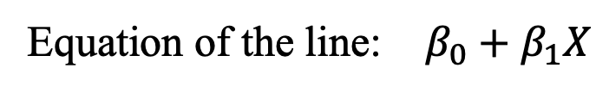
Simple Linear Regression: Tendency
Equation of the line: $β_{0}+β_{1}X$
$Y=$ price
$X=$income
Notes:
Equation of the line is the tendency

Slide 13
Simple Linear Regression: Tendency
Equation of the line: $β_{0}+β_{1}X$
$Y=$ price
$β_{1}:$ slope
1
$β_{0}:$ intercept
$X=$income

Slide 14

Simple Linear Regression: Tendency
$Y=$ price
$$E\left[Y ∣ X\right]=β_{0}+β_{1}X$$
We expect observations to be on the line.
The tendency gives the predicted value of Y
for some given value of X
$X=$income

Slide 15

Simple Linear Regression
$Y=$ price
$$E\left[Y ∣ X\right]=β_{0}+β_{1}X$$
We expect observations to be on the line.
But individuals may be above or below
the line
Why? Because of unknown factors
$X=$income

Slide 16
Simple Linear Regression: The Error
$E\left[Y ∣ X\right]=β_{0}+β_{1}X$ $Y=β_{0}+β_{1}X+ε$
$Y=$ price
tendency
data
The unknown factors imply a difference between the tendency and the data.
This diff. is called the error term
$X=$income

Slide 17






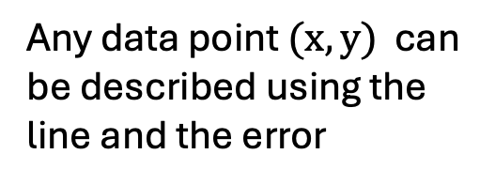
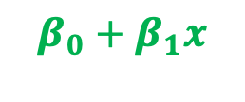

Simple Linear Regression: The Error
$$Y=β_{0}+β_{1}X+ε$$
$Y=$ price
$$ε>0$$
$$(x,y)$$
$$y$$
$$β_{0}+β_{1}x$$
Any data point $(x,y)$ can be described using the line and the error
$$x$$
$X=$income
Notes:
Any data point (x,y) can be described using the line and the error

Slide 18





Simple Linear Regression: The Error
$$Y=β_{0}+β_{1}X+ε$$
$Y=$ price
$$ε<0$$
$$β_{0}+β_{1}x$$
Any data point $(x,y)$ can be described using the line and the error
$$y$$
$$(x,y)$$
$$x$$
$X=$income
Notes:
Any data point (x,y) can be described using the line and the error

Slide 19



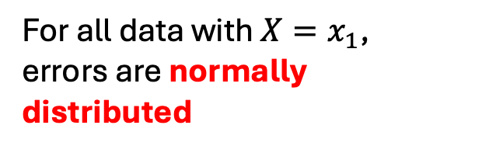


Simple Linear Regression: The Error
$$Y=β_{0}+β_{1}X+ε$$
, where $ε\sim N(0,σ_{ε}^{2})$
$Y=$ price
For all data with $X=x_{1}$,
errors are normally
distributed
$$X=x_{1}$$
$X=$income
Notes:
That’s lots of assumptions about the population!

Slide 20


Simple Linear Regression: The Error
$$Y=β_{0}+β_{1}X+ε$$
, where $ε\sim N(0,σ_{ε}^{2})$
$Y=$ price
For all data with $X=x_{2}$,
errors are normally
distributed
$$X=x_{2}$$
$X=$income
Notes:
That’s lots of assumptions about the population!

Slide 21


Simple Linear Regression: The Error
$$Y=β_{0}+β_{1}X+ε$$
, where $ε\sim N(0,σ_{ε}^{2})$
$$ε\sim N(0,σ_{ε}^{2})$$
error
The linear regression model is completely described by $β_{0}, β_{1}$ and $σ_{ε}$
Notes:
That’s lots of assumptions about the population!

Slide 22
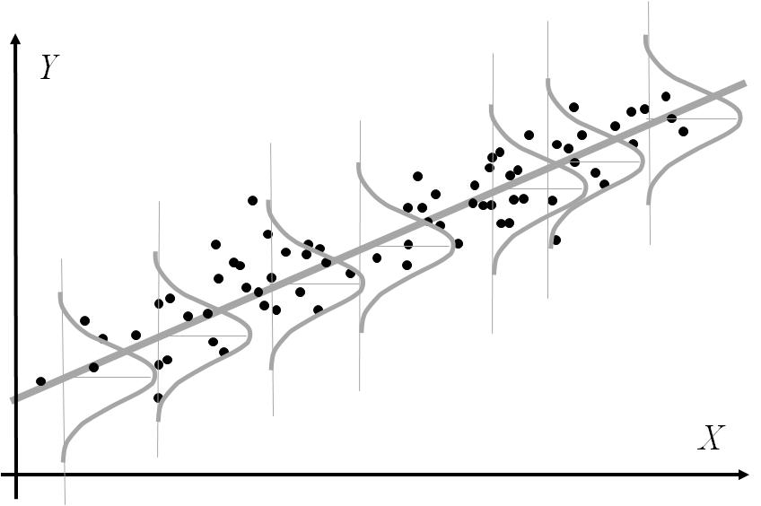
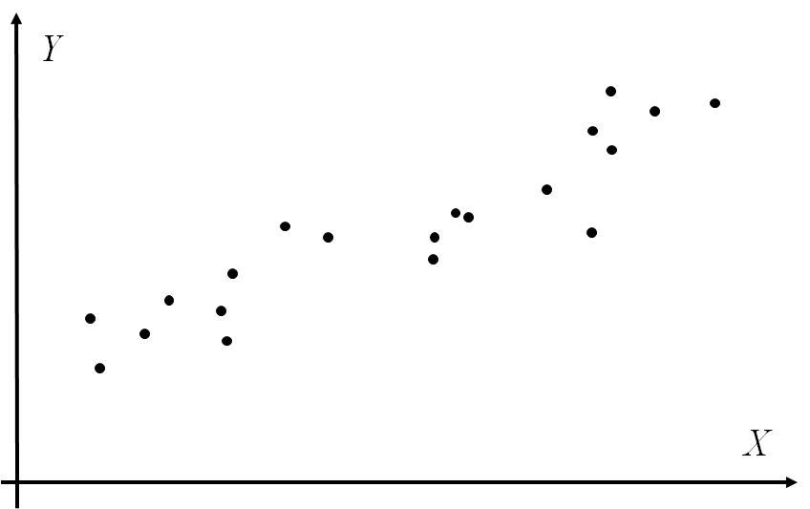
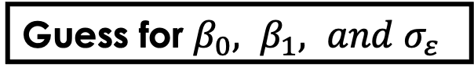
Linear Regression: Population vs Sampling
SAMPLING
Population
Sample
$Y=β_{0}+β_{1}X+ε$
$$ε \sim N(0,σ_{ε}^{2})$$
But our computations are HERE!
Want this!
INFERENCE
Guess for ${β_{0}, β_{1}, and σ}_{ε}^{}$
Number crunching
Notes:
That’s lots of assumptions about the population!

Slide 23







Population Model vs Sample Model
Regression equation for the population model:
$$Y=β_{0}+β_{1}X+ε, ε\sim N(0,σ_{ε}^{2})$$
Regression equation for the sample model:
$$Y={\hat{β}}_{0}+{\hat{β}}_{1}X, ε\sim N(0,S_{ε}^{2})$$
$$β_{0}$$
$${\hat{β}}_{0}$$
Estimate these
population
parameters
Using these
sample
characteristics
$$β_{1}$$
$${\hat{β}}_{1}$$
$$σ_{ε}^{}$$
$$S_{ε}^{}$$
Notes:
Notation: we use for estimated things
Example: ${\hat{β}}_{j}$ is the estimate for $β_{j}$

Slide 24
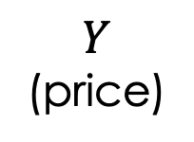

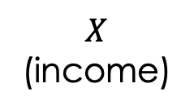


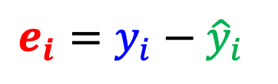
Estimate The Regression Line
$$Y$$
(price)
Residual
$$e_{i}=y_{i}−{\hat{y}}_{i}$$
$$y_{i}$$
$${\hat{y}}_{i}$$
$$x_{i}$$
$$X$$
(income)

Slide 25
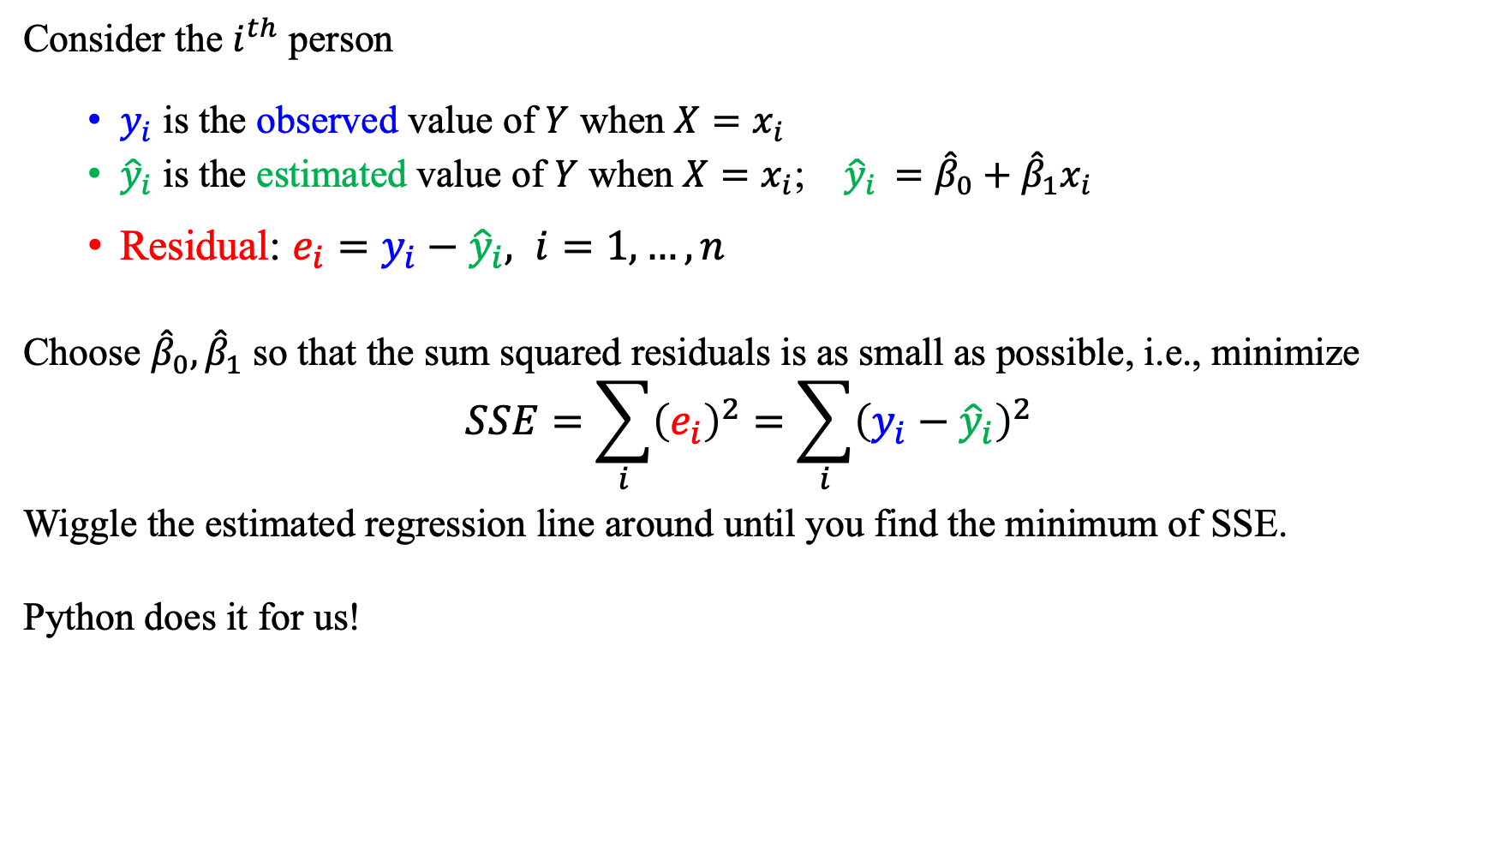
Estimate The Regression Line
Consider the $i^{th}$ person
$y_{i}$ is the observed value of $Y$ when $X=x_{i}$
${\hat{y}}_{i}$ is the estimated value of $Y$ when $X=x_{i}$; ${\hat{y}}_{i }={\hat{β}}_{0}+{\hat{β}}_{1}x_{i}$
Residual: $e_{i}=y_{i}−{\hat{y}}_{i}, i=1,…, n$
Choose ${\hat{β}}_{0}, {\hat{β}}_{1}$ so that the sum squared residuals is as small as possible, i.e., minimize
$$SSE=\sum_{i}{{\left(e_{i}\right)}^{2}}=\sum_{i}{{\left(y_{i}−{\hat{y}}_{i}\right)}^{2}}$$
Wiggle the estimated regression line around until you find the minimum of SSE.
Python does it for us!
Least Squares
Method

Slide 26
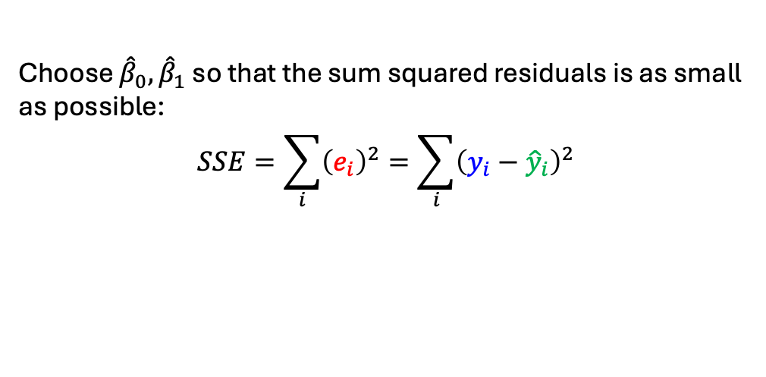
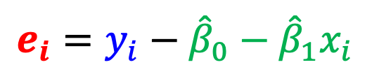
Estimate The Regression Line
Choose ${\hat{β}}_{0}, {\hat{β}}_{1}$ so that the sum squared residuals is as small as possible:
$$SSE=\sum_{i}{{\left(e_{i}\right)}^{2}}=\sum_{i}{{\left(y_{i}−{\hat{y}}_{i}\right)}^{2}}$$
$$Y$$
(price)
$$e_{i}=y_{i}−{\hat{β}}_{0}−{\hat{β}}_{1}x_{i}$$
$$y_{i}$$
$${\hat{y}}_{i}$$
$$x_{i}$$
$$X$$
(income)

Slide 27

Focus 1: Estimate the Linear Relationship
Obtain the regression line (Get ${\hat{β}}_{0}$ , ${\hat{β}}_{1}$, $S_{ε}^{}$)
Point estimation of $β_{0}$ and $β_{1}$ (Interpret the regression line)

Slide 28
Example Pittsburgh Housing Prices

Slide 29


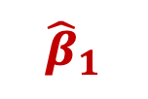







Population Model vs. Sample Model
Regression equation for the population model:
$$Y=β_{0}+β_{1}X+ε, ε\sim N(0,σ_{ε}^{2})$$
Regression equation for the sample model:
$$Y={\hat{β}}_{0}+{\hat{β}}_{1}X, ε\sim N(0,S_{ε}^{2})$$
Estimate these
population
parameters
$${\hat{β}}_{0}$$
$$β_{0}$$
$${\hat{β}}_{0}$$
Using these
sample
characteristics
$$β_{1}$$
$${\hat{β}}_{1}$$
$${\hat{β}}_{1}$$
$$σ_{ε}^{}$$
$$S_{ε}^{}$$
$$S_{ε}^{}$$

Slide 30
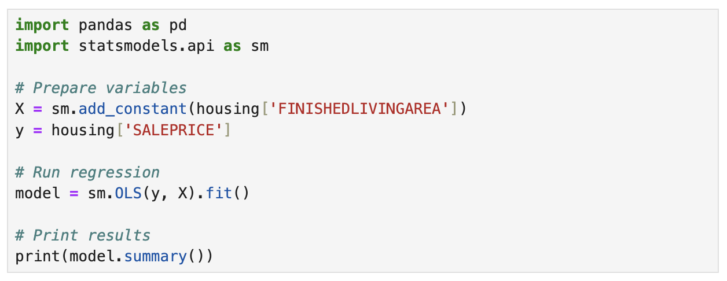
Example Pittsburgh Housing Prices

Slide 31
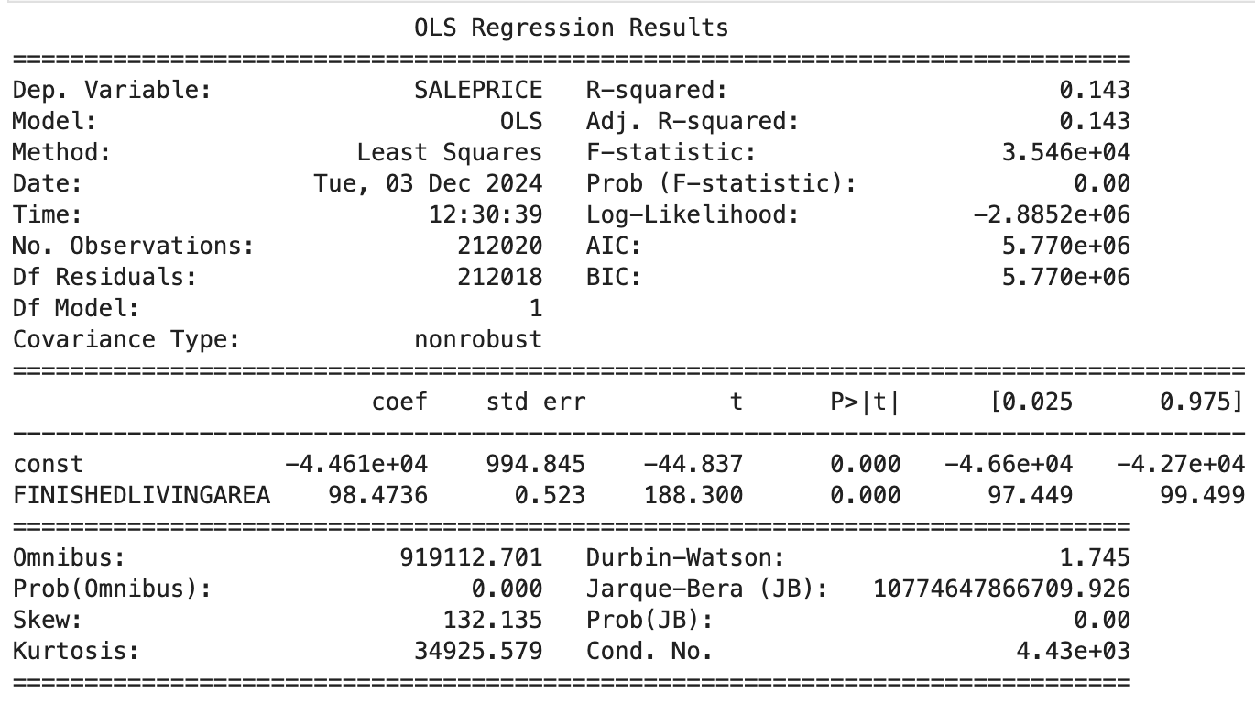




Example Pittsburgh Housing Prices
$$Y={\hat{β}}_{0}+{\hat{β}}_{1}X$$
$=−44610 +98.473 X$
Y
${\hat{β}}_{0}$
X
${\hat{β}}_{1}$

Slide 32

Population Model vs. Sample Model
Regression equation for the population model:
$$Y=β_{0}+β_{1}X+ε, ε\sim N(0,σ_{ε}^{2})$$
Regression equation for the sample model:
$$Y={\hat{β}}_{0}+{\hat{β}}_{1}X, ε\sim N(0,S_{ε}^{2})$$
Estimate these
population
parameters
$$β_{0}$$
$${\hat{β}}_{0}$$
Using these
sample
characteristics
$$β_{1}$$
$${\hat{β}}_{1}$$
$$σ_{ε}^{}$$
$$S_{ε}^{}$$
$$S_{ε}^{}$$
$$S_{ε}^{}$$

Slide 33
Example Pittsburgh Housing Prices
$$Y={\hat{β}}_{0}+{\hat{β}}_{1}X$$
$=−44610 +98.473 X$
Y
${\hat{β}}_{0}$
X
${\hat{β}}_{1}$

Slide 34



$$Y=β_{0}+β_{1}X+ε$$
, where $ε\sim N(0,σ_{ε}^{2})$
$$ε\sim N(0,σ_{ε}^{2})$$
error
Notes:
That’s lots of assumptions about the population!

Slide 35
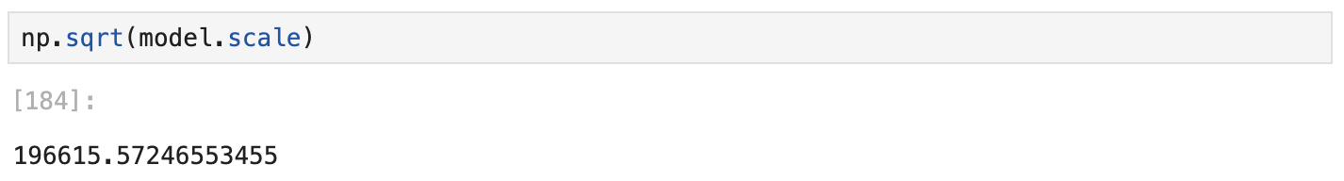
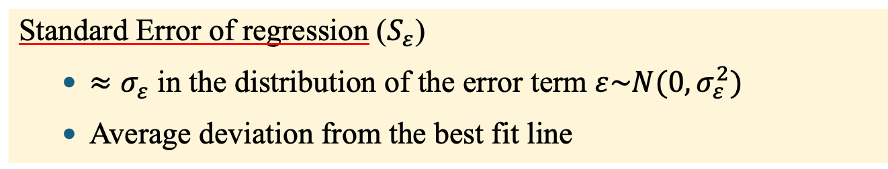




Example Pittsburgh Housing Prices
$$Y={\hat{β}}_{0}+{\hat{β}}_{1}X$$
$$where ε\sim N(0, S_{ε}^{2})$$
$=−44610 +98.473 X$
$$where ε\sim N(0, {196615}^{2})$$
Std. Err. Reg.
Standard Error of regression ($S_{ε}$)
$≈σ_{ε}$ in the distribution of the error term ${ε\sim N(0,σ}_{ε}^{2})$
Average deviation from the best fit line

Slide 36

Example Pittsburgh Housing Prices
$$Y={\hat{β}}_{0}+{\hat{β}}_{1}X$$
$$where ε\sim N(0, S_{ε}^{2})$$
$=−44610 +98.473 X$
$$where ε\sim N(0, {197.3}^{2})$$
Std. Err. Reg.
$$Price=−44610 +98.473 Area, ε\sim N(0, {196615}^{2})$$
Standard Error of regression ($S_{ε}$)
$≈σ_{ε}$ in the distribution of the error term ${ε\sim N(0,σ}_{ε}^{2})$
Average deviation from the best fit line

Slide 37
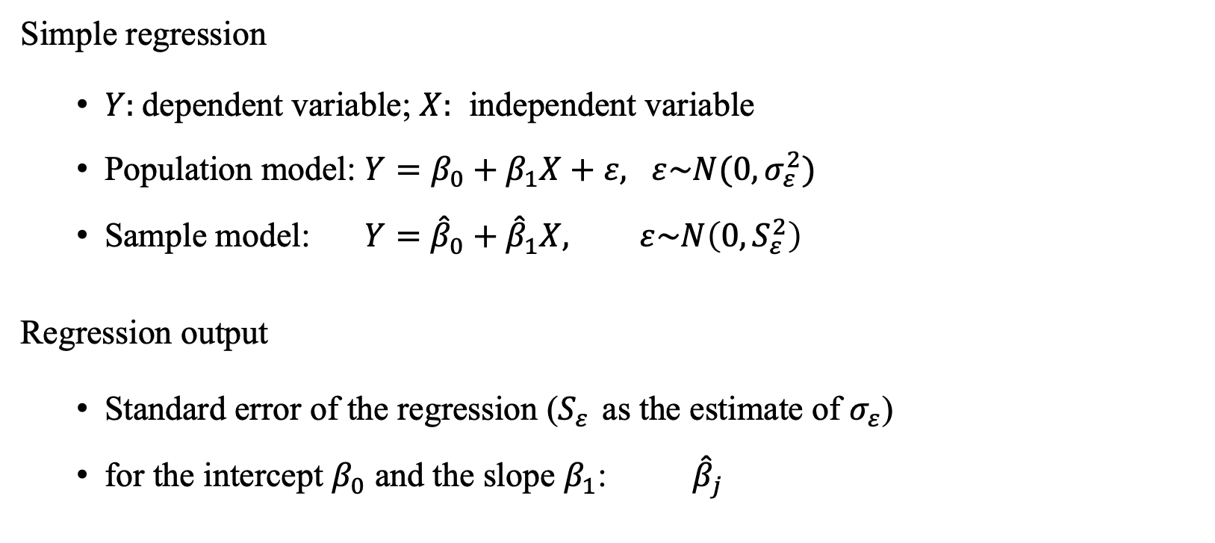
Summary
Simple regression
$Y:$dependent variable; $X:$ independent variable
Population model: $Y=β_{0}+β_{1}X+ε, ε\sim N(0,σ_{ε}^{2})$
Sample model: $Y={\hat{β}}_{0}+{\hat{β}}_{1}X, ε\sim N\left(0,S_{ε}^{2}\right)$
Regression output
Standard error of the regression ($S_{ε}^{}$as the estimate of $σ_{ε}$)
for the intercept $β_{0}$ and the slope $β_{1}$: ${\hat{β}}_{j}$

Slide 38

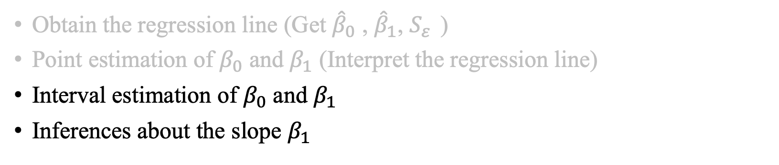

Focus 1: Estimate the Linear Relationship
Obtain the regression line (Get ${\hat{β}}_{0}$ , ${\hat{β}}_{1}$, $S_{ε}^{}$)
Point estimation of $β_{0}$ and $β_{1}$ (Interpret the regression line)
Interval estimation of $β_{0}$ and $β_{1}$
Inferences about the slope $β_{1}$
$$H_{0}:{ β}_{1}=0$$
$${ H}_{0}:{ β}_{1}=some number other than 0$$

Slide 39

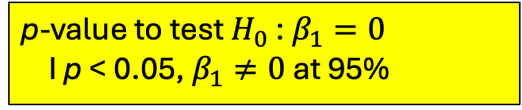




Example Pittsburgh Housing Prices
$$Price=−44.9781 +0.0997 Area, ε\sim N(0, {197.3}^{2})$$
${\hat{β}}_{1}$: point estimate of $β_{1}$
$S_{{\hat{β}}_{1}}:$ std. dev. (std. error) of ${\hat{β}}_{1}$
units of $S_{{\hat{β}}_{1}}$that ${\hat{β}}_{1}$ is from 0
p-value to test $H_{0}$ : $β_{1}=0$
I p < 0.05, $β_{1}≠0$ at 95%
95% C.I for $β_{1}$
$H_{0}: β_{1}=0$ vs. $H_{1}$: ${ β}_{1}≠0$

Slide 40
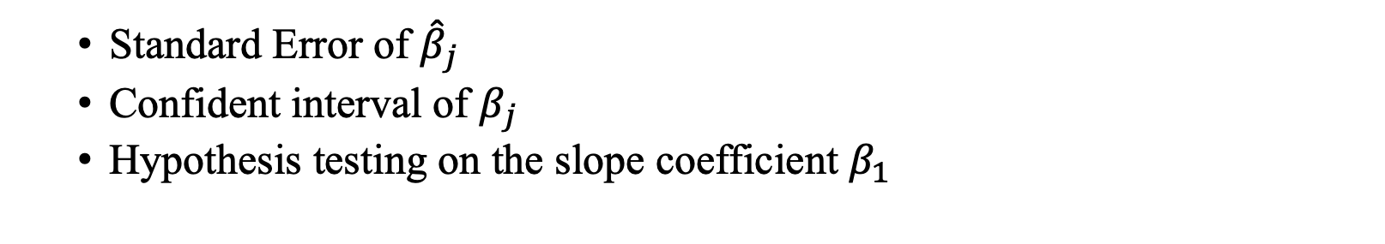


Summary
Standard Error of ${\hat{β}}_{j}$
Confident interval of $β_{j}$
Hypothesis testing on the slope coefficient $β_{1}$
$$H_{0}:{ β}_{1}=0$$
$$H_{0}:{ β}_{1}=some number other than 0$$

Slide 41
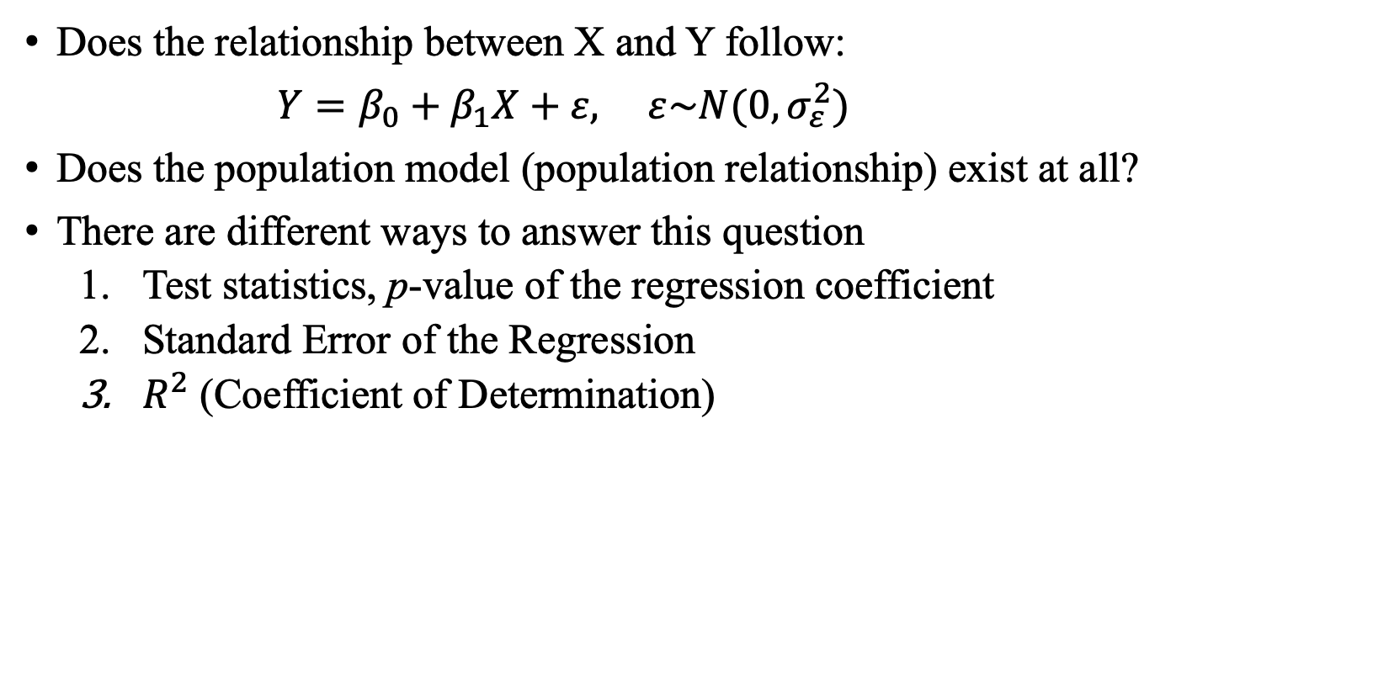
Focus 2: How good is the model fit?
Does the relationship between X and Y follow:
$Y=β_{0}+β_{1}X+ε, ε\sim N(0,σ_{ε}^{2})$
Does the population model (population relationship) exist at all?
There are different ways to answer this question
Test statistics, p-value of the regression coefficient
Standard Error of the Regression
$R^{2}$ (Coefficient of Determination)

Slide 42
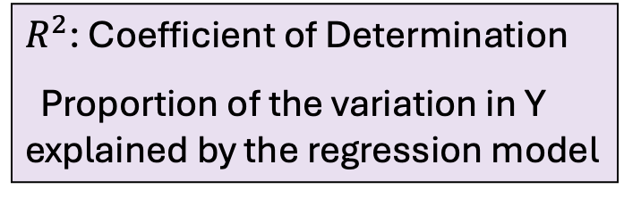

Example Pittsburgh Housing Prices
$$Price=−44.9781 +0.0997 Area, ε\sim N(0, {197.3}^{2})$$
$R^{2}$: Coefficient of Determination
Proportion of the variation in Y explained by the regression model
$β_{1}≠0$, linear relationship exists

Slide 43

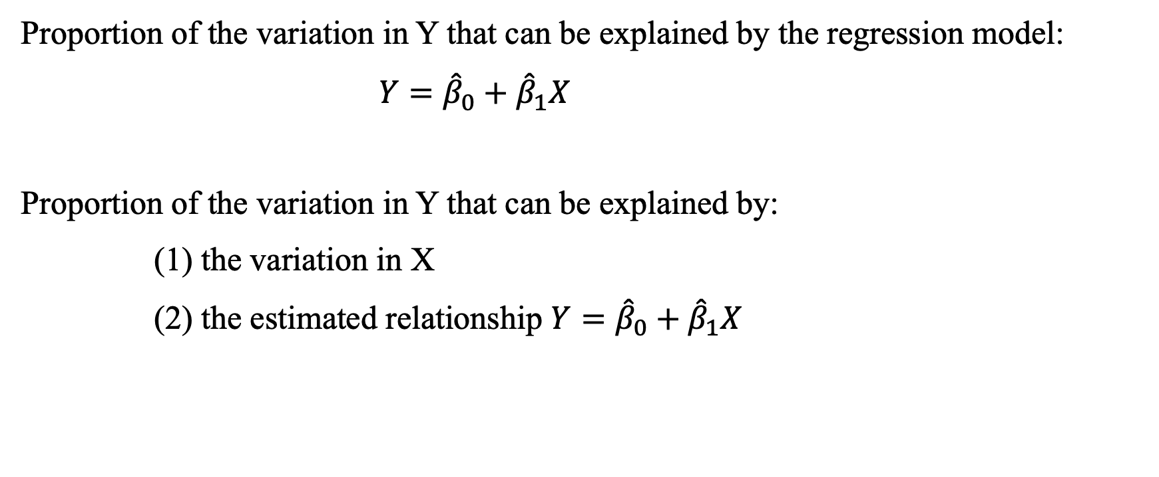
What is $R^{2}?$
Proportion of the variation in Y that can be explained by the regression model:
$Y={\hat{β}}_{0}+{\hat{β}}_{1}X$
Proportion of the variation in Y that can be explained by:
(1) the variation in X
(2) the estimated relationship $Y={\hat{β}}_{0}+{\hat{β}}_{1}X$

Slide 44









Measures of Variation
want this part small
fixed; given
by raw data
$$Y$$
$$Y_{i}−\overline{Y}$$
$$Y_{i}$$
$$Y_{i}−{\hat{Y}}_{i}$$
$${\hat{Y}}_{i}$$
$${\hat{Y}}_{i}−\overline{Y}$$
$$\overline{Y}$$
want this part large
$$X_{i}$$
$$X$$
Notes:
Any data point (x,y) can be described using the line and the error

Slide 45






Measures of Variation
want this part small
$$Y$$
SST
= $\sum{{(Y_{i}−\overline{Y})}^{2}}$
SSE
= $\sum{{(Y_{i}−{\hat{Y}}_{i})}^{2}}$
$$Y_{i}$$
$${\hat{Y}}_{i}$$
want this part large
$$\overline{Y}$$
SSR
= $\sum{{({\hat{Y}}_{i}−\overline{Y})}^{2}}$
$$X_{i}$$
$$X$$
Notes:
Any data point (x,y) can be described using the line and the error

Slide 46
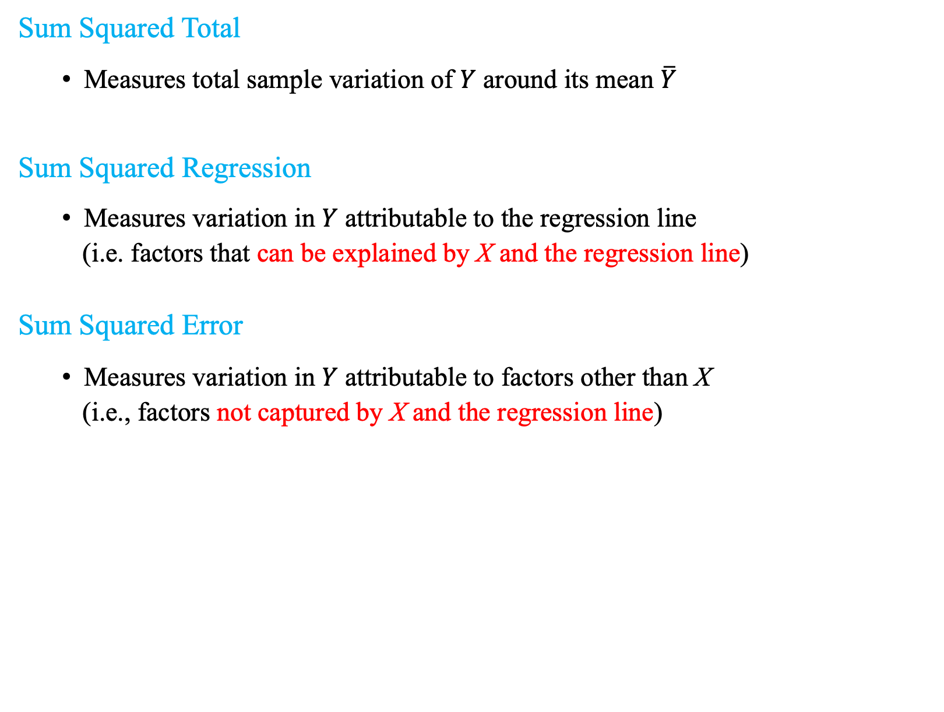
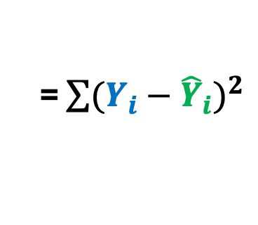
Measures of Variation
Fixed
by data
Sum Squared Total
Measures total sample variation of $Y$ around its mean $\overline{Y}$
Sum Squared Regression
Measures variation in $Y$ attributable to the regression line
(i.e. factors that can be explained by X and the regression line)
Sum Squared Error
Measures variation in $Y$ attributable to factors other than X
(i.e., factors not captured by X and the regression line)
SST
= $\sum{{(Y_{i}−\overline{Y})}^{2}}$
want this
large
SSR
= $\sum{{({\hat{Y}}_{i}−\overline{Y})}^{2}}$
want this
small
SSE
= $\sum{{(Y_{i}−{\hat{Y}}_{i})}^{2}}$

Slide 47

What is $R^{2}?$
… the proportion of the variation in $Y$ in the sample that can be explained by the regression model.
SSR
$$R^{2}$$
=
$${0≤R}^{2}≤1$$
SST

Slide 48
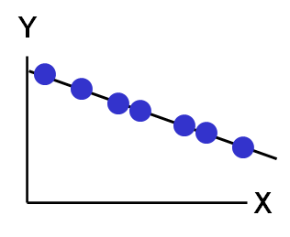
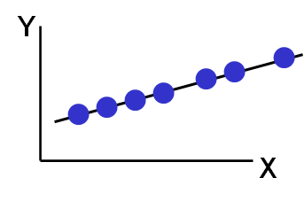

What is $R^{2}?$
… the proportion of the variation in $Y$ in the sample that can be explained by the regression model.
$$R^{2}=1$$
Perfect linear relationship between X and Y:
100% of the variation in Y is explained by variation in X

Slide 49
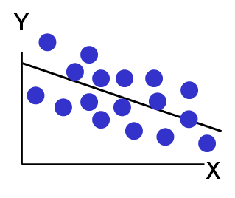
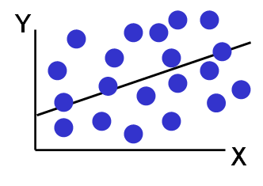

What is $R^{2}?$
… the proportion of the variation in $Y$ in the sample that can be explained by the regression model.
$${0<R}^{2}<1$$
Weaker linear relationship between X and Y:
Some but not all the variation in Y is explained by variation in X

Slide 50
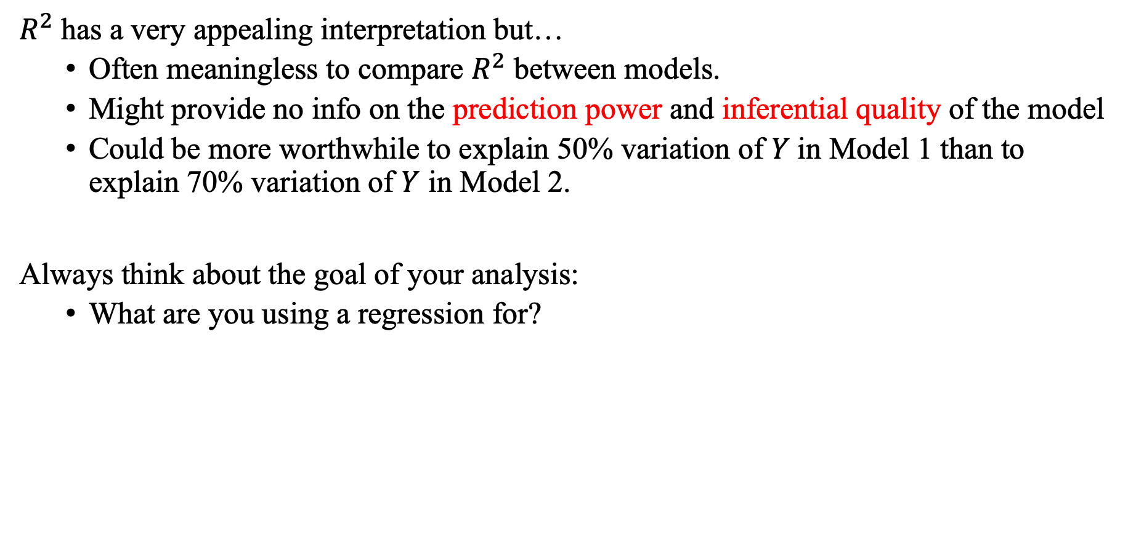
But be careful…
$R^{2}$has a very appealing interpretation but…
Often meaningless to compare $R^{2}$ between models.
Might provide no info on the prediction power and inferential quality of the model
Could be more worthwhile to explain 50% variation of $Y$in Model 1 than to explain 70% variation of $Y$ in Model 2.
Always think about the goal of your analysis:
What are you using a regression for?
Notes:
A counter example:
Regress Y on Y.
R2=1
But no prediction power at ala

Slide 51
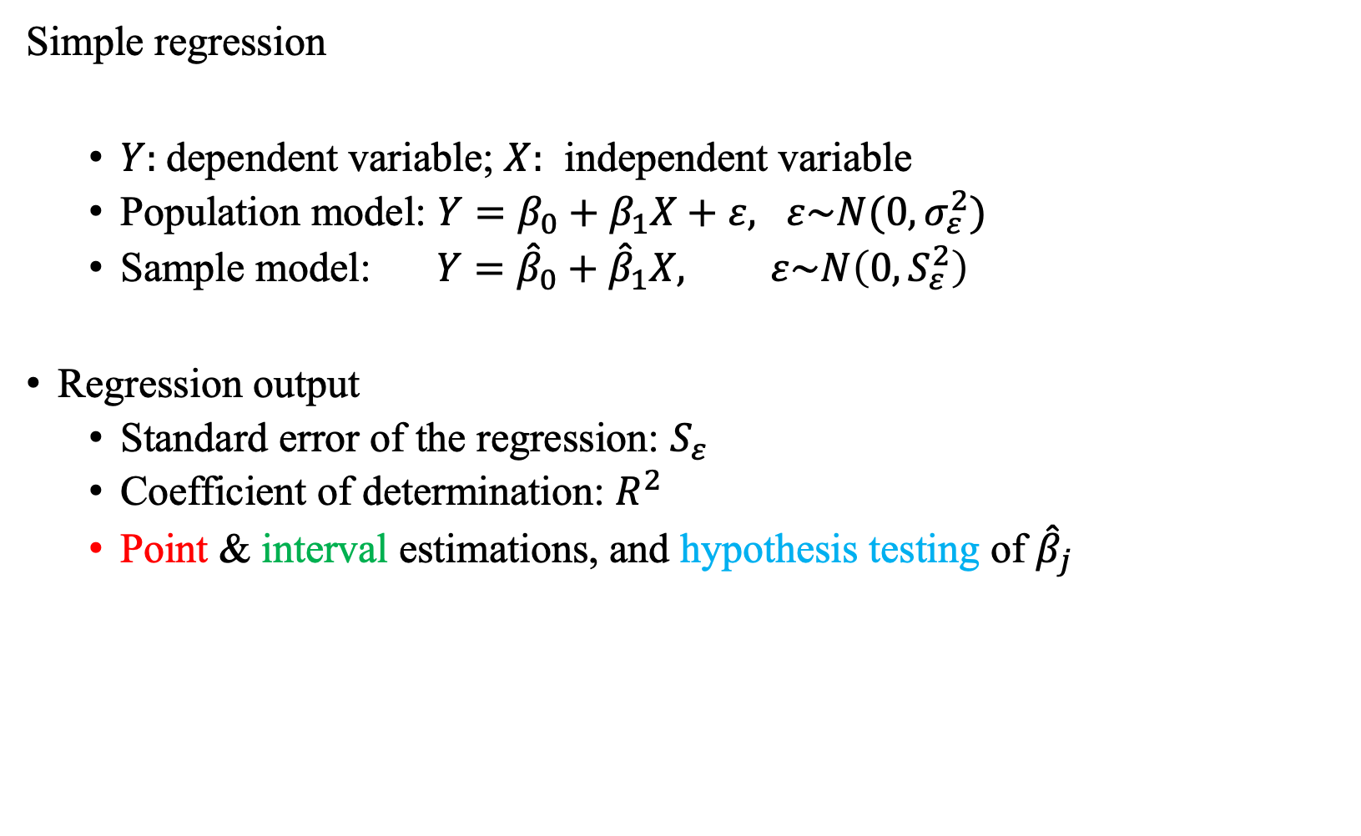
Summary
Simple regression
$Y:$dependent variable; $X:$ independent variable
Population model: $Y=β_{0}+β_{1}X+ε, ε\sim N(0,σ_{ε}^{2})$
Sample model: $Y={\hat{β}}_{0}+{\hat{β}}_{1}X, ε\sim N\left(0,S_{ε}^{2}\right)$
Regression output
Standard error of the regression: $S_{ε}$
Coefficient of determination: $R^{2}$
Point & interval estimations, and hypothesis testing of ${\hat{β}}_{j}$

