Slide 1
General Linear Model
Part 3.4 Regression Examples

Slide 2
Use RegressIt to open the Excel dataset
“salary-education-height” (available on Canvas)
Directory:
Canvas
→ Module folder of “Lecture 8”
→ “Class demo 2, salary-education-height.xlsx”

Slide 3
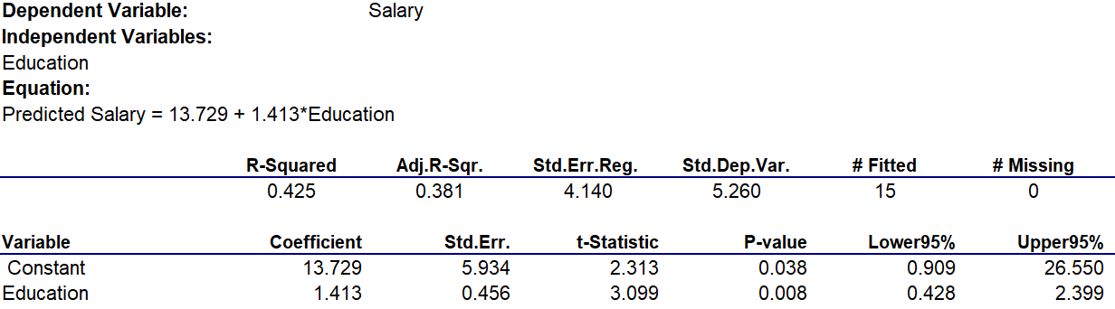
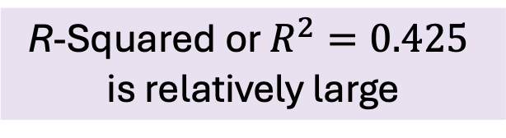


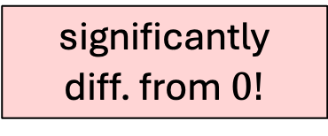
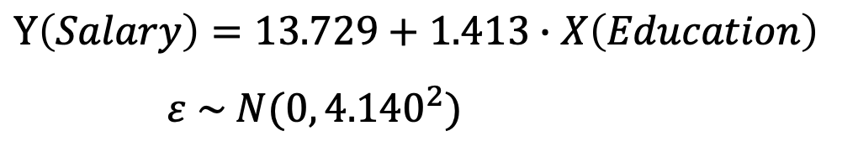
Good Model: Effect of Education on Salary
R-Squared or $R^{2}=0.425$
is relatively large
p-value $=0.008<α=$0.05
$$Y\left(Salary\right)=13.729+1.413∙X\left(Education\right)$$
$ε \sim N(0, {4.140}^{2})$
$$1.413$$
significantly
diff. from $0!$
Linear relationship exists

Slide 4
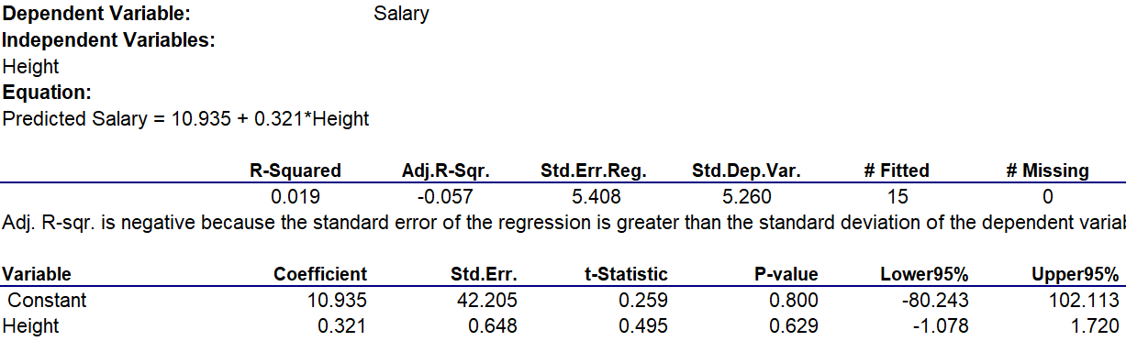
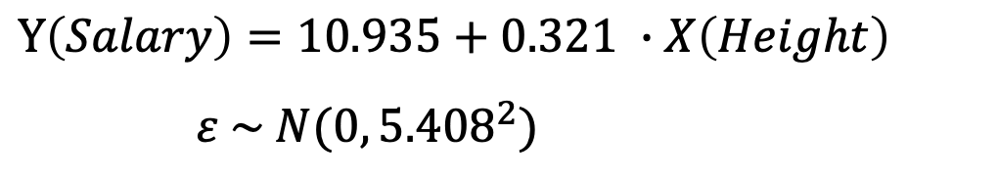

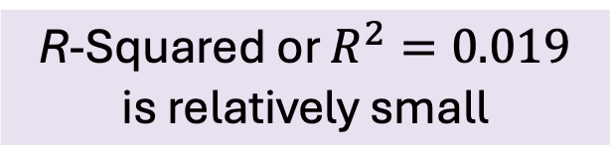

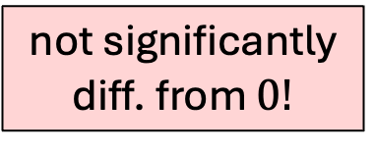
Bad Model: Effect of Height on Salary
R-Squared or $R^{2}=0.019$
is relatively small
p-value $=0.629>α=$0.05
$$Y\left(Salary\right)=10.935+0.321 ∙X\left(Height\right)$$
$ε \sim N(0, {5.408}^{2})$
$$0.321$$
not significantly
diff. from $0!$
Linear relationship doesn’t exist

Slide 5

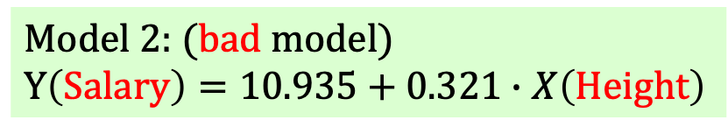
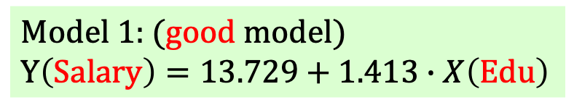
Model 1: (good model)
$$Y\left(Salary\right)=13.729+1.413∙X\left(Edu\right)$$
Model 2: (bad model)
$$Y\left(Salary\right)=10.935+0.321∙X\left(Height\right)$$
Notes:
Three ways to measure the quality of the regression model
The best way?
The p-value
A very clear benchmark: alpha = 0.05

Slide 6
These two “obs.” would be
the 101st and 102nd obs
(actual sample size 100)
Standard deviation of
the predicted/forecasted Price (Y)
95% C.I of
the predicted/forecasted Price (Y)
Predicted / forecasted price:
$$Y\left(Price\right)=5788+0.228∙X\left(Income\right)$$
$$14889.509 (\$)$$
when $X=40000 (\$)$
$$=$$
$$23991.117(\$)$$
when $X=80000 (\$)$

Slide 7
Example
Caesar Steak is a chain of steakhouse with many locations across the nation.
Your intern collected data from a random sample of 95 of Caesar Steak stores that shows their size (measured in numbers of employees) and their profits for the past month (measured in units of $1,000)
You run a simple regression on the data and obtain the following table:

Slide 8
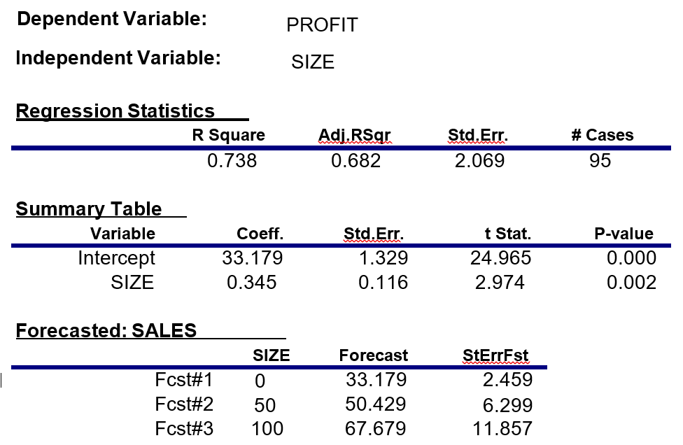
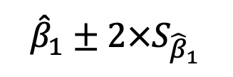


(in units of $1000)
(1) Construct the 95% C.I. for the slope of the regression line.
$${\hat{β}}_{1}±2×S_{{\hat{β}}_{1}}$$
$$=0.345±2×0.116$$
$$=[0.113, 0.577]$$

Slide 9
(in units of $1000)
50
(2) For a store with 50 employees,
what is the probability that the profit is above $44,000?

Slide 10
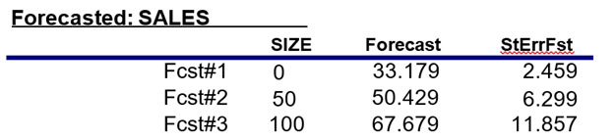
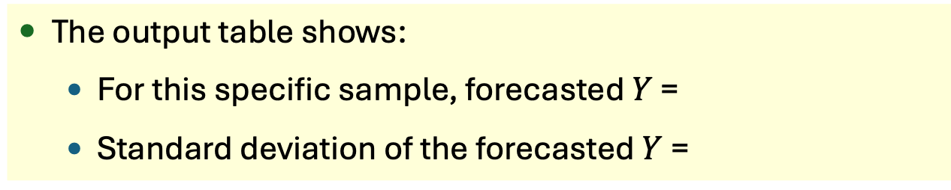
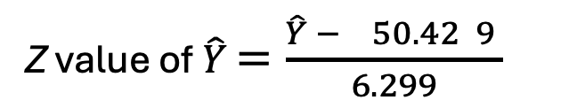
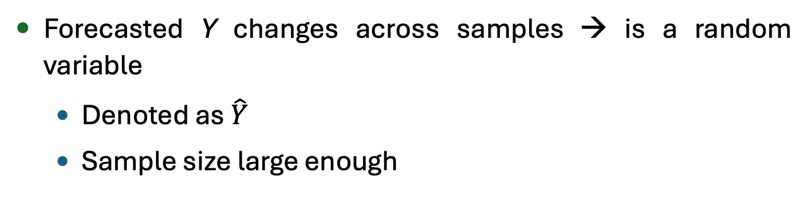
(2) For a store with 50 employees,
what is the probability that the profit is above $44,000?
The output table shows:
For this specific sample, forecasted $Y$ =
Standard deviation of the forecasted $Y$ =
50.429
6.229
Forecasted Y changes across samples → is a random variable
Denoted as $\hat{Y}$
Sample size large enough
50.429
Z value of $\hat{Y}$ $=\frac{\hat{Y} − 50.42 9 }{6.299}$
6.229

Slide 11
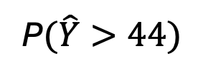

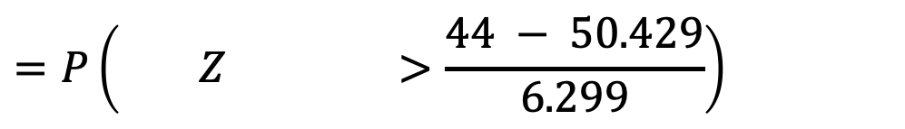
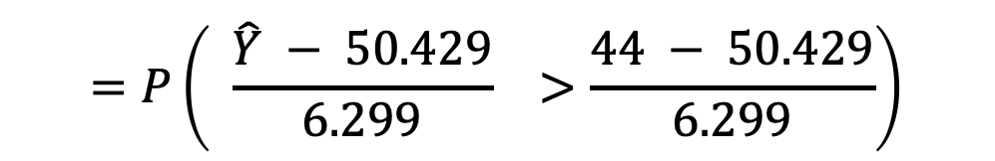
(2) For a store with 50 employees,
what is the probability that the profit is above $44,000?
$$=P\left( \frac{\hat{Y} − 50.429}{6.299} >\frac{44 − 50.429}{6.299}\right)$$
P$(\hat{Y}>44)$
$$=P\left( Z >\frac{44 − 50.429}{6.299}\right)$$
$$=P\left(Z>−1.02\right)$$
Both
work !
$≈P\left(Z>−1\right)$
$$=0.84$$
$$=1−norm.s.dist\left(−1.02,true\right)=0.846$$

Slide 12
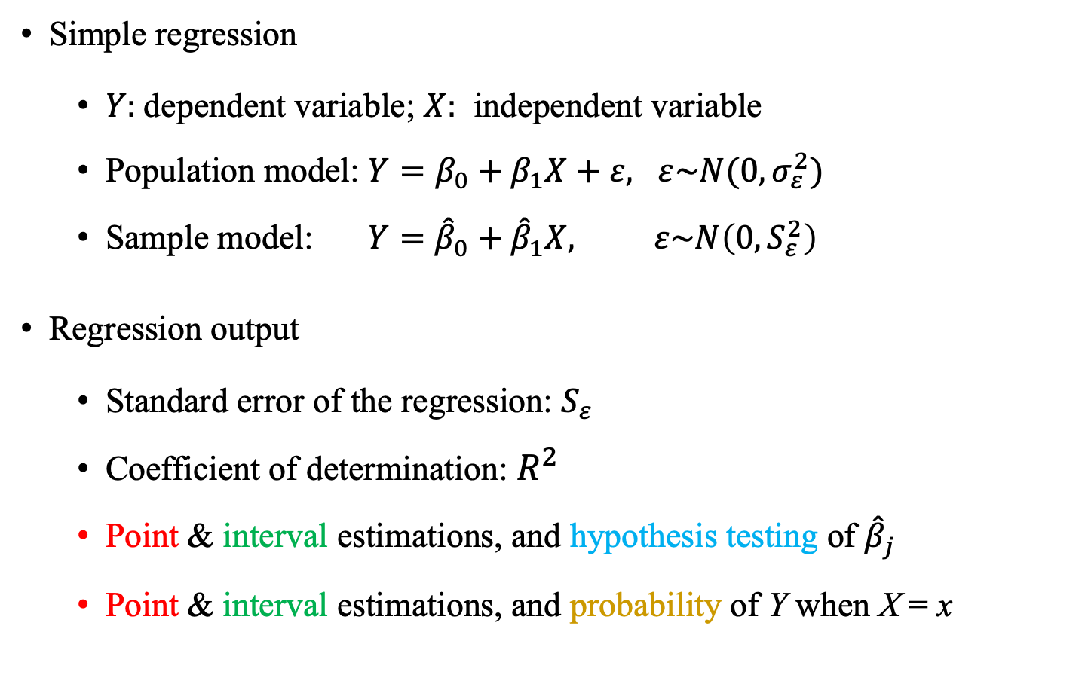
Useful Facts About Simple Regression
Simple regression
$Y:$dependent variable; $X:$ independent variable
Population model: $Y=β_{0}+β_{1}X+ε, ε\sim N(0,σ_{ε}^{2})$
Sample model: $Y={\hat{β}}_{0}+{\hat{β}}_{1}X, ε\sim N\left(0,S_{ε}^{2}\right)$
Regression output
Standard error of the regression: $S_{ε}$
Coefficient of determination: $R^{2}$
Point & interval estimations, and hypothesis testing of ${\hat{β}}_{j}$
Point & interval estimations, and probability of Y when X = x

Slide 13



Population model: $Y=β_{0}+β_{1}X+ε$, where $ε\sim N(0,σ_{ε}^{2})$
vs. Sample model: $Y={\hat{β}}_{0}+{\hat{β}}_{1}X$, where $ε\sim N(0,S_{ε}^{2})$
Obtain the sample model: “Run the regression”
HW7 Q2
C
Focus 1:
Estimate
Interpret the output table
What’s the linear function?
What do ${\hat{β}}_{0}$ and ${\hat{β}}_{1}$ tell?
HW7 Q5(a)
HW7 Q1
$β_{0}$& $β_{1}$ are population features, so ${\hat{β}}_{0}$ and ${\hat{β}}_{1}$ are random variables
C.I. of $β_{0}$and$β_{1}$
Hypo testing of $β_{0}$and $β_{1}$
Class Eg on 04/16, HW7 Q3,6(a)
Class Eg on 04/11, HW7 Q5(c)

Slide 14

Population model: $Y=β_{0}+β_{1}X+ε$, where $ε\sim N(0,σ_{ε}^{2})$
vs. Sample model: $Y={\hat{β}}_{0}+{\hat{β}}_{1}X$, where $ε\sim N(0,S_{ε}^{2})$
C
Meaning of $β_{1}:$
1. Slope coefficient
2. When X increases by 1, Y will increases by $β_{1}$
→ Impact of X on Y
Focus 1:
Estimate
C.I. of $β_{0}$and$β_{1}$
Hypo testing of $β_{0}$and $β_{1}$
Class Eg on 04/16, HW7 Q3,6(a)
Class Eg on 04/11, HW7 Q5(c)

Slide 15



Population model: $Y=β_{0}+β_{1}X+ε$, where $ε\sim N(0,σ_{ε}^{2})$
vs. Sample model: $Y={\hat{β}}_{0}+{\hat{β}}_{1}X$, where $ε\sim N(0,S_{ε}^{2})$
C
Focus 2:
Evaluate
Does the linear model make sense?
Does a linear relationship ever exist between Y and X?
p-value of ${\hat{β}}_{1}$
$$R^{2}$$
Standard error of the regression, $S_{ε}$
Class Eg. on 04/11

Slide 16
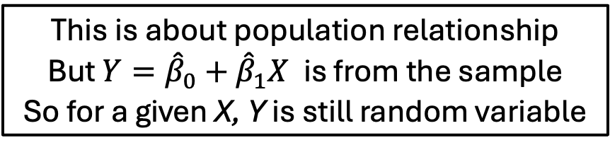
Population model: $Y=β_{0}+β_{1}X+ε$, where $ε\sim N(0,σ_{ε}^{2})$
vs. Sample model: $Y={\hat{β}}_{0}+{\hat{β}}_{1}X$, where $ε\sim N(0,S_{ε}^{2})$
C
Focus 3:
Forecast
If X is equal to some specific value,
what would happen to Y?
Point estimation of Y
HW7 Q5(b)
This is about population relationship
But $Y={\hat{β}}_{0}+{\hat{β}}_{1}X$ is from the sample
So for a given X, Y is still random variable
Interval estimation of Y
Prob of Y in some range
HW7 Q4
Class Eg on 04/16, HW7 Q6(b)

Slide 17
Modeling Hourly Wage
We have estimated the effect of education on wage
Can we measure the impact of one additional year of education
on wage?
Questions:
Is work experience relevant to wage?
Can we predict the wage of a college graduate who has been
working for 5 years?

Slide 18
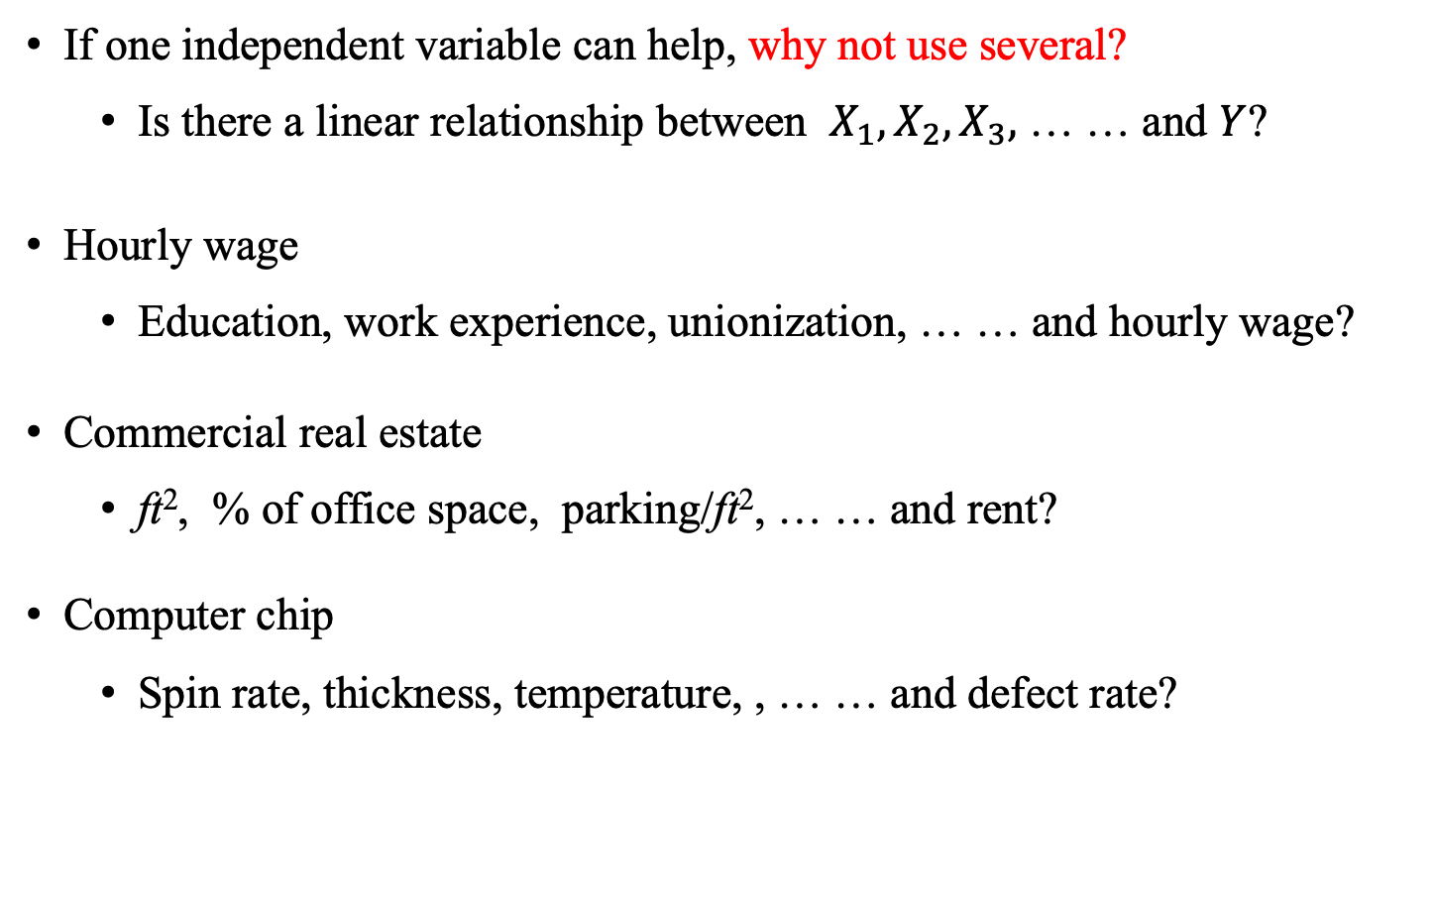
The Idea
If one independent variable can help, why not use several?
Is there a linear relationship between $X_{1},X_{2}, X_{3},$ … … and $Y$?
Hourly wage
Education, work experience, unionization, … … and hourly wage?
Commercial real estate
ft², % of office space, parking/ft², … … and rent?
Computer chip
Spin rate, thickness, temperature, , … … and defect rate?

Slide 19
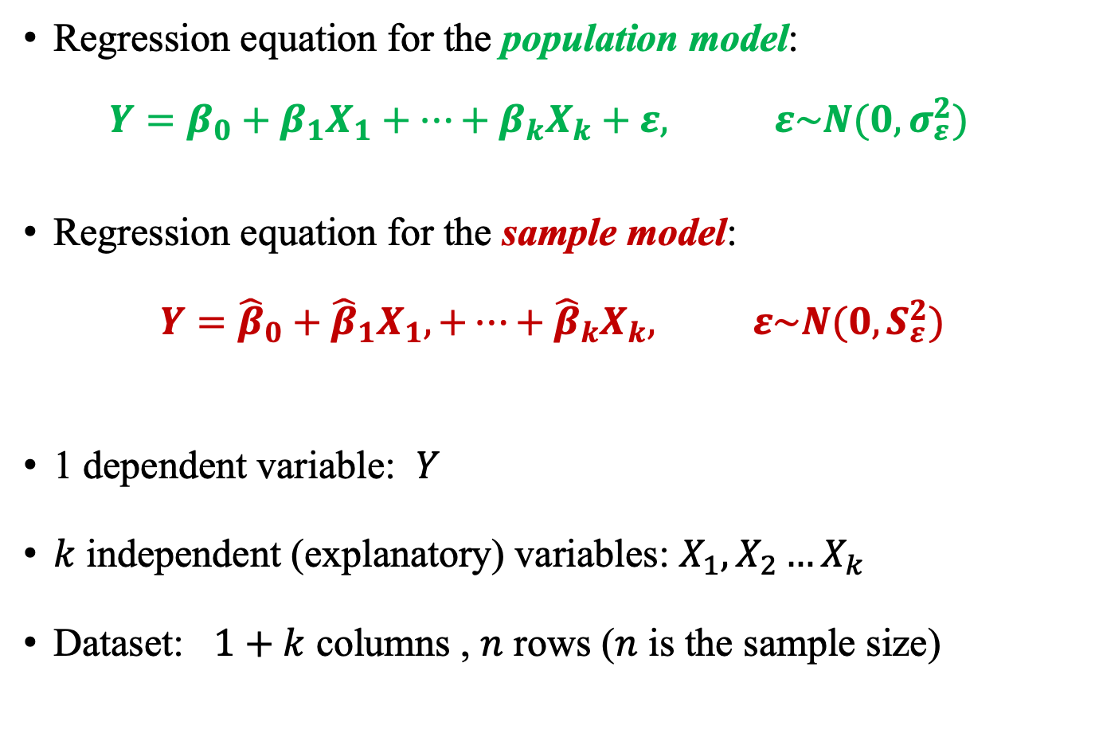
Population Model vs Sample Model
Regression equation for the population model:
$$Y=β_{0}+β_{1}X_{1}+…+β_{k}X_{k}+ε, ε\sim N(0,σ_{ε}^{2})$$
Regression equation for the sample model:
$$Y={\hat{β}}_{0}+{\hat{β}}_{1}X_{1},+…+{\hat{β}}_{k}X_{k}, ε\sim N(0,S_{ε}^{2})$$
1 dependent variable: $Y$
$k$ independent (explanatory) variables: $X_{1},X_{2}…X_{k}$
Dataset: $1+k$ columns , $n$ rows ($n$ is the sample size)
Notes:
Notation: we use for estimated things
Example: ${\hat{β}}_{j}$ is the estimate for $β_{j}$

Slide 20

Let’s go to the Data!
Current Population Survey of 1985
534 observations
Variables observed:
Hourly wage,
education, work experience, age, sector, occupation,
gender, marital status, unionization, race, location.
Use RegressIt to open the Excel dataset
“Class demo 3, wage micro data” (on Canvas)
Y
$$X_{1} , X_{2}$$

Slide 21
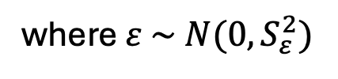
Let’s go to the Data!
Estimate
Forecast the hourly wage for
Someone with a college degree and 5 years of work experience?
Someone as a fresh college graduate?
Someone with a high school diploma and 10 years of work experience?
$Hourly Wage={\hat{β}}_{0}+{\hat{β}}_{1}$ Education $+{\hat{β}}_{2}$ Work Experience
where $ε \sim N(0,S_{ε}^{2})$

Slide 22
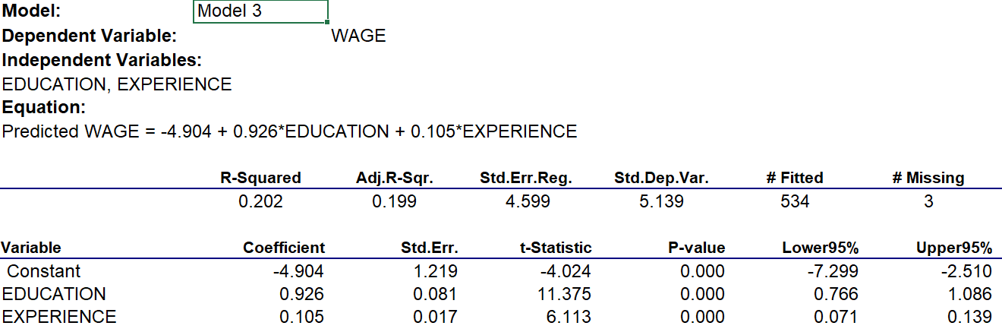
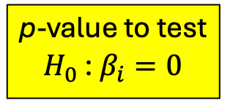

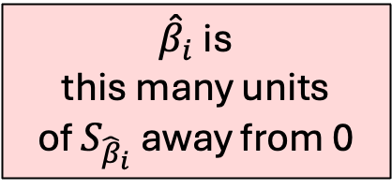
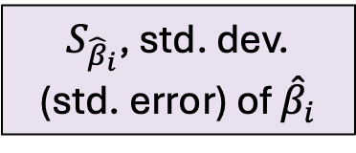

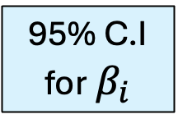
$Hourly Wage=−4.904+0.926$Education $+0.105$ Work Experience
where $ε \sim N(0,{4.599}^{2})$
Y
$S_{ε}$
$X_{1},$ $X_{2}$
$${\hat{β}}_{0},{\hat{β}}_{1},{\hat{β}}_{2}$$
${\hat{β}}_{i}$ is
this many units
of $S_{{\hat{β}}_{i}}$away from 0
p-value to test
$H_{0}$ : $β_{i}=0$
95% C.I
for$β_{i}$
$S_{{\hat{β}}_{i}}$, std. dev.
(std. error) of ${\hat{β}}_{i}$

Slide 23
$Hourly Wage=−4.904+0.926$Education $+0.105$ Work Experience
where $ε \sim N(0,{4.599}^{2})$
Standard deviations of
predicted hourly wages
95% C.I of
predicted hourly wages
Their predicted Hourly Wages
based on this specific sample
For Person 1 ($Edu=16,Exp=5)$
For Person 2 ($Edu=16,Exp=0)$
(point estimation of predicted Y)
For Person 3 ($Edu=12,Exp=10)$

Slide 24
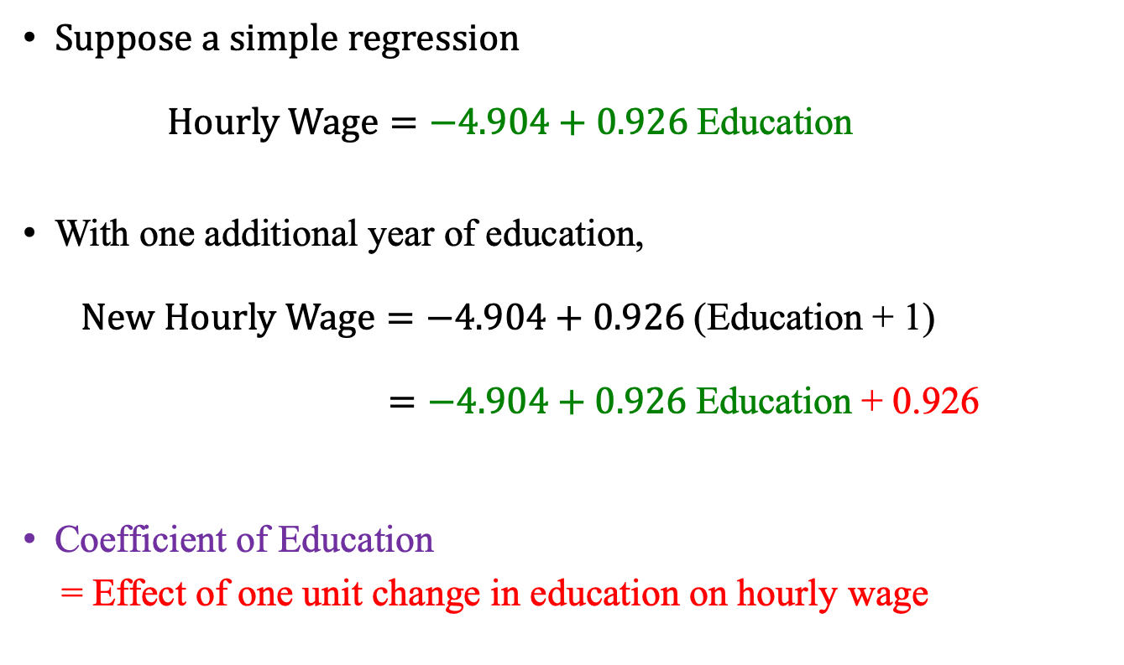
Interpretation of Reg. Coefficients
Suppose a simple regression
$Hourly Wage=−4.904+0.926$Education
With one additional year of education,
$New Hourly Wage=−4.904+0.926$(Education + 1)
$=−4.904+0.926$Education + 0.926
Coefficient of Education
= Effect of one unit change in education on hourly wage

Slide 25
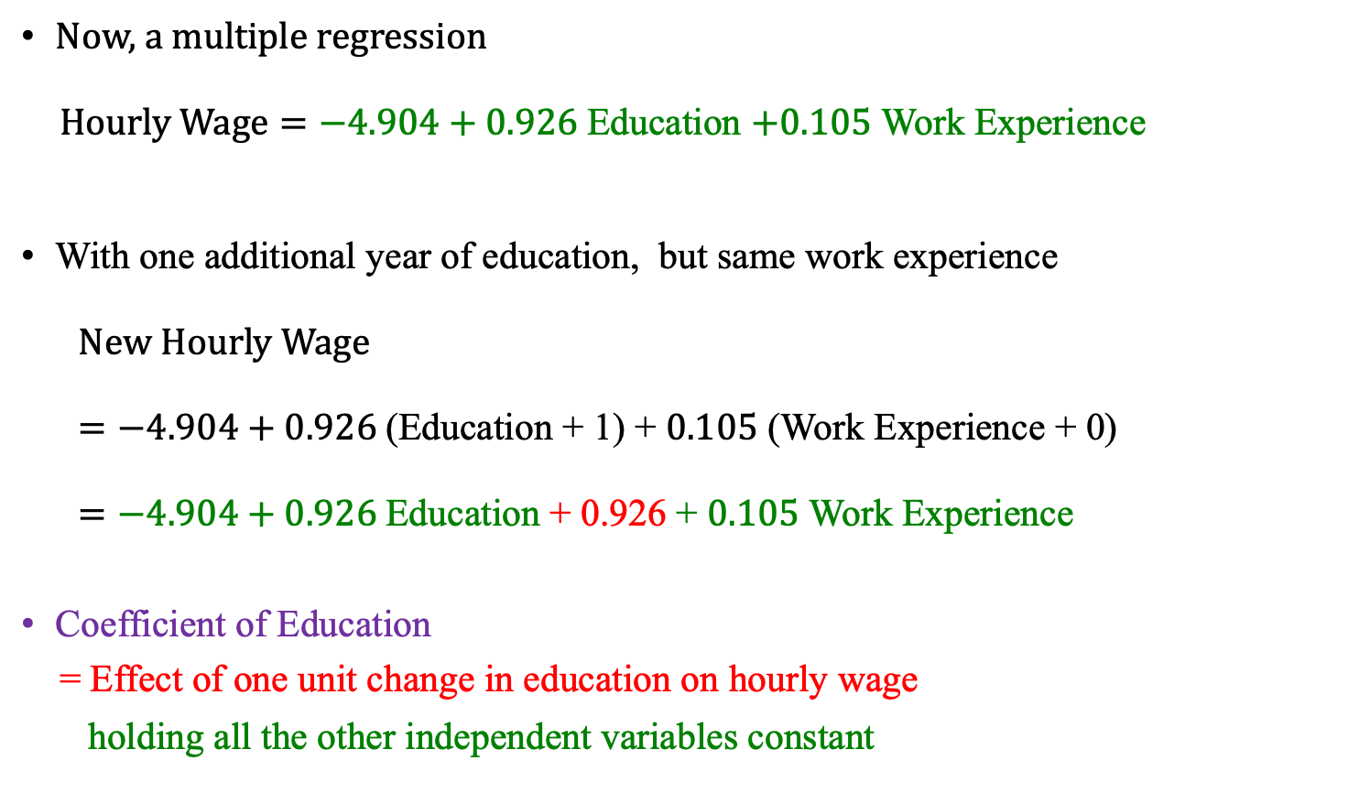
Interpretation of Reg. Coefficients
Now, a multiple regression
$Hourly Wage=−4.904+0.926$Education $+0.105$ Work Experience
With one additional year of education, but same work experience
$New Hourly Wage$
$=−4.904+0.926$(Education + 1) + $0.105$ (Work Experience + 0)
$=−4.904+0.926$Education + 0.926 + $0.105$ Work Experience
Coefficient of Education
= Effect of one unit change in education on hourly wage
holding all the other independent variables constant

Slide 26

Multicollinearity
“Too many X’s” in the regression model
Two or more independent variables are in an exact linear relationship between them
We may be using redundant information for predicting $Y$
Not very common after you understand the data

Slide 27
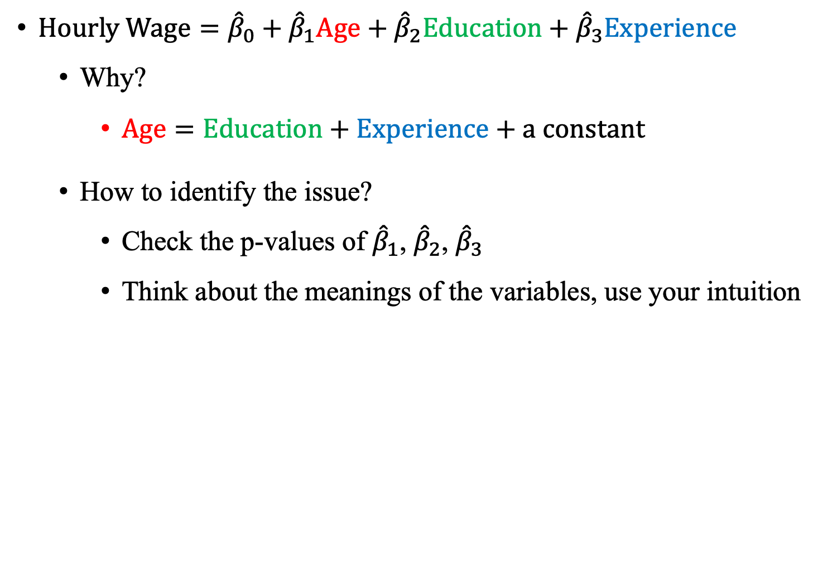
Example of Perfect Multicollinearity
$Hourly Wage={\hat{β}}_{0}+{\hat{β}}_{1}Age+{\hat{β}}_{2}Education+{\hat{β}}_{3}Experience$
Why?
$Age=Education+Experience+a constant$
How to identify the issue?
Check the p-values of ${\hat{β}}_{1}$, ${\hat{β}}_{2}$, ${\hat{β}}_{3}$
Think about the meanings of the variables, use your intuition

Slide 28
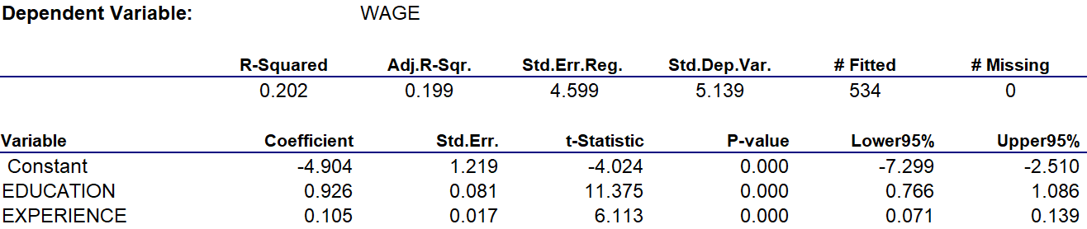
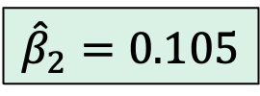
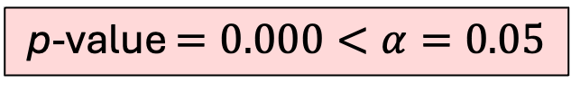
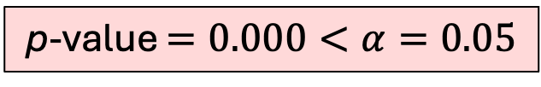

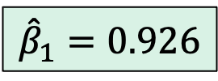

$$Hourly Wage={\hat{β}}_{0}+{\hat{β}}_{1}Education+{\hat{β}}_{2}Experience$$
$${\hat{β}}_{1}=0.926$$
p-value $=0.000<α=0.05$
$$Reject β_{1}=0$$
$${\hat{β}}_{2}=0.105$$
p-value $=0.000<α=0.05$
$$Reject β_{2}=0$$
Intuitive:
“The more you learn, the more you earn.”
“The more experienced you are, the more you earn.”

Slide 29
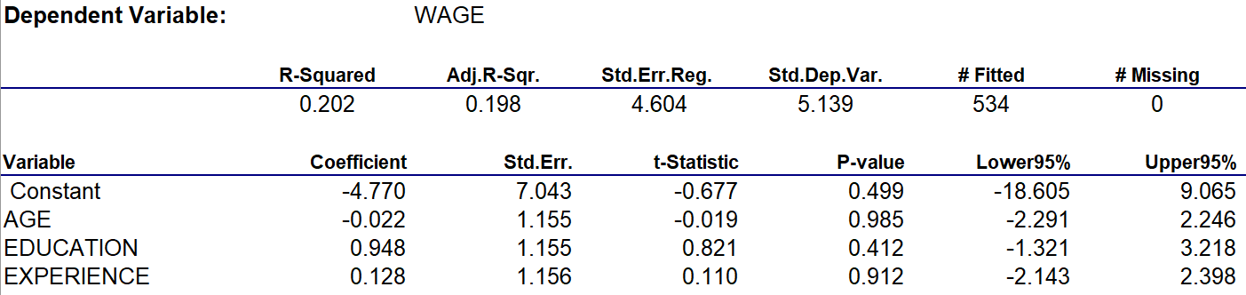


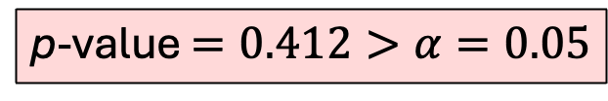




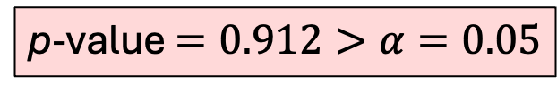
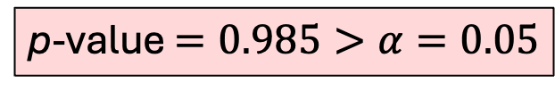

$$Hourly Wage={\hat{β}}_{0}+{\hat{β}}_{1}Age+{\hat{β}}_{2}Education+{\hat{β}}_{3}Experience$$
$${\hat{β}}_{1}=−0.222$$
p-value $=0.985>α=0.05$
C${Can}^{′}t reject β_{1}=0$
$${\hat{β}}_{2}=0.948$$
p-value $=0.412>α=0.05$
C${Can}^{′}t reject β_{2}=0$
$${\hat{β}}_{3}=0.128$$
p-value $=0.912>α=0.05$
C${Can}^{′}t reject β_{3}=0$
Counterintuitive:
Age, Edu, Experience. Nothing matters.

Slide 30
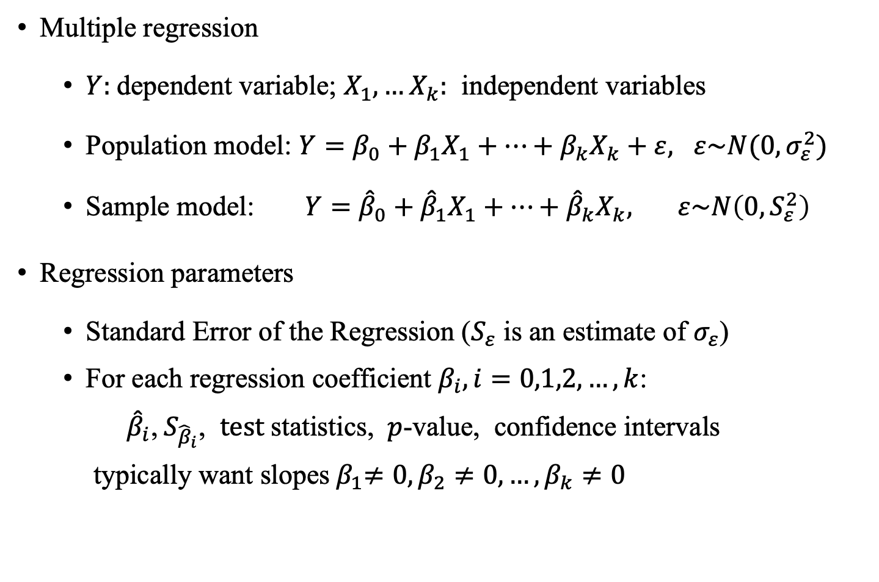
Useful Facts: Multiple Regression
Multiple regression
$Y:$dependent variable; $X_{1}, …X_{k}:$ independent variables
Population model: $Y=β_{0}+β_{1}X_{1}+…+β_{k}X_{k}+ε, ε\sim N(0,σ_{ε}^{2})$
Sample model: $Y={\hat{β}}_{0}+{\hat{β}}_{1}X_{1}+…+{\hat{β}}_{k}X_{k}, ε\sim N\left(0,S_{ε}^{2}\right)$
Regression parameters
Standard Error of the Regression ($S_{ε}$ is an estimate of $σ_{ε}$)
For each regression coefficient $β_{i}, i=0,1,2,…,k$:
${\hat{β}}_{i}$,${ S}_{{\hat{β}}_{i}}$, $test$statistics, $p$-value, confidence intervals
typically want slopes${ β}_{1}≠0, β_{2}≠0, …, β_{k}≠0$

Slide 31
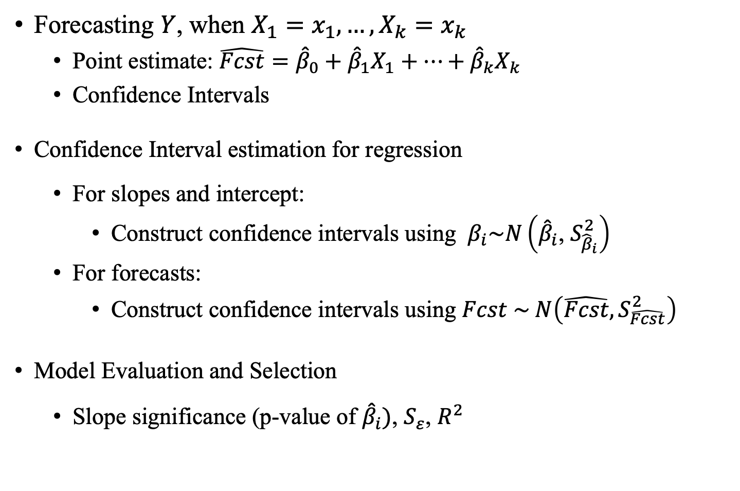
Useful Facts: More About Regression
Forecasting $Y$, when $X_{1}=x_{1},…,X_{k}=x_{k}$
Point estimate: $\hat{Fcst}={\hat{β}}_{0}+{\hat{β}}_{1}X_{1}+⋯+{\hat{β}}_{k}X_{k}$
Confidence Intervals
Confidence Interval estimation for regression
For slopes and intercept:
Construct confidence intervals using $β_{i}\sim N\left({\hat{β}}_{i}\text{, }S_{{\hat{β}}_{i}}^{2}\right)$
For forecasts:
Construct confidence intervals using $Fcst \sim N\left(\hat{Fcst},S_{\hat{Fcst}}^{2}\right)$
Model Evaluation and Selection
Slope significance (p-value of ${\hat{β}}_{i}\text{)}$, $S_{ε}$, $R^{2}$

