Slide 1
Presenting Data With Slides
Some principles for effectively communicating data to a live audience

Slide 2
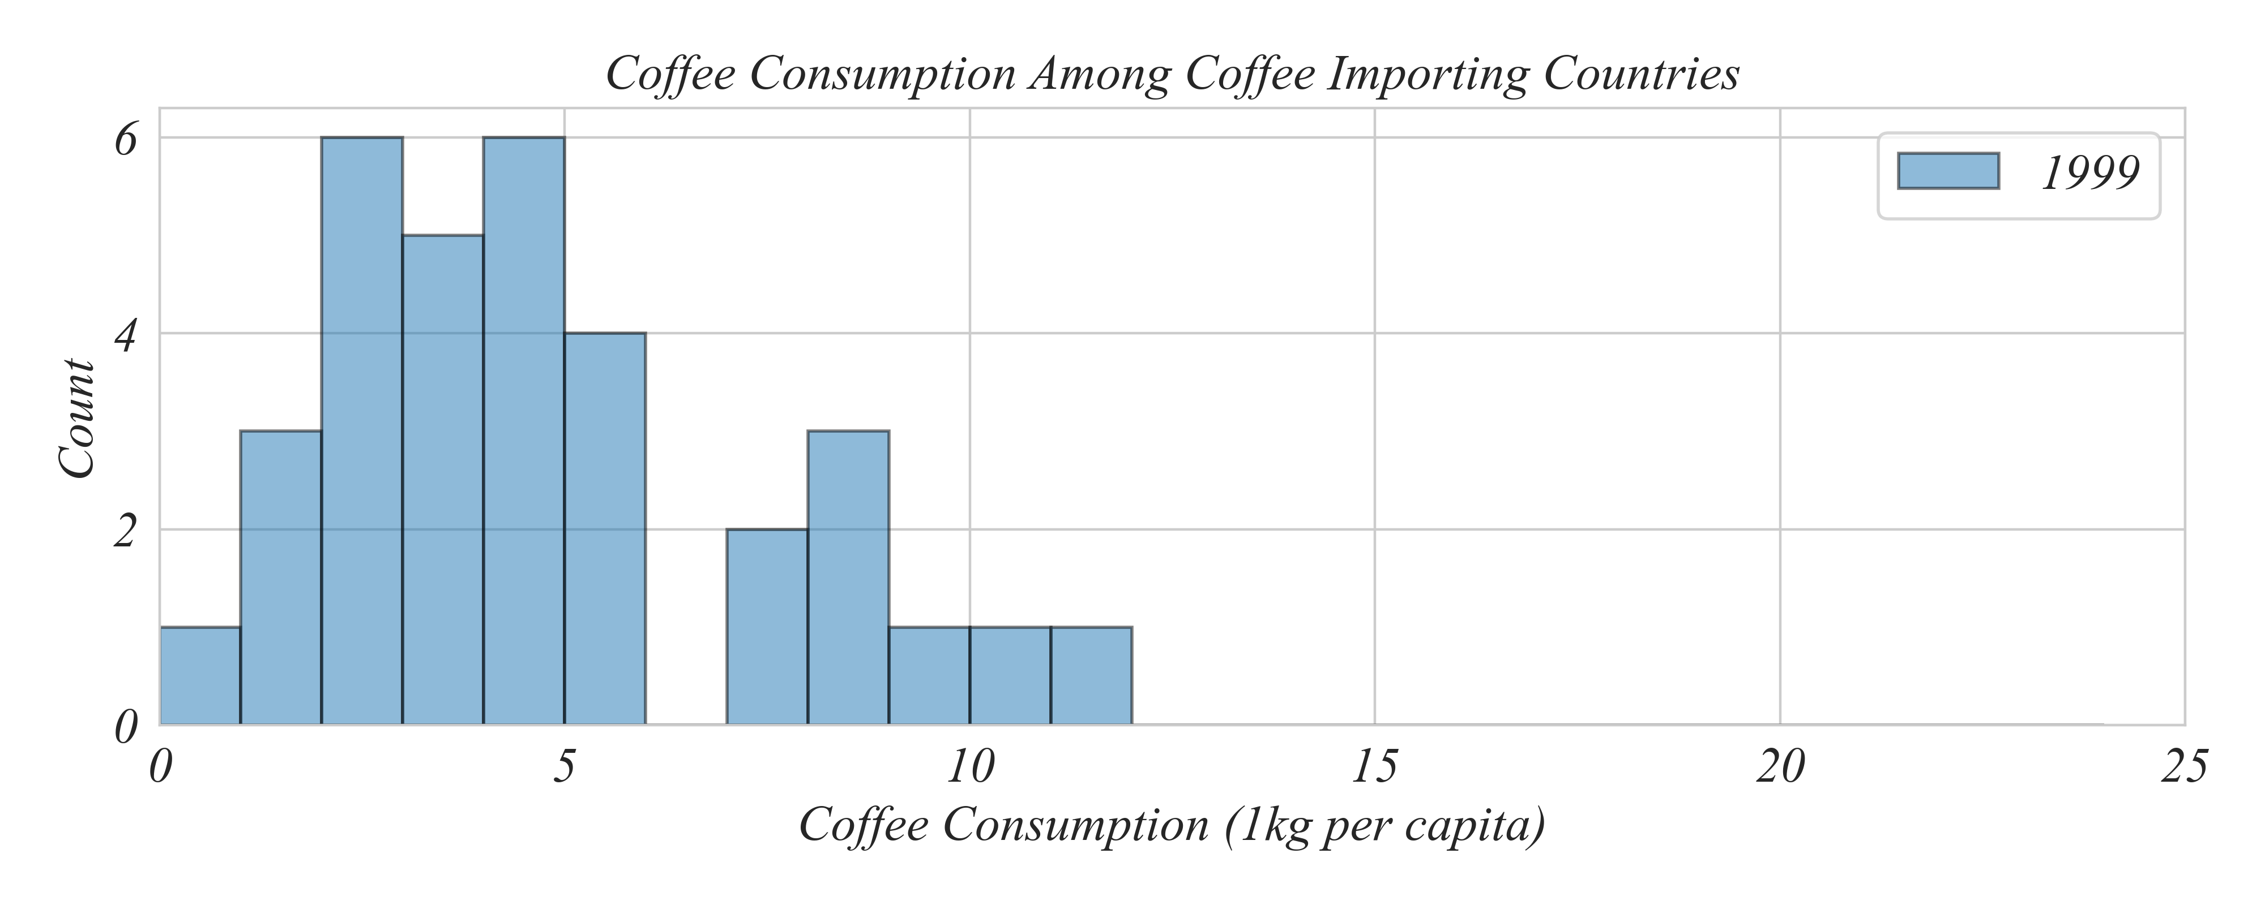
Keep it simple
Focus on one main idea per slide.

Slide 3
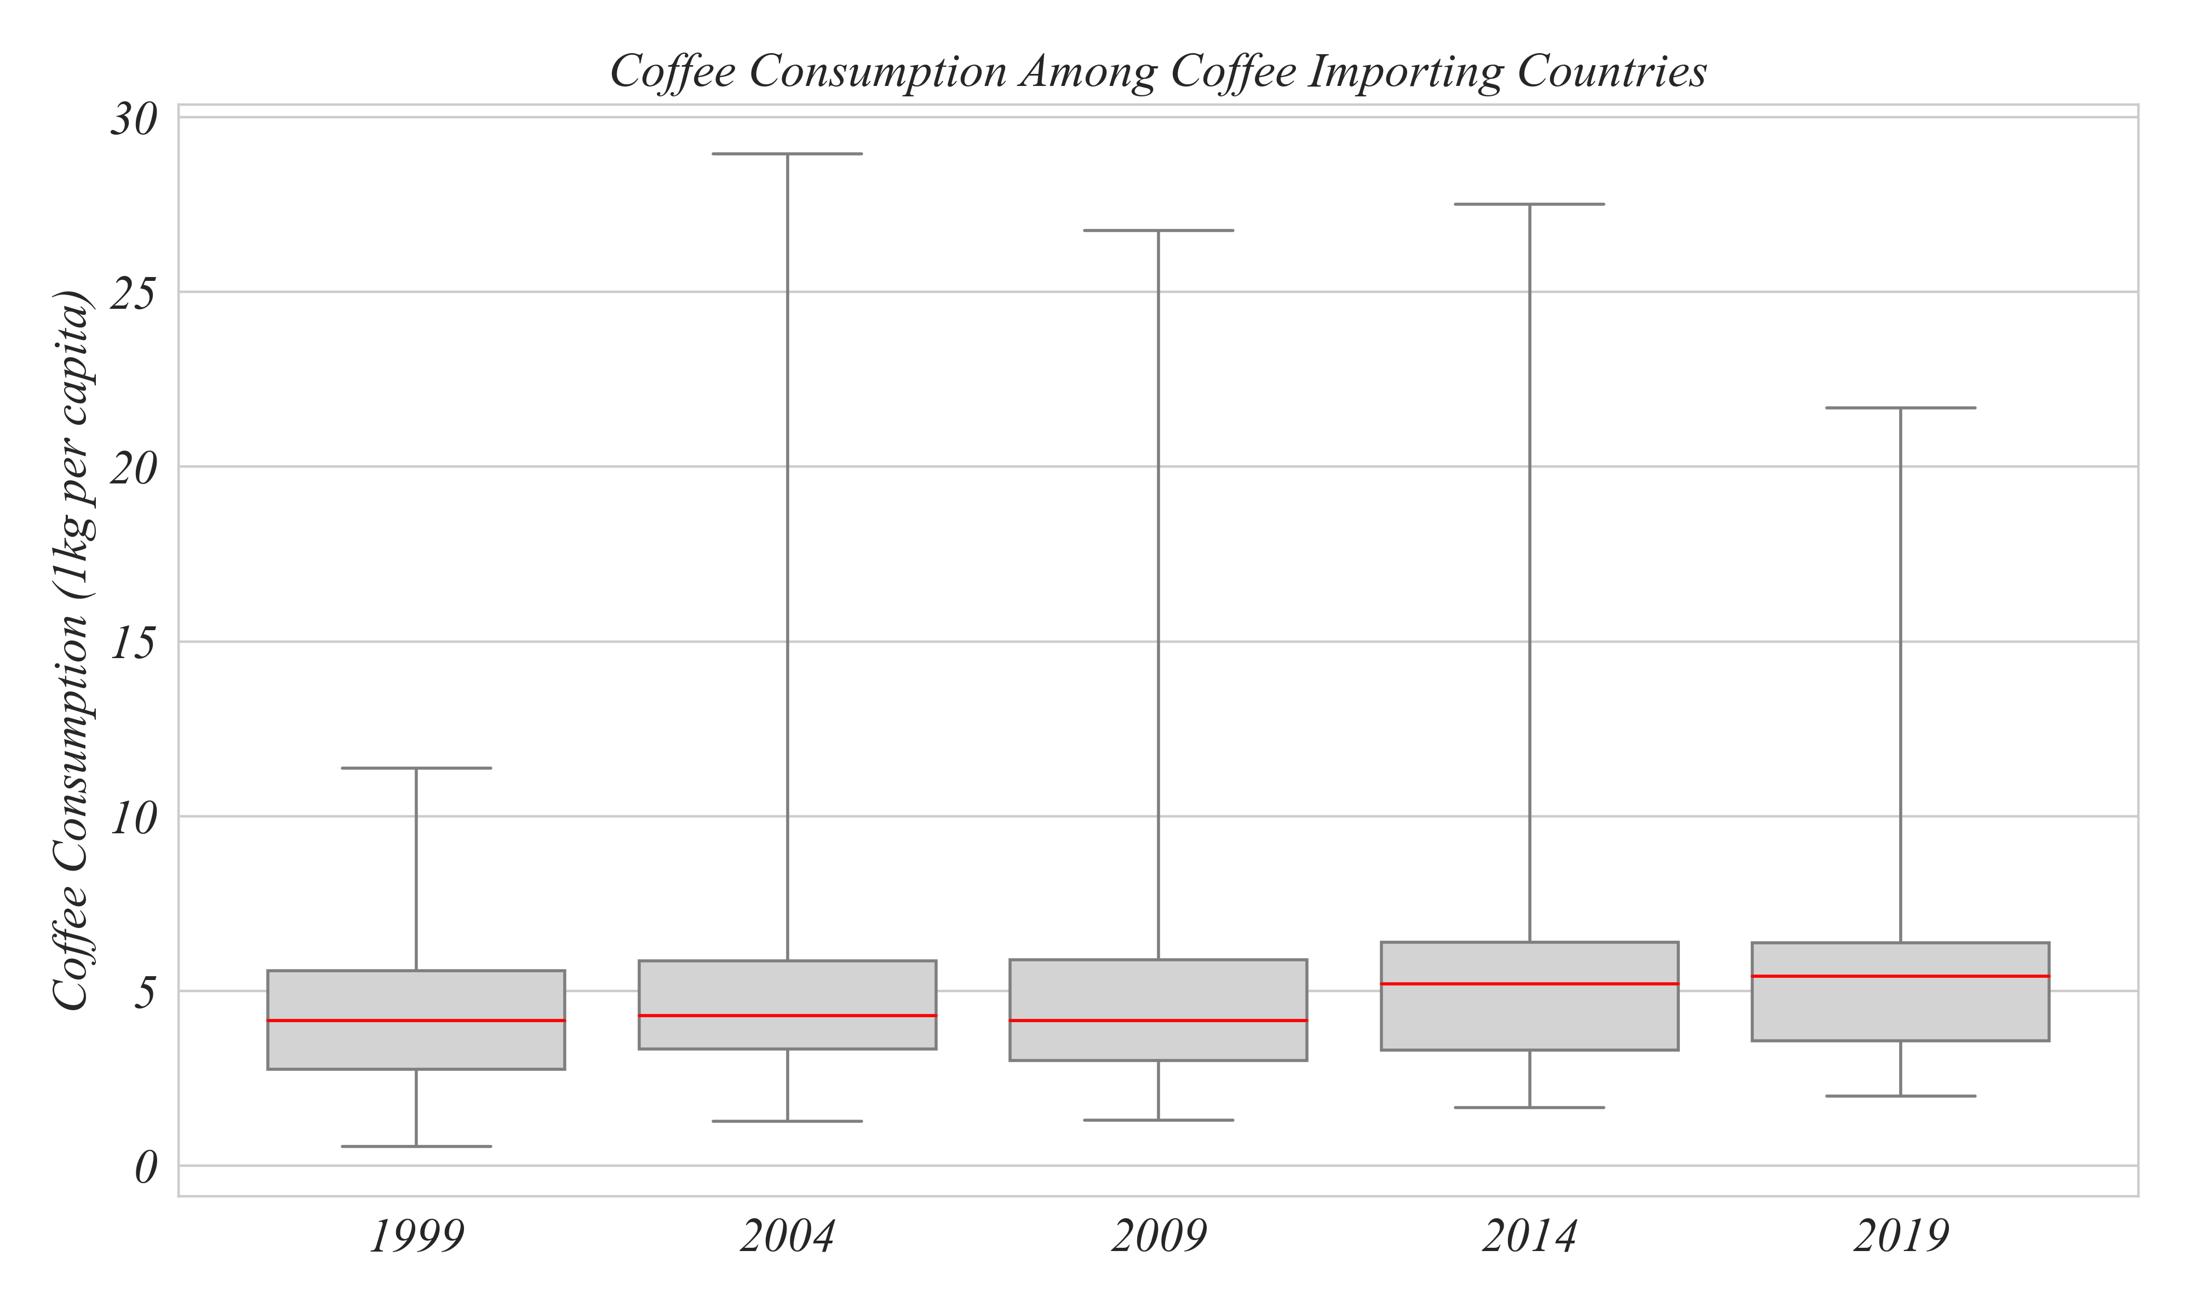
Highlight your key insights
Focus on one main idea per slide. Remove extraneous details.

Slide 4
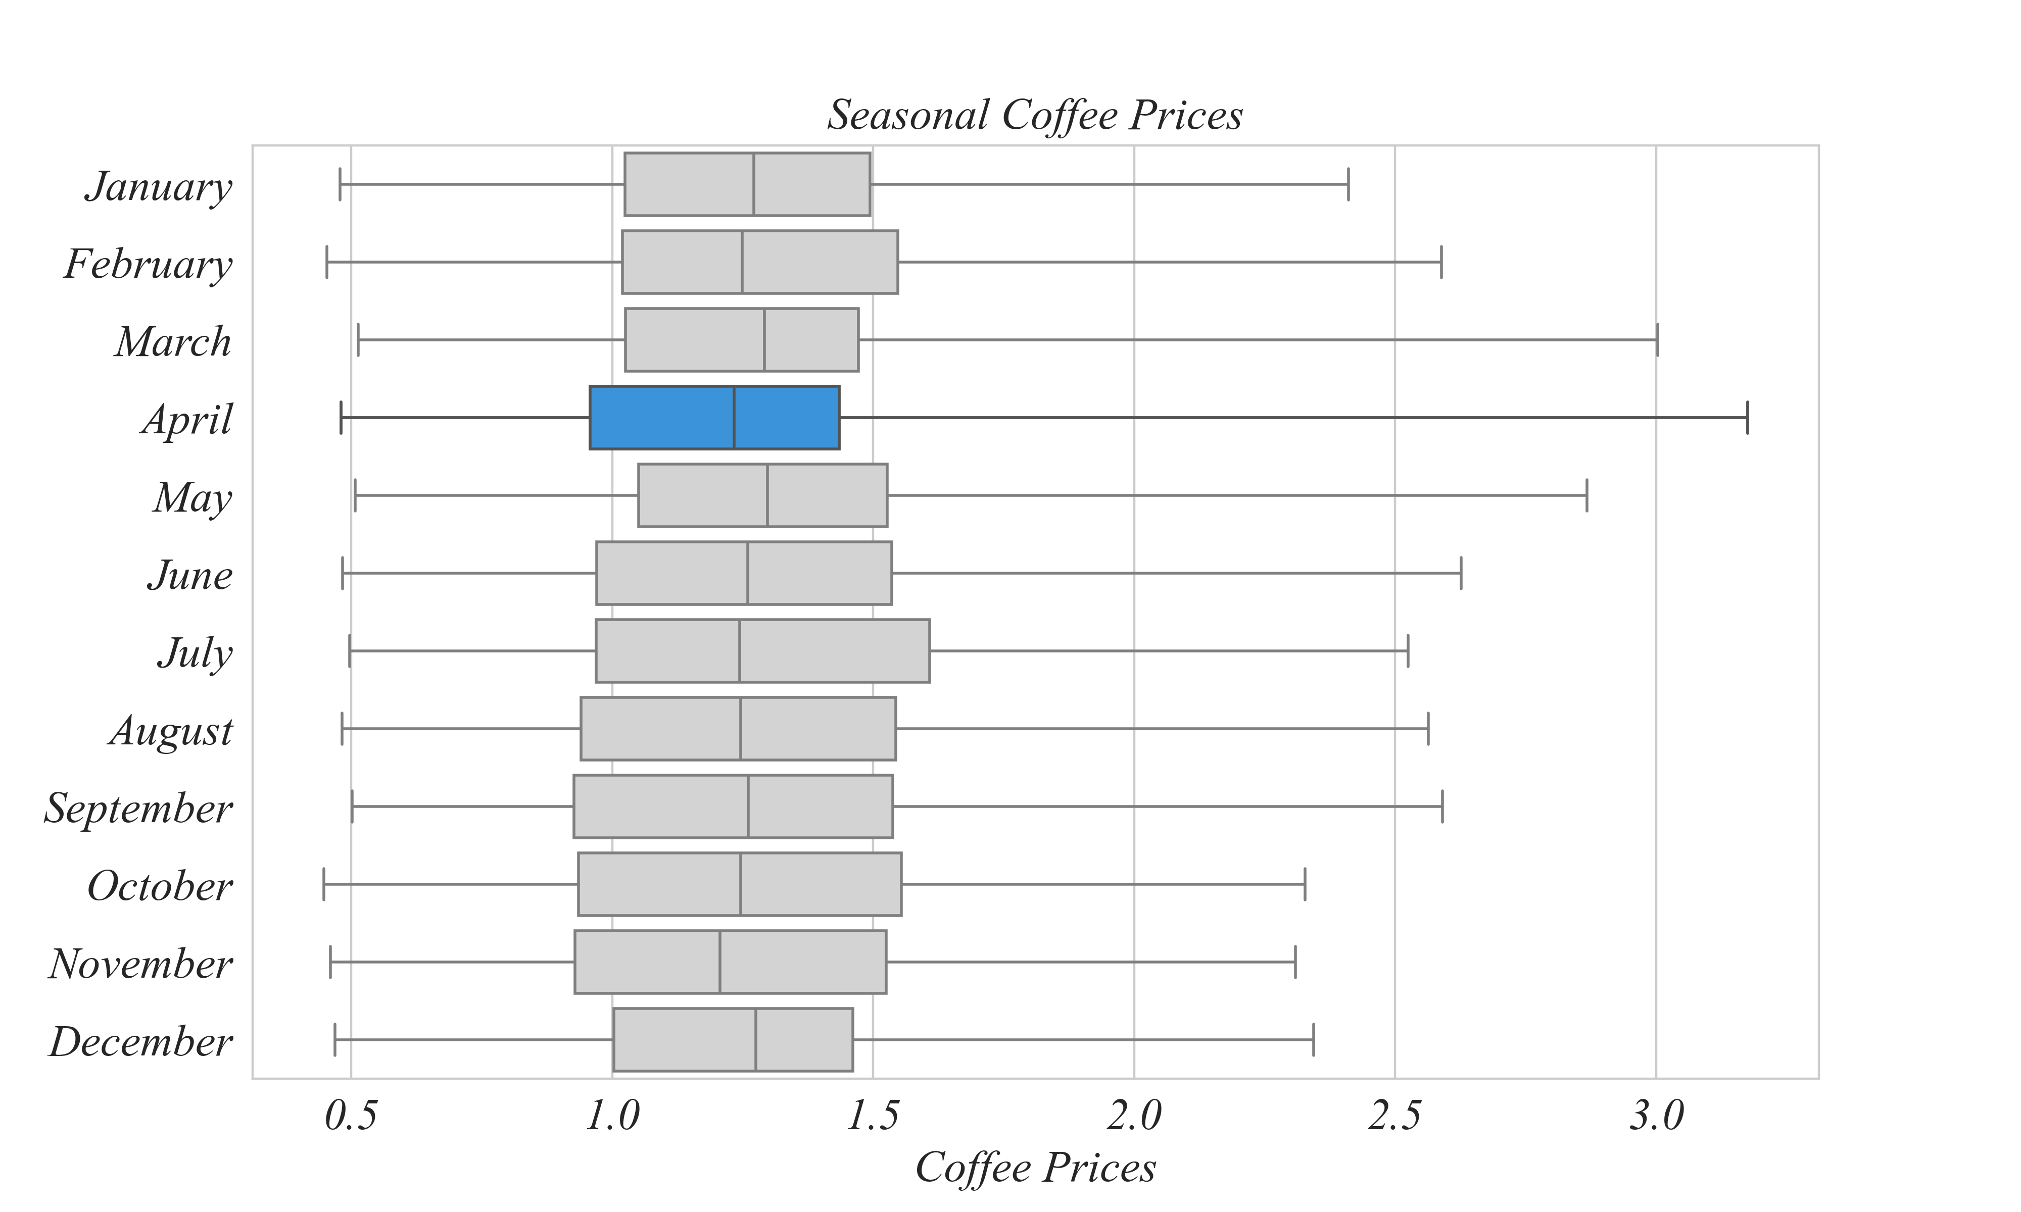
Use Visuals Effectively
Use color, chart annotations, or bold text to emphasize the main ideas.
The highest price was in April

Slide 5
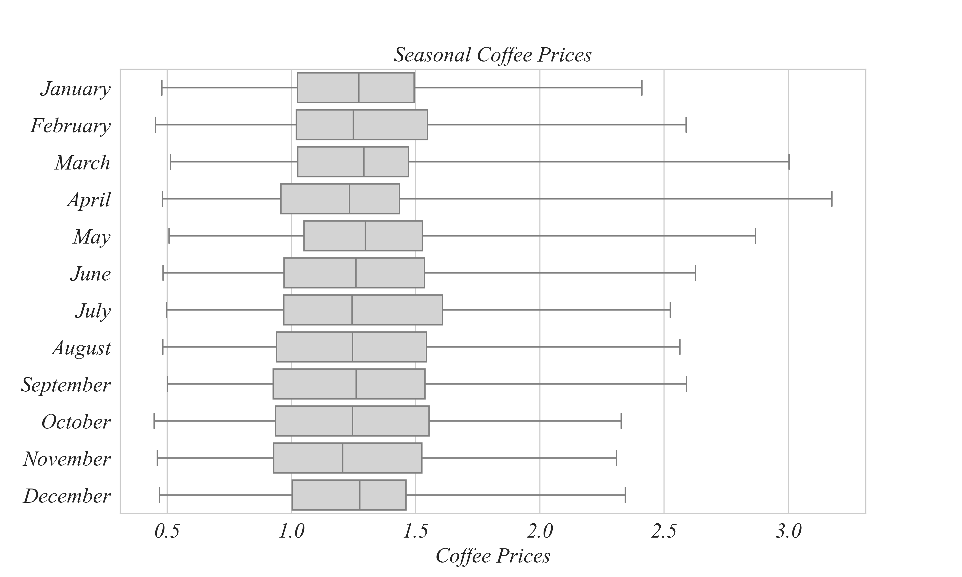
Maintain Consistency
Use consistent fonts, colors, and layout throughout, and a clean professional design.
Times New Roman

Slide 6
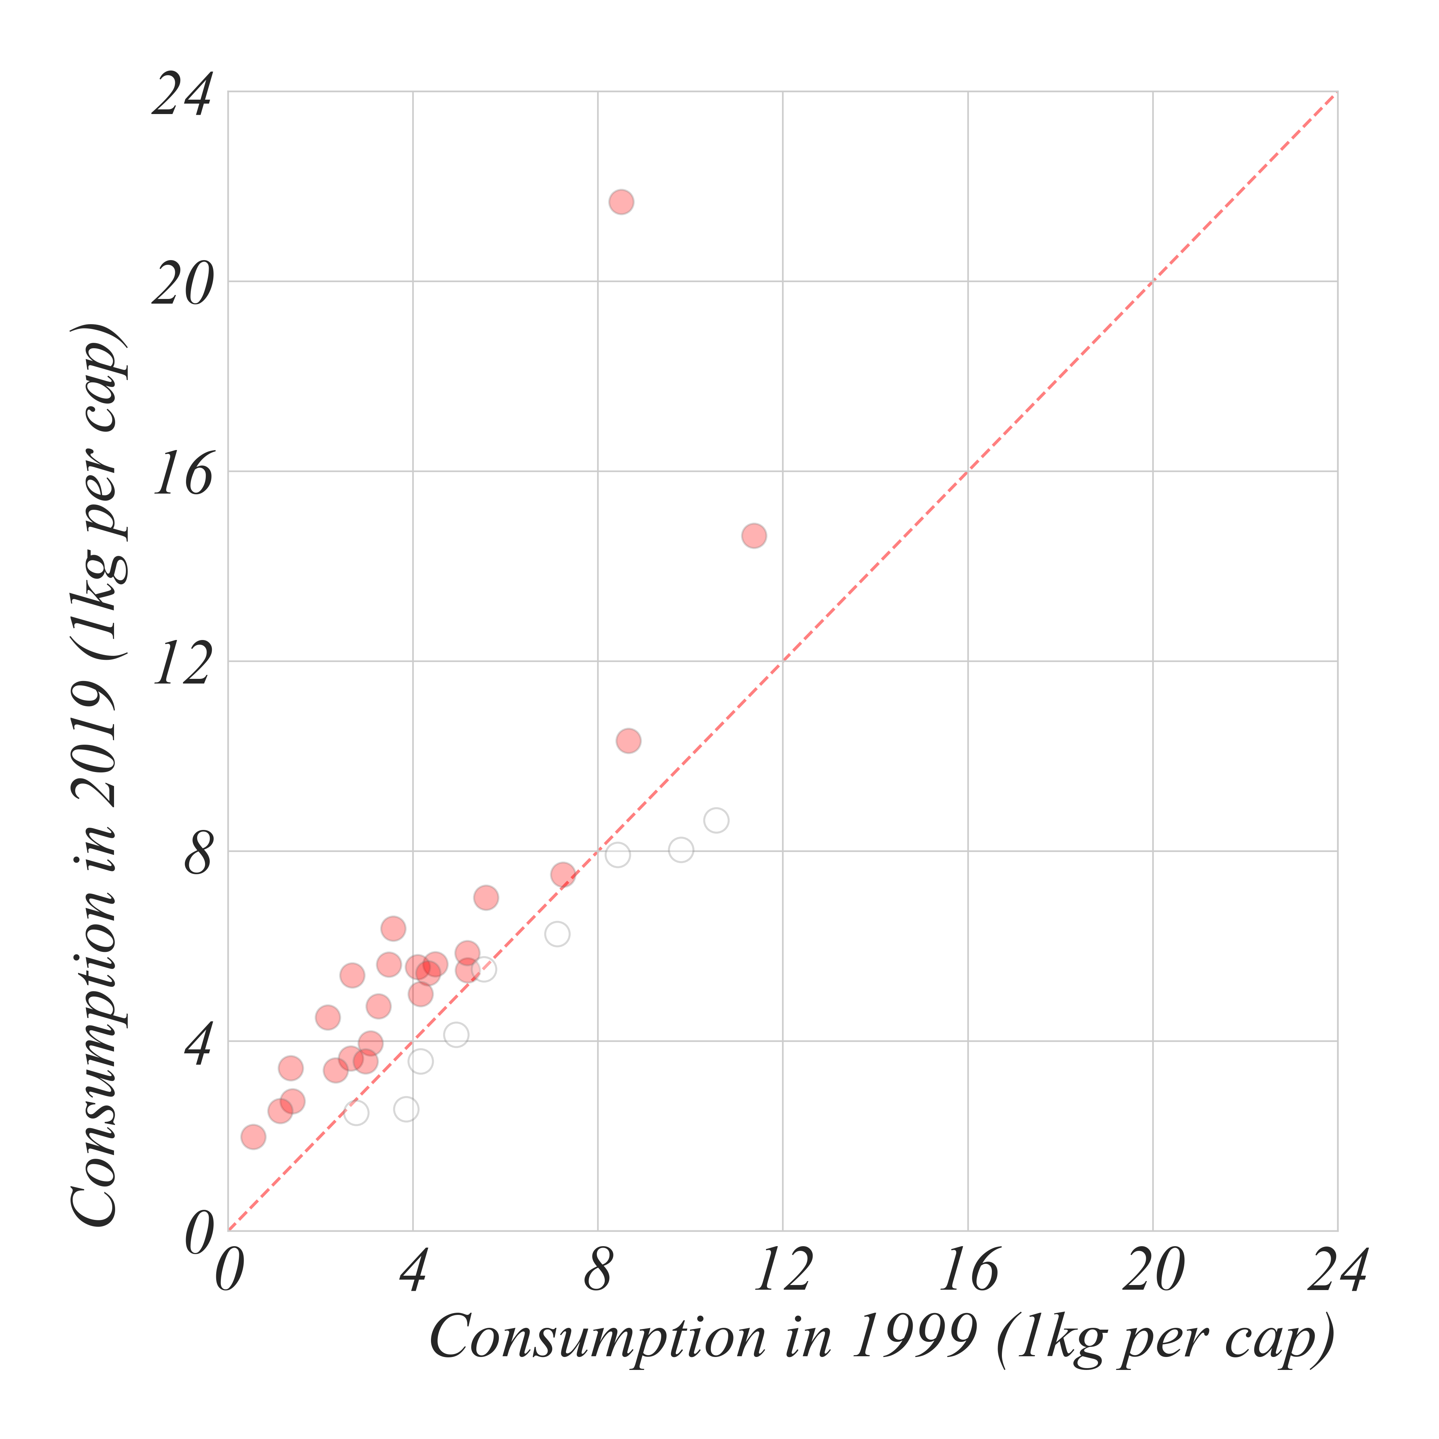
Provide Context
Use descriptive titles to emphasize the key message, label axes, and include units.
Countries with higher coffee consumption

Slide 7
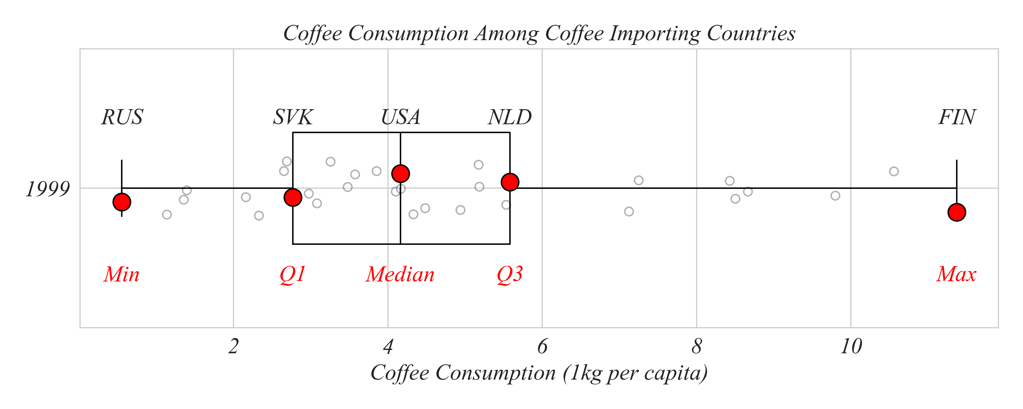
Be Audience-Centered
Avoid jargon and tailor the level of detail to your audience.
What does Q1 mean?

Slide 8
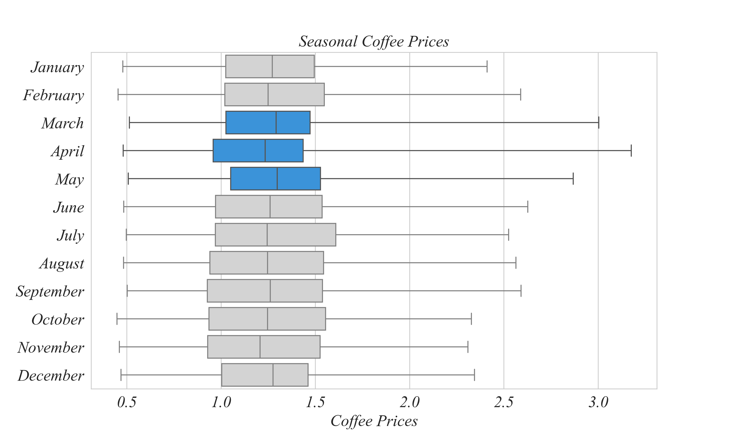
Minimize Cognitive Load
Limit the amount of text (one or two sentences), use bullet points, and leverage whitespace.
Median coffee prices were highest in the Spring
Maximum coffee prices were highest in the spring

Slide 9
Rehearse The Flow
Ensure slides follow a logical progression and practice a few times.
Aim for 2 minutes per group.
Aim for 1 minute per slide.
Plan the order (descriptives then tests)
THEN plan what to say at each point in the presentation.
Include nothing extraneous.

Slide 10
In Class Live Example

Slide 11
Are coffee prices higher in the summer?
The maximum coffee price is highest in April.

Slide 12
Are coffee prices higher in the summer?
Coffee prices are $1.3 higher in the summer (p value = 0.03).
STAND-IN FIGURE

