Slide 1
Web Accessibility Checklist
Team 2: Jadyn Smith, Javid Ditty, Jacob Mathison, Emily Buzle, and Taylor Williams

Slide 2
Project Scope
The Website Accessibility Checklist (WAC) was created to help its users determine how accessible a website is.
Users will provide “yes,” “no,” and “n/a” answers to each question in the questionnaire.
User responses will be stored temporarily in order to compute the necessary calculations to determine the score. But results and responses will not be saved long-term. This means that the only data storage in this program will be for the questions and related content.
Accessibility score will be calculated based on the user’s answer. Accessibility tips will be provided to the user to assist them in improving their websites accessibility.

Slide 3

User Stories
As a software developer, I want to conduct testing as I develop my website to ensure that it is accessible to users of all capabilities. This will allow me to test my design over time and evaluate changes over time.
As a tester, I want a quantitative way to evaluate the usability and accessibility of a website.
As a user, I want to be able to evaluate a website without any prior knowledge about preferred practice of web development.

Slide 4
Pages of this Application
User Input Screen (Home Page): the questions will be presented with hints available. The user can answer the questionnaire here.
Results Screen: presents the user with their website accessibility score and an idea of how good that score is. The user will also be presented with tips to improve their website accessibility.
User Manual: gives the user information about using the website accessibility checklist.

Slide 5
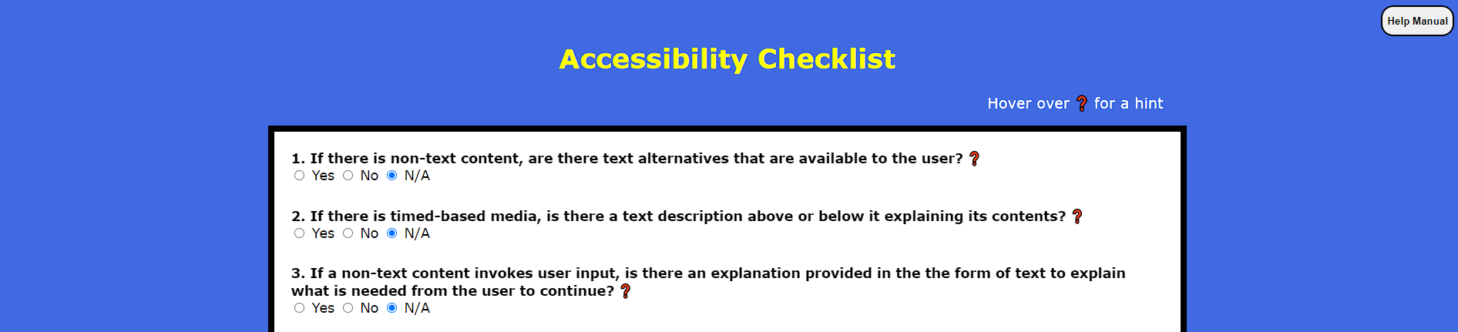
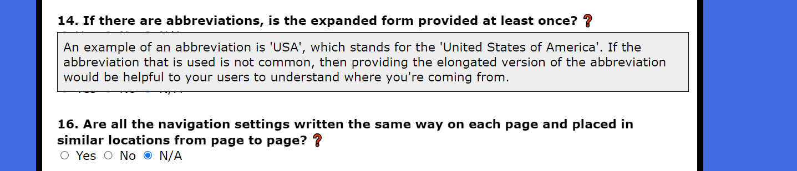
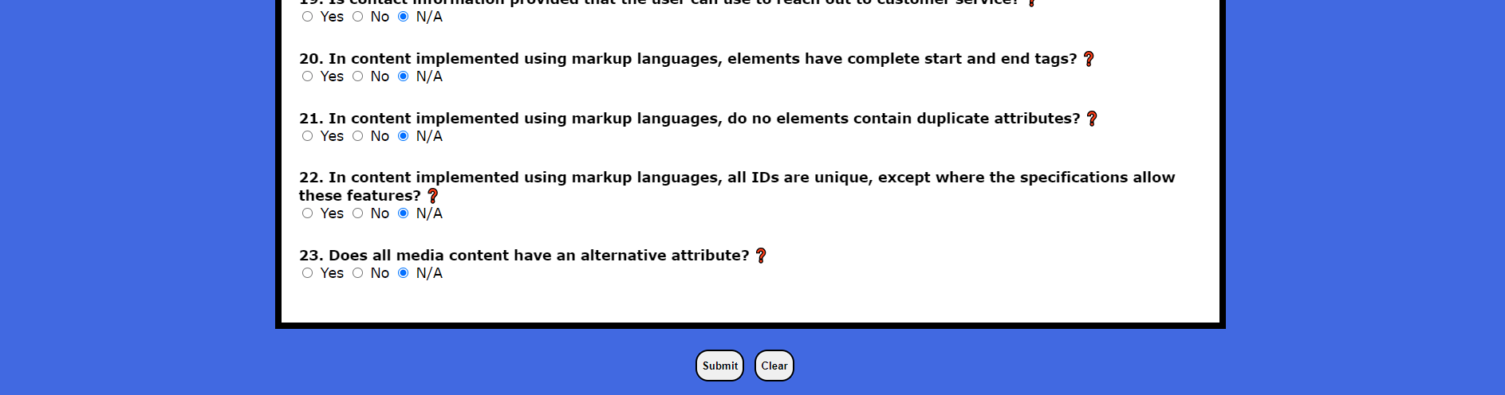
Home Page

Slide 6
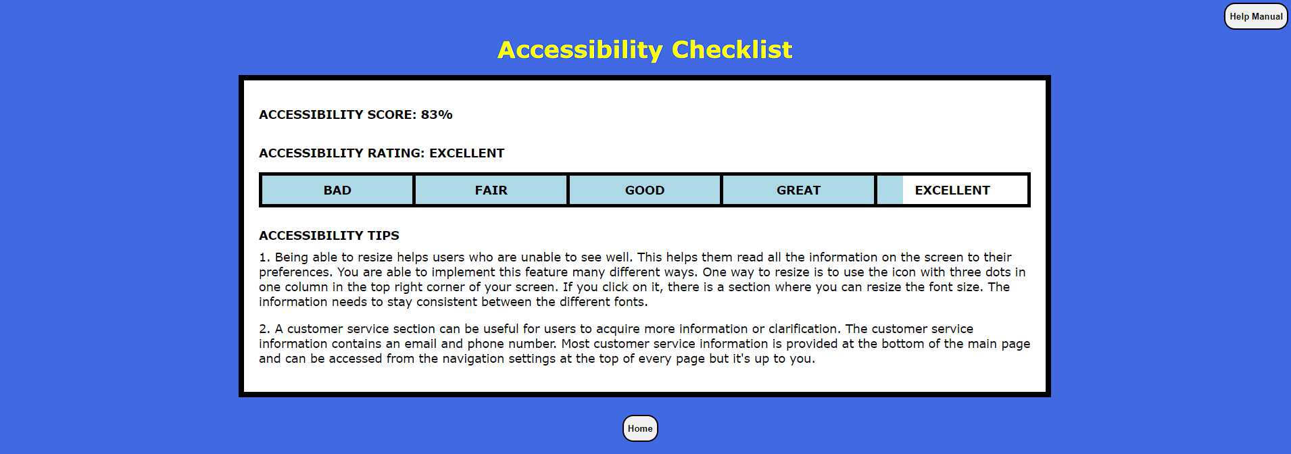
Results Page

Slide 7
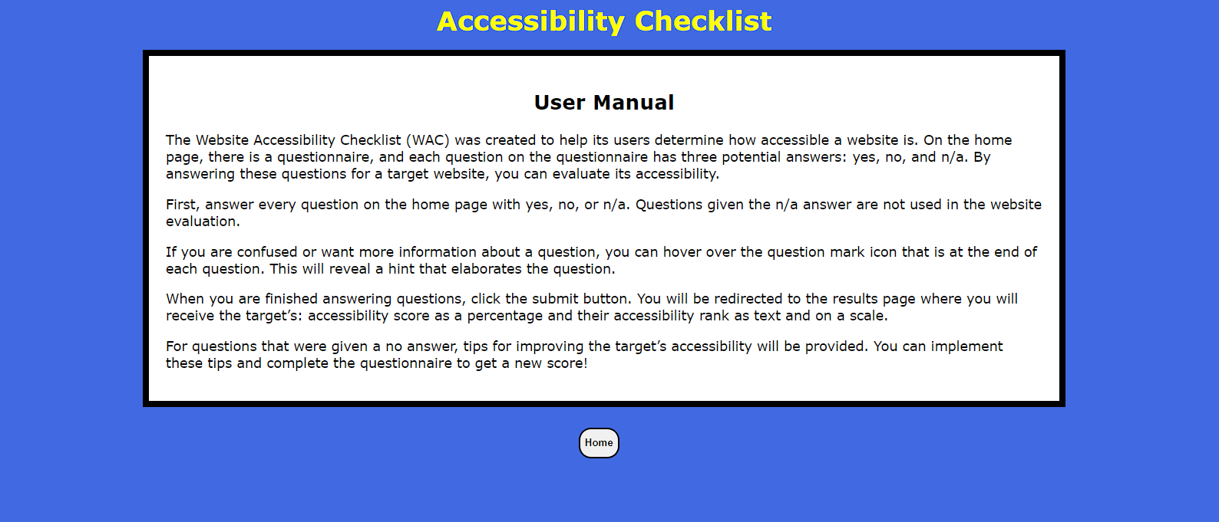
Manual Page

Slide 8
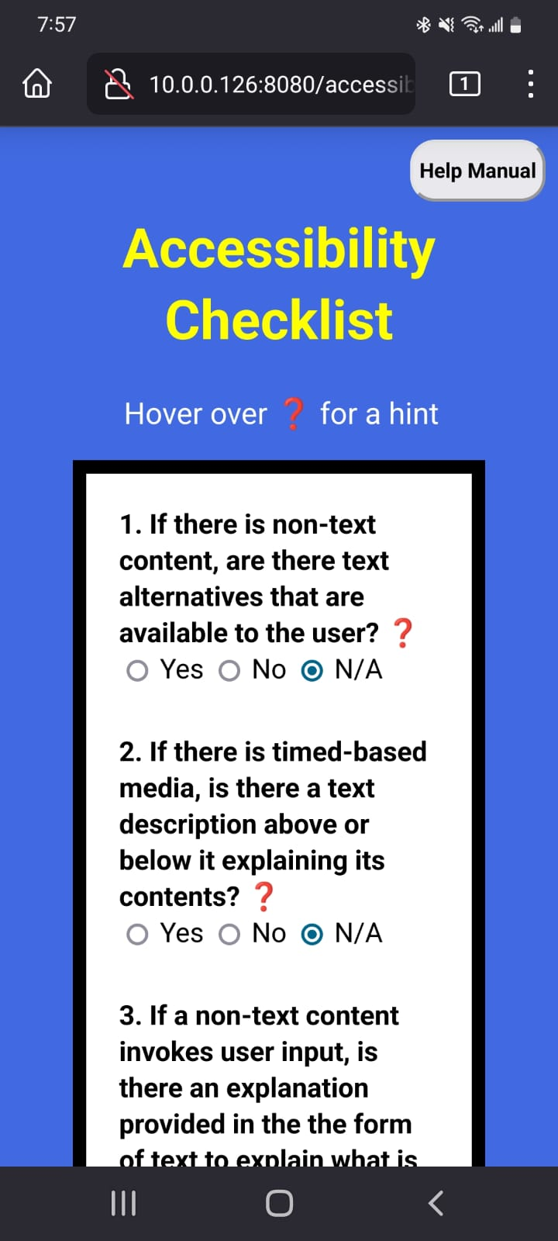
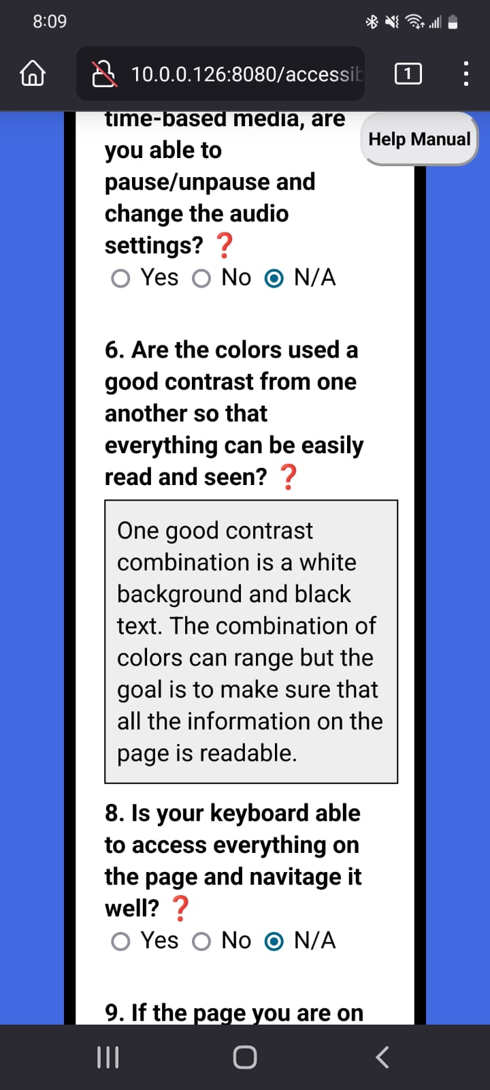
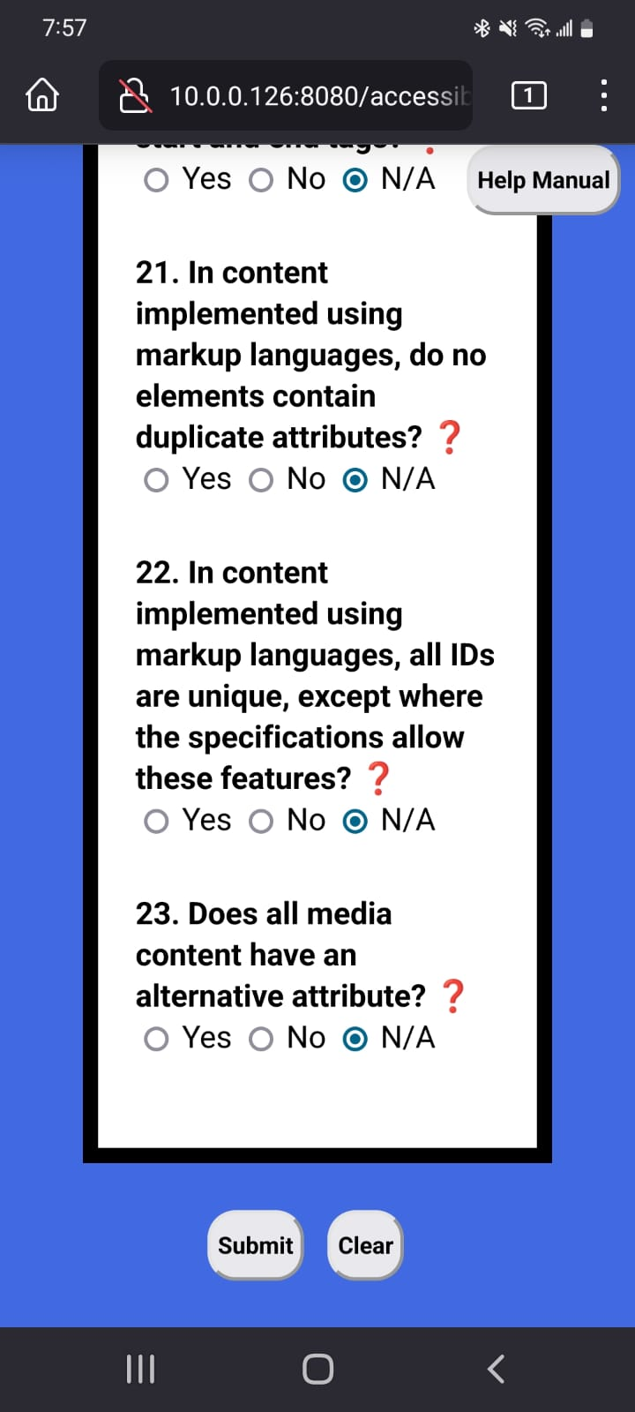
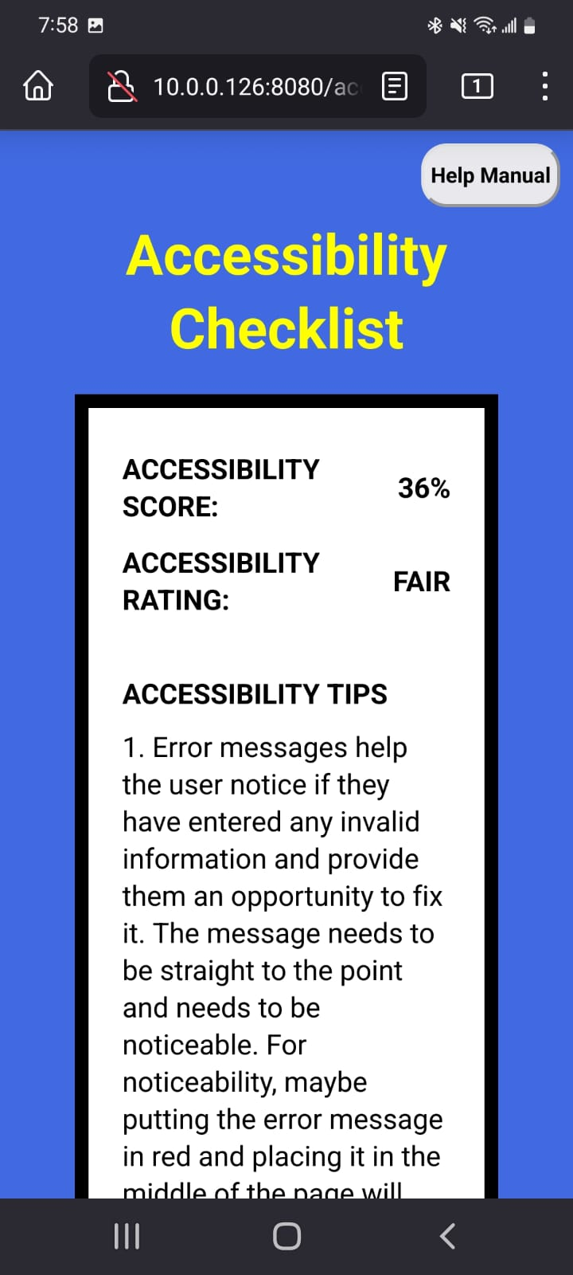
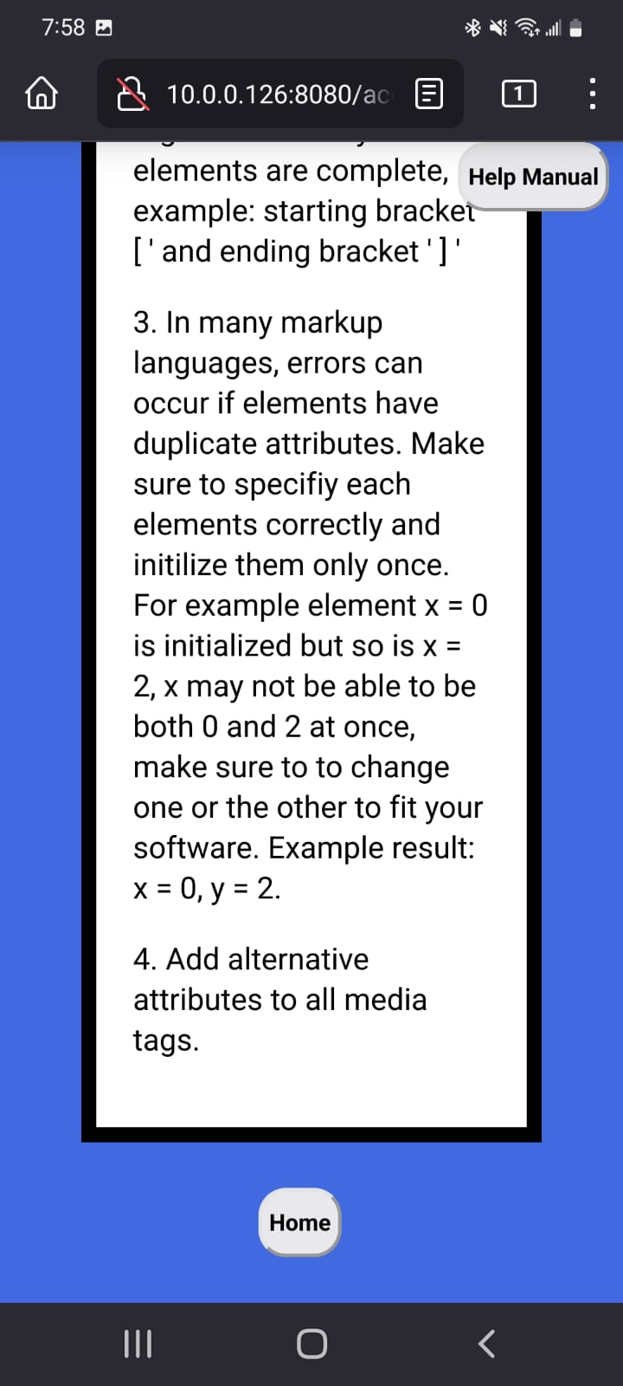
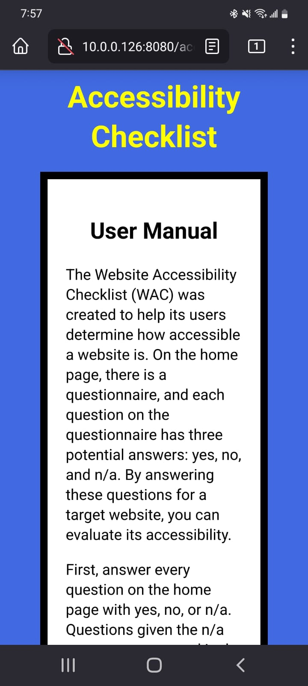
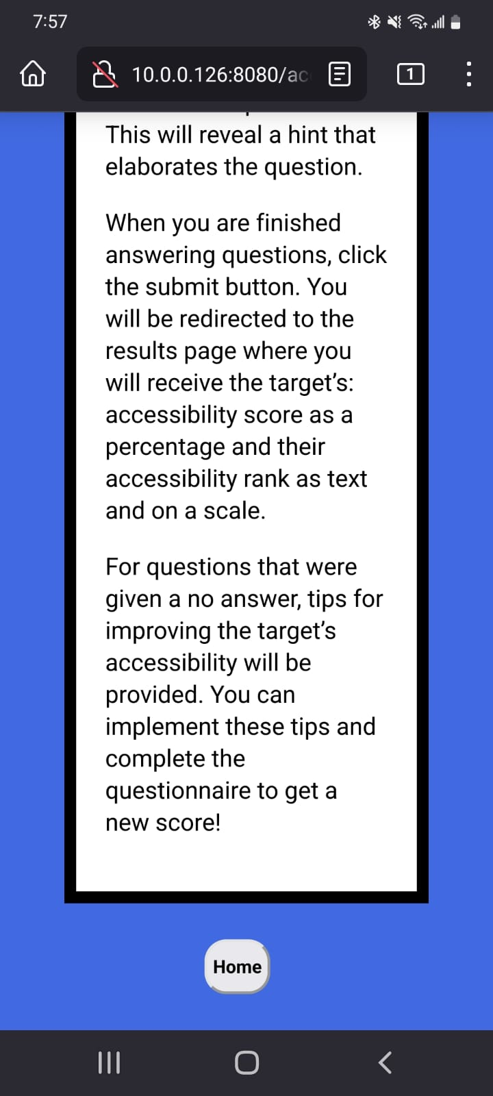
Mobile Website
Home Results Manual

Slide 9
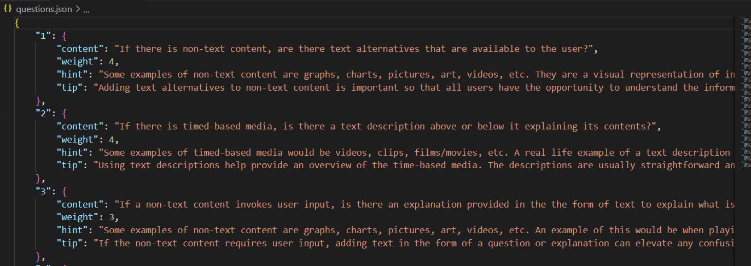
JSON File Examples - Question Weighting

Slide 10
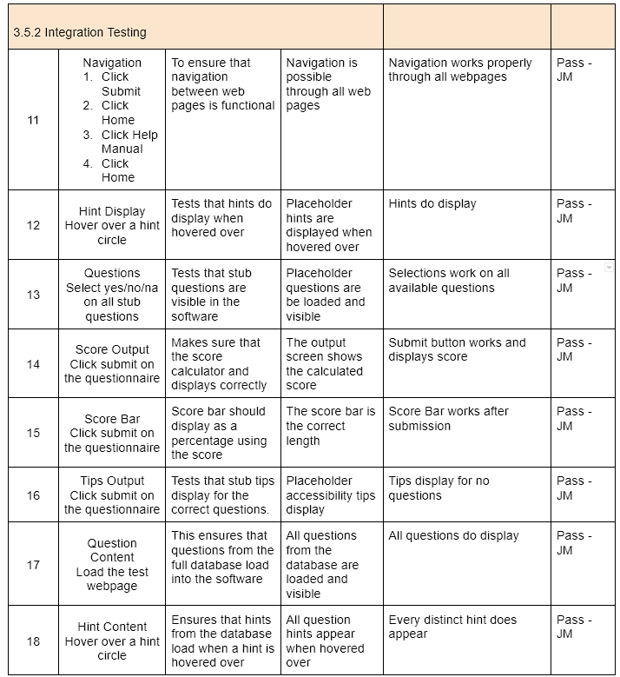
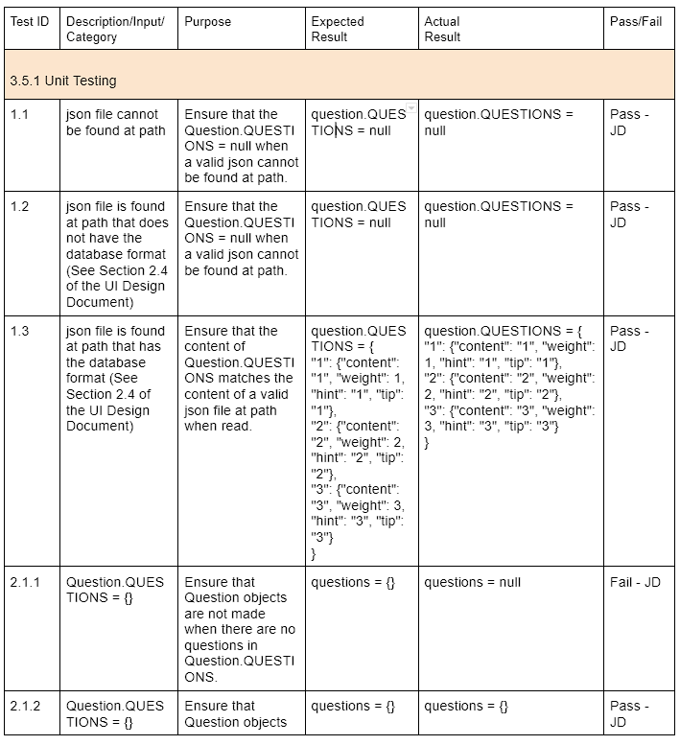
Functional Testing Results

Slide 11
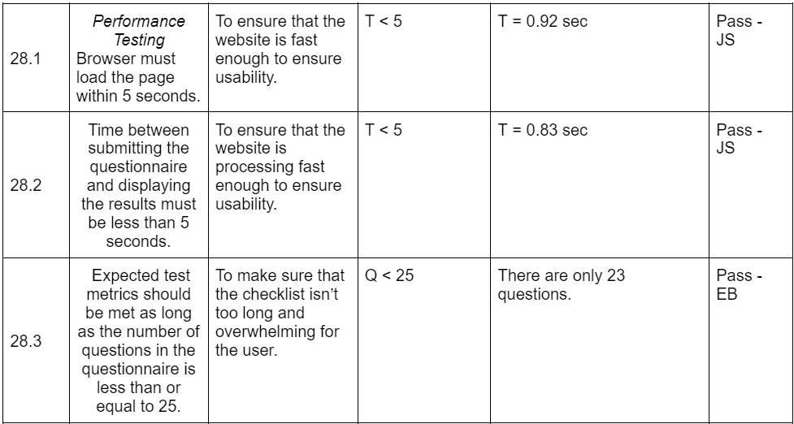
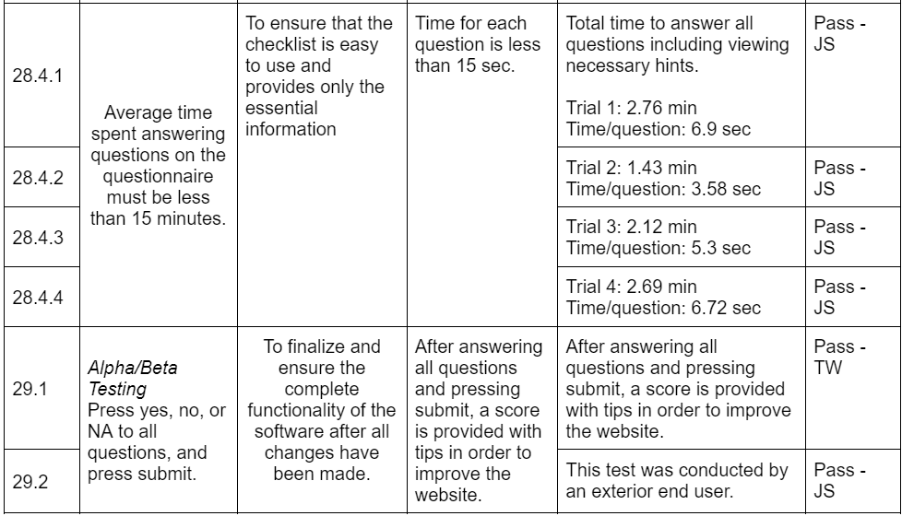
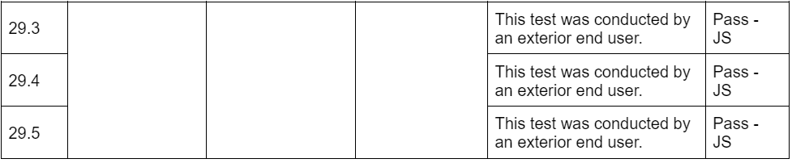
Non-Functional Testing Results

Slide 12
Thanks! Questions?
Live Demonstration…

