Slide 1
SECURE Data hiding in images using steganography
CAPSTONE PROJECT
Presented By : Tayyeba Ali
Student Name : Tayyeba Ali
College Name : Shriram Institute of Management & Technology, Kashipur
Department: Computer Science

Slide 2
OUTLINE
Problem Statement
Technology used
Wow factor
End users
Result
Conclusion
Git-hub Link
Future scope

Slide 3
Problem Statement
This project focuses on Image Steganography, enabling users to securely hide and retrieve secret messages within images. The system embeds text into an image without noticeable distortion, ensuring discrete communication. An optional password-based verification enhances security, allowing only authorized users to decode the hidden message.

Slide 4
Technology used
Programming Language: Python
Libraries: OpenCV (cv2) for image processing, NumPy for data manipulation, OS for file handling
Encryption: Basic ASCII encoding (optionally extendable to AES or other cryptographic methods)
Development Environment: Visual Studio Code (VS Code)
Platform: Windows (Compatible with Linux and macOS too)
Version Control: Git & GitHub for project management and collaboration

Slide 5
Wow factors
Simple & Intuitive Encoding/Decoding: Easily hide and extract messages within images using a streamlined process.
Password Protection: Ensures only authorized users can decode the hidden message.
Custom Steganography Approach: Uses pixel manipulation to store secret messages without noticeable changes in the image.
Lightweight & Fast Execution: Runs efficiently without heavy dependencies, making it suitable for quick encryption.
Cross-Platform Compatibility: Works on Windows, Linux, and macOS with minimal setup.
Scalability: Can be extended with stronger encryption like AES for higher security.
Educational Purpose: A great introduction to steganography and cybersecurity concepts.

Slide 6
End users
Cybersecurity Enthusiasts & Researchers – Those exploring data hiding techniques and encryption.
Developers & Programmers – Individuals looking to integrate steganography into applications.
Privacy-Conscious Users – People who want to securely store and transmit sensitive information.
Students & Educators – Those learning about cryptography, steganography, and digital forensics.
Journalists & Whistleblowers – For securely communicating confidential information without detection.

Slide 7
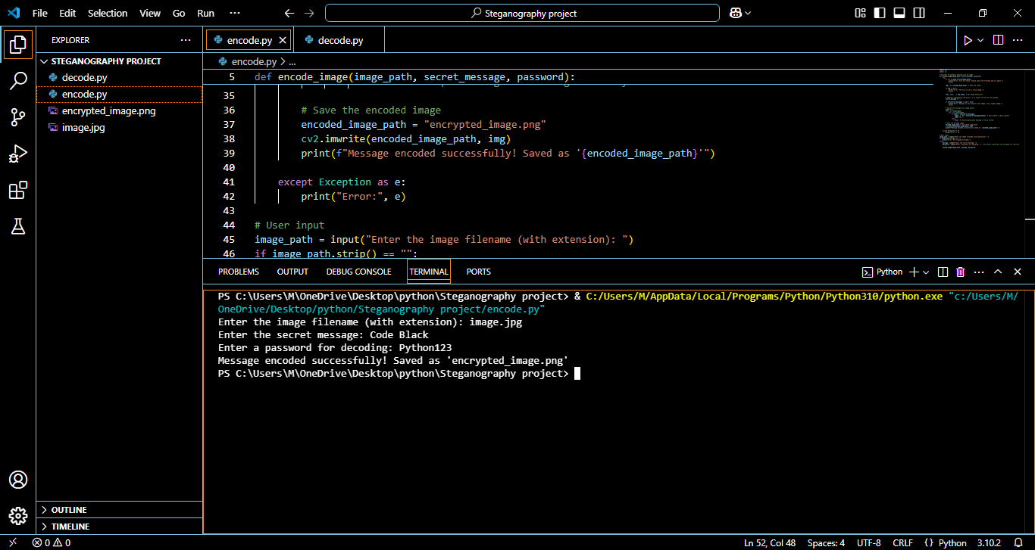
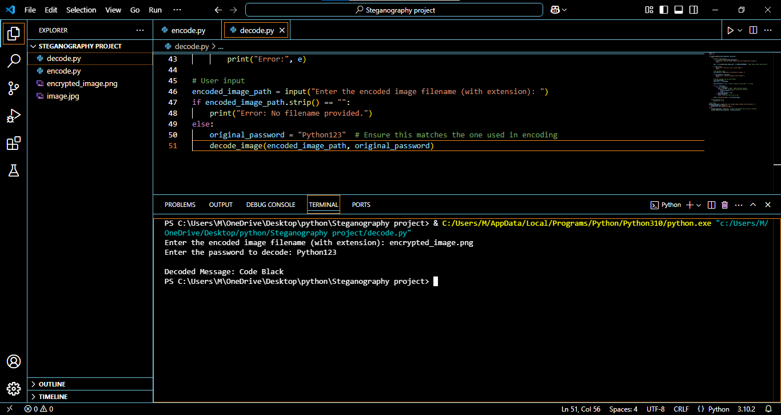
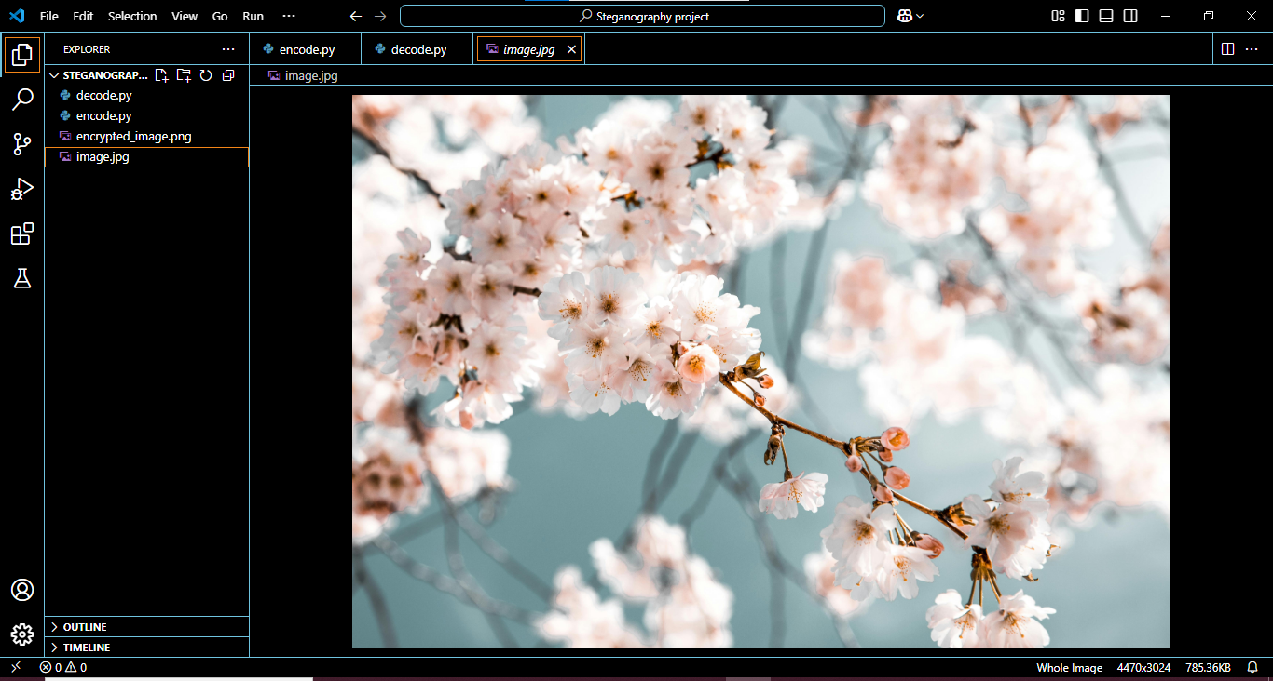

Results

Slide 8
Conclusion
This Image Steganography project successfully demonstrates a secure and efficient method for hiding secret messages within images. By leveraging OpenCV and Python, the project ensures that sensitive data can be concealed without altering the visual integrity of the image. The integration of password protection enhances security, making it suitable for confidential communication. Overall, this project provides a simple yet effective approach to digital steganography, highlighting its potential for secure data transmission.

Slide 9
GitHub Link
https://github.com/tayy-codes/Image-Steganography.git

Slide 10
Future scope(optional)
Enhanced Security: Implementing advanced encryption algorithms like AES along with steganography for dual-layer security.
Support for Different File Formats: Expanding compatibility to support various image formats like BMP, TIFF, and GIF.
Increased Capacity: Optimizing encoding techniques to store larger messages without compromising image quality.
GUI Integration: Developing a user-friendly graphical interface to make the process more accessible to non-programmers.
Audio & Video Steganography: Extending the project to hide messages in audio and video files for broader applications.

Slide 11
THANK YOU

