Slide 1
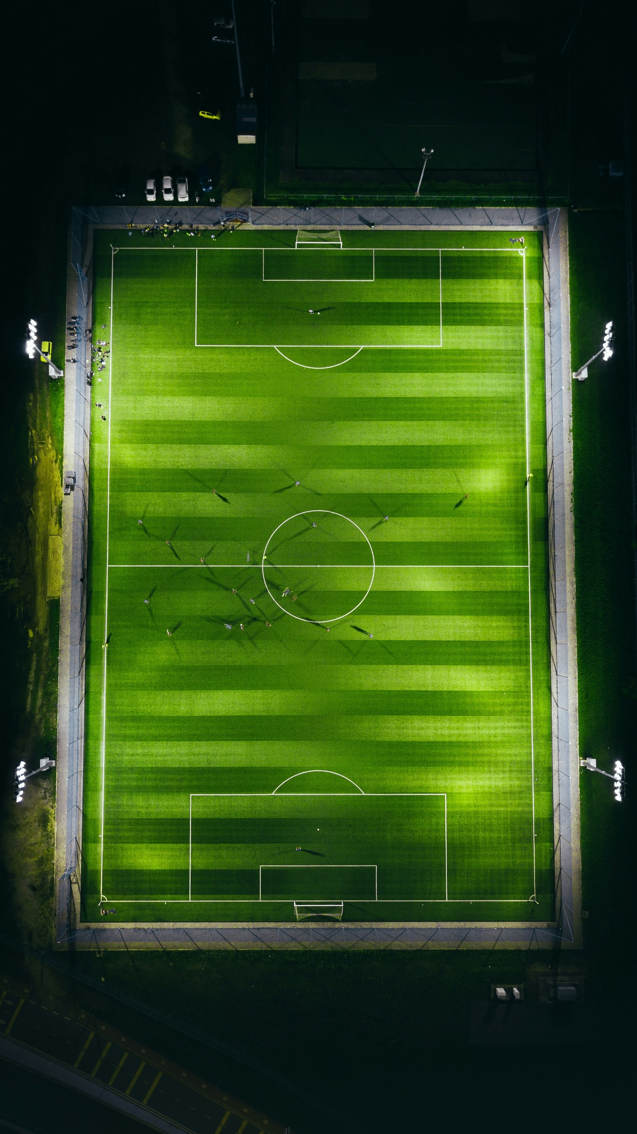



Photo by Andrej Lišakov on Unsplash
Page 0
Contains rough templates for future use in the wireframes
https://coolors.co/palette/21295c-1b3b6f-065a82-1c7293-9eb3c2
academic projects
home
personal projects

Slide 2

github logo
<a target="_blank" href="https://icons8.com/icon/RHLuYrY4GjUv/github">GitHub</a> icon by <a target="_blank" href="https://icons8.com">Icons8</a>
email logo
<a target="_blank" href="https://icons8.com/icon/12623/email">Email</a> icon by <a target="_blank" href="https://icons8.com">Icons8</a>
Linkedin logo
<a target="_blank" href="https://icons8.com/icon/85348/linkedin">LinkedIn</a> icon by <a target="_blank" href="https://icons8.com">Icons8</a>
Photo by Izuddin Helmi Adnan on Unsplash
Home page
Contains home and contact
tayyab hussain
software engineer
about
passionate-about
{
coding,
problem-solving,
continuous learning,
}
personal projects
academic projects
<- When hovering over ->
about
passionate-about
{
coding,
problem-solving,
continuous learning,
Arsenal F.C
}
personal projects
academic projects

Slide 3

Link to access group about page
home
About Page
Scroll wheel
home
hi, i’m tayyab
i`m a software engineer currently working at the access group uk
i have been programming for roughly 10 years
my ability to learn and pick up new skills is what sets me apart

Slide 4
Pin to the top of the page.
About Page
home
Access Group UK 2024
Software Engineer
BSc Computer Science 2023
2:1
A-Levels 2019
AAB
GCSE`s 2017
A*A*A*A*AAAAAABB

Slide 5
About Page
Java
home
Elm
Haskell
SQL
C#
C++
Data Visualisation
DSA
CSS
Python
Functional
Databases
HTML
Scikit-Lean
General Proficiency
JavaScript
AI
TensorFlow
Web Dev
My Skill Tree

Slide 6
Personal Projects
Insert background image when the home page is finished
home
personal projects
this portfolio website
full-stack developer course
codecademy
Template for next section.
Scroll to next slide to see detail.

Slide 7
Personal Projects
home
html + css
full-stack developer course
codecademy
javascript
full-stack developer course
codecademy

Slide 8
academic Projects
home
academic projects
stealth game prototype
final year project
Template for next section.
Scroll to next slide to see detail.

Slide 9
academic Projects
home
3d platformer
advanced games technology
car racing game
computer graphics

Slide 10
academic Projects
home
asteroids
games technology
premier league players` xG/xA vs G/A
data visualisation

