Slide 1
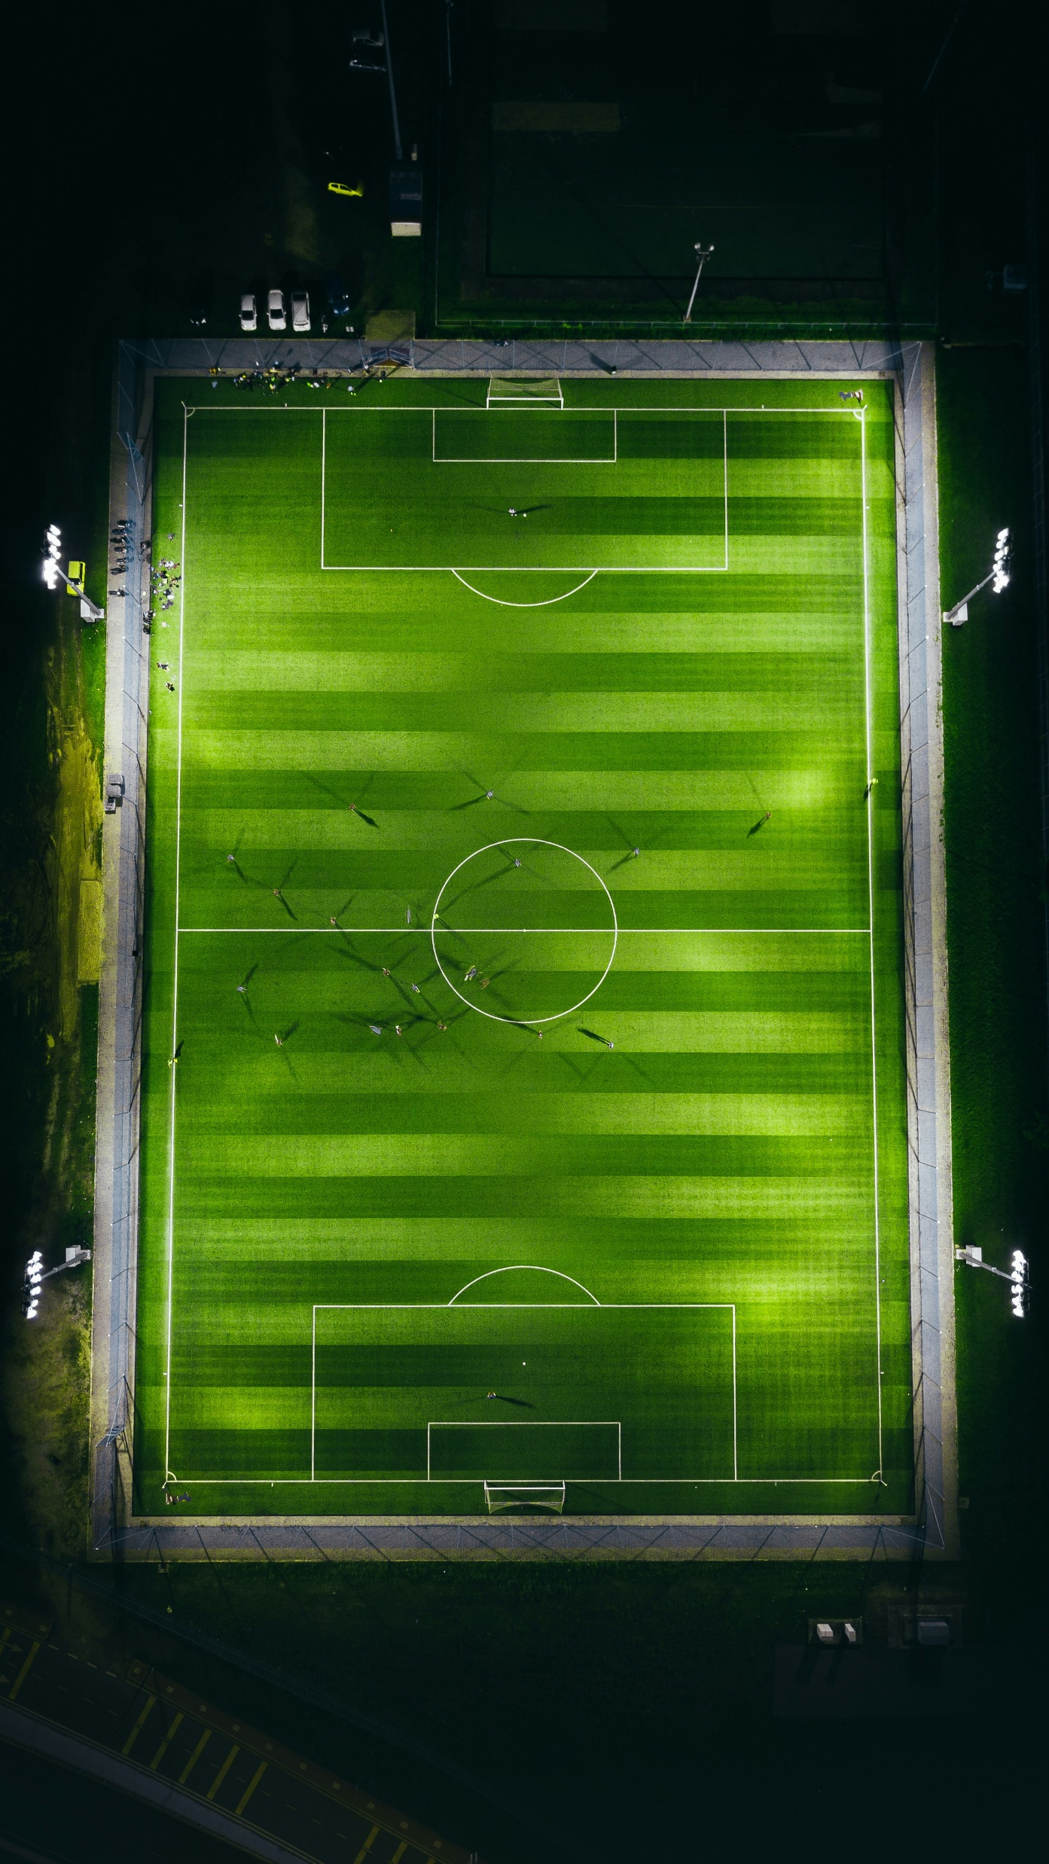
Page 0
Contains rough templates for future use in the wireframes
https://coolors.co/palette/21295c-1b3b6f-065a82-1c7293-9eb3c2
academic projects
home
personal projects

Slide 2




github logo
<a target="_blank" href="https://icons8.com/icon/RHLuYrY4GjUv/github">GitHub</a> icon by <a target="_blank" href="https://icons8.com">Icons8</a>
email logo
<a target="_blank" href="https://icons8.com/icon/12623/email">Email</a> icon by <a target="_blank" href="https://icons8.com">Icons8</a>
Linkedin logo
<a target="_blank" href="https://icons8.com/icon/85348/linkedin">LinkedIn</a> icon by <a target="_blank" href="https://icons8.com">Icons8</a>
Photo by Izuddin Helmi Adnan on Unsplash
Home page
Contains home and contact
tayyab hussain
software engineer
about
passionate-about
{
coding,
problem-solving,
continuous learning,
}
personal projects
academic projects
<- When hovering over ->
about
passionate-about
{
coding,
problem-solving,
continuous learning,
Arsenal F.C
}
personal projects
academic projects

Slide 3

Link to access group about page
home
About Page
Scroll wheel
home
hi, i’m tayyab
i`m a software engineer currently working at the access group uk
i have been programming for roughly 10 years
my ability to learn and pick up new skills is what sets me apart

Slide 4
Pin to the top of the page.
About Page
home
Access Group UK 2024
Software Engineer
BSc Computer Science 2023
2:1
A-Levels 2019
AAB
GCSE`s 2017
A*A*A*A*AAAAAABB

Slide 5
About Page
home
HTML
DSA
Data Visualisation
Functional
General Proficiency
CSS
Databases
Web Dev
JavaScript
Web dev
Dsa
Databases
Functional
AI
Data Vis
General proficiency
AI

