Slide 1
SlipFlow
Marketplace orders.
Reviewed production slips.
Offline Windows desktop application
Muhammad Tayyab
Diploma in Computer Science · Methodist College Kuala Lumpur
01
Notes:
My name is Muhammad Tayyab, a Diploma in Computer Science student at Methodist College Kuala Lumpur. SlipFlow is a Windows application that converts marketplace order exports into reviewed production instructions. This demonstration uses synthetic records. No factory time saving is claimed.

Slide 2
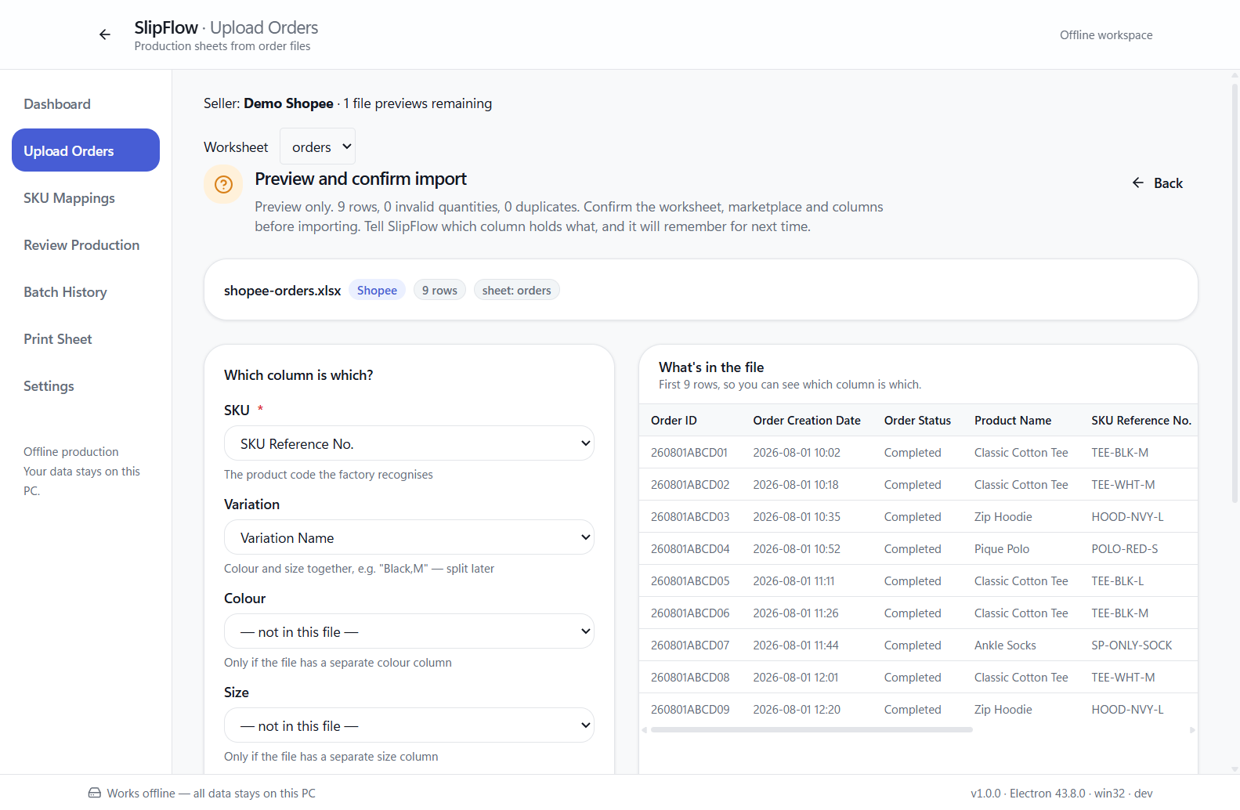
The manufacturing problem
An order export is not yet
a production instruction.
Staff must identify the product, interpret its variant and reconcile quantities before sewing starts.
02
Notes:
Factory staff receive exported orders from TikTok Shop, Shopee and Lazada. The same product can have different seller identifiers and variation formats. Manually transferring these details to a tailor slip creates opportunities for missed or repeated quantities. The screenshot is a real import preview of the supplied synthetic Shopee fixture.

Slide 3
The manual workflow
Read exports
Identify SKU
Check variants
Add quantities
Write slips
A repeated file or a misread quantity can change what the factory produces.
The design priority is traceable, accurate quantities.
03
Notes:
The original workflow involves reading each export, identifying the product, separating colour and size, adding quantities, and preparing a slip. Every transfer is a possible transcription error. SlipFlow keeps the source record available for review instead of replacing it with an unexplained total.

Slide 4
The SlipFlow workflow
Select seller
Preview import
Map and group
Print and retain
Approve batch
Review issues
Operator approval is a required step before production output.
04
Notes:
The operator selects the seller, previews the file and worksheet, confirms the columns, and imports the orders. SlipFlow flags uncertain identities and unknown mappings. The operator reviews these items, reconciles the batch, and explicitly approves it before generating a production slip. PDF export does not mark a batch physically printed.

Slide 5
Objectives and functional scope
INPUT
OUTPUT
Marketplace exports
CSV, XLS and XLSX
Seller account identity
Explicit SKU mappings
Reviewed batch quantities
Readable A4 tailor slips
PDF and native printing
History and recovery copies
Local SQLite storage. No server or marketplace credentials required.
05
Notes:
The first release works locally on Windows. It reads CSV, XLS and XLSX files, supports seller accounts, and stores data in SQLite. It does not connect to marketplace APIs or a cloud database. The factory mapping and operator review remain the authority for production instructions.

Slide 6
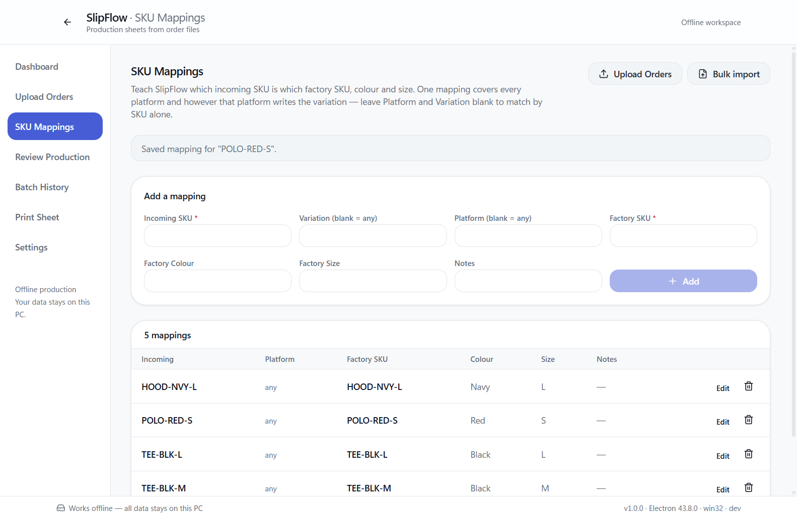
Main features
Explicit mappings
Variant review
Duplicate control
Batch history
Verified recovery
06
Notes:
The mapping screen lets operators create, edit and bulk import factory mappings. Conflicts do not silently overwrite existing entries. Unmapped products stay unresolved. Additional workflows cover seller selection, file preview, selective order-line batching, review, history, settings and backups. Existing batches keep their saved production values when a mapping changes.

Slide 7
Application architecture
React renderer
Preload bridge
Electron main
Screens and review
Named IPC functions
Validated operations
SheetJS parses local exports.
Chromium renders A4 output.
SQLite database
07
Notes:
React renders the operator screens. A sandboxed preload exposes named IPC functions. The Electron main process validates the sender and arguments before accessing files, parsing spreadsheets, updating SQLite or generating print documents. The renderer has no Node integration. Electron packages the application for Windows.

Slide 8
Source records remain traceable
Seller account
Import file
Imported order
Batch
Production item
Source link
61
28 original order lines
12 repeated rows excluded
reconciled production units
08
Notes:
Seller accounts identify the origin of each import. Imported orders retain source values and worksheet row numbers. Production source links connect each grouped item back to its original order lines. Batches store status and reconciled totals. Audit events record changes. The demonstration imports 28 original rows plus 12 repeated rows, excludes the repeated rows, and produces 61 units.

Slide 9
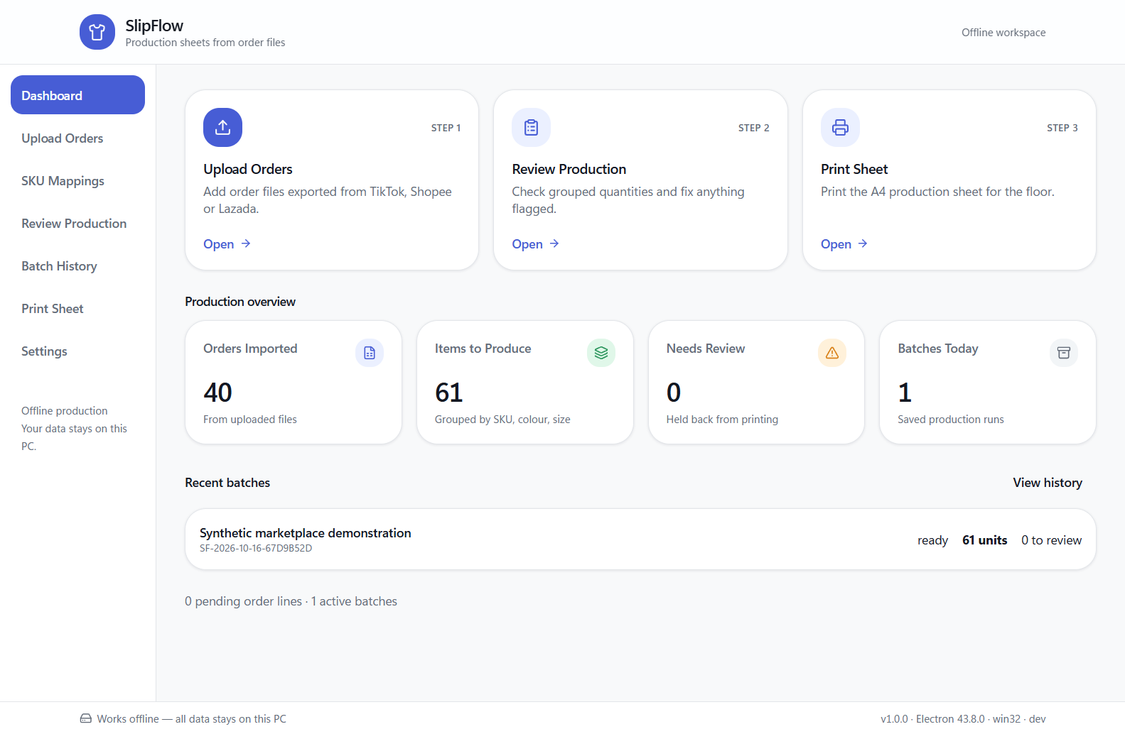
The working application
40 imported rows
12 duplicates
excluded
61 units
ready
09
Notes:
This is an actual screenshot from the automated operator workflow. It uses the supplied synthetic sample files. The dashboard shows 40 imported rows because 12 rows came from a repeated TikTok file. Production remains 61 units. The batch is ready only after the three unknown products have been reviewed.

Slide 10
Testing, reliability and security
96
Quantity and duplicate regressions
Transactional imports and grouping
Verified backup and restoration
A4 and multi-page PDF generation
Sandboxed renderer and validated IPC
automated verification checks
2 Electron UI scenarios
Synthetic data on Windows 11
10
Notes:
The original verification scripts contribute 45 passing checks. The added release suite contributes 51 passing checks. Two Playwright scenarios drive the complete operator workflow in Electron and confirm persistence after restart. Backup restoration and corruption rejection use temporary databases. The print test includes 120 lines across seven A4 pages. Context isolation, renderer sandboxing, disabled Node integration and IPC allowlisting protect the desktop boundary. These results use synthetic records, not a real factory deployment.

Slide 11
Limits and next validation
Validate in the factory
Next development
Live export formats
Physical printers
Operator usability
Measured before-and-after workflow
Signed Windows distribution
More anonymized fixtures
Factory pilot feedback
Broader compatibility testing
No live API integration or verified factory time-saving claim.
11
Notes:
The sample fixtures establish tested layouts only. Live marketplace exports can change and require operator confirmation. Physical printer output and real factory use still need field validation. The installer is unsigned. Eight moderate npm findings remain in a development-only packaging dependency chain. Future work should be driven by actual factory feedback, more anonymized marketplace fixtures, signed distribution and broader Windows compatibility tests.

Slide 12
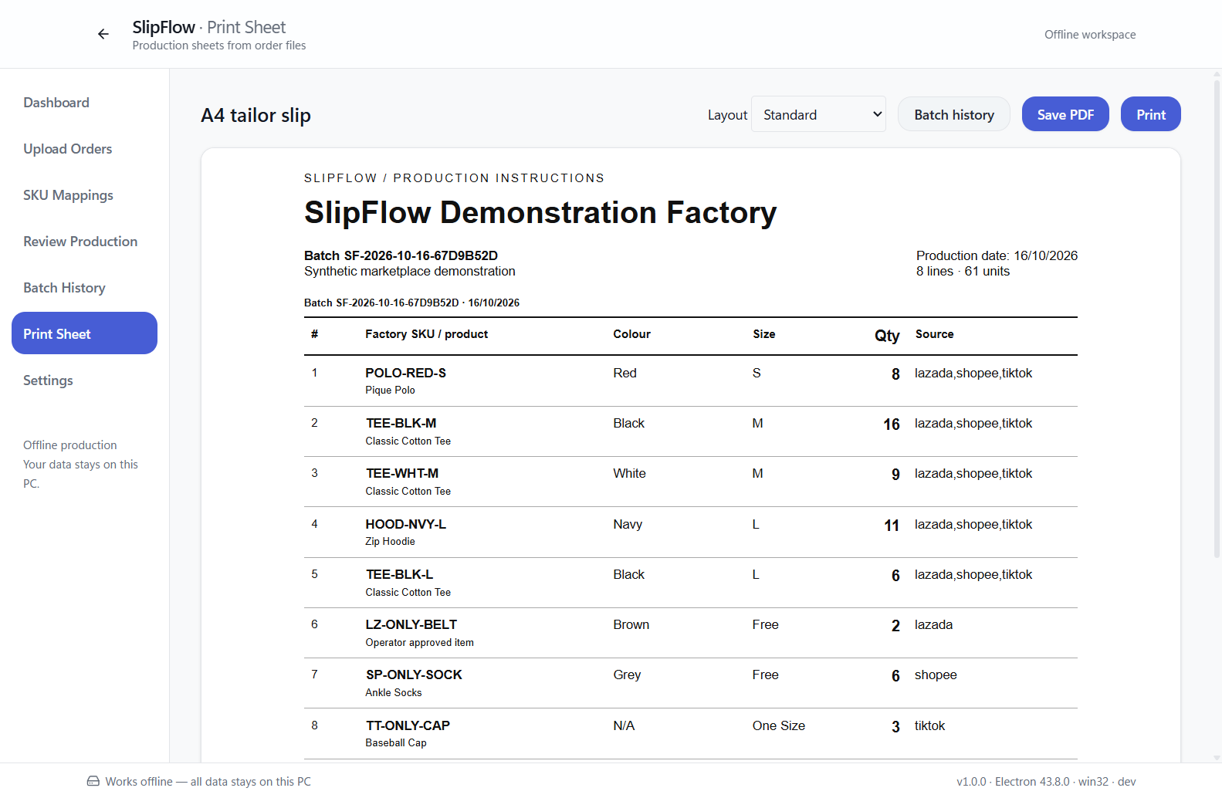
Demonstration
Import a sample
Resolve one issue
Approve 61 units
Export the tailor slip
Reopen and restore
Muhammad Tayyab
12
Notes:
For the demonstration, select a seller and import a sample export. Show the column preview, then import the repeated file to demonstrate duplicate control. Create a batch and resolve an unknown SKU. Reconcile source and production quantities, approve the batch and export an A4 PDF. Reopen the batch from history and show a verified backup. Finish by explaining that factory deployment and real-printer checks are the next validation steps. The project demonstrates desktop application engineering, database integrity, testing and delivery.

