Slide 1


Global Super Store Sales Dashboard: Insights for Business Stakeholders
Interactive Analysis Using Tableau

Slide 2

Objective & Tools
Objective: Design an interactive dashboard for business stakeholders to inform decision-making.
Tools Used: Tableau (Power BI/Tableau was specified; we used Tableau).
Deliverables: Interactive Dashboard + PPT Summary.

Slide 3
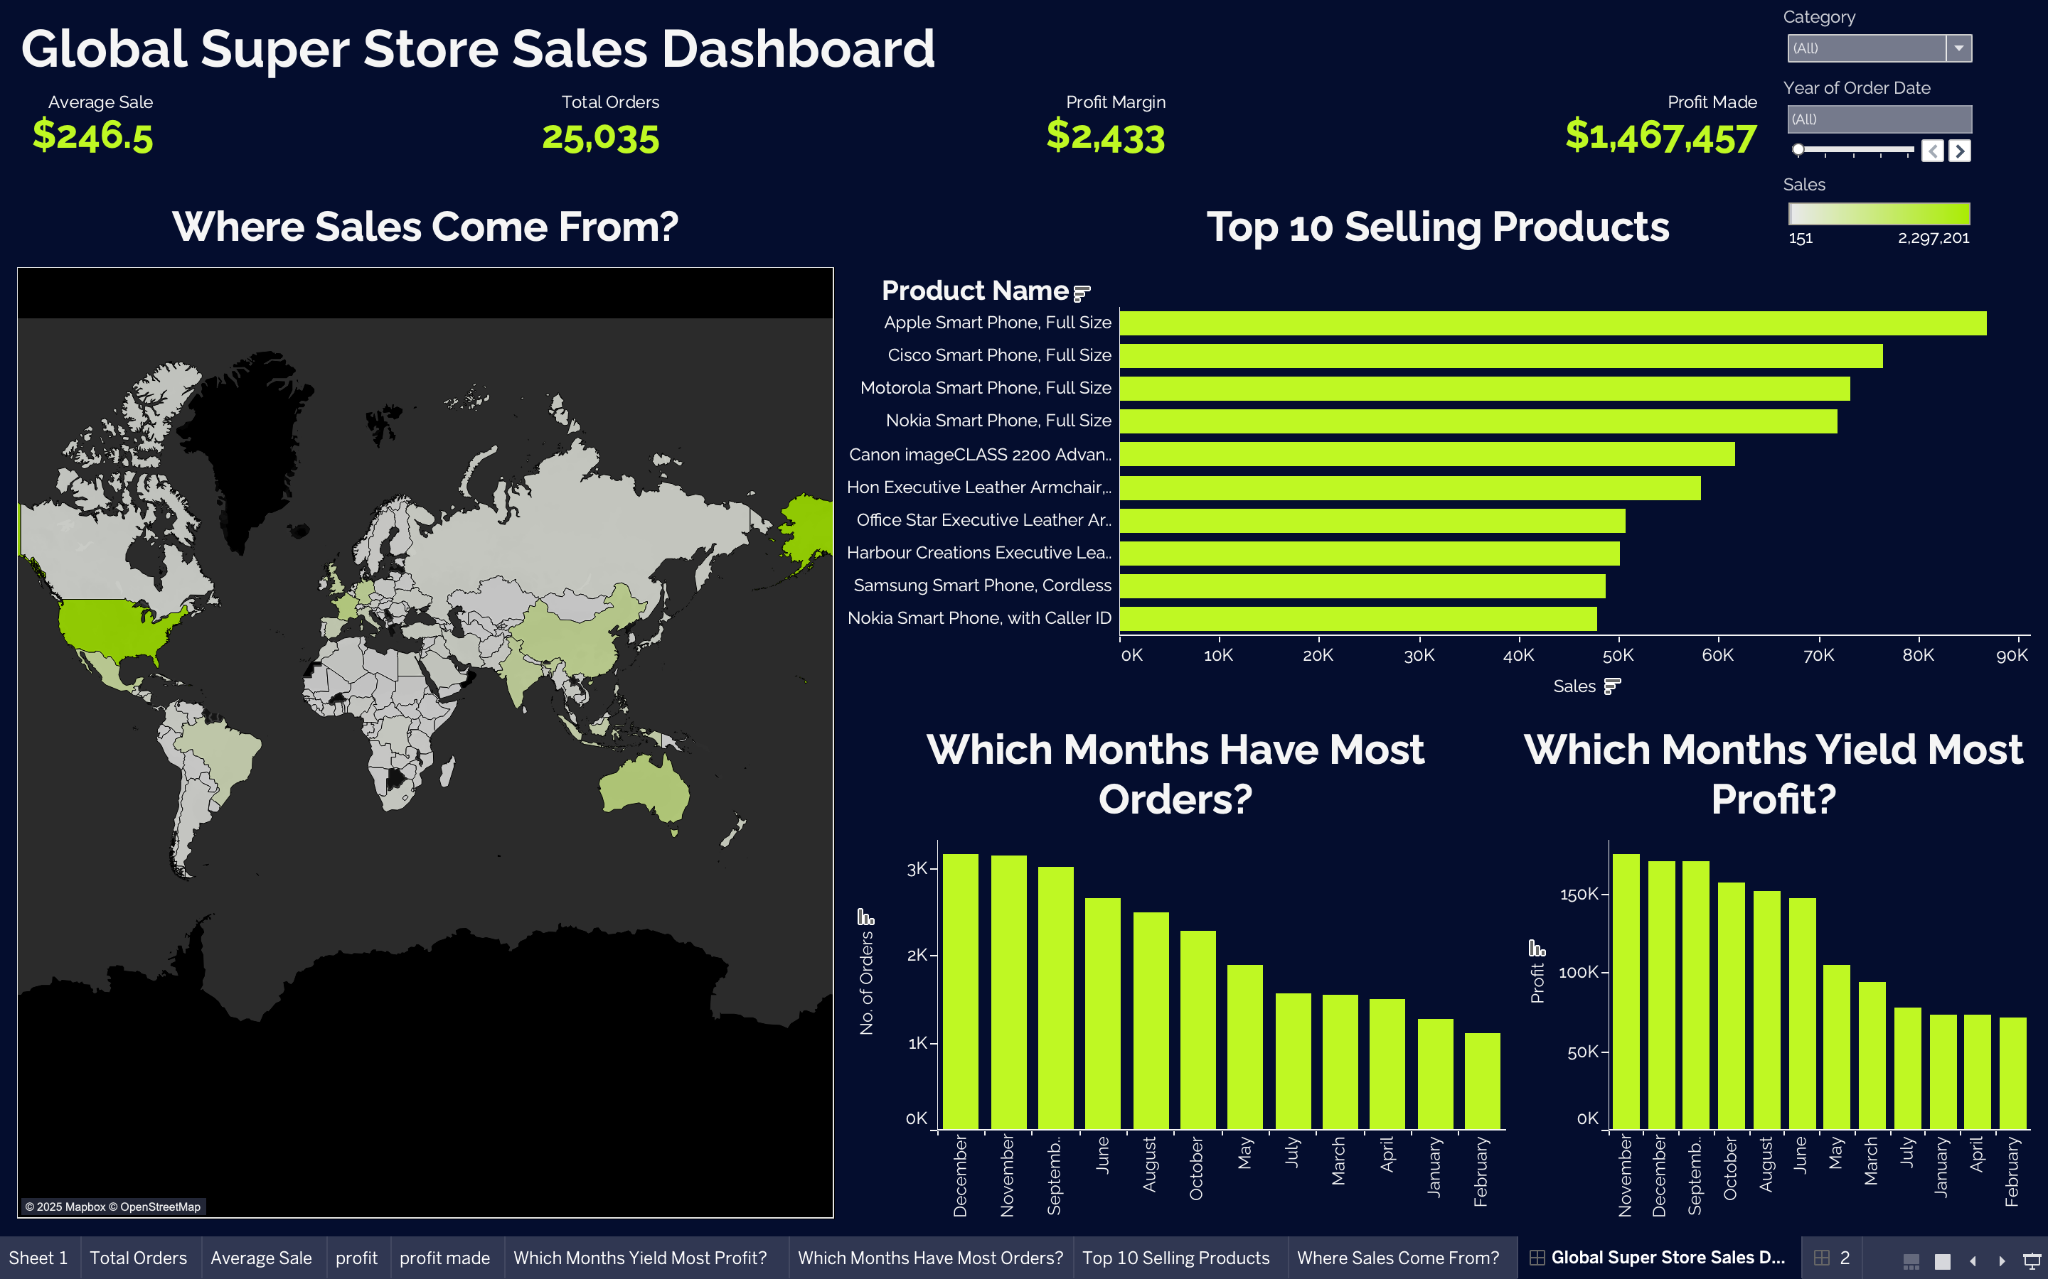
Dashboard Overview
The Global Super Store Sales Dashboard provides key insights into sales, profit, and product performance.
Key Metrics Displayed:
Average Sale: $249.5
Total Orders: 25,035
Profit Margin: $2,433
Total Sales: $1,467,457
Purpose: To help
stakeholders understand
sales trends and make
data-driven decisions.

Slide 4
Key Performance Indicators (KPIs)
Sales: Total Sales of $1,467,457.
Profit: Profit Margin of $2,433.
Growth: Visualized through time-series analysis (as per task hint c).
Interactivity: Slicers/filters allow stakeholders to drill down into specific time periods, products, or regions.

Slide 5
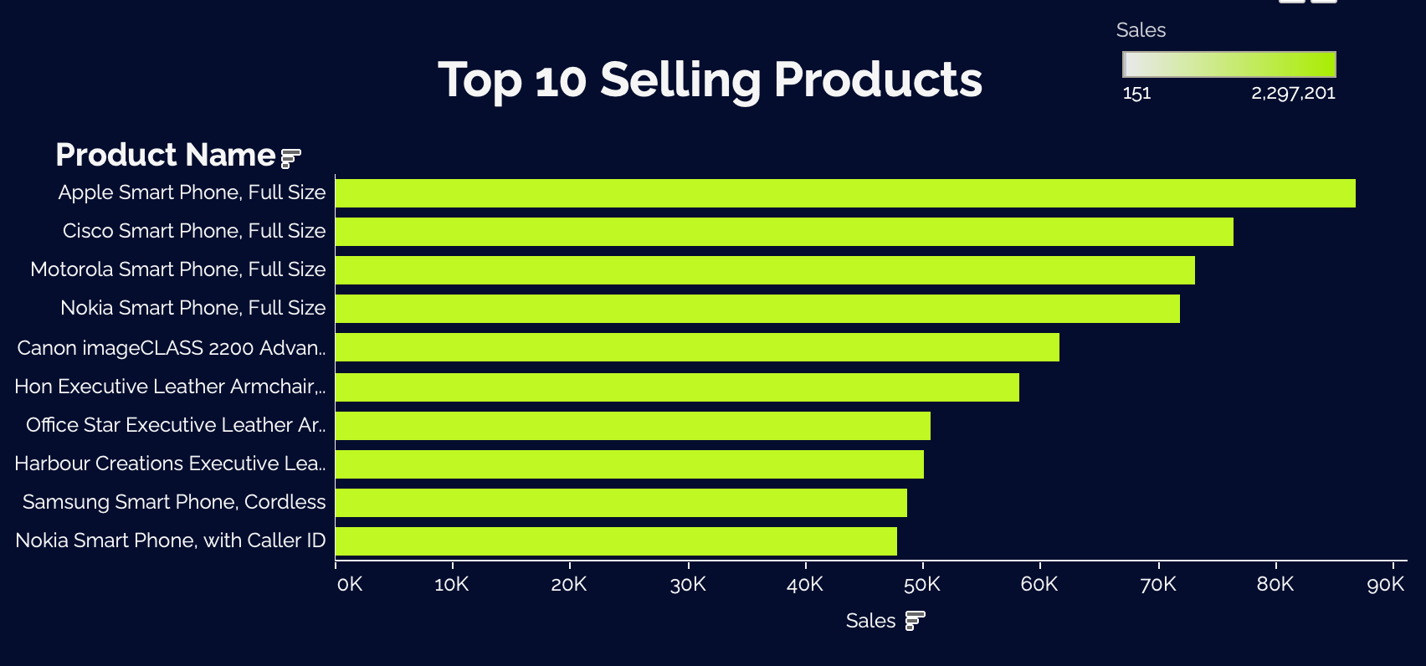
Sales Breakdown by Product
Top-performing products:
Apple Smart Phone, Full Size: ~90K
Cisco Smart Phone, Full Size: ~70K
Motorola Smart Phone, Full Size: ~60K
Insight: Smartphones dominate sales, with
Apple leading the category.
Interactivity: Filters allow stakeholders to exploresales by product or category

Slide 6
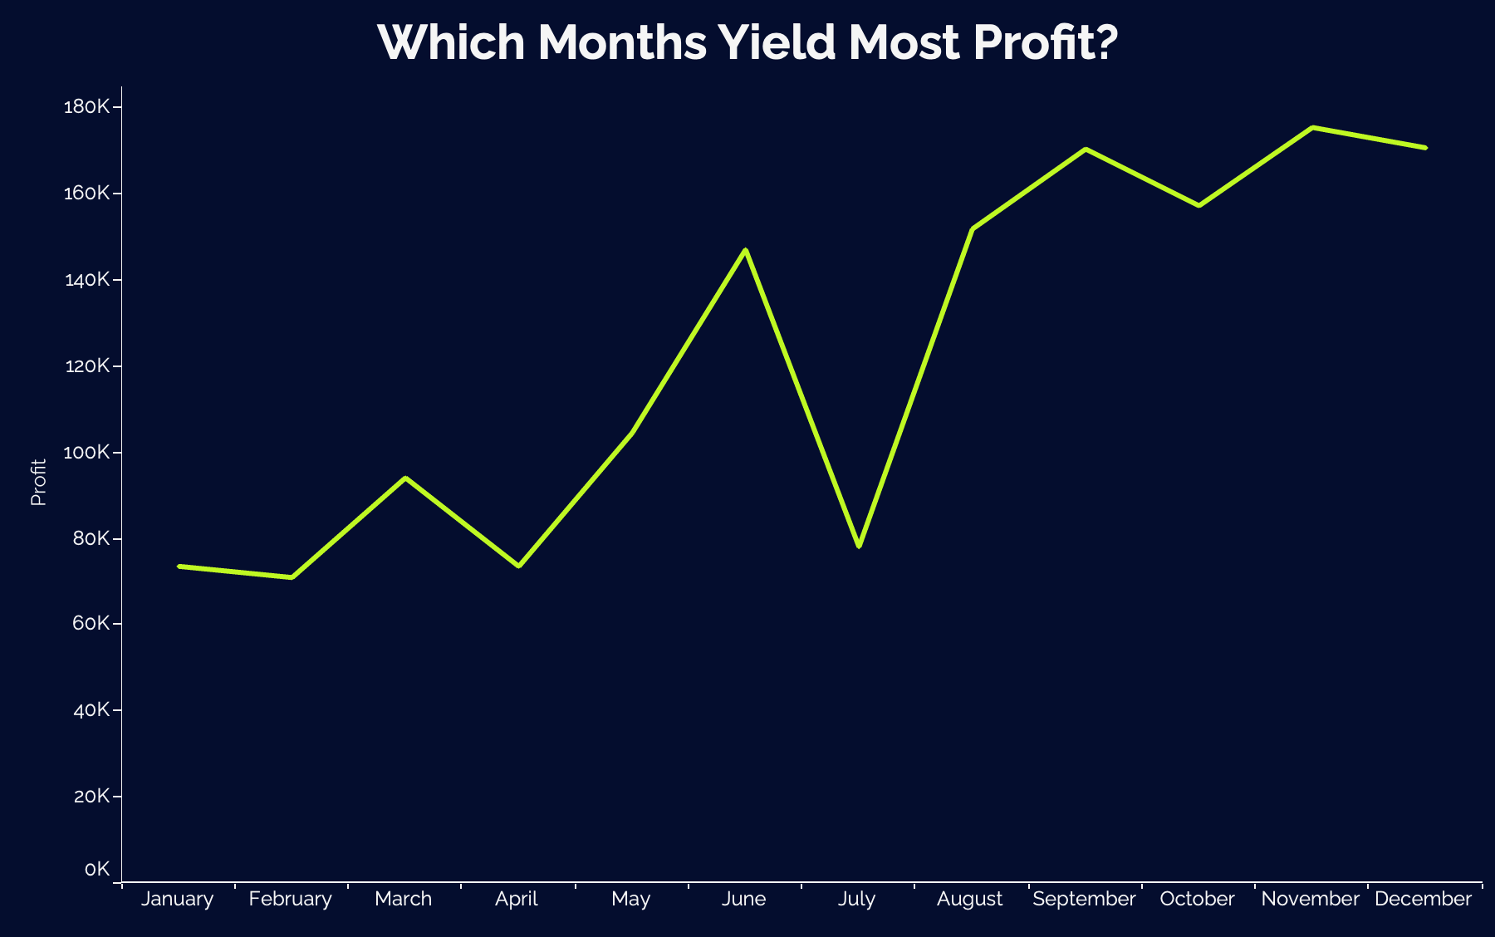
Time-Series Analysis
Tracks sales and profit trends over time (as per task hint c).
Insight: Helps identify seasonal patterns or growth opportunities.
Interactivity: Filters allow stakeholders to exploresales by product or category

Slide 7
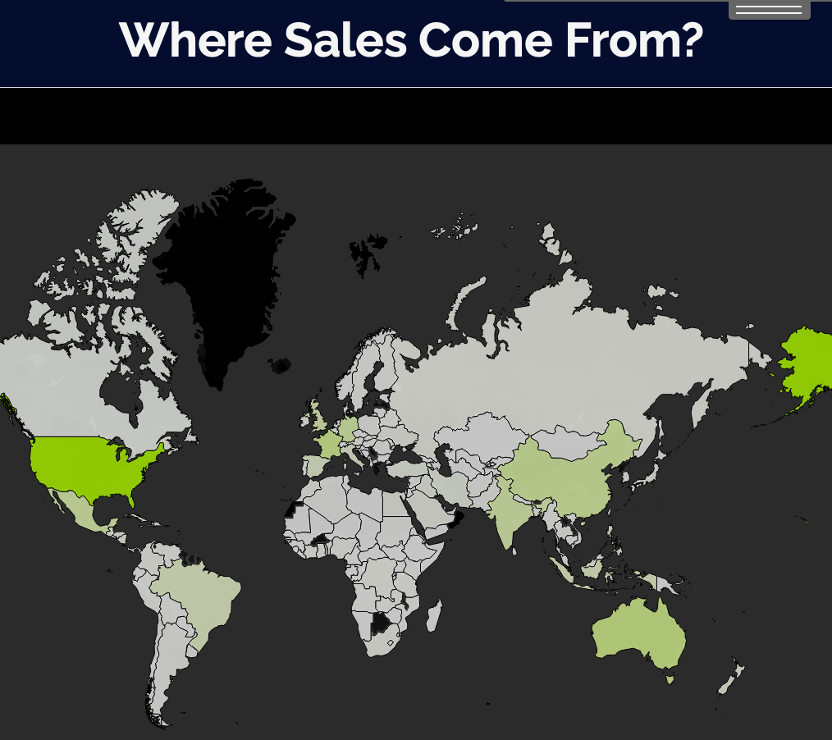
Map Summary & Key Findings
Map Summary:
Visualizes sales distribution across regions using a geographic map.
Top regions by sales: [e.g., North America: $500K, Europe: $400K, Asia: $300K]
Maximum Sales are from USA
Interactivity: Filters allow stakeholders to exploresales by product or category

Slide 8
Thank You!

