Slide 1

Design Report Vit Eat Application

Slide 2
Introduction
The VitEat mobile application will help to easily order freshly prepared made-to-order meals from local restaurants and help the users to track their diets. Users can have personal preferences for nutrition restriction or so for instance gluten-free, vegan or low-carb meals.
Though, as mentioned in earlier usability and need assessment study, there is requirement to enhance navigation of the app, further the customization feature particularly with respect to diet plan and nutrition information.
This design report provides a whole new design which enhances the overall UX, enhancing the navigation system, or rather helping the app to address the different users’ needs.
The primary goals of the redesign are to improve the perceived usability, engagement and support the overall goal of making a difficult process – managing individual nutrition – as easy as possible

Slide 3

Design Process
Empathize: Identification of overall user requirements and their problem areas as per the data collected through the usability report
Define: Describing the key issues of the users
Complex Navigation: People have complained about problems with lack of information on caloric intake, availability of different diets, confusion and more
Limited Customization Options: Consumers expected better freedom when it came to personalizing the meals, with extended options search such as multilevel filters, for instance, both gluten-free and low in carbohydrates
Inaccurate Nutritional Information: This is because users did not trust nutritional data since there were issues of inconsistencies regarding calorie and macro information

Slide 4
Design Process
3. Ideate: Brainstorming possible solutions for the identified issues
A simplified dashboard to centralize key features like favorite meals, recent orders, and a nutritional tracked
An advanced filter system to allow users to apply multiple filters
Partnering with verified nutritional databases to provide more accurate data
4. Prototype: Actual ideas on the design were followed by the creation of a wireframe prototype
5. Test: The redesigned app interface was first brought to a sample of the user population who had already participated in the VitEat usability tests

Slide 5

Design Rationale
Enhanced Navigation: The new dashboard acts as a central hub. New main menu serves as a central navigation which includes recent activities such as meals, favorite restaurants and quick access to nutritional summary. Such icons as a search bar are also included to allow users an easy access to all the various features of the app
Customizable Filters: In filters we added choice to include specific dietary needs like gluten-free, dairy-free, and low-carb, which can now be combined. We also used a simple slider tool for setting macronutrient (proteins, carbs, fats) goals.

Slide 6
Design Rationale
Improved Nutritional Data: We suggested cooperation with some verified nutritional databases and the usage of the verified information which restaurants can provide. This would not only make searches accurate but also help gain the user’s trust.
Dashboard Redesign: Home screen has listed the options such as, recent meals, favorite restaurants and active diet options. This enhances utility.
Users themselves have an option whereby after login they note down the unit nutritional values if there is a gap between the values as they can adjust nutritional values manually (customized nutrition value).
Functions such as ordering food and tracing diet should be easily located since they were put on the first page

Slide 7
Design Rationale
Visual and Interaction Enhancements: These changes were made again for easier interactions What you see is What you get.
This was mainly in the form of, bigger icons, enhancing the labels so that they could be easily seen and also the designs was made much simpler.
The development was based on several feedback from the users where stakeholders aimed at developing something that was easy to use.
Increasing the scope of step-by-step tutorials and in-app tooltips to help users succeed at some critical actions such as creating a diet plan or with the help of the nutritional tracker.

Slide 8
User Interface Design
Simplicity: This simplifies the current UI design to be more effective at reducing the amount of cognitive load required to operate
Quick Access: It is easily accessible and the favorite restaurants, dietary plans, and other commonly used sections like orders are placed on the incremental bar for less menu hassles
Nutritional Tracker: The feature is now available as a icon on the home page and with a simple touch or click, the users can check their intake for the day or even monitor their progress
Meal Suggestions: In this case, details from previous orders and users’ dietary requirements give personalized meals recommendations
Consistency: External features including fonts, buttons, and color schemes were integrated across the application to affordability
Accessibility: There were changes made to the accessibility options so that, for instance, text options are larger and there is better contrast

Slide 9
User Interface Design
Mobile-First Design: Given that VitEat is a mobile application, the design prioritized responsive elements that ensure a seamless experience across different screen sizes
Search Bar: To make it easier for the users to find the various features or certain meals for instance, a search option bar was placed at the top of the dashboard as opposed to having to scroll through two menus
Clear Labels: Every part of the application has a particular name on its tab which means that there are no misunderstandings here
User Flow Diagram: Demonstrates how people interact with the new layout of the interface starting with the moment they launch the application and ending with the moment they place an order

Slide 10
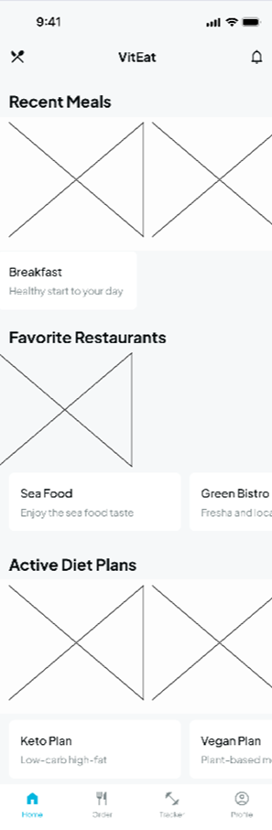
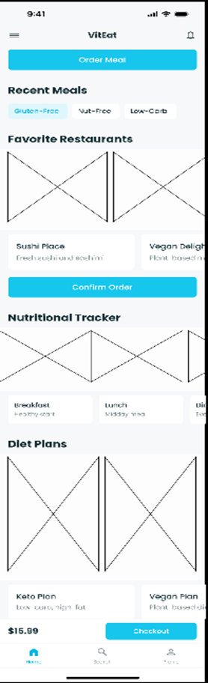
Dashboard page

Slide 11
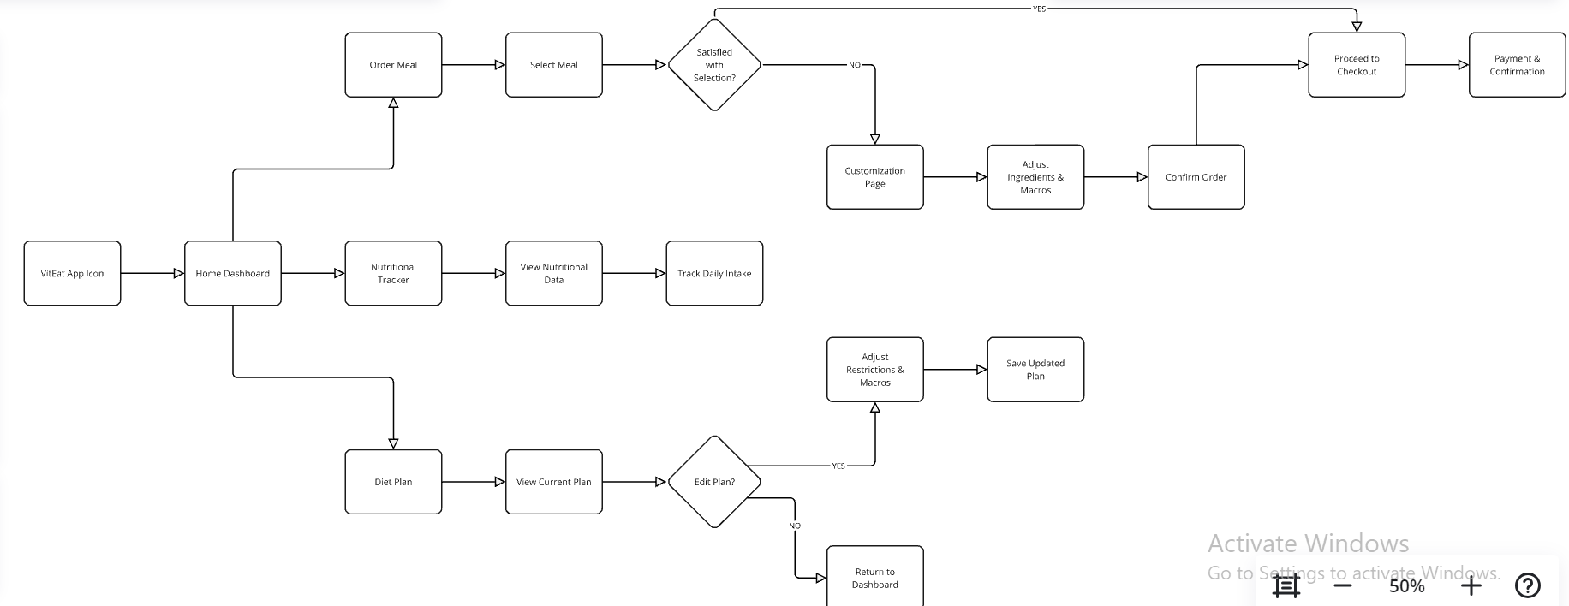
User flow

Slide 12

App Start
The user begins by tapping the VitEat App Icon, which leads to the Home Dashboard

Slide 13

Nutritional Tracking Process
From the Home Dashboard, the user can access the Nutritional Tracker
Here, the user can View Nutritional Data and Track Daily Intake to monitor their diet

Slide 14

Diet Plan Management
If NO, they return to the Home Dashboard
If YES, the user proceeds to Adjust Restrictions & Macros and then Save Updated Plan

Slide 15

Meal Ordering Process
If NO, they can go to a Customization Page to Adjust Ingredients & Macros
If YES, the user Confirms Order

Slide 16

Meal Ordering Process
Once the order is confirmed, the user proceeds to the Checkout and completes the Payment & Confirmation process
Wireframe Diagrams: Prescribe dashboard and other significant screens including nutrition tracker and customization pages in its revitalized look

Slide 17
Usability Evaluation
1.Task Completion: 85% of users were able to complete core tasks such as ordering a meal and customizing their diet plan without significant issues. Similarly 90% of users can update their diet plan in first visit, and 80% could access nutritional details with a few clicks.
2.Error Rate: It led to the decrease of possible end-user errors for those, who were confused with the previous settings options. Error reduced from 30 percent to 10 percent through speaking to new interface. The options which contributed to the improvement of the mistakes were search bar and the labels .
3.User Satisfaction: Usability testing showed that there was higher positive satisfaction which included comments such as the app was: ‘more intuitive’ and ‘easier to use’. Users said that it was easier to read large icons and fonts; and particularly on devices with small screen sizes.

Slide 18
Usability Evaluation
4.Performance Metrics: The amount of time taken to load pages was reduced and users’ experience indicated that it was easier to move from one page to the other. Testing also revealed a higher click through interaction with other features such as the Nutritional Tracker that had less interaction before due to poor positioning.
5.Recommendations for Improvement: Despite that, few users still needed some of the basic features that were left out in the redesign of the main hierarchy to be highlighted to accommodate for additional details of nutritional tracking. The possible future enhancements can refer to extending more detailed tracking for macros and micronutrients

Slide 19
Conclusion
Essentially, the poor usability design that defined Vit-Eat application was noted to have been effectively handled in the redesign. Due to better navigation, personalization and more accurate nutrition information the app is now ready.
The new sleek and more modernized dashboard design, wider and more efficient filters for dietary options, and a greatly enhanced system meant for tracking of other nutrients will enhance the general user experience as well as interaction thus increasing satisfaction levels.
Usability testing revealed reduced error occurrences during the interactions and shorter time of executing a given task while overall satisfaction increased.
The new layout and clean interface allow everyone to easily understand the possibilities of the application. Moreover, in the testing phase, users also admit that the proposed changes meet their main concerns stated during using this instrument.

