Slide 1
Classification of Malignant Melanoma in Canines
Week 1–2 Progress — Foundation Phase
Muhammad Tayyab Abbas · MSc AI & Data Science · University of Hull
Supervisor: Dr Claire Cashmore · 1st fortnightly meeting
@reallygreatsite

Slide 2
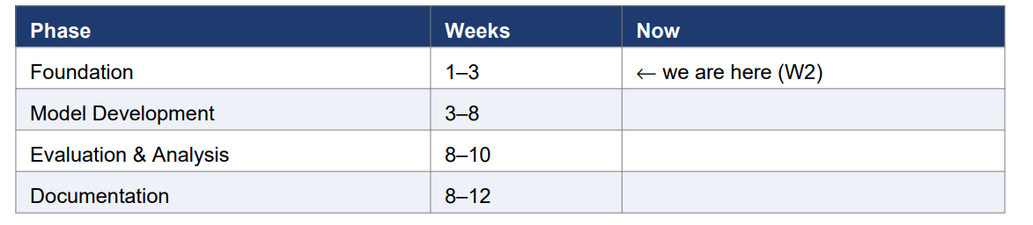
Where we are in the plan
12-week project: 26 May → 14 Aug 2026, submission 17 Aug 2026.

Slide 3
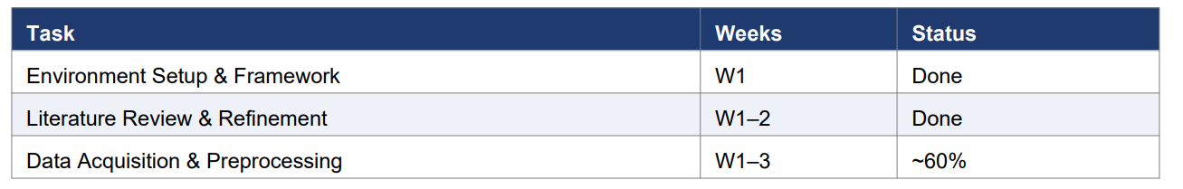
Planned vs. done (Gantt)
On schedule.

Slide 4
1 · Environment setup ✓
Isolated virtual environment (.venv) — other projects untouched
Python 3.12 + OpenCV, scikit-image, scikit-learn, OpenSlide (PyTorch next)
Reproducible: requirements.txt + requirements-lock.txt + setup_env scripts
Clean modular src/ package, version-controlled (Git)

Slide 5
2 · Literature review refined ✓
Segmentation: U-Net (Ronneberger 2015), Attention U-Net (Oktay 2018)
Classification: ResNet-50 (He 2016), EfficientNet-B3 (Tan & Le 2019)
Preprocessing: Macenko stain normalisation (2009)
Interpretability: Grad-CAM (Selvaraju 2017)
Comparative oncology: Gillard (2014), Prouteau & André (2019)

Slide 6
3 · Preprocessing pipeline — built & validated ✓
Whole-slide image → QA → Macenko normalise → patch extraction → 70/15/15 split
Quality check flags blurry / low-tissue / washed-out slides automatically
Macenko removes scanner/lab colour variation
Only tissue patches (≥50%) are kept
Stratified split preserves class balance

Slide 7
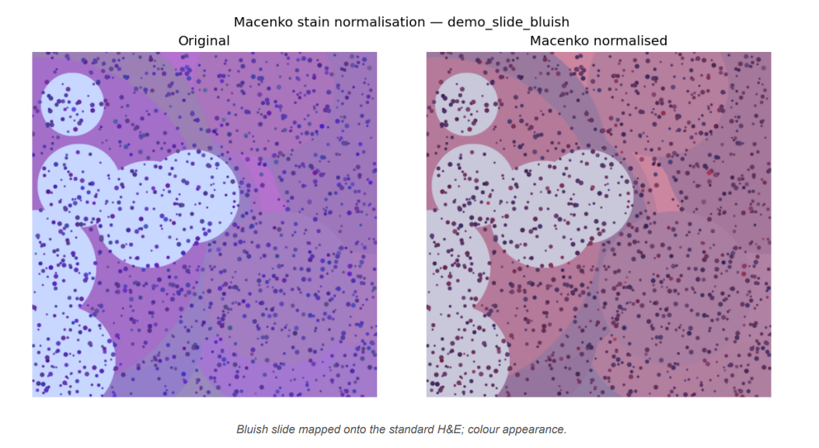
Result — stain normalisation (before / after)

Slide 8
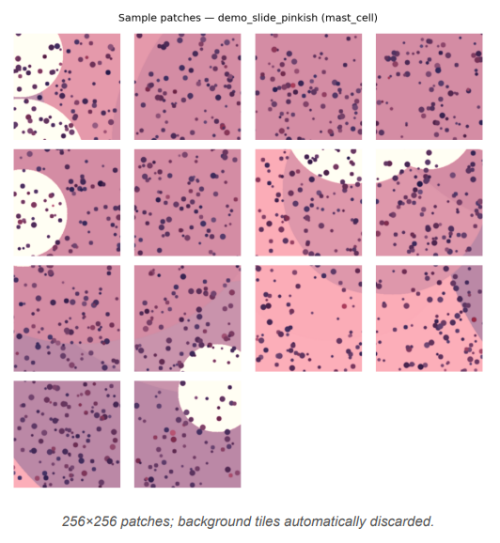
Result — extracted tissue patches

Slide 9
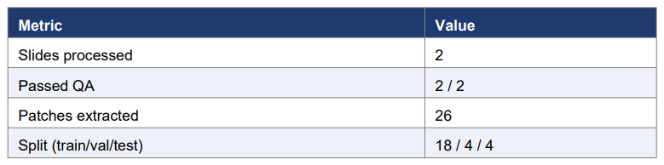
Validation run (synthetic slides)
Pipeline runs end-to-end and is ready to run unchanged on the real CATCH slides once the TCIA download completes.

Slide 10
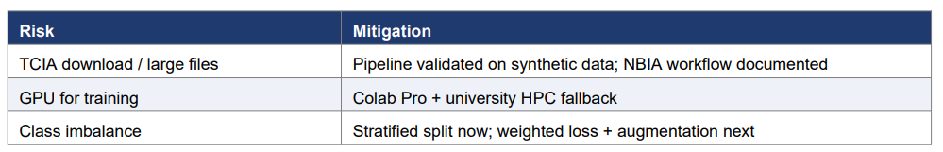
Risks & mitigations

Slide 11
Next fortnight (Weeks 3–5)
Complete CATCH download → run pipeline on all real slides
Finalise patch dataset + class statistics
Start U-Net segmentation (baseline → ResNet-34 encoder)
Questions: QA thresholds OK? · final class list? · magnification priority?

Slide 12
Thank You
Questions & feedback welcome
@reallygreatsite

