Slide 1



Food Trends Understanding Customer Preferences in FB
Presented By : Tayyaba Haroon

Slide 2
Agenda Overview
01
02
03
Perform sentiment
analysis based on ratings
Identify high performing restaurants
Analyze restaurant performance
04
05
06
Generate product insights based on sales & revenue
Customer Segmentation based on behavior patterns
Identifying Hidden Opportunities
07
Build interactive dashboards for business decision-making

Slide 3
Data Collection
The dataset was collected in raw structured format containing:
Restaurant Name
City
Cuisine
Dining Rating
Delivery Rating
Votes
Price
Engagement Metrics
The dataset initially contained raw numerical and categorical values.

Slide 4
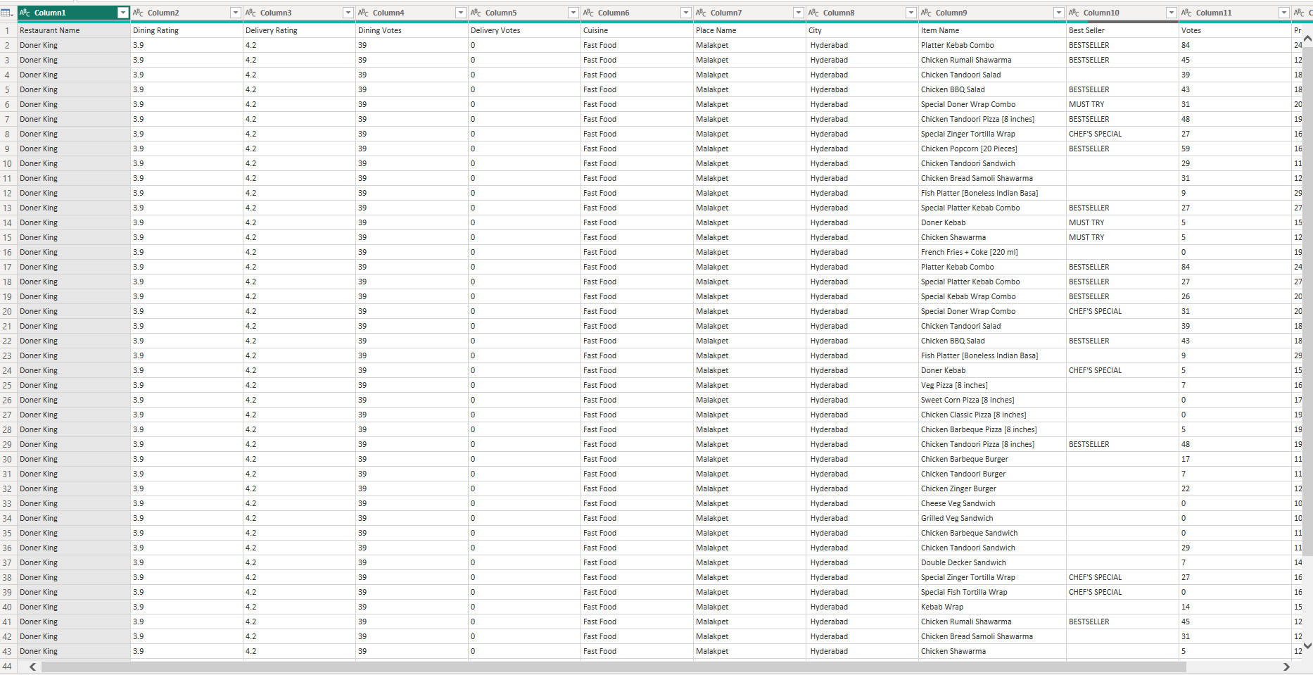

Slide 5


Data Understanding
Initial Observations:
Some columns required type correction
Engagement data needed aggregation
Ratings were numerical but required classification
No direct sales column initially
Identified key variables for analysis:
Ratings
Votes
Engagement
Cuisine
City

Slide 6
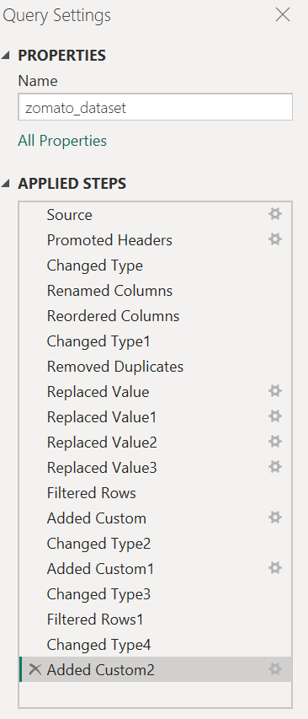
Data Cleaning Process (Power Query)
Steps performed in Power Query:
Removed null/irrelevant columns
Corrected data types (text, decimal, whole number)
Renamed columns properly
Created calculated columns:
Avg_Rating
Total_Engagement
Restaurant_Status (High/Low Performing)

Slide 7
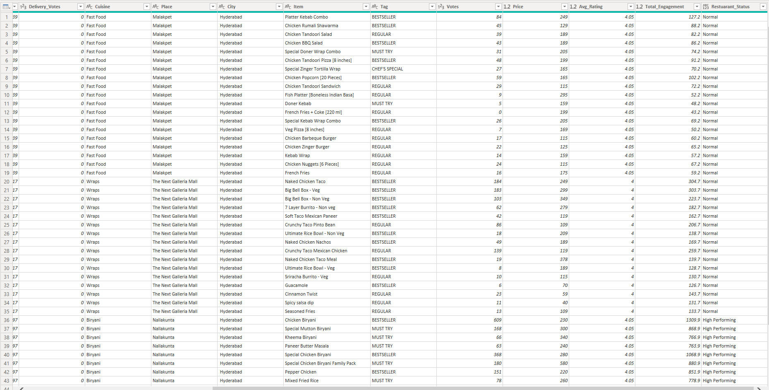
Transformed Data:

Slide 8
Data Structuring
The dataset was transformed into structured format:
Cleaned column names
Aggregated engagement metrics
Created calculated columns
Prepared dataset for dashboard visualization
Structured Data Enabled:
KPI creation
Dynamic filtering
Advanced DAX measures

Slide 9
SENTIMENT ANALYSIS SECTION

Slide 10
KPI creation
Dynamic filtering
Advanced DAX measures
Sentiment Analysis was performed based on rating values:
Rating ≥ 4 → Positive
Rating between 3–4 → Neutral
No ratings below 3 → No negative sentiment
Sentiment Analysis Concept
Created:
Sentiment column
Sentiment Score measure
Net Sentiment Score

Slide 11
DAX Measures Created
Key Measures:
Net Sentiment Score
High Performing Count
High Performing Percentage
Total Engagement
Average Rating
These measures allow dynamic analysis based on filters.

Slide 12
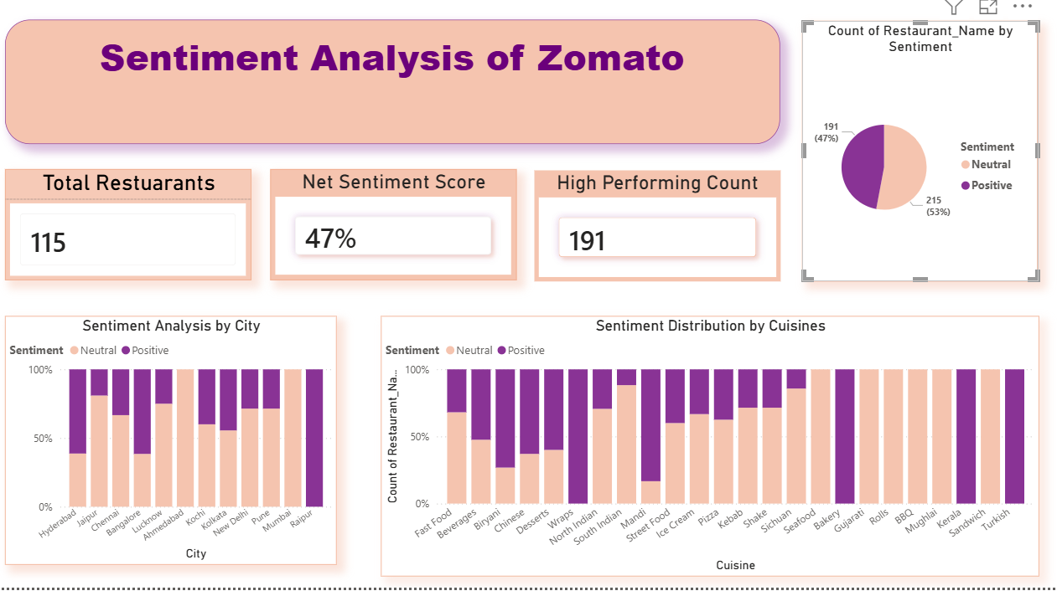
Sentiment Dashboard
This dashboard shows:
KPI creation
Dynamic filtering
Advanced DAX measures
Total Restaurants
Net Sentiment Score
High Performing Count
Sentiment distribution (Pie Chart)
Sentiment by City
Sentiment by Cuisine

Slide 13
Sentiment Insights
Key Findings:
KPI creation
Dynamic filtering
Advanced DAX measures
Majority ratings are Positive
No Negative sentiment observed
Some cuisines show higher neutral sentiment
City-level sentiment varies
Business Impact:
KPI creation
Dynamic filtering
Advanced DAX measures
Helps identify improvement areas
Helps measure customer satisfaction

Slide 14
PRODUCT INSIGHTS SECTION

Slide 15
Product Insights Objective
KPI creation
Dynamic filtering
Advanced DAX measures
Goal of Product Insights Module:
Analyze Total Sales
Analyze Total Revenue
Identify Top Performing Products
Study Sales vs Rating relationship
Enable filtering by Category & City

Slide 16
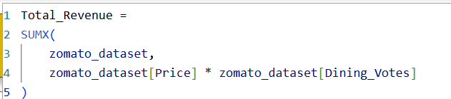
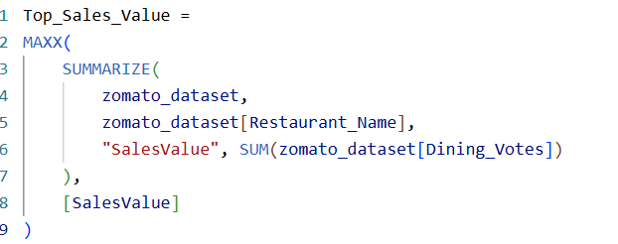

Sales & Revenue Measures
KPI creation
Dynamic filtering
Advanced DAX measures
Created DAX Measures:
Total Sales
Total Revenue
Top Sales Value
Average Rating

Slide 17
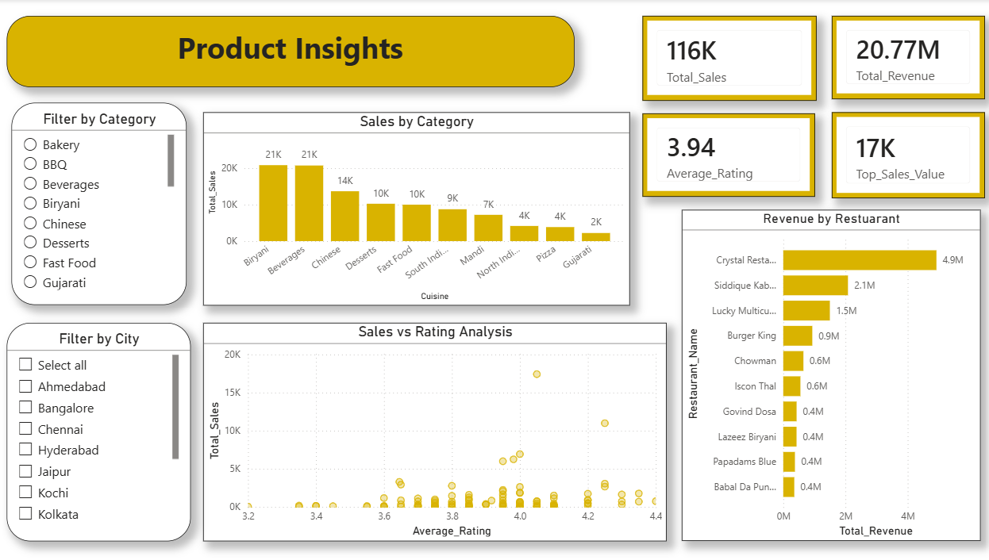
Product Insights Dashboard
Dashboard Components:
KPI creation
Dynamic filtering
Advanced DAX measures
KPI Cards (Sales, Revenue, Rating, Top Sales)
Sales by Category (Column Chart)
Revenue by Restaurant (Bar Chart)
Sales vs Rating (Scatter Plot)
Category & City Slicers
KPI creation
Dynamic filtering
Advanced DAX measures
The measures are dynamic and update with slicers.

Slide 18
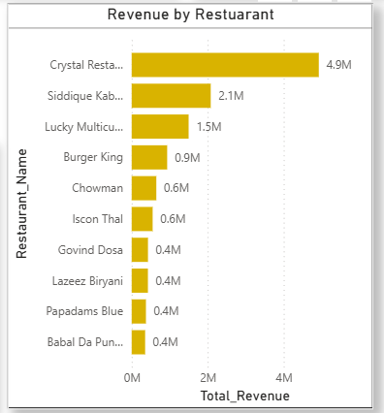
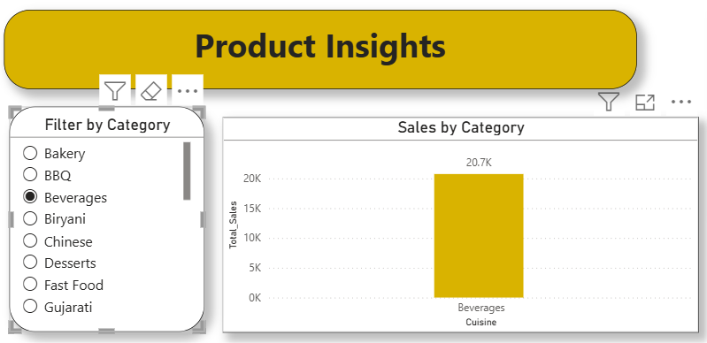
KPI creation
Dynamic filtering
Advanced DAX measures
Key Business Insights
1️⃣ Beverages category generates highest sales
2️⃣ Few restaurants contribute major revenue
3️⃣ Higher ratings generally correlate with better sales
4️⃣ Filters allow location-based performance analysis

Slide 19
CUSTOMER SEGMENTATION SECTION

Slide 20
Customer Segmentation Objective
KPI creation
Dynamic filtering
Advanced DAX measures
Goal of Customer Segmentation Module:
Identify different user behavior patterns toward restaurants
Understand engagement, satisfaction, and feedback levels
Detect passive vs active customer groups
Support targeted marketing and retention strategies

Slide 21
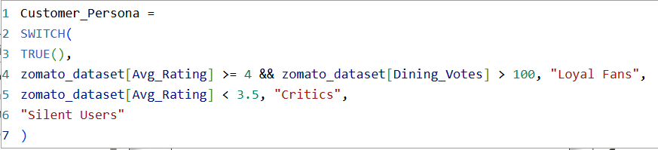

Measures
Used
KPI creation
Dynamic filtering
Advanced DAX measures
Created DAX Measures:
Average Rating → Customer satisfaction level
Votes → Customer engagement level
Sentiment Score → Nature of feedback
Customer Persona Classification:
Loyal Fans
Silent Users
Critics
Engagement(Votes)

Slide 22
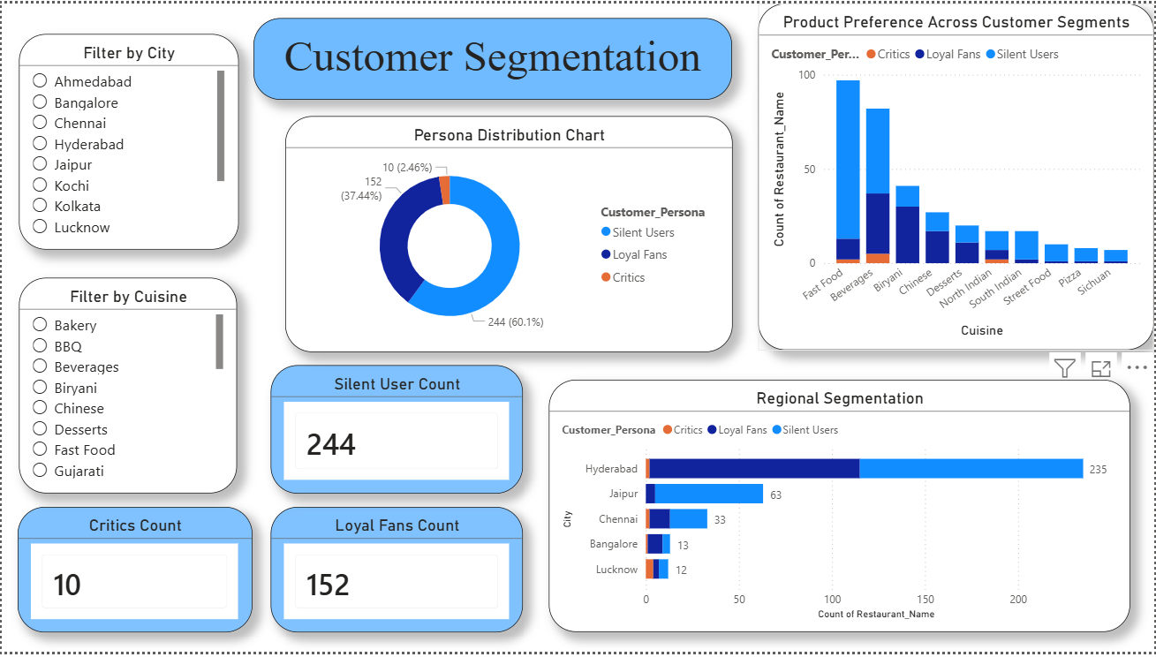
Customer Segmentation Dashboard
Dashboard Components:
KPI creation
Dynamic filtering
Advanced DAX measures
KPI Cards (Count of Silent Users, Loyal Fans and Critics)
Persona Distribution Chart (Pie Chart)
Regional Segmentation (Bar Chart)
Product Preferences (Column Chart)
Cuisines & City Slicers
KPI creation
Dynamic filtering
Advanced DAX measures
The measures are dynamic and update with slicers.

Slide 23
Key Business Insights
KPI creation
Dynamic filtering
Advanced DAX measures
Silent Users form the largest segment → High passive engagement
Loyal Fans represent strong positive support for specific cuisines
Critics are fewer but highlight problem areas
Some cuisines attract strong loyalty, others show weak engagement
Customer behavior varies significantly across cities
Opportunity exists to convert Silent Users into Loyal Fans

Slide 24
STRATEGY AND INNOVATION SECTION

Slide 25
Strategy and Innovation Objectives
KPI creation
Dynamic filtering
Advanced DAX measures
Goals:
Identify high-growth opportunities within the restaurant ecosystem
Detect underperforming areas requiring improvement
Support data-driven strategic decisions
Highlight hidden potential restaurants

Slide 26
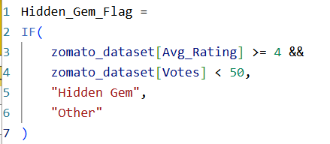
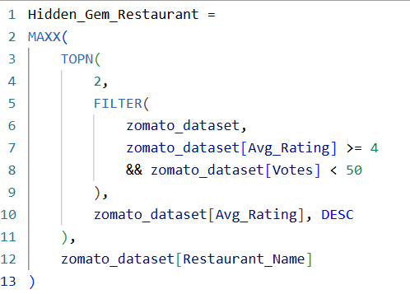
Measures
Used
KPI creation
Dynamic filtering
Advanced DAX measures
Created DAX Measures:
Average Rating
Total Engagement (Votes)
HiddenGem Flag
Top Performing Count
Count of Restaurant Name
Cuisine-wise Performance Metrics
Underperforming Cuisine Indicator

Slide 27
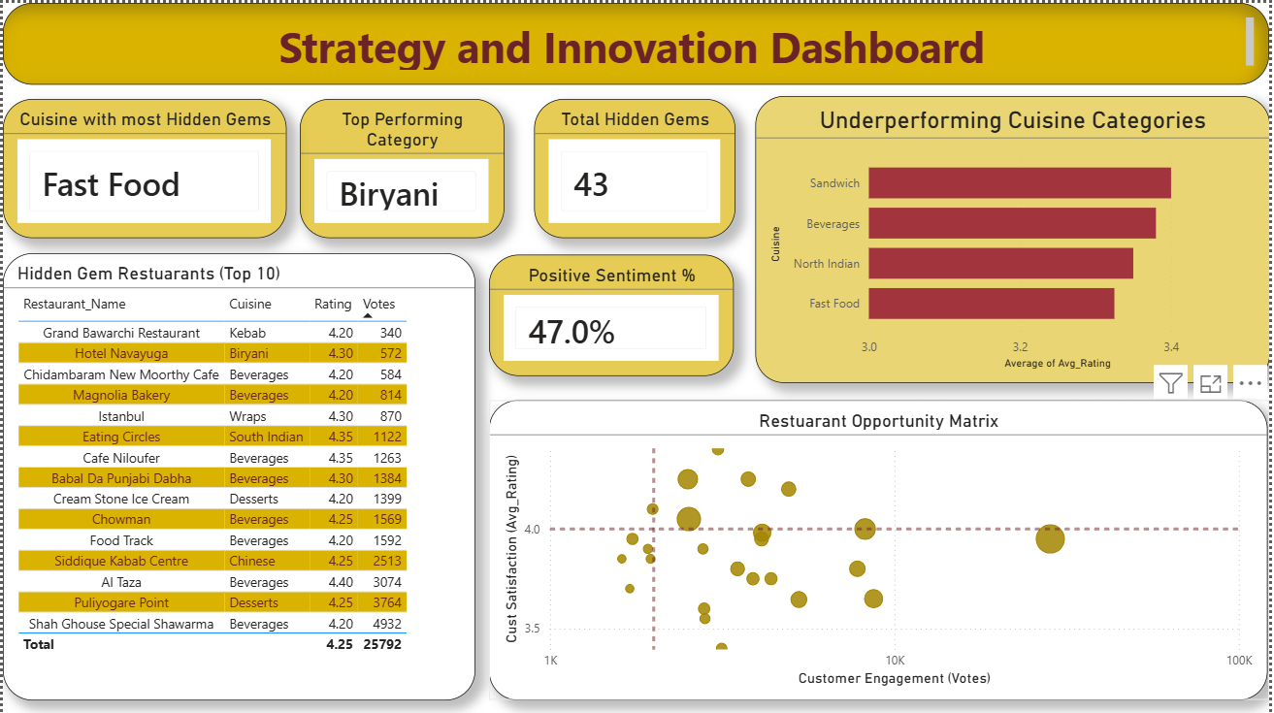
Strategy and Innovation Dashboard
Dashboard Components:
KPI creation
Dynamic filtering
Advanced DAX measures
gh
KPI cards for top performing category, hidden cuisine gems,positive sentiment %, total hidden gem
Clustered bar chart for showcasing underperforming cuisines
Table for top 10 hidden gem restuarant
Scatter plot for restuarant opprtunity matrix

Slide 28
Key Business Insights
KPI creation
Dynamic filtering
Advanced DAX measures
Hidden Gem restaurants deliver high quality but lack visibility
Top performing categories combine high ratings and engagement
Low-rated categories indicate service or product issues
Some cuisines contain many hidden gems → Untapped potential
High-engagement but low-rating restaurants need quality improvement
Strategic focus should be on promoting hidden gems and improving weak categories

Slide 29
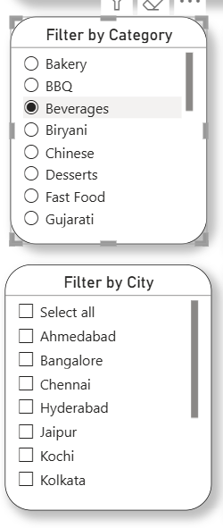
Interactivity & Filters
KPI creation
Dynamic filtering
Advanced DAX measures
Interactive Features:
Category slicer
City slicer
Dynamic KPI updates
Cross-filtering between visuals

Slide 30
Tools Used
KPI creation
Dynamic filtering
Advanced DAX measures
Power BI Desktop
Power Query
DAX (Data Analysis Expressions)
Data Modeling
Visualization Techniques

Slide 31
Future Scope
KPI creation
Dynamic filtering
Advanced DAX measures
Incorporation of Real Customer Data
Text-Based Sentiment Analysis
Real-Time Data Integration
Predictive Analytics
Enhanced Data Modeling
Geospatial Analysis
Advanced Customer Segmentation

Slide 32
Conclusion
This project demonstrates:
KPI creation
Dynamic filtering
Advanced DAX measures
End-to-end data cleaning
Data structuring
Sentiment classification
Business KPI development
Advanced interactive dashboard creation
The analysis provides actionable insights for restaurant and product performance optimization.

