Slide 1
Google Location Tracking and geofencing Periodic Updates
By:
Saad Rafique
Tayyaba Sadiq
Rimsha Amer
Ibraheem Ahmed

Slide 2
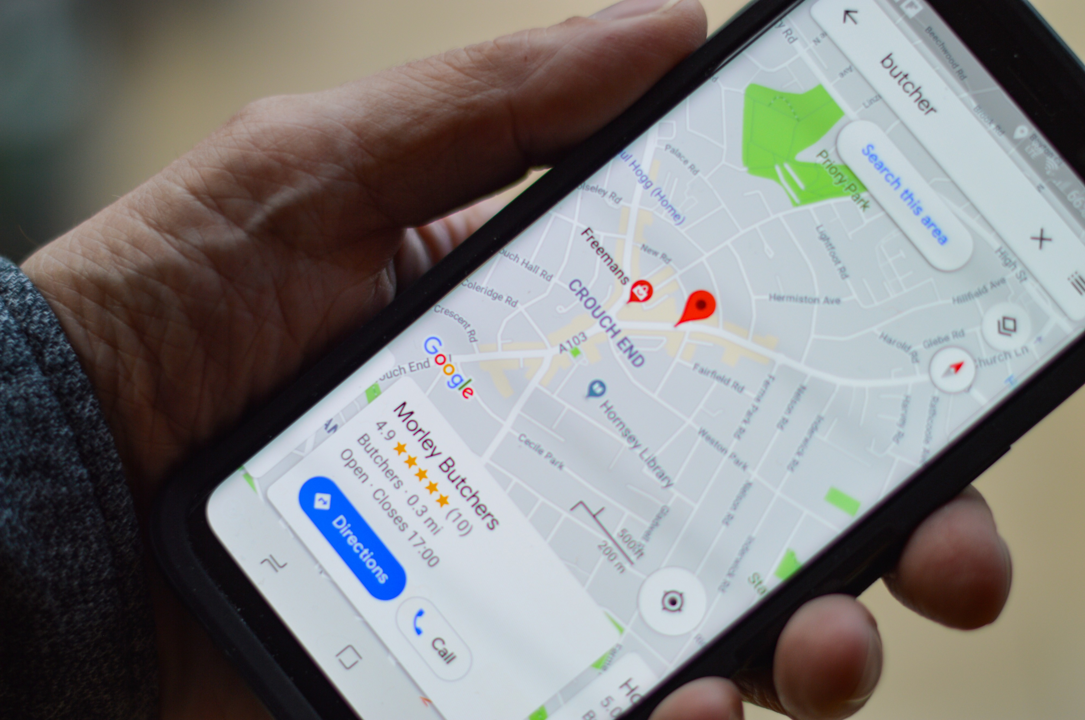
Location Tracking
Many applications need to know the location of the user and provide services based on the characteristics of the location.
Get Fused Location Provider Client- A Google API

Slide 3
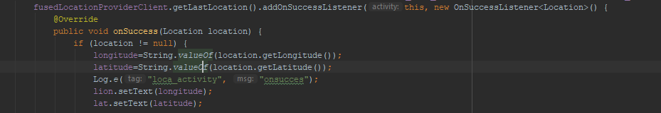
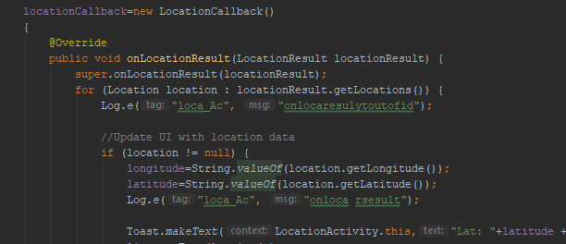
Towards implementation
Check permissions
getFusedLocationProviderClient
(To get last location)
Requests location Updates
Location Callback()
(Location Update)

Slide 4
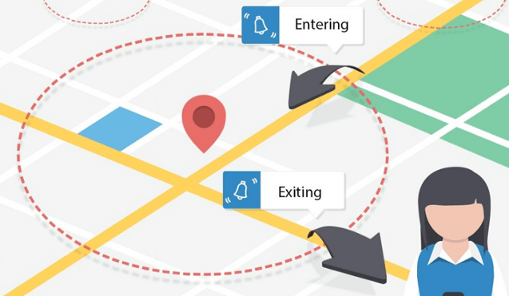
What is a geofence?
A VIRTUAL Barrier
A location-based service that sends a notification to smartphone users who enter a defined geographic area.
Notes:
The latitude and longitude of the location should be an input parameter for the geofence periodic updates.

Slide 5
Towards Implementation
Latitude, longitude, and radius
Expiration time
Transition type
Geofence ID
<uses-permission android:name="android.permission.ACCESS_FINE_LOCATION/> <uses-permission android:name="android.permission.ACCESS_COARSE_LOCATION/> <uses-permission android:name="android.permission.INTERNET" />
Manifest Permissions
Geofence object
Notes:
Coming onto the implementation quickly

Slide 6
The Geofencing process
GeofenceBuilder()
Builds a Geofence/initializes Geofence Object/s
GeofenceRequest
Triggers request for all added geofence object in the list
Geofence PendingIntent
Add Geofences
Forms a pending intent and invokes the broadcast receiver
For each geofencing client, geofence is added using geofence request and pending intent
Notes:
All these functions would be demonstrated in a while.

Slide 7
Helping References
https://developer.android.com/training/location/retrieve-current
https://developer.android.com/training/location/geofencing#define-a-broadcast-receiver-for-geofence-transitions
Git Link:

